Slide 1
safety &
maintenance
Workshop
Tire Securement and Lift Operational Maintenance Safety Best Practices

Slide 2
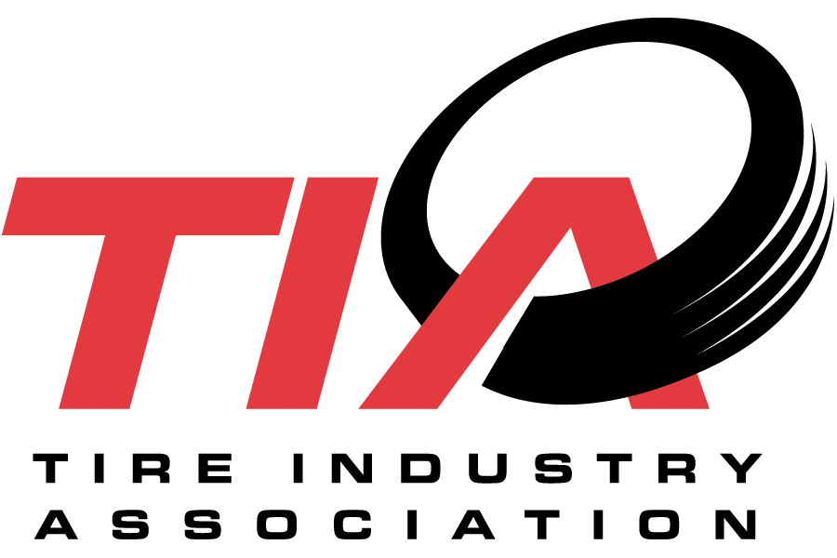
Tire Securement and Lift Operational Maintenance Safety Best Practices Workshop
The Tire Industry Association Needs Our Help and Expertise!
They are looking for help with servicing motorcoaches and trucks roadside and training technicians to do this safely
This is an interactive exercise and hopefully informative

Slide 3
Tire Securement and Lift Operational Maintenance Safety Best Practices Workshop
Who do you direct the driver to call if they have a flat tire or multiple flat or deflating tires?
What parameters do you have in your operations before a change?
When considering servicing wheels and wheel components, remember there are some regulations involved in addition to best practices.

Slide 4
Tire Securement and Lift Operational Maintenance Safety Best Practices Workshop
29 CFR 1910.177(c):
Employee training
Tire servicing equipment
Wheel component acceptability
Safe operating procedure - multi-piece rim wheels
Safe operating procedure - single piece rim wheels

Slide 5
Tire Securement and Lift Operational Maintenance Safety Best Practices Workshop
49 CFR § 393.75 Tires
Tire loading restrictions
Tire inflation pressure

Slide 6
Tire Securement and Lift Operational Maintenance Safety Best Practices Workshop
How would you service a tire/tires roadside?
Or would you not service and tow back to your yard or an OEM service center?
Do you jack or lift the bus?
What do you need to jack safely?
What do you need to lift safely?

Slide 7
Tire Securement and Lift Operational Maintenance Safety Best Practices Workshop
Where do you position the jack?
Where do you position a mobile lift?
How do you know?
Does this change depending on which tire it is?

Slide 8
Tire Securement and Lift Operational Maintenance Safety Best Practices Workshop
Should the passengers be removed from the bus before work can begin?
If the bus has an air suspension, should it be inflated throughout tire service or deflated?
If deflated, is there a way to lift and support the chassis to provide the technician with additional room? (There is minimal clearance to begin with when working on a tour bus or coach, releasing the air makes it even less.)
Are there specific lift and support points for the different types of suspensions? Tag axles?
Are there any potential lift and support points that should not be used?

Slide 9
Tire Securement and Lift Operational Maintenance Safety Best Practices Workshop
Should the parking brake be engaged? Should the wheels be chocked?
If you are using mobile lifts how high should you lift the vehicle to service a tire?
How do you know if a new tire has been secured properly? How do you gauge the proper torque?
Do weather conditions impact your interest or ability to provide service or make considerations to the range of service repairs you will undertake?
Would you rebalance a new tire roadside? Inspection procedure after it returns to service?

Slide 10
Tire Securement and Lift Operational Maintenance Safety Best Practices Workshop
What are some training resources that you would refer to someone to establish their own best practices?
What resources do you make available for your own staff to refresh themselves on these topics?

