Slide 1
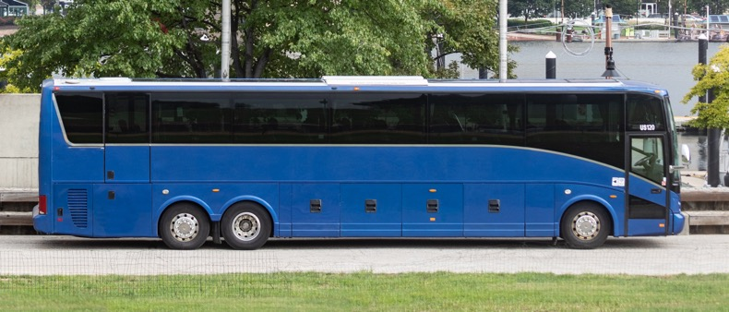
Federal Motor Carrier Safety Administration
Passenger Carrier Safety Division
Notes:
Available cover design option. Please delete any unneeded cover page designs.

Slide 2
Bus Industry Safety Council a FMCSA Update July 2024 Passenger Carrier Safety Division

Slide 3
Agenda
Regulatory Updates
Passenger Division Personnel Update
Field Activities Update
Federal Motor Carrier Safety Administration
Passenger Carrier Safety Division

Slide 4
Regulatory Update

Slide 5
Safety Fitness Determinations - Virtual Public Listening Sessions
FMCSA is hosting one more virtual listening session pertaining to the current Safety Fitness Determination and Safety Measurement System.
The next virtual public listening session will be held on Wednesday, July 31, 2024, from 2:00 p.m. to 3:30 p.m. ET. A copy of the agenda will be available in advance of the session at https://events.gcc.teams.microsoft.com/​event/​6d8b1246-2138-4ba9-821c-e926441fd2e1@c4cd245b-44f0-4395-a1aa-3848d258f78b.
The virtual sessions will allow members of the public to make brief statements to the panel. FMCSA will also accept written comments to the docket through August 7, 2024. http://www.regulations.gov/docket/FMCSA-2022-0003
Federal Motor Carrier Safety Administration
Passenger Carrier Safety Division

Slide 6
NPRM – Docket No. FMCSA-2023-0115 – CDL Requirements
Amendments to the Commercial Driver’s License Requirements; Increased Flexibility for Testing and for Drivers After Passing the Skills Test.
Includes proposal to remove the requirement CMV drivers must have a passenger (P) endorsement to transport CMV’s designed to carry passengers, including school buses, when the vehicle is being used in a driveaway-towaway operation and the vehicle is not carrying any passengers.
Comment period closed April 2nd, 2024.
Visit https://www.regulations.gov/docket/FMCSA-2023-0115/document.
Federal Motor Carrier Safety Administration
Passenger Carrier Safety Division

Slide 7
CMVs equipped with camera-based mirror systems
FMCSA has granted exemptions to 393.80(a), allowing the use of a camera-based mirror system in lieu of two rear vision mirrors.
These camera-based mirror systems are likely to achieve a level of safety equivalent to or greater than the level of safety provided by the regulation.
Manufactures granted a FMCSA exemption to 393.80(a) include:
Vision Systems North America Exemption Expires – 01/15/2025
Bosch and Mekra Lange Exemption Expires – 09/17/2025
Rosco Vision, Inc. Exemption Expires – 12/04/2027
Stoneridge, Inc. Exemption Expires – 02/12/2029
Note: Additional manufactures have petitioned FMCSA for exemption.
Federal Motor Carrier Safety Administration
Passenger Carrier Safety Division

Slide 8
FMCSA Passenger Carrier Division Personnel Update

Slide 9
FMCSA – Passenger Carrier Division Personnel
FMCSA is working on getting the Passenger Carrier Division fully staffed following recent retirements.
Staffing will include:
Division Chief
– Michael Christopher
Team Lead – currently going through the hiring process
Transportation Specialists (2)
– Roger Lutz
– Clifton Willey
Federal Motor Carrier Safety Administration
Passenger Carrier Safety Division

Slide 10
FMCSA Passenger Carrier Division Field Activities Update

Slide 11
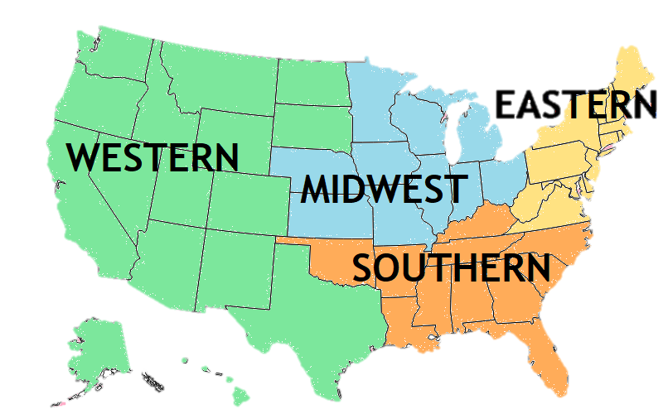
Upcoming Passenger Carrier Field Activities
The Passenger Technical Advisory Group (PTAG) has been revitalized recently:
There will likely be more collective inspections events in the near future.
Focus on Level I destination inspections, when practicable.
High-profile special events having an abundance of commercial passenger vehicle traffic.
Details to follow at a later date.
Federal Motor Carrier Safety Administration
Passenger Carrier Safety Division

Slide 12
Safety Briefing Reminder
Reminding passengers to fasten their seatbelts and information about where the emergency exits are located and how to operate them saves lives.
Please encourage your drivers to conduct safety briefings.
Federal Motor Carrier Safety Administration
Passenger Carrier Safety Division

Slide 13
CONTACT INFO clifton.willey@dot.gov MCSEP@dot.gov
Federal Motor Carrier Safety Administration
Passenger Carrier Safety Division

