Slide 1
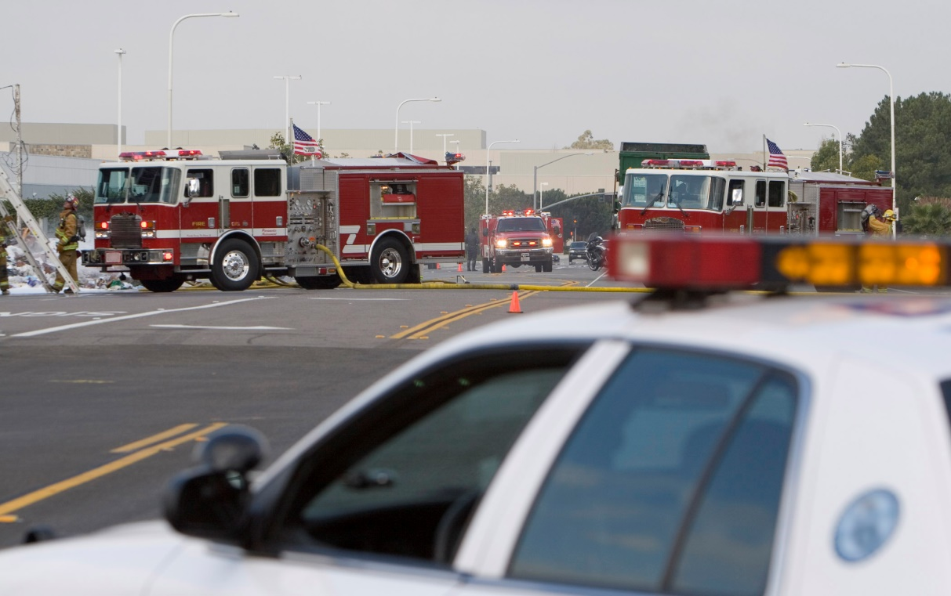
CHECKLIST: What to Do in an Emergency
presented by Daniel Tomlinson, Loss Control Manager
2023 BISC Summer Meeting
July 22, 2024

Slide 2
A serious incident involving one of your company’s coaches has just occurred…

Slide 3
Developing a Crisis Plan
Do you already have a plan? If so, does it need to be dusted off and updated?
There is no specific checklist for this process; a plan has to be tailored to YOUR operation
CRISIS PLAN

Slide 4
Developing a Crisis Plan (cont’d)
Who to include on the team
Key duties/tasks in priority order
Phone log
Management list/contact info
Who has access to the complete written crisis plan
Team training
Practice
Review and update

Slide 5
Purpose of Developing a Crisis Plan
Get personnel organized, and ensure all team members know their roles
Help company gain control of all aspects of the incident within the first 24 hours of the event
Identify resources prior to an incident
Help prevent any bad situation from becoming much worse

Slide 6
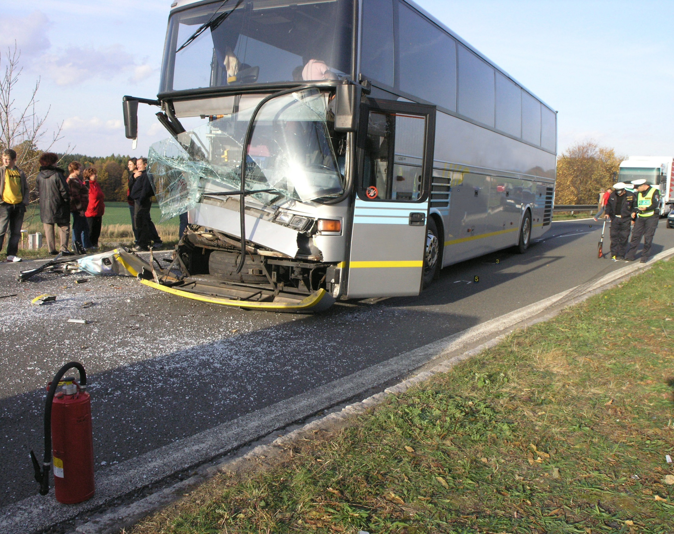
Crisis Plan Elements
Protecting the passengers
Managing the accident scene
Communicating
Sustaining operations
Upholding the company’s professional reputation
Educating and training drivers and employees

Slide 7
Protecting the Passengers
Pre-trip safety briefing
Training driver in his/her role
Delegating to others (e.g., chaperones, leaders, tour guides)
Arranging alternative transportation; continuation of trip

Slide 8
Managing the Accident Scene
www.lancerinsurance.com/safety/manage-accident-scene

Slide 9
Managing the Incident
Role of the driver
Identifying staff roles
Assigning backup roles
Contact information for staff
After hours contacts
Creating a call log
Determining whether you should stay or go
Traffic
On phone while en route?

Slide 10
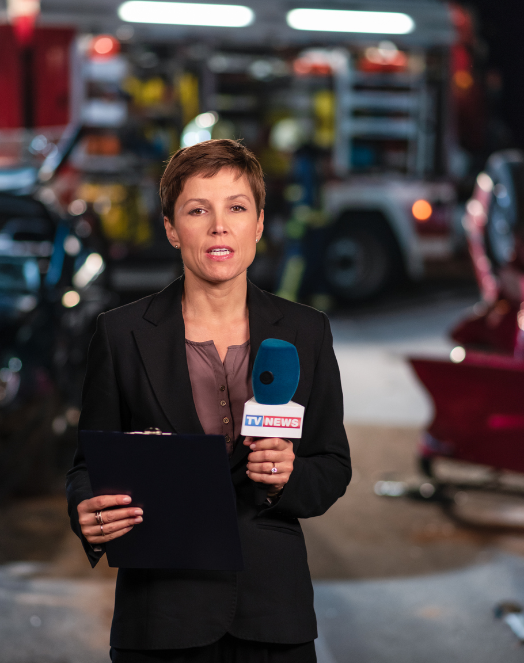
Initial Notification of the Incident
By phone
Driver
Law enforcement
Passenger
Chartering group
Witness
Through technology
On social media
From media

Slide 11
Company Response
Notification of crisis team
What do you know so far?
What do you know about the trip?
Charter order
Notification of other drivers
Notification of driver’s emergency contacts
Company social media and posts
Command post

Slide 12
Communicating: Incoming Calls
Listening; remaining calm, professional and courteous
Prioritizing calls
Forwarding calls to the proper person
Returning calls
Gathering information from callers

Slide 13
Phone Log
Easily accessible and identifiable
Keeping detailed notes; facts not speculation
Name, call back number, day and time of call, is person on site?
Relationship to event (e.g., passenger, parent, witness, law enforcement)
Who took the call?
Does person require a call back?
Who was call referred to?
Did person receive a call back?

Slide 14
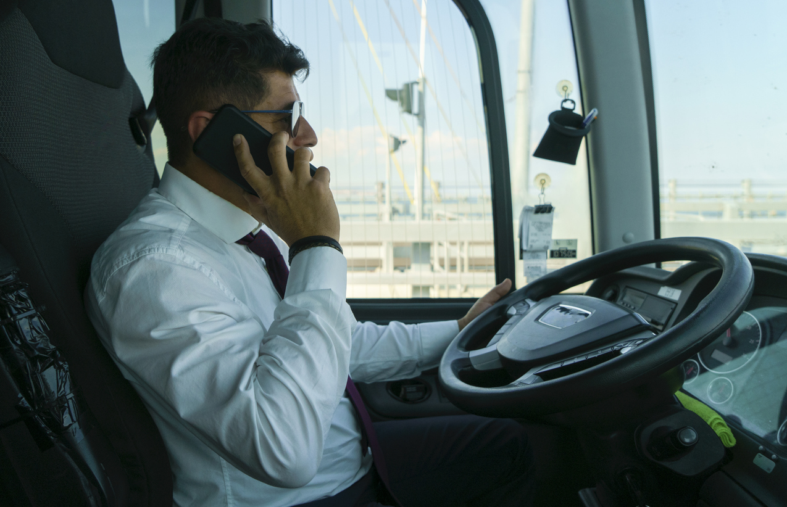
Communicating: Driver
Listening
Keeping driver calm and focused
Has 911 been notified?
Evacuation, smoke, fire, injuries, egress
What does driver need from you? How can you assist driver?
Instructions for driver – reminders of their on-scene duties
Communicate with driver often

Slide 15
Communicating: Insurer
Reporting accident to insurance company – prompt notification regardless of fault
Assistance that claims department can provide handling calls
Information insurer may request
Attorney-client privilege

Slide 16
Communicating: Clients
Contacting the chartering party
Obtaining passenger list/roster
Updating clients
Identifying contact person(s)…who’s in charge?
Notifying destinations

Slide 17
Communicating: Law Enforcement
Information driver is required to share with authorities
Citations issued to driver
Information authorities may request from motor carrier
Post incident records and compliance review

Slide 18
Communicating: Media & Social Media
Handling requests for comments; need to respond promptly, accurately and confidently
Securing the office
Identifying the company spokesperson
Consulting with company legal counsel
Making media statements
Responding to posts on social media
Company reputation can be positively or negatively impacted

Slide 19
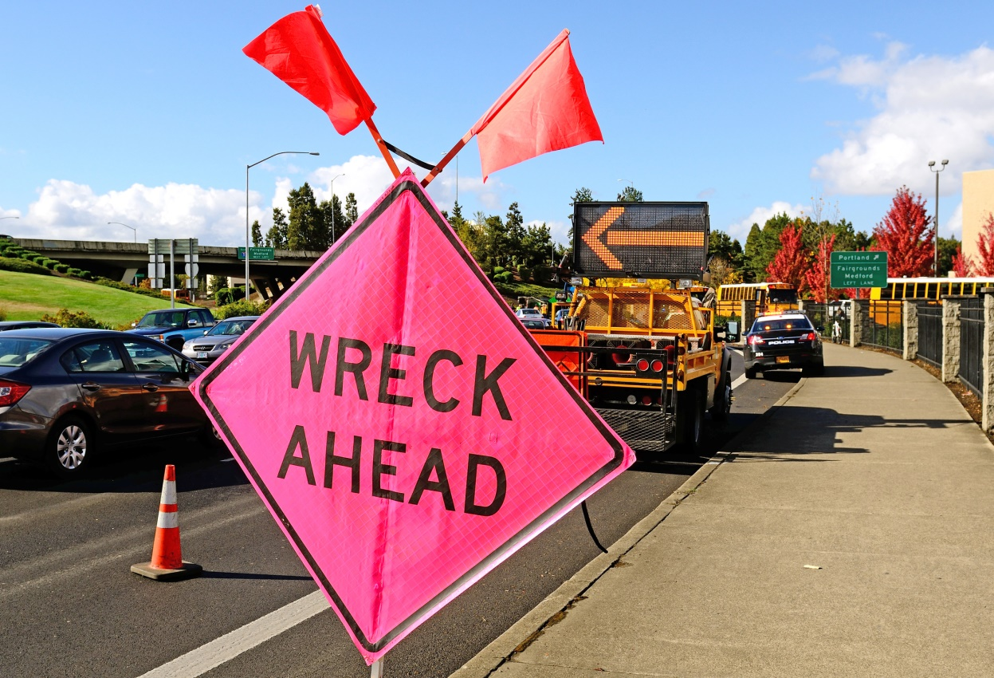
Communicating: Others
OSHA – serious injury/fatality
EPA or state environmental agency due to large fuel leaks
Post-accident drug and alcohol testing (§382.303) – after hours contact
Alternate transportation providers
Service providers (e.g., tow trucks, clean-up crews)
Workers’ compensation carriers

Slide 20
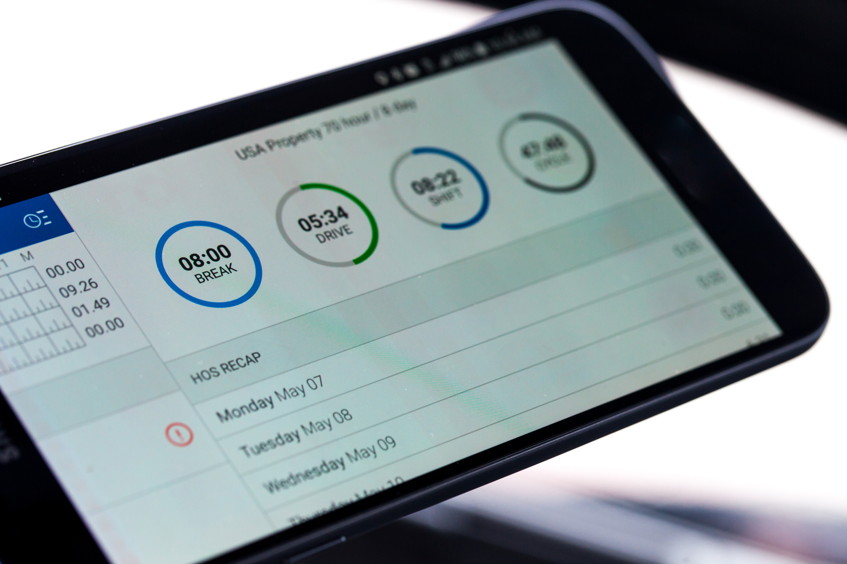
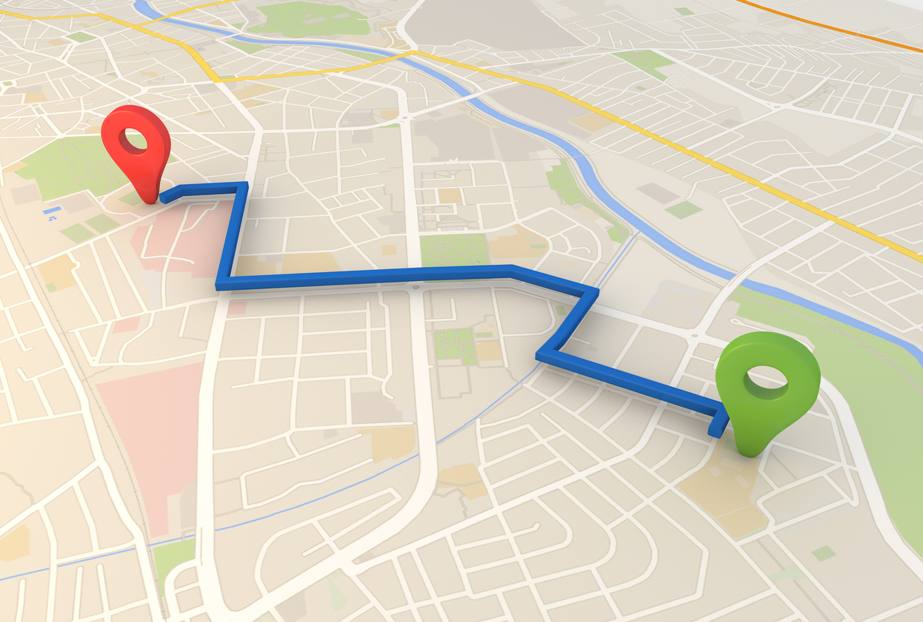
Gathering Data: Technology
Smart phones
Dash cameras
Electronic logging devices (ELDs) and telematics
GPS devices – planned travel routes
Video feeds
Photos

Slide 21
Documents to Obtain/Secure
Passenger list/ roster
Charter order
Driver qualification file
Maintenance files
ELD information
Electronic video recording (EVR) information
Phone logs
Supporting records
Record retention

Slide 22
Creating a “Go” Kit
Cell phone
Cell phone charger
Important phone numbers
Flashlights
Inclement weather gear
Reflective vests
Luggage tags
Bags, containers
Witness cards
Pencils, markers
Etc.

Slide 23
Practice Makes Perfect!
Plan should be in writing
If you say you are going to do it, do it!
If you put it in writing, expect it to be read to a jury
Training of crisis team
Practicing at least once a year
Reviewing plan annually
Updating your plan as needed

Slide 24
Sustaining Operations
Everyone who is not on the crisis team should continue to conduct business as usual
No one but the designated person(s) on the crisis team should speak to anyone outside the company about the incident
Arranging replacement drivers and coaches for upcoming trips

Slide 25
Thank You for Participating!
presented by Daniel Tomlinson, Loss Control Manager
2025 BISC Summer Meeting
July 22, 2025

