Slide 1
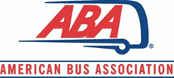
Washington & Industry Update
BISC West Virtual
August 12, 2024

Slide 2







Hot Topics
- Charter Petition – DNC
- FMCSA SFD Changes
- OSHA Heat Standard
- NPS – CUA Registration System
$$$ - FY 2024 FEMA/TSA Bus Security Grants
- California Meal & Rest Break

Slide 3
Other Highlights
Legislative
Rural Transportation hearing before House T&I Committee, March 21 (Industry Testified)
Regulatory/Administrative
Green House Gas Phase 3 – Motorcoaches Excluded
FMCSA Registration Changes – Lots of Public Meetings
Other NPS CUA changes
State Issues
NYC tolling – supported local efforts, some success
Boston Tolling (👀)

Slide 4
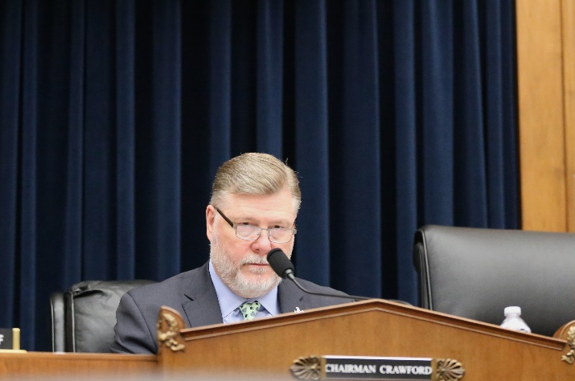
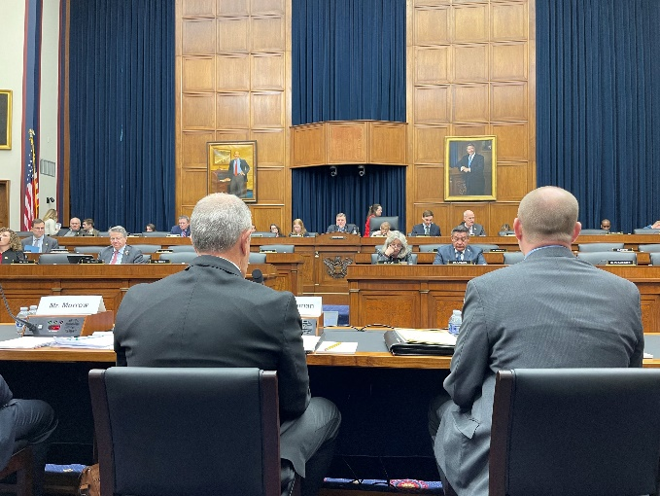
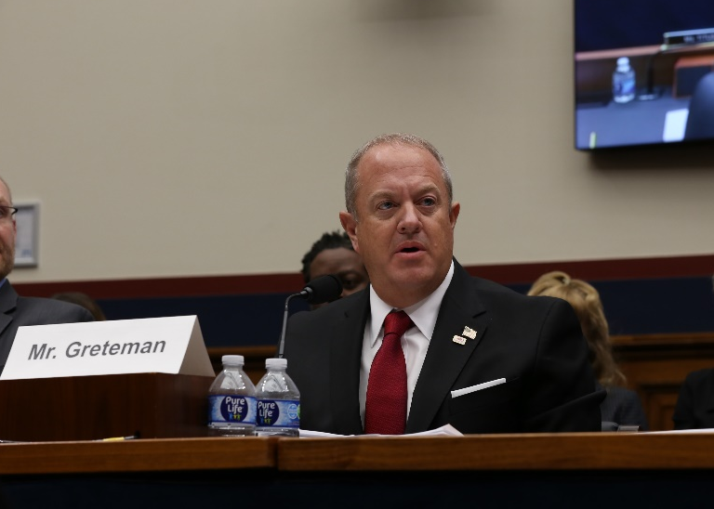
Washington Update
MARCH 21ST – T&I SUBCOMMITTEE HEARING
Rural Transportation Challenges: Stakeholders Perspectives
Access issues
Funding
Infrastructure & resources
Emissions and ZEV challenges
Tolling/congestion mitigation programs

Slide 5


Washington Update
2024 - CONGRESS TO DATE
V.
CONGRESS:
FY 2024 Funding Completed; moving on FY 2025 process
Avoided government shutdown
Retained Speaker
FAA reauthorization
HOUSE:
Members leaving early; disillusionment
Continued threats on Speaker’s seat
SENATE:
McConnell departure - loss of institutional knowledge & negotiation skills
BILLS:
Tax bill not moving
4

Slide 6
Washington Update
WHAT’S LEFT?
FY 2025 Funding
Appropriation Bills, expect a CR
Bus Security Grants Funding Battle
NPS Dynamic Pricing Study
Tax Package?
Not Likely
No CERTS fix
100% Bonus Depreciation/Sec. 163 v. Enhanced child tax credit
Notes:
Sec. 163 – business interest limitation – interest expense deductibility

Slide 7
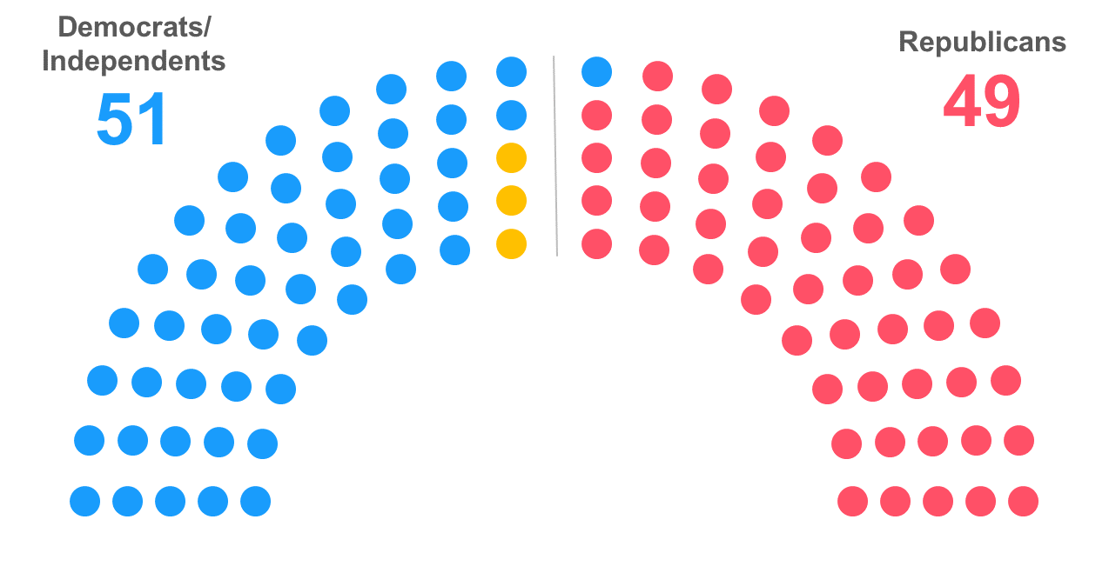
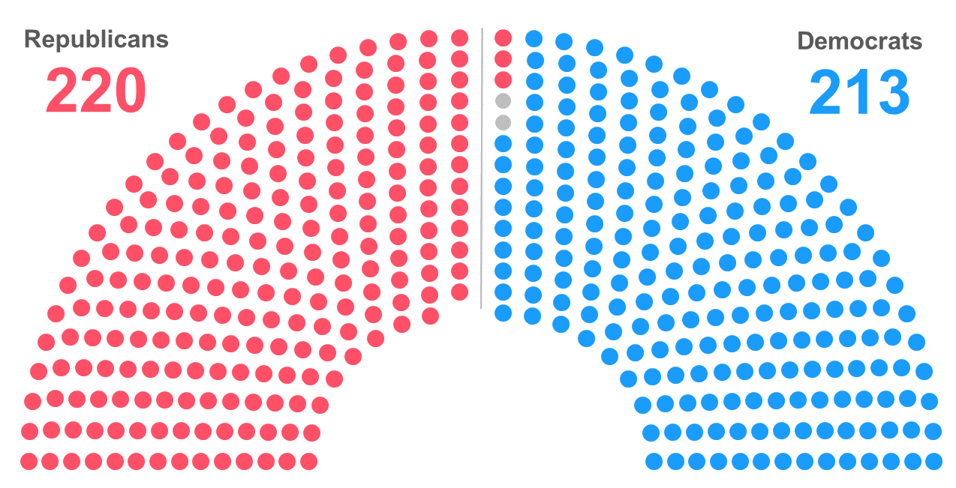
Current Balance of Power in the 118th Congress
2024 – Federal Election Status
Senate
House
219
212
3– vacancies
Notes: As of Jan. 8. The yellow dots in Senate graphic reflect three independents who align with Democrats. Gray dots in the House graphic represent two vacancies caused by the expulsion of George Santos (R-N.Y.) and resignation of Kevin McCarthy (R-Calif.). Rep. Bill Johnson (R-Ohio) announced his resignation effective Jan. 21, while Rep. Brian Higgins (D-N.Y.) said he would resign early this year.
Notes:
House:
432 Members, 219-R v. 213-D, 3 vacancies. Close margins for partisan votes, R’s can only lose 2 votes (need 217 to be majority). R’s expect to add one more to make it 220 (Ken Buck replacement).
Senate: Numbers have held, 47 Ds, with 4-Is that tend to vote D, along with Veep, so 51 to 49.
Congress:
52 House members (26-D’s/26-Rs) retiring, seeking other office, lost primary;
10 - who died, resigned or expelled; 4-Ds (currently 1- vacant) and 6 R’s (3 replaced, one flipped, 1 vacant, waiting on another to be seated)
- 2 Senate members, early on switching to independent status, and have announced retirement
*The number of retirements is not unusual. What is unusual, is the number of retirements/resignations coming in the middle of a Congress. "It speaks in part to how deeply unhappy members, especially Republican House members are with being in Congress. They would rather just bail and not even fulfill their two-year obligation to their constituents than put up with being in the chamber any longer."
**a lot of frustration in House, particularly for GOPs, moderates being pushed out/leaving. Also, chairman term limits on House GOP side, driving members away

Slide 8

2024 – Federal Election Status
Congressional Races
U.S. SENATE
U.S. HOUSE OF REPRESENTATIVES
- D-control (47 seats, joined by 4-I’s, and VP = 52)
- R’s have 49 seats
- 34* seats up (~1/3 of Senate),
- D/I’s defending 23 seats
- 10 Senators death/resign/retire, 7 are Ds
- R’s started with 222, now currently at 220
- D’s are now at 212
- 3 vacancies*
*Rep. Donald Payne Jr. (D-NJ) died 04/24/2024; Rep. Mike Gallagher (R-WI) resigned effective 04/25/2024; Rep. Sheila Jackson Lee (D-TX) died 07/19/2024
- All 435 seats up for election
7
Notes:
Congress:
52 House members (26-D’s/26-Rs) retiring, seeking other office, lost primary;
10 - who died, resigned or expelled; 4-Ds (currently 1- vacant) and 6 R’s (3 replaced, one flipped, 1 vacant, waiting on another to be seated)
- 2 Senate members, early on switching to independent status, and have announced retirement
*The number of retirements is not unusual. What is unusual, is the number of retirements/resignations coming in the middle of a Congress. "It speaks in part to how deeply unhappy members, especially Republican House members are with being in Congress. They would rather just bail and not even fulfill their two-year obligation to their constituents than put up with being in the chamber any longer."
**a lot of frustration in House, particularly for GOPs, moderates being pushed out/leaving. Also, chairman term limits on House GOP side, driving members away
Elections:
Senate – 34 seats up for election, 23 currently held by D’s, 11 held by R’s = R’s well positioned to retake the Senate (need a net gain of 2 seats)
- of 23 D seats, 14 expected to stay D; 1 likely to remain (MD); 4 lean D; 3 toss ups; at least one expected to flip (WV);
- of 11 R seats, 9 expected to stay R; 2 likely to remain R (TX, FL)
- Also of note, retirement from leadership position of Sen. McConnell: interest from Cornyn (TX), Thune (SD), Scott (FL), others?
U.S. House:
- All 435 house seats up for reelection – seeing some interesting fallout through primaries. Good (R-VA) – only Trump pick; Bowman (D-NY)

Slide 9
Regulations/Administration
DOT
Office of the Secretary of Transportation: ADA/permanent seating
FMCSA: Speed Limiters, CDL Requirements, Safety Fitness, CA MRB, Registration, S-endorsement testing
FTA: HOS rules for transit operators, 5311 Circular, CTA petition
NHTSA: AEB final rule
FHWA – GHG targets
EPA
Office of Air and Radiation: Green House Gases – Phase 3 (ZEVs)
CARB waiver requests for Omnibus NOx and ACF rules
DOL
Wage and Hour Division: Overtime pay thresholds (non-driver)
OSHA: Heat std, outdoor workers
DOI
National Park Service: Commercial Use Authorizations registration system; fees
DHS
FEMA – Simplifying preparedness grant process; FY 2024 IBSGP grants
Cybersecurity Reporting Rule
Treasury
Financial Crimes Enforcement Network (FinCEN): Beneficial Owners Information Reporting

Slide 10
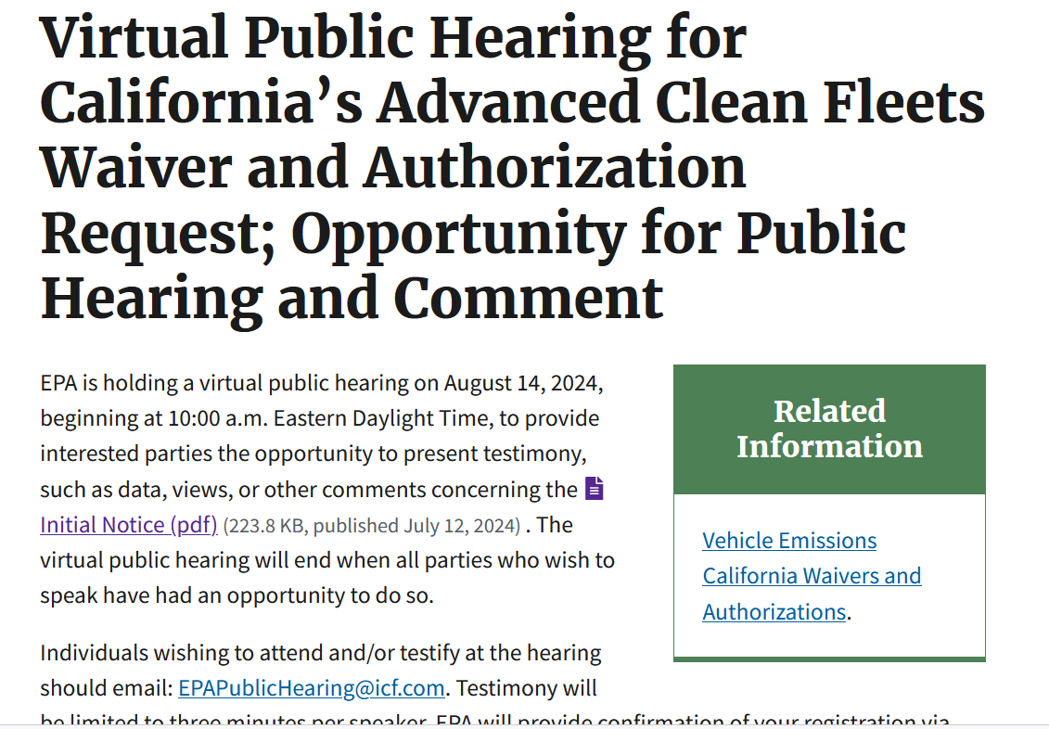
Regulations/Administration
Regulations/Administration
EPA is also accepting written comments through September 16, 2024, at www.regulations.gov via Docket # EPA–HQ–OAR–2023–0589.

Slide 11
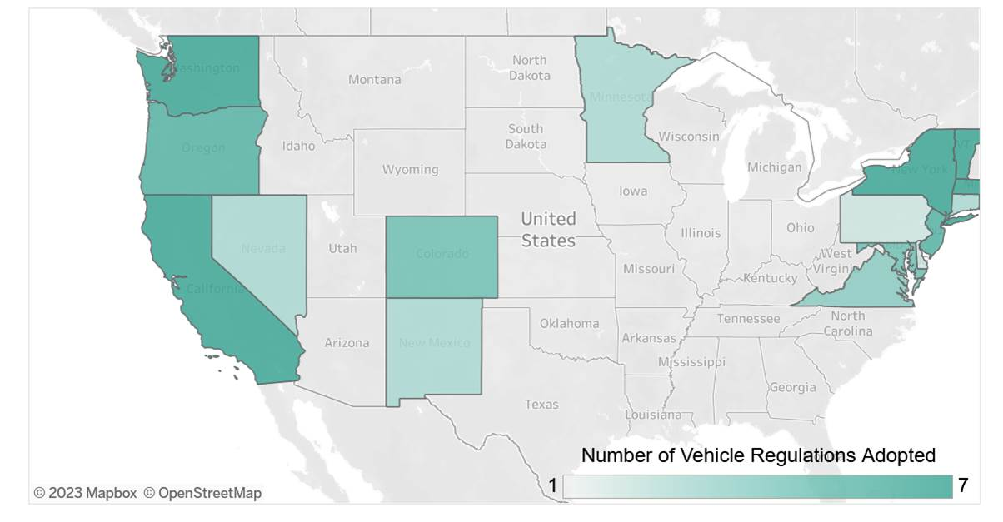
Emissions Control – ZEV Push
CLEAN AIR ACT
(1955, 1963,1967, 1970s)
FEDs
Environmental Protection Agency aka EPA
CALIFORNIA
California Air Resources Board aka CARB
Other 49 States
CARB States v. Non-CARB States
Notes:
-EPA sets emissions standards for air pollutants for new motor vehicles or new motor vehicle engines.
-1967 – California was given authority to set its own, more stringent air quality rules.
-Must first obtain a waiver from EPA
-States can adopt only after CA receives waiver
- Unlike other federal laws, States have choice to adopt either EPA’s rules or California’s rules
“CARB States”
CAA CA provision intended to recognize historic CA efforts to address air pollution due to its unique geography, weather and population.
July 2020 – MOU to accelerate electric buses/trucks – 15 states, DC – now up to 18, collectively
MN – July 2021, first Midwest state to adopt CARB emissions and ZEV sales for passenger cars - not trucks, yet….VW settlement award used for HD trucks, most if at all – short-haul/municipal trucks

Slide 12
CARB Update
Emissions Regulation/Zero-Emission Vehicles (ZEVs)
      Truck & Bus Regulation (finalized 2011)
      Clean Truck Check (finalized 2021) – compliance started in Jan. 2023
      ACT Rule – (finalized 2021) – ZEV sales mandate; now being amended
      Omnibus NOx – (~2022) still working on amending (?)
      ACF Rule – (2023) ZEV purchase mandate, a request for EPA waiver made Nov. 2023

Slide 13
CA & WA Meal and Rest Break
California requires commercial drivers to stop for a meal and/or rest break – Intra and Inter State
FMCSA issued preemption determination January 21, 2020 for drivers of passenger carriers subject to federal HOS requirements
Challenged in federal court of appeals by Calif. Labor Commissioner
ABA filed amicus curiae brief in support of FMCSA on October 7, 2020
FMCSA considering a waiver petition of pre-emption determination (Reviewing comments)

Slide 14

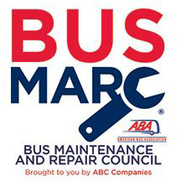
Council Updates
2024 UPCOMING MEETINGS:
BISC West Virtual Meeting: August 12, 2024
BISC East Meeting: September 19, 2024 – with Greater Northeast Motorcoach Association
BISC West Meeting: October 29, 2024 – with California Bus Association
Next Era Leadership Council – Quarterly
African American Motorcoach Council – Monthly
Hispanic Motorcoach Council – Met in May
Women in Buses Council – Monthly meetings and webinars
Diversity, Equity and Inclusion Committee – Monthly meetings

Slide 15
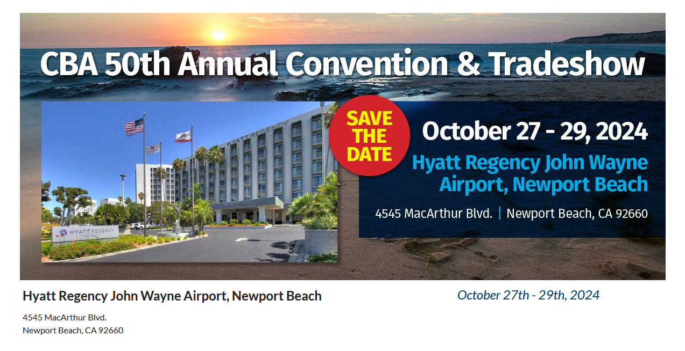
CBA Convention

Slide 16




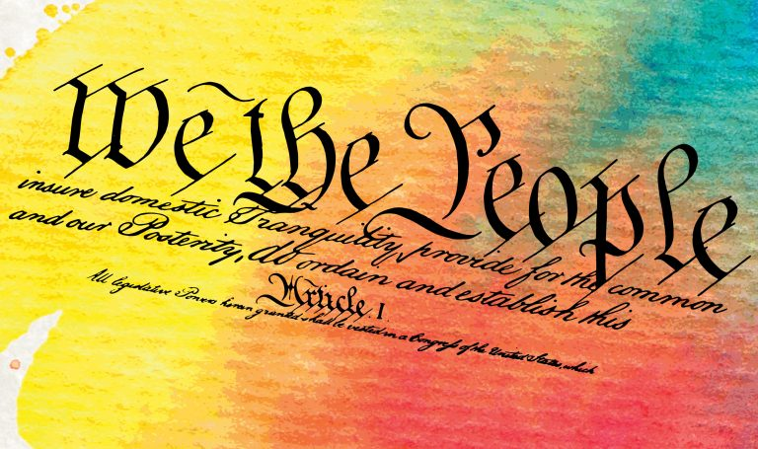
ABA Marketplace
Registration is Open now!
Hotel block opened August 9
Appointment Requests Open in October

Slide 17
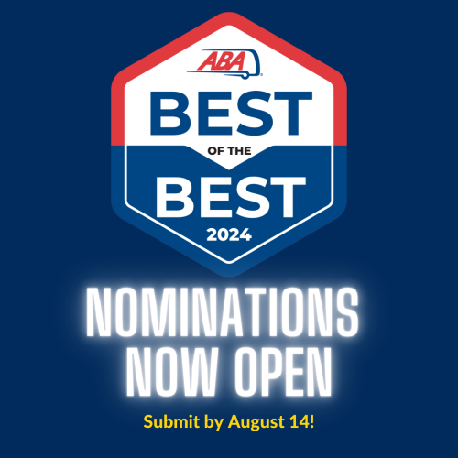
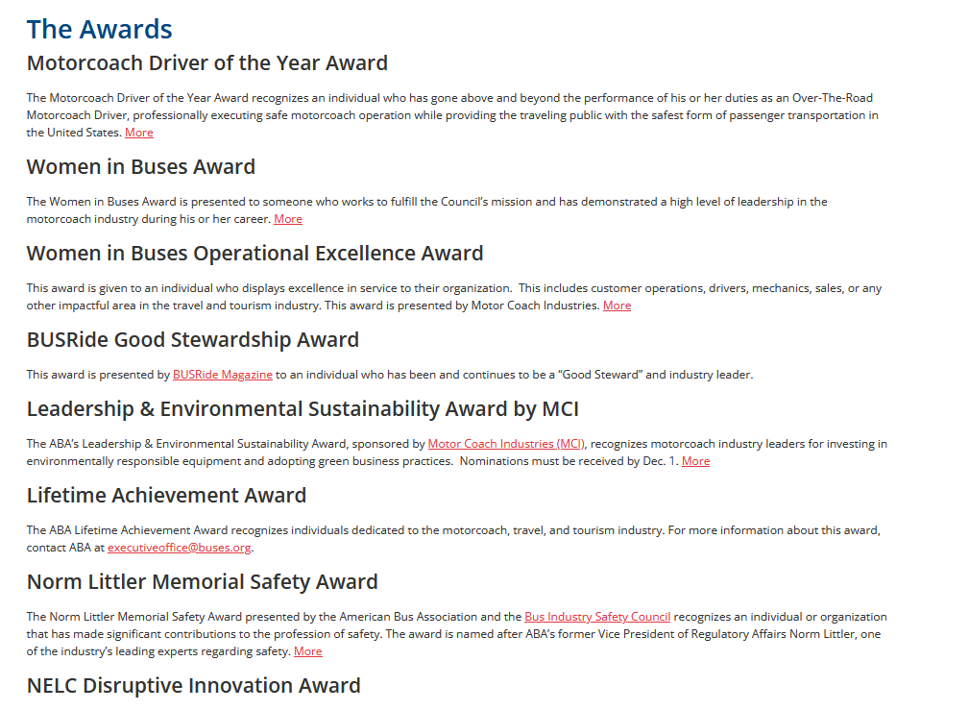

ABA Updates
Award Season is Coming!

Slide 18
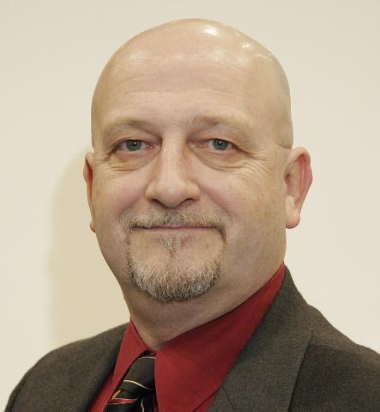
NORM LITTLER MEMORIAL SAFETY AWARD
SAFETY AWARDS
The Norm Littler Memorial Safety Award presented by the American Bus Association and the Bus Industry Safety Council recognizes an individual or organization that has made significant contributions to the profession of safety through the development or implementation of techniques, products or safety processes and demonstrates a commitment and investment in the day-to-day safety of the traveling public by motorcoach.

Slide 19

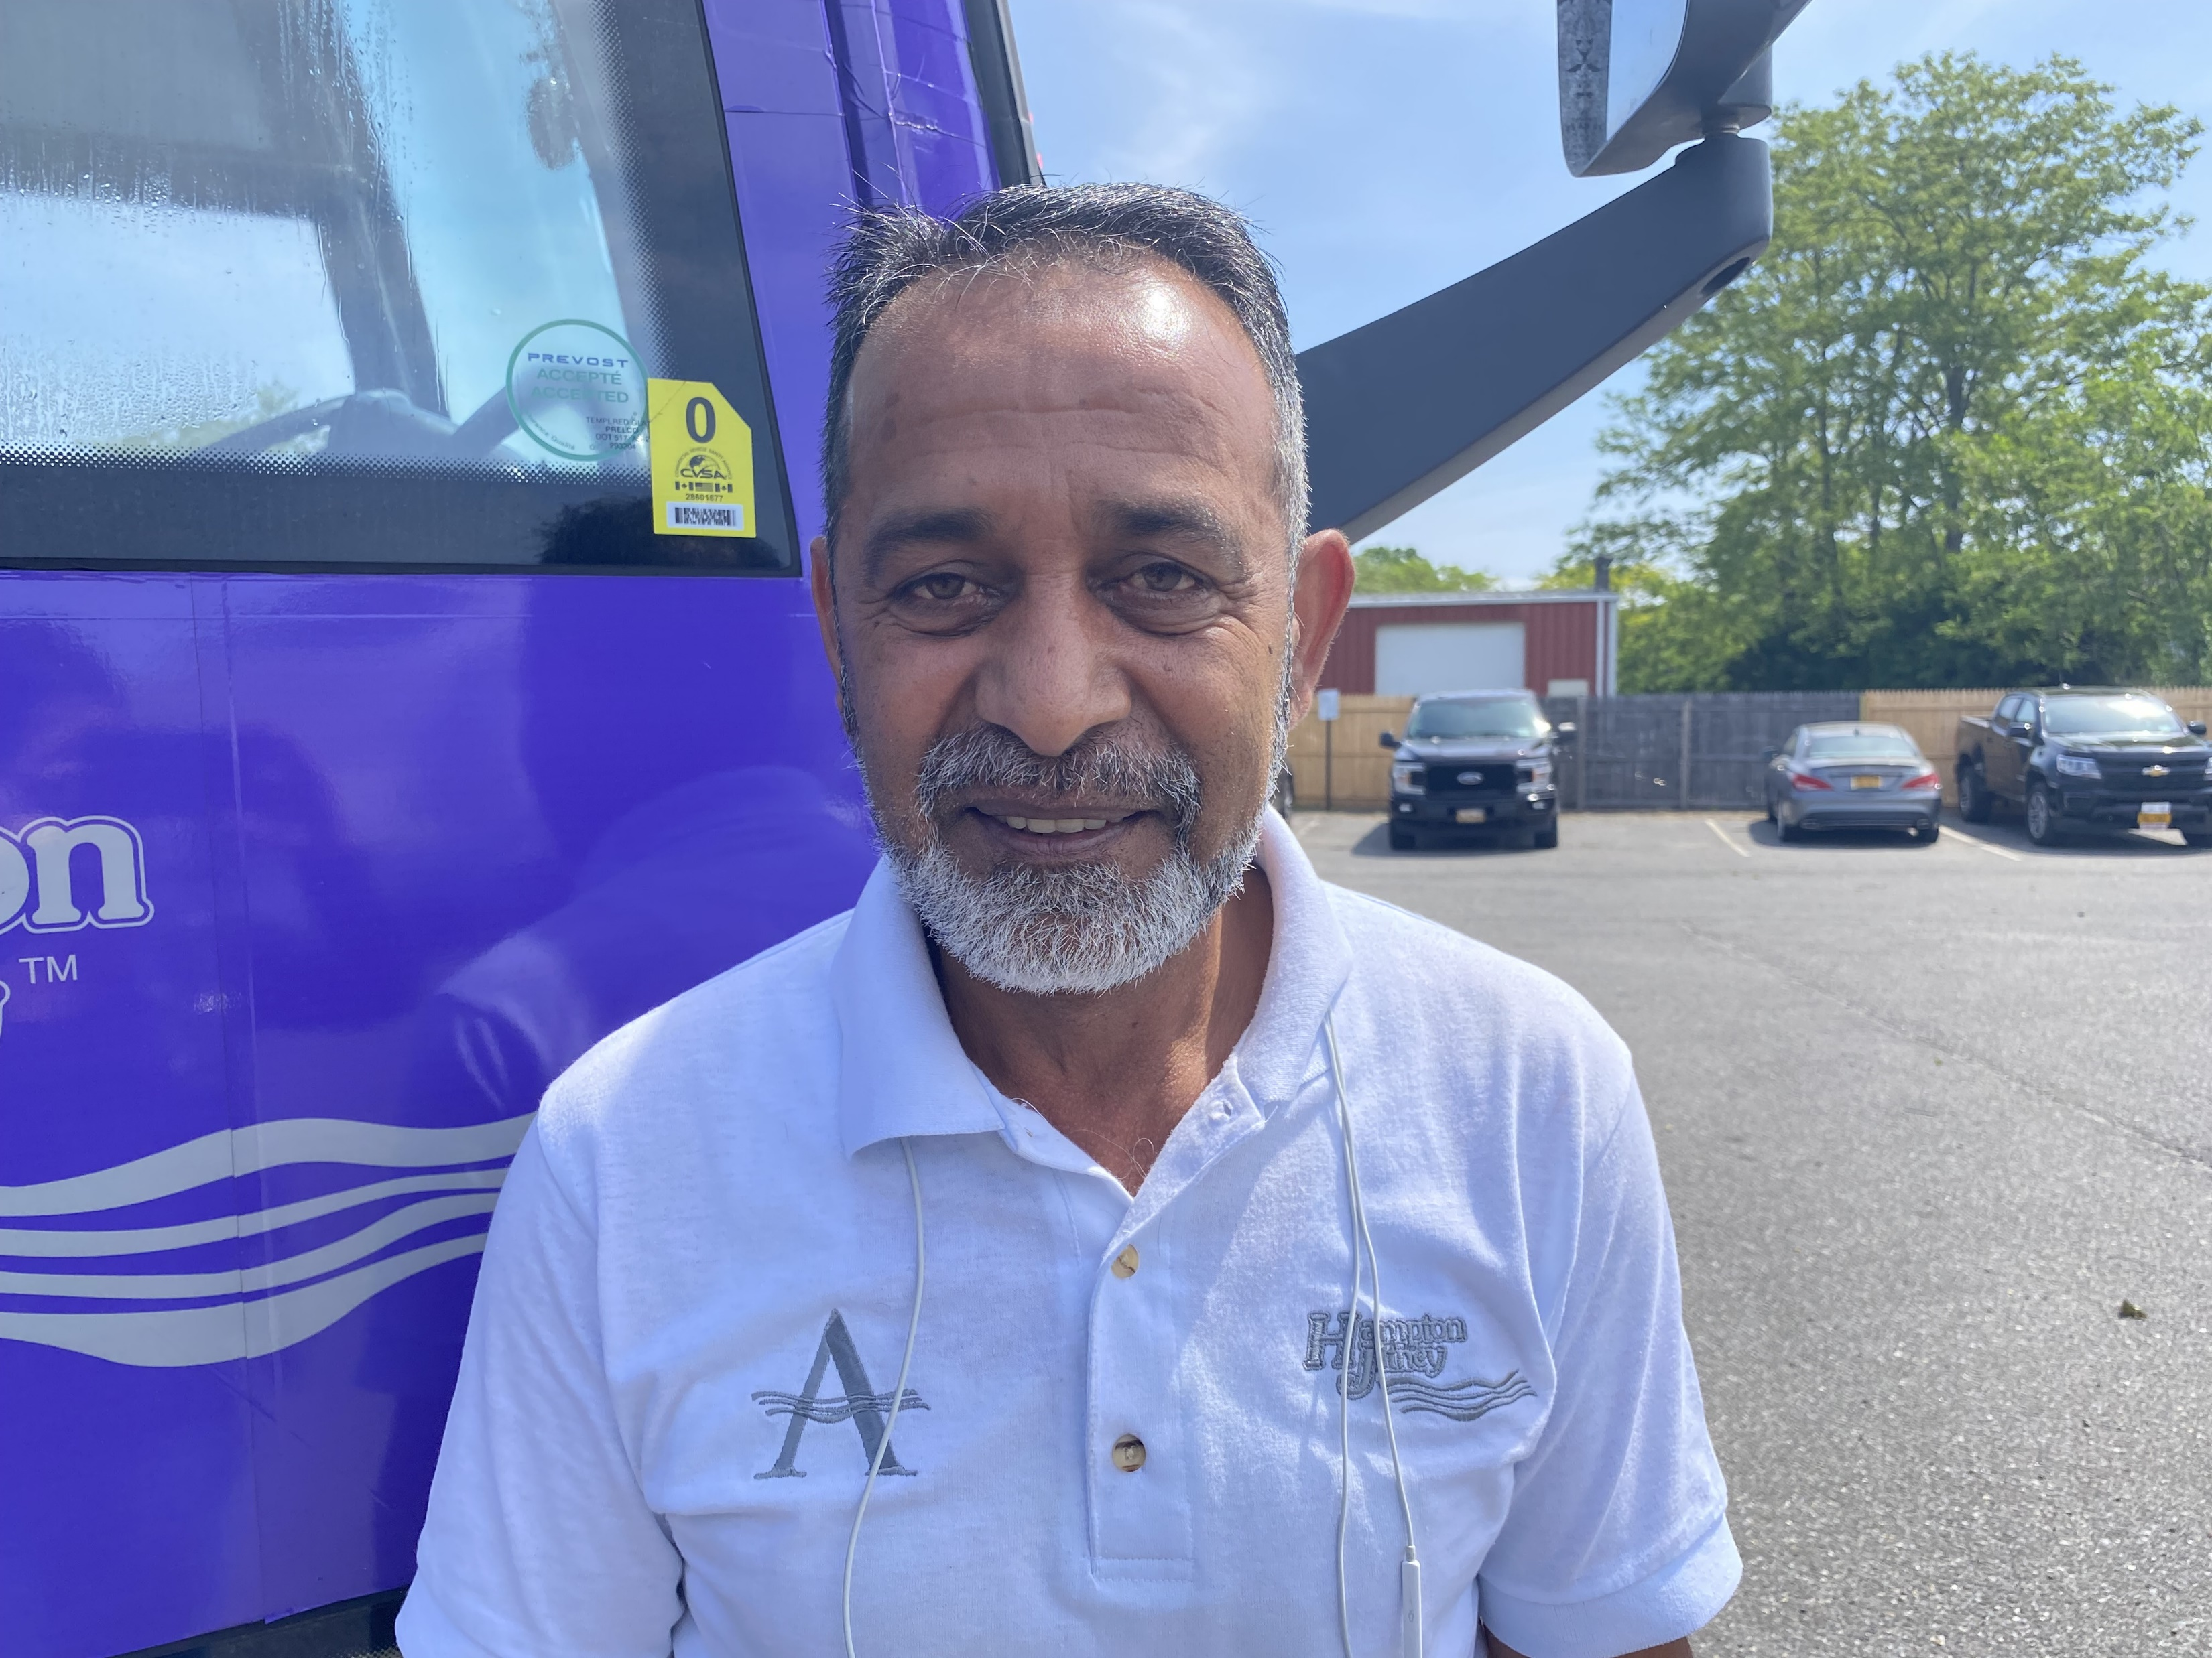
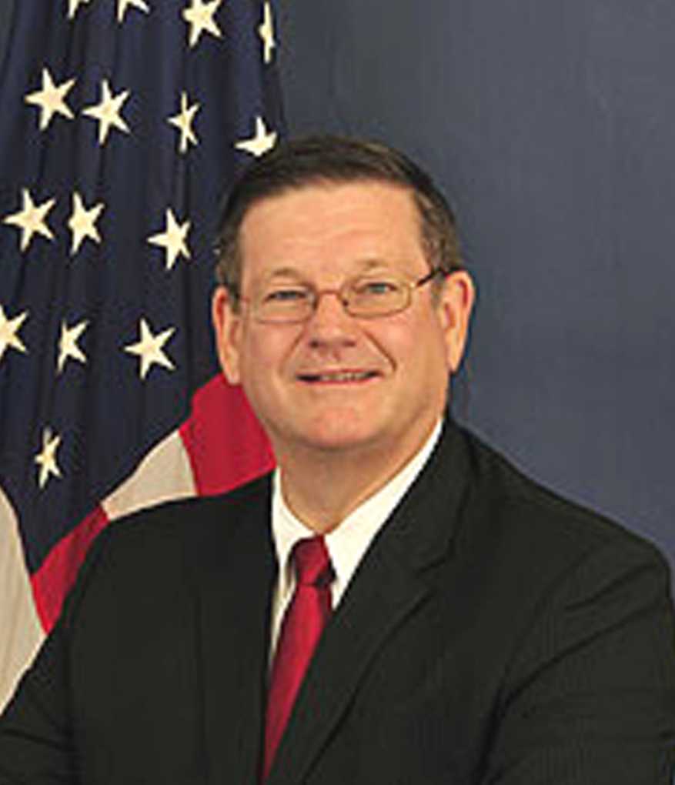
THE ABA DRIVER OF THE YEAR AWARD
SAFETY AWARDS
Award Criteria:
The Nominee must be employed as an over-the-road motorcoach driver by an ABA Member (full- or part-time).
The Nominee must have a minimum of ten (10) years cumulative experience driving an over-the-road motorcoach.
The Nominee must not have any felony convictions.
The Nominee must not have any driving violations in the past three (3) years, excluding form and manner violations.
The Nominee must not have had a chargeable accident for a minimum of ten years. Non-chargeable incidents or incidental accidents (bumpers, mirrors) do not count.
The supporting documentation required is a three (3) year history of the nominee’s motor vehicle record (MVR) and customer testimonial letters on behalf of the nominee.
Visit https://www.buses.org/about/about-aba/awards/ on or around September 1, 2024

Slide 20
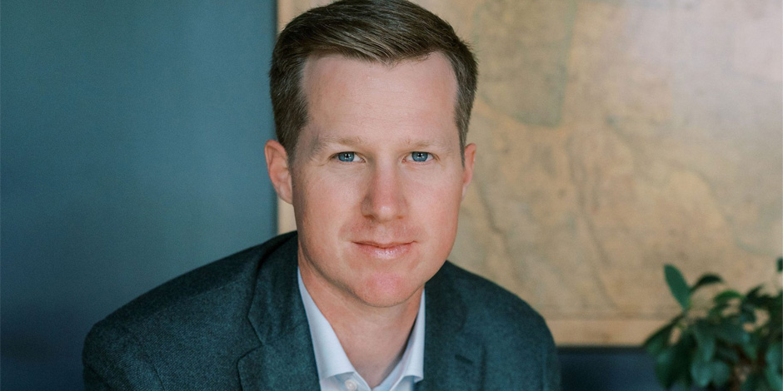
CEO Search Update
Fred Ferguson

Slide 21
Motorcoach Parking
ABA Supports Increased Motorcoach Parking.
For all federal legislation calling for increased truck parking, we have inserted motorcoach or had it changed to CMV.
Motorcoach parking decreases traffic congestion
Motorcoach parking decreases idling, especially if restaurants and lounge facilities are nearby
ABA has advocated for motorcoach parking as part of intermodal facilities for years and annually participates in DC Loves Buses Day to promote parking awareness throughout the tourism community.

Slide 22
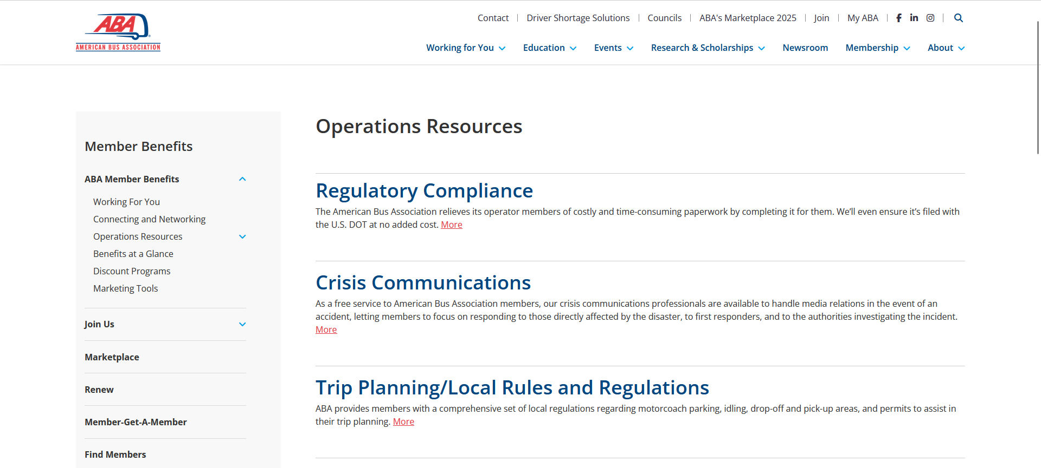
Motorcoach Parking

Slide 23
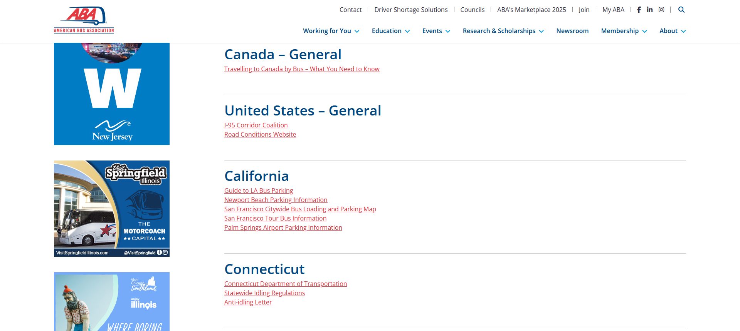
Motorcoach Parking

Slide 24
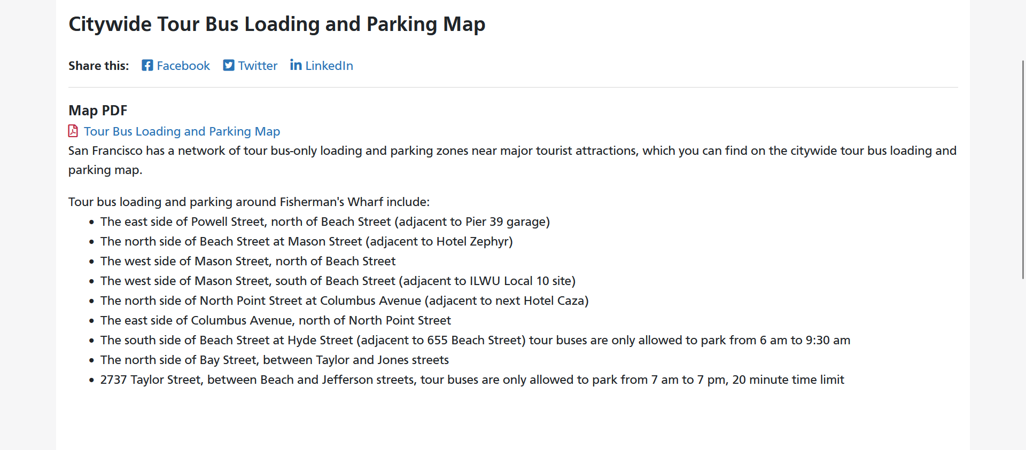
Motorcoach Parking - SF

Slide 25
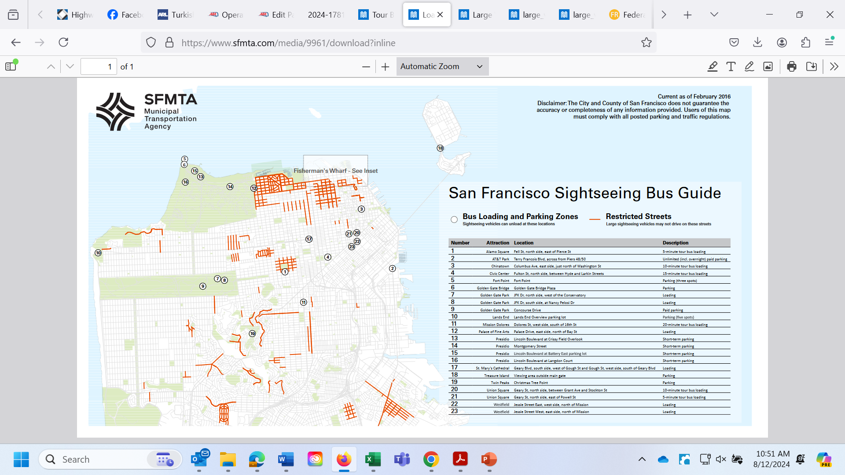
Motorcoach Parking - SF

Slide 26
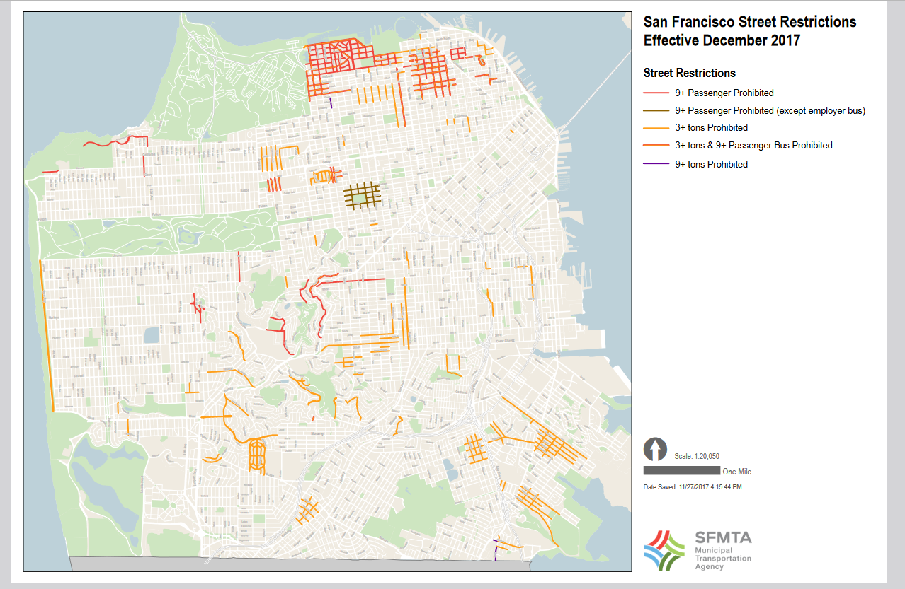
Motorcoach Parking - SF

Slide 27
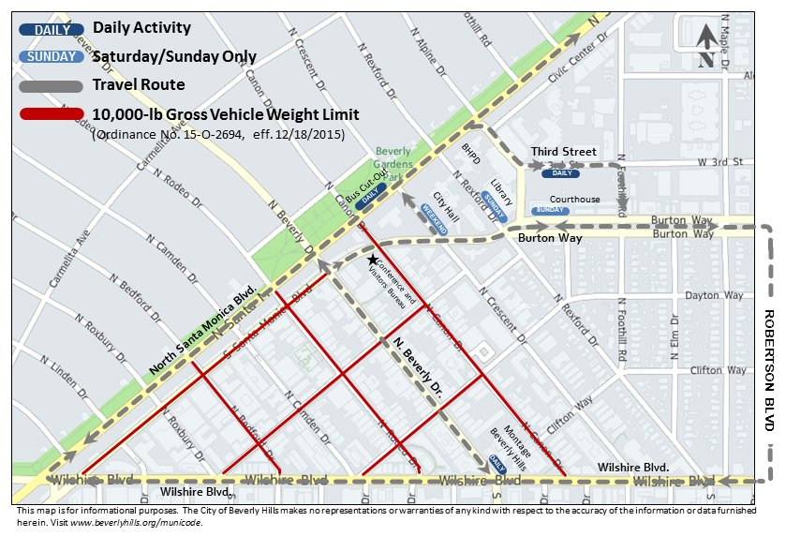
Motorcoach Parking - LA

Slide 28
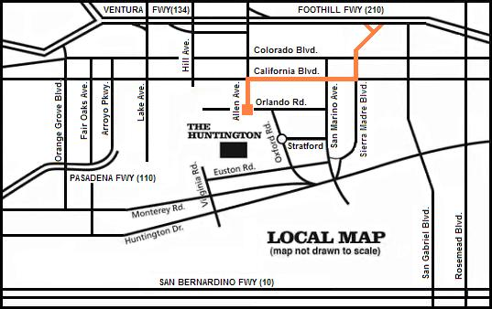
Motorcoach Parking - LA

Slide 29
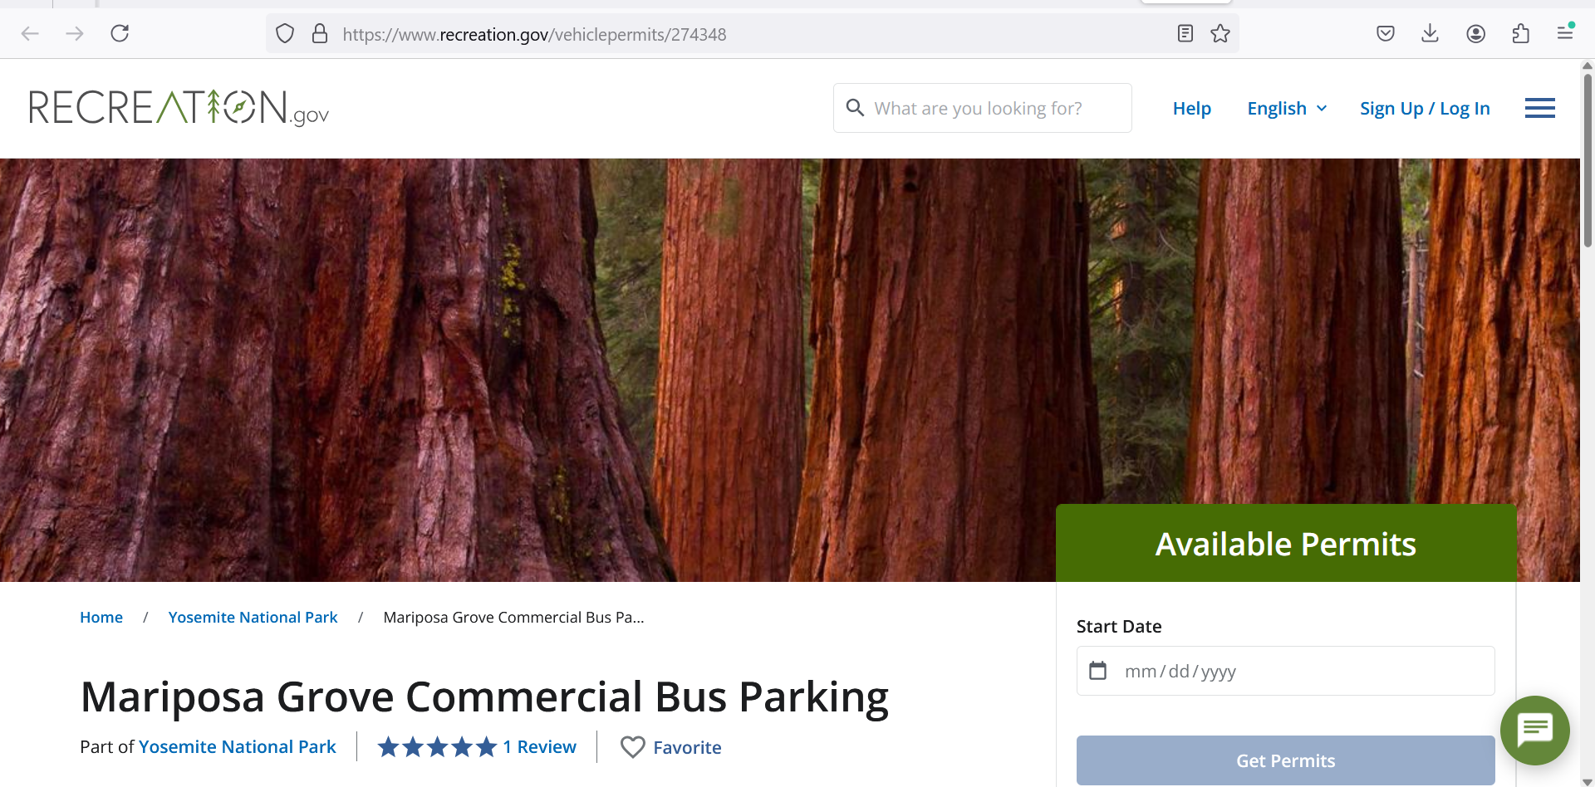
Motorcoach Parking - nps

Slide 30
Questions or Comments?
Thank you
*******************
Brandon Buchanan
Bbuchanan@buses.org
202- 218-7227

