Slide 1



Are Our Shops Safe?
(from Heat Illness & Injury Risks)

Slide 2

Salvatore Caccavale CPEA-EHS
Contact information:
scaccavale@martzbus.com
570-821-3830 (office)
815-302-9185 (cell)
Vice Chairperson BISC

Slide 3
Thermoregulation
Your body works to keep your inner temperature at 98.6 degrees F in a
process called thermoregulation.
Thermoregulation occurs in both heat and cold.
Amount of heat that stays stored in you depends on:
Environment
Level of Physical activity
Type of work
Time spent working
Number & length of breaks between work periods

Slide 4
Thermoregulation
Thermoregulation occurs four ways:
Conduction – transfers body heat to objects colder or warmer that your body
Convection – transfers body heat to air moving over your skin
Radiation – transfer heat to or from objects not in direct contact with your body
Evaporation – cools body heat by air or moisture exiting lungs or skin
In radiation, conduction and convection, your blood vessels expand carrying internal
body heat to your skin for release to the air.
In evaporation, perspiration cools on your skin releasing heat to the air.

Slide 5
Thermoregulation
Thermoregulation is hindered – minor heat disorder such as sunburn or heat rash
Thermoregulation breaks down – may suffer major heat disorders such as heat cramps,
heat exhaustion or heat stroke
Amount and rate of heat gain or loss depends on:
Air temperature - measured by a normal thermometer
Temperature of surrounding objects – radiant heat from sun or equipment
Air movement (caused by wind or fans)
Humidity (% of water vapor in the air)
Clothing worn – number or layers & thermal efficiency of clothing & where it is worn on body
Personal Protective Equipment – e.g., respiratory protection may increase effort breathing
Physical activity – hard or modest work increases the heat within the body
Medical state of the individual and body mass – age, gender, acclimatization, hydrated state (% of liquid in body)
possible medical conditions, medication being taken and level of fitness
Time exposed to temperature – both in total and short bursts and rest period

Slide 6
Thermoregulation
When environmental temperature is higher than your body temperature YOU absorb heat resulting in your temperature increasing and the body’s cooling system activating to prevent damage by:
Blood vessels expand to carry heat to your skin surface for release to the air
Your pulse rate rises, adding strain to heart and circulatory systems
Perspiration flows to your skin to evaporate
Heat Index
The heat index is the "feels like" temperature.
As relative humidity increases, the air seems warmer than it actually is because the body is less able to cool itself via evaporation of perspiration.

Slide 7

Heat Index
As the heat index rises, so do health risks:
  Heat index is 90°-103°F heat exhaustion is possible.
  Heat index above 103°F heat exhaustion is probable.
  Heat index > 125°F heatstroke is possible.
  Heat index > 130°F heatstroke very likely.
Physical activity and prolonged exposure to the sun or heat increase the risks.
The Heat Index Table (next slide) uses the Dry Bulb temperature and the Relative Humidity to determine the Heat Index.

Slide 9
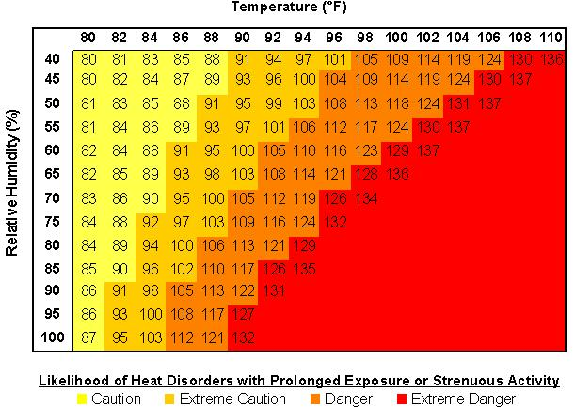
Heat Index Table

Slide 10

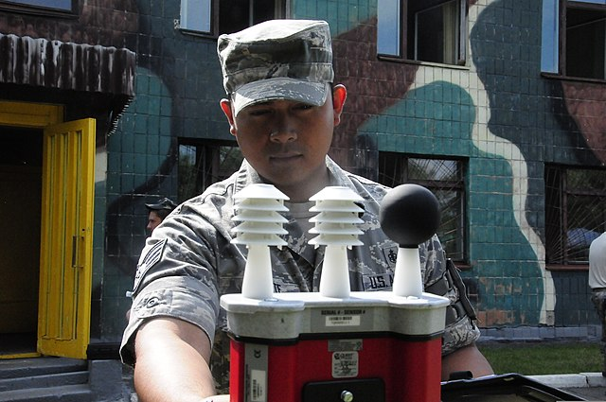
Wet Bulb Globe Thermometer

Slide 11
Heat Index Recommendations
Heat index >90 to 103°F
  Mandatory break every hour in cool/shade
  Drink fluids at each break
Heat index > 103 to 124°F
  Mandatory break every 30 minutes in cool/shade
  Drink fluids at each break
  Mandatory use fluid cooled vest
  Recommended use of vests (Others)
  Rotate employees frequently
Heat index > 124°F
  Discontinue all outdoor work, if possible
  Mandatory use of vests (All)
  Reschedule work to early AM or the evening, if possible

Slide 12
Minor Heat-Stress Disorders
Heat Rash (Prickly heat) – occurs in humid conditions . To prevent heat rash:
Keep skin dry and clean
Wear loose-fitting clothing
Sunburn – can stop your body from thermoregulating efficiently. To minimize harmful sun exposure:
Apply sunscreen both before and during work in the sun
Work in the shade whenever possible
If you are sunburned, stay out of the sun as much as possible.
Perspiration and Mineral Loss – glands secrete salts and water onto your skin for evaporative cooling
Drink at least 7 ounces of water every 15 to 20 minutes or risk dehydration
Drink lightly salted liquids (watch if you have medical conditions pertaining to salt intake)

Slide 13
Major Heat-Stress Disorders
If your body warns you to cool down and you ignore it, hyperthermia increases until you risk permanent damage.
Heat Cramps – severe muscle cramps, fluids depleted through perspiration or decreased mineral content.
If you or co-worker is suffering from heat cramps:
Move into the shade
Drink lightly (1 percent) salted water
Heat Exhaustion – thermoregulation is overwhelmed but not completely broken down.
MUST receive medical attention.
Heat exhaustion symptoms may include:
Clammy, cool, moist and pale skin
Fatigue or weakness
Heavy perspiration
Intense thirst from dehydration
Clouded senses or impaired judgement
Fainting or lose of coordination
Loss of appetite
Nausea or vomiting
Rapid breathing
If you suspect Heat exhaustion:
Call 911
Move the victim into the shade
Remove or loosen clothing and boots
Fan the victim
Elevate the victim’s legs
Massage the victim’s legs
Give the victim lightly salted water
Pour water and ice on the victim
Stay until medical help arrives

Slide 14
Major Heat-Stress Disorders
Heat Stroke – most severe of heat disorders, life-threatening emergency requires immediate medical attention
Early symptoms:
High body temperature
No perspiration on skin
Hot, red or flushed skin
Rapid pulse
Difficulty breathing
Constricted pupils
High blood pressure
Headache or dizziness
Confusion or disorientation
Weakness
Nausea or vomiting
Advanced symptoms:
Seizures or convulsions
Collapse
Loss of consciousness
Deep coma
No detectable pulse
Body temperature over 103 degrees F
If you suspect heat stroke:
Lower victim’s body temperature as quickly as possible
Complete immersion in water or apply ice packs to armpits, elbows, wrists or backs of knees may help.
Call 911 immediately

Slide 15

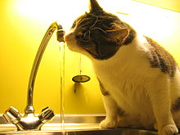
Controlling Heat Stress
Acclimatization – development of the ability to work in a hot environment by gradually getting yourself
used to the conditions. To acclimate safely you should be in good physical condition. Some reach full
acclimatization within a week. Others may take longer.
Work/Rest Cycles – proper work procedures to reduce ill effects of heat stress involve scheduled
work/rest cycles that keep you from overdoing it. Rest means minimal activity, not halting work completely.
Food and Water Intake – fluid replacement is the most important way to protect your body’s
Thermoregulation system. You must take in as much fluid as you lose during the day and replace salts your body
uses up in cooling. NEVER drink alcohol beverages since alcohol dehydrates the body.

Slide 16
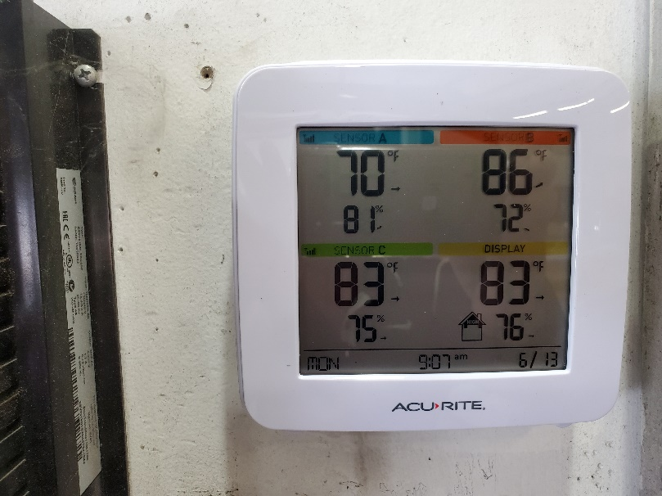
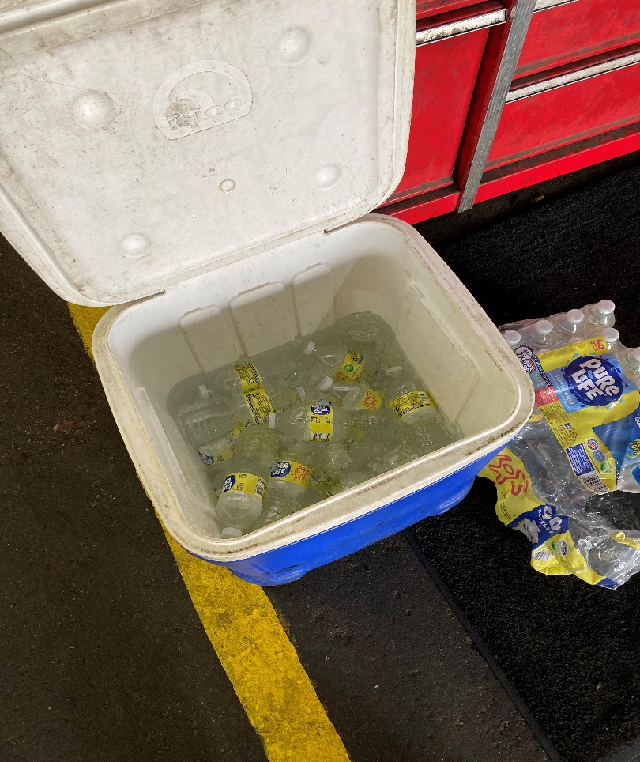
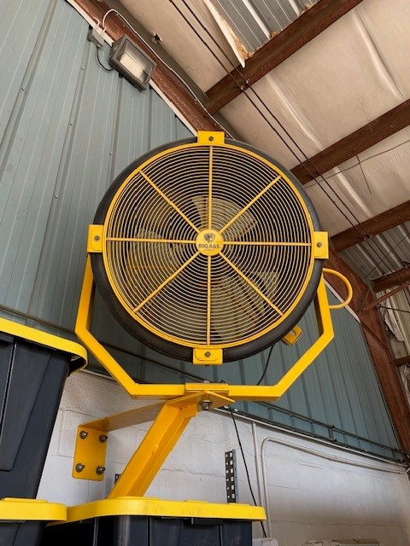
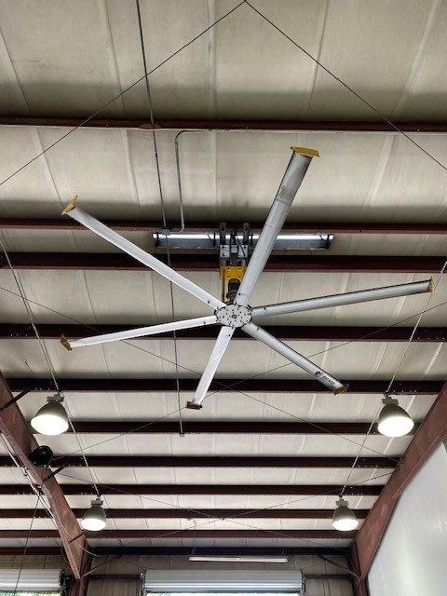
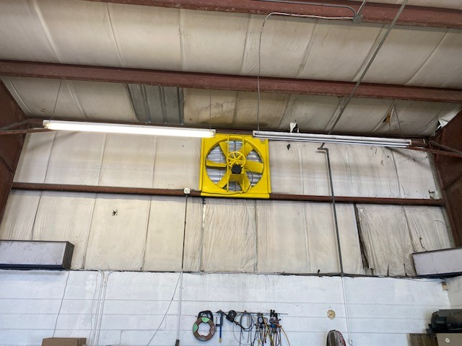
Protective Measures

Slide 17
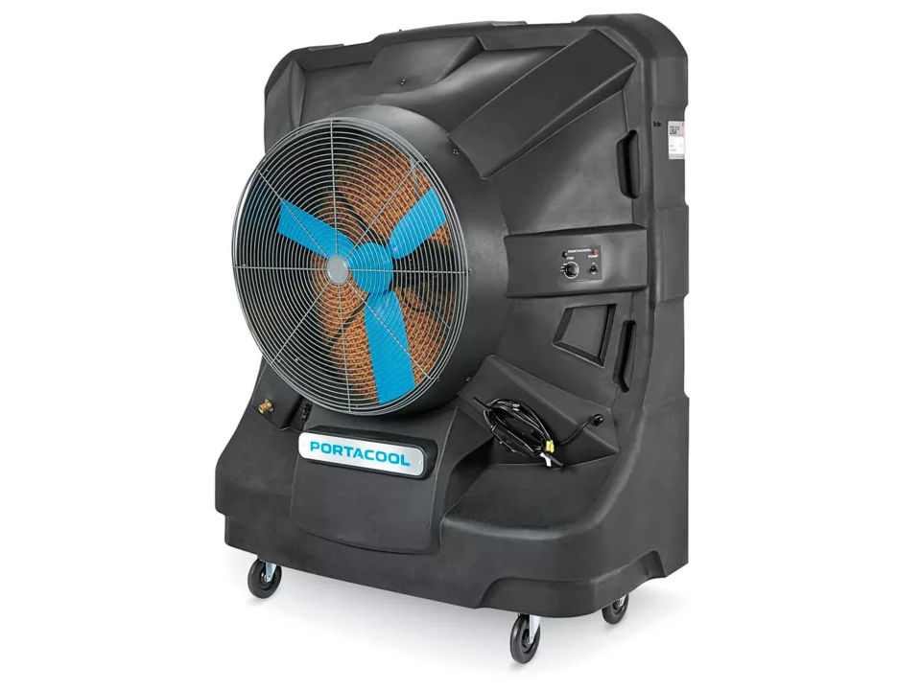
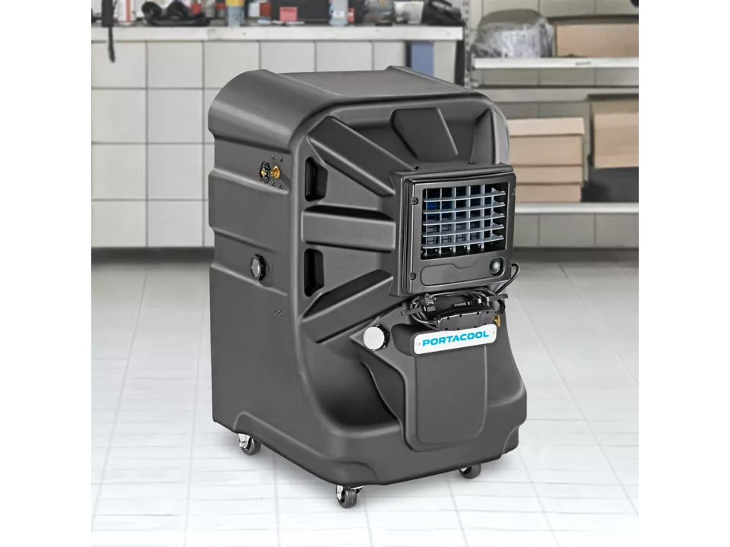
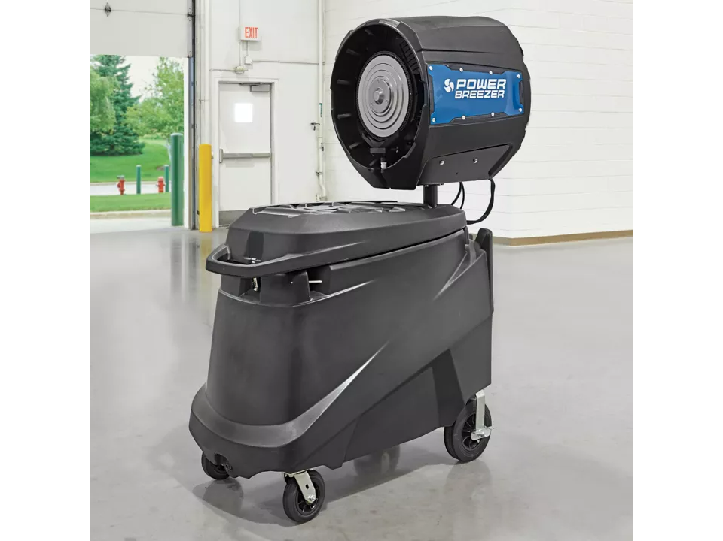
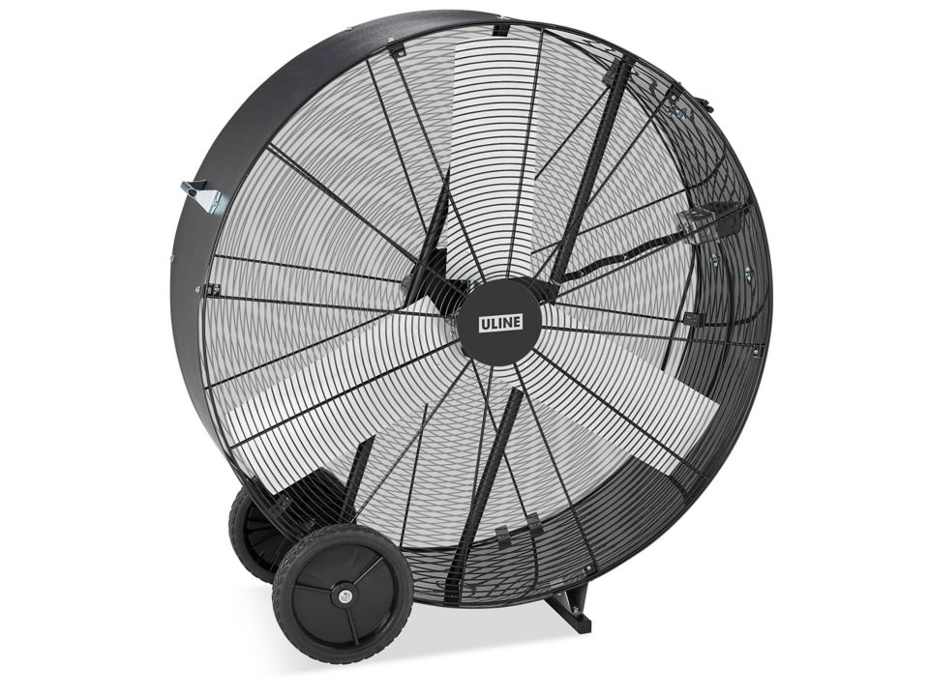
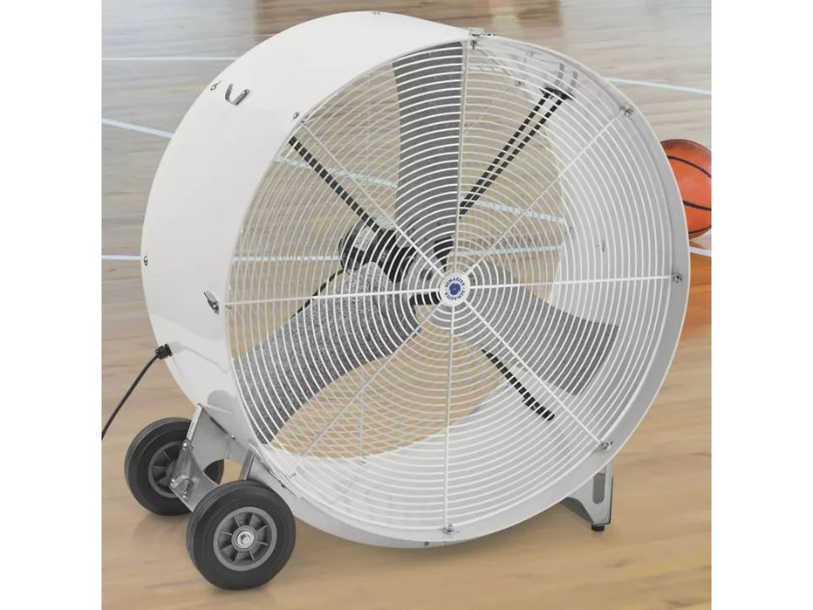

Slide 18

Incidents Due to Heat Stress
Direct causes of incidents include:
Dizziness or fainting
Fogged glasses
Slippery hands
Perspiration in the eyes
Indirect causes of incidents include:
Loss of attention to the job
Irritability and anger
Fatigue
Poor judgement
Slower mental and physical reactions

Slide 19
Florida Fuel Tax Rebate
You may request a refund of Florida fuel tax paid on undyed diesel consumed by the engine of a qualified motor coach during idle time for purposes of running climate control systems and maintaining electrical systems for the motor coach in this state. Download an Application for Refund of Tax Paid on Undyed Diesel Consumed by Motor Coaches During Idle Time in Florida (Form DR-309640 PDF Icon). A purchaser may make one refund claim per calendar year.
https://floridarevenue.com/taxes/taxesfees/Pages/fuel_tax_refunds.aspx

Slide 20
Summary
To work safely in hot environments:
Be aware of environmental heat and its consequences
Take in enough fluid and minerals to prevent hyperthermia
Follow suggested work/rest cycles until you are fully acclimated to the environment.
If you or a co-worker suffer symptoms of heat stress, follow accepted first-aid procedures.
Risk Assessments
Job Safety Analysis

Slide 21
Your Maintenance Shop
And Safety Recommendations

Slide 22
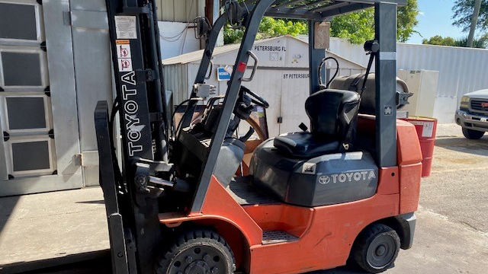
Forklifts
OSHA 29 CFR 1910.178/ANSI B56.1 (2020)
Powered Industrial Trucks

Slide 23
Forklift Maintenance
Perform preventive maintenance according to manufacturer's scheduled recommendations.
OSHA requires all forklifts be examined at least daily before being placed in service. Forklifts used on a round-the-clock basis must be examined after each shift.
The operator should conduct a pre-start visual check with the key off and then perform an operational check with the engine running.
The forklift should not be placed into service if the vehicle is not be safe to operate. (Red Tag – Do Not Operate)

Slide 24
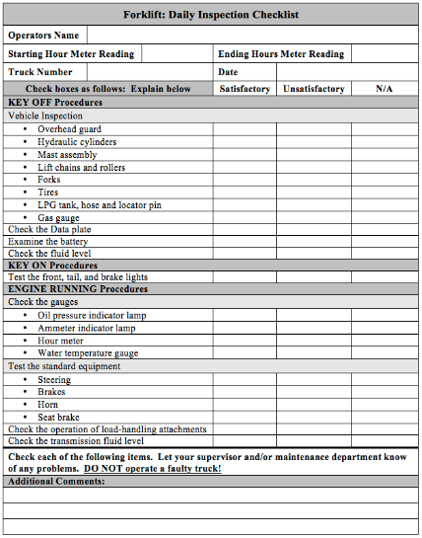
Forklift Maintenance
Remember! A vehicle in need of repair, defective or in any way unsafe, should not be driven and removed from service immediately.
Any problems should be recorded on the Daily Inspection Sheet and reported to a supervisor.

Slide 25
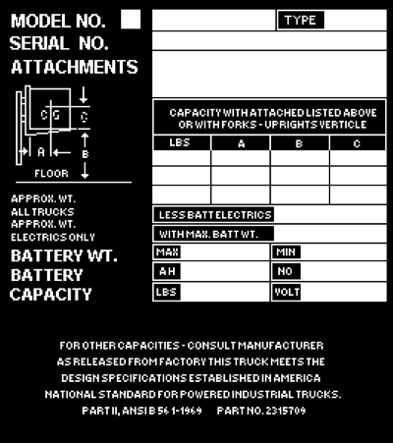
Forklift Dataplates
Data Plate Information
Type
Capacity
Load Center
Truck Weight
Regulations
Dataplates and markings must be in place and legible
All modifications and additions which affect the safe operation and capacity must be approved by the manufacturer

Slide 26
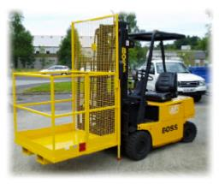
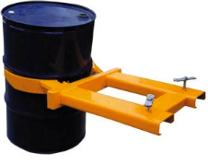
Forklift Attachments
Using an unapproved attachment could alter the forklift’s lifting and balance characteristics and lead to a forklift overturning.
Whenever an attachment is used that could affect the capacity or safe operation of a forklift, its use must be approved by the forklift manufacturer.
Attachment information should be included on the forklift dataplate.
“Fall protection” is
required while working
in the man basket

Slide 27
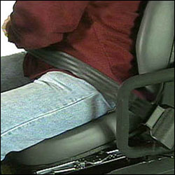
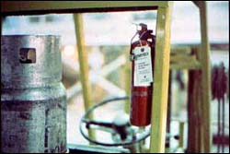
Warning and Safety Devices
Powered industrial trucks must be equipped with the following safety devices:
Seatbelts
Horns
Fire Extinguishers
Overhead Guard
May be equipped with:
Backup Alarms
Warning Lights
Mirrors
Directional and Brake Lights

Slide 28
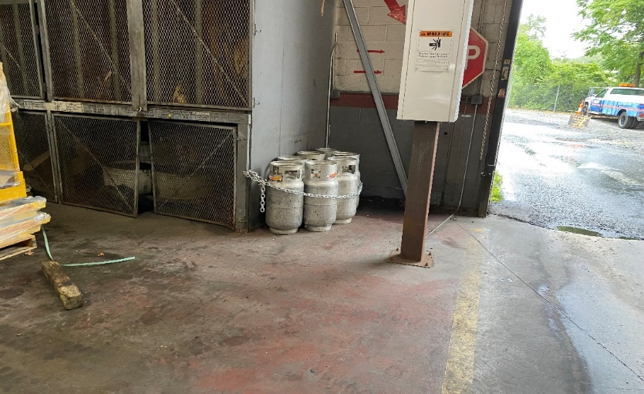
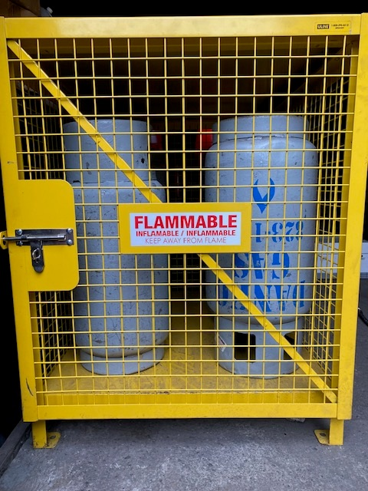
Fueling
Liquid Petroleum Gas
Storage
Store tanks in dry, well-ventilated areas.
Protect cylinders from physical damage.
Keep away from ignition sources and oxidizers.
Do not store near exits, stairways, and areas with potential for excessive temperatures
Use first-in/first-out method of usage
Separate full and empty cylinders.
Do not drag, roll, slide, or drop cylinders.
OSHA 29 CFR 1910.110
Storage and Handling of Liquified Petroleum Gases

Slide 29
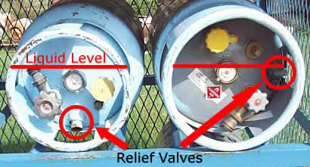
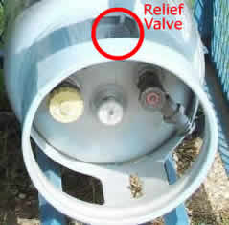
Fueling
No smoking in storage area
Storing propane in doors is not advisable
Store tanks with the relief valves in communication with the vapor area
https://www.youtube.com/watch?v=z39r0aHkxIU

Slide 30
Training Requirements
Refresher training is conducted to ensure the operator has the knowledge and skills needed to safely operate the powered industrial truck.
Refresher training is to be provided when:
Observed unsafe operation of vehicle
Driver involved in an accident or incident
A driver evaluation indicates a need for retraining
The driver is assigned a different type of truck.
A condition in the workplace changes that could affect safe operation of the truck.
Performance evaluated at least once every three years

Slide 31
Lock, Tag and Try
(Lock out/Tag-out)
OSHA 29 CFR 1910.147
Control of Hazardous Energy

Slide 32
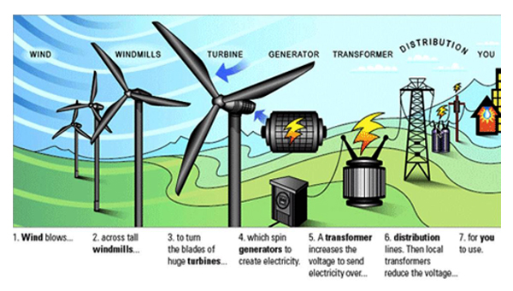
Definitions . . .
Energy Source - any source of electrical, mechanical, hydraulic, pneumatic, chemical, thermal, gas, water, steam, air or gravity.
Notes:
Energy sources come in many different forms.

Slide 33
Energized - when the equipment is still connected to any energy source or contains residual pressure or stored energy.

Slide 34
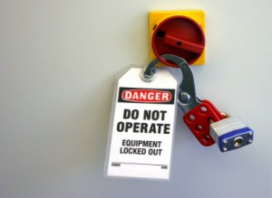
Lockout - isolating an energy source & locking the isolating device in the “off” or “safe” position.
Tagout - isolating an energy source and/or communicating a condition or situation.
Try - testing the energy state and administrative controls to ensure zero energy state.

Slide 35
Authorized employee - an individual who uses the Lock, Tag & Try procedure on a machine or piece of equipment that is to be serviced or maintained.
Affected employee - an individual whose job requires him/her to operate or use a machine or piece of equipment on which servicing, or maintenance is being performed under the Lock, Tag & Try procedure.
This also pertains to any employee whose job requires him/her to work in an area where servicing or maintenance is being performed.
Notes:
An example here is a maintenance mechanic or contractor servicing a saw would be considered an Authorized employee while the machine operator would be considered the Affected employee. Now if the saw operator had to lock out the saw to change the blade they would be considered both the Authorized and Affected employee.

Slide 36
An authorized employee and an affected employee may be the same person when the affected employee’s duties also include performing maintenance or service on a machine or equipment that requires use of the Lock, Tag & Try procedure.

Slide 37
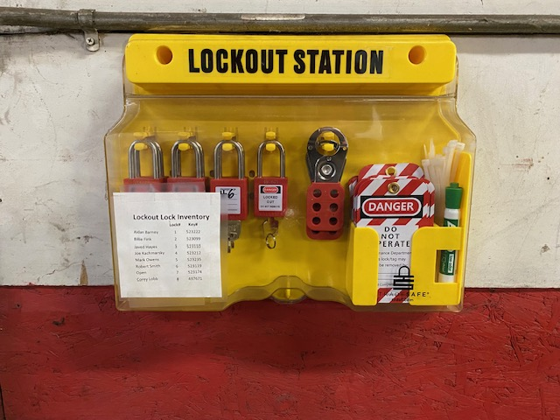
Hardware
Locks
Tags
Plastic Ties
Hasps
Lockout Valves
Circuit Breakers
Lockout, Tag-out stations

Slide 38
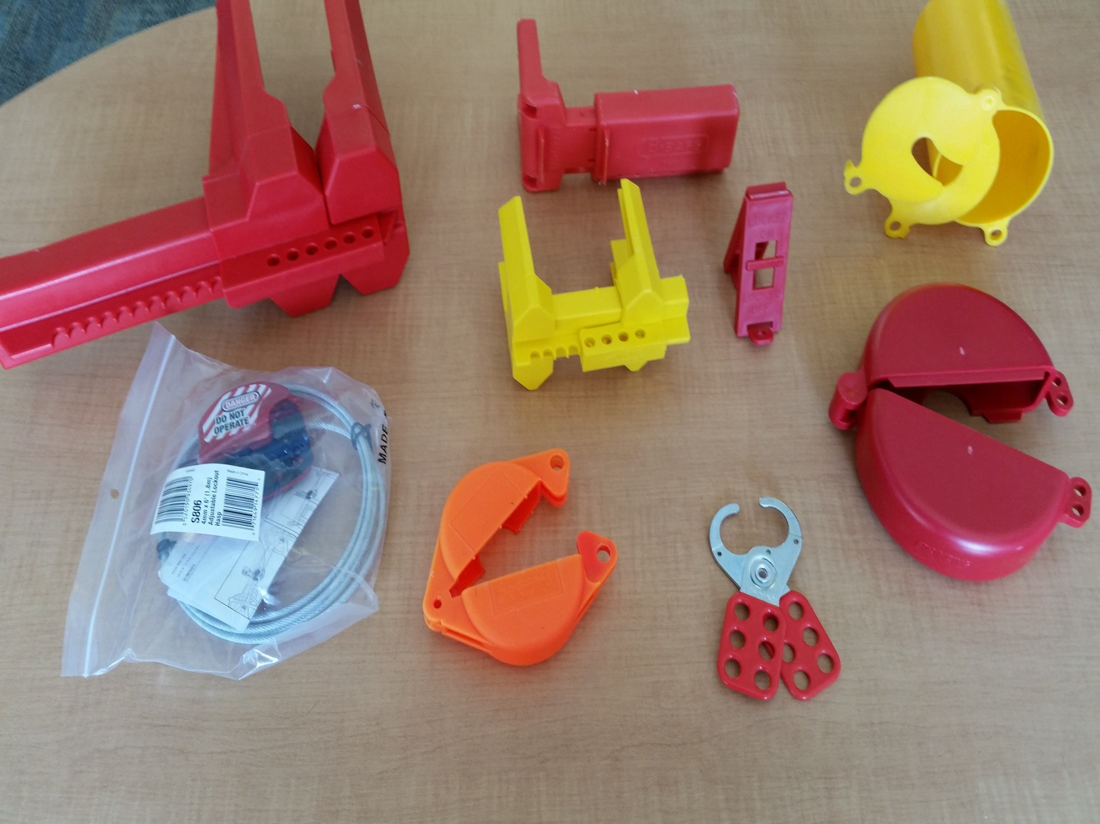
X
Wire cable NOT approved for
Lock out purposes!

Slide 39
Locks
Differentiate LOTO devices (locks and tags) from similar devices used for other purposes.
Standardize LO devices (locks) by color, shape or size and TO devices (tags) by color, shape, format and print.
User must be identified on the devices.
“Do Not Operate” or “Do Not Energize”
One Person, One Lock, One Key

Slide 40

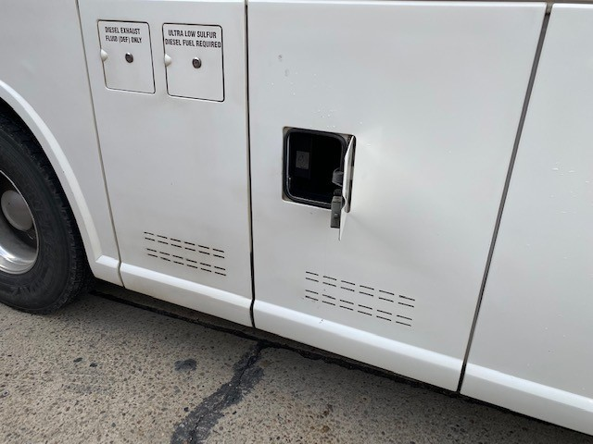
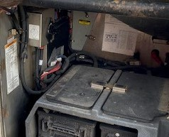
Mechanic ensures Bus
cannot be
started
Lock/Tag/Try for Bus Maintenance
Shift the Transmission to Neutral & set Parking Brake
Remove key (or turn off switch)
Key placed in Authorized employee’s pocket
Master battery switch turned off (locked)
Engine enable switch in rear junction box turned off
Door in open position signifies
battery switch in “off” position
Master battery On/Off
and lock out switch

Slide 41
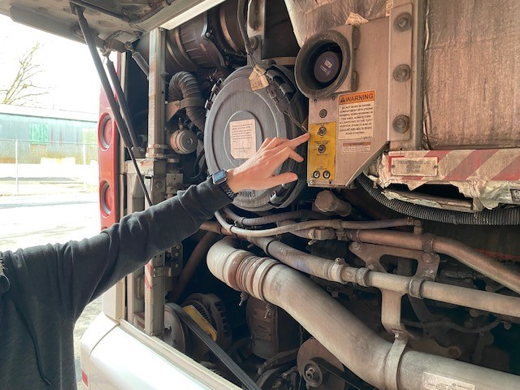
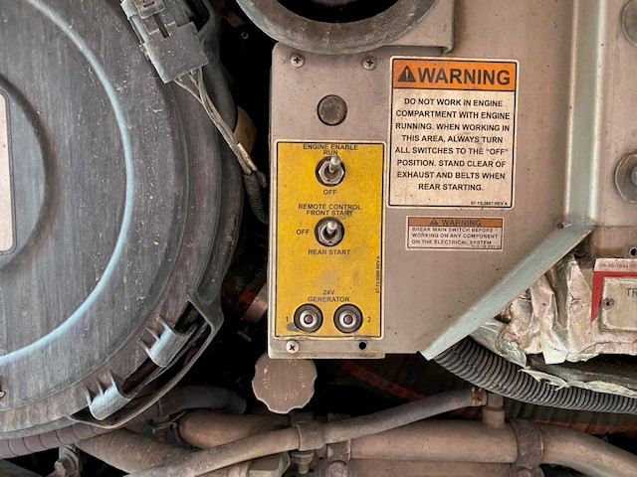
Kill switch in rear
Engine compartment

Slide 42

Vehicle Out Of Service
Tag Placed Over Steering Wheel

Slide 43
Confined Spaces
Permit-Required Confined Spaces
According to OSHA, a confined space requires a permit when it:
Contains or has the potential to contain a hazardous atmosphere (like carbon monoxide, smoke, hydrogen sulfide, and others)
Contains a material that has the potential to engulf an Entrant (like water or sand)
Has an internal configuration (like walls that converge inward or floors that slope downward) that can cause an Entrant to become trapped or asphyxiated
Contains any other recognized SERIOUS safety and health hazards (such as unguarded machines that can start up again, electrical hazards such as exposed wiring, and areas that are extremely hot or extremely cold)
Non-Permit-Required Confined Spaces
As opposed to confined spaces that require a permit to allow entry and operation, non-permit-required confined spaces do not contain or have the potential to contain a serious hazard that can cause serious harm or death. Examples of these types of spaces include crawl spaces under a house and ventilated tunnels.
OSHA 29 CFR 1910.146
Permitted Required Confined Spaces

Slide 44
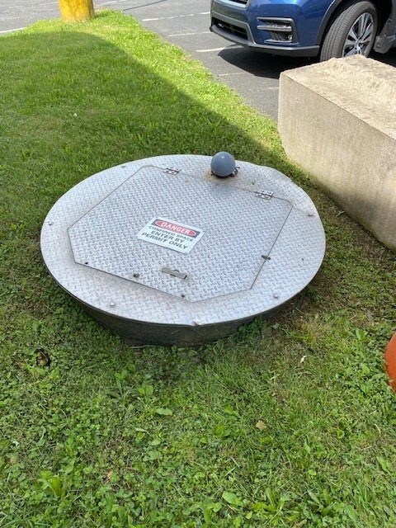
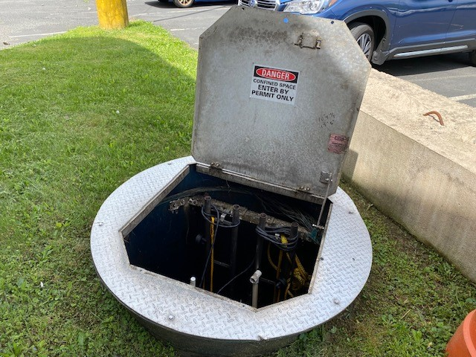

Slide 45
Housekeeping

Slide 46
General Information
75% of injury cases when the investigation is complete can be attributed to housekeeping.
According to OSHA, good housekeeping implies a workplace is kept in an organized, uncluttered and hazard free condition.
Safe work environments lead to healthier workers, higher worker morale, and increased productivity.
To some the word “housekeeping” calls to mind cleaning floors and surfaces, removing dust, and organizing clutter. But in the work environment it means much more. Housekeeping is crucial to safe workplaces.

Slide 47
Slips, Trips & Falls
Report and clean up spills and leaks
Keep aisles and exits clear of items
Consider installing mirrors & warning signs to help with blind spots
Replace worn, ripped or damaged flooring
Consider installing anti-slip flooring in areas that can’t always be cleaned
Use drip pans and guards
Eliminate slippery conditions, such as snow, ice, oil and grease for walkways and working surfaces, as necessary.

Slide 48
Eliminate Fire Hazards
Keep flammable materials in the work area only in the amounts necessary for the job. When they are unneeded (weekend), move them to assigned safe storage area.
Store quick-burning, flammable materials in designated locations away from ignition sources.
Avoid contaminating clothes with flammable liquids. Change clothes if contamination occurs.
Keep passageways and fire doors free of obstructions.
Stairwell doors should be kept closed . Do not store items in stairwells.

Slide 49
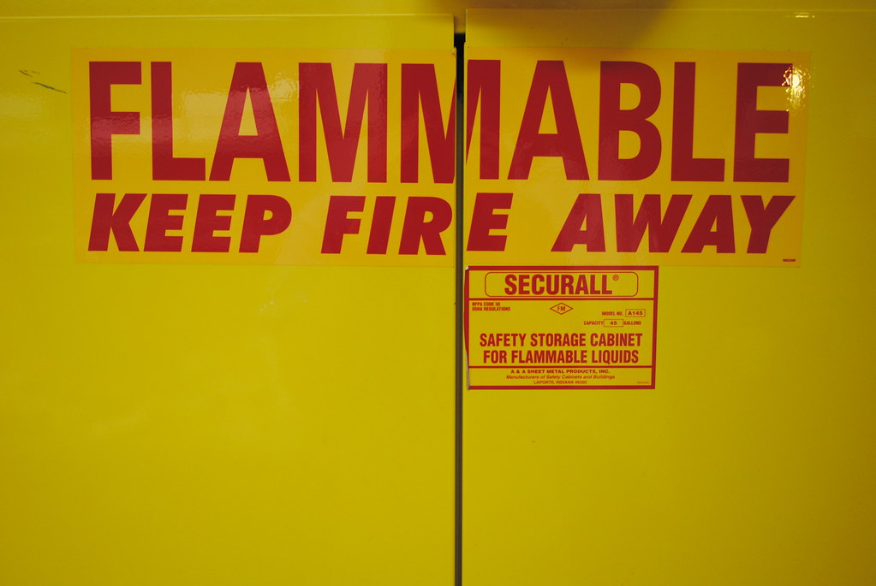
Eliminate Fire Hazards
Keep materials at least 18 inches away from automatic sprinklers, fire extinguishers, and sprinkler controls. 18 inches is required, but 24 to 36 inches is recommended.
Clearance of 3 feet is required between piled material and the ceiling. If stock is piled more than 15 feet high, clearance should be doubled.
Hazards in electrical areas should be reported, and work orders should be issued to fix them.

Slide 50
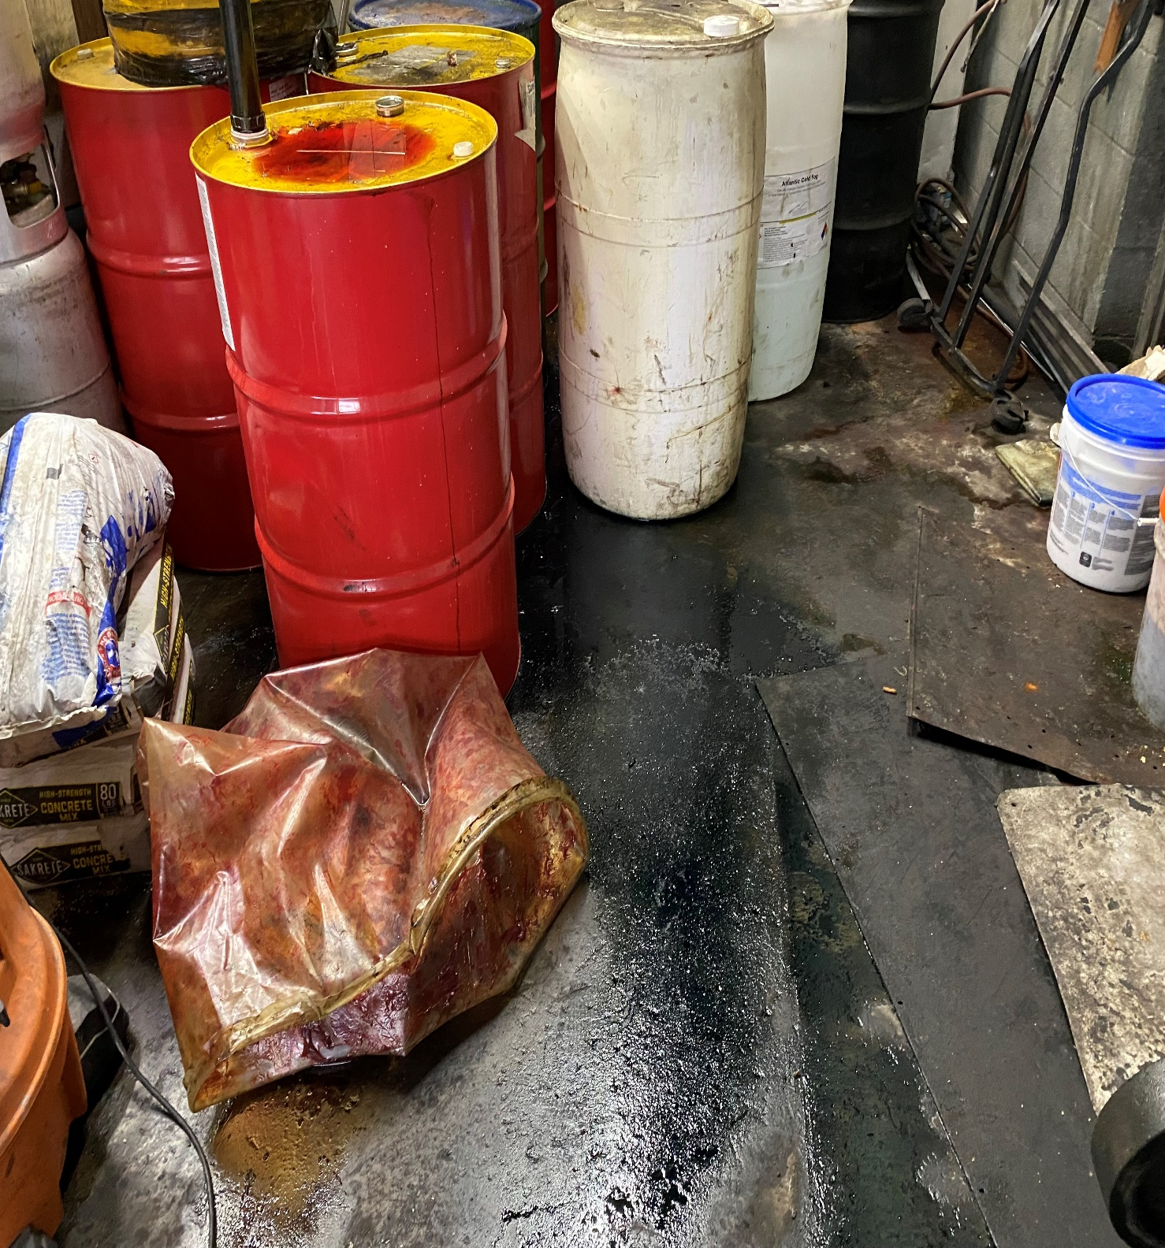
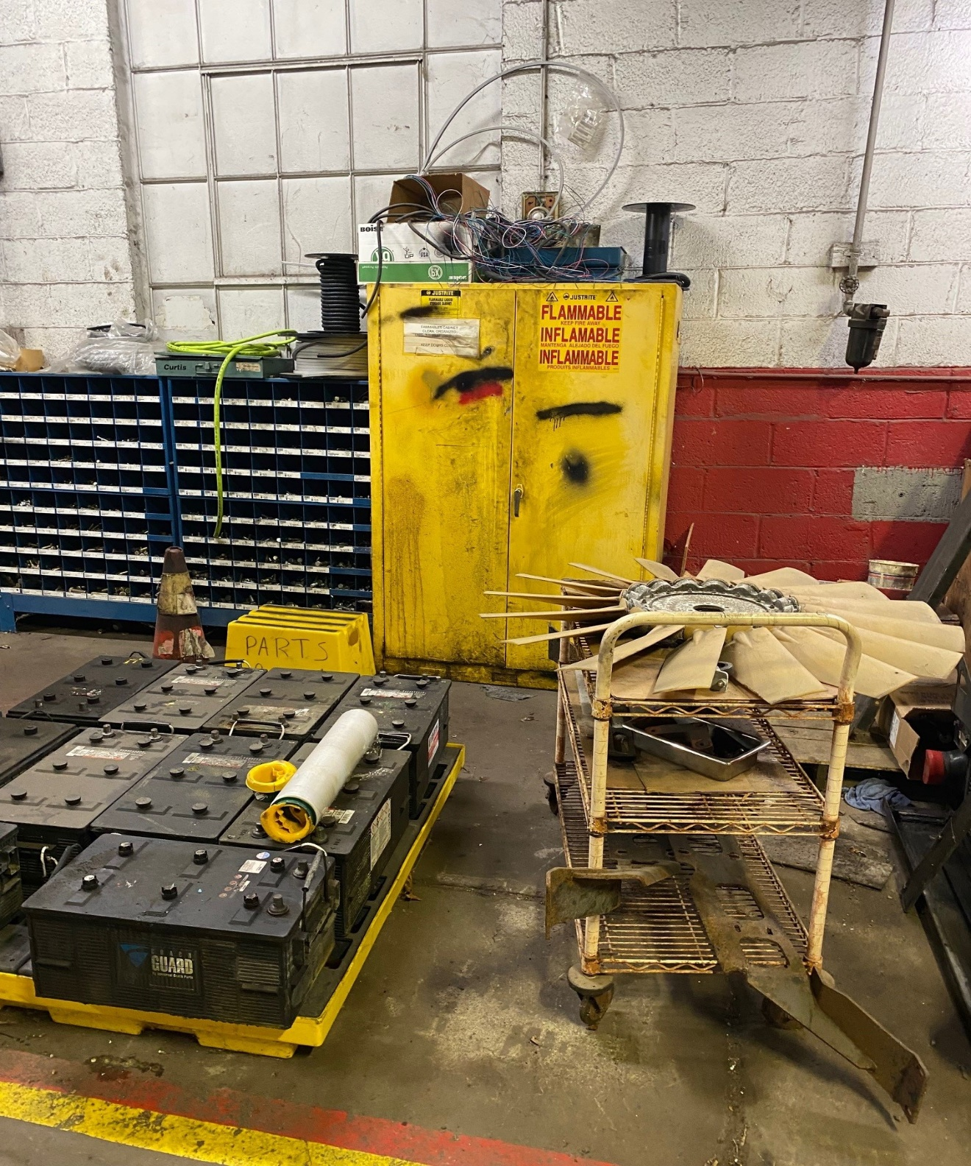
And this…..

Slide 51
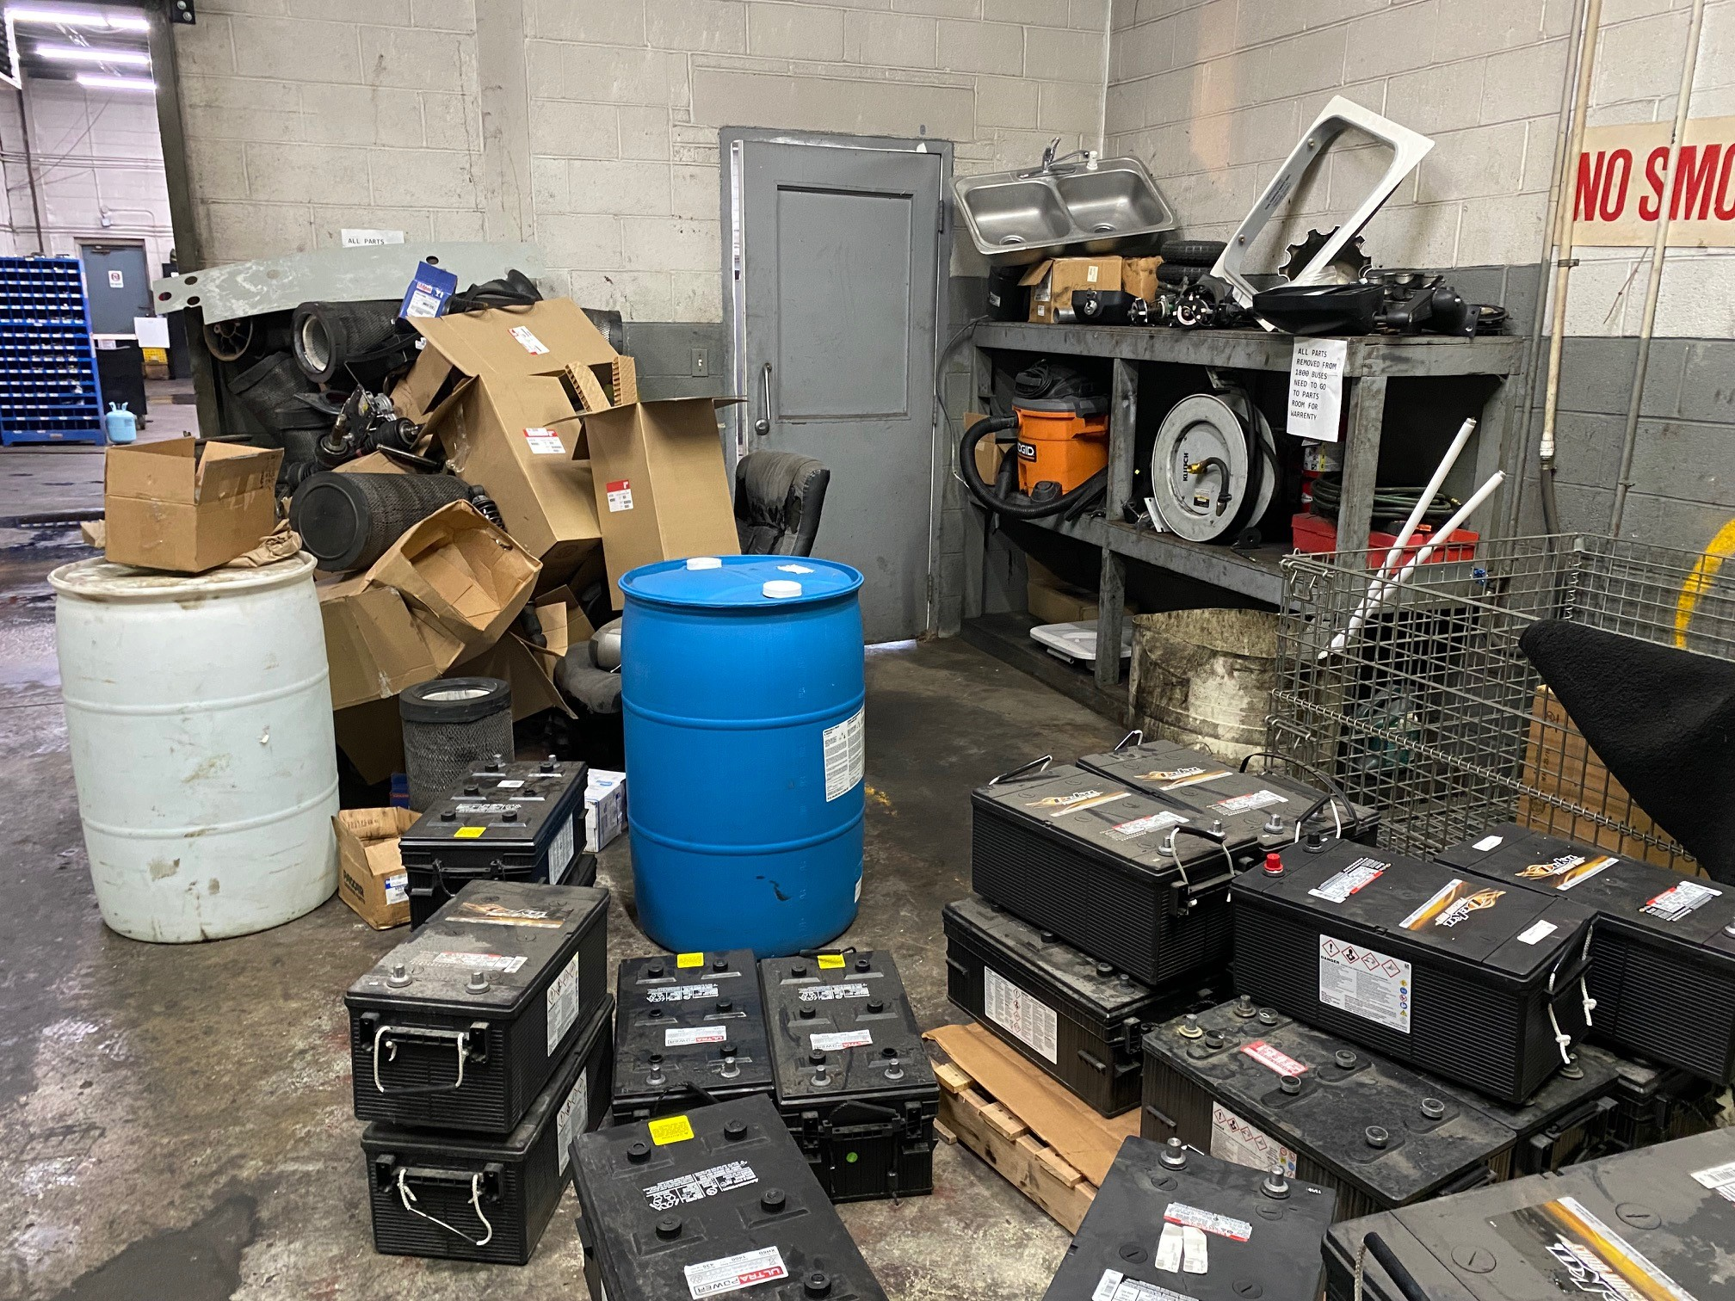
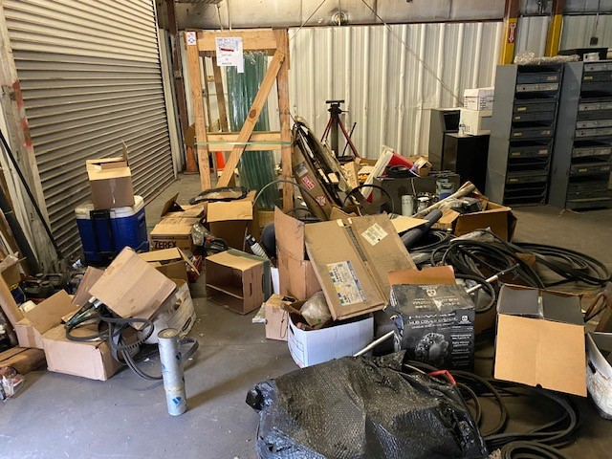

Slide 52
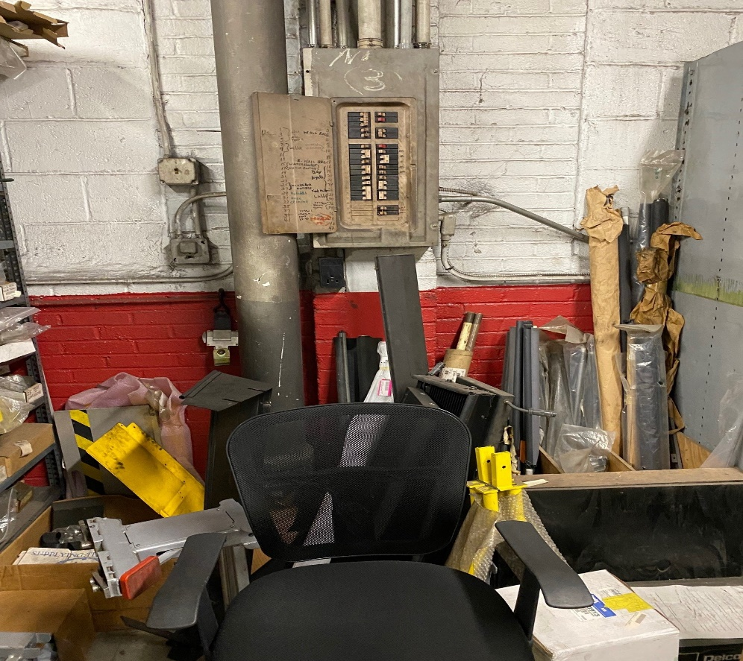
Electrical panel blocked
and open
OSHA 29 CFR 1910 Subpart S
Electrical

Slide 53
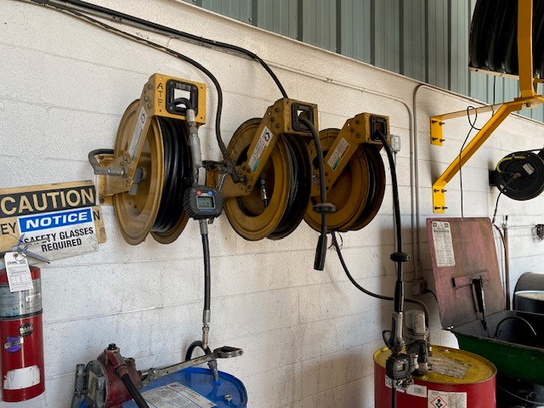
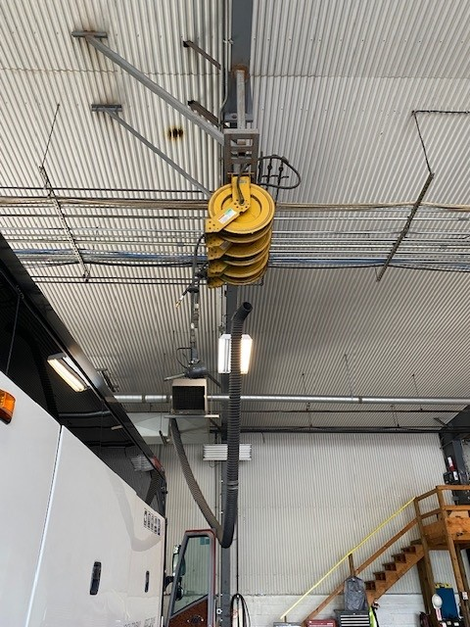
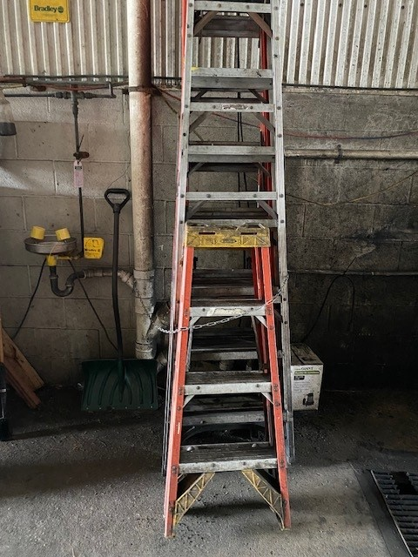

OSHA 29 CFR 1910.23
Ladders

Slide 54
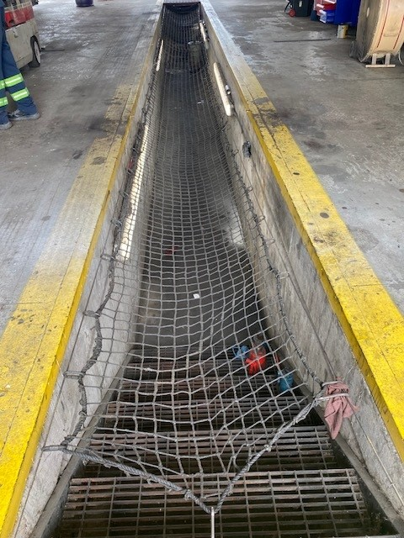

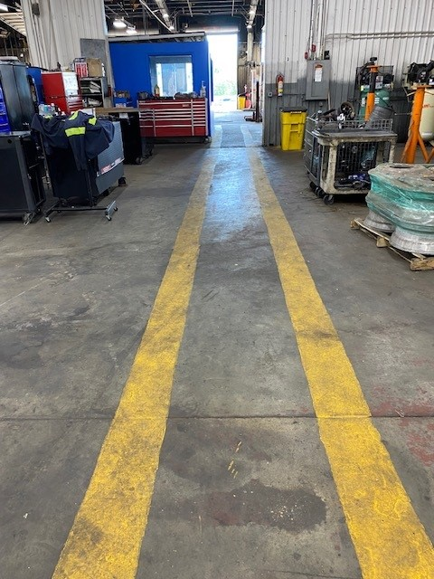
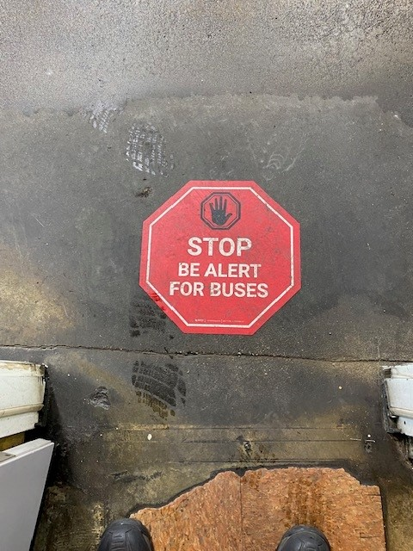
OSHA 29 CFR 1910.22
Walking/Working Surfaces

Slide 55
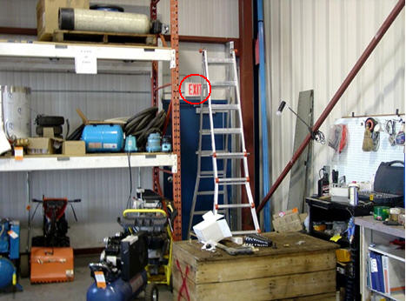
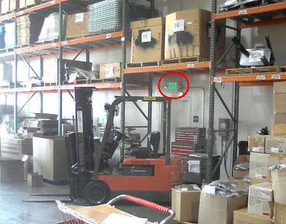
Exit Routes
Exits routes must be free and unobstructed
No materials or equipment may be placed, either permanently or temporarily, within the exit route.
Keep exit routes free of flammables and combustibles
OSHA 29 CFR 1910 Subpart E
Exit Routes and Emergency Planning

Slide 56
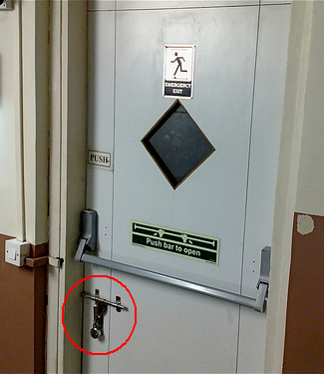
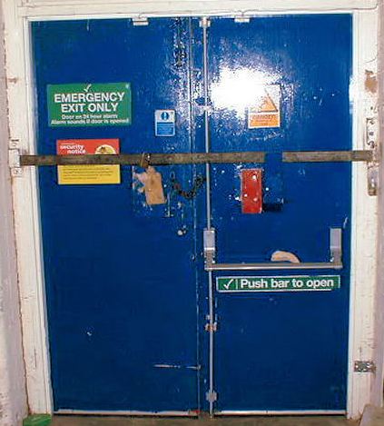
Exit Doors
When occupied, must be able to always open from the inside without keys, tools, or special knowledge
Device such as a panic bar that locks only from the outside is permitted
Imperial Food Products
Hamlet, N.C. 9/1991

Slide 57



OSHA 29 CFR 1910.151(c); ANSI Z358.1
Where the eyes or body of any person may be exposed to injurious corrosive materials, suitable facilities for quick drenching or flushing of the eyes and body shall be provided within the work area for immediate emergency use.

Slide 58






Parts Room
Annual Certification
Storing heavy equipment
Tire storage

Slide 59



Slide 60
Personal
Protective
Equipment

Slide 61
PPE, Equipment & Tools
PPE hazard assessment must be conducted (insurance carrier).
Make sure you wear the proper PPE for every job task based on the potential risks.
Make sure the PPE is in good working condition and properly fits the employee wearing it.
Wear PPE when cleaning up spills or other materials, such as broken glass or wood.
Wear safety shoes (steel or composite toed) and safety glasses (Rx if necessary) – while performing housekeeping tasks.
Regularly inspect, clean and fix tools. Remove any damages tools from your work area.

Slide 62

  M – Male based safety shoes
  F – Female based safety shoes
  I – indicative of falling or dropping objects I/75 means 75ft.-lbs. force on toes of shoe
  C – Compression provide protection from rolling objects. C/75 means 2500 lbs. of force onto the toe.
  EH – Electrical Hazard: designed to protect wearers from up to 600 volts in a dry setting.
OSHA 29 CFR 1910.136
Footwear

Slide 63

Lens Crafter (LC)
Monogram
Safety glasses (prescription or otherwise) will meet the requirements of ANSI Z87.1 + as indicated by the Z87.1+ logo stamped on the frame of the glasses. Prescription glasses must have the optical company letters or logo monogramed in the lens to be "safety" approved.
OSHA 29 CFR 1910.133
Eye and Face Protection

Slide 64

Picture this…..
Other PPE
Goggles
Face shield
FR Clothing
Nitrile gloves
Rubber gloves and apron
Rain gear
Rubber boots
Hearing protection (muffs, plugs)
Noise Reduction Rating - 30
OSHA 29 CFR 1910.138
Hand Protection
OSHA 29 CFR 1910.95
Occupational Noise Exposure

Slide 65


Respiratory Protection
OSHA 29 CFR 1910.134
Respiratory Protection

Slide 66
Requirements of Respirator Program
YOU must:
Pass a physical evaluation & be fit tested annually.
Inspect before each use.
Have supervisor/designee inspect annually.
Check fit before each use.
Cannot have facial hair that interferes with the seal between the respirator and the wearer’s face. Clean after each use (Wipes or Wash).
Replace with same make, model and size that was fit tested.
Store in a vinyl bag in PPE (or personal) locker

Slide 67
Training and Information
Employees are trained so they can demonstrate knowledge of:
  why the respirator is necessary and how improper fit, use, or maintenance can compromise its protective effect.
  limitations and capabilities of the respirator.
  effective use in emergency situations.
  how to inspect, put on and remove, use and check the seals.
  maintenance and storage.
  recognition of medical signs and symptoms that may limit or prevent effective use.

Slide 68

Training and Information (cont’d)
Training must be provided prior to respirator use.
Retraining is required annually, and when:
  changes in the workplace or type of respirator render previous training obsolete.
  there are inadequacies in the employee’s knowledge or use.
  any other situation arises in which retraining appears necessary.

Slide 69
Definitions - Employee Exposure
Employee exposure is the concentration of an airborne contaminant that would occur if the employee were not using respiratory protection.
PEL, TWA and TLV refer to the concentration of contaminant in air that one can be exposed to continuously over an 8-hour period without having to wear respiratory protection.
- Permissible Exposure Limit (PEL) is set by OSHA
  - Time Weighted Average (TWA) is set by NIOSH
  - Threshold Limit Value (TLV) is set by ACGIH
The Short-Term Exposure Limit (STEL) is the concentration in air of a contaminant that one can be exposed to over a 15-minute period without having to wear respiratory protection.

Slide 70
Types of Respirators - Negative Pressure
Respirators in which the air pressure inside the face piece is negative during inhalation with respect to the ambient air pressure outside the respirator.
- Air Purifying Respirator uses an air-purifying filter, cartridge, or canister that removes specific air contaminants by passing ambient air through the air-purifying element.
- Dust mask uses a filter as an integral part of the face piece or with the entire face piece composed of the filtering medium.

Slide 71

Types of Respirators - Positive Pressure
Respirators in which the pressure inside the respiratory inlet covering exceeds the ambient air pressure outside the respirator.
- Powered air-purifying respirator (PAPR) uses a blower to force ambient air through air-purifying elements to the inlet covering.
- Airline respirator supplies breathing air from a source independent of the ambient atmosphere (Grade D air)

Slide 72

Fall Protection
I will not work at heights >4 feet without using required fall protection or having been trained in its use.
Wear harness with correct lanyards/hardware when fall potential could be
encountered (100%)
Tie off and use correct lanyards/hardware when fall potential is encountered
Inspect all gear, work platforms, scaffolds, ladders, and anchor points
Secure all tools and work materials
Rescue Plan is in place and ready to execute
OSHA 29 CFR 1910.140
Personal Fall Protection

Slide 73
Fall Protection Requirements
Trigger Heights
Steel Erection
15′
    Scaffolds
10′
  Construction Sites
6′
General Industry
(Bus Industry)
4′
From Ground

Slide 74
GRAVITY works 24/7
GRAVITY does not ask for IQ.
GRAVITY does not ask how good is your balance.
GRAVITY does not consider how long you have been on the job.
GRAVITY does not ask how many years of schooling you have.
GRAVITY does not ask how quickly you can react.
Know the human factors that come into play
Perception versus Reality in Fall Protection Training
The Perception is smarter, more educated, younger people fall less often than those less educated and older.
The Reality is well stated above. When scaffolding gives way, it does not ask any of the questions listed.
GRAVITY does not discriminate!

Slide 75




Fall Protection Hierarchy
Assessing the Fall Hazard
ELIMINATE
Work At
Ground
Level
PREVENT
Work In
Guarded Area
RESTRAIN
Work
while
Anchored
ARREST
Work with an
Engineered
Fall Arrest System

Slide 76



Slide 77




Inspected prior to each use
and annual certification

Slide 78

This is NOT an Anchorage
or a harness, or a lanyard…

Slide 79



OSHA 29 CFR 1910.27
Scaffold & Rope Descent Systems

Slide 80


Working At Heights – Ladder Safety
Ladders must meet OSHA/ANSI requirements.
OSHA 29 CFR 1910.27/ANSI a14
Ladders
A valiant attempt to avoid
getting a taller ladder

Slide 81
Working At Heights – Ladder Safety
Choose the right style of ladder for the job. Weight of user, tools and materials should never exceed rating of the ladder.
Ladders must be inspected before each use for loose or damaged rungs, steps, rails, braces or non-slip feet.
If damage is found that may affect safety, the ladder must be immediately tagged and removed from service.
Wear shoes with non-slip soles.
Place all ladder legs on solid, level ground or on stable base
While ascending/descending you MUST face the ladder.
Do not carry heavy/bulky items; use bucket/rope or tool belt.
Do not work on ladders during a severe storm or strong wind.
Protect the ladder base from traffic. If a ladder must be placed in front of a door, ensure the door is locked/guarded.

Slide 82
Working At Heights – Ladder Safety
Always use "three-points of contact”: two hands and a foot OR two feet and a hand.
Never use the top step of ladder or step over the top of ladder.
Never attempt to "walk", "hop", or "laterally" move a ladder while standing on it. Never overreach! Move it.
Tie off the ladder once you have climbed to your working height OR have someone hold at the base.
  When extension ladders are used to access an upper landing or surface, the ladder rails must extend at least 36 inches above the upper landing surface AND must maintain a 4:1 ratio (4 feet up versus 1 foot out) from the base of the ladder to the base of the structure.

Slide 83


Not exactly a 4:1 ratio
Proper placement
of ladder

Slide 84

Working at Heights – Personnel Lifts
      Personnel lift devices
        Aerial lifts - Scissor lifts and other personnel lifting devices require the use of a fall restraint device or a personal fall limiter (retractable lanyard).
        The fall protection device must be tied off regardless of height.
        Follow the manufacturer’s requirements for anchorage points.
        Do not tie off to a building structure, use the anchor point on the lift.
OSHA 29 CFR 1910 Subpart F
Powered Platforms, Manlifts & Vehicle-Mounted Work Platforms
OSHA 29 CFR 1910.66
Building Maintenance
Notes:
Aerial lifts, Scissor lifts and other personnel lifting devices such as manlift cages for forklifts require the use of a fall restraint device or a personal fall limiter (retractable lanyard). The fall protection device must be tied off regardless of height due to the risk of operator ejection from the lift. Follow the manufacturer’s requirements for anchorage points.

Slide 85




What is Hot Work?
Hot work is any work process that produces flames or sparks that present a fire ignition hazard to the surrounding environment and personnel.
Examples of hot work:
Gas torch welding and cutting uses a flame to join or cut metal.
Arc welding and cutting uses an electric arc between a metal electrode and a base material to join or cut metal.
Grinding uses a grinding wheel that rotates at high speed to cut metal.
Brazing and soldering uses heat to melt a filler metal that is used to join metal.
OSHA 29 CFR 1910.252
Welding, Cutting & Brazing

Slide 86
Hazards Associated with Hot Work
Hot work presents a variety of hazards:
Fire
Intense heat, sparks, or metal splatter produced during hot work can create fire hazards.
Electric shock
If you touch two metal objects containing voltage, you will become a part of the electrical circuit. Higher voltages increase the risk of injury or death.
Arc flash
Arc flash occurs when an electric current leaves its intended path and travels through the air from one conductor to another or to the ground.
Burns
Radiant energy, sparks, or metal splatter can cause serious burns.
Flammable gases
If allowed to accumulate, flammable gases can flash or explode with catastrophic results.
Intense light
The incredibly bright light of arc welding can cause serious eye damage.

Slide 87

Hazard Controls
Based on the hazard assessment, you should establish hazard controls for each risk.
Controlling combustible materials:
Remove all combustible materials 35 feet from the work area.
Move combustibles located on the opposite side of partitions and ceilings that will be subject to welding or cutting.
Avoid unmovable combustible materials, such as wooden floors.
If unable to remove or avoid fire hazards:
Cover combustible floors or materials with fire blankets or other suitable non-combustible material to contain slag and sparks.
Use guards.
Establish restrictions.
In some cases, hot work may be prohibited entirely.

Slide 88

Additional Fire Prevention Measures
Fire watch: Establish a fire watch in areas where fires might develop. Continue the watch for at least 30 – 60 minutes after completion of hot work.
Fire extinguishers: Provide at least one 10-pound ABC fire extinguisher in each hot work zone.
Ducts and conveyer systems: Shut down ducts and conveyor systems that might carry sparks.
Atmosphere control: Monitor the air, checking for flammable or explosive gases or vapors. If necessary, purge and inert the atmosphere.
Safe disposal: Provide metal buckets or containers for safe disposal of hot work debris.

Slide 89


Other Hazards
Welding arc rays: Position welding curtains to protect employees from intense light. Provide the proper shade of lens.
Electrical shock: Keep working conditions dry and provide proper PPE.
Arc flash: Provide high-resistance grounding and proper PPE.
Burns: Install guards and provide proper PPE.
Fumes and other toxic byproducts: Properly ventilate work areas and provide adequate respirators.
Toxic coatings: When possible, strip toxic coatings from metal before beginning hot work.
A welding curtain shields employees from the direct rays of arc welding and cutting operations.
A welder uses a local exhaust duct to quickly remove toxic fumes and gases.

Slide 90

Common PPE
To protect against burns, cover all exposed flesh.
PPE that protects against electric shock includes insulated gloves and rubber-soled shoes.
Buttonable collar
Welding hood
with adjustable lens filter
Fire resistant gloves
Fire resistant jacket
hanging outside of pants without open pockets
Fire resistant trousers
without cuffs on pant legs
Leather high-top boots with steel/composite toes

Slide 91

OSHA 29 CFR 1910.157
Fire Extinguishers
OSHA 29 CFR 1910.159
Automatic Sprinkler Systems
Notes:
Fire safety encompasses many aspects of the terminal. Emergency exits, shutting down equipment such as the boiler and tank wash if an emergency exists, designated smoking areas, locations where welding can and can’t be done and electrical systems.

Slide 92

Notes:
Remember the fire pyramid includes oxygen, ignition, fuel and a chemical reaction. Without any one of these factors a fire cannot be started or sustained.

Slide 93




Notes:
Class A fires are ordinary combustible materials, Class B fires are flammable and combustible liquids, Class C fires are energized electrical equipment and Class D fires are flammable metals.

Slide 94

Fire Extinguisher Identification
All ratings are shown on the extinguisher faceplate.
Some extinguishers marked with multiple ratings.
  Capable of putting out more than one class of fire
  (e.g., AB, BC, ABC)
All fire extinguishers are required to include directions. Take a moment to read them, first!
Notes:
Fire extinguishers are required to include directions on the faceplate. When in doubt take a moment to read them before using the fire extinguisher. The fire extinguisher rating will be shown on the faceplate. Ratings will tell you what type of fires the extinguisher will be good for. Many fire extinguishers today are rated ABC (contents sodium bicarbonate or baking soda) that can handle any type of fire in our terminals. Check the rating before using the fire extinguisher. An extinguisher rated for Class A and B fires will not work on an electrical or Class C fire.

Slide 95




Notes:
Use the PASS method when fighting a fire with an extinguisher.

Slide 96
Quick Inspection
Know the location of the fire extinguisher
Check the classification
Check the seal for tampering or use
Ensure pin, nozzle and nameplate are intact
Notes:
You should always know the location of the fire extinguishers in your respective work areas. What classifications are they and someone should be checking the plastic seal for tampering or use on a monthly basis. The pin, nozzle and nameplate also need to be checked to make sure they are intact. The time to find out your fire extinguisher doesn’t work or isn’t charged is not when you absolutely need it.

Slide 97





Fire Extinguishers
Portable fire extinguishers must be mounted, identified, and readily accessible
Portable fire extinguishers must be visually inspected monthly, and inspection must be documented
Portable fire extinguishers must undergo an annual certification

Slide 98


Spill Response – What’s Your Gameplan?

Slide 99
Questions
Questions
Questions
Questions

