Slide 1
ABA-BISC Meeting NTSB Update on Current Crash Investigations Orlando, Florida June 23, 2024
Michael LaPonte
Highway Accident Investigator
Washington, DC
Notes:
Good morning. Its great to be here today and be part of the 2024 Summer BISC Meeting I appreciate the opportunity to present and to be part of the effort to reduce crashes, injuries, and fatalities involving commercial motor vehicles. Today I will be highlighting crashes that we have been investigating over the past year.
[NEXT SLIDE]

Slide 2
Agenda
What is the NTSB?
Current crash investigations
Completed crash investigation
Repeat causal factors
Countermeasures
Notes:
Here are the topics I will be discussing today. I will briefly describe what the NTSB, next I will review current crashes we are investigating. Next, I will discuss a recently completed crash investigation. Then I will highlight some repeat causal factors we are seeing. Lastly, I will conclude with some countermeasures that fleets can pursue to help eliminate crashes.
[NEXT SLIDE]

Slide 3
What is the NTSB?
Independent Federal Agency
Aviation, Marine, Rail, Pipeline and Highway
Headquartered in Washington, DC
400 staff nationwide
Mission: Probable cause and issue safety recommendations
Notes:
So, what is the NTSB? For those who are not familiar with us, the National Transportation Safety Board is an independent Federal agency charged by Congress with investigating every civil aviation accident in the United States and significant accidents in other modes of transportation – that includes marine, rail, pipeline, and highway. We are headquartered in Washington, DC. We are a very small Federal agency with about 400 staff nationwide. Our mission is simple, we investigate transportation accidents and then we determine what was the probable cause and then we issue safety recommendations aimed at preventing future crashes.
[NEXT SLIDE]

Slide 4
Current Crash Investigations
Notes:
Currently we have 22 open highway investigations. This slide represents the various crash locations we are investigating. As you can see, our investigations are spread throughout the US. Due to time limitations, I will briefly discuss some of the recent crashes that took place over the past year.
[NEXT SLIDE]

Slide 5
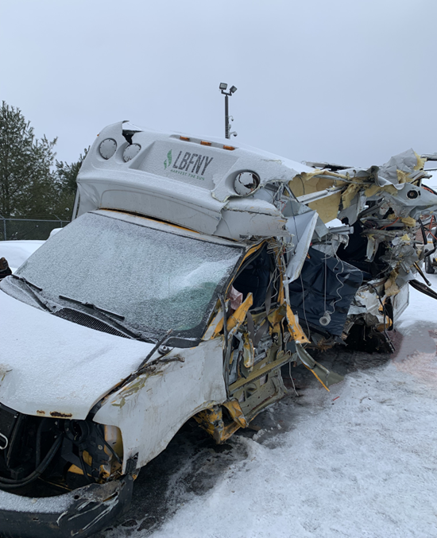
Louisville, NY January 28, 2023
2013 Chevrolet Express Micro Bird Bus
2021 Freightliner Straight Truck
Notes:
The first crash I will be discussing occurred on January 28, 2023, at about 6:02 a.m. A 2013 medium size bus with 15 occupants was westbound on New York State Route 37, in Louisville, New York. At the same time, a 2021 Freightliner straight truck was eastbound in the opposite direction on SR-37. As the two vehicles approached each other, the box truck crossed over the highway centerline and collided with the driver's side of the bus. As a result of the crash, six bus occupants were fatally injured, two were seriously injured, six had minor injuries, and one was uninjured. The truck driver, who was the only occupant in the truck, was seriously injured. At the crash location, SR-37 is a two-lane highway with a posted 55 mph speed limit.
[NEXT SLIDE]

Slide 6
Excelsior, WI May 12, 2023
Notes:
The next crash took place on May 12, 2023, about 7:20 a.m. A 2016 Bluebird school bus stopped to board passengers in the westbound lane of State Highway 33 near Excelsior, Wisconsin. At this location, State Highway 33 is a two-lane, roadway with paved shoulders and a speed limit of 55-mph. The flashing amber and red lights at the front and rear of the school bus were activated and the left-side-mounted STOP arm was deployed. Eastbound traffic had stopped for the school bus. A 2010 Ford F-150 pickup truck, operated by a 17-year-old driver, was traveling westbound on State Highway 33. As the pickup truck approached the rear of the stopped school bus, it swerved to the right, sideswiped the right rear corner of the bus, continued across the 8-foot-wide paved shoulder onto a private driveway, and struck a 13-year-old student pedestrian. The student sustained fatal injuries and the pickup truck driver sustained minor injuries. The school bus driver and the 16 student passengers on the school bus were not injured.
[NEXT SLIDE]

Slide 7
Millersburg, OR May 18, 2023
2001 Ford van & utility trailer
2023 Combination vehicle
2018 Freightliner & soft-sided trailer
Source: KPTV
Notes:
The next crash took place on May 18, 2023, about 2:45 p.m. A 2018 Freightliner truck-tractor in combination with a 2014 Utility soft-sided semitrailer, was traveling northbound on Interstate 5 north of Millersburg, Oregon. A 2001 Ford Econoline van towing a small utility trailer, was parked on the right shoulder north of the highway exit ramp leading to the North Santiam rest area. A 2023 truck-tractor in combination with an enclosed semitrailer was also parked on the shoulder in front of the van. The 2018 Freightliner departed the highway travel lanes while approaching the location of the stopped vehicles and collided with the rear of the van and its trailer. The van was subsequently pushed forward into the rear of the 2023 combination vehicle. As a result of the crash, seven van occupants were fatally injured, three were seriously injured, and one sustained minor injuries. The drivers of the combination vehicles were not injured. The speed limit is 65 mph at the vicinity of the crash with a reduced speed limit of 60 mph for trucks.
[NEXT SLIDE]

Slide 8
Philadelphia, PA June 11, 2023
Notes:
The next crash took place on June 11, 2023, at 6:17 a.m. A 2017 International truck-tractor in combination with a 2004 - 406 tank-trailer was exiting Interstate 95 northbound on the Cottman Avenue off-ramp in Philadelphia, Pennsylvania. At this location, I-95 was an eight-lane divided highway with four lanes each in the northbound and southbound directions. The combination vehicle was transporting about 8,500 gallons of gasoline from Wilmington, Delaware, to a gas station located in Philadelphia. The posted speed limit on I-95 in the vicinity of the crash was 55 mph, and the Cottman Avenue off-ramp was posted with a 25-mph advisory limit. The truck driver was unable to maintain control of the combination vehicle on the off-ramp. The truck rolled over and subsequently caught fire under the northbound lanes of the I-95 overpass. As a result of the rollover crash and subsequent fire, the driver was fatally injured. The postcrash fire caused the northbound lanes of I-95 to collapse onto the Cottman Avenue off-ramp. The southbound lanes of I-95 were significantly damaged by the postcrash fire. No other injuries resulted from this crash.
[NEXT SLIDE]

Slide 9
Highland, IL July 12, 2023
Notes:
On July 12, 2023, about 1:48 a.m. a 2014 Prevost 50-passenger motorcoach with 21 occupants was westbound on Interstate 70, near Highland, Illinois. The motorcoach was on a scheduled route from Indianapolis, Indiana, to St. Louis, Missouri. As the motorcoach approached the westbound Silver Lake rest area, the motorcoach departed I-70 onto the rest area exit ramp, where it collided with three tractor trailers that were parked on the right shoulder. As a result of the crash, three motorcoach passengers were fatally injured. The driver and remaining motorcoach passengers sustained injuries ranging from minor to serious. The three tractor-trailer drivers, who were inside the combination vehicles at the time of the crash, were uninjured.
[NEXT SLIDE]

Slide 10
Wawayanda, NY September 21, 2023
Notes:
The next crash occurred on September 21, 2023, about 1:12 p.m. A 2014 Prevost motorcoach was traveling westbound on Interstate 84 near Wawayanda, New York. The motorcoach was transporting 40 high-school students and four adults from the Farmingdale, New York School District. At the crash location, I-84 is a four-lane divided highway with a speed limit of 65 mph. Just after mile marker 12, the motorcoach departed the right lane, crossed the left lane and shoulder, and departed the westbound roadway. The motorcoach then struck a roadside cable barrier and traveled down the depressed earthen median. The motorcoach came to rest on its left side at the bottom of the depression. Several occupants were ejected from the motorcoach, including the driver and the two front-row adult occupants. Both front-row occupants were fatally injured, and the driver was seriously injured. The remaining bus occupants were transported to area hospitals for treatment of various injuries.
[NEXT SLIDE]

Slide 11
Teutopolis, IL September 29, 2023
Notes:
On September 29, 2023, about 8:41 p.m. a 2005 International truck-tractor in combination with a MC331 cargo tank was traveling west on US-40, a two-lane roadway near Teutopolis, Illinois. The cargo tank was loaded with approximately 7,500 gallons of anhydrous ammonia. At the same time, an oncoming eastbound vehicle was approaching the westbound combination vehicle, and a westbound passenger vehicle was passing the combination vehicle in a no-passing zone. The driver of the combination vehicle took evasive action by steering to the right. The combination vehicle departed the roadway and traveled into a roadside drainage ditch, jackknifed and rolled onto its right side with its cargo tank sliding forward. The exposed front end of the cargo tank struck the tow ring of a utility trailer that was parked adjacent to the roadway on private property. The tow ring punctured the front of the cargo tank, which led to the release of anhydrous ammonia. The driver of the combination vehicle sustained injuries as a result of the crash and exposure to the anhydrous ammonia. Additionally, five people in the area of the crash died and 11 others sustained injuries ranging from minor to severe due to exposure to anhydrous ammonia. The posted speed limit on US-40 was 55 mph. [NEXT SLIDE]

Slide 12
Etna, OH November 14, 2023
Notes:
On November 14, 2023, about 8:52 a.m. a 2019 Freightliner truck-tractor in combination with semitrailer, was traveling west in the right lane of Interstate 70 near Etna, Ohio. At this location, I-70 was a divided, four-lane roadway with a 70-mph speed limit. As the combination vehicle reached the area of milepost 118.7, it encountered a traffic queue that had formed due to an earlier crash. The combination vehicle did not slow and struck the rear of a 2015 Nissan Murano, occupied by the driver and two passengers. The combination vehicle overrode the Nissan and then collided with the rear of a 2009 Van Hool motorcoach occupied by the driver and 54 passengers, that was transporting members of the Tusky Valley School Band. A post-crash fire ensued and consumed the combination vehicle, the Nissan, and the rear of the motorcoach. The three occupants of the Nissan that consisted of a school teacher and two adult chaperones were fatally injured. Additionally, three student passengers on the motorcoach were fatally injured. The drivers of the 2019 Freightliner combination vehicle, the motorcoach, and several motorcoach passengers were treated for injuries.
[NEXT SLIDE]

Slide 13
Millstone, West Virginia March 4, 2024
Notes:
On Monday, March 4, 2024, about 5:50 p.m. eastern standard time, a 2022 IC school bus operated by Calhoun County Schools, Calhoun County, West Virginia, was southbound on West Virginia Route 16 (South Calhoun Highway) transporting students on an activities/after-school route. As the bus negotiated a left-hand curve in the 8900 block, the right-side tires crossed the white edge line, departed the paved roadway, and began to enter a ditch along the right side of the road. The front tire struck the end of a driveway culvert, the bus went airborne, and began to rotate counterclockwise while rolling to the right. The front of the bus landed back in the southbound lane of Route 16 and continued to rotate and roll, coming to rest on its right side across both lanes of Route 16

Slide 14
Rushville, IL March 11, 2024
Notes:
​The next crash I will discuss occurred on March 11, 2024, at about 11:29 a.m. A 2020 Micro Bird 25-passenger school bus was traveling east on U.S. Highway 24, near Rushville, Illinois. The bus was occupied by a female driver and three student passengers ranging in age from 3 to 5 years old. At the same time, a 2001 Mack truck-tractor in combination with a 2001 end dump semitrailer, was traveling west on US-24 approaching the school bus. The school bus was traveling through a right-hand curve. About halfway through the curve, the school bus crossed over the broken yellow centerline and entered the westbound traffic lane, where it subsequently collided head-on with the combination vehicle. Following the impact, both vehicles departed the roadway where the combination vehicle’s semitrailer overturned, and both vehicles were engulfed in a postcrash fire. As a result, the drivers of both vehicles and the three student passengers on the school bus were fatally injured. The posted speed limit on US-24 was 55 mph.
[NEXT SLIDE]

Slide 15
Carrizo Springs, Texas June 6, 2024
Notes:
On Thursday, June 6, 2024, about 4:40 p.m. central daylight time, a 2021 Chrysler 300 passenger car operated by a 17-year-old driver was traveling west on Farm to Market Road 1433 (FM1433) near Carrizo Springs, in Dimmit County, Texas. According to the Texas DPS, the car was traveling at a high rate of speed through a curve when it crossed the roadway centerline and struck a 1998 Dodge Ram pickup truck that was traveling in the opposite direction. Following the impact between the two vehicles, a post crash fire ensued that consumed the car. The pickup truck was not involved in the post crash fire.
As a result of the crash and fire, the 17-year-old driver of the car and three car passengers (aged from 13 to 20 years-old) were fatally injured. The 50-year-old driver of the pickup truck and two passengers were fatally injured, and two passengers in the pickup truck were seriously injured.

Slide 16
Completed Investigation
Collapse of the Fern Hollow Bridge: 1/28/2022
Board Meeting: 2/21/2024
Report Number: HIR-24-02
Notes:
Now, I will highlight a completed investigation for the Fern Hollow Bridge Collapse that took place in January 2022. This past February we held a Board Meeting for that investigation and adopted the final report.
[NEXT SLIDE]

Slide 17
Pittsburgh, PA January 28, 2022
Notes:
On January 28, 2022 at about 6:37 a.m. the Fern Hollow Bridge in Pittsburg, PA experienced a structural failure. As a result, the 447-foot- long bridge fell about 100 feet below into the Frick Park. At the time of the collapse, a Port Authority Bus and four passenger vehicles were on the bridge. A fifth passenger vehicle drove off the east side of the bridge and landed on its roof on the ground below. As a result of the collapse, the bus driver sustained minor injuries and the other passengers on the bus were uninjured. Of the 6 passenger vehicle occupants 2 sustained serious injuries, one sustained a minor injury and 2 were uninjured. We determined the probable cause of the collapse resulted from the failure of the transverse tie plate due to corrosion and lack of maintenance and poor-quality inspections. As a result of this investigation, we issued safety recommendations to the Federal Highway Administration, the Pennsylvania Department of Transportation, ​the City of Pittsburgh, and ​the American Association of State Highway and Transportation Officials.
[NEXT SLIDE]

Slide 18
Repeat Causal Factors in Past Investigations
Human Factors
Fatigue
Distraction
Impairment
Operations
Inadequate safety culture
Improper use of driver monitoring systems
Lack of fatigue management system
Notes:
Unfortunately, we see many repeat causal factors in our crash investigations. In general terms they can be divided into two categories. In human factors – we see over and over fatigue, distraction, and impairment as causal or contributory factors. We also see issues with motor carrier operations with their oversight of drivers – that would include inadequate safety culture, improper use of driver monitoring systems, and lack of a fatigue management system.
[NEXT SLIDE]

Slide 19
Countermeasures - Drivers Should…
Minimize all distractions and follow federal regulations about cell phone use.
Follow posted speed limits; drive even slower in bad weather.
Stay healthy! Take breaks and exercise, manage fatigue, and avoid driving while taking impairing medications —prescription and over-the-counter.
Wear seatbelts. And ensure your passengers do too!
Drive sober — never get behind the wheel while impaired by drugs or alcohol..
Notes:
There are countermeasures that can be taken to minimize or eliminate these factors. For example, Drivers should:
Minimize all distractions and follow federal regulations about cell phone use.
Follow post speed limits, drive slower in bad weather,
Stay healthy! Take breaks and exercise, manage fatigue, and avoid driving while taking impairing medications – that includes prescription and over the counter.
Wear seatbelts and ensure that your passengers do too!
Drive sober and never get behind the wheel while impaired by drugs or alcohol.
[NEXT SLIDE]

Slide 20
Owners/Managers Should…
Implement a fatigue management program based on the North American Fatigue Management Program. (www.CVSA.org).
Purchase trucks equipped with underride protection, advanced speed-limiting technologies, collision avoidance systems (then train drivers on their use).
Establish policies to address driver medical fitness for duty.
If you have installed driver monitoring system, implement a coaching program to improve driver behavior.
Notes:
If you own or manage a fleet, we recommend that you implement a fatigue management program such as the one based on the North American Fatigue Management Program. CVSA has been doing a wonderful job of conducting training and outreach on this program. We also encourage you to purchase trucks equipped with underride protection, advanced speed limiting technologies, collision avoidance systems – and then train your drivers on their use. Next, we recommend that you establish policies to address medical fitness for duty. Lastly, we recommend that if you have installed driver monitoring system on your fleet, that you take full advantage of that system and implement a coaching program to improve driver behavior.
[NEXT SLIDE]

Slide 21
Notes:
On the NTSB website we have resources available that address truck, passenger carriers, and school buses. This page for example, you will find multiple safety topics and safety recommendations that address school bus safety.
[NEXT SLIDE]

Slide 22
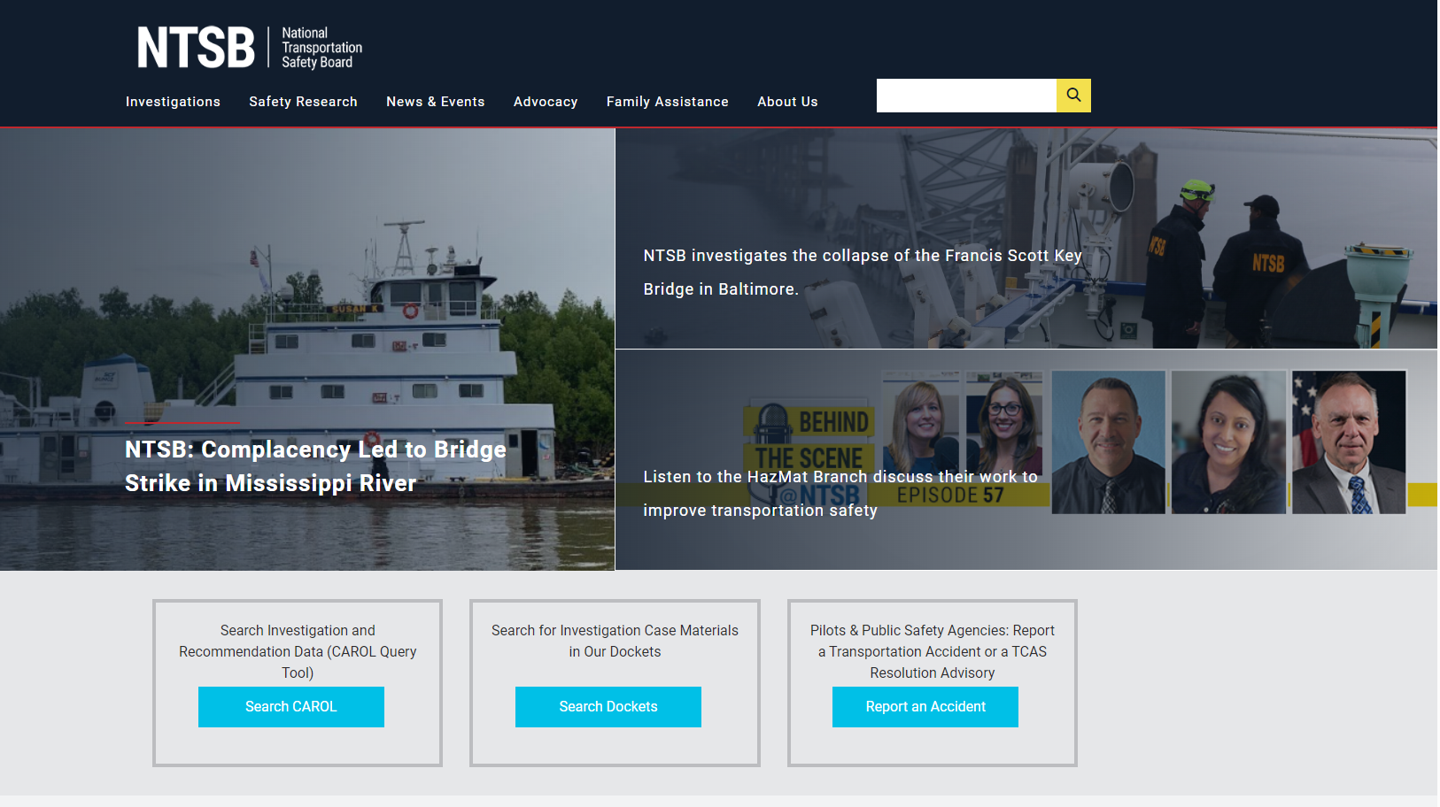
Notes:
If you are interested in learning more about these investigations or other closed investigations, you can visit our website at NTSB.gov and click on the “Search Dockets” tab to learn more.
[NEXT SLIDE]

Slide 23
Michael.laponte@ntsb.gov
Notes:
This concludes my presentation. I appreciate the opportunity to be part of the ABA BISC Meeting today. Here is my contact information. I’ll pass it back over to Brandon. Thank you

