Slide 1
MARKETPLACE 2024
NASHVILLE, TN
JANUARY 13-16

Slide 2
FINAL MARKETPLACE 2024 STATISTICS
More than:
2800 people attended the show.
1039 motorcoach and tour operators were in attendance
335 motorcoach and tour operator delegates took appointments all week
43 appointments on average were prescheduled for each seller
107,892 business appointments
123 sponsors ($860,070)
Plus:
295 Associate service & product suppliers attended
47 associate product and service suppliers and allied associations exhibited at MKPL
Networking Floor offered 8 motorcoaches and 135 exhibitors
$35,300 raised for Strings for Hope

Slide 3
FINAL MARKETPLACE 2024 EVALUATION
OVERALL IMPRESSIONS | OVERALL | BUS OP | TOUR OP | DMO | LODGING | ATTRACTION | RECEPTIVE OP | ASSOCIATES
OVERALL MARKETPLACE EXPERIENCE | 9.1 | 9.5 | 9.2 | 8.8 | 8.8 | 8.7 | 8.4 | 8.8
BUSINESS APPOINTMENTS | 8.6 | 8.9 | 8.8 | 8.4 | 8.1 | 8.1 | 8.1 | 8.3
EDUCATION & TRAINING | 8.2 | 9.1 | 7.7 | 8.3 | 8.3 | 7.7 | 3.5 | 8.6
EVENING EVENTS | 8.9 | 9.0 | 8.4 | 8.5 | 8.6 | 8.2 | 7.6 | 8.5
BOOTHS/ EXHIBITS | 9.3 | 9.3 | 9.2 | 8.8 | 9.0 | 8.7 | 8.9 | 9.1
NETWORKING OPPORTUNITIES | 9.0 | 9.3 | 8.9 | 8.6 | 8.7 | 8.4 | 7.6 | 8.6

Slide 4
FINAL MARKETPLACE 2024 EVALUATION
BOOKED BUSINESS FROM MKPL COMPARED TO OTHER INDUSTRY SHOWS
MUCH BETTER(23%)
BETTER(37%)
ABOUT THE SAME(36%)
WORSE (3%)
MUCH WORSE (1%)
MKPL COMPARED TO NTA
MUCH BETTER(35%)
BETTER(35%)
ABOUT THE SAME(25%)
WORSE (5%)
MUCH WORSE (0%)
#1 TAKE AWAY
BUSINESS LEADS (62%)
BOOKED BUSINESS (18%)
INDUSTRY INFORMATION (10%)
OTHER (7%)
EDUCATION (3%)
MKPL COMPARED TO UMA
MUCH BETTER(32%)
BETTER(29%)
ABOUT THE SAME(35%)
WORSE (4%)
MUCH WORSE (1%)

Slide 5


Slide 6
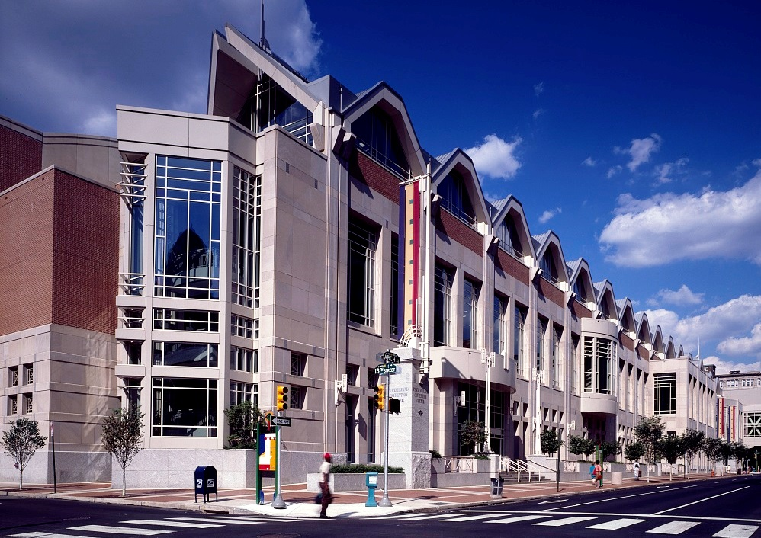
Location | Pennsylvania
Convention Center
Hotels | 4 Host Hotels
Registration Opens | May 1

Slide 7
NEW FOR MKPL 2025
Transportation | ABA
Housing Bureau | ABA
Union Labor | Budget Impact
Tours (Sightseeing and FAM) | Philadelphia
Evening Event | New Jersey
PHiL Hospitality Grant | Based on Room Nights
Non-Appointment Registration Fee for Operators
Advance Registration for Operators

Slide 8
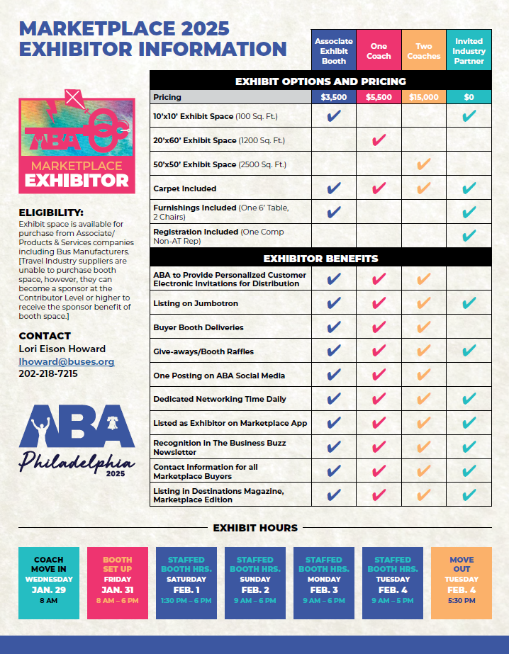


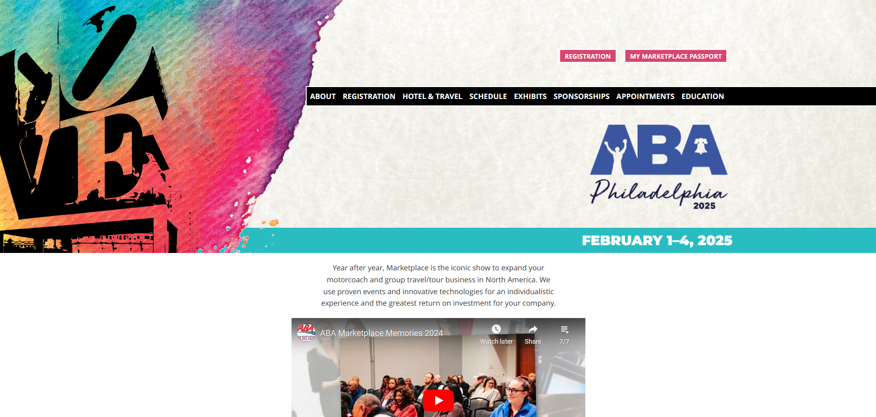

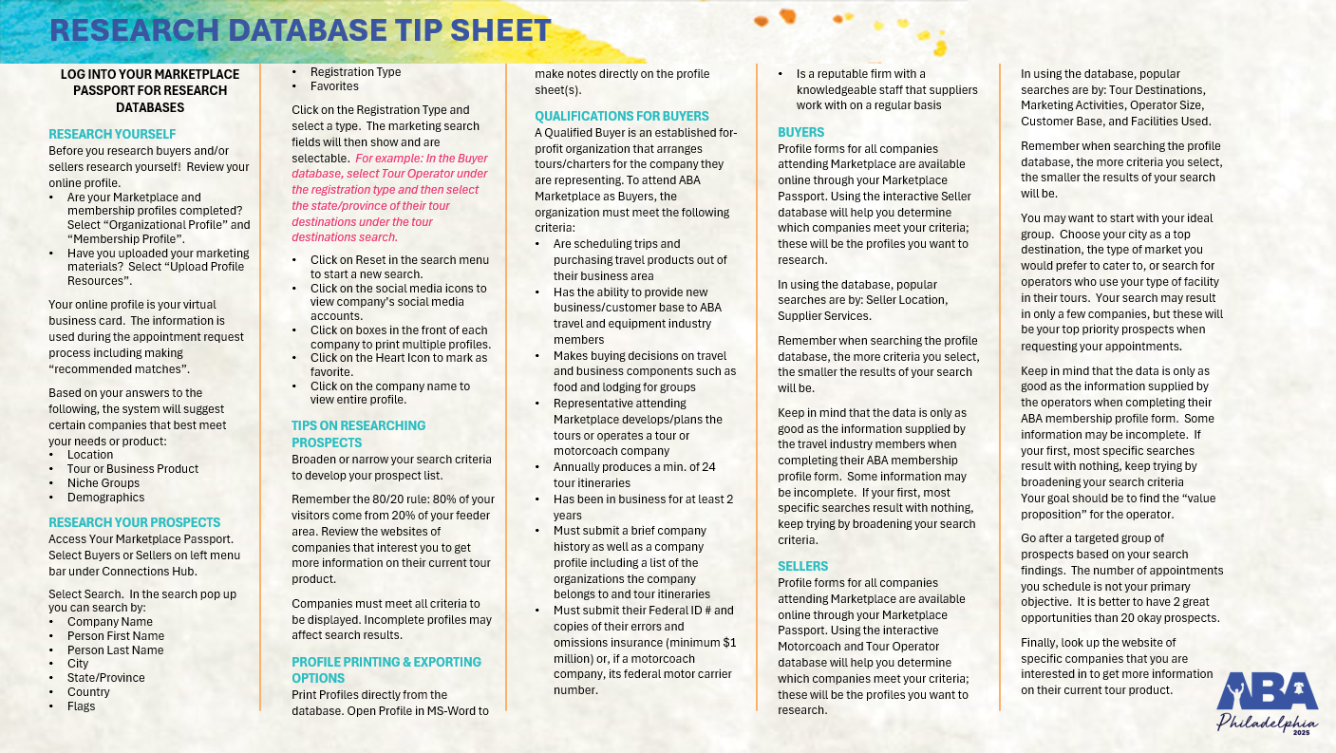


Slide 9

SCHEDULE OF EVENTS
Thursday, Jan. 30
12:00 pm – 5:00 pm
Registration Open
2:00 pm – 5:00 pm
National Bus Traffic Association Meeting
NBTA Members Only
Friday, Jan. 31
8:00 am – 5:00 pm
IMG Registration Open
8:00 am – 12:00 pm
IMG Exhibitor Set Up
8:00 am – 6:00 pm
Registration Open
Sightseeing Ticket Pick-Up Open
Exhibitor/Sponsor Move-In
9:00 am – 5:00 pm
National Bus Traffic Association Meeting
NBTA Members Only
10:00 am – 6:00 pm
Airport Shuttles
1:00 pm – 2:00 pm
IMG Opening Session
1:00 pm – 6:00 pm
Women in Buses Day
2:00 pm – 5:00 pm
IMG Maintenance Session
IMG Safety Session
3:00 pm – 4:00 pm
School Bus Council Meeting
4:00 pm – 5:00 pm
ABA Board of Directors Executive Committee Meeting
Invitation Only
Saturday, Feb. 1
7:00 am – 5:00 pm
IMG Registration Open
7:00 am – 8:30 pm
Sightseeing Ticket Pick-Up Open
7:00 am – 6:00 pm
Registration Open
8:00 am – 5:00 pm
IMG Vendor Exhibits
IMG Maintenance Session
IMG Safety Session
8:00 am – 12:00 pm
ABA Board of Directors Breakfast/Meeting
Invitation Only
9:00 am – 1:00 pm
Sightseeing Tours
10:00 am – 2:00 pm
Airport Shuttles
10:00 am – 5:30 pm
Education Seminars
12:00 pm – 1:00 pm
IMG Tailgate Lunch
12:15 pm – 2:00 pm
Next Era Leadership Council Lunch and Meeting
Invitation Only
1:00 pm – 3:00 pm
IMG Best Ideas Contest
1:30 pm – 6:00 pm
Networking Floor Reception
2:00 pm – 3:00 pm
African American Motorcoach Council Meeting
Hispanic Motorcoach Council Meeting
3:30 pm – 4:30 pm
Diversity, Equity & Inclusion Committee Meeting
5:30 pm – 6:30 pm
Operator Reception
7:00 pm
ABA Board of Directors Dinner
Invitation Only
7:00 pm
Experience Philadelphia on Your Own
Sunday, feb. 2
7:00 am – 5:00 pm
IMG Registration Open
7:00 am – 6:00 pm
Registration Open
7:45 am – 8:45 am
Operator Breakfast
8:00 am – 5:00 pm
IMG Vendor Exhibits
IMG Maintenance Session
9:00 am – 5:30 pm
Bus Industry Safety Council Meetings
9:00 am – 5:47 pm
DMO/Receptive Appointment Sessions
9:30 am – 5:30 pm
Education Seminars
12:16 pm – 2:30 pm
All-Delegate Lunch and Annual Meeting
12:30 pm – 1:30 pm
IMG Lunch
4:00 pm – 6:00 pm
IMG Board Meeting
7:00 pm – 9:30 pm
All-Delegate Evening Event
Sponsored by Philadelphia CVB
Monday, feb. 3
7:00 am – 6:00 pm
Registration Open
7:45 am – 8:45 am
Operator Breakfast
9:00 am – 5:47 pm
Lodging/Attraction/Associate/
Allied Appointment Sessions
9:30 am – 5:30 pm
Education Seminars
9:30 am – 5:30 pm
BISC/BusMARC Meetings
12:16 pm – 2:30 pm
All-Delegate Lunch
7:00 pm – 10:00 pm
Dine Around Philadelphia
9:00 pm – 12:00 am
Foundation Afterglow
Tuesday, feb. 4
7:00 am – 6:00 pm
Registration Open
7:45 am – 8:45 am
Operator Breakfast
9:00 am – 3:00 pm
BusMARC Meetings Offsite
9:00 am – 5:03 pm
Lodging/Attraction/Associate/
Allied Appointment Sessions
9:30 am – 12:00 pm
Education Seminars
12:30 pm – 2:00 pm
All-Delegate Lunch
5:30 pm – 8:00 pm
Exhibitor Move-Out
7:00 pm – 9:00 pm
All-Delegate Evening Event
Sponsored by Reno-Sparks Convention & Visitors Authority
Wednesday, feb. 5
5:30 am – 12:30 pm
Airport Shuttles

Slide 10

Future marketplace locations

Slide 11
MARKETPLACE 2026
RENO, NV | JANUARY 10-13
MARKETPLACE 2027
CALGARY, AB| FEBRUARY 5-9
MARKETPLACE 2028
CHARLOTTE, NC| JANUARY 22-25

Slide 12
Future board & foundation locations

Slide 13
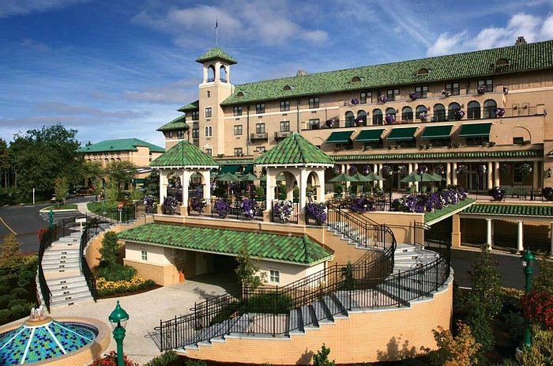
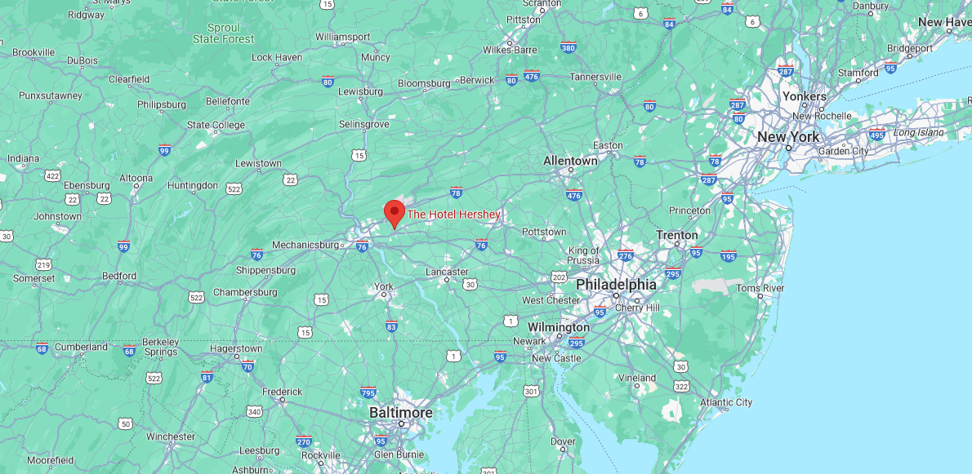
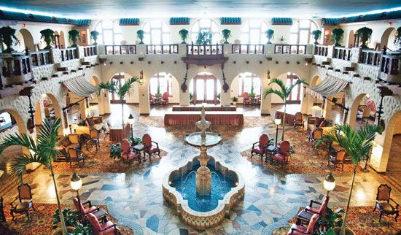

2024 FALL BOARD OF DIRECTORS MEETING
HOTEL HERSHEY| HERSHEY, PA
SEPTEMBER 25-26

Slide 14
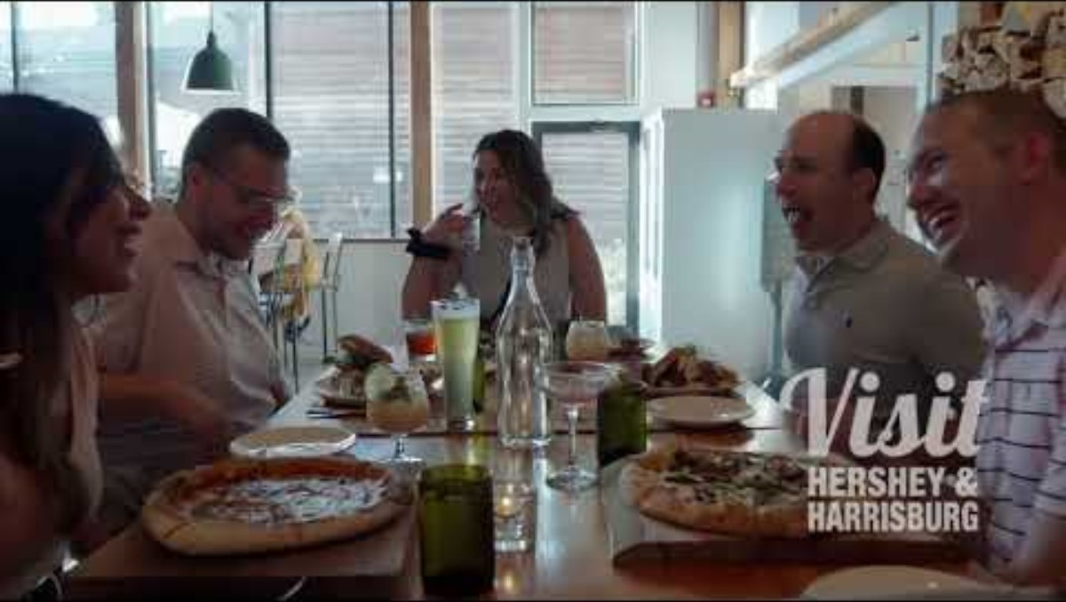
2024 FALL BOARD OF DIRECTORS MEETING
HOTEL HERSHEY| HERSHEY, PA
SEPTEMBER 25-26

Slide 15
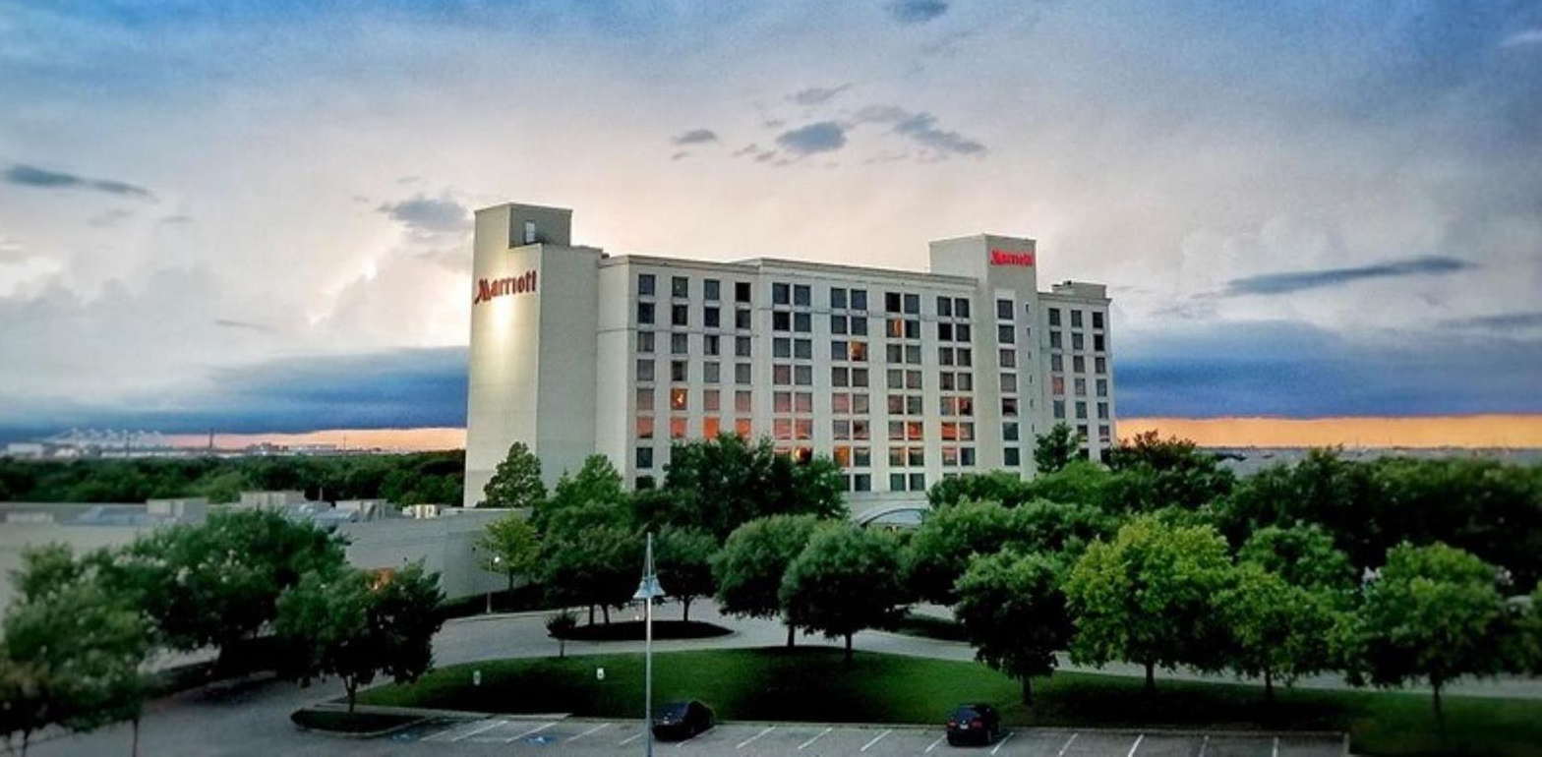
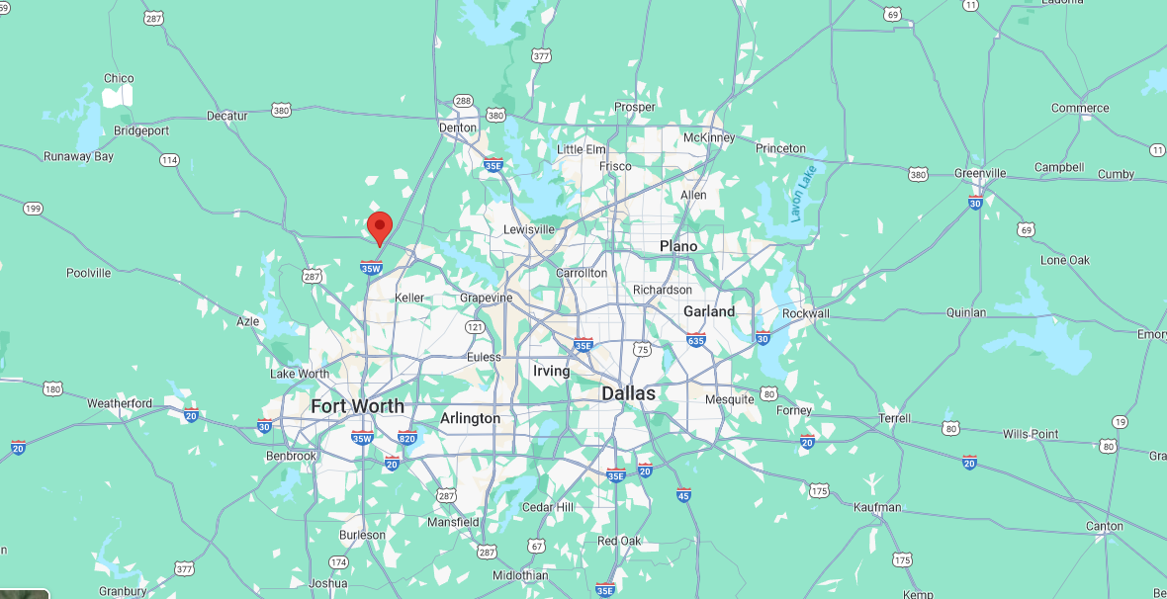
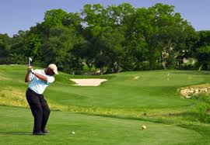

2025 FALL BOARD OF DIRECTORS MEETING
DALLAS/FORT WORTH MARRIOTT HOTEL & GOLF CLUB AT CHAMPIONS CIRCLE | FORT WORTH, TX
SEPTEMBER 15-16

Slide 16
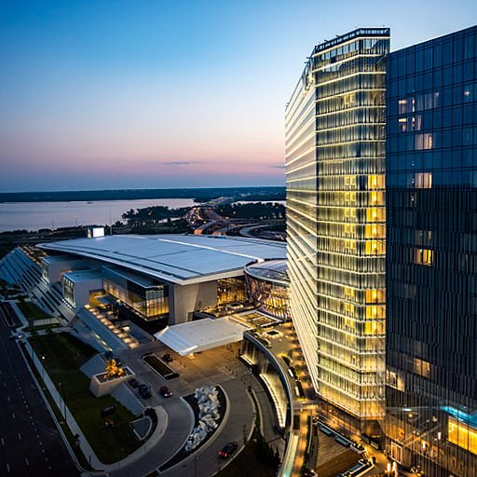
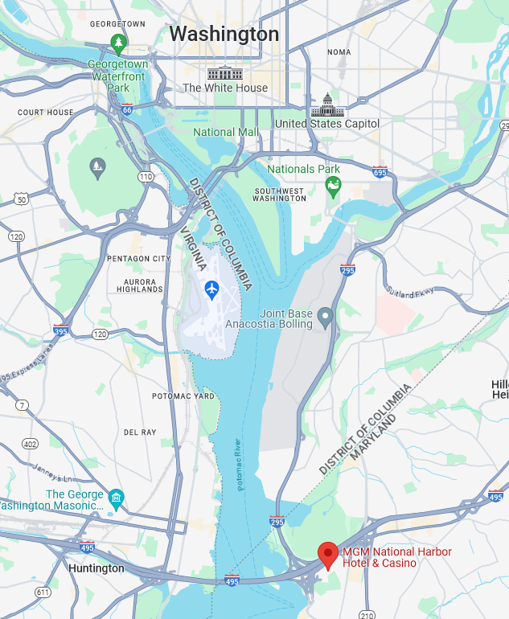
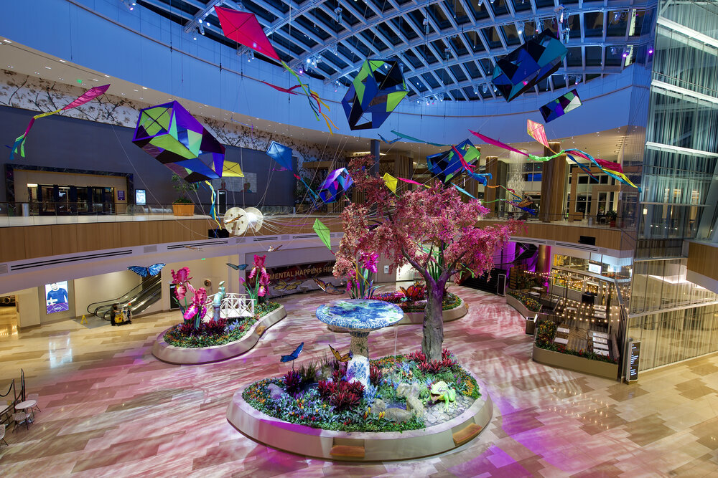


2025 spring BOARD OF DIRECTORS MEETING
MGM National harbor
DATES AVAILABLE | ROOM RATE
Mon., April 28-Tues., April 29 | $319
Tues., April 29-Wed., April 30 | $319
Thurs., May 8-Fri., May 9 | $319
CONCESSIONS
Complimentary internet in meeting space and sleeping rooms
1 per 50 comp, cumulative
Three Week cut-off date for reservations
80% Cumulative Attrition
Guaranteed (1) complimentary upgrade to a Corner Suite for Chairman at group rate
Comp. Wi-fi in guestrooms, meeting space and throughout the property
F&B MINIMUM | $23,475
ROOM RENTAL | Waived

Slide 17
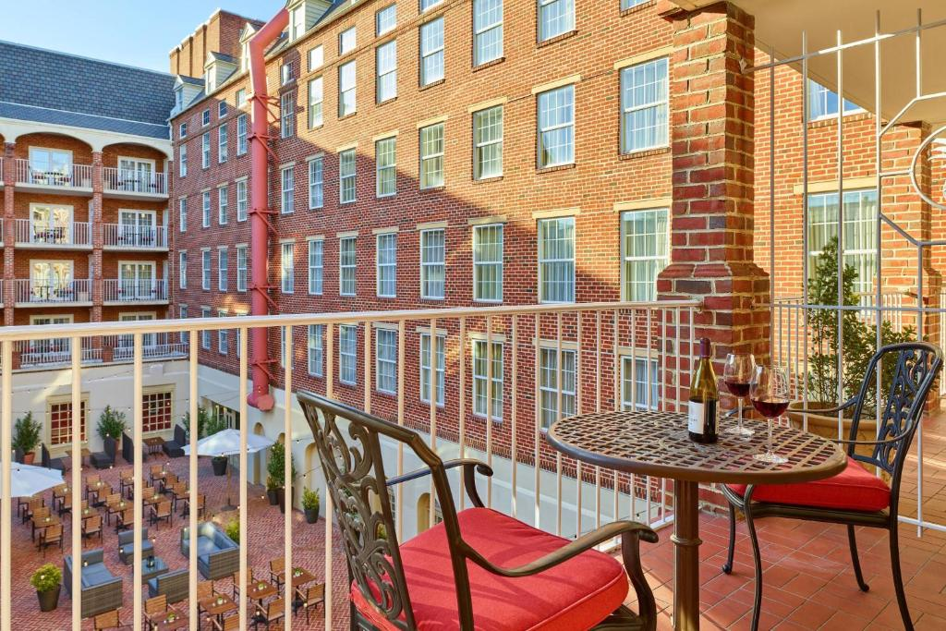
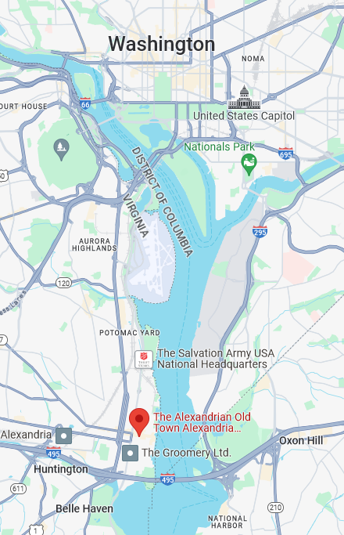
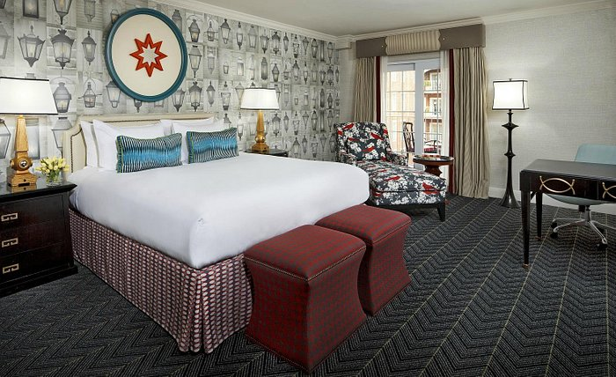
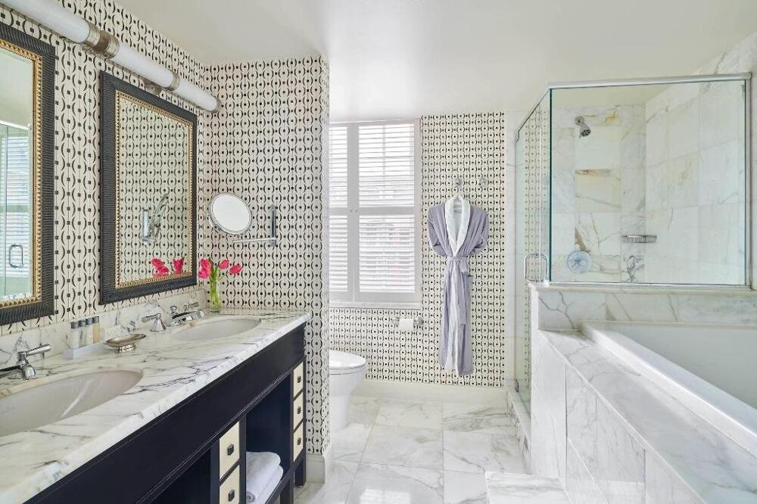

2025 spring BOARD OF DIRECTORS MEETING
the alexandrian
DATES AVAILABLE | ROOM RATE
Mon., April 28-Tues., April 29 | $269
CONCESSIONS
Complimentary wireless internet in meeting space and guestrooms
Two Chef’s Choice VIP Amenities Upon Arrival
Two Guest Room Upgrades at the Group Rate
$26 discounted parking for all attendees
20% Off A/V
Waived destination fee (a $25.00 daily value)
Group rates available 3 days pre/post (based on availability)
F&B MINIMUM | $18,000
ROOM RENTAL | $1000 per Day

Slide 18
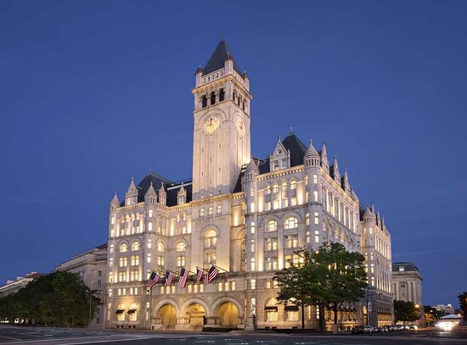
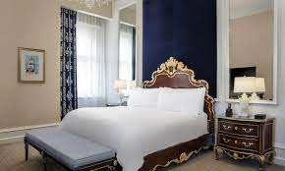
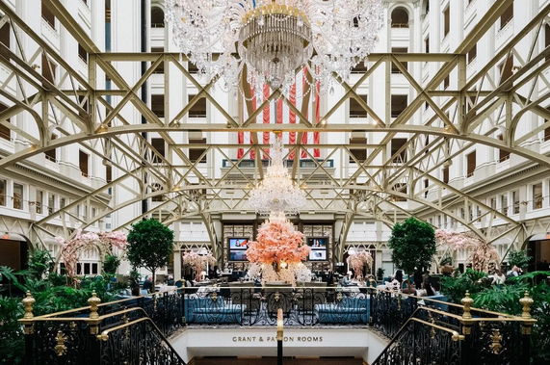
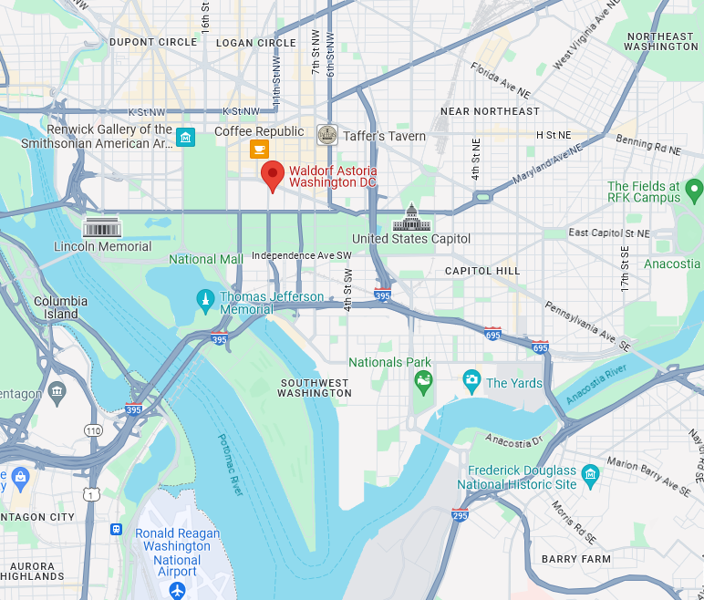

2025 spring BOARD OF DIRECTORS MEETING
waldorf astoria
DATES AVAILABLE | ROOM RATE
Mon., April 28-Tues., April 29 | $409
Tues., April 29-Wed., April 30 | $445
Thurs., May 1-Fri., May 2 | $425
Mon., May 4-Tues., May 6 | $409
Thurs., May 8-Fri., May 9 | $425
CONCESSIONS
1 per 40 comp, cumulative
Three Week cut-off date for reservations
80% Cumulative Attrition
(1) upgrade to a 1BR Suite for Chairman at $1,000/night
Comp. Wi-fi in guestrooms and throughout the property
Group rate available 3 days pre/post program dates.
10% A/V discount using hotel's in-house company
F&B MINIMUM | $25,000
ROOM RENTAL | $3000 Total

Slide 19
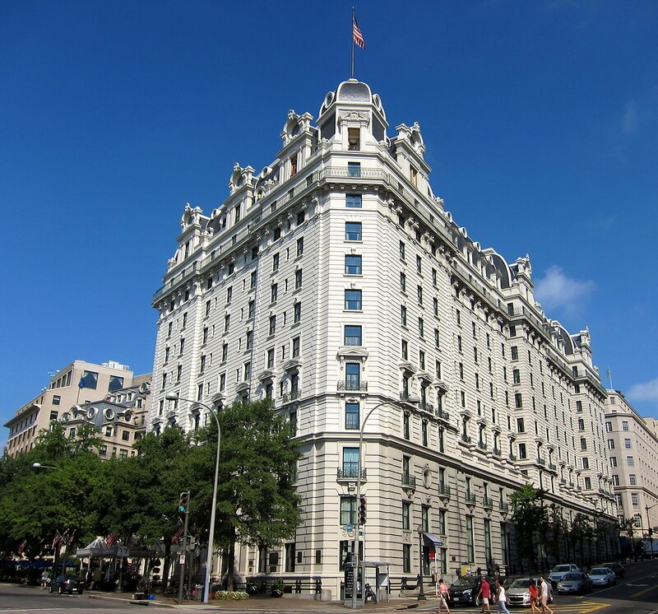
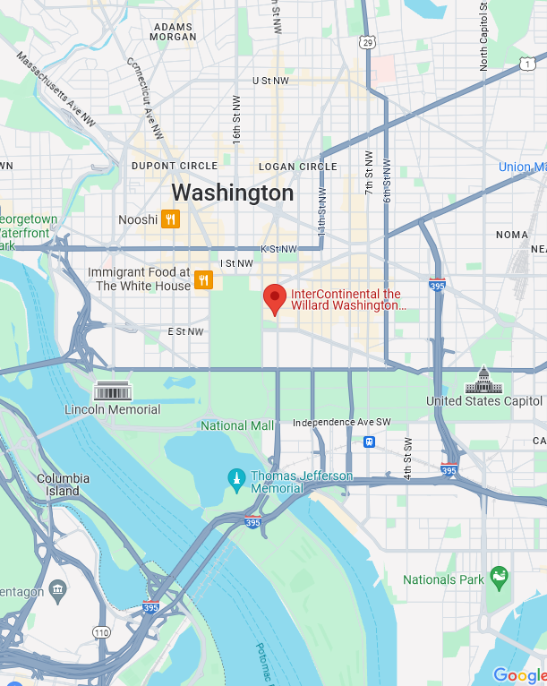
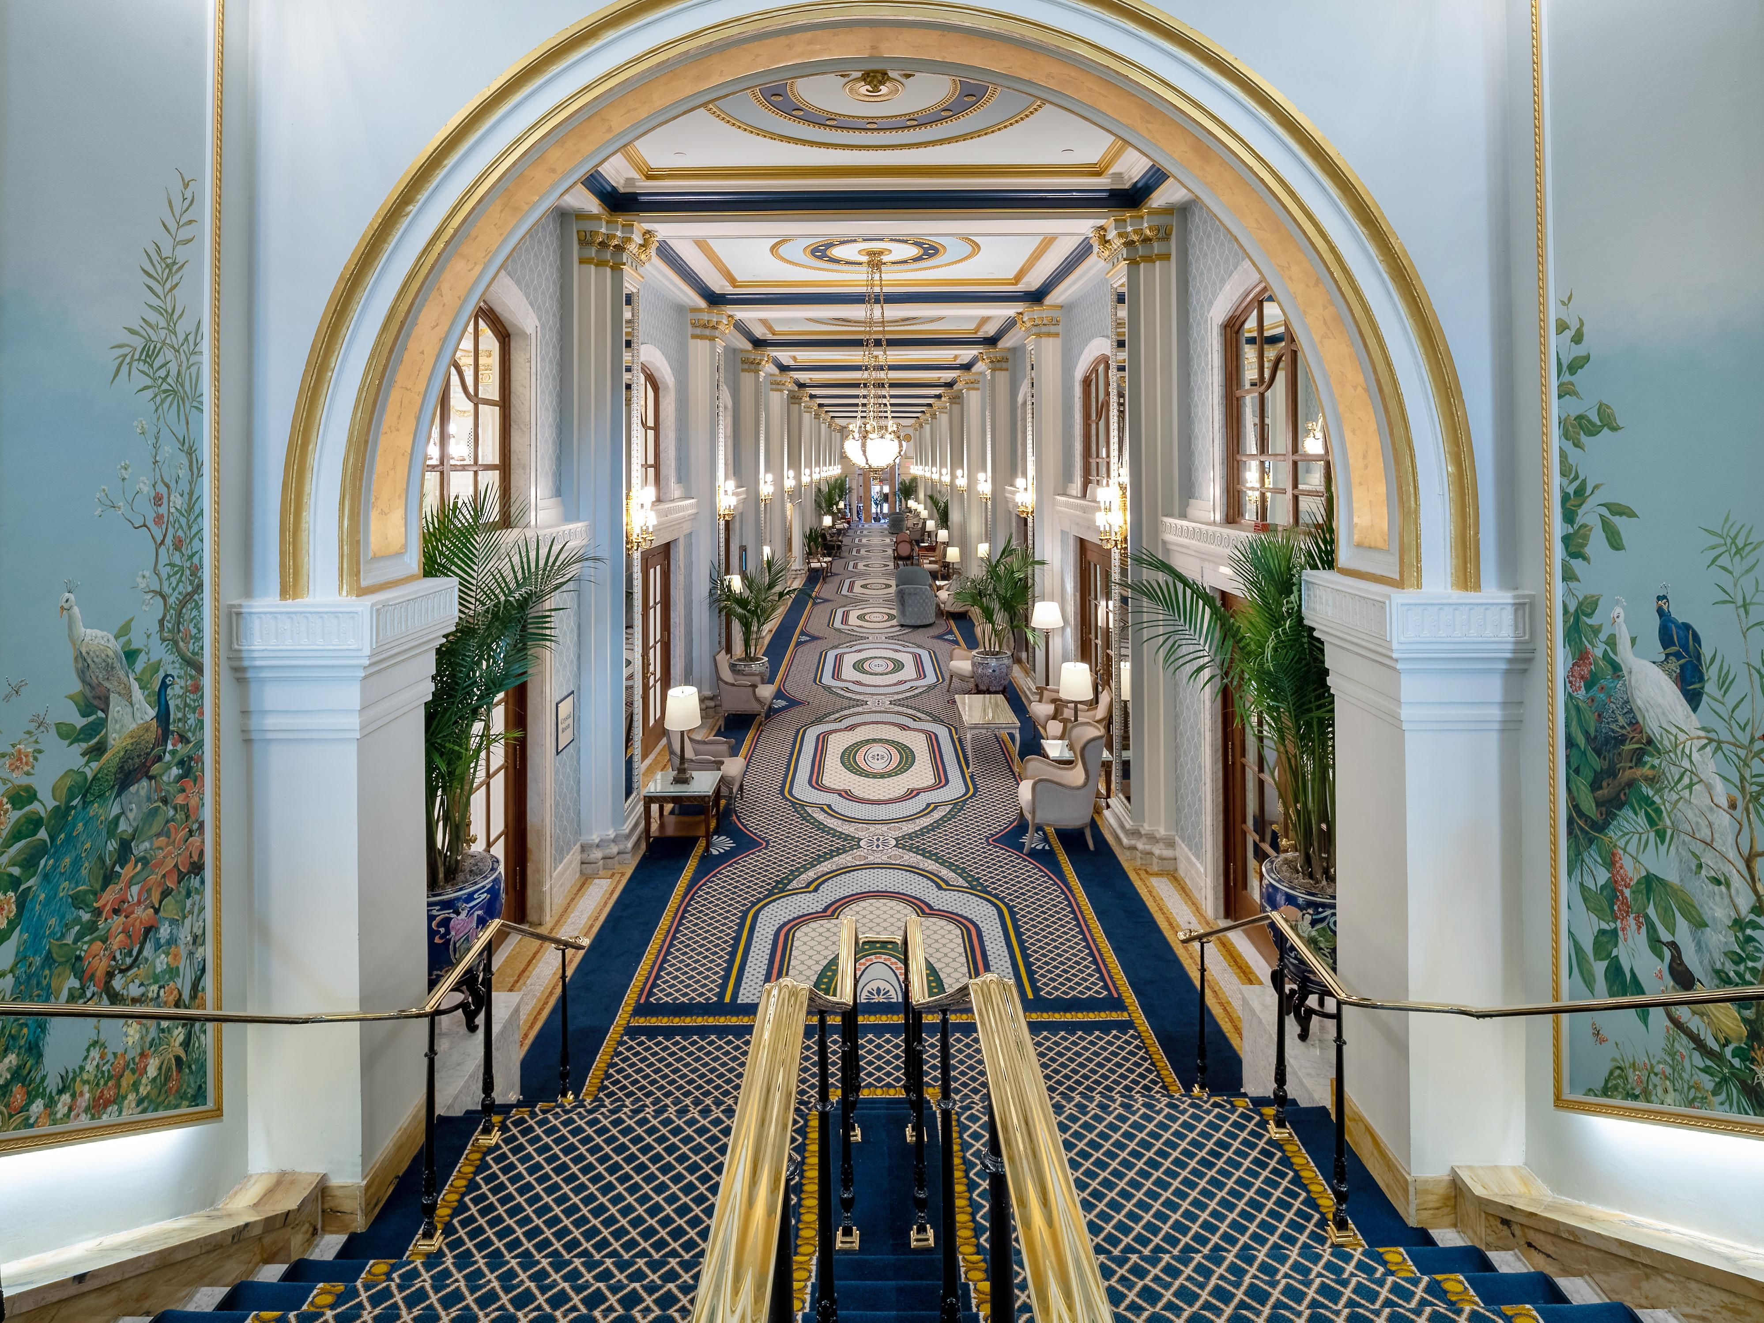
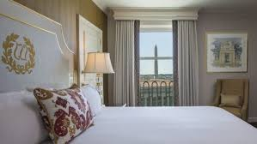

2025 spring BOARD OF DIRECTORS MEETING
Willard intercontinental
DATES AVAILABLE | ROOM RATE
Tues., April 29-Wed., April 30 | $419
CONCESSIONS
Complimentary standard internet in meeting space and sleeping rooms
1 per 40 comp, cumulative
Three (3) week cut-off date for reservations
80% Cumulative Attrition
Guaranteed (1) complimentary upgrade to a junior suite at the group rate
Group rate available 3 days pre/post program dates based on availability
10% A/V discount using hotel's in-house company
F&B MINIMUM | $18,000
ROOM RENTAL | $4000 per Day

Slide 20
Future COUNCIL MEETNG locations

Slide 21



Hispanic Motorcoach Council
las vegas, nv| may 21
Park mgm
Bus industry safety Council/
bus maintenance & repair council
Orlando, fl| July 22-24
Doubletree by Hilton Orlando at seaworld

Slide 22
EDUCATION PROGRAM

Slide 23
Marketplace 2024 education
42 SESSIONS ON 20 TRACKS
REGISTRATION TYPE | PERCENTAGE OF OVERALL SESSION ATTENDEES
BUS OPERATOR | 41%
TOUR OPERATOR | 15%
DMO | 16%
LODGING | 7%
ATTRACTIONS | 17%
RECEPTIVE OPERATORS | 1%
ASSOCIATES | 2%
GOVERNMENT/MEDIA | 1%

Slide 24

2024 WEBINAR PROGRAM
22 WEBINARS SCHEDULED THROUGHOUT 2024
22 SPEAKERS
13 TRACKS
SPONSORED BY EXPERIENCE SIOUX FALL

Slide 25


NOTEWORTHY WEBINARS

Slide 26

WOMEN IN BUSES COUNCIL

Slide 27


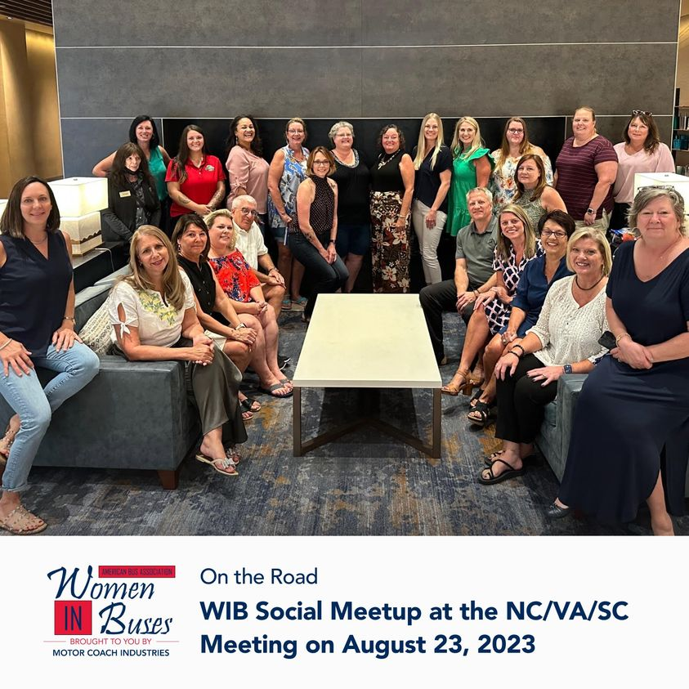

WOMEN IN BUSES activities
WOMEN IN BUSES
WEDNESDAYS
MEET & EAT
WIB ON THE ROAD
SOCIAL MEDIA
SPOTLIGHTS

Slide 28
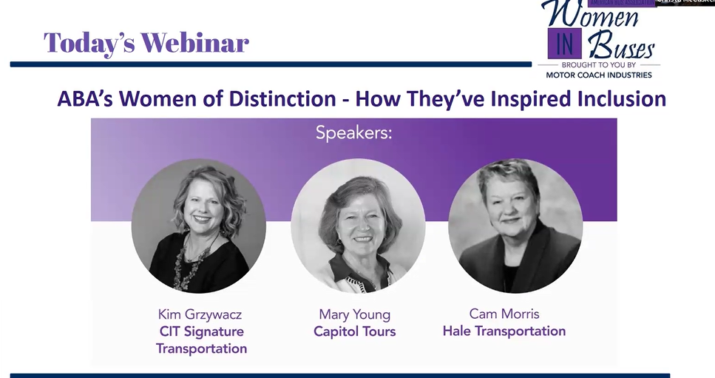


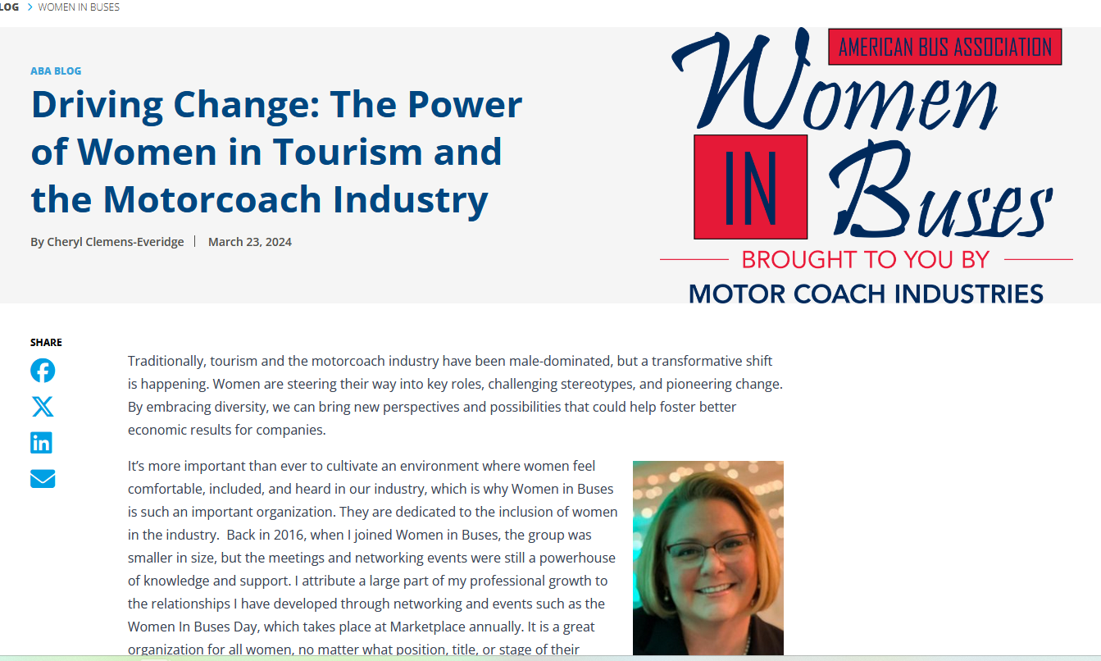
INTERNATIONAL WOMEN’S MONTH

Slide 29


CONNECTING THROUGH CONVERSATIONS

