Slide 1

Finance & Budget

Slide 2
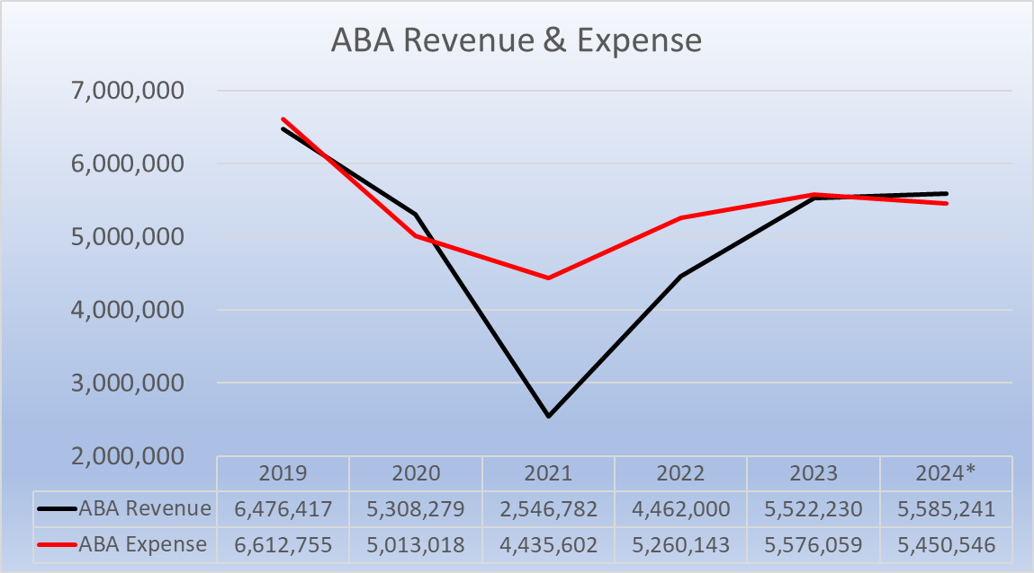

Slide 3
ABA Revenue Comparison

Slide 4
ABA Expense Comparison

Slide 5
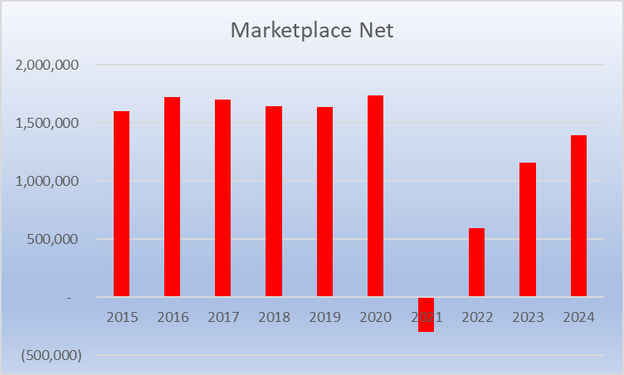

Slide 6
ABA Reserve
ABAF Endowment

