Slide 1


Communications Update
Advocacy
Newsletters
Social Media
Website
Road Ahead

Slide 2
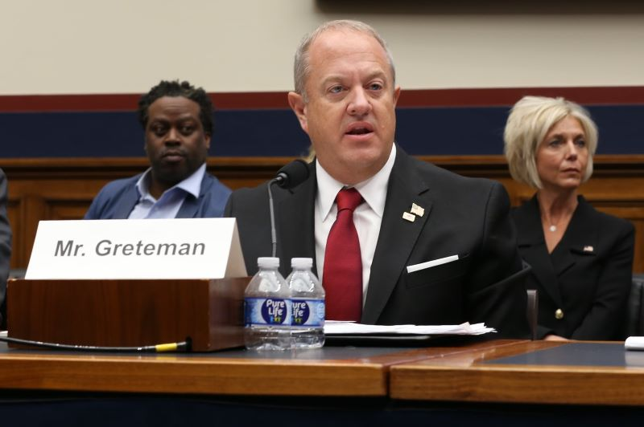
Advocacy
Comms has assisted the GAP team in messaging through various channels regarding key issues over the first few months of this year.
CERT Tax Bill
New York MTA Congestion Tolling
PANJNY Midtown Terminal revamp project
FMCSA CDL Requirements
EPA GHG Phase 3 final rule
Windstar Line’s Jeff Greteman’s testimony in front of the Subcommittee on Highways and Transit of the Committee on Transportation and Infrastructure
Monthly GAP report dissemination

Slide 3
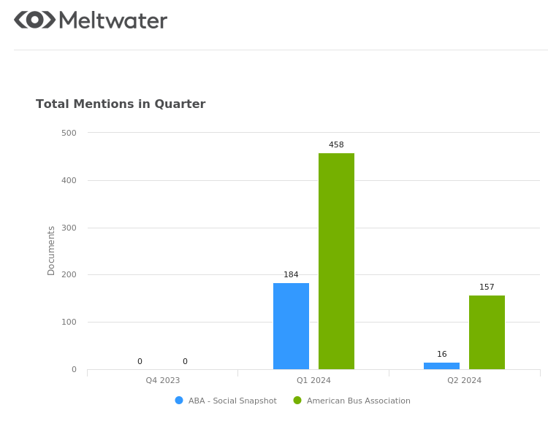
Media Outreach
Advisory
Clean Freight Coalition to Release Landmark Study on Cost of Supply Chain Electrification
Press Releases
ABA Begins Search to Replace Retiring CEO
ABA Applauds Motorcoaches as Eco-Friendly Transportation Leaders
Electrification of US Medium- and Heavy-Duty Commercial Fleets Requires Nearly $1 Trillion
ABA Urges Caution in Transition to Electric Vehicles
In addition, a few ABA blog articles also had some traction with the press:
ABA Joins Call on Mayor Bowser and DC City Council to Reduce Crime and Enhance Safety
ABA’s Jeff Greteman Testifies Before House Subcommittee on Rural Transportation Challenges
ABA Submits Comments on New York City’s Congestion Pricing Plan

Slide 4
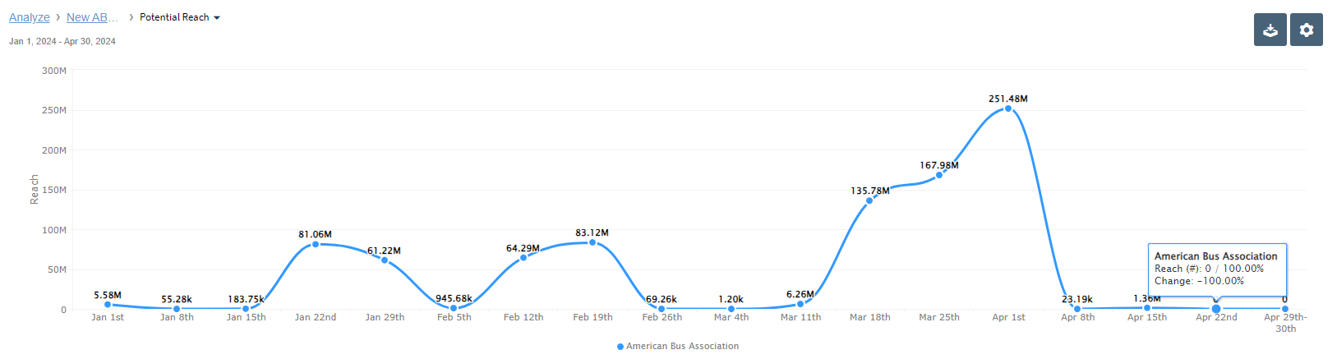
Media Outreach
616 mentions in the press; news reach of 873M

Slide 5
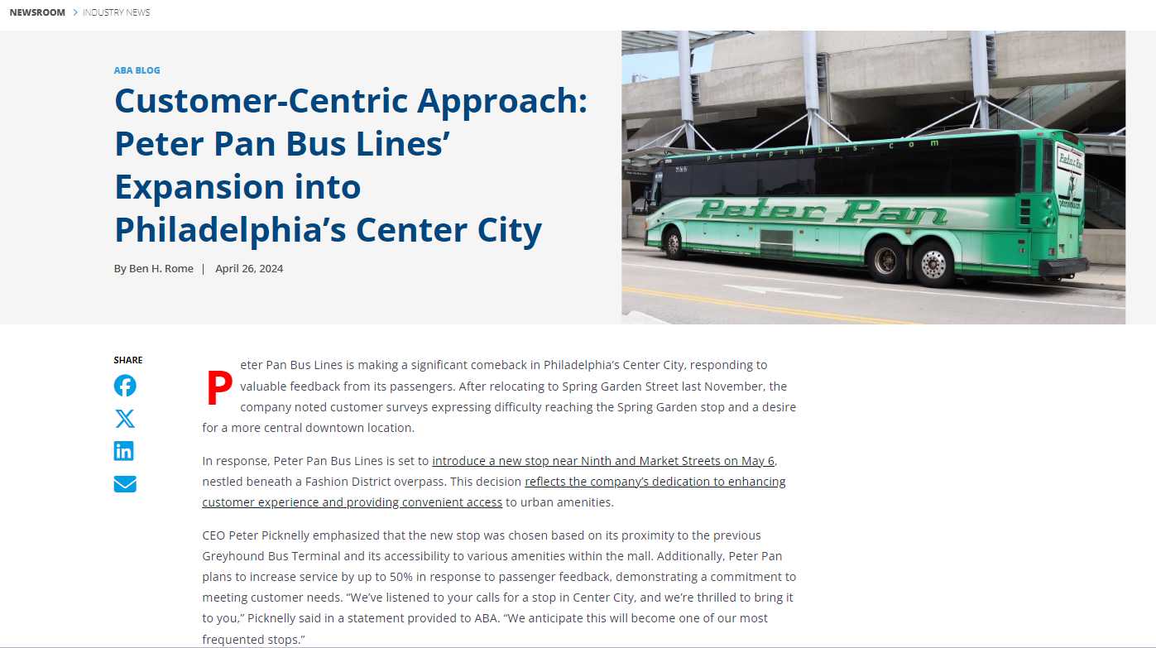
Looking Ahead
More article-oriented posts and blogs on critical topics that affect members
Articles by members sharing their perspectives on topical issues, industry trends, and other happenings

Slide 6
Newsletters: Before
Tour Stop (weekly)
  36% avg open; 4.2% avg CTOR
  Best-performing digest format
Bus Bulletin (4x week)
  32% avg open; 2.2% avg CTOR
  High send frequency hurting views, increased unsubscribes
Insider (weekly)
  26% avg open; 3% avg CTOR
  Most advertisements despite poor readership
  Hybrid content hurt views (no focus)
  Advertisers consulted and moved ad buys to social (better views and exposure)
  Telling: no one has asked about the Insider’s “disappearance”

Slide 7
Newsletters: After
Tour Stop
  Slight change in format with more images, ties to Destinations articles
Bus Bulletin
  Frequency shifted to 2x week
  Curated articles with expanded content (longer digest w/ more depth)
  One month: 39% avg open; 4.2% avg CTOR
Monthlies
  WIB: reformatting layout for better readability
  GAP: Most opened and read; slight format changes for consistency
  Itinerary: shifted to a blog presence on the website, promoted via social; no dedicated newsletter
    Working with new research partner on content

Slide 8
Newsletters: Moving Forward
Enhance newsletter effectiveness
Leverage high-performing content
Optimize engagement strategies through ABA’s website and social channels
Adjust for other communication priorities
Transition towards more dynamic and targeted content
Reflect a commitment to better serve the association's audience and stakeholders
Maximize communication impact across various platforms

Slide 9
Social Media
Evaluation of current channels:
  X (Twitter)
  YouTube
  Instagram
  Facebook
  LinkedIn
ABA followers across all social media accounts as of April 22):
Facebook: 9,206, compared to UMA’s 4,200 (approx.)
Instagram: 2,192, compared to UMA’s 0 (no account)
LinkedIn: 5,409, compared to UMA’s 2,012
X: 4,810*, compared to UMA’s 1,724
*There has been a flood of spambot accounts “following” many organizations and branded accounts. ABA sees 30-50 of these accounts latch on every month.

Slide 10
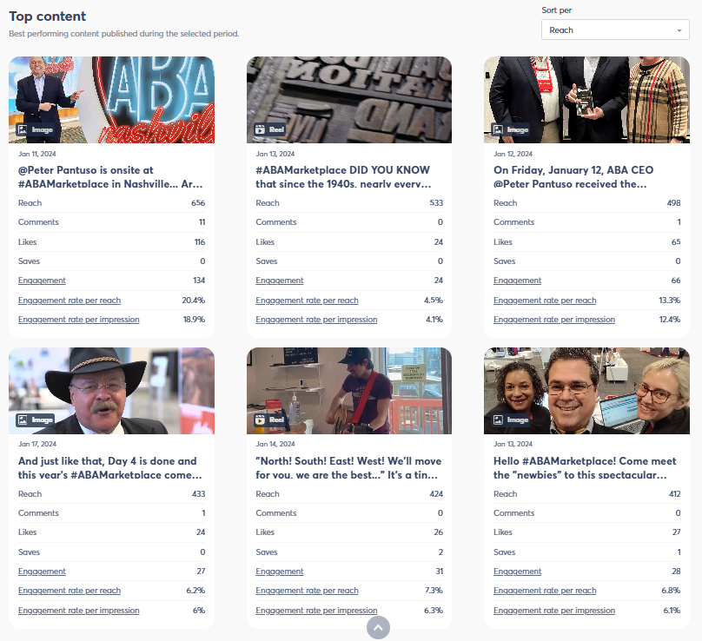
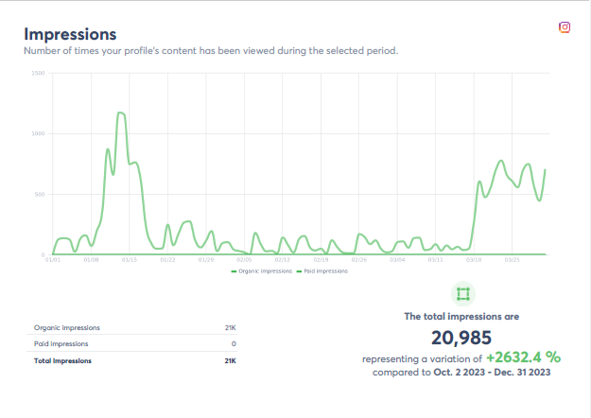
Social Media: Instagram

Slide 11
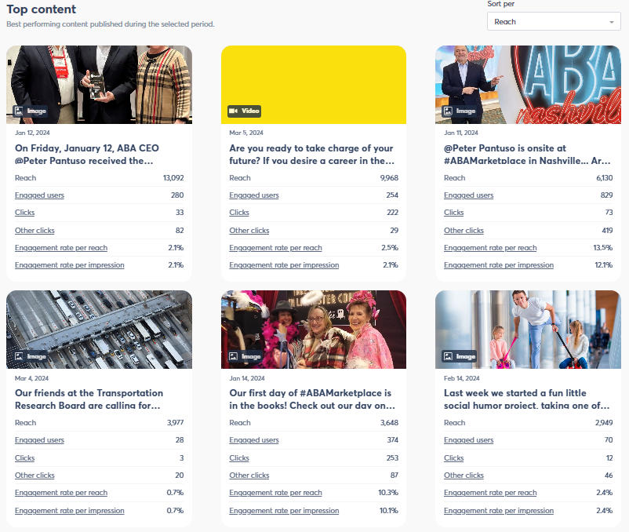
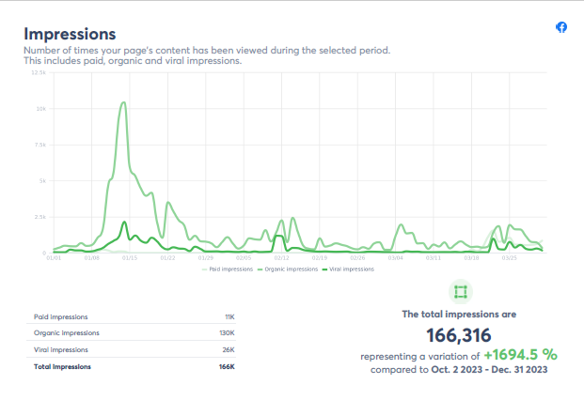
Social Media: Facebook

Slide 12
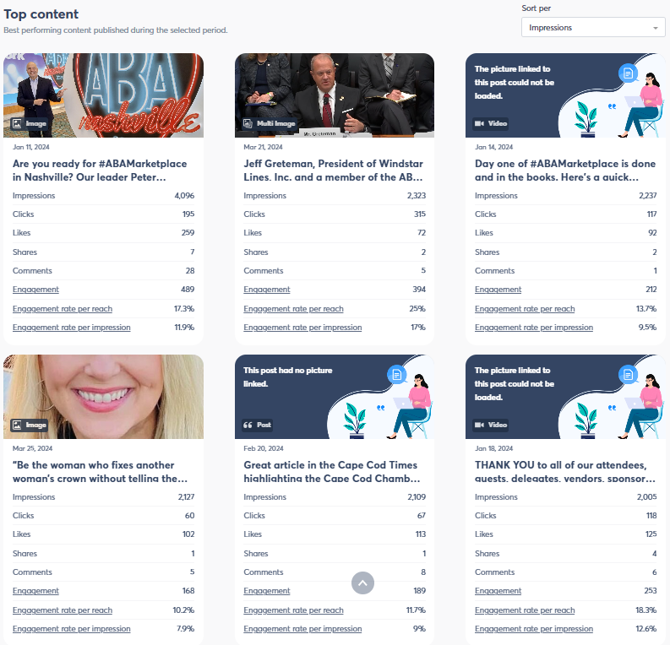
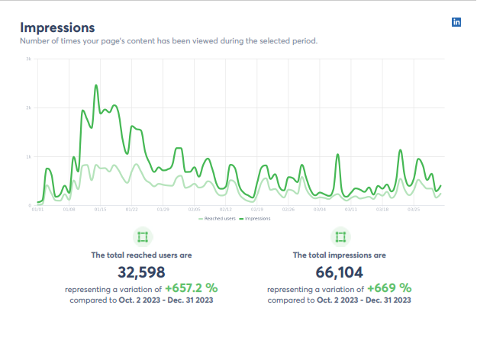
Social Media: LinkedIn

Slide 13
Social Media: Eco-friendly Campaign
Using the recent TTI research report showcasing motorcoach as most eco-friendly group transport
Earth Day posts generated mini-viral movement
Provide messaging and graphics to members, to post/share
Targeted for:
June 5 “World Environment Day”
September 16 “World Ozone Day”

Slide 14
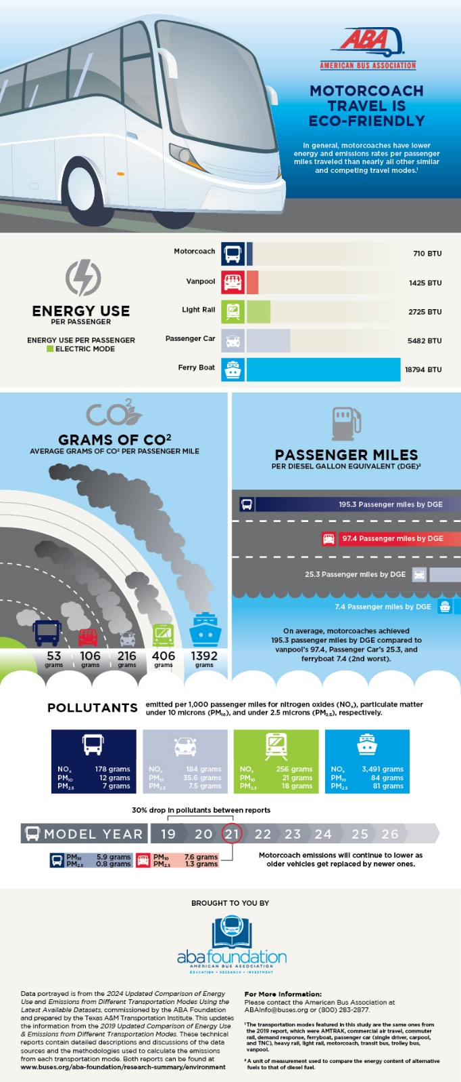
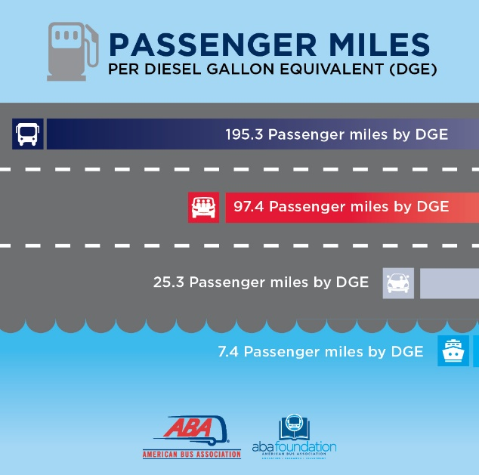
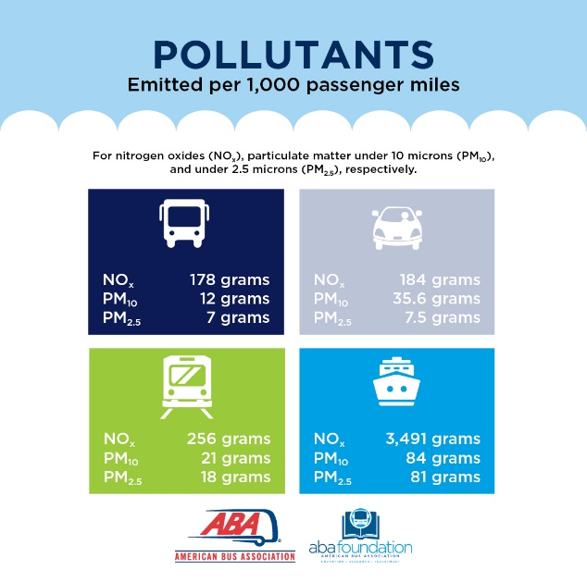
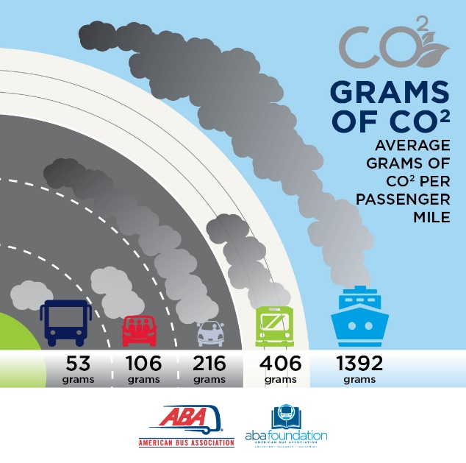
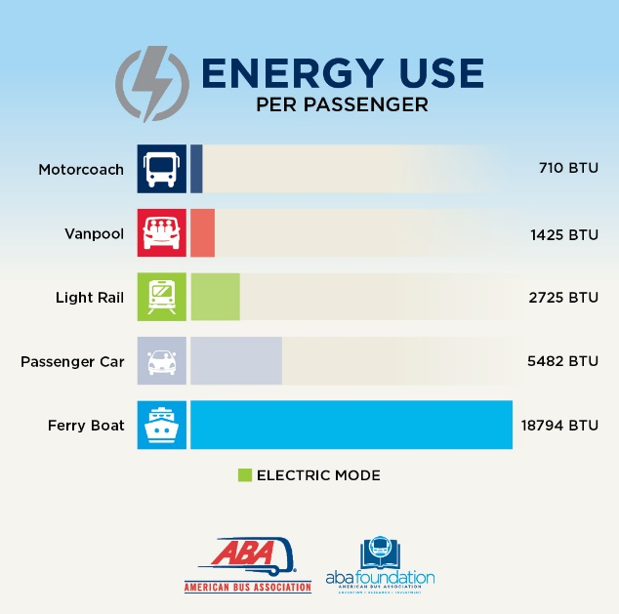

Slide 15
Social Media: Moving Forward
Consistent, rhythmic posting
Catering content to channel audience
  LinkedIn – primarily bus industry, advocacy news
  Facebook/Insta – primarily tour operators, industry-adjacent
New channels to evaluate
  Blue Sky (operated by “old” Twitter staff)
    similar functionality, but currently less brand-occupied)
  Mastadon
    “Unified but separate”
    Complex landscape for disseminating

Slide 16
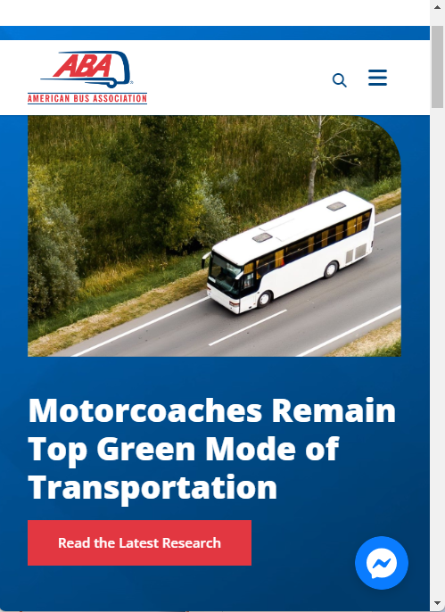
Website
Overhaul initiated in Q2 2023
Move from Raka Creative to YGS Group
Shift to more robust and compatible Wordpress platform
Agreement with YGS to be their test bed for new content delivery platform
More responsive for mobile users (about half our visitors)

Slide 17
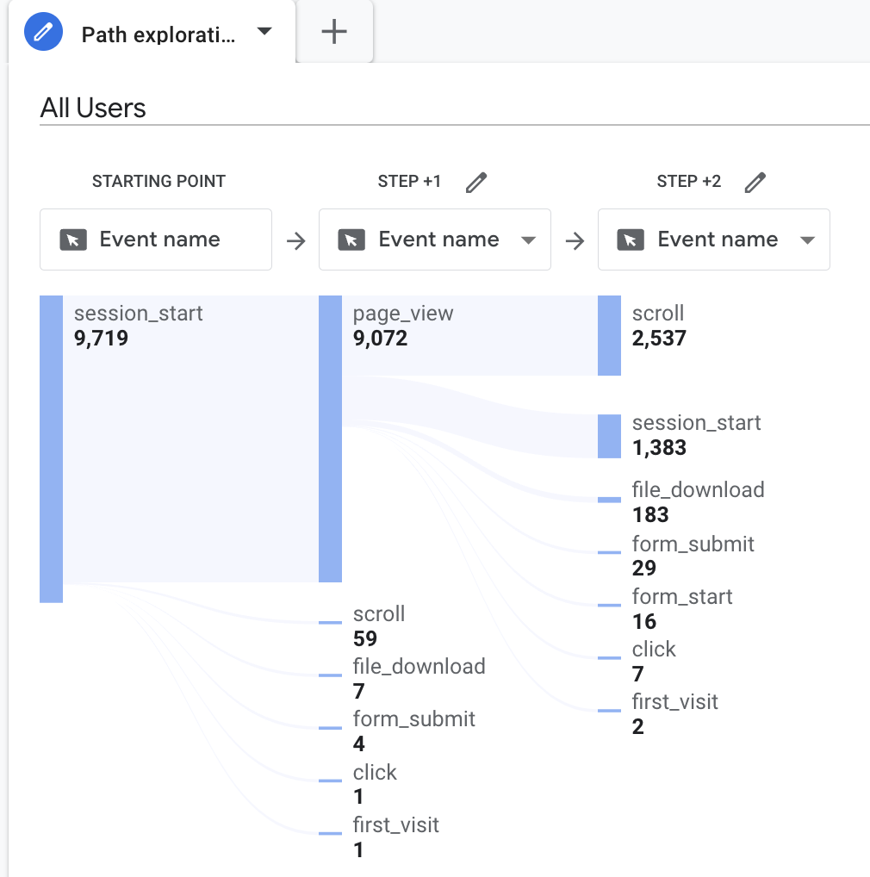
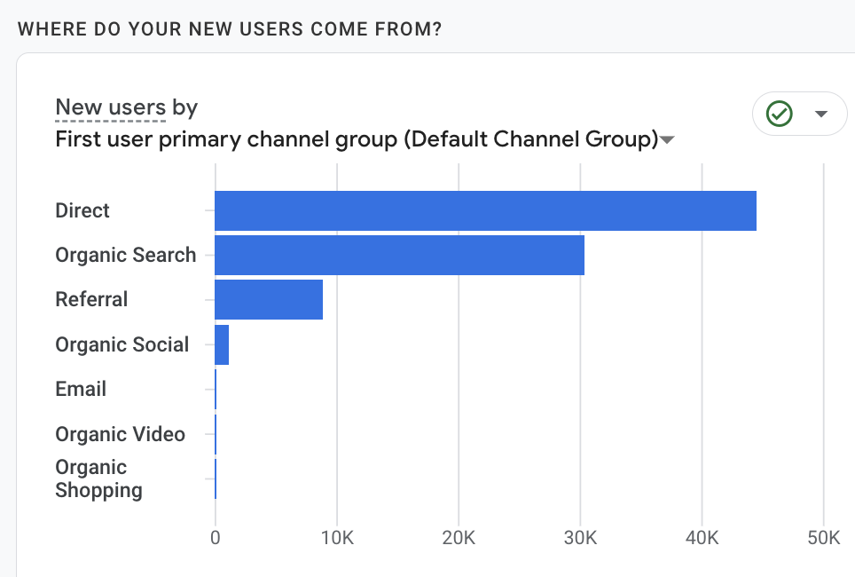
Website: Before
Large chunk of visitors enter via direct URL (typing in the site)
Search accounts for less than half of visitors
Referrals from outside links/shares

Slide 18
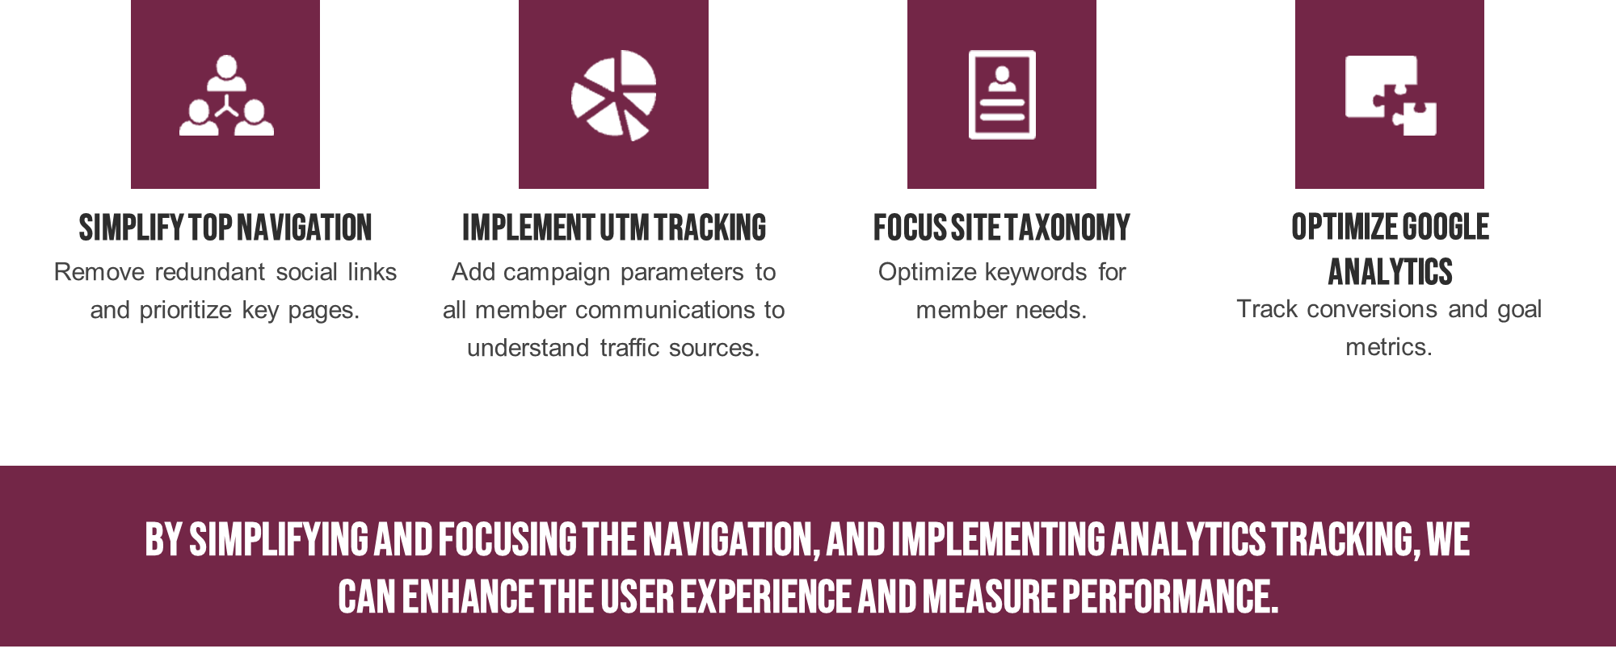
Website: High-level Audit

Slide 19
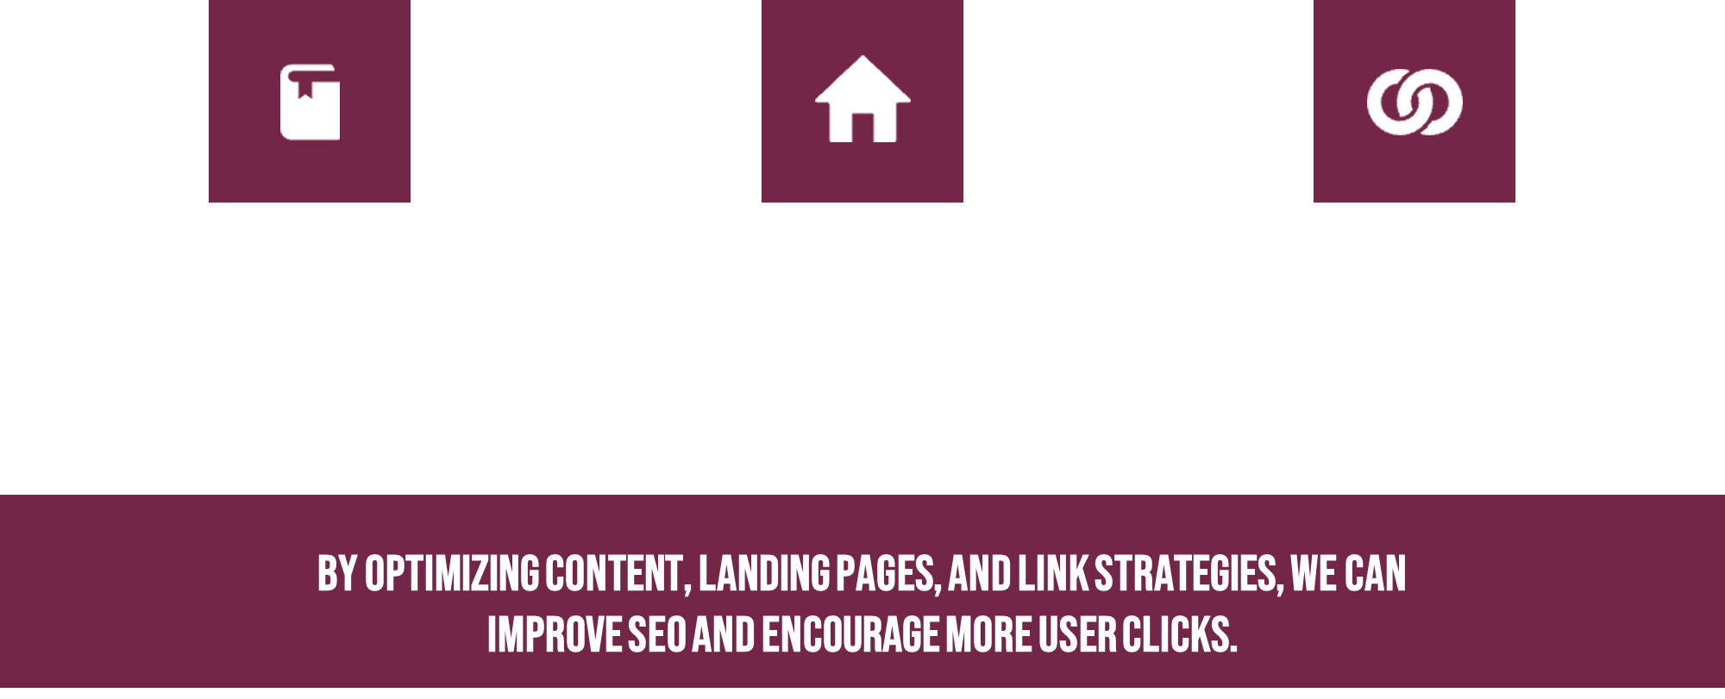
Website: High-level Audit

Slide 20
Website: High-level Audit
Other recommendations:
Member-specific navigation paths
Simplify navigation
ABAF Research Hub
Revamp story visuals
Reduce public archival info
  Remove outdated; some content goes back to early 2000’s
Update / Re-vision Scholarship information for 2025
  Overview and opportunities
  Showcase past winners
  Update FAQ to site (rather than PDF)
  Combine page content
  Clear contact information
  Landing page for social outreach

Slide 21
Website: Current state
Migration complete
99% of bugs corrected
Minor hiccups in Events section – regarding layout and Upcoming/Past listings
Adding content to News Center for more robust look
Identifying evergreen content for sharing
Summer tasks:
  Navigation audit
  Page consolidation
  Branded iconography
  Updated taxonomy & categories (for better SEO and domain authority)
  Toxic backlinks
  Generate more member contributed content

Slide 22
Communications Tasks 2024
Priority
  Written SOPs for various website inputs (Events, articles, newsletters, etc.)
  ABAF Research Hub
  Refresh ABAF Scholarship section
  More ABA member-driven and submitted content
  UTM spreadsheet for campaigns (better analytics)
“Nice to do”
  Interactive audio training for crisis communications
  Prototype crisis comms module for MKPL 25
  More video content and strategy

