Slide 1
Safety – Best Practices
DC Trails
Customer Service
Policy Review
Safety
Legal Overview
Accidents
Closing

Slide 2
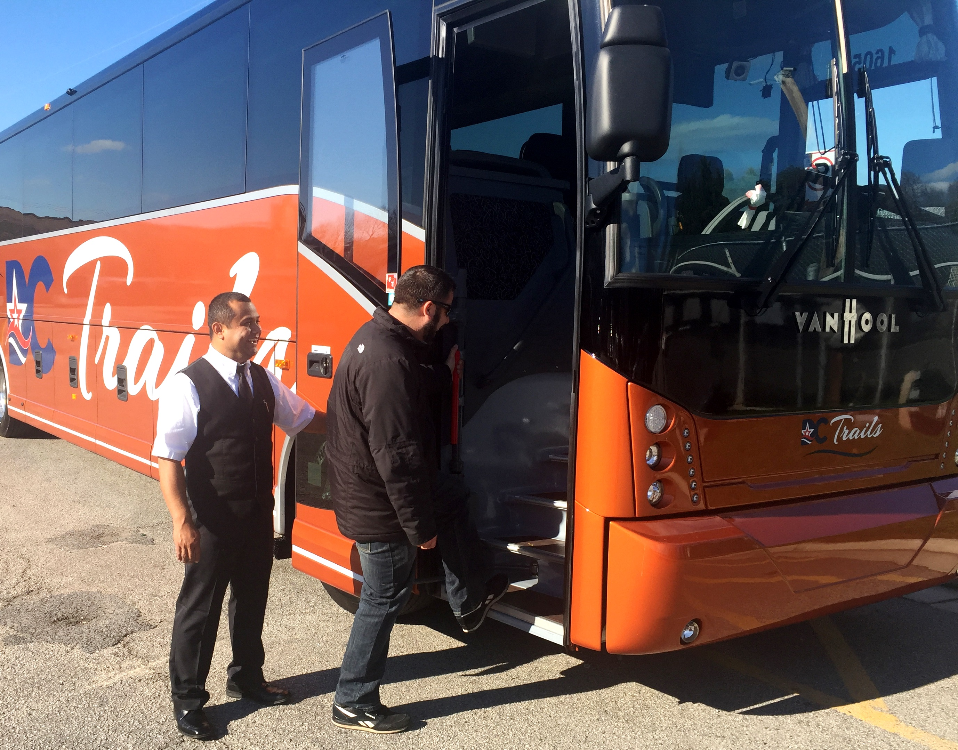
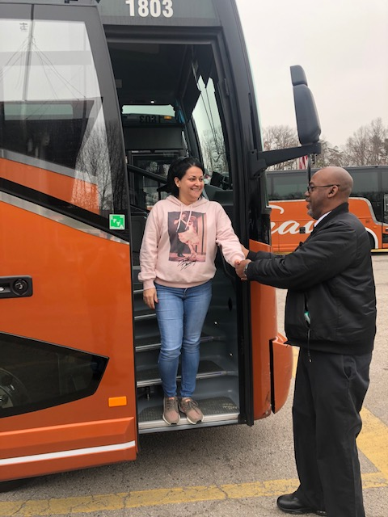
Mandatory:
Provide assistance to Customers:
Drivers must exit the bus at each and every stop in order to assist customers.
Announce to use caution when disembarking:
PLEASE USE HAND RAILS!
Notes:
Add slide: report any incident to Marvin

Slide 3
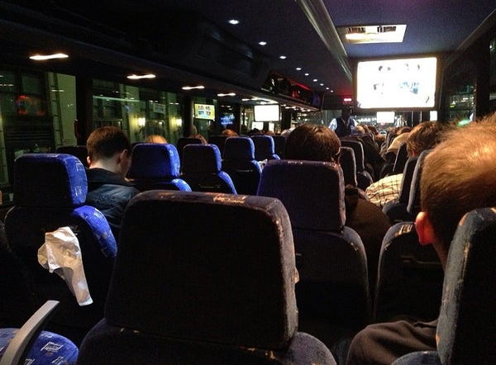
Passenger Safety Reminder:
Every ½ hour, Drivers should announce that customers should stay seated while the vehicle is in motion.
In addition, at the end of the trip Drivers are required to announce to customers that they should hold onto the hand rails when exiting the bus.
Please stay seated while Bus is in motion..!!

Slide 4
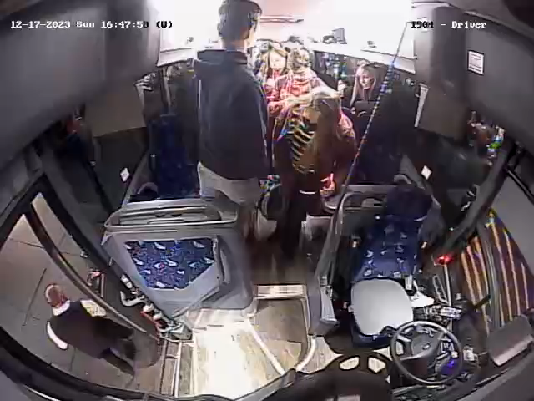

Slide 5
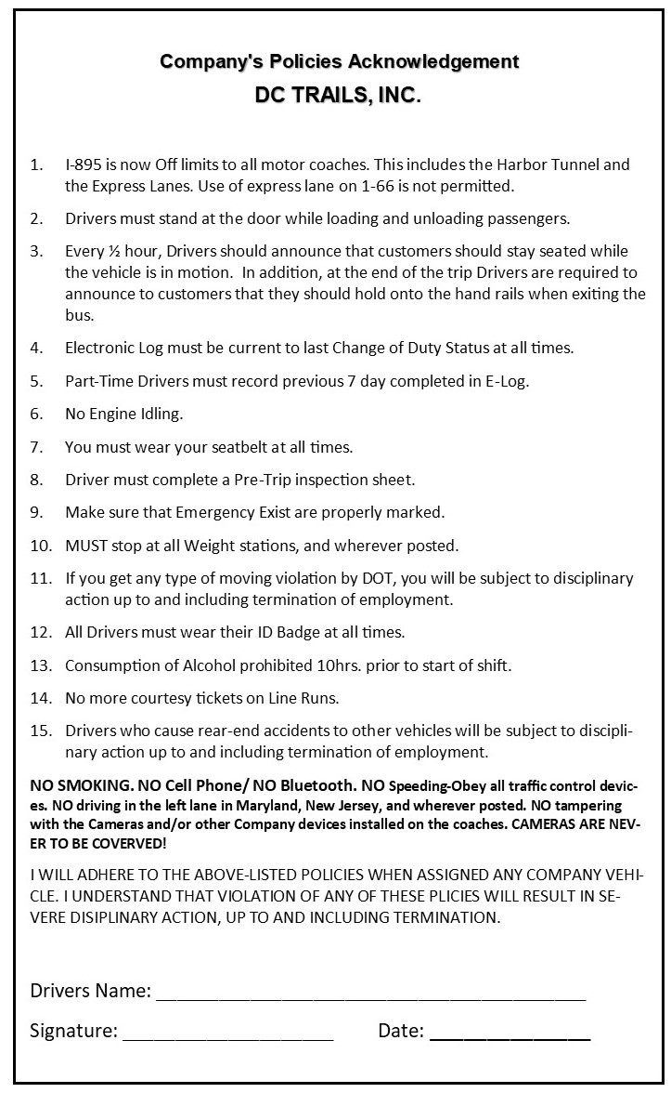
Company’s Policies Acknowledgement that the driver needs to read and sign prior to every trip
Notes:
Insert 2024 version

Slide 6
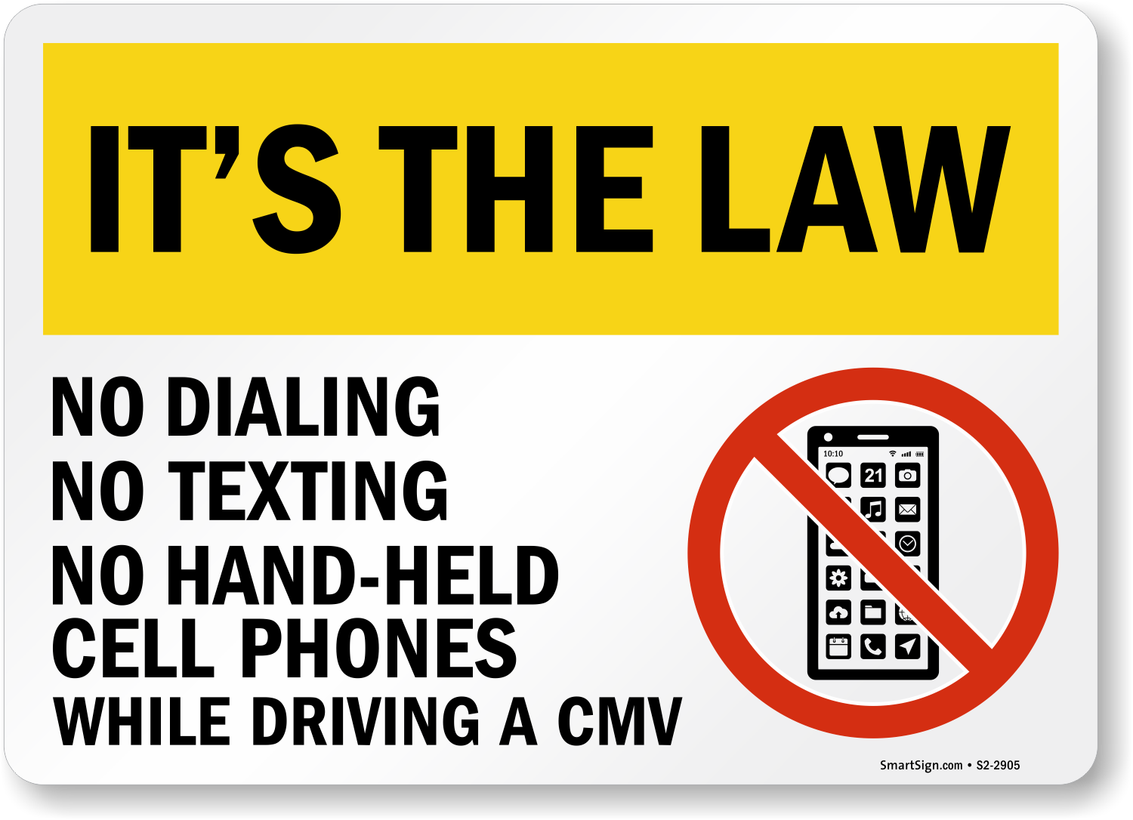

Mobile Device Policy

Slide 7
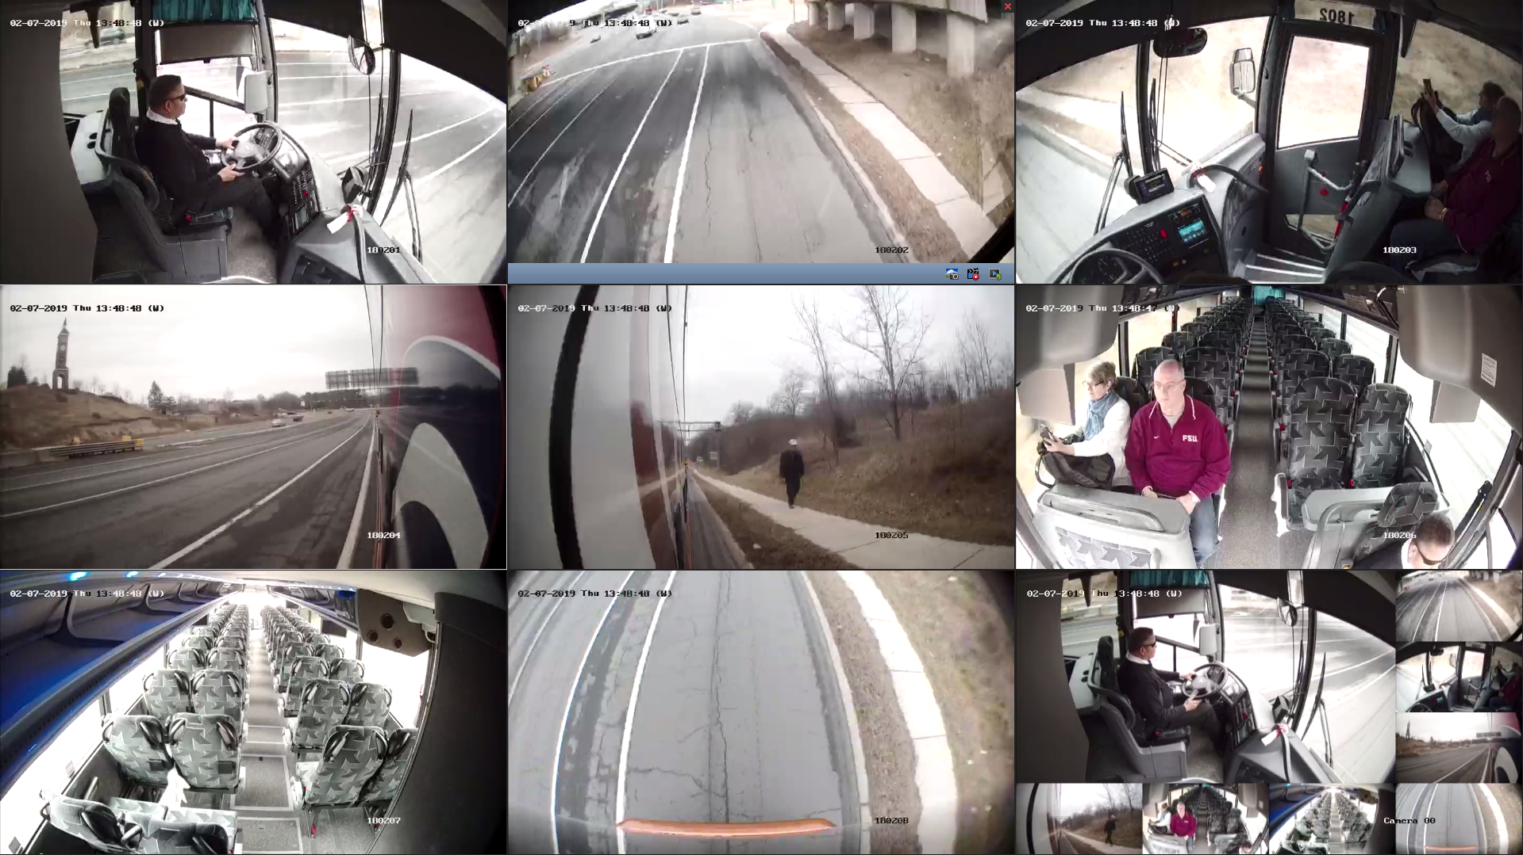
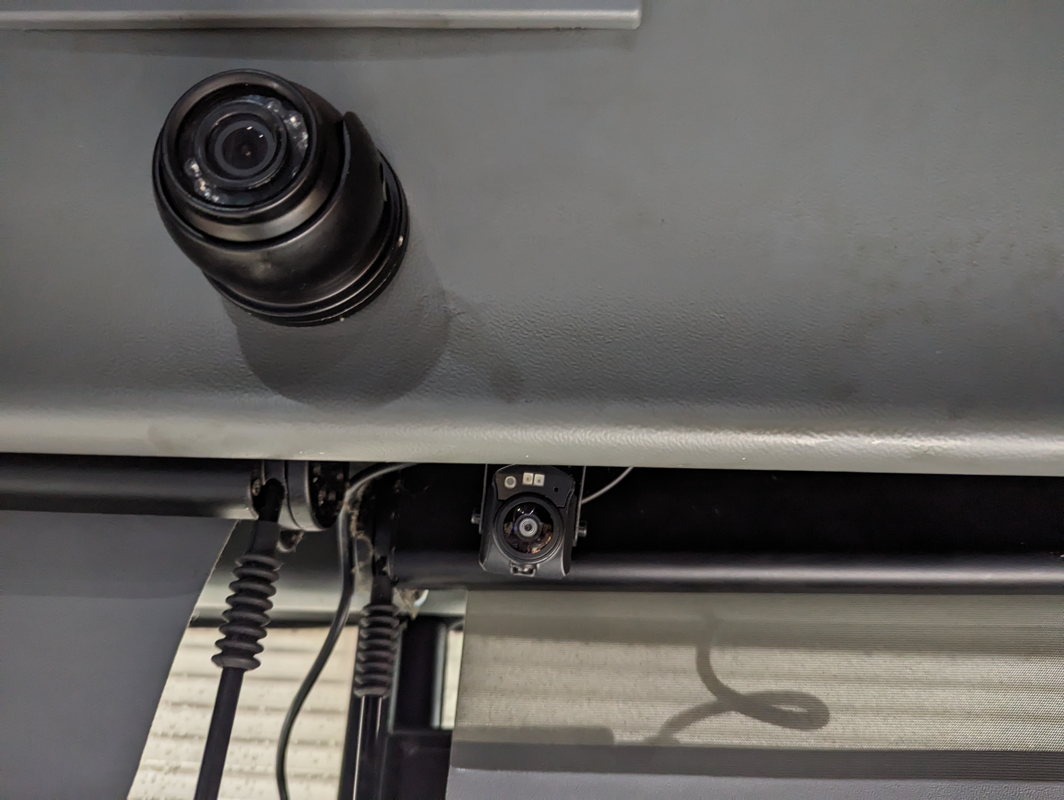
Video Cameras & Recordings
Notes:
Replace pics

Slide 8


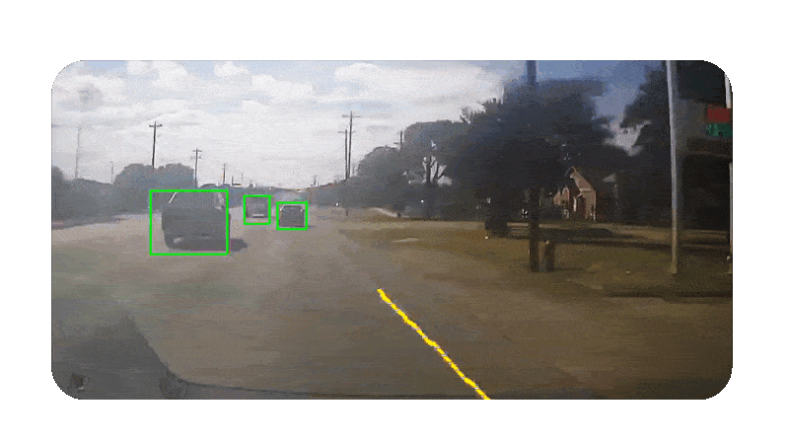
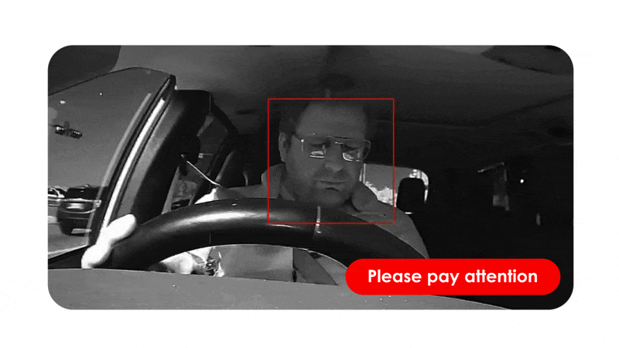
Ai technology to assist with safety
Notes:
Replace pics

Slide 9
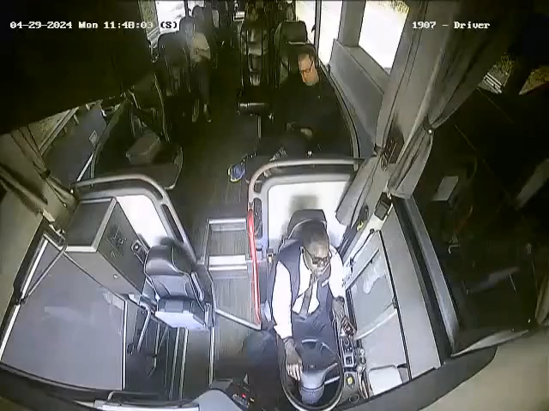

Slide 10
THE END

