Slide 1




Office Space Overview
MAY 7, 2024

Slide 2
ABA’S CURRENT SITUATION.
BUILDING OVERVIEW
OFFICE MARKET OVERVIEW.
Today’s
POTENTIAL OPTIONS.
Discussion

Slide 3

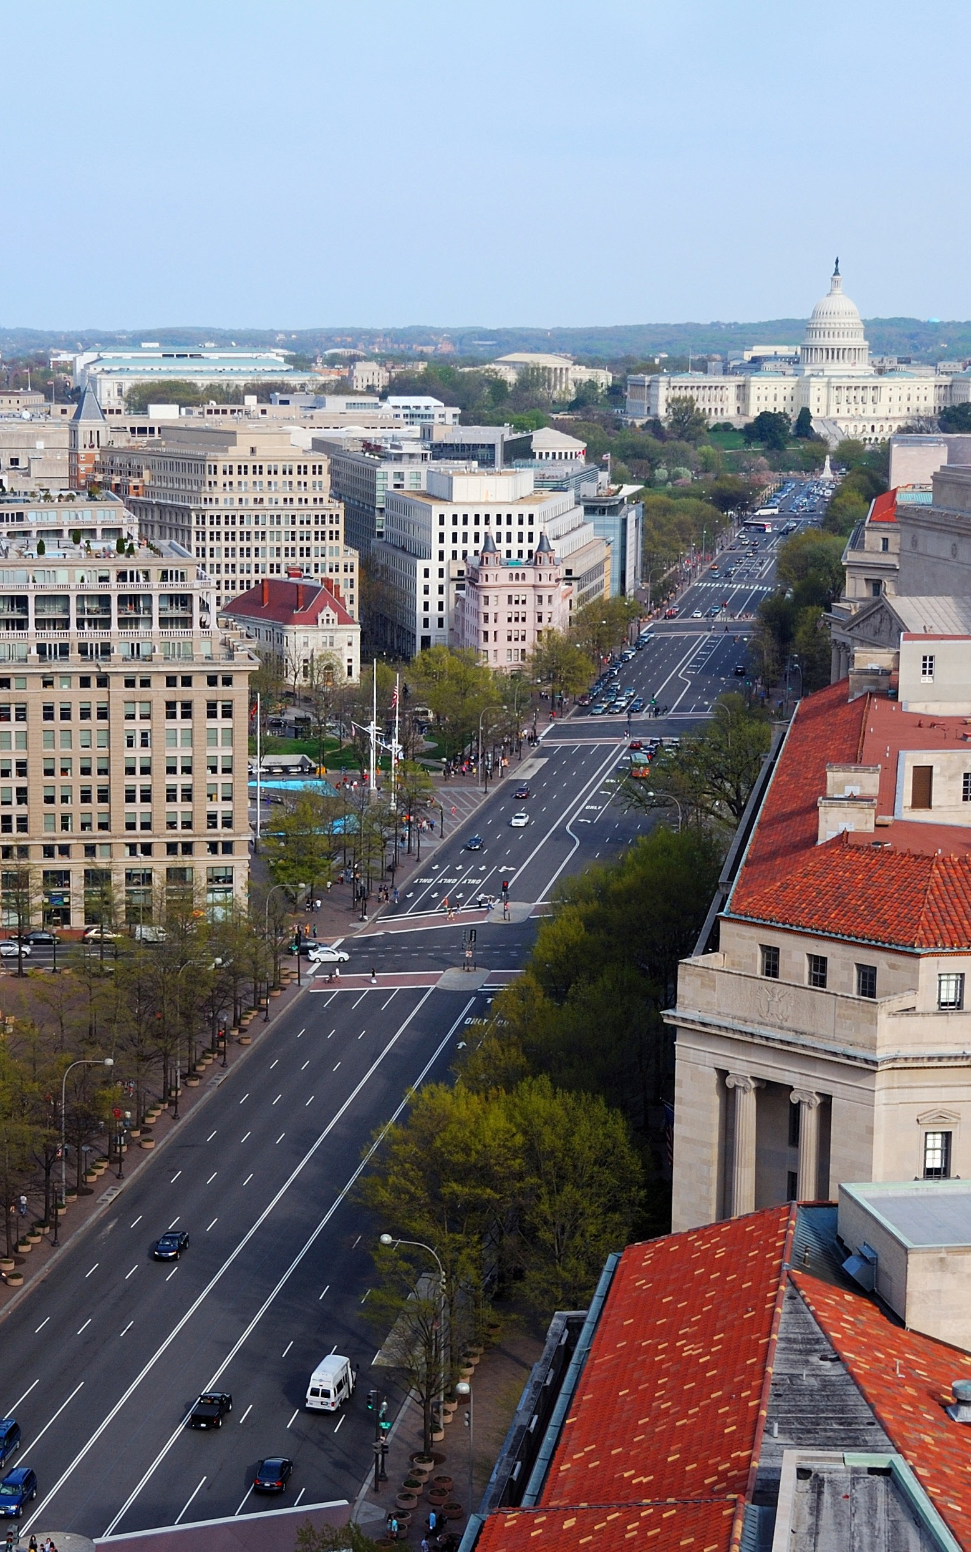
ABA’s Current Situation
CURRENT SITUATION
SPACE SIZE | 8,980 SF
PURCHASE PRICE | $4,762,000
DOWN PAYMENT AND RENOVATION COST | $2,000,000
CURRENT DEBT | $2,527,000 @ 2.60% Interest
DEBT MATURITY | April 2030
2025 EST. OWNERSHIP COST LESS DEPRECIATION | $301,818 // $33.61 PSF

Slide 4
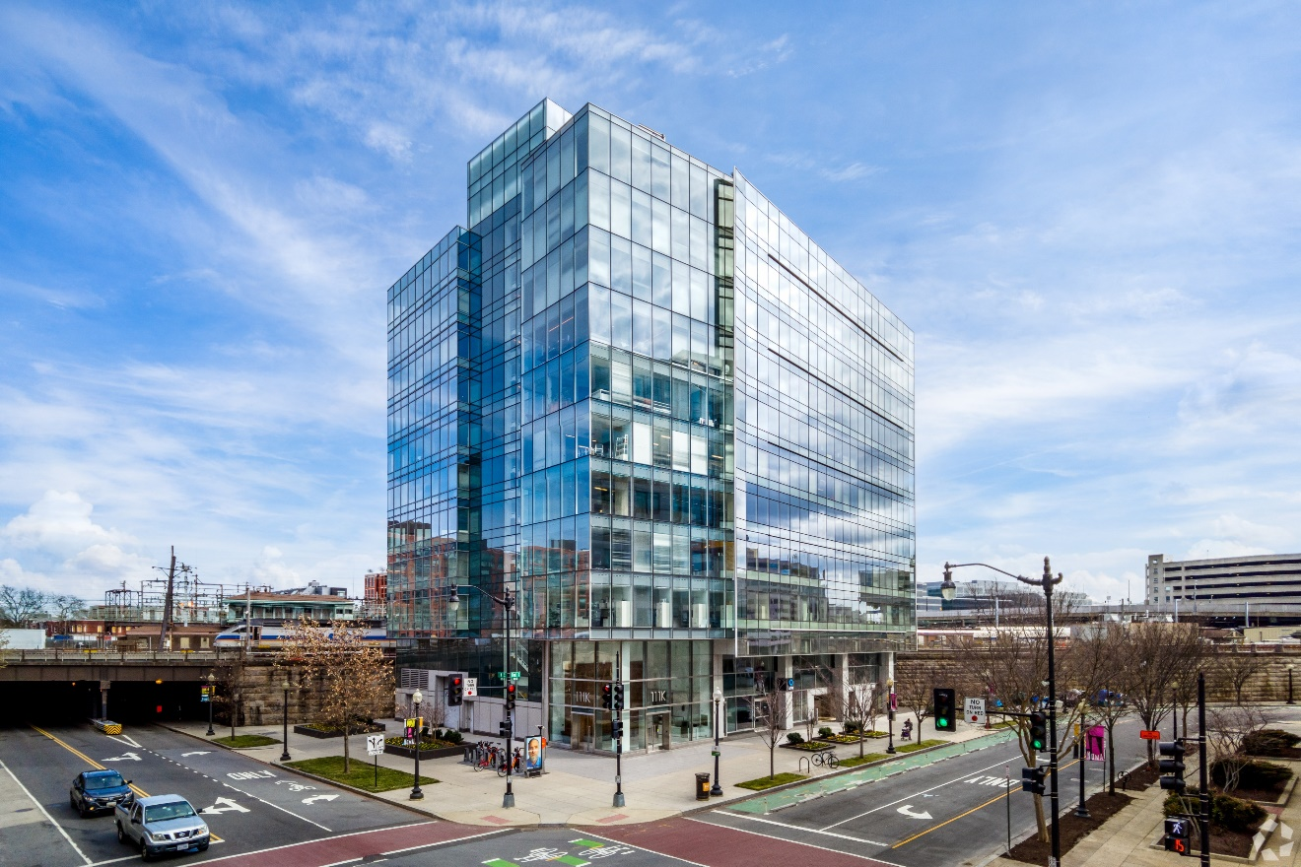
111 K Street NE
BUILDING SITUATION
OWNERSHIP | Condominium consisting of Rubenstein Partners (78%) NASPA (~11%), ABA (~11%)
BUILDING SIZE | 98,780 SF
LEASING CO. | Lincoln Property Company
AVAILABILITY | 35,920 SF (36.4%)
ASKING RENTS | $46.00 - $59.50 PSF FS
BUILDING / LANDLORD INFO:
Available space in the building has been on the market for an average of 49 months
In 2018, Rubenstein Partners purchased ~78% condominium interest for $27.5M / $424 PSF

Slide 5
Washington, DC Market Updates
MARKET, OWNER, & BUILDING CONDITIONS
Q1 2023 |  | TRENDING | Q1 2024
WASHINGTON DC
INVENTORY | 145.4 MSF |  | 144.9 MSF
UNDER CONSTRUCTION | 741K SF |  | 849K SF
DIRECT VACANCY RATE | 13.9% |  | 14.8%
DIRECT AVAILABILITY RATE | 19.4% |  | 21.4%
AVAILABLE SUBLEASE SPACE | 3.2 MSF |  | 3.7 MSF
DIRECT LEASING ACTIVITY | 1.6 MSF |  | 1.0 MSF
YOY NET ABSORPTION | (-47K SF) |  | (-1.9 MSF)
NOMA
INVENTORY | 11.9 MSF |  | 11.8 MSF
UNDER CONSTRUCTION | 32K SF |  | 32K SF
DIRECT VACANCY RATE | 4.9% |  | 6.8%
DIRECT AVAILABILITY RATE | 12.8% |  | 13.8%
AVAILABLE SUBLEASE SPACE | 212K SF |  | 235K SF
DIRECT LEASING ACTIVITY | 51K SF |  | 34K SF
YOY NET ABSORPTION | (-12K SF) |  | (-304K SF)

Slide 6
SALES COMPARATIVES
Address | Submarket | Property Type | SF | Sale Date | Sale Price | Price PSF | Buyer | Seller
1510 H St NW (Condo) | East End | Condo | 6,007 | 2/16/24 | $4,000,000 | $666 | BAU International University | Rust Insurance Agency, LLC
1430 K St NW | East End | Condo | 11,728 | 3/24/24 | $5,300,000 | $452 | Yunus Emre Foundation Inc | American Sociological Association
4400 MacArthur Blvd | Uptown | Condo | 52,730 | 10/31/23 | $1,675,000 | $318 | HRGM Corp | Cameron Building Envelope Specialists
2112 F St NW (Condo) | CBD | Condo | 6,053 | 11/18/22 | $1,632,500 | $270 | King Street Properties, LLP | Roberta M Braun | Martin Braun
1621 New Hampshire Ave NW | Dupont Circle | Office | 7,066 | 5/23/24 | $4,055,000 | $574 | AK Party Representation to the United States LLC | The Fund For American Studies
2201 R St NW | Dupont Circle | Office | 13,604 | 6/23/24 | $7,100,000 | $522 | Abdul Hafeez Khan | Government of Islamic Republic of Pakistan
471-473 H St NW | East End | Office | 9,227 | 12/8/23 | $3,000,000 | $325 | Aventus Pay | Loewinger, Brand & Kappstatter
1710 16th St NW | Dupont Circle | Office | 6,000 | 4/28/23 | $1,850,000 | $308 | Ashkan Rahimi | American Association of Geographers
2001 Rhode Island Ave NE | Northeast | Office | 8,616 | 5/1/23 | $2,650,000 | $308 | July/ Residential | Teamsters Local Union 730
1722-1724 Connecticut Ave NW | Dupont Circle | Office | 12,524 | 12/21/23 | $3,500,000 | $279 | American Housing | Circle Management Company
5305 Dana Pl NW | Uptown | Office | 6,527 | 5/16/23 | $1,775,000 | $272 | C&O Real Estate Partners | Jaffray W Ford
2385 Rhode Island Ave NE | Northeast | Office | 7,300 | 12/13/22 | $1,740,000 | $238 | Olatunde Ogungbade | Mohammad Fridy
4626 Wisconsin Ave NW | Uptown | Office | 12,089 | 2/28/24 | $1,500,000 | $124 | Advanced Computer Center | Columbia Typographical Union No 101
Note: The median price $308 PSF

Slide 7
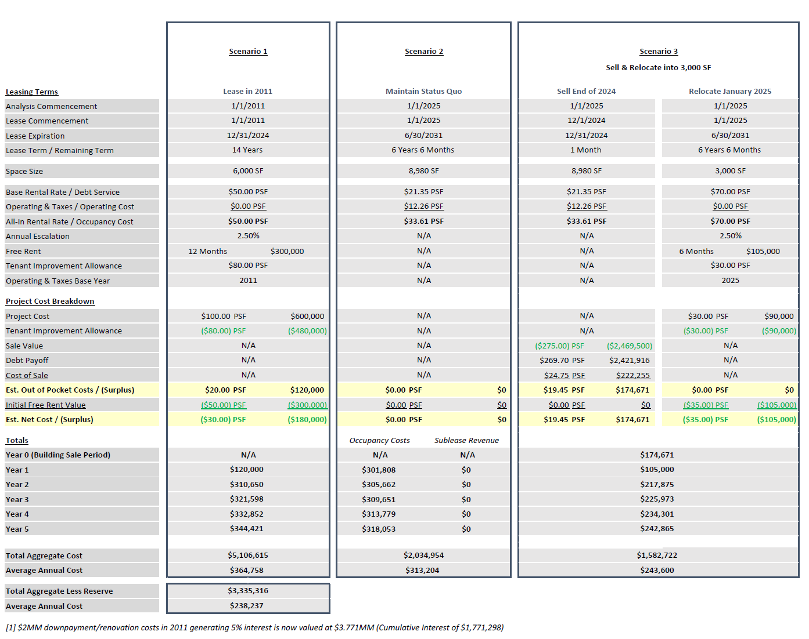
FINANCIAL ANALYSIS
2011-2024 NET OWNERSHIP COST
Total aggregate $3,072,591
Average annual $219,471

Slide 8
Thank you
Eric West
Tyler Marshall
202.835.3652
eric.west@transwestern.com
202.835.1208
tyler.marshall@transwestern.com

