Slide 1
ABA Foundation
Research
Press release for TTI study
  Contributed* to 219 press mentions in January
  Potential reach of 88.7M
  Research was picked up twice; initial Jan release and again during EPA GHG Phase 3 ruling remarks (referenced)
March transition from Guerilla Economics to Tourism Economics (Oxford Economics) for census and quarterly coach sales data
*Other factor was Peter mentioned in NPR outlet stories regarding demise of Greyhound stations
Marketplace 2024
$90,000+ raised through raffle and silent auction
Recommend repeating both events for 2025
  Donation requests to begin in June; please contact Ben Rome if you already have something to donate

Slide 2
Marketplace 2024 Fundraising

Slide 3
ABA Reserve | ABAF Endowment
 | Value* | YTD | 2023 | ITD (11/2018)
ABA Reserve Fund | 4,600,000 | 3.75% | 14.99% | 6.48%
ABAF Endowment | 9,400,000 | 5.61% | 18.03% | 8.99%
* as of April 11, 2024

Slide 4
Research: Tourism Economics
March 2024, transitioned from Guerilla Economics (John Dunham Associates) to Tourism Economics (part of Oxford Economics)
2024 projects:
  2023 Census (moving to an annual project)
  Q2-Q4 Manufacturer survey
  Monthly economics blog (replacing Itinerary newsletter)
  3 presentations (1 live, 2 webinar)
Adam Sacks, President, Tourism Economics

Slide 5
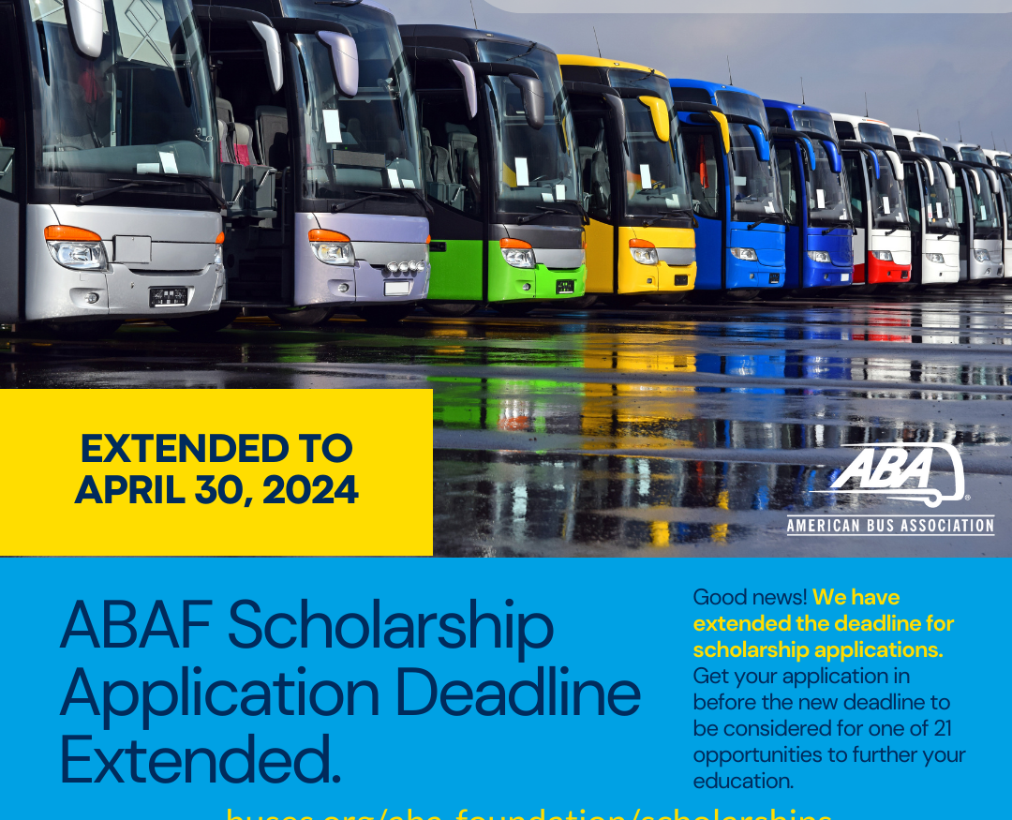
ABA Foundation: Scholarships
Slow start to this year, due primarily to FAFSA issues
Extended until April 30 to account for FAFSA delays
Closed with highest number of initial submissions (1850+) ever
Third-highest completions in last five years (280+)
Suppressed completed submissions (185+) due to FAFSA delays

Slide 6
2023-2024 Scholarship Season
Opened December 1, 2023
Closed April 30, 2024
Key issue: the poorly timed revamped FAFSA application
  Across the United States, FAFSA submission rates have plummeted by 29% compared to this time last year. The decline is particularly pronounced in schools with higher proportions of low-income students, according to the National College Attainment Network. Currently, only 27% of the class of 2024 has completed the FAFSA, lagging significantly behind the 45.5% completion rate achieved by the class of 2023.

Slide 7
2024-2025 Scholarship Season
Season | Applications started | Applications submitted | Applications completed
2023-2024 | 1699 | 355 | 253
2024-2025 | 1856 | 302 | 185
Data as of May 1, 2024

