Slide 1


Your Transportation Partners
Top Three Workers’ Compensation Injuries
and How to Prevent Them
Ronda Tack, CDS & Kimberlee Bissegger, CDS, AIS
October 23, 2018

Slide 2


Why Workers' Compensation needs to be addressed
Lost productivity by the injured employee | Loss of experienced employee | Decreased motivation/ morale
Hiring and Training new staff | Overtime/temp employee pay | Dissatisfied customers
Damage to reputation | Layover costs | Compensation
Dispatching delays | Impacted new business | Increased insurance costs
OSHA fines | Equipment repair | Trip delay
Administrative costs | Bad publicity | Additional travel expense
Direct Costs
Medical (Dr., RX, etc.)
Wages
Legal
Permanent Disability
Indirect Costs

Slide 3
Exercise
Bob works for Hart Tours which specializes in casino tours.
Set up: On Wednesday, he is transporting 38 passengers from an assisted living center to a casino. The casino they are scheduled to go to is roughly 8 hours from the center. They are scheduled to go to the casino on Wednesday, spend one night and travel back home the next day.
On Thursday evening that bus is scheduled for a corporate event in the nearby downtown area.
Drama: When Bob arrives at the casino he begins to unload the passenger’s luggage. While doing so he reaches for a heavy bag placed at the back of the cargo hold and injures his back.
Result: He is barely able to stand and there is no way he can finish unloading the bus, or to walk without assistance. He calls dispatch for assistance.

Slide 4

Exercise
Direct | Indirect
Medical (Dr., Rx, Mileage, etc.) | Lost productivity by the injured employee
Wages | Dissatisfied customers
Legal | Hiring and Training new staff
Permanent Disability | Dispatching delays
 | Increased insurance costs
 | Impacted new business
 | Other

Slide 5

Top 3 Causes of Injuries
Vehicular Accidents
Lower Back Injuries
Workplace Violence

Slide 6

Interesting Fact
In relation to motorcoach accidents, the most common types of injuries aren’t to the driver, but to passengers or others outside the vehicle
Slip/Fall
Struck Pedestrian/Bicyclist
Notes:
The average cost of a slip/fall injury is over $37,000 and the average cost for a pedestrian or bicyclist injury is over $28,000.

Slide 7
Vehicle accidents
Most common WC Injury:
Strains and Sprains
$32,000
$75,000
Vehicle Accident

Slide 8
Accident Prevention - General
Hiring
Maintenance
Training
Notes:
The first thing is to identify who we are really hiring. Let’s make sure we aren’t hiring our problems to begin with.
The second is what are we doing about training our drivers to prevent injuries during a collision?
The third is reviewing maintenance policies and procedures to ensure equipment issues are not causing accidents. Let’s spend some time talking about these three accident prevention measures.

Slide 9
Accident Prevention – Driver Screening & Hiring
Typical Process
Application
Interview
Road Test
MVR review
PSP
Criminal background
Post offer Physical Abilities Test (PAT)

Slide 10

Without the complete hiring process how do you know who you are entrusting with not only your company but the lives you put in their hands?

Slide 11



Accident Prevention – Driver Training
Training type
Orientation, Refresher, Post Incident
Format
Video
Interactive
Classroom
Handouts
Other
Depth of Training
How often
Duration

Slide 12
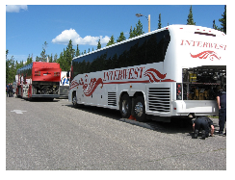
Accident Prevention – Vehicle Maintenance Program
Who (Certified?)
When
Where
Are we following FMCSA regulations?
Documentation

Slide 13

Vehicular Accident
The most frequent type of motorcoach accidents fall into one of these three categories:
Struck by other
Rear-end other
Side Swipe (by count), Intersection (by $)
Notes:
We’ve paid out right around $13,000,000 in auto liability over the past three years for just these three types of claims. When we look at the most frequent types of losses by dollars incurred, Struck By Other and Rear End Other Vehicle are still the two most common types of losses but Sideswipe is replaced by Intersection collisions. We’ve paid out over $500,000 more in Intersection collisions than Sideswipes over the past three years. But these dollar amounts don’t account for ANY driver injuries, only payments to others.

Slide 14
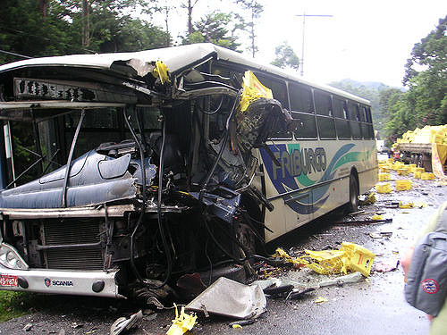
Accident Type – Struck By Other
Defensive Driving
Speed & Space Management
Fatigue Management

Slide 15
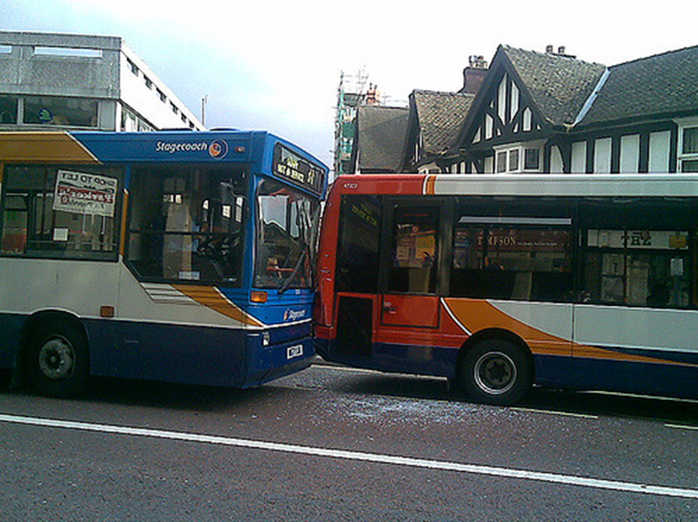
Accident type – Rear End Other Vehicle
Following Distance
Speed Management
Collision Avoidance Technologies
Distractions

Slide 16
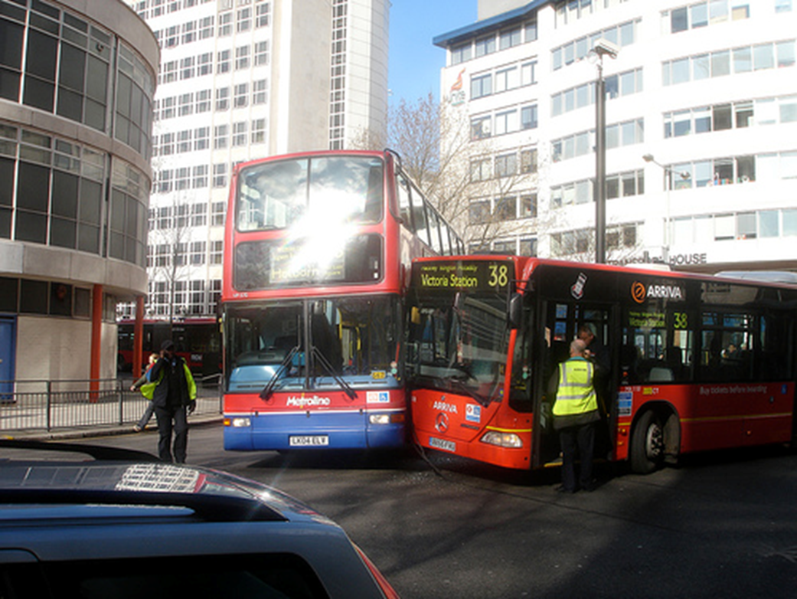
Accident type – Sideswipe
Speed & Space Management
Proper Mirror Adjustment / Mirror Check Stations
Mirror Checks
Exterior Cameras
Blind Spot Technology

Slide 17

Accident type – Intersection
Knowledge of Basic Rules
Left, Right, Left
Defensive Driving
Distractions

Slide 18

Top 3 Causes of Injuries
Vehicular Accidents
Lower Back Injuries
Workplace Violence

Slide 19
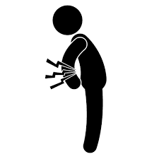

Lower Back Injuries

Slide 20

Lower Back Injuries
Only the common cold accounts for more lost work days
20%
Of injuries in the workplace are back injuries
Best way to avoid:
Stretch
Good posture
Proper Lifting Techniques

Slide 21


Causes of back injury
Repetitive lifting bags from an awkward posture
Twisting the torso while keeping feet stationary
Lifting heavy bags, one handle lifts and uneven weights
Overextended reaching
100 lb.
10 lb.

Slide 22

MATH
3,600 lb.
per trip
Standard bag weighs 30lbs
Heavy bag weighs 60 lbs
If take an average of 50 passengers and assume 20% of the bags are heavy
That means you are handling 1,800lbs each time you load or unload

Slide 23




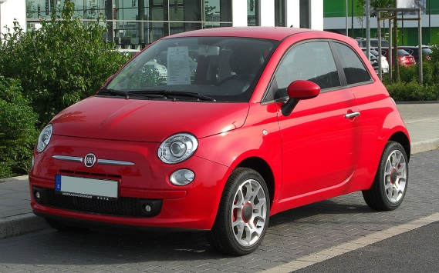
1800 pounds=
1/10

Slide 24

So maybe a little caution is in order

Slide 25
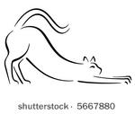

Back Injury Prevention
One preventative measure to avoid back injury is a daily stretch and flex
When do you want to stretch:
Before the start of each work day
Before, during and after strenuous tasks
After prolonged sitting
When you feel tightness, aches and discomfort.
STRETCH

Slide 26
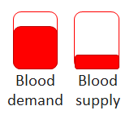
Why Stretch?
When muscles remain static, blood flow is decreased and the potential for injury increases.
When you stretch, muscles relax and lengthen.
Relaxed muscles withstand stress better than tight ones.

Slide 27
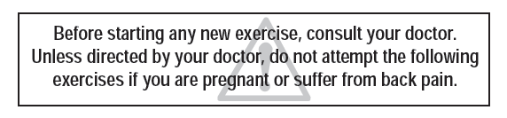
Stretch
Disclaimer:
Other important guidelines include:
Stretch slowly, avoiding bouncy or jerky movements.
Go only to the point where you feel mild tension.
It shouldn’t hurt.
Relax into the stretch and hold for at least 5 seconds.
Breathe!

Slide 28
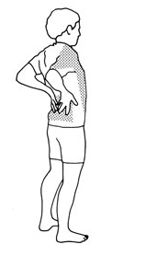
Standing Back Arch
Stand up straight with your feet shoulder-width apart.
Put the palms of your hands on your lower back. Take a few slow, deep breaths to relax.
Bend your upper body backwards, keeping your knees straight. Support your back with your hands.
Hold for 5 seconds.
Return slowly to your starting position.
Repeat 5 times.

Slide 29
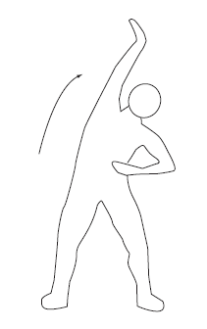
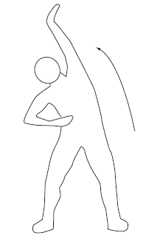
Side Bends
Start with feet shoulder width apart
Stand up tall
Raise one hand up and over your head while bending to the side
With the other hand reach toward the floor
Hold the stretch for 3 seconds and repeat on the other side
Do not twist or lean forward
Repeat 5 times each side

Slide 30
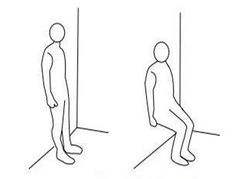
Wall Sits
Stand 10 to 12 inches from the wall
Lean back until your back is flat against the wall
Slowly slide down until your knees are slightly bent
Press your lower back into the wall. Hold for a count of 10, then carefully slide back up the wall. Repeat

Slide 31
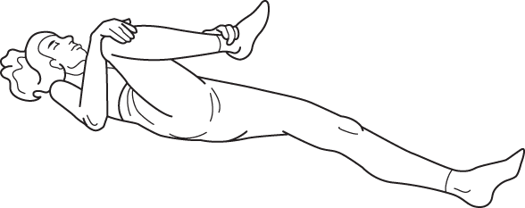
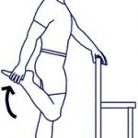
Don't forget your hamstrings
Tightness in the hamstrings limits motions of the pelvis and can place undue stress on the lower back.
Simple hamstring stretches can help decrease the pressure on your pelvis and provide relief across your low back.

Slide 32
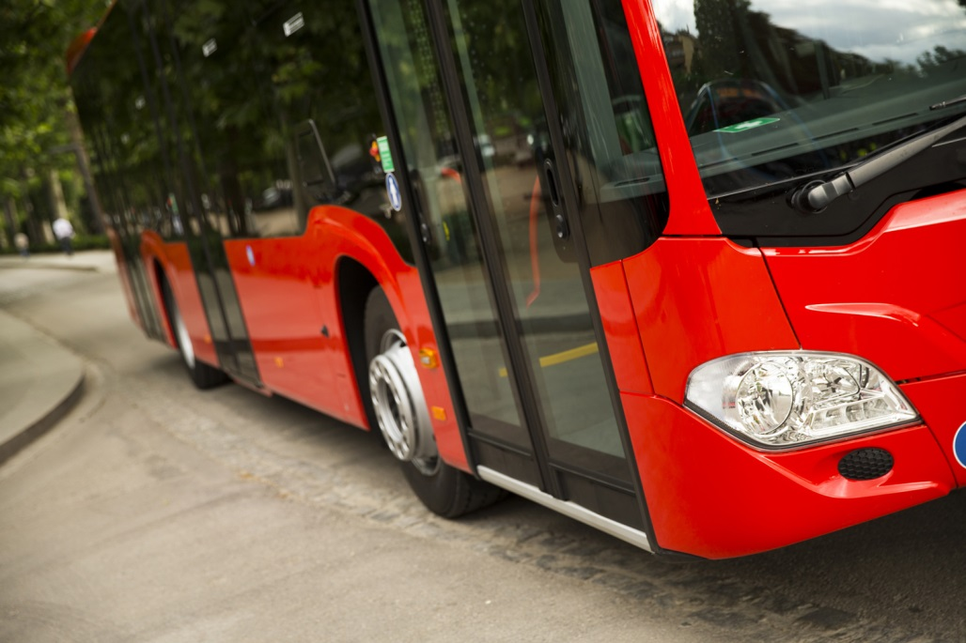
Bus stretch
While standing on the ground, place one foot on the first step of the bus
While holding on to the hand rails, keep hips square with shoulders and lean forward until you feel the stretch
Hold 5 Seconds repeat on the other side

Slide 33
Seated hamstring stretch
Sit on the edge of a chair and stretching your right leg out in front of you with your heel on the floor and your toes pointing up.
Sit up tall, drawing your shoulders away from your ears, and draw your belly button toward your thigh keeping your spine long.
Keep hands at your waist for stability.
Repeat on other side

Slide 34
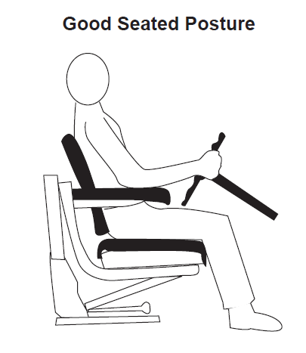
Good posture is important
When you slouch you put 3x the pressure on your spine, over time this will wear on your discs
If sitting for long periods of time consider adding a lumbar pillow to you seat to encourage better posture and maintaining the S curve of your spine

Slide 35
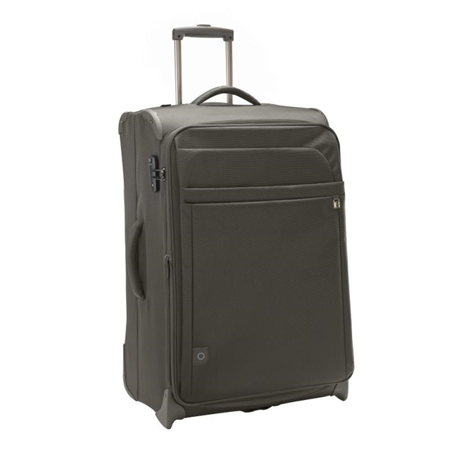
Back Injury Prevention
Use two hands to lift up bags
Avoiding lifting bags by just one handle
Minimize twisting while you lift
Load heavy bags as close to the baggage area door area as possible to avoid the extended reach

Slide 36
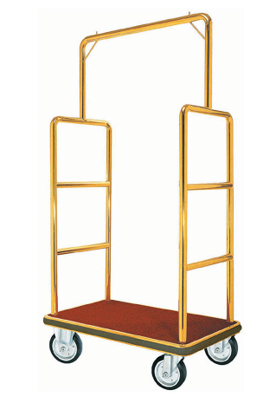
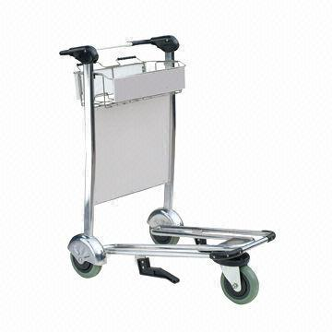
Back injury prevention
If you are loading on to a luggage cart, keep the cart 3 feet from you.
Too close and you will find you don’t move your feet and you twist to load the cart,
Too far and you are carrying that heavy luggage way to far.

Slide 37
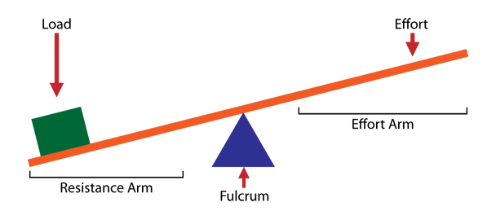
Levers
Lever principle that the further away from the fulcrum the more exponential the weight
When you approach a bag, stand close to it, bend your knees, and squat, using the muscles in your legs and hold the bag close to you and stand straight up.

Slide 38

Levers
When you do this correctly you keep the ratio 1:1 meaning that a 30 lb bag the force exerted on your body is 30 lbs
However if you do it wrong the ratio can be as much as 10:1 causing your body 10x the strain. This is like lifting a couch instead of an overnight bag

Slide 39

Loading and unloading
When loading and unloading do not reach across the baggage area, this will cause excess strain on your back and shoulders
Grab bags by the handle and slide them toward the front
Luggage hook?

Slide 40
Proper Lifting
Most people believe bending their knees will ensure a safe lift, but bending the knees alone will still allow a person to curve the back and risk injury.
TIPS
Bend the hips and push the chest out, pointing forward
Keep your head up
When changing directions, move the hips and feet first
Do not twist!

Slide 41
Top 3 Causes of Injuries
Vehicular Accidents
Lower Back Injuries
Workplace Violence

Slide 42
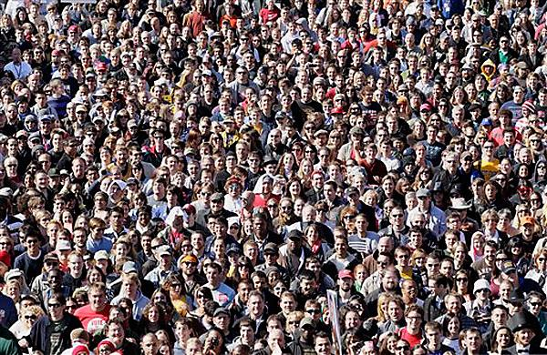
Workplace Violence
2,000,000
How many people do you think fall victim to workplace violence in the United States each year?

Slide 43
4 types of workplace violence
Violence by customers
Violence by employee
Violence by someone known by employee
Violence committed during a crime

Slide 44

Workplace violence
Prevention Programs Should:
Establish a clear policy for workplace violence-
Zero tolerance
Employee empowerment
Ensure no worker who faces workplace violence faces reprisal
Encourage workers to promptly report incidents and suggests ways to reduce or eliminate risks

Slide 45
Workplace violence
Management and worker involvement
Safety and Health training
Hazard prevention
Worksite analysis

Slide 46
Controls
Engineering Controls
GPS- can provide emergency services your location
Security cameras - discourage violent behavior, aids in identifying passengers
Alarm system
Chaperones
Procedural Controls
Establish protocols
Provide training to drivers

Slide 47

Top 3 Causes of Worker's Compensation Injuries
Vehicular Accidents
Lower Back Injuries
Workplace Violence

Slide 48


Slide 49
Go Ahead – Contact Us!
Ronda Tack, CDS Ronda.Tack@cfins.com 719.368.0273
Kimberlee Bissegger, CDS, AIS KBissegger@cfins.com 916.201.3318

