Slide 1


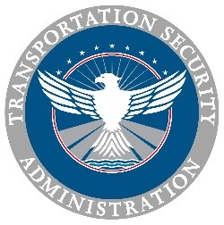
TSA Surface Inspection Programs and Resources

Slide 2
TSA Regional Map

Slide 3
HMC Landscape
Motorcoach – OTR
3300+ companies, 29K+ motorcoaches, 118K employees
751M passengers annually
Why OTRB is an attractive target?
Hijacking and use as a VBIED
Used in urban centers
Proximity to high-value buildings or venues
Serve visible and populated sites, i.e. events and attractions
Potential for a large number of casualties
Source for hostages

Slide 4
OTRB Information Sharing
Over-the-Road Bus Information Sharing and Analysis Center (ISAC)
Collect, analyze, and disseminate alerts and incident reports
Allows membership to exchange information
Helps the government understand OTRB impacts
Share information on cyber, physical, and all threats
https://www.surfacetransportationisac.org/

Slide 5
TSA Surface Resource Programs
BASE - Baseline Assessment for Security Enhancement
First Observer Plus – Security Awareness Training
EXIS – Exercise Information System
SETA - Security Enhancement Through Assessment
RMAST – Risk Mitigation Activites for Surface Transportation
T-START – Transportation Security

Slide 6
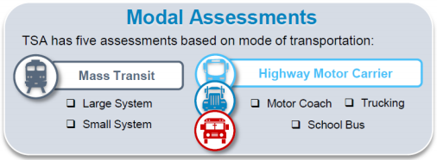
BASE

Slide 7
BASE – Baseline Assessment for Security Enhancement
Baseline Assessment for Security Enhancement (BASE) is a no-cost, voluntary, risk-based program that evaluates the security posture of surface transportation systems
BASE aids Mass Transit (MT) and Highway Motor Carrier (HMC) systems in elevating their security posture by implementing and sustaining baseline security measures applicable to their operating environments and specific system characteristics

Slide 8
BASE
BASE was developed in partnership with:
An Industry Working Group (APTA)
The Department of Transportation (FTA)
Designed by Industry for Industry
Security Action Items (SAIs) incorporate industry feedback
Best Practices from MT and HMC organizations of all sizes

Slide 9
BASE
BASE is an assessment of the processes and procedures of MT and HMC organizations
Critical review intended to improve daily security activities
Many times organizations tell us that they want to clean up procedures before a BASE
Goal - identify and improve security procedures
Intent of conducting a BASE is not to get a good score but improve security procedures

Slide 10
BASE Timeline
Schedule the BASE with the organization’s security-related personnel
Provide the organization with a BASE Resource Kit, which includes the assessment’s focus areas, industry smart practices, and additional resources to aid in preparing for the assessment
Interview the organization’s security personnel to assess and evaluate their security plans
Debrief the stakeholder and provide an Executive Summary with findings and recommendations

Slide 11
BASE
Inspectors assess organizations on Security Action Items (SAIs) that address industry fundamentals
BASE includes SAIs relating to topics such training/awareness programs and cyber/physical protections that are designed to measure the breadth of organizational security plans
Following the BASE, TSA inspectors provide organizations with the results of the assessment and actionable recommendations to improve their security posture

Slide 12


Slide 13
First Observer Plus FOP+
First Observer Plus™ Program provides transportation professionals with the knowledge needed to recognize suspicious or criminal activity that may be related to terrorism
The training is usually facilitated by a TSA Inspector in a classroom setting or group meeting setting with PowerPoint slides or a PowerPoint/Video combination

Slide 14
First Observer Plus FOP+
Observe
If you see something that "Doesn't Look Right" (a "DLR"), perform your job as you normally would, but report suspicious activities that you observe
Assess the situation or observation based on:
Your workplace experience and awareness
Your job knowledge
Any suspicious activity reporting training that you may have received

Slide 15
First Observer Plus FOP+
Report
Your safety is a priority, so follow your company guidelines in reacting or responding to an incident
First Observer Plus™ does not super cede your company guidelines or procedures for reporting suspicious activity
Take notice of suspicious, unusual behaviors - not a person's physical appearance
Use your knowledge, judgment and experience

Slide 16
First Observer Plus FOP+
First Observer Plus™ provides specific training for the following transportation modes:
• School transportation
• Mass transit
• Passenger rail
• Over-the-road bus
• Transit law enforcement
• Parking (general/large venue)
• Vehicle rental

Slide 17
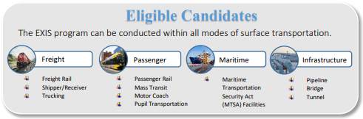
EXIS

Slide 18
EXIS Workshop
Small, discussion - based workshop
examining standardized
security scenarios
Ideal for small groups of participants

Slide 19
EXIS – Exercise Information System
TSA’s Exercise Information System (EXIS) program is a no-cost, voluntary program that is designed to prepare a surface transportation stakeholder to effectively respond to security incidents.
Tailored to individual stakeholders
Utilizes a practical exercise
Examines a stakeholder’s implementation of security procedures

Slide 20
EXIS
Transportation Focused
Exercises designed to emphasize how transportation stakeholders respond to incidents
Focuses on the stakeholder’s role during a security incident
Each exercise is specifically tailored to the stakeholder’s operation
Designed from the ground up
Examines operation at multiple levels, from management to frontline

Slide 21
EXIS Timeline
TSA Inspectors meet with stakeholder to discuss which type of exercise is best suited for the entity
EXIS Workshop date is agreed upon between TSA Inspectors, the stakeholder, and TSA Headquarters.
TSA Inspectors conduct the EXIS Workshop
EXIS After Action Brief is presented to the stakeholder, and next steps are determined

Slide 22
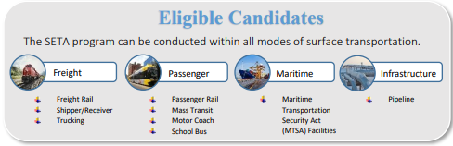
SETA

Slide 23
SETA - Security Enhancement Through Assessment
Security Enhancement Through Assessment (SETA) program is a no-cost, collaborative, voluntary program that is designed to evaluate and improve a surface transportation stakeholder’s security posture at the front line employee level
Designed to evaluate and improve a surface transportation stakeholder’s vehicle inspection procedures and suspicious person responses

Slide 24
SETA - Security Enhancement Through Assessment
Scenarios include:
Testing vehicle inspection procedures
Suspicious and unattended bag response
Suspicious individual procedures
SETA consists of covertly placing unattended bags on multiple vehicles simultaneously
Placing unattended bags at a Transportation Facility
Suspicious Person access Transportation Facility

Slide 25
SETA Timeline
From the initial planning stages to the completion of the assessment, the goal is to complete all three phases of SETA within ninety days
Pre-planning (TSA): Prior to the assessment, TSA Surface inspectors conduct operational planning with the stakeholder to gain first-hand knowledge of daily stakeholder operations.
Pre-planning (Stakeholder): Through collaboration, the stakeholder and TSA agree to assessment scenarios utilized. To ensure a valid assessment, the stakeholder limits employee knowledge of the assessment to those with a need to know.

Slide 26
TSA Resources
For More Information on a TSA Program Contact, Ask me for your Local TSA Surface Office Info
BASE - Baseline Assessment for Security Enhancement
First Observer Plus – Security Awareness Training
EXIS – Exercise Information System
SETA - Security Enhancement Through Assessment

Slide 27
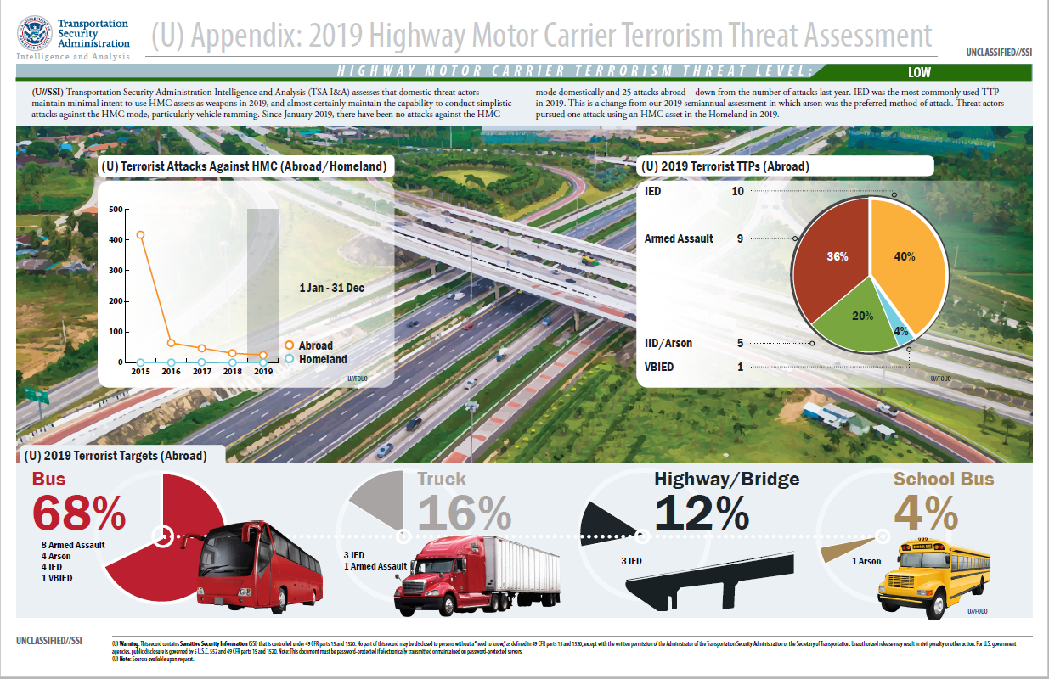
Notes:
27

Slide 28
(U) Targets, Threats to Highway
(U) Terrorist groups have demonstrated the ability to plan and execute complex attacks against multiple targets -- including against (and in using) vehicles such as buses, trucks
(U) Assault teams, suicide bombers, vehicle-borne improvised explosive devices (VBIED)
(U) Vehicle-ramming the latest tactic and is likely the tactic of choice due to minimal preoperational planning or specialized training
Terrorists are opportunistic
(U) Exploit vulnerabilities, choosing the time, place, method of attack according to perceived weaknesses
(U) Prior to 9/11 the two most destructive terrorist attacks carried out on U.S. soil involved large truck VBIEDs
(U) The 1993 World Trade Center attack using a rented truck to deliver a VBIED serves as one of the most catastrophic U.S. examples
(U) The 1995 Oklahoma City bombing of the Alfred P. Murrah Federal Abuilding, where a rented truck was used in attack carried out by domestic terrorists

Slide 29
(U) Key Judgments
U//FOUO) The terrorist threat to the highway mode of transportation in the US is low
(U//FOUO) Continuous terrorist propaganda advocating for targeting bus and commercial vehicles
(U//FOUO) Extremists in the U.S. likely have the capability to conduct a crude and unsophisticated attack
(U//FOUO) Most likely methods to target buses in the U.S. are hijacking, sabotage, vandalism, IEDs, vehicle-ramming, Active Shooter (Arson is the preferred method of attacks against the highway mode overseas in 2019.)
(U//FOUO) Simple tactics which could occur with little or no warning
(U//FOUO) May attempt to seize a vehicle through hijacking, assault
U//FOUO) Outlook: Attacks against busing and transit sector would likely be from lone offenders, criminals, domestic extremists or radicalized supporters of terrorist groups.

Slide 30
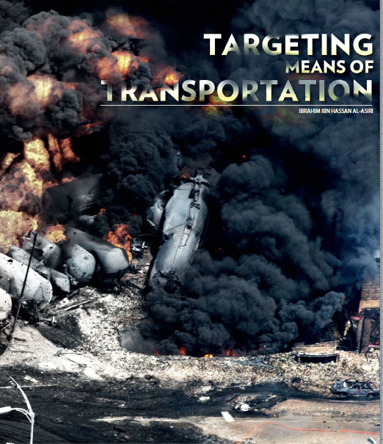
(U) Terrorist Media Advocating Attacks on Transportation
(U//FOUO) Al-Qa’ida in the Arabian Peninsula’s Inspire magazine has advocated attacks against buses
(U//FOUO) Latest issue highlights three ways that transportation overall can be targeted
(U) The vehicle itself
(U) The line of transport and pathway
(U) Stations, terminals or transit points
(U) ISIS English-language propaganda highlighted vehicle ramming as a desired terrorist tactic.
(U) Ideal vehicle – Large-capacity, load-bearing trucks because of weight and size
(U) Less suspicious, no special skill set, minimal planning
(U) Rentals, purchase, theft, hijacking, or insider threat
(U)
(U//FOUO) Article from Inspire 17

Slide 31
Highway & Motor Carrier Overview
Highway and Motor Carrier (HMC) modes and their supporting infrastructure are by their very nature open systems presenting wide-ranging challenges to address identified vulnerabilities to terrorist attacks.
TSA is responsible for engaging with public and private stakeholders to develop security policies to mitigate those vulnerabilities and enhance security of the overall transportation sector.
TSA’s HMC scope spans commercial trucking, over-the-road bus (OTRB), school bus, and highway transportation infrastructure.

Slide 32
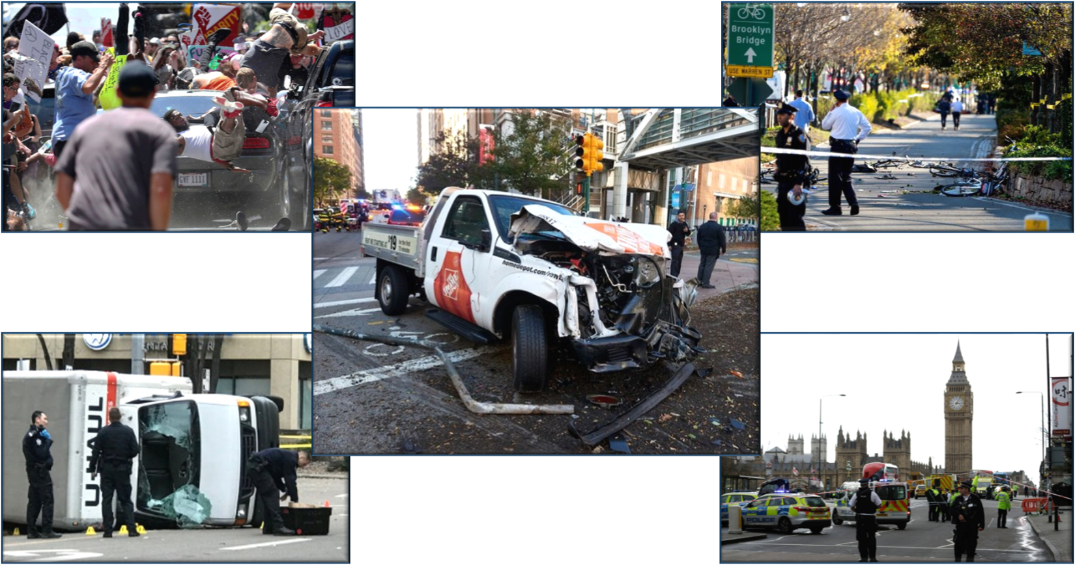
Threat Landscape
Highway and Motor Carrier transportation modes continue to be attractive targets for terrorists and criminals to carry out attacks both domestically and overseas.

Slide 33
HMC Risk Profile
Vehicle ramming attacks using commercial trucks and over-the-road buses (OTRB) continue to pose the highest threat to the HMC mode.
Highway transportation infrastructure is potentially vulnerable to disruption by terrorists with cascading consequences for supply chains and other sectors.
Confined areas, such as inside buses and bus terminals, also present potentially attractive targets for releasing chemical and/or biological agents, as those pathogens would have maximum impact and effect in confined spaces where egress options are limited or non-existent, and ventilation can also be a challenge.
Terrorists may attack highway assets—structures, trucks, or buses—directly or use vehicles as a weapon or to deploy explosives or other weapons to attack targets.

Slide 34
HMC Risk Scenarios
The following HMC attack scenarios inform the development of risk-based priority planning:
Use of a vehicle as a kinetic weapon (ramming) to cause loss of life or significant damage to critical infrastructure
Attacks using Improvised Explosive Devices (IED) or Vehicle-borne Improvised Explosive Devices (VBIED) on critical infrastructure such as bridges or tunnels
Small arms or IED attacks on passenger or school buses
A direct attack using a truck or vehicle loaded with explosives or toxic materials as a weapon against people or property
Insider threat
Intentional contamination of food products during bulk transportation.

Slide 35
HMC Risk-Based Priorities
Seven HMC risk-based priorities provide the programmatic focus for activities to reduce terrorism risks identified in the preceding Risk Profile and Risk Scenario sections:
Security planning
Security training
Security exercises
Critical infrastructure protection
Operational detection and deterrence
Intelligence and security information sharing
Community outreach.

Slide 36

Security Awareness training; situational training; job briefings; task specific training
Risk-Based Priorities
Training
Tabletop, situational drills and full-scale exercises
Base state security plans; Contingency plans; Recovery plans; Special event plans
Exercises
Planning
Information &
Intelligence Sharing
Outreach and education for customers, passengers, emergency responders and law enforcement
Operational procedures that reduce risk through inspection and vulnerability mitigation
Risk
Reducing
Practices
Community
Outreach
Critical
Infrastructure
Protection
Hardening of critical assets along with detection and deterrence countermeasures
Two-way information sharing informs all of the security priorities

Slide 37
Cyber Critical Infrastructure Protection
Five things that can be implemented immediately to enhance cyber security efforts:
Password updates (PCs, routers, servers, firewalls, etc.)
Access controls (who needs access)
Internet connections (business network, operations, etc.)
Spear-phishing and ransom ware
National Institute of Standards and Technology (NIST) Cybersecurity Framework
Implementation Guidance
TSA Resource Toolkit
Cybersecurity “Pocket” Awareness Guide
TSA “No-cost” Resources
Surface Information Sharing and Analysis Center (ISAC)

Slide 38
TSA Regional Map

Slide 39
Contact Info
Curt Secrest
TSA - Region 2 RSI - Jacksonville, Florida
Cell: 904-874-7224
curt.secrest@tsa.dhs.gov

