Slide 1
TSA Updates Ben Currier Surface Policy Division Policy, Plans, & Engagement
American Bus Association, Marketplace 2023
February 5, 2023

Slide 2
Agenda
Introduction – Industry Engagement Manager (Highway)
OTRB Security Training Rule
TSA Security Directives & Information Circulars
Cyber Policy/Rulemaking
Security Initiatives & Resources:
TSA Engagement with ABA Security stakeholders
Guidance Documents, Exercises, & Workshops
Baseline Assessment for Security Enhancement (BASE) Program
TSA Regions

Slide 3
Security Training Rule - OTRB
The rule went in to effect on September 1, 2020. Codified at 49 CFR Subchapter D, Parts 1570 and 1584.
The rule requires owner/operators of higher-risk freight railroad carriers, public transportation agencies (including rail mass transit and bus systems), passenger railroad carriers and over-the-road bus (OTRB) companies to provide TSA-approved security training to employees who perform security-sensitive functions.
49 CFR § 1584.101 Applicability
The requirements of this subpart apply to each OTRB owner/operator providing fixed-route service that originates, travels through, or ends in a geographic location identified in appendix A to this part.

Slide 4
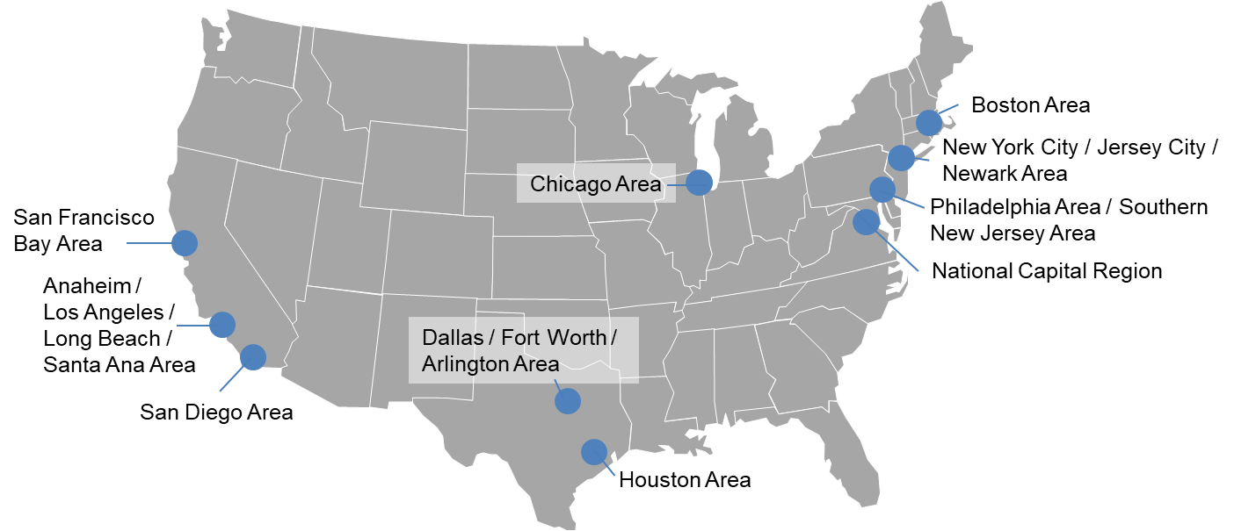

Urban Areas Covered by the Rule

Slide 5
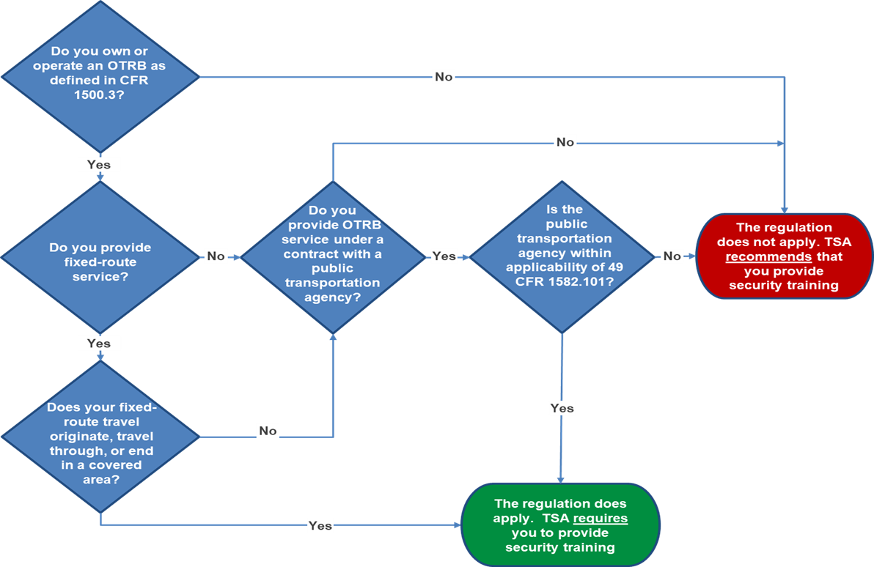
Applicability Flowchart

Slide 6
Key Requirements of the Rule
Each Entity covered by this rule must:
Designate a Security Coordinator and at least one alternate Security Coordinator
Report significant security concerns to TSA
Develop a comprehensive security training program
Provide security training to employees in security-sensitive positions

Slide 7
Required Elements of Security Training
Training must address:
PREPARE
Employee (craft) specific responsibilities
Duties as applicable in the security program
OBSERVE
Awareness and recognition of suspicious persons and items
ASSESS
Determine if an item or situation requires a response
RESPOND
Know how to report and react to security threats

Slide 8

How to Notify TSA if the Rule Applies to your Company
Send an email to: SecurityTrainingPolicy@tsa.dhs.gov.
Include in the subject line of the email: Security Training Rule Applicability (Company name)
Include in the body of the email:
Mode of Transportation (e.g. Over-the Road bus)
Owner/operator corporate name
Doing business as (DBA) name
Corporate address
Contact name, email address, and telephone number

Slide 9
TSA Information Circulars (Cyber)
TSA has issued three Cybersecurity Information Circulars (IC) for surface transportation operators:
Surface Transportation IC-2021-01 (December 2021) for railroads, public transportation agencies, and certain over-the-road bus operator recommends designation of cybersecurity coordinator, reporting of cybersecurity incidents to CISA, developing and implementing a cybersecurity incident response plan, and completing a cybersecurity vulnerability assessment.
Surface Transportation IC-2022-01 (February 2022) for railroads, public transportation agencies, and certain over-the-road bus operators recommended reviewing and implementing the recommended actions in the Joint Cybersecurity Alert, Understanding and Mitigating Russian State-Sponsored Cyber Threats to U.S. Critical Infrastructure and the Cybersecurity and Infrastructure Security Agency’s “Shields Up” site.

Slide 10
TSA Information Circulars (Cyber) cont.
Surface Transportation IC-2022-02 (March 2022) for railroads, public transportation agencies, rail transit agencies, pipelines, and certain over-the-road bus operators recommended reviewing and implementing the recommended actions in two Joint Cybersecurity Advisories issued on March 15 “Russian State Actors” (AA2-074A) and on March 17 “Strengthening Cybersecurity of SATCOM Network providers and customers” (AA22-076A).

Slide 11
Future Cyber Policy/Rulemaking
Forthcoming issuances of other SDs/ICs
Issued “Advanced Notice of Proposed Rulemaking” on pipeline, rail transit, and passenger rail cybersecurity risk management programs
Coordinate with DHS Policy and other DHS Components on the development of cybersecurity standards and regulations

Slide 12
Security Initiatives and Resources
TSA engagement with ABA Security Committee
Monthly telephonic meetings with TSA and ABA stakeholders
Surface Transportation Security Advisory Committee (STSAC)
Continued STSAC member opportunities in the 2023 membership cycle
Participate in STSAC as industry subject matter experts on a sub-committee:
1) Security Risk and Intelligence, 2) Cybersecurity Information Sharing, 3) Insider Threat, and
4) Emergency Management and Resiliency
Next (closed) meeting scheduled for February 16, 2022
tsa.gov/for-industry/surface-transportation-security

Slide 13
Security Initiatives and Resources
Guidance documents:
TSA, Motor Coach Counterterrorism Guide
TSA, Motor Coach Security – Best Practices
DHS, Planning and Response to an Active Shooter: An Interagency Security Committee Policy and Best Practices Guide
Exercises & Workshops:
Facilitated by TSA and/or the Cybersecurity and Infrastructure Security Agency at the national and field levels
TSA has regional points of contact in the field to coordinate training and exercises

Slide 14
TSA BASE Program
The TSA Highway Baseline Assessment for Security Enhancement (BASE) program includes:
Structured security assessments
Designed as a free, voluntary program
TSA-certified Security Action Items (SAIs)
Assessments conducted locally by Transportation Security Inspectors-Surface (TSI-S)
Includes: Motorcoach/Over-the-Road-Bus Operators, Trucking, School Districts, and School Bus Operators
High level Executive Summary
New for Fiscal Year 2023, the Cybersecurity BASE (Cy-BASE) Program
Based upon the National Institute of Standards and Technology Cybersecurity Framework
Conducted in collaboration with Regional Cyber Subject Matter Experts
Since Fiscal Year 2005, TSA has conducted approximately 1,078 Highway BASE assessments
Notes:
NOTES:
The Transportation Security Administration (TSA) conducts security assessments on various surface transportation entities through our Baseline Assessment for Security Enhancement (BASE) program.
It is a free, voluntary program designed to establish a security profile for individual companies’ security programs and it tracks progress from the baseline value.
The assessment is predicated upon TSA-certified Security Action Items or “SAIs.” This list of SAIs includes items such as recommended physical security measures and also security polices to assess each organization undergoing a BASE. The BASE assessment is sometimes followed up with a targeted BASE that addressees specific security areas found in the initial assessment.
Transportation Security Inspectors-Surface (TSI-S) conduct assessments locally. This is coordinated through TSA’s regional offices in your area and can be scheduled at your location, based upon your availability.
Transportation Security Inspectors conduct assessments on Motorcoach/Over-the-Road-Bus Operators, Trucking, School Districts and School Bus Operators
Each participant of a BASE assessment will be provided a high-level Executive Summary detailing their assessment and TSA’s recommendations. This document is tailored to each participating company and is written specifically for that respective participant's leadership.
New for FY 2023, the Cybersecurity BASE program or “Cy-BASE,” includes additional cybersecurity components for the aforementioned highway motor carrier modes of transportation. These additional components are based on the U.S. Department of Commerce’s National Institute of Standards and Technology (NIST) Cybersecurity Framework (CSF) for the transportation sector.
TSIs conduct Cy-BASEs in collaboration with the newly established Regional Cyber/Pipeline Subject Matter Experts (SMEs), and the SMEs are responsible for the bulk of the recommendations in the executive summary.
Since Fiscal Year (FY) 2005 there have been approximately 1,078 Highway BASE assessments

Slide 15
BASE Procedures & Benefits
ESTABLISH a baseline of the company’s internal security processes, procedures, and policies against the TSA-developed security recommendations.
IDENTIFY security program strengths and areas for improvement.
ELEVATE the company’s overall security posture through development of corrective action recommendations to remediate any security program vulnerabilities detected during the review.
ENHANCE security partnership between TSA and transportation stakeholders through ongoing engagement.
Interview
Security Coordinators, Operators, or Cybersecurity Coordinators
Review
Relevant Documents
Observe Security Measures in Place
Verify Information with Management and Frontline Employees
For further BASE Program information please contact STSIP@tsa.dhs.gov
Notes:
NOTES: The Highway BASE program supports the agency’s strategic goals of increasing domain awareness, enhancing prevention and protection capabilities, and furthering response preparedness of the highway transportation system nationwide. Specifically, the BASE review achieves these goals by accomplishing the following:
Establishes a baseline of a surface transportation entity’s internal security processes, procedures, and policies against TSA’s developed security recommendations
Identifies programs and protocols that might be “Smart Practice” models for other transportation entities
Increases TSA’s insight into universal security issues, concerns, and trends occurring nationally to inform future policy decisions and to target resources accordingly
Elevates a surface transportation entity’s overall security posture through development of corrective action recommendations to remediate any security program weaknesses identified during the review
Enhances the security partnership between TSA and transportation stakeholders through ongoing engagement. This increases TSA’s insight into universal security issues, concerns, and trends occurring nationally to inform future policy decisions and to target resources accordingly
If you are interested in learning more about the TSA BASE program or you would like to possibly have us work with you to schedule one, please feel free to contact me after the presentation or email STSIP@tsa.dhs.gov

Slide 16
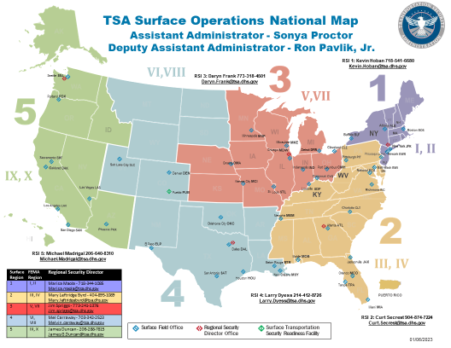
TSA - Surface Operations Field Leadership
5 Regional Security Offices
Regional Security Directors
Regional Security Inspectors

Slide 17
Questions & Contact Information
TSA Industry Engagement Manager - Highway & Motor Carrier
Ben Currier
Mobile: 571-361-3921
Office: 571-227-5839
benjamin.currier@tsa.dhs.gov
TSA BASE Program
STSIP@tsa.dhs.gov

