Slide 1
safety &
maintenance
Safety Director 101 / 201
Being Audit Ready

Slide 2

SAFETY DIRECTOR 101 / 201: BEING AUDIT READY
Being audit ready is a review of the Key Elements in your safety program and processes.
Remember that Compliance Investigations are just that, an investigation to determine if you are meeting the requirements of the regulations in a systematic process.
All of the regulations contained in the FMCSRs are minimum requirements not the be all end all.
If you have company policies that go beyond the regulations be sure you are monitoring them as well and are treating them with the same
weight as a regulation would.

Slide 3
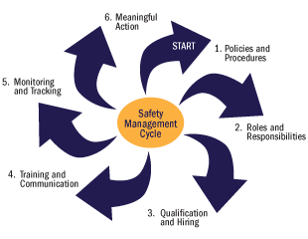
SAFETY DIRECTOR 101/ 201: BEING AUDIT READY

Slide 4
SAFETY DIRECTOR 101/201: BEING AUDIT READY
COMPLIANCE ITEMS FOR INVESTIGATION
DRIVER QUALIFICATION
DRUG TESTING
HOURS OF SERVICE
MAINTENANCE RECORDS
ACCIDENT REGISTER
VEHICLE INSPECTION
ADMINISTRATIVE MCS90-B MCS-150 BOC-3 QUALIFIERS

Slide 5
SAFETY DIRECTOR 101/201: BEING AUDIT READY
DQ FILES NEED TO BE A FEW THINGS RIGHT OFF THE BAT
CONSISTENT
UP TO DATE
QUARTERLY REVIEWS
SPOT CHECKS
NEW HIRE REVIEWS
COMPANY POLICY UPDATES

Slide 6
SAFETY DIRECTOR 101/201: BEING AUDIT READY
BUILDING A DQ FILE
MAKE IT SIMPLE
CONCISE
CONSISTENT
REMEMBER THE DQ FILE IS NOT THE PERSONNEL FILE
IT COVERS ONLY THE ITEMS WITHIN 391, 382, 383 AND
PART 40

Slide 7
SAFETY DIRECTOR 101/201: BEING AUDIT READY
ANNUAL REVIEWS AND DRIVER CERTIFICATIONS
391.25 AND 391.27
391.25 IS THE COMPANY ANNUAL REVIEW OF THE DRIVING RECORD
THIS STILL APPLIES TODAY
391.27 IS THE DRIVER REPORT OF VIOLATIONS
THAT REQUIREMENT WAS REMOVED ON MAY 9 OF THIS YEAR
GOING FORWARD IT IS NOT REQUIRED , DO NOT REMOVE
PREVIOUS REPORTS
DOES NOT ELIMINATE 383.31 OR 383.33 TO NOTIFY STATE AND EMPLOYER
OF CONVICTED VIOLATIONS OR LICENSE SUSPENSIONS, REVOCATIONS,ETC

Slide 8
SAFETY DIRECTOR 101/201: BEING AUDIT READY
LIST OF EXPERIENCE WITH ALL TYPES OF CMVS
LIST OF ALL ACCIDENTS IN ANY VEHICLES OVER THE LAST 3 YEARS INCLUDE LOCATION, NATURE OF ACCIDENT AND ANY INJURIES/FATALITIES
LIST OF ALL TRAFFIC VIOLATIONS OTHER THAN PARKING FOR THE 3 YEARS IN WHICH THEY WERE CONVICTED OR FORFEITED BOND
A STATEMENT OF ANY DENIAL, REVOCATION OR SUSPENSION OF LICENSE TO OPERATE A CMV OR A STATEMENT THAT SAYS THAT DID NOT OCCUR
A LIST OF ALL PREVIOUS EMPLOYERS FOR THE LAST 3 YEARS 10 YEARS IF APPLYING TO BE CMV DRIVER MUST INCLUDE COMPANY NAME AND ADDRESS
MULTIPLE EMPLOYER DRIVERS AND LOANED DRIVERS 391.63
AND 391.65

Slide 9
SAFETY DIRECTOR 101/201: BEING AUDIT READY
§ 391.63 MULTIPLE-EMPLOYER DRIVERS.
(A) IF A MOTOR CARRIER EMPLOYS A PERSON AS A MULTIPLE-EMPLOYER DRIVER (A DRIVER, WHO IN ANY PERIOD OF 7 CONSECUTIVE DAYS, IS EMPLOYED OR USED AS A DRIVER BY MORE THAN ONE MOTOR CARRIER.) THE MOTOR CARRIER SHALL COMPLY WITH ALL REQUIREMENTS OF THIS PART, EXCEPT THAT THE MOTOR CARRIER NEED NOT -
(1) REQUIRE THE PERSON TO FURNISH AN APPLICATION FOR EMPLOYMENT IN ACCORDANCE WITH § 391.21;
(2) MAKE THE INVESTIGATIONS AND INQUIRIES SPECIFIED IN § 391.23 WITH RESPECT TO THAT PERSON;
(3) PERFORM THE ANNUAL DRIVING RECORD INQUIRY REQUIRED BY § 391.25(A); OR
(4) PERFORM THE ANNUAL REVIEW OF THE PERSON'S DRIVING RECORD REQUIRED BY § 391.25(B).
(B) BEFORE A MOTOR CARRIER PERMITS A MULTIPLE-EMPLOYER DRIVER TO DRIVE A COMMERCIAL MOTOR VEHICLE, THE MOTOR CARRIER MUST OBTAIN THE DRIVER'S NAME, THE DRIVER'S SOCIAL SECURITY NUMBER, AND THE IDENTIFICATION NUMBER, TYPE, AND ISSUING DRIVER'S LICENSING AUTHORITY OF THE DRIVER'S COMMERCIAL MOTOR VEHICLE OPERATOR'S LICENSE. THE MOTOR CARRIER MUST MAINTAIN THIS INFORMATION FOR THREE YEARS AFTER EMPLOYMENT OF THE MULTIPLE-EMPLOYER DRIVER CEASES.

Slide 10
SAFETY DIRECTOR 101/201: BEING AUDIT READY
§ 391.65 DRIVERS FURNISHED BY OTHER MOTOR CARRIERS.
A MOTOR CARRIER MAY EMPLOY A DRIVER WHO IS NOT A SINGLE-EMPLOYER DRIVER, AS DEFINED IN § 390.5, OF THAT MOTOR CARRIER WITHOUT COMPLYING WITH THE GENERALLY APPLICABLE DRIVER QUALIFICATION FILE REQUIREMENTS IN THIS PART, IF -
(1) THE DRIVER IS A SINGLE-EMPLOYER DRIVER FOR ANOTHER MOTOR CARRIER; AND
(2) THAT OTHER MOTOR CARRIER CERTIFIES THAT THE DRIVER IS FULLY QUALIFIED TO DRIVE A COMMERCIAL MOTOR VEHICLE IN A WRITTEN STATEMENT WHICH -
(I) IS SIGNED AND DATED BY AN OFFICER OR AUTHORIZED EMPLOYEE OF THE MOTOR CARRIER THAT EMPLOYS THE SINGLE-EMPLOYER DRIVER;
(II) CONTAINS THE DRIVER'S NAME AND SIGNATURE;
(III) CERTIFIES THAT THE DRIVER HAS BEEN EMPLOYED AS A SINGLE-EMPLOYER DRIVER.
(IV) CERTIFIES THAT THE DRIVER IS FULLY QUALIFIED TO DRIVE A COMMERCIAL MOTOR VEHICLE UNDER THE RULES IN PART 391 OF THE FEDERAL MOTOR CARRIER SAFETY REGULATIONS;
(V) STATES THE EXPIRATION DATE OF THE DRIVER'S MEDICAL EXAMINER'S CERTIFICATE;
(VI) SPECIFIES AN EXPIRATION DATE FOR THE CERTIFICATE, WHICH SHALL BE NOT LONGER THAN 2 YEARS OR, IF EARLIER, THE EXPIRATION DATE OF THE DRIVER'S CURRENT MEDICAL EXAMINER'S CERTIFICATE; AND
(VII) IS SUBSTANTIALLY IN ACCORDANCE WITH THE FOLLOWING FORM:

Slide 11
SAFETY DIRECTOR 101/201: BEING AUDIT READY
§ 391.65 DRIVERS FURNISHED BY OTHER MOTOR CARRIERS.
____________________(NAME OF DRIVER)
____________________(SS NO.)
____________________(SIGNATURE OF DRIVER)
I CERTIFY THAT THE ABOVE NAMED DRIVER, AS DEFINED IN § 390.5, IS A SINGLE-EMPLOYER DRIVER DRIVING A COMMERCIAL MOTOR VEHICLE OPERATED BY THE BELOW NAMED CARRIER AND IS FULLY QUALIFIED UNDER PART 391, FEDERAL MOTOR CARRIER SAFETY REGULATIONS. HIS/HER CURRENT MEDICAL EXAMINER'S CERTIFICATE EXPIRES ON ______(DATE).
THIS CERTIFICATE EXPIRES:
(DATE NOT LATER THAN EXPIRATION DATE OF MEDICAL CERTIFICATE)
ISSUED ON______(DATE)
ISSUED BY__________
(NAME OF CARRIER)
(ADDRESS)
(SIGNATURE)
(TITLE)

Slide 12
SAFETY DIRECTOR 101/201: BEING AUDIT READY
§ 391.65 DRIVERS FURNISHED BY OTHER MOTOR CARRIERS.
(B) A MOTOR CARRIER THAT OBTAINS A CERTIFICATE IN ACCORDANCE WITH PARAGRAPH (A)(2) OF THIS SECTION SHALL:
(1) CONTACT THE MOTOR CARRIER WHICH CERTIFIED THE DRIVER'S QUALIFICATIONS UNDER THIS SECTION TO VERIFY THE VALIDITY OF THE CERTIFICATE. THIS CONTACT MAY BE MADE IN PERSON, BY TELEPHONE, OR BY LETTER.
(2) RETAIN A COPY OF THAT CERTIFICATE IN ITS FILES FOR THREE YEARS.
(C) A MOTOR CARRIER WHICH CERTIFIES A DRIVER'S QUALIFICATIONS UNDER THIS SECTION SHALL BE RESPONSIBLE FOR THE ACCURACY OF THE CERTIFICATE. THE CERTIFICATE IS NO LONGER VALID IF THE DRIVER LEAVES THE EMPLOYMENT OF THE MOTOR CARRIER WHICH ISSUED THE CERTIFICATE OR IS NO LONGER QUALIFIED UNDER THE RULES IN THIS PART.

Slide 13
SAFETY DIRECTOR 101/201: BEING AUDIT READY
MEDICAL – SEPARATE FOLDER
ALL DOCTOR NOTES FOR LIGHT DUTY AND OR RESTRICTIONS AND RETURN TO DUTY AS WELL AS ANY DOT MEDICAL WAIVERS
3 YEARS OF THE MEDICAL EXAMINER CERTIFICATES
ALWAYS TRY TO MAINTAIN THE LONG FORM AS WELL EVEN THOUGH NOT REQUIRED
REVIEW ANY MEDICAL LESS THAN A 2 YEAR CERTIFICATION
REVIEW AND DOCUMENT ALL PROVIDERS THROUGH THE
REGISTRY

Slide 14
SAFETY DIRECTOR 101/201: BEING AUDIT READY
MEDICAL FILE
THE MEDICAL EXAMINER'S CERTIFICATE AS REQUIRED BY § 391.43(G) OR A LEGIBLE COPY OF THE CERTIFICATE.
(II) FOR CDL HOLDERS, BEGINNING JANUARY 30, 2012, IF THE CDLIS MOTOR VEHICLE RECORD CONTAINS MEDICAL CERTIFICATION STATUS INFORMATION, THE MOTOR CARRIER EMPLOYER MUST MEET THIS REQUIREMENT BY OBTAINING THE CDLIS MOTOR VEHICLE RECORD DEFINED AT § 384.105 OF THIS CHAPTER. THAT RECORD MUST BE OBTAINED FROM THE CURRENT LICENSING STATE AND PLACED IN THE DRIVER QUALIFICATION FILE. AFTER JANUARY 30, 2015, A NON-EXCEPTED, INTERSTATE CDL HOLDER WITHOUT MEDICAL CERTIFICATION STATUS INFORMATION ON THE CDLIS MOTOR VEHICLE RECORD IS DESIGNATED “NOT-CERTIFIED” TO OPERATE A CMV IN INTERSTATE COMMERCE. AFTER JANUARY 30, 2015, AND THROUGH JUNE 22, 2025, A MOTOR CARRIER MAY USE A COPY OF THE DRIVER'S CURRENT MEDICAL EXAMINER'S CERTIFICATE THAT WAS SUBMITTED TO THE STATE FOR UP TO 15 DAYS FROM THE DATE IT WAS ISSUED AS PROOF OF MEDICAL CERTIFICATION.

Slide 15
SAFETY DIRECTOR 101/201: BEING AUDIT READY
DRUG TESTING FILE
COPY OF SIGNED COMPANY DRUG TEST POLICY
PREEMPLOYMENT DRUG TEST MAINTAINED FOR THE PROPER TIME PERIOD
ANY REFERRALS TO A SAP AND THE RETURN TO WORK DOCUMENTATION TO INCLUDE THE DRUG TESTS
CURRENT DRUG TESTS FOR THE CURRENT TESTING CYCLE
CORRESPONDING REPORTS FROM THE CLEARINGHOUSE

Slide 16
SAFETY DIRECTOR 101/201: BEING AUDIT READY
TRAINING FILE
ANY NEW ENTRANT DRIVER CERTIFICATES
ALL TRAINING COMPLETED PRIOR TO AND DURING EMPLOYMENT
ADA
DEFENSIVE DRIVING
TOUR GUIDE TRAINING
ANNUAL RECERTIFICATIONS
REMEDIAL TRAINING FOR POST ACCIDENTS/ INCIDENTS

Slide 17
SAFETY DIRECTOR 101/201: BEING AUDIT READY
MANILA FILE
THE REST OF THE PERSONNEL FILE
TAX FORMS
I-9
BACKGROUND CHECKS
COMPANY POLICY ACKNOWLEDGEMENTS
USUALLY KEPT SEPARATE FROM ALL OF THE OTHER FILES
MAINTAINED BY HR

Slide 18
SAFETY DIRECTOR 101/201: BEING AUDIT READY
GENERAL TIPS FOR SUCCESS FOR DQ FILES
PERMISSIONS FROM THE DRIVER USUALLY THROUGH THE APPLICATION FOR EMPLOYMENT OR SEPARATE FORM TO ALLOW THE COMPANY TO REQUEST AND RESPOND TO INQUIRIES
COMPLETENESS OF DOCUMENTS
IT’S REALLY EASY TO HAVE A DOCUMENT THAT IS INCOMPLETE
MISSING SIGNATURES/ DATES
TIME GAPS IN EMPLOYMENT
VERIFY DRIVER STATEMENTS THROUGH THE PSP AND THE
DRUG AND ALCOHOL CLEARING HOUSE REPORTS
THIS CAN SHOW ACCIDENTS AS WELL AS DRUG/ALCOHOL USE

Slide 19
SAFETY DIRECTOR 101/201: BEING AUDIT READY
RETENTION PERIODS
DOCUMENTS THROUGHOUT THE DQ FILE HAVE DIFFERENT EXPIRATION DATES
INITIAL MVR IS A FOREVER DOCUMENT
ANNUAL REVIEWS 3 YEARS
MEDICALS MAINTAINED FOR 3 YEARS
NEGATIVE DRUG TESTS 1 YEAR
POSITIVE DRUG TESTS 5 YEARS
MAKE SURE YOU ARE TRACKING AND PRUNING YOUR FILES
CORRECTLY
THE COMPETE DQ FILE MUST BE KEPT 3 YEARS AFTER THE
DRIVER LEAVES YOUR COMPANY

Slide 20
SAFETY DIRECTOR 101/201: BEING AUDIT READY
DIGITALIZING DQ FILES
MANY CARRIERS HAVE COMPLETED THIS DURING COVID
MANY PRODUCTS OUT THERE
DO YOUR HOMEWORK
NOTIFICATIONS
EASE OF USE
ABILITY TO UPLOAD DIRECTLY TO FMCSA DURING INVESTIGATIONS
MAKE SURE YOU ARE FOLLOWING DIGITAL SIGNATURE REQUIREMENTS
THIS GUIDANCE CAN BE FOUND IN 390.31

Slide 21
SAFETY DIRECTOR 101/201: BEING AUDIT READY
Drug and Alcohol Clearinghouse
Full query
Limited query
Top 2 issues in compliance investigations

Slide 22
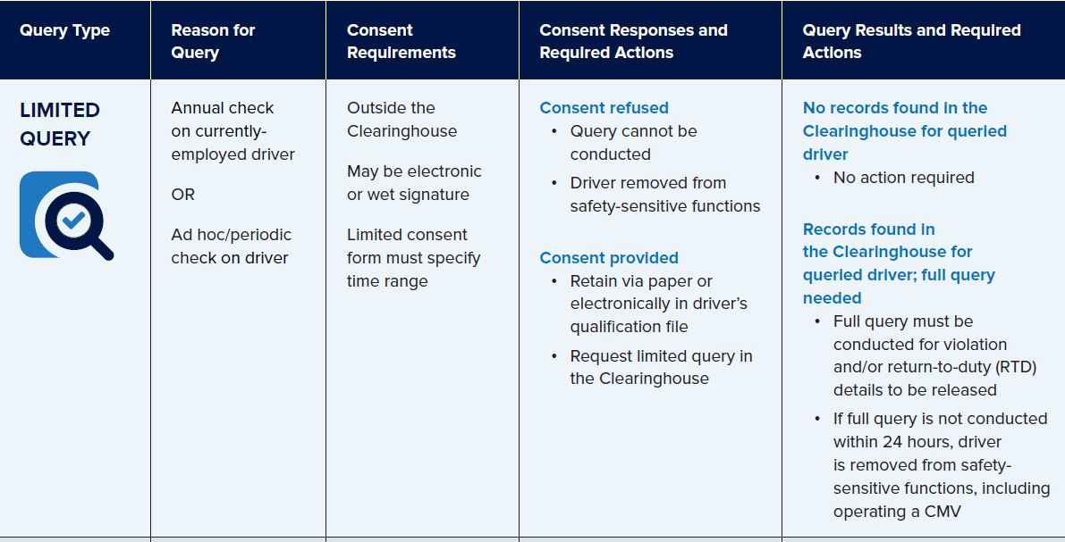
SAFETY DIRECTOR 101/201: BEING AUDIT READY

Slide 23
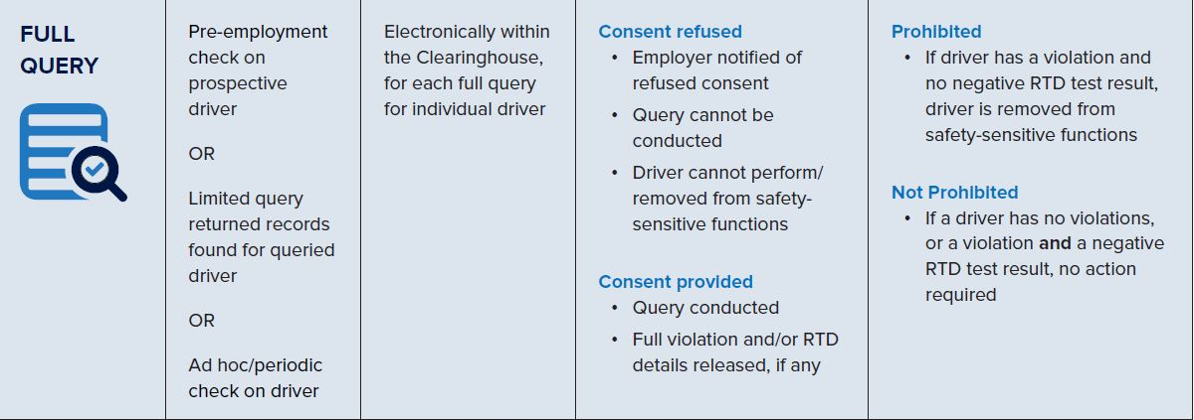
SAFETY DIRECTOR 101/201: BEING AUDIT READY

Slide 24
SAFETY DIRECTOR 101/201: BEING AUDIT READY
Maintenance records
DVIRs
PM records
Repair orders
Deferred maintenance
Certifications for annual inspectors and brake inspectors
Include outside service provider certifications
Include outside vendor records

Slide 25
SAFETY DIRECTOR 101/201: BEING AUDIT READY
Vehicle inspections
Only vehicles on your ready line
Make sure all assets out of service are marked accordingly
They will perform a CVSA level 5 inspection
Ask for a CVSA decal if a vehicle qualifies

Slide 26

SAFETY DIRECTOR 101/201: BEING AUDIT READY
Mentors Available

Slide 27
MIKE MCDONAL
DIRECTOR, REGULATORY COMPLIANCE AND INDUSTRY RELATIONS
SAUCON TECHNOLOGIES
MMCDONAL@SAUCONTECH.COM
410-245-5525

