Slide 1
California dmv employer pull notice program
Best Practices

Slide 2
Must enroll Commercial drivers
Must sign and date records
1808.1 CVC

Slide 3
Secure File Transfer epn agent
ACCOUNT SET UP:
*BY MAIL
or
*ELECTRONIC

Slide 4
ANNUAL RECORDS (12 mo driver record)
NOTIFICATION OF ACTIVITY
REVIEWING RECORDS

Slide 5
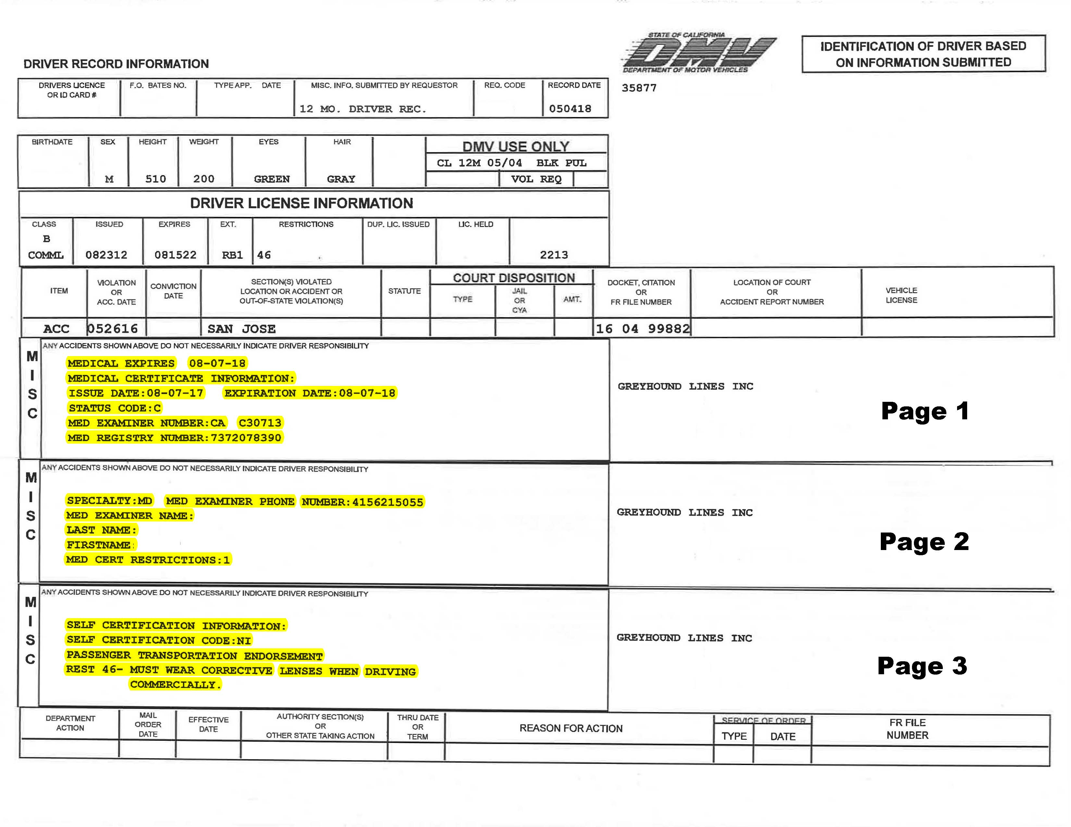
12 Mo driver rec

Slide 6
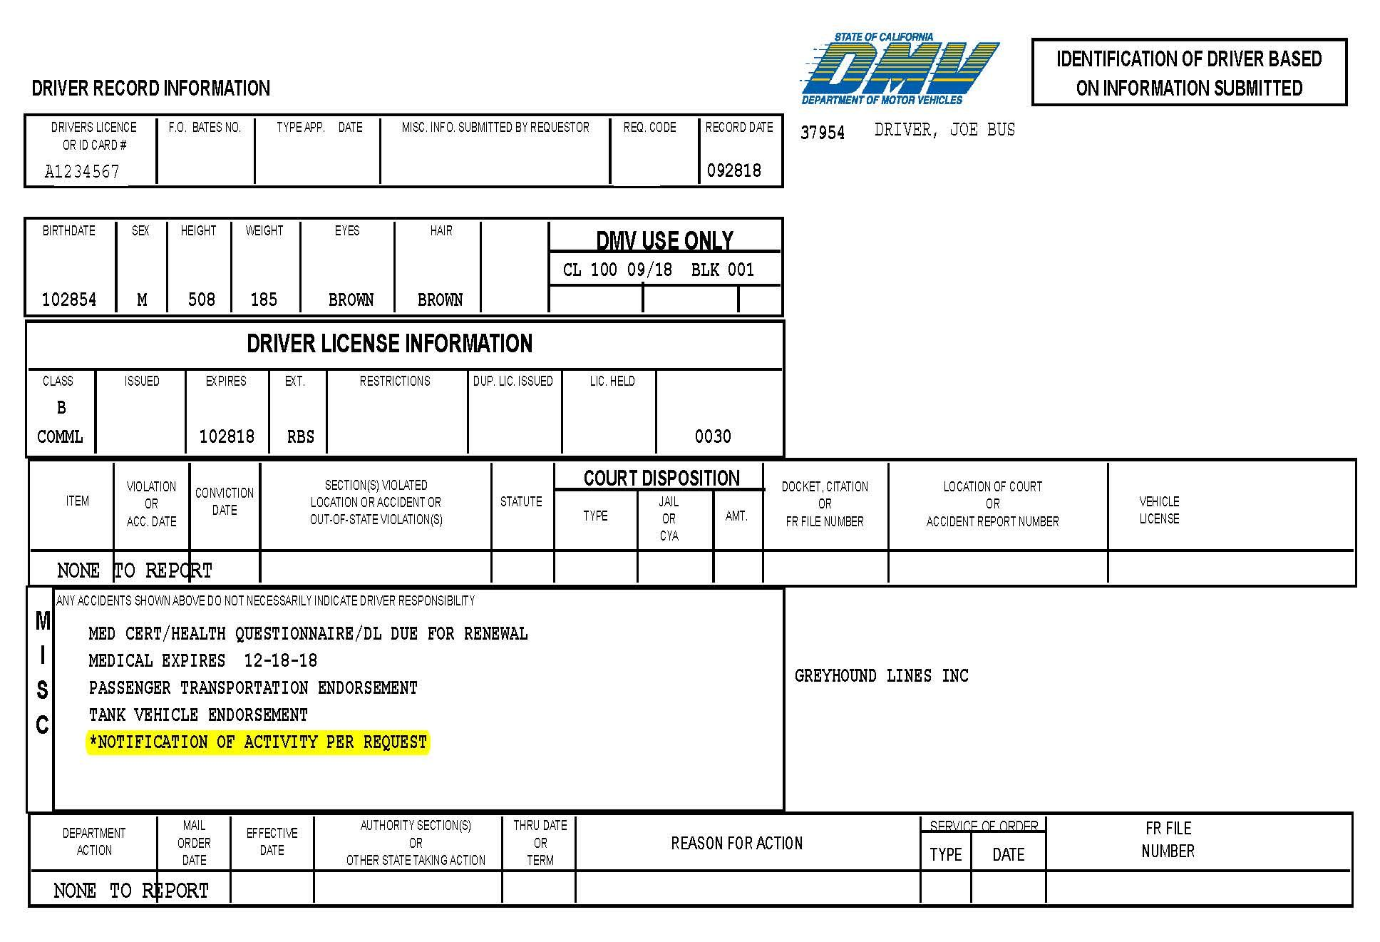
*NOTIFICATION OF ACTIVITY

Slide 7
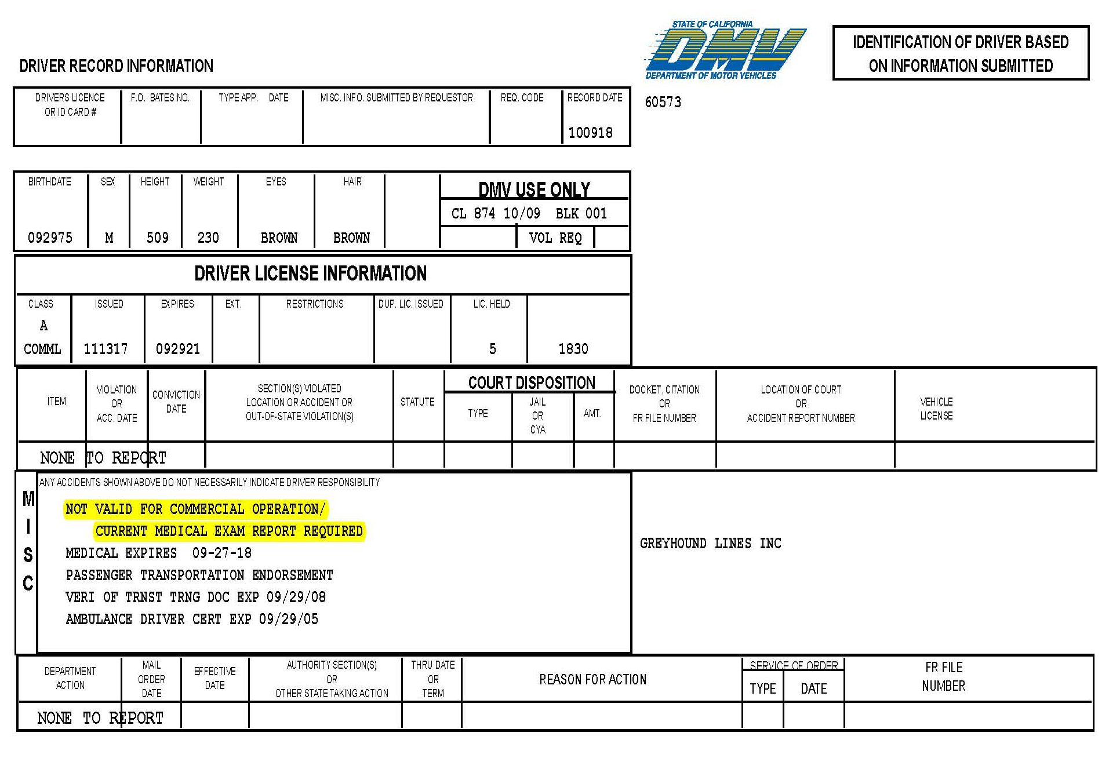
When dot medical is not on file with dmv

Slide 8
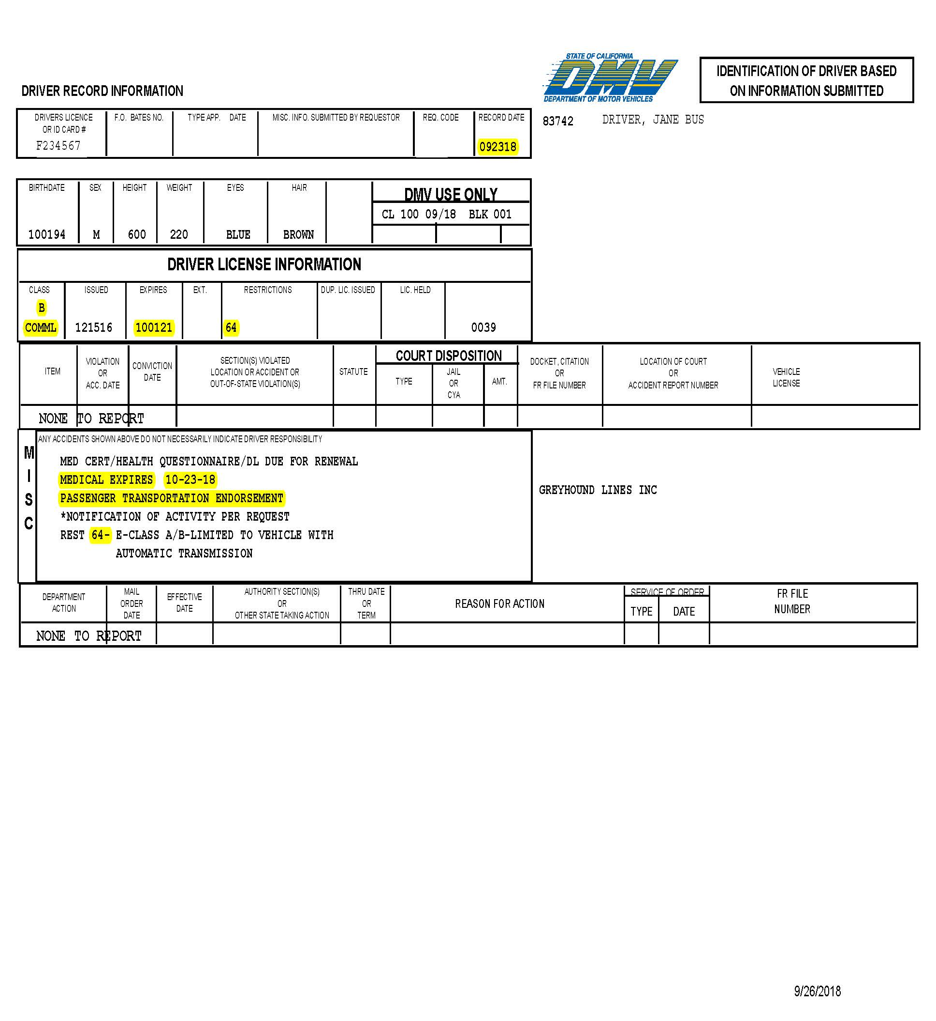
Review
DON’T FORGET TO SIGN & DATE!!!

Slide 9
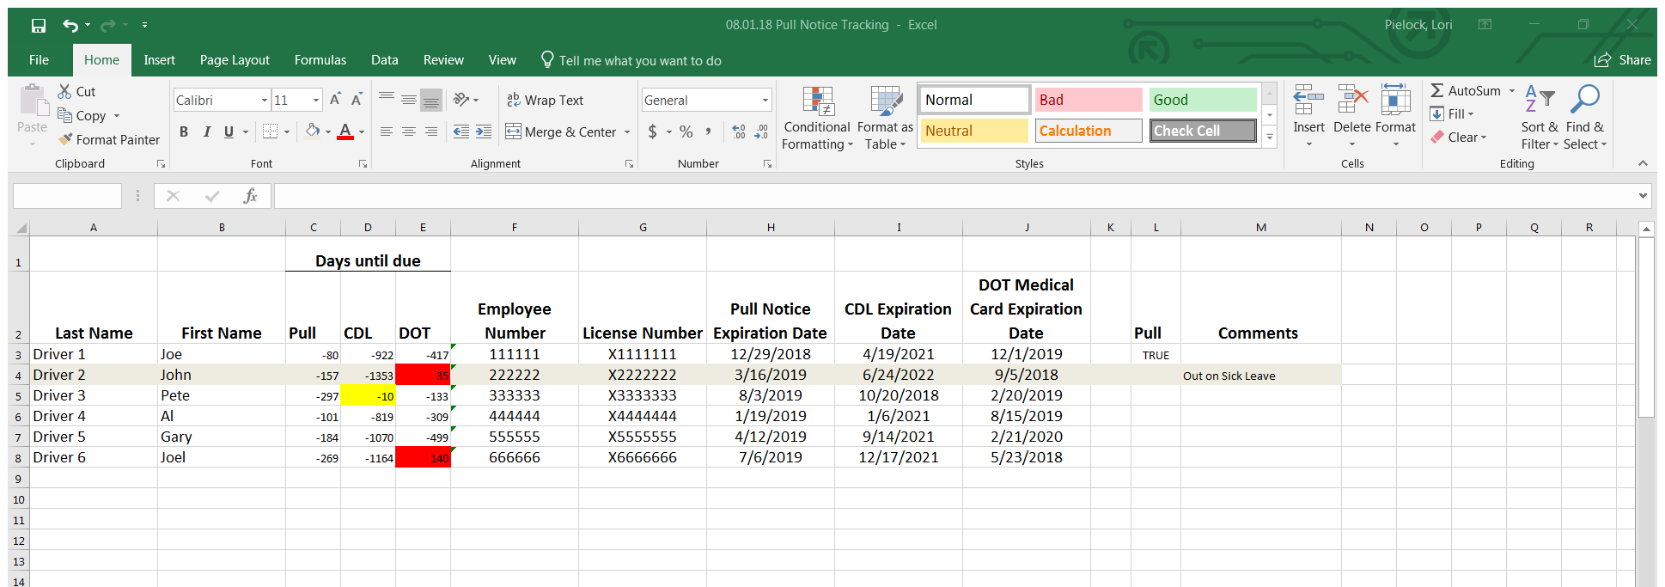
Pull Notice Spread sheet 10/10/18

Slide 10

SELF – CERTIFCATION
NON – EXCEPTED INTERSTATE (NI)
vs
NON – EXCEPTED INTRASTATE (NA)

Slide 11
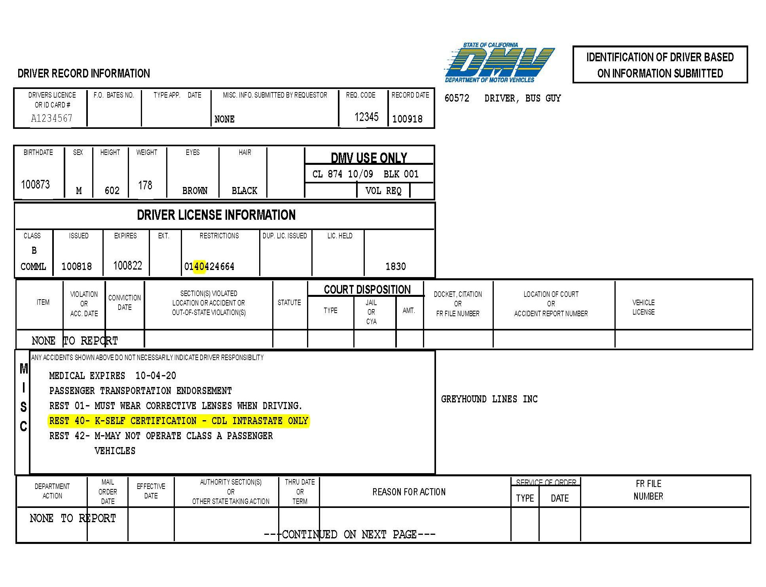
40 or k restriction

Slide 12
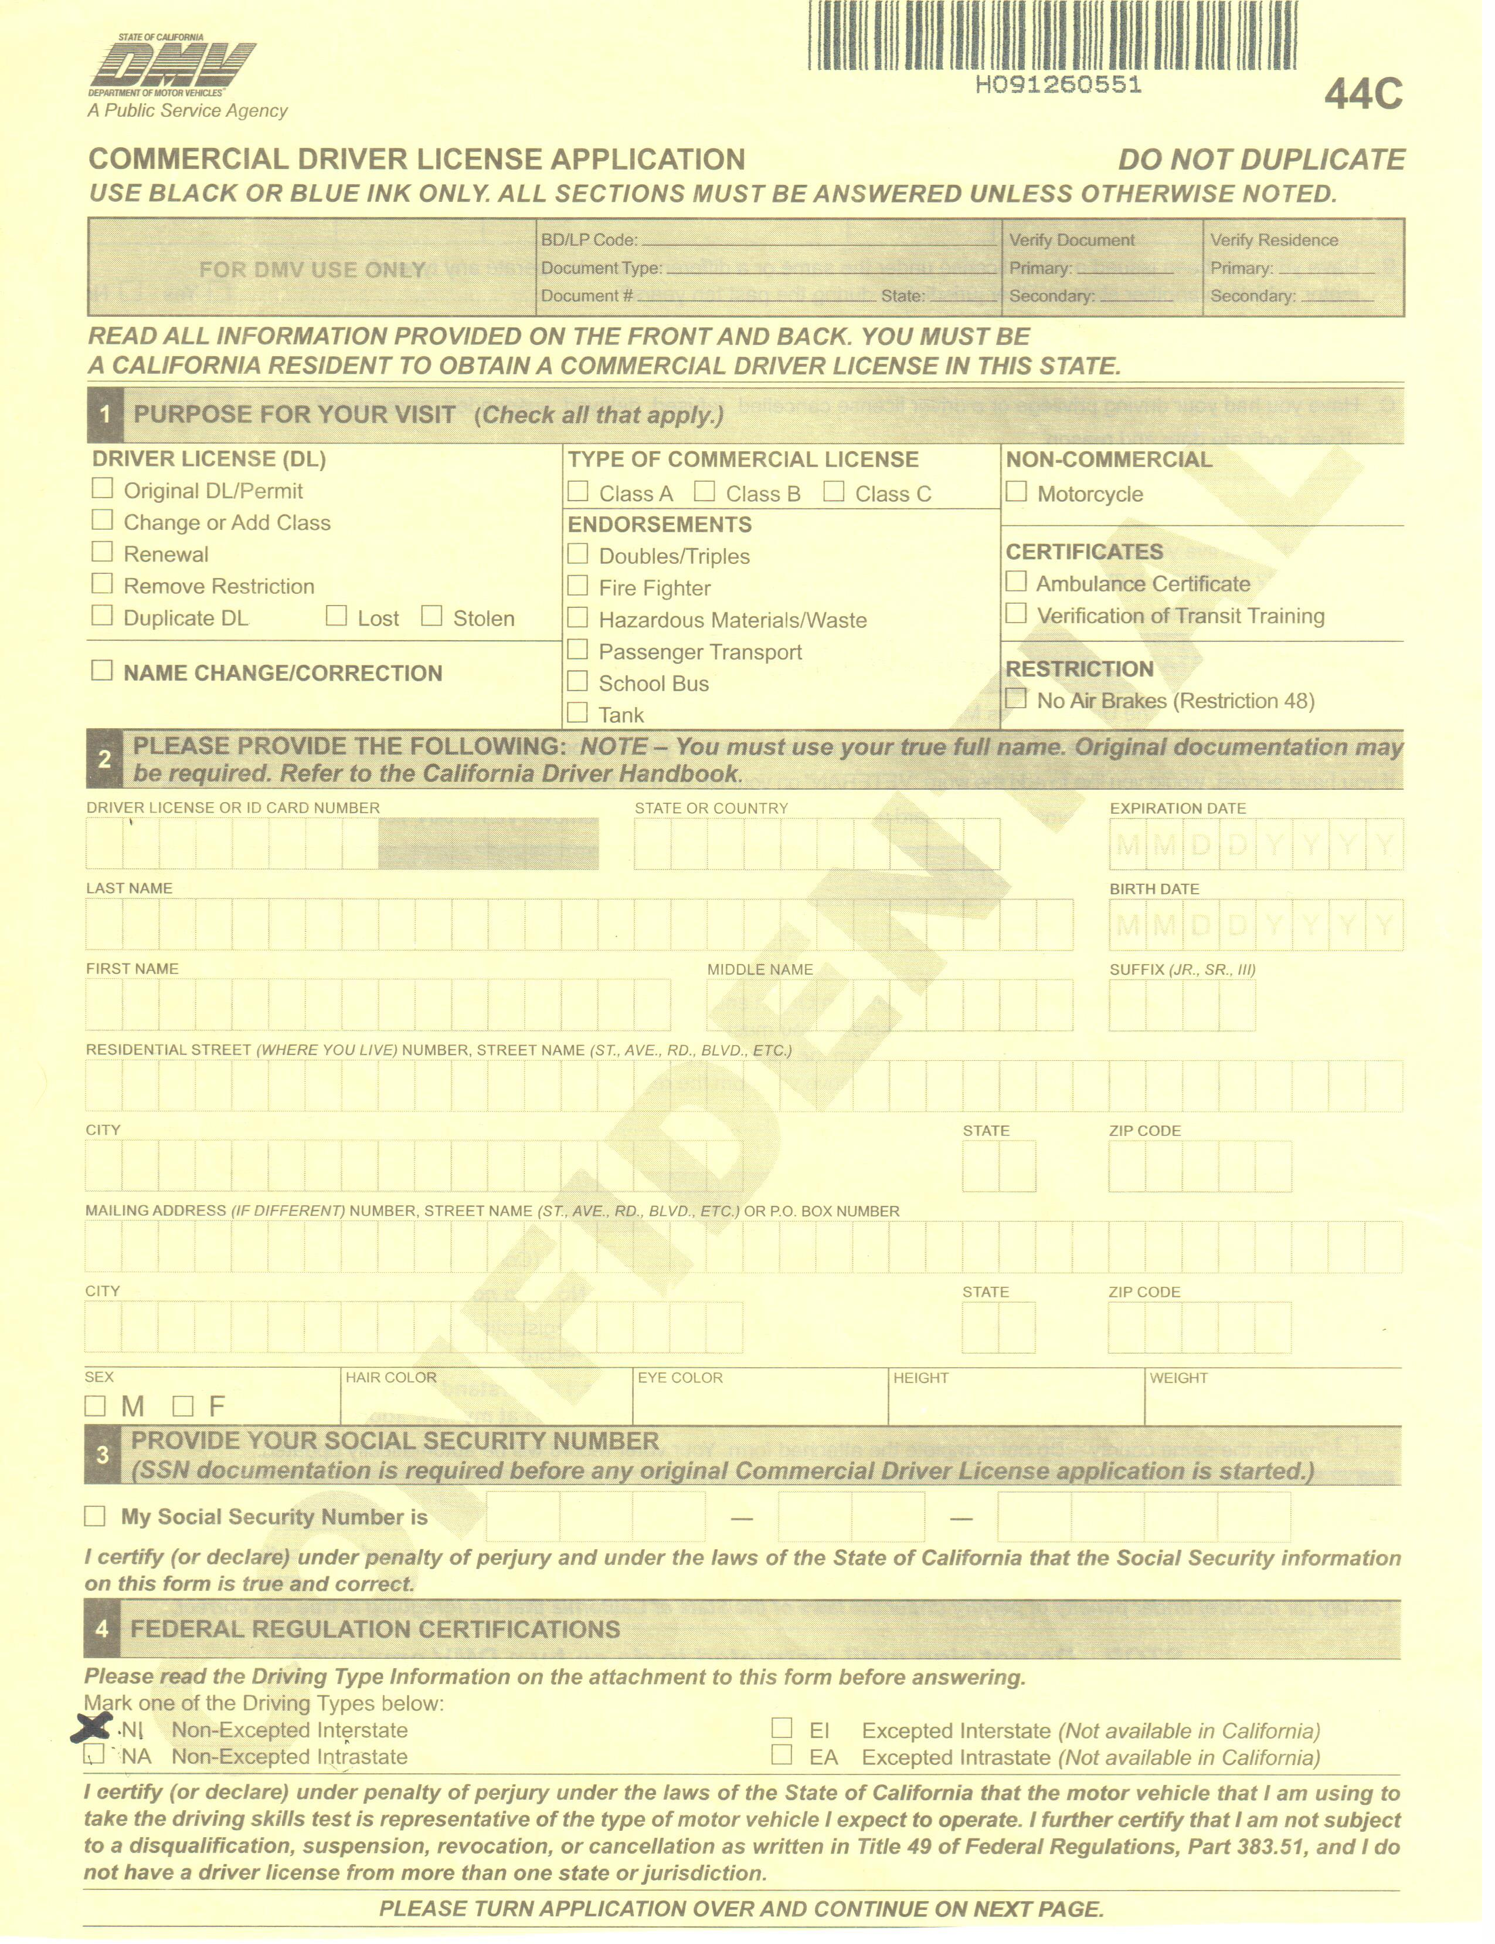
Commercial Driver License Application
44c

Slide 13
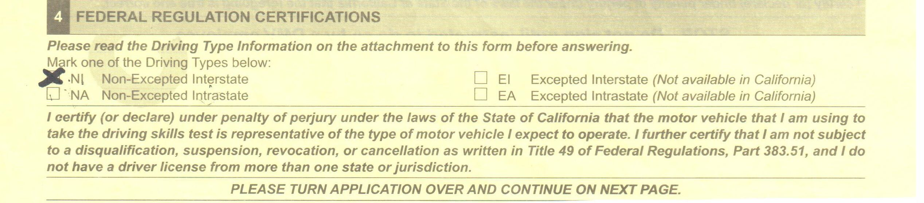
44 c self certification

Slide 14
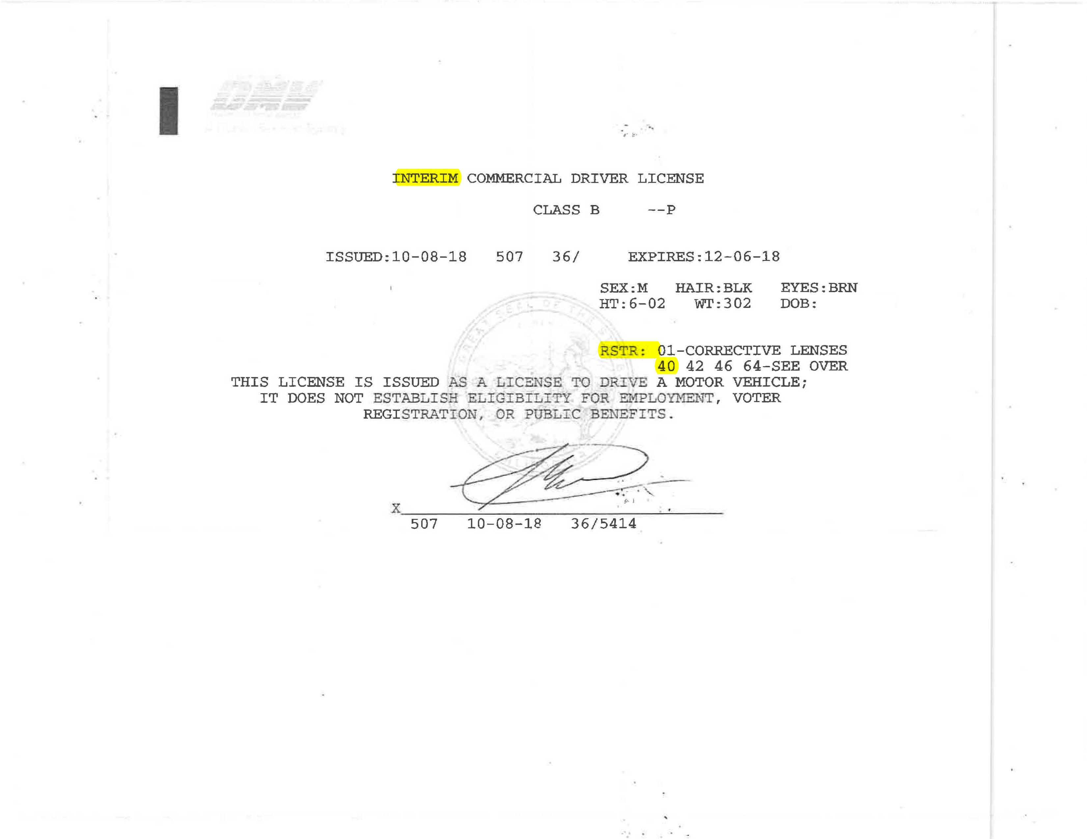
Interim cdl

Slide 15
Thank you!
Lori Pielock
Safety compliance greyhound lines, inc
LORI.PIELOCK@GREYHOUND.COM

