Slide 1
Upcoming Active Shooter/Assailant Tabletop Exercises
Active Shooter/Assailant on a Bus Tabletop Exercises:
This event will provide industry professionals an opportunity to discuss security processes, expectations, and issues relevant to the School Bus, Motorcoach, and Mass Transit Bus industries.
Participants will receive an intelligence briefing, a TSA resources and programs overviews, and industry-specific security briefings; discussed a hypothetical scenario on how to prevent and respond to an active shooter/assailant on a bus during a tabletop exercise (TTX); and observe law enforcement demonstrations.
Locations:
Atlantic City, NJ, September 12, 2023
Los Angeles, CA, September 27, 2023

Slide 2
Upcoming Security Plan Workshops
Security Plan Workshop:
The purpose of the workshop is to strengthen, prevention, mitigation, responds, and recovery capabilities among Highway and Motor Carrier (HMC) transportation providers by developing comprehensive and tailored security plans using a TSA-provided Security-Plan Template.
The workshop is designed to assist HMC transportation providers in learning how to utilize the TSA provided Transportation Security-Plan Template and Review Toolkit (T-START) to create their own security plan.
TSA-sponsored, half-day workshop guides operators through developing company-specific security plans
TSA provides required workshop planning and staff
Locations:
Baton Rogue, LA July 18, 2023
Buffalo, NY, July 26, 2023
Oakland, CA, August 2, 2023
Atlanta, GA, August 29, 2023

Slide 3

Purpose of the Proposed Surface
Transportation Employee Vetting Rule
  The Vetting of Certain Surface Transportation Employees Notice of Proposed Rulemaking was published in the Federal Register on May 23, 2023
  The NPRM proposes to implement requirements in the 9/11 Act to vet certain public transportation, freight and passenger railroad, and over-the-road bus (OTRB) employees:
    Require security-sensitive employees to undergo a Level 2 Security Threat Assessment (STA)
    Require security coordinators to undergo a Level 3 STA
    Provide appeal and waiver procedures for vetted populations similar to those established for the Transportation Worker Identification Credential (TWIC); and
    The rule also proposes to standardize the TSA vetting structure in a new Part 1530:
      Vetting Standards
      Fees
      Redress procedures
Notes:
Purpose of the Regulation
This proposed rulemaking would serve three purposes:
Surface transportation security vetting. The NPRM proposes to implement requirements in the 9/11 Act to vet certain public transportation, railroad, and OTRB employees:
Conduct a “name-based security background check against the consolidated terrorist (2) Fees. TSA is proposing an equitable fee schedule to recover the costs of vetting services. TSA must sustain vetting programs, like those proposed in this rulemaking, through user fees in accordance with 6 U.S.C. 469, Fees for Credentialing and Background Investigations in Transportation.
(3) Redress. The 9/11 Act provides that if TSA issues a regulation requiring operators to conduct vetting of public transportation and railroad employees, TSA must require the operators to provide appeal and waiver procedures, like the procedures TSA established in the Transportation Worker Identification Credential (TWIC) program in accordance with 46 U.S.C. 70105 and codified at 49 CFR parts 1515, 1572. TSA proposes appeals, waivers, review by Administrative Law Judges (ALJs), and review by the TSA Final Decision Maker for individuals who are adversely affected by the vetting.

Slide 4
Proposed Surface Transportation
Populations Impacted by the NPRM
  Generally, populations covered under the Rail Security and Security Training Rules may be impacted by this rule:
Workers | Level 2 STA (Terrorism, Immigration) | Level 3 STA (Terrorism, Immigration, CHRC)
Security-Sensitive Freight Railroad Employees | 
Security-Sensitive Public Transportation and Passenger Railroad Employees | 
Security-Sensitive OTRB Employees | None
Security Coordinators of Freight Railroads |  | 
Security Coordinators of Public Transportation Agencies and Passenger Railroads |  | 
Security Coordinators of OTRBs |  | 
Notes:
.
Summary of Major Provisions
In accordance with the 9/11 Act and risk-based principles, TSA proposes to require frontline or “security-sensitive” employees of public transportation and railroad operators to undergo a Level 2 STA, which includes an immigration check and a terrorism check and other analyses (terrorism/other analyses). Specifically, sections 1411 and 1520 of the 9/11 Act require TSA to conduct terrorist and immigration status vetting of public transportation and railroad employees, similar to the check TSA conducted in 2006 in the maritime sector. In sections 1143 and 1170 of the Act, Congress defines a security background check as vetting that includes criminal, immigration and terrorist checks, and provides that if TSA issues a rulemaking to require operators to conduct security background checks, TSA must require use of the criminal standards and redress required by 46 USC 70105, and 49 CFR part 1572.
Further, TSA proposes to require security coordinators of public transportation, railroad, and OTRB operators to complete a Level 3 STA, which includes an immigration check, criminal check, and terrorism/other analyses check. Table 1 below provides a summary of these proposed vetting requirements. Also, TSA proposes a robust redress process for individuals who are deemed ineligible for a position as a result of the vetting, to ensure that they are not disqualified in error. Finally, TSA proposes user fees to cover the costs of TSA’s vetting, as required by statute.
This portion of the STA is called “terrorism check and other analyses.” This portion of the STA may include searches of many data sources, such as the consolidated terrorist watchlist (TSDB), U.S. Marshal’s Service wants and warrants, U.S. Department of State lost and stolen passports, and Interpol.
See 6 U.S.C. 469.

Slide 5

Proposed Cost of an STA
  Proposed cost of an initial STA:
STA Level | Low | Mid | High
Level 1 (Processing, Terrorism/Other Analysis) | $50 | $63 | $76
Level 2 (Processing, Terrorism/Other Analysis, Immigration) | $52 | $66 | $80
Level 3 (Processing, Terrorism/Other Analysis, Immigration, CHRC) | $69 | $87 | $105
Notes:
Purpose of the Regulation
This proposed rulemaking would serve three purposes:
Surface transportation security vetting. The NPRM proposes to implement requirements in the 9/11 Act to vet certain public transportation, railroad, and OTRB employees:
Conduct a “name-based security background check against the consolidated terrorist (2) Fees. TSA is proposing an equitable fee schedule to recover the costs of vetting services. TSA must sustain vetting programs, like those proposed in this rulemaking, through user fees in accordance with 6 U.S.C. 469, Fees for Credentialing and Background Investigations in Transportation.
(3) Redress. The 9/11 Act provides that if TSA issues a regulation requiring operators to conduct vetting of public transportation and railroad employees, TSA must require the operators to provide appeal and waiver procedures, like the procedures TSA established in the Transportation Worker Identification Credential (TWIC) program in accordance with 46 U.S.C. 70105 and codified at 49 CFR parts 1515, 1572. TSA proposes appeals, waivers, review by Administrative Law Judges (ALJs), and review by the TSA Final Decision Maker for individuals who are adversely affected by the vetting.

Slide 6

Proposed Process for Getting an STA
TSA proposes to use its established enrollment process to vet surface employees
TSA operates a network of more than 300 enrollment centers
These enrollment centers are currently used to vet individuals participating in the following programs:
  TSA PreCheck®
  Transportation Worker Identification Credential (TWIC®)
  HAZMAT Endorsement
  Flight Training Security Program (FTSP)
Notes:
Purpose of the Regulation
This proposed rulemaking would serve three purposes:
Surface transportation security vetting. The NPRM proposes to implement requirements in the 9/11 Act to vet certain public transportation, railroad, and OTRB employees:
Conduct a “name-based security background check against the consolidated terrorist (2) Fees. TSA is proposing an equitable fee schedule to recover the costs of vetting services. TSA must sustain vetting programs, like those proposed in this rulemaking, through user fees in accordance with 6 U.S.C. 469, Fees for Credentialing and Background Investigations in Transportation.
(3) Redress. The 9/11 Act provides that if TSA issues a regulation requiring operators to conduct vetting of public transportation and railroad employees, TSA must require the operators to provide appeal and waiver procedures, like the procedures TSA established in the Transportation Worker Identification Credential (TWIC) program in accordance with 46 U.S.C. 70105 and codified at 49 CFR parts 1515, 1572. TSA proposes appeals, waivers, review by Administrative Law Judges (ALJs), and review by the TSA Final Decision Maker for individuals who are adversely affected by the vetting.

Slide 7

How Long Is The Comment Period? How Do Stakeholders Submit A Comment?
  The public will have 90 days (August 21, 2023) to provide comments to the rule
  Comments may be submitted to the docket via three methods:
    Web: Electronic Federal eRulemaking Portal: https://www.regulations.gov
    Mail:
      Docket Management Facility (M-30)
      U.S. Department of Transportation
      1200 New Jersey Avenue SE, West Building Ground Floor, Room W12-140 Washington, DC 20590-0001
    Fax: (202) 493-2251
Notes:
ADDRESSES: You may submit comments, identified by the TSA docket number to this rulemaking, to the Federal Docket Management System (FDMS), a government-wide, electronic docket management system. To avoid duplication, please use only one of the following methods:
Electronic Federal eRulemaking Portal: https://www.regulations.gov. Follow the online instructions for submitting comments.
Mail: Docket Management Facility (M-30), U.S. Department of Transportation, 1200 New Jersey Avenue SE, West Building Ground Floor, Room W12-140, Washington, DC 20590-0001. The U.S. Department of Transportation (DOT), which maintains and processes TSA’s official regulatory dockets, will scan the submission and post it to FDMS.
Fax: (202) 493-2251.

Slide 8
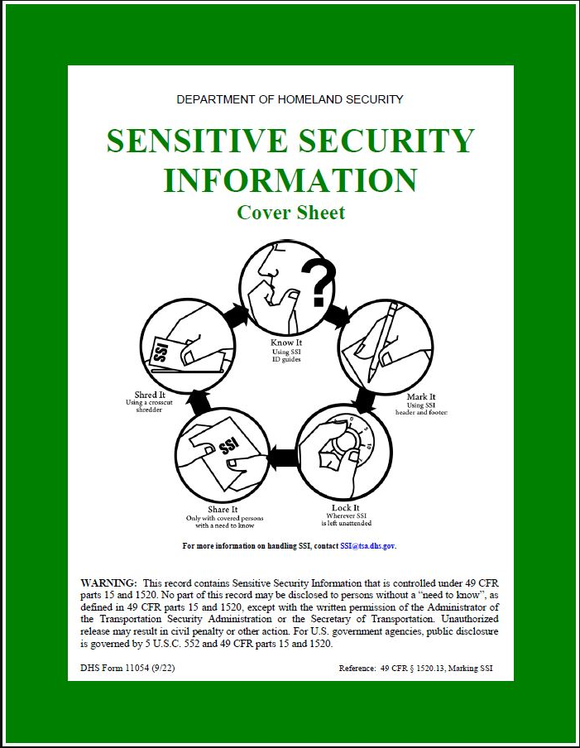
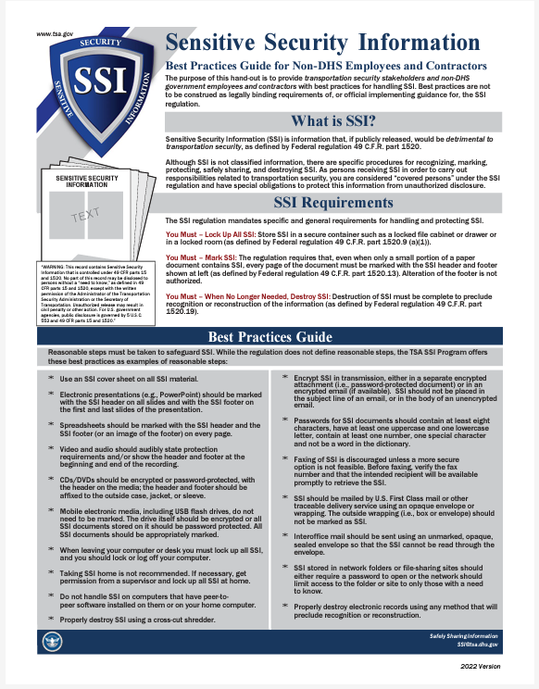
How do Stakeholders Submit A Comment
Containing Security Sensitive Information?
  Comments considered Sensitive Security Information (SSI) may be submitted to TSA via the SurfaceVetting@tsa.dhs.gov mailbox
    Ask submitters to submit a request for instructions to submit SSI via the mailbox
    PPE Surface Division will send instructions on handling SSI
Notes:
ADDRESSES: You may submit comments, identified by the TSA docket number to this rulemaking, to the Federal Docket Management System (FDMS), a government-wide, electronic docket management system. To avoid duplication, please use only one of the following methods:
Electronic Federal eRulemaking Portal: https://www.regulations.gov. Follow the online instructions for submitting comments.
Mail: Docket Management Facility (M-30), U.S. Department of Transportation, 1200 New Jersey Avenue SE, West Building Ground Floor, Room W12-140, Washington, DC 20590-0001. The U.S. Department of Transportation (DOT), which maintains and processes TSA’s official regulatory dockets, will scan the submission and post it to FDMS.
Fax: (202) 493-2251.

Slide 9

Where can the Public Submit Administrative
Questions Regarding the NPRM?
Administrative-related inquires may be submitted by the following means:
  By email at: SurfaceVetting@tsa.dhs.gov
  By voicemail at: (571) 227-1039
Notes:
On May 7, 2021, the Colonial Pipeline Company proactively shut down its pipeline system in response to a ransomware attack. On May 13, 2021, Colonial Pipeline announced the company restarted their entire pipeline system and product delivery commenced to all markets.
TSA issued in May 2021 following the ransomware attack on a major petroleum pipeline. The May 2021 Security Directive requires critical pipeline owners and operators to (1) report confirmed and potential cybersecurity incidents to CISA; (2) designate a Cybersecurity Coordinator to be available 24 hours a day, seven days a week; (3) review current practices; and, (4) identify any gaps and related remediation measures to address cyber-related risks and report the results to TSA and CISA within 30 days.
President Biden on July 28, 2021, signed a new National Security Memorandum, “Improving Cybersecurity for Critical Infrastructure Control Systems which directs the Department of Homeland Security (DHS) to work with the Department of Commerce (DOC) in developing cybersecurity performance goals that will drive adoption of effective practices and controls. NIST will play a role in that collaboration.
TSA issued a second SD on July 20, 2021 requiring pipeline owner/operators to perform specific tasks to mitigate risks to its information technology and operational technology systems.

Slide 10
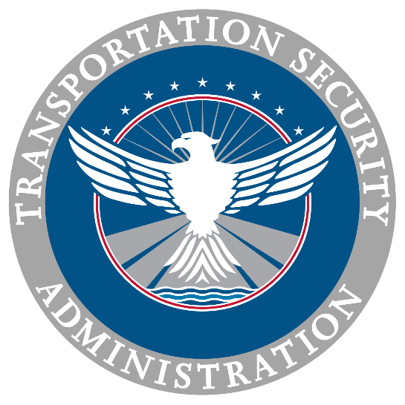
Where do I ask Questions Regarding the Proposed Rule?
PPE Surface Division Rulemaking POC is Vic Parker
Send inquiries to the SurfaceVetting@tsa.dhs.gov mailbox
Call (571) 227-1039

