Slide 1
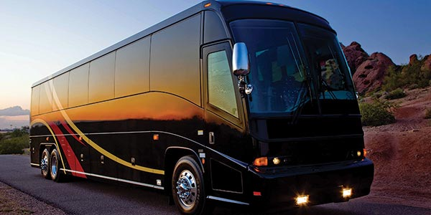

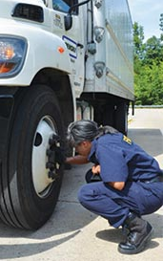
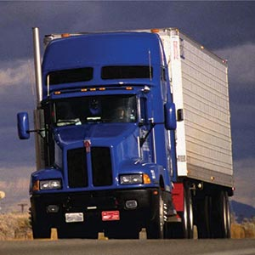
FMCSA
Pre-Employment Screening Program
(PSP)
Federal Motor Carrier Safety Administration

Slide 2

Pre-Employment Screening Program
PSP What
2010 FMCSA Initiative
May 2010: PSP 1.0 launched
October 2012: PSP 2.0 rolled out
Provides motor carriers with crash and inspection data on potential new hires
Voluntary program
Driver must provide authorization
Notes:
FMCSA recognizes that strong education and outreach programs are vital to fulfilling the Agency’s mission to reduce crashes, injuries and fatalities involving large trucks and buses. The Office of Outreach and Education supports six key measures that drive the Federal Motor Carrier Safety Administration’s critical mission:
Regulation
Enforcement
Education
Research
Technology
Partnerships

Slide 3
Pre-Employment Screening Program
PSP Why
Required by SAFETEA-LU
Increase safety
Assist companies in making better informed decisions on new hires
Improves data quality
Can request a review of the data through FMCSA’s DataQs System https://dataqs.fmcsa.dot.gov/login.asp
Notes:
FMCSA recognizes that strong education and outreach programs are vital to fulfilling the Agency’s mission to reduce crashes, injuries and fatalities involving large trucks and buses. The Office of Outreach and Education supports six key measures that drive the Federal Motor Carrier Safety Administration’s critical mission:
Regulation
Enforcement
Education
Research
Technology
Partnerships

Slide 4
Pre-Employment Screening Program
PSP Data
Motor Carrier Management Information System (MCMIS)
5 years crash data
3 years inspection data
Not preventable crash data
Same as FMCSA’s Driver Information Resource (DIR)
PSP Data Enhancements
Notes:
FMCSA recognizes that strong education and outreach programs are vital to fulfilling the Agency’s mission to reduce crashes, injuries and fatalities involving large trucks and buses. The Office of Outreach and Education supports six key measures that drive the Federal Motor Carrier Safety Administration’s critical mission:
Regulation
Enforcement
Education
Research
Technology
Partnerships

Slide 5
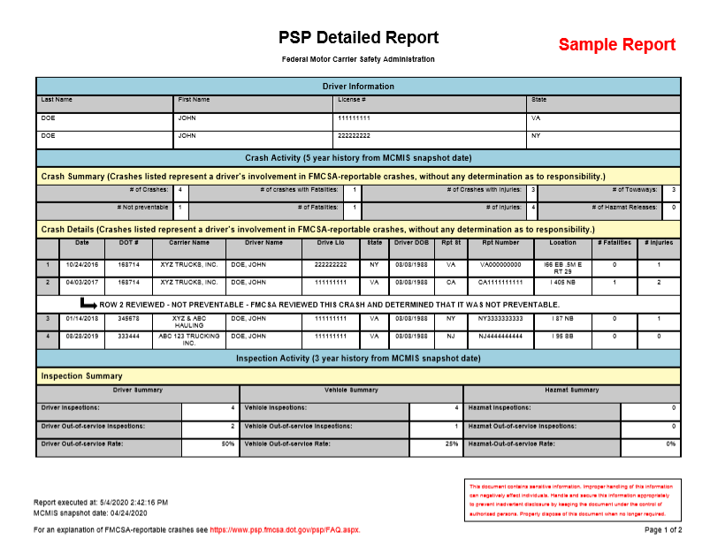
Pre-Employment Screening Program
Notes:
FMCSA recognizes that strong education and outreach programs are vital to fulfilling the Agency’s mission to reduce crashes, injuries and fatalities involving large trucks and buses. The Office of Outreach and Education supports six key measures that drive the Federal Motor Carrier Safety Administration’s critical mission:
Regulation
Enforcement
Education
Research
Technology
Partnerships

Slide 6
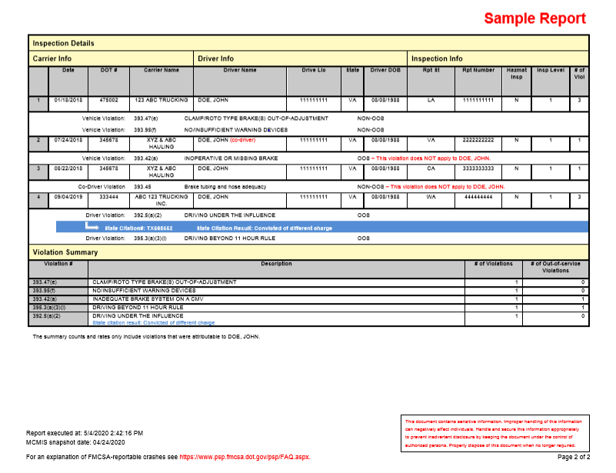
Pre-Employment Screening Program
Notes:
FMCSA recognizes that strong education and outreach programs are vital to fulfilling the Agency’s mission to reduce crashes, injuries and fatalities involving large trucks and buses. The Office of Outreach and Education supports six key measures that drive the Federal Motor Carrier Safety Administration’s critical mission:
Regulation
Enforcement
Education
Research
Technology
Partnerships

Slide 7
Pre-Employment Screening Program
PSP and the Motor Vehicle Record – What’s the Difference?
Notes:
FMCSA recognizes that strong education and outreach programs are vital to fulfilling the Agency’s mission to reduce crashes, injuries and fatalities involving large trucks and buses. The Office of Outreach and Education supports six key measures that drive the Federal Motor Carrier Safety Administration’s critical mission:
Regulation
Enforcement
Education
Research
Technology
Partnerships

Slide 8
Pre-Employment Screening Program
PSP and Motor Vehicle Records (MVR) offer different information
An MVR shows the driver’s convictions
A PSP record includes violations collected at the roadside inspection or crash
Citations, warnings and tickets yet to be settled in court will not appear on an MVR
A driver’s PSP will show violations regardless of the conviction result
Notes:
FMCSA recognizes that strong education and outreach programs are vital to fulfilling the Agency’s mission to reduce crashes, injuries and fatalities involving large trucks and buses. The Office of Outreach and Education supports six key measures that drive the Federal Motor Carrier Safety Administration’s critical mission:
Regulation
Enforcement
Education
Research
Technology
Partnerships

Slide 9
Pre-Employment Screening Program
PSP Data and Motor Vehicle Records (MVR) offer different information
States are responsible for maintaining motor vehicle records
Conviction data is posted periodically to a motor vehicle record, depending on each state’s unique process
FMCSA manages inspection and violation data
A PSP report will show the original violation when a citation has been adjudicated and has resulted in a conviction of a different charge
Notes:
FMCSA recognizes that strong education and outreach programs are vital to fulfilling the Agency’s mission to reduce crashes, injuries and fatalities involving large trucks and buses. The Office of Outreach and Education supports six key measures that drive the Federal Motor Carrier Safety Administration’s critical mission:
Regulation
Enforcement
Education
Research
Technology
Partnerships

Slide 10
Pre-Employment Screening Program
How Important is PSP
PSP helps FMCSA and you make our roads safe
PSP can help you get your cargo to its destination safely and on time – it can help you keep your business running
Thorough pre-employment screenings help accomplish these goals, maintain compliance, and helps ensure you are protected
Notes:
FMCSA recognizes that strong education and outreach programs are vital to fulfilling the Agency’s mission to reduce crashes, injuries and fatalities involving large trucks and buses. The Office of Outreach and Education supports six key measures that drive the Federal Motor Carrier Safety Administration’s critical mission:
Regulation
Enforcement
Education
Research
Technology
Partnerships

Slide 11
Pre-Employment Screening Program
National Transportation Safety Board (NTSB)
Conducted an investigation in November 2016 after a fatal accident in Chattanooga, TN. The investigation identified PSP as a useful tool to help make sound hiring decisions
Notes:
FMCSA recognizes that strong education and outreach programs are vital to fulfilling the Agency’s mission to reduce crashes, injuries and fatalities involving large trucks and buses. The Office of Outreach and Education supports six key measures that drive the Federal Motor Carrier Safety Administration’s critical mission:
Regulation
Enforcement
Education
Research
Technology
Partnerships

Slide 12
Pre-Employment Screening Program
PSP How
Requesting a PSP record is easy
Four data elements
Driver name
Date of birth
Driver license number
Driver license state
Some drivers may have more than one name or license in the past five years
Notes:
FMCSA recognizes that strong education and outreach programs are vital to fulfilling the Agency’s mission to reduce crashes, injuries and fatalities involving large trucks and buses. The Office of Outreach and Education supports six key measures that drive the Federal Motor Carrier Safety Administration’s critical mission:
Regulation
Enforcement
Education
Research
Technology
Partnerships

Slide 13
Pre-Employment Screening Program
Best Practices for Requesting a PSP Record
Notes:
FMCSA recognizes that strong education and outreach programs are vital to fulfilling the Agency’s mission to reduce crashes, injuries and fatalities involving large trucks and buses. The Office of Outreach and Education supports six key measures that drive the Federal Motor Carrier Safety Administration’s critical mission:
Regulation
Enforcement
Education
Research
Technology
Partnerships

Slide 14
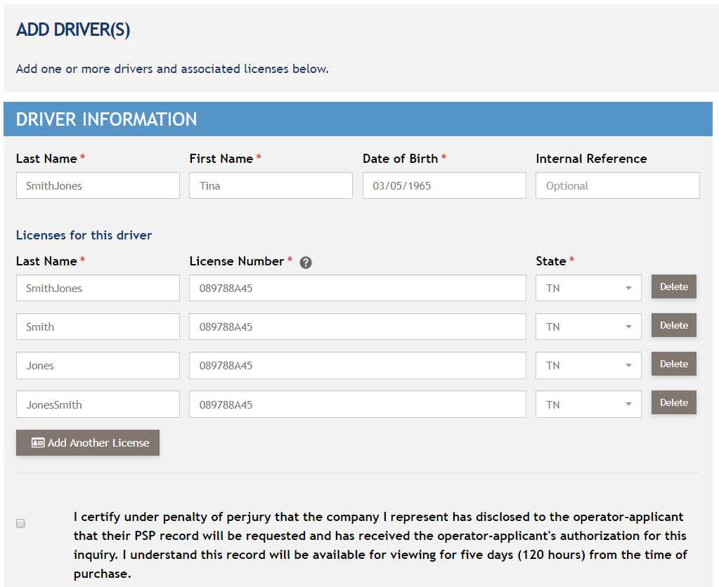
Pre-Employment Screening Program
Hyphenated Names
Notes:
FMCSA recognizes that strong education and outreach programs are vital to fulfilling the Agency’s mission to reduce crashes, injuries and fatalities involving large trucks and buses. The Office of Outreach and Education supports six key measures that drive the Federal Motor Carrier Safety Administration’s critical mission:
Regulation
Enforcement
Education
Research
Technology
Partnerships

Slide 15
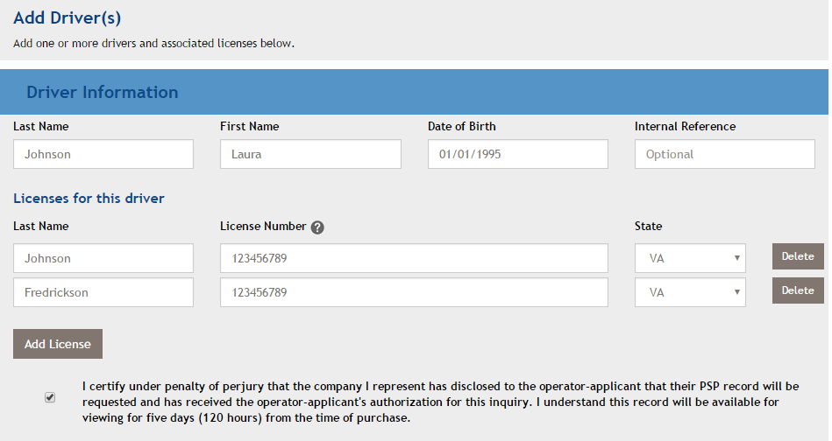
Pre-Employment Screening Program
Multiple Last Names
Notes:
FMCSA recognizes that strong education and outreach programs are vital to fulfilling the Agency’s mission to reduce crashes, injuries and fatalities involving large trucks and buses. The Office of Outreach and Education supports six key measures that drive the Federal Motor Carrier Safety Administration’s critical mission:
Regulation
Enforcement
Education
Research
Technology
Partnerships

Slide 16
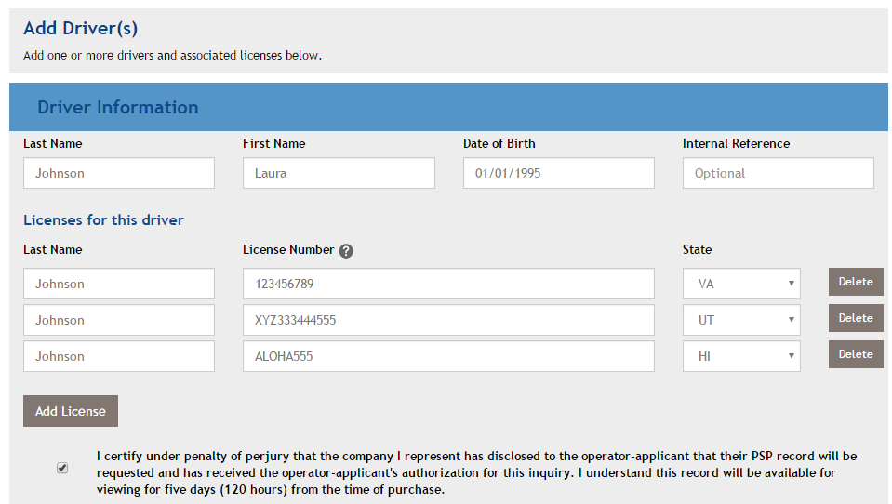
Pre-Employment Screening Program
Multiple Driver Licenses
Notes:
FMCSA recognizes that strong education and outreach programs are vital to fulfilling the Agency’s mission to reduce crashes, injuries and fatalities involving large trucks and buses. The Office of Outreach and Education supports six key measures that drive the Federal Motor Carrier Safety Administration’s critical mission:
Regulation
Enforcement
Education
Research
Technology
Partnerships

Slide 17
Pre-Employment Screening Program
PSP Monitoring
Notes:
FMCSA recognizes that strong education and outreach programs are vital to fulfilling the Agency’s mission to reduce crashes, injuries and fatalities involving large trucks and buses. The Office of Outreach and Education supports six key measures that drive the Federal Motor Carrier Safety Administration’s critical mission:
Regulation
Enforcement
Education
Research
Technology
Partnerships

Slide 18
Pre-Employment Screening Program
PSP Monitoring
PSP monitoring notifies a driver when there is an update to their PSP record
New service launched 5/31/19
PSP monitoring is free of charge and is for use by “drivers only” – employers do not receive notifications
Drivers can enroll through their PSP account by clicking the “Enroll in PSP Monitoring” button on their dashboard
Drivers can unsubscribe anytime
Notes:
FMCSA recognizes that strong education and outreach programs are vital to fulfilling the Agency’s mission to reduce crashes, injuries and fatalities involving large trucks and buses. The Office of Outreach and Education supports six key measures that drive the Federal Motor Carrier Safety Administration’s critical mission:
Regulation
Enforcement
Education
Research
Technology
Partnerships

Slide 19
Pre-Employment Screening Program
PSP Not Preventable
Crash Data
Notes:
FMCSA recognizes that strong education and outreach programs are vital to fulfilling the Agency’s mission to reduce crashes, injuries and fatalities involving large trucks and buses. The Office of Outreach and Education supports six key measures that drive the Federal Motor Carrier Safety Administration’s critical mission:
Regulation
Enforcement
Education
Research
Technology
Partnerships

Slide 20
Pre-Employment Screening Program
PSP Not Preventable Crash Data
On May 1, 2020, FMCSA initiated the Crash Preventability Determination Program (CPDP) which allows 16 eligible crash types to be submitted for review. Information on the program is available at www.fmcsa.dot.gov/crash-preventability-determination-program.
Eligible crashes on a driver’s PSP record that were not preventable may be submitted for review by FMCSA through DataQs at dataqs.fmcsa.dot.gov.
Crashes that are determined to be not preventable through the CPDP are now notated on PSP records.
By listing all FMCSA-reportable crashes, inspections, and violations, each PSP record serves as a complete driver history snapshot and notes not preventable crash determinations from the CPDP.
Notes:
FMCSA recognizes that strong education and outreach programs are vital to fulfilling the Agency’s mission to reduce crashes, injuries and fatalities involving large trucks and buses. The Office of Outreach and Education supports six key measures that drive the Federal Motor Carrier Safety Administration’s critical mission:
Regulation
Enforcement
Education
Research
Technology
Partnerships

Slide 21
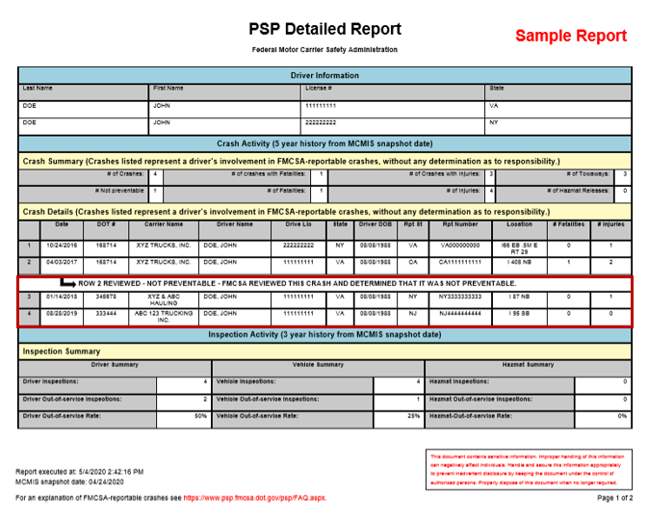
Pre-Employment Screening Program
Not Preventable Crash Data
Notes:
FMCSA recognizes that strong education and outreach programs are vital to fulfilling the Agency’s mission to reduce crashes, injuries and fatalities involving large trucks and buses. The Office of Outreach and Education supports six key measures that drive the Federal Motor Carrier Safety Administration’s critical mission:
Regulation
Enforcement
Education
Research
Technology
Partnerships

Slide 22
Pre-Employment Screening Program
FMCSA Resolves Discrepancies
Notes:
FMCSA recognizes that strong education and outreach programs are vital to fulfilling the Agency’s mission to reduce crashes, injuries and fatalities involving large trucks and buses. The Office of Outreach and Education supports six key measures that drive the Federal Motor Carrier Safety Administration’s critical mission:
Regulation
Enforcement
Education
Research
Technology
Partnerships

Slide 23
Pre-Employment Screening Program
DataQs
FMCSA provides a mechanism for fixing data discrepancies – DataQs
Anyone may submit a Request for Data Review (RDR) to DataQs
DataQs is the centralized system which routes the RDR to the appropriate state for analysis
https://dataqs.fmcsa.dot.gov/
Notes:
FMCSA recognizes that strong education and outreach programs are vital to fulfilling the Agency’s mission to reduce crashes, injuries and fatalities involving large trucks and buses. The Office of Outreach and Education supports six key measures that drive the Federal Motor Carrier Safety Administration’s critical mission:
Regulation
Enforcement
Education
Research
Technology
Partnerships

Slide 24
Pre-Employment Screening Program
DataQs
DataQs allows a user to submit a Request for Data Review (RDR) to have incorrect data analyzed
This also applies to the outcome of an adjudicated citation
For adjudicated citations a driver must submit certified court documentation and inspection details with the RDR
Notes:
FMCSA recognizes that strong education and outreach programs are vital to fulfilling the Agency’s mission to reduce crashes, injuries and fatalities involving large trucks and buses. The Office of Outreach and Education supports six key measures that drive the Federal Motor Carrier Safety Administration’s critical mission:
Regulation
Enforcement
Education
Research
Technology
Partnerships

Slide 25
Pre-Employment Screening Program
Adequate Documentation
Adequate documentation includes:
Scanned copies of certified documentation from the appropriate court or administrative tribunal
A direct web link to the adjudication results of an official court or agency website that presents adequate and verifiable documentation of the adjudication result
Notes:
FMCSA recognizes that strong education and outreach programs are vital to fulfilling the Agency’s mission to reduce crashes, injuries and fatalities involving large trucks and buses. The Office of Outreach and Education supports six key measures that drive the Federal Motor Carrier Safety Administration’s critical mission:
Regulation
Enforcement
Education
Research
Technology
Partnerships

Slide 26
Pre-Employment Screening Program
Disclosure and Authorization
FMCSA requires that anyone requesting drivers’ PSP records must use a specific disclosure and authorization form
The form’s language must be used as-is, without alteration
The form may not be combined with other language or forms
To get a PSP record:
Provide disclosure to the driver
Get the driver’s authorization
Monthly audits are conducted to verify compliance
Notes:
FMCSA recognizes that strong education and outreach programs are vital to fulfilling the Agency’s mission to reduce crashes, injuries and fatalities involving large trucks and buses. The Office of Outreach and Education supports six key measures that drive the Federal Motor Carrier Safety Administration’s critical mission:
Regulation
Enforcement
Education
Research
Technology
Partnerships

Slide 27
Pre-Employment Screening Program
PSP Improves Safety
Notes:
FMCSA recognizes that strong education and outreach programs are vital to fulfilling the Agency’s mission to reduce crashes, injuries and fatalities involving large trucks and buses. The Office of Outreach and Education supports six key measures that drive the Federal Motor Carrier Safety Administration’s critical mission:
Regulation
Enforcement
Education
Research
Technology
Partnerships

Slide 28
Pre-Employment Screening Program
PSP Safety Impact Analysis Findings
Both the PSP and non-PSP carriers experienced declines in crashes and driver out-of-service rates during the study’s time period
Carriers using PSP experienced more improvements in their crash and driver OOS rates
Findings are available online
https://rosap.ntl.bts.gov/view/dot/12
Notes:
FMCSA recognizes that strong education and outreach programs are vital to fulfilling the Agency’s mission to reduce crashes, injuries and fatalities involving large trucks and buses. The Office of Outreach and Education supports six key measures that drive the Federal Motor Carrier Safety Administration’s critical mission:
Regulation
Enforcement
Education
Research
Technology
Partnerships

Slide 29
Pre-Employment Screening Program
PSP Safety Study Results
All driver class sizes experienced decreases in crash and OOS rates
On average, carriers who use PSP reduced crashes by 8% and driver OOS rates fell by 17.2%!
Notes:
FMCSA recognizes that strong education and outreach programs are vital to fulfilling the Agency’s mission to reduce crashes, injuries and fatalities involving large trucks and buses. The Office of Outreach and Education supports six key measures that drive the Federal Motor Carrier Safety Administration’s critical mission:
Regulation
Enforcement
Education
Research
Technology
Partnerships

Slide 30
Pre-Employment Screening Program
How do I enroll in PSP?
Notes:
FMCSA recognizes that strong education and outreach programs are vital to fulfilling the Agency’s mission to reduce crashes, injuries and fatalities involving large trucks and buses. The Office of Outreach and Education supports six key measures that drive the Federal Motor Carrier Safety Administration’s critical mission:
Regulation
Enforcement
Education
Research
Technology
Partnerships

Slide 31
Pre-Employment Screening Program
PSP Enrollment
Enroll at the PSP web site – www.psp.fmcsa.dot.gov
Fee for account holder service, single monthly invoice
Notes:
FMCSA recognizes that strong education and outreach programs are vital to fulfilling the Agency’s mission to reduce crashes, injuries and fatalities involving large trucks and buses. The Office of Outreach and Education supports six key measures that drive the Federal Motor Carrier Safety Administration’s critical mission:
Regulation
Enforcement
Education
Research
Technology
Partnerships

Slide 32
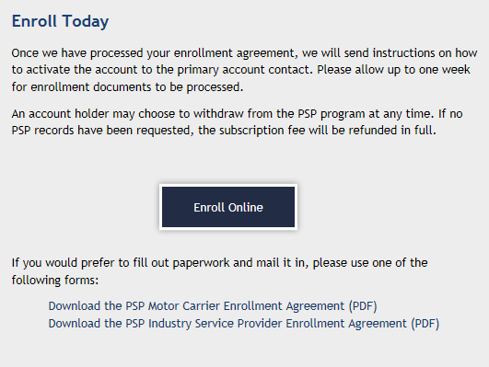
Pre-Employment Screening Program
PSP Cost
$10 per driver record request (includes multiple licenses per driver)
$100 / $25 annual subscription fee
PSP managed by NIC on behalf of FMCSA
Notes:
FMCSA recognizes that strong education and outreach programs are vital to fulfilling the Agency’s mission to reduce crashes, injuries and fatalities involving large trucks and buses. The Office of Outreach and Education supports six key measures that drive the Federal Motor Carrier Safety Administration’s critical mission:
Regulation
Enforcement
Education
Research
Technology
Partnerships

Slide 33
Pre-Employment Screening Program
Contact PSP
FMCSA PSP email: psp.fmcsa@dot.gov
Enrollment inquiries: PSPhelp@egov.com
or call 1-877-642-9499
PSP URL: www.psp.fmcsa.dot.gov
Twitter: @PSP_help
Yvonne Glover
Yvonne.Glover@egov.com
Contact Us
Notes:
FMCSA recognizes that strong education and outreach programs are vital to fulfilling the Agency’s mission to reduce crashes, injuries and fatalities involving large trucks and buses. The Office of Outreach and Education supports six key measures that drive the Federal Motor Carrier Safety Administration’s critical mission:
Regulation
Enforcement
Education
Research
Technology
Partnerships

Slide 34
Pre-Employment Screening Program
Questions?
Notes:
FMCSA recognizes that strong education and outreach programs are vital to fulfilling the Agency’s mission to reduce crashes, injuries and fatalities involving large trucks and buses. The Office of Outreach and Education supports six key measures that drive the Federal Motor Carrier Safety Administration’s critical mission:
Regulation
Enforcement
Education
Research
Technology
Partnerships

