Slide 1



Operational Excellence – Employee Retention
Jeff Shanker,
Chief Strategy Officer
Black Tie Transportation and Bus Charters
Chairman – Bus Industry Safety Council – American Bus Association

Slide 2

Putting the Pieces of the puzzle together

Slide 3

Processes
A little example to bring this to the forefront

Slide 4
Processes
37 | 21 | 18 | 42
9 | 33 | 54 | 30
69 | 1 | 58 | 2
29 | 73 | 22 | 38
57 | 49 | 70 | 26
53 | 41 | 10 | 46
45 | 13 | 62 | 6
61 | 65 | 50 | 66
5 | 25 | 74 | 34
17 | 77 | 14 | 78
24 | 44 | 63 | 11
12 | 60 | 15 | 51
56 | 20 | 31 | 39
4 | 48 | 3 | 67
40 | 68 | 43 | 59
28 | 32 | 47 | 27
72 | 16 | 7 | 75
52 | 76 | 35 | 71
8 | 80 | 23 | 19
64 | 36 | 79 | 55
In numerical order, how many can you locate in 30 seconds

Slide 5
Why would someone want to work with you, stay with you / your company
List 3 reasons people would want to work with you – your company?
Culture
Clients
Equipment

Slide 6

Critical Thinking
Dispatching / Operations

Slide 7
Critical Thinking
Entails effective communication and problem-solving abilities and a commitment to overcome problematic situations with learned behavior and available analytical tools
Self-directed, self-disciplined, self-monitored, and self-corrective thinking.

Slide 8

How many “Squares” do you count?

Slide 9
How Many Squares?
___ (1×1 squares)
___ (2×2 squares)
___ (3×3 squares)
_ (4 ×4 square)
___ Squares

Slide 10
How Many Squares?
16 (1×1 squares)
9 (2×2 squares)
4 (3×3 squares)
1 (4×4 square)
30 squares

Slide 11
Dispatch / Operations Excellence - What does this require
Communication

Slide 12
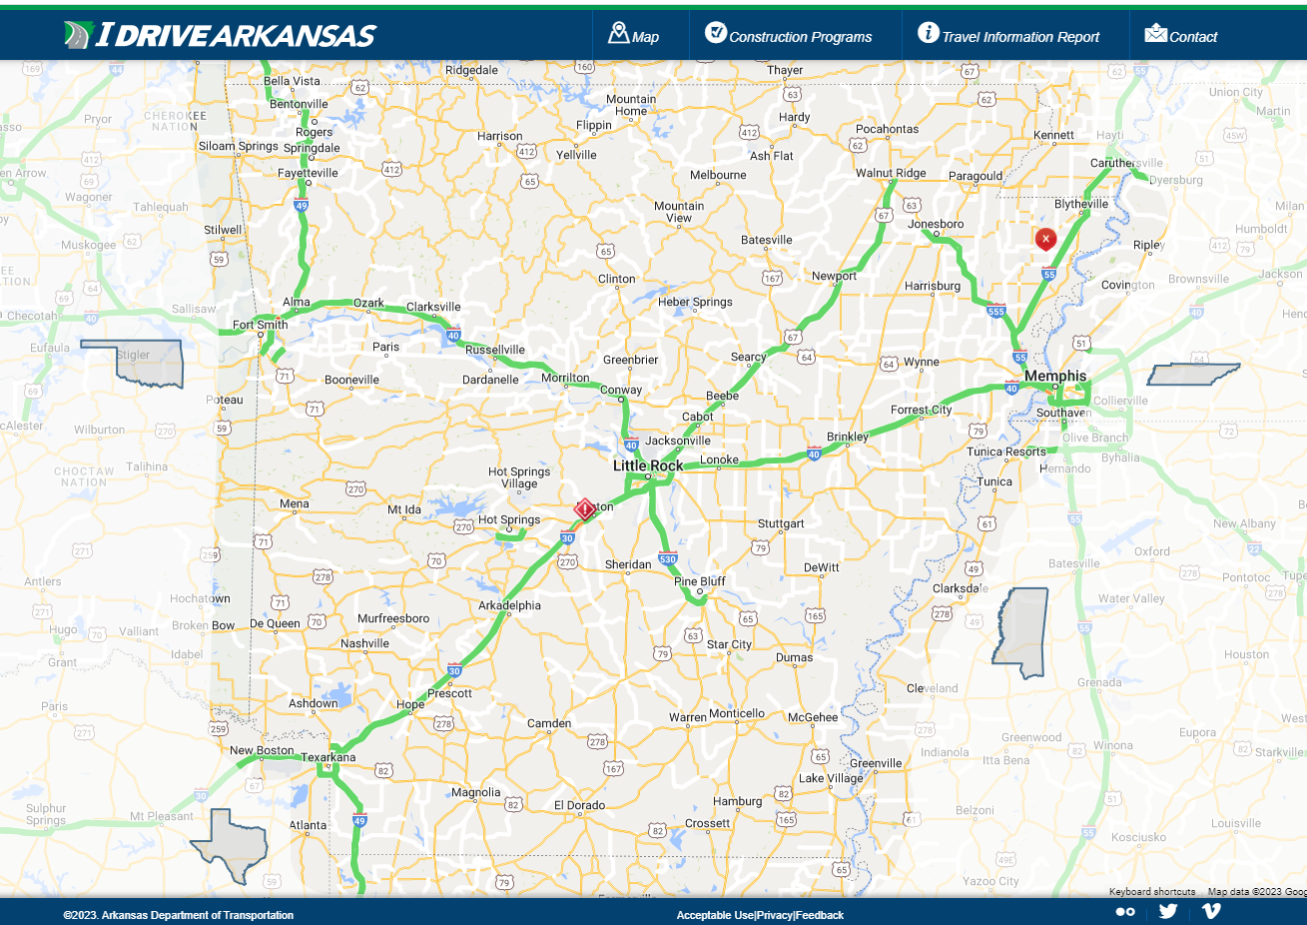
A great Team Member is an Expert, with:
Geography
  Travel Time
Traffic
    Monitor real time traffic – www.cypresspmg.com
    Resource Locations
      “Ports of Entry”
      Airports
      Seaports
      Rail Stations
Best Routes in and out of Venues

Slide 13
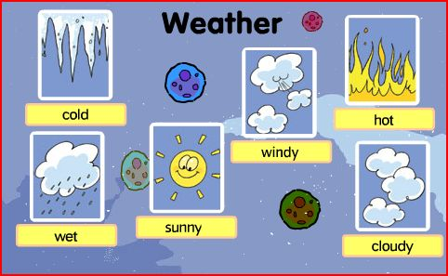
A great Team Member is an Expert, with:
Geography
Traffic
Best routes in/out of venues
Weather

Slide 14

A great Team Member is an Expert, with:
Geography
Traffic
Best routes in/out of venues
Weather
Client requests

Slide 15
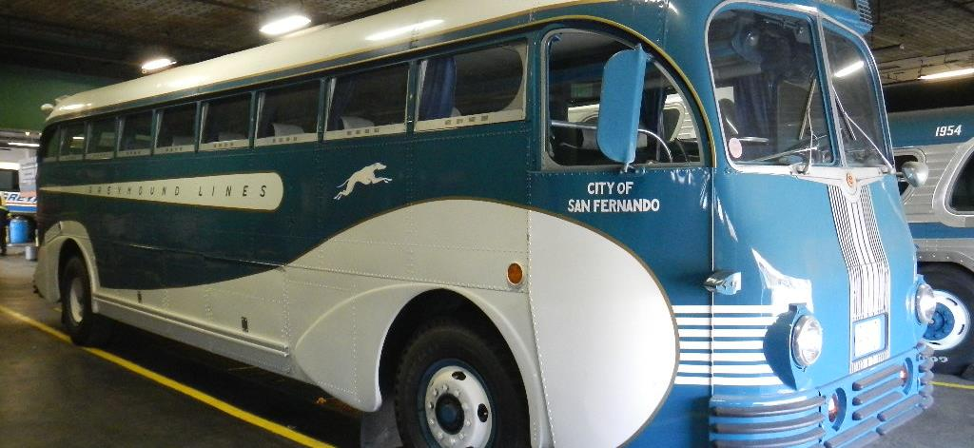
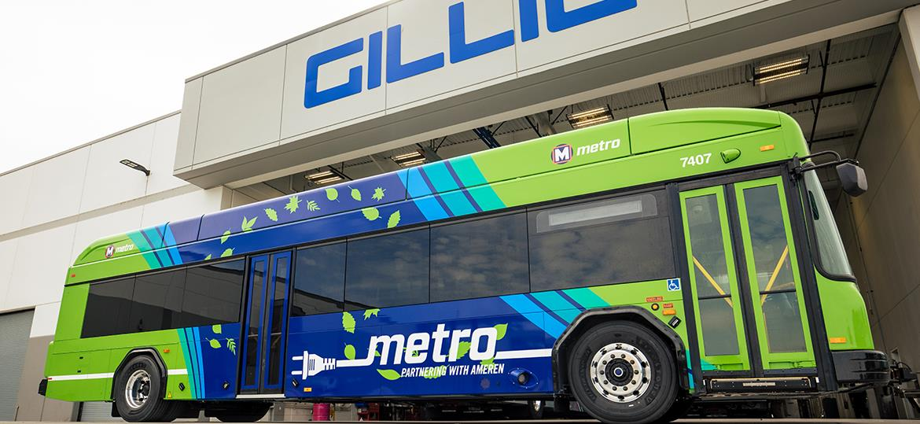
A great Team Member is an Expert, with:
Geography
Traffic
Best routes in/out of venues
Weather
Client requests
Vehicles

Slide 16
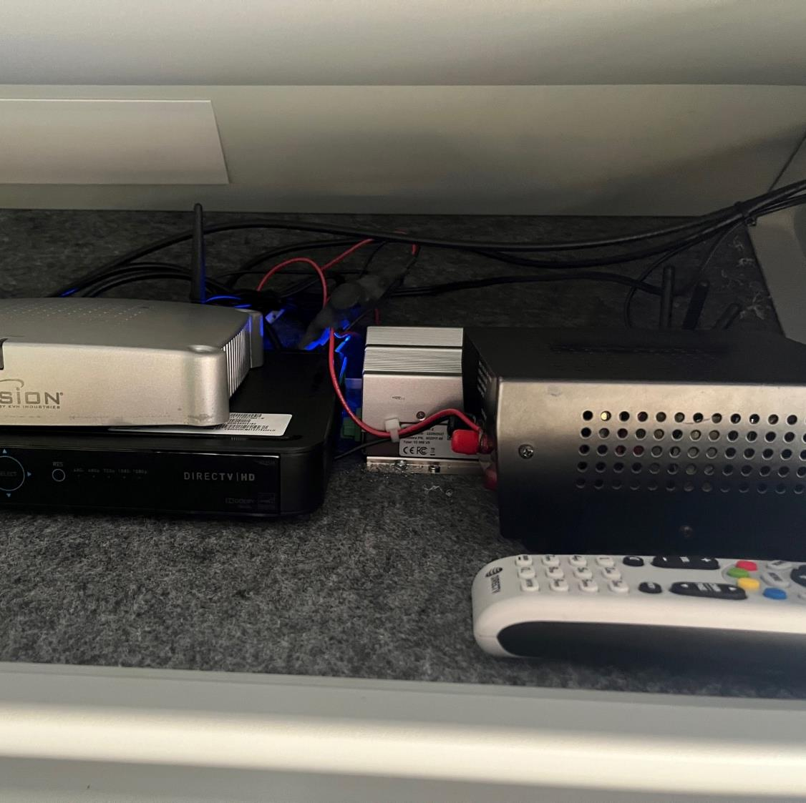
A great Team Member is an Expert, with:
Geography
Traffic
Best routes in/out of venues
Weather
Client requests
Vehicles
Operating of equipment

Slide 17
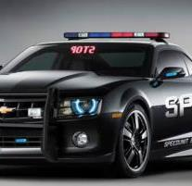
A great Team Member is an Expert, with:
Geography
Traffic
Best routes in/out of venues
Weather
Client requests
Vehicles
Operating of equipment
Laws of the jurisdictions you serve

Slide 18
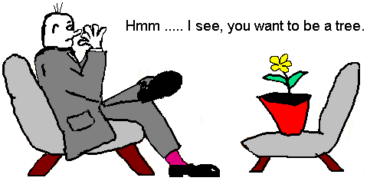
A great Team Member is an Expert, with:
Geography
Traffic
Best routes in/out of venues
Weather
Client requests
Vehicles
Operating of equipment
Laws of the jurisdictions you serve
Psychologist

Slide 19

A great Team Member is an Expert, with:
Information
  Where does it start
    Booker / Passenger
    Reservationist
    Operations
Find The Information
  The Internet

Slide 20
Know your Drivers
The lifeblood of our industry

Slide 21
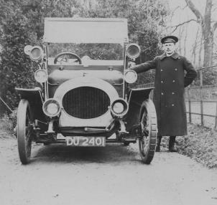
Know you Driver’s habits
Drivers tend to have habits.
  Responsible Driver
    Hours of Service
      “it’s okay boss, I can handle one more ride”
  Observant and obey the rules on the road
    GPS speed alerts
    Client concerns (or complaints)
  Complete necessary documents correctly and accurately

Slide 22
Assigning work to the Driver
Availability
Capabilities
  Geographical challenges
Personality / Temperament
  How will they handle the passenger
    Religious
    Gender
  Situation
    Traffic
    Other

Slide 23

Assisting the Driver
Make sure they have all the needed information.
  Special notes and instructions
  Name of the Account or Affiliation

Slide 24
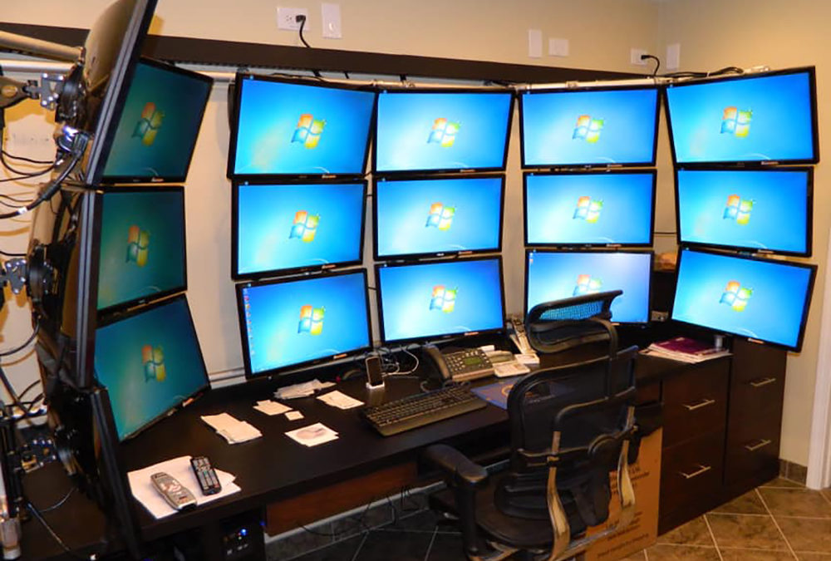
Assisting the Driver
You….
  Controlled environment
  Computer
    Multiple “BIG Screens”
  Internet access (high speed)
  Multiline Telephone Lines

Slide 25

Driver…
  Not in a controlled environment
    Panic mode
  Small computer screen
  Internet access, on a phone, tablet, etc. all on “1” device.

Slide 26

Create a pleasant atmosphere
Situations that arise could flair tempers,
  but shouldn’t (CAN’T).
Keep in mind that you are the person in control
  Remain in control of yourself and the situation.
Passenger’s safety and satisfaction are the first and foremost considerations.
Responsibility is to resolve the situation.
Keep the Driver’s concentration on the task at hand.
Take a bad situation and fix it.
Take personality(everyone involved) out of the situation.

Slide 27

Operational Excellence Requires
Great Communicators, that are always polite and nice.
Excellent knowledge of the transportation industry and mind-blowing intuition.
Is the person that leads the Motorcoach Company to greatness, success depends on his/her leadership capabilities.
Be a strong leader take your company to Success!
Retain your employees

Slide 28
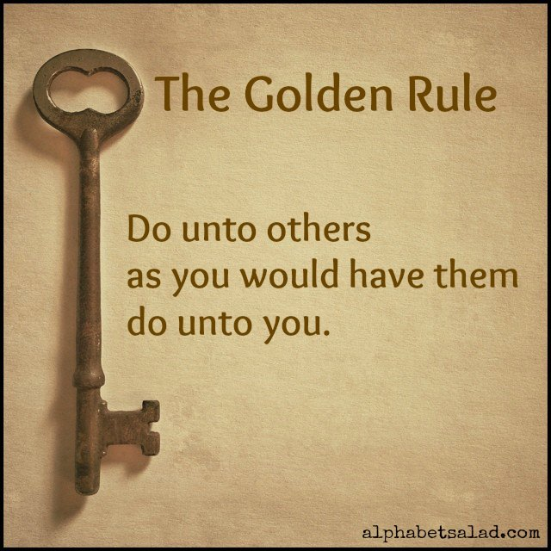
Responsibility to Other Team Members and the Entire Company

Slide 29

Questions

Slide 30
Jeff Shanker,
Chief Strategy Officer,
Black Tie Transportation and Bus Charters
Chairman, Bus Industry Safety Council
Jeff@BlackTieTransportation.Net
336-768-5177 office

