Slide 1


Operational Excellence
Jeff Shanker,
Chief Strategy Officer
Black Tie Transportation and Bus Charters

Slide 2

Goals of the Session
Operational Excellence
What is it, how do we achieve it
Customer Service
Describe and identify how we provide it
Dispatch
Critical Thinking
Operational Periods
Motorcoach Operator / Chauffeur / Driver and Operations Symbiotic relationships

Slide 3

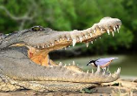
Operational Excellence
Why do we want Operational Excellence
Increased Revenue
Better Profitability
Symbiotic relationships
Drivers
Clients
External
Internal

Slide 4

Putting the Pieces of the puzzle together

Slide 5

What is the definition of “Excellent Customer Service”?
Service that treats customers
With a friendly attitude
Tries to resolve their problem or question as efficiently as possible.
Quality customer service has a big impact on customer-oriented businesses

Slide 6
Operational Excellence
A skilled customer service / dispatcher will ensure the right people are in the right place at the right time.
Customer Service will learn to help create the puzzle with all the information necessary to build it.
Dispatchers will learn how to put the pieces in place that will maximize your company’s efficiency and guarantee seamless operations.

Slide 7

Phone etiquette
Proper telephone etiquette is very important in that you are representing everyone within your company.

Slide 8

Telephone Etiquette
Have pen and paper handy
1
Always answer the phone as promptly as possible, never let it ring more than 2 times
2
Provide a greeting
3
Thank you for calling….. how may I may I assist you?
Write down the caller's name and number
4

Slide 9

Telephone Etiquette 3 Steps
Ask
If you can’t understand the caller, ask them to slow down or repeat what is necessary
Listen
Listen Actively
Let the caller do the talking
Respond accordingly
Confirm
Confirm the reservation by verbally and via e-mail

Slide 10

Critical Thinking
Dispatching / Operations

Slide 11
Critical Thinking
Entails effective communication and problem-solving abilities and a commitment to overcome problematic situations with learned behavior and available analytical tools
Self-directed, self-disciplined, self-monitored, and self-corrective thinking.

Slide 12

How Many Squares?

Slide 13
How Many Squares?
16 (1×1 squares)
9 (2×2 squares)
4 (3×3 squares)
1 (4×4 square)
30 squares

Slide 14
How Many Squares?
16 (1×1 squares)
9 (2×2 squares)
4 (3×3 squares)
1 (4×4 square)
30 squares

Slide 15
Operational Expert – What does this require

Slide 16
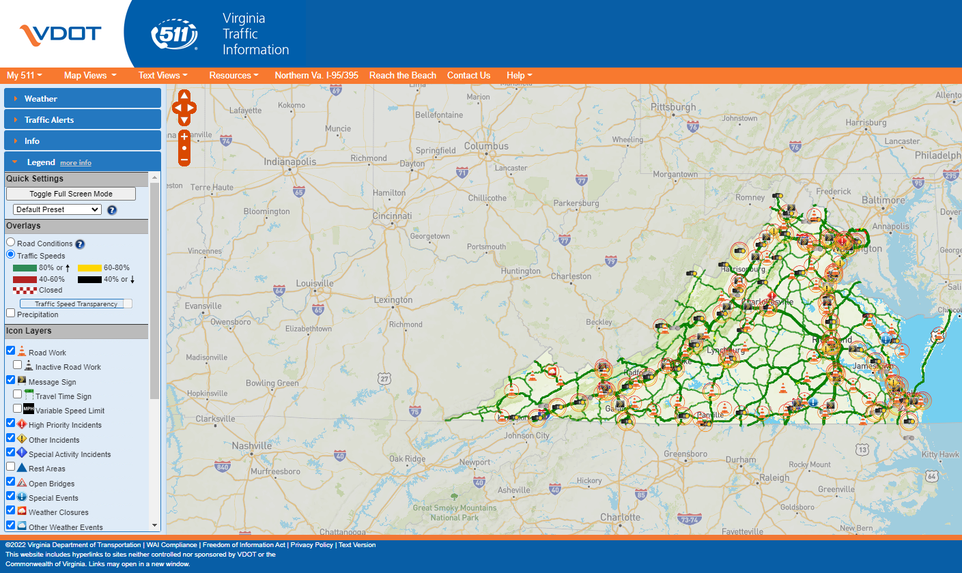
A great Team Member is an Expert, with:
Geography
Travel Time
Traffic
Monitor real time traffic – https://www.511virginia.org/
Resource Locations
“Ports of Entry”
Airports
Seaports
Rail Stations
Best Routes in and out of Venues

Slide 17
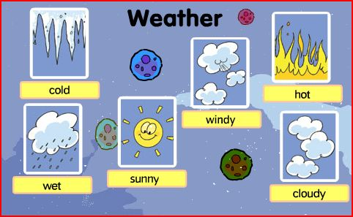
A great Team Member is an Expert, with:
Geography
Traffic
Best routes in/out of venues
Weather

Slide 18

A great Team Member is an Expert, with:
Geography
Traffic
Best routes in/out of venues
Weather
Client requests

Slide 19
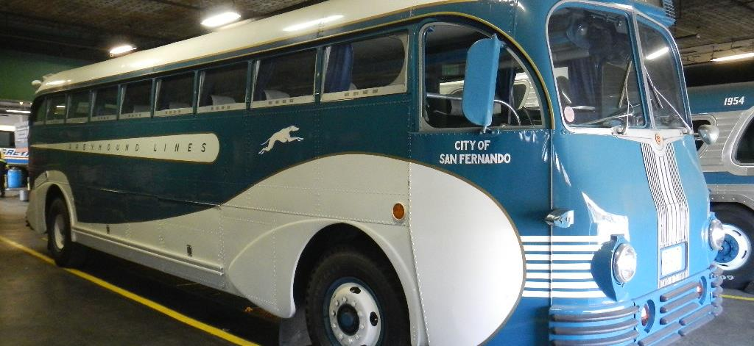
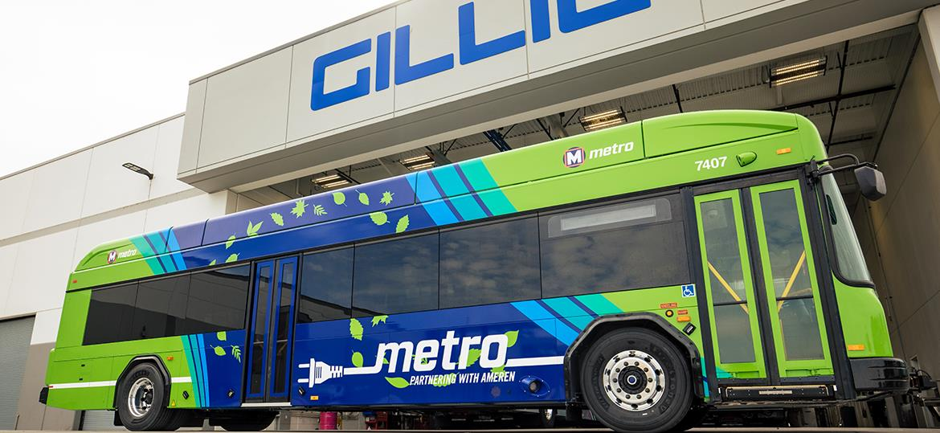
A great Team Member is an Expert, with:
Geography
Traffic
Best routes in/out of venues
Weather
Client requests
Vehicles

Slide 20
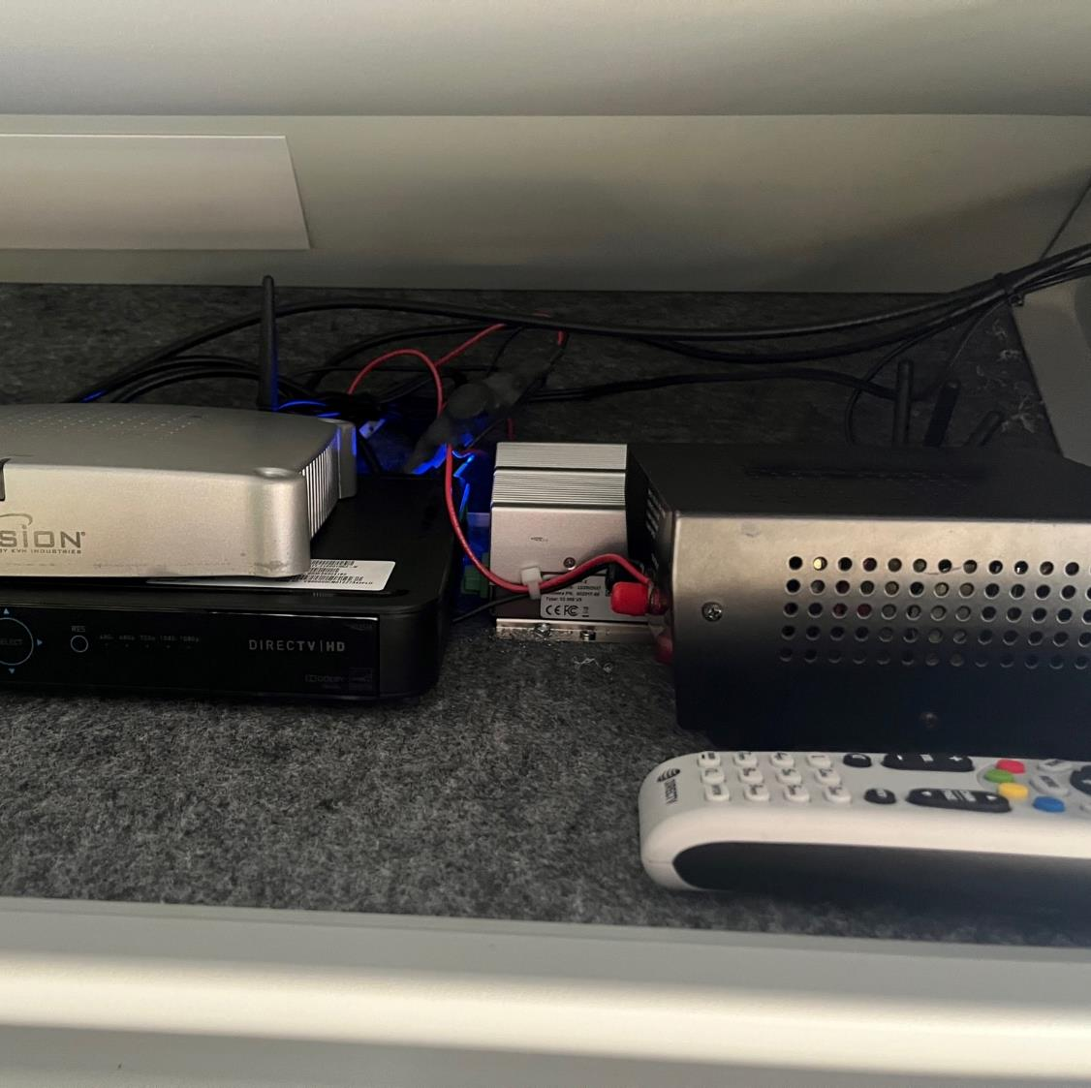
A great Team Member is an Expert, with:
Geography
Traffic
Best routes in/out of venues
Weather
Client requests
Vehicles
Operating of equipment

Slide 21
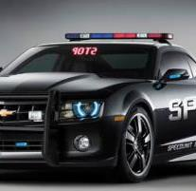
A great Team Member is an Expert, with:
Geography
Traffic
Best routes in/out of venues
Weather
Client requests
Vehicles
Operating of equipment
Laws of the jurisdictions you serve

Slide 22
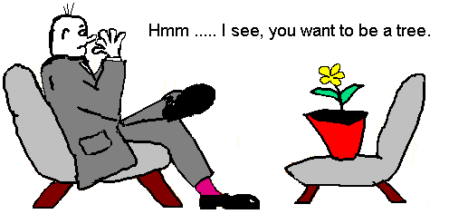
A great Team Member is an Expert, with:
Geography
Traffic
Best routes in/out of venues
Weather
Client requests
Vehicles
Operating of equipment
Laws of the jurisdictions you serve
Psychologist

Slide 23

A great Team Member is an Expert, with:
Information
Where does it start
Booker / Passenger
Reservationist
Operations
Find The Information
The Internet

Slide 24
Know your Drivers
The lifeblood of our industry

Slide 25
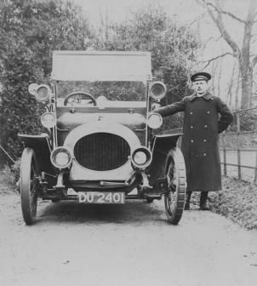
Know you Driver’s habits
Drivers tend to have habits.
Responsible Driver
Hours of Service
“it’s okay boss, I can handle one more ride”
Observant and obey the rules on the road
GPS speed alerts
Client concerns (or complaints)
Complete necessary documents correctly and accurately

Slide 26
Assigning work to the Driver
Availability
Capabilities
Geographical challenges
Personality / Temperament
How will they handle the passenger
Religious
Gender
Situation
Traffic
Other

Slide 27

Assisting the Driver
Make sure they have all the needed information.
Special notes and instructions
Name of the Account or Affiliation

Slide 28
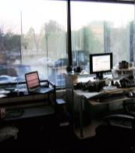
Assisting the Driver
You….
Controlled environment
Computer
Multiple “BIG Screens”
Internet access (high speed)
Multiline Telephone

Slide 29

Assisting the Driver
Driver…
Not in a controlled environment
Panic mode
Small computer screen
Internet access, on a phone, tablet, etc. all on “1” device.

Slide 30

Assisting the Driver
Create a pleasant atmosphere
Situations that arise could flair tempers,
but shouldn’t (CAN’T).
Keep in mind that you are the person in control
Remain in control of yourself and the situation.
Passenger’s safety and satisfaction are the first and foremost considerations.
Responsibility is to resolve the situation.
Keep the Driver’s concentration on the task at hand.
Take a bad situation and fix it.
Take personality(everyone involved) out of the situation.

Slide 31

Assisting the Driver
Assist the Driver with meeting the Client
It is your responsibility to have the Driver meet the client, not the client meet the Driver.

Slide 32
Pulling it all together

Slide 33

Team Members Responsibilities
Take personality (everyone that may involved) out of the situation.
Driver
Passenger
Booker
Reservationist

Slide 34
Team Members Responsibilities
Report; “IN WRITING”; all incidents and occurrences to management for disciplinary action.

Slide 35
Team Members Responsibilities
LEADERSHIP ROLE
EVEN TEMPERMENT
EVEN HANDEDNESS
CULTIVATION
GAINING TRUST OF FELLOW Team Members
CREATING WORKING RELATIONSHIPS
E-MAIL

Slide 36

Operational Excellence Requires
Great Communicators, that are always polite and nice.
Excellent knowledge of the transportation industry and mind-blowing intuition.
Is the person that leads the Motorcoach Company to greatness, success depends on his/her leadership capabilities.
Be a strong leader take your company to Success !

Slide 37
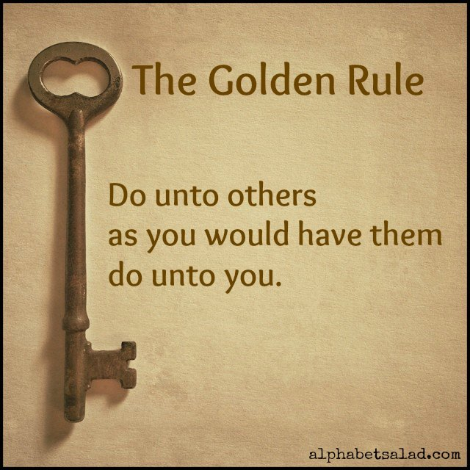
Responsibility to Other Team Members and the Entire Company

Slide 38

Questions

Slide 39
Jeff Shanker, Chief Strategy Officer, Black Tie Transportation and Bus Charters Chairman, Bus Industry Safety Council
Jeff@BlackTieTransportation.Net
336-768-5177 office

