Slide 1
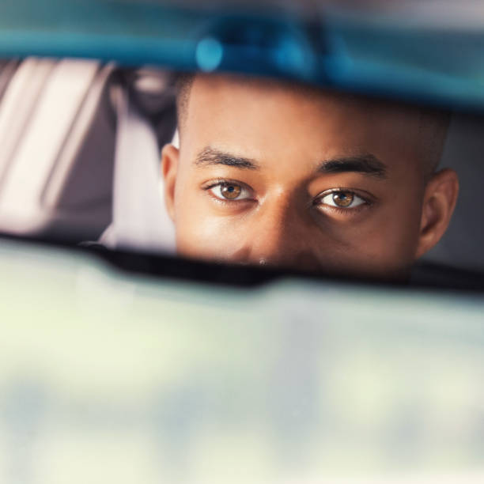
Stopped! Now what??

Slide 2
WELL….WHY DID YOU GET STOPPED IN THE FIRST PLACE??
POLICE FIND STUFF!!
WHAT ARE THEY LOOKING FOR AND WHY?

Slide 3
COMMON REASONS LAW ENFORCEMENT AGENTS STOP COMMERCIAL MOTOR VEHICLES
According to the U.S. Dept. of Transportation, Federal Motor Carrier Safety Administration common stops are a result of:
Distracted Driving/Lane Deviation
Tailgating
Traffic Control Device Violations
School/Road Work Zone Violations
Unsafe Speed/Aggressive Driving
Alcohol/Drug Impaired Driving
Use of a Hand-Held Phone
Lighting Violations
Improper/Expired Registration

Slide 4
OK…HOW DO WE PREVENT THE STOP?
Pre-Trip due diligence regarding the inspection of our vehicle!

Slide 5

PRE TRIP INSPECTIONS AND MAINTENANCE
POLICE ARE LOOKING FOR broken/inoperable tail lights, headlights and a reason to stop the vehicle
Also - operational issues - Understand that the STOP will be blamed on an operation issue or a maintenance related issues.

Slide 6
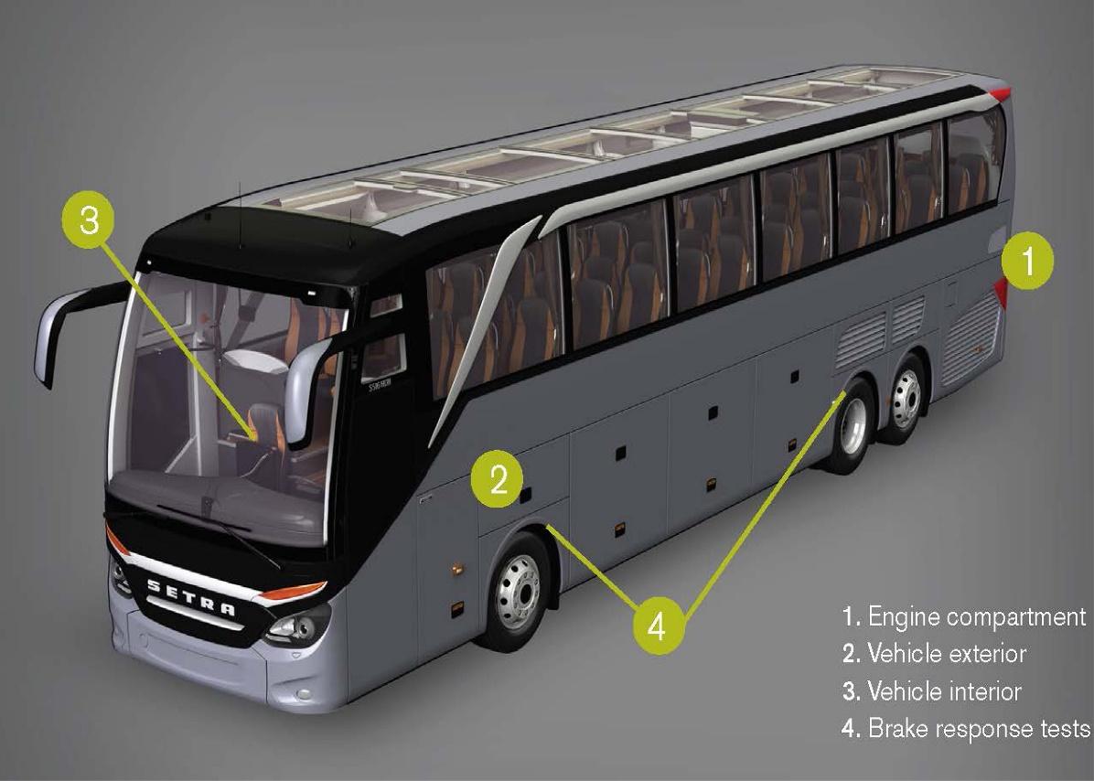
PRE-TRIP INSPECTIONS
Obvious damage
Open Hood Checks
The “Walk-Around”
Passenger Entry/Lift
Emergency Exits
Passenger Seating
External Inspection

Slide 7
OBVIOUS DAMAGE INSPECTION
Look for:
  FLAT TIRES, BUS LEANING TO ONE SIDE
  BROKEN GLASS
  ANYTHING HANGING DOWN UNDER THE BUS
  OBVIOUS LEAKS

Slide 8
OPEN HOOD INSPECTION
Look for:
  WATER PUMP LEAKAGE
  POWER STEERING FLUID CHECK
  COOLANT LEVEL CHECK
  OIL LEVEL CHECK
  CHECK FOR HOSES/ENGINE LEAK

Slide 9
THE “WALK-AROUND” INSPECTION
Look For:
FRONT WHEELS & CORNERS
CHECK
  MIRROR AND MIRROR BRACKETS CHECK
  TIRE PRESSURE CHECK
  TIRE TREAD
  RIMS FOR CRACKS/DAMAGE
  SIDEWALLS FOR CUTS/DAMAGE
  LUGNUT CHECKS
  BRAKE CHAMBER
  BRAKE HOSE
SIDE OF VEHICLE CHECK
  BODY DAMAGE CHECK
  BAGGAGE AND BATTERY DOORS CHECK
  CLEARANCE LIGHT LENSES
  REFLECTORS FOR DAMAGE
  EXHAUST FOR LEAKS
  MUFFLERS AND HANGING PIPES
  FRAME CHECK FOR CRACKS AND DAMAGES
  DRIVESHAFT CHECK

Slide 10
THE “WALK-AROUND” INSPECTION CONT’D
Look For:
REAR OF BUS CHECK
  LIGHT LENSES/REFLECTORS FOR DAMAGE
  INSIDE TIRE PRESSURE
  OUTSIDE TIRE PRESSURE
  TIRE TREAD
  RIMS FOR CRACKS/DAMAGE
  LUG NUTS FOR TIGHTNESS
  MUD FLAP SECURE CHECK

Slide 11
EXTERNAL PRE-TRIP INSPECTION
Level/Air Leaks (Pre Trip Inspection)
•See that the vehicle is sitting level (front and rear), and if air-equipped, check for audible air leaks from the suspension system.
Fuel Tank(s) (Pre Trip Inspection)
•See that fuel tank(s) are secure with no leaks from tank(s) or lines and the fuel cap is tight.
Compartments (Pre Trip Inspection)
•Check that baggage and all other exterior compartment doors are not damaged, operate properly, and latch securely.
Battery/Box (Pre Trip Inspection)
•Wherever located, see that battery(s) are secure, connections are tight, and cell caps are present.

Slide 12
NOW YOU’RE STOPPED/KNOW YOUR RIGHTS!
    What do you do?
    Start with:
    Body language
      Hands / steering wheel
      WHY??
Eye contact
AND
Clear communication

Slide 13
ARTICULABLE REASON TO STOP THE VEHICLE
A Terry stop in the United States allows the police to briefly detain a person based on reasonable suspicion of involvement in criminal activity.
"United States v. Sokolow, 490 US 1, 109 S. Ct. 1581, 104 L. Ed. 2d 1 (1989)". Google Scholar. Retrieved 11 September 2019. ("In Terry v. Ohio, 392 U. S. 1, 30 (1968), we held that the police can stop and briefly detain a person for investigative purposes if the officer has a reasonable suspicion supported by articulable facts that criminal activity "may be afoot," even if the officer lacks probable cause.")

Slide 14

IF YOU ARE STOPPED
Law Enforcement must have a reasonable suspicion for believing that you have committed a traffic violation or criminal offense.
Show your license, registration, and proof of insurance when asked.

Slide 15
CONSTITUTIONAL RIGHTS IN
POLICE INTERACTIONS
The Fourth Amendment prevents the government from performing unreasonable searches and seizures.
The Supreme Court has recognized some exceptions, particularly where motor vehicles are concerned. Each exception has its own set of factual predicates that must be present, as well as limits on the scope of the search and seizure action.
Exception
  Pat-Downs
    must have reasonable suspicion of a readily accessible deadly weapon in the vehicle; the examination must be limited to areas where such weapons could be concealed
  Passenger Compartment (limited)
  Probable Cause=Full Search

Slide 16
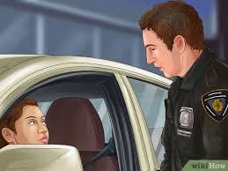
A ROUTINE TRAFFIC STOP IS NOT REASON FOR PROBABLE CAUSE
Keep your vehicle interior clear of unnecessary objects. It may give the police reason to search the car.
If they see anything illegal, this may create probable cause for them to search you or your car. They cannot search the trunk unless they have your consent, a search warrant, or probable cause to believe the trunk contains evidence of a crime.
If you are pulled over for a routine traffic stop (like running a red light or speeding), then there should not be a reason for the officer to search the car.

Slide 17
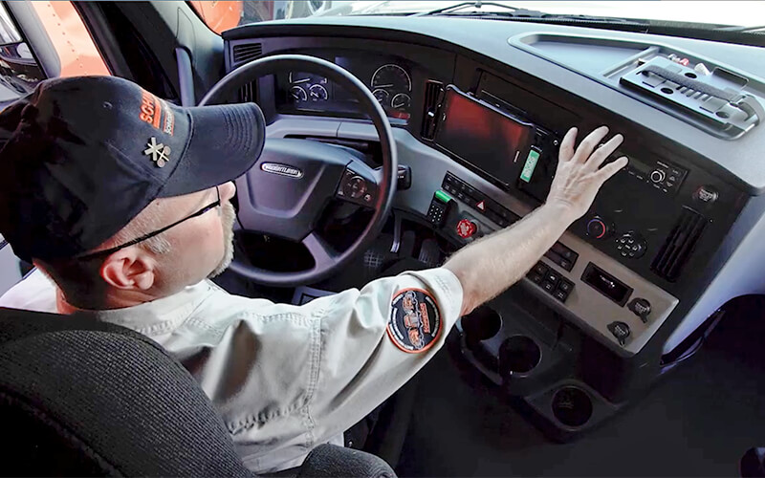
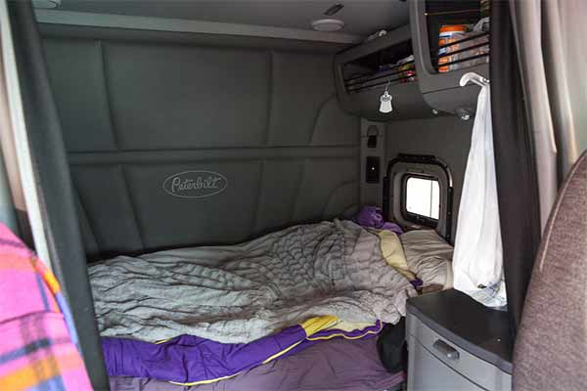
IS YOUR CAB CLEAN?

Slide 18
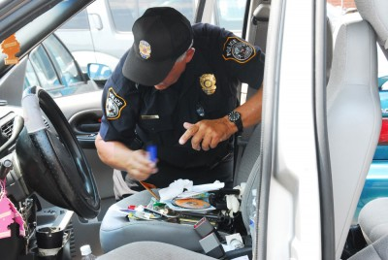
DOES THE TROOPER / OFFICER HAVE A BASIS TO MOVE FURTHER
  What’s in plain view?
    Keep the cab clean to avoid plain view search
    If contraband or weapons are readily
    observable, probable cause to search the
    commercial vehicle is now allowed.
  PC to search?
  PC to get you out of the car?

Slide 19
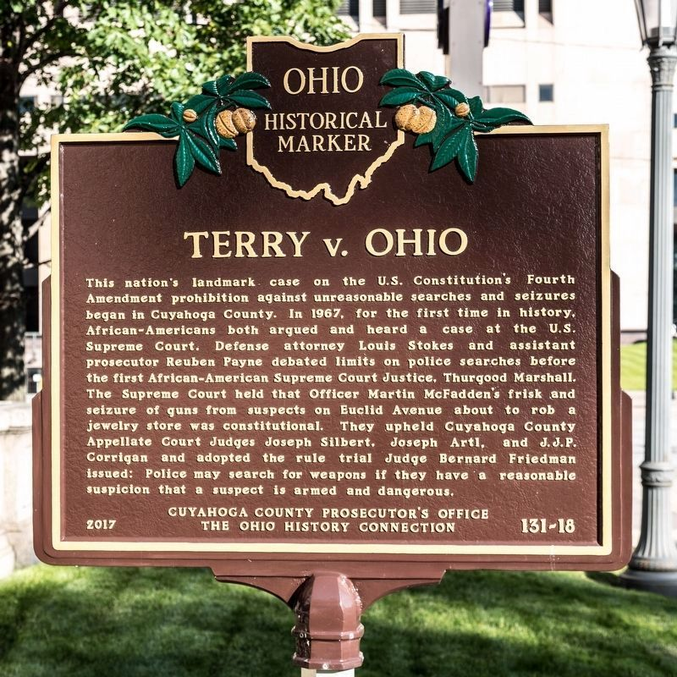
TERRY STOP EXPANDED
PRE-TEXTUAL STOPS
If the police stop a motor vehicle on minor infringements in order to investigate other suspected criminal activity, this is known as a pre-textual stop. Additional rules apply to stops that occur on a bus.[3] Those stops relate to the BORDER patrol issues
So what if there isn’t a reason?

Slide 20
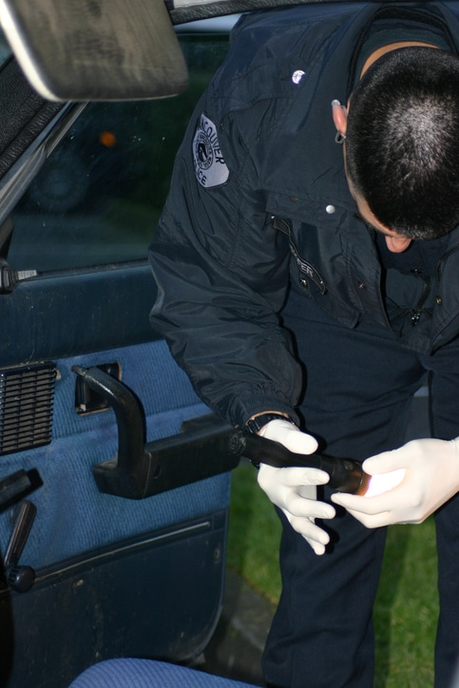
SEARCHES
Provide your:
License and Registration when asked.
  However, if you are pulled over for a routine traffic stop (i.e. running a red light or speeding), then there should not be a reason for the officer to search the car.

Slide 21
FOURTH AMENDMENT TO THE UNITED STATES CONSTITUTION
The right of the people to be secure in their persons, houses, papers, and effects, against unreasonable searches and seizures, shall not be violated, and no warrants shall issue, but upon probable cause.
The Fourth Amendment is a guarantee against unreasonable governmental intrusion into the lives of private citizens.
Bus travel presents unique Fourth Amendment situations.
Bus travelers generally do not have an absolute reasonable expectation of privacy simply because you have purchased a ticket.

Slide 22
BUS DRIVERS GIVING CONSENT TO A WARRANTLESS SEARCH
A BUS DRIVER MUST BE AWARE THAT HE CAN DECLINE THE POLICE OFFICER’S REQUEST FOR A WARRANTLESS SEARCH OF THE BUS IF STOPPED FOR A TRAFFIC VIOLATION.
BUS DRIVER IS THE CUSTODIAN OF THE COMMERCIAL VEHICLE WHILE IN OPERATION.
  HOWEVER!
BUS DRIVER CANNOT CONSENT TO A RANDOM SEARCH OF A PASSENGER’S PERSONAL BELONGINGS.

Slide 23
CONSENT, CONT’D
IF A BUS DRIVER ALLOWS POLICE OFFICERS ON TO THE COMMERCIAL VEHICLE FOR A SEARCH OF A PASSENGER’S BELONGINGS….
  POLICE MUST FIRST IDENTIFY THE OWNER OF THE SUBJECT LUGGAGE AND SEEK PERMISSION TO SEARCH HIS/HER PERSONAL BELONGINGS.

Slide 24
WARRANTLESS SEARCH
IF A WARRANTLESS SEARCH OF A PASSENGER’S LUGGAGE TAKES PLACE ON A COMMERCIAL VEHICLE
  OUR DRIVERS SHOULD CONTACT DISPATCH TO INFORM OF THE STOP AND SEARCH.
  COMMUNICATE WITH DISPATCH REGARDING POTENTIAL DELAYS FOR SCHEDULED ARRIVAL.
  IF POSSIBLE, REQUEST FOR THE SEARCH AND DETENTION OF SUBJECT PASSENGER TO OCCUR OUTSIDE AND NOT ON THE COMMERCIAL VEHICLE.

Slide 25
SUSPICIONLESS BUS SWEEPS AND CONSENSUAL SEARCHES
THE SUPREME COURT HAS ADDRESSED INSTANCES WHEREIN SUSPICIONLESS BUS SWEEPS WERE CONDUCTED ABOARD COMMERCIAL MOTOR VEHICLES
  UNITED STATES V. DRAYTON, 536 U.S. 194 (2002)
  FLORIDA V. BOSTICK, 501 U.S. 429

Slide 26
UNITED STATES V. DRAYTON, 536 U.S. 194 (2002)
Trial court determined police conduct was not coercive
On appeal: Eleventh Circuit Court reversed trial court holding that the passengers did not feel free to disregard the officers request.
The Supreme Court held:
  The Fourth Amendment does not require police officers to advise bus passengers of their right not to cooperate and to refuse consent to searches.
Also, U.S. v. Guzman
FACTS: Bus driver allowed three police officers to board the bus for a drug/weapons search.
Officers did not block the aisle nor impede exit of the bus.
Notified passengers of reason for search and asked to search bags and persons.
Found cocaine on the person of two passengers.

Slide 27
RACIAL DISPARITIES TO BE AWARE OF REGARDING DRAYTON SWEEPS
The Court should not ignore any effect that the race of a citizen might have on his own experience of the encounter.
Although a Caucasian individual may feel free to decline a police officer's questions in the course of a bus sweep, it is not too far-fetched to say that minorities in the exact same position may not.
Language barriers are also important in the event of a bus sweep in order to ensure that a citizen’s legal rights are not being abridged.

Slide 28
FLORIDA V. BOSTICK, 501 U.S. 429
FACTS:
Officers boarded buses and asked passengers for permission to search luggage, without articulable suspicion.
Requested consent to search luggage for drugs and advised passenger of his right to refuse.
Passenger did not refuse and search was conducted which uncovered contraband.
TOTALITY OF THE CIRCUMSTANCES TEST: whether passenger feel free to decline or terminate the search encounter.
A consensual encounter does not trigger Fourth Amendment scrutiny.
The United States Supreme Court held that if the police indicated that Bostick was free to refuse consent and terminate the encounter, and that the police would not detain him if he refused, his consent was voluntary.

Slide 29
FLA V. BOSTICK CONT’D
If law enforcement asks to search both the bus and a passenger’s belongings as a part of a routine traffic stop, both the driver and the passenger have the right to decline the request as there is a lack of probable cause to search.
Your driver and passengers must know about their ability to exercise the right decline as police officer are not required to tell you.

Slide 30
CHARTERED BUS PASSENGER V. TICKETED PASSENGER EXPECTATION OF PRIVACY
There is no distinguishable difference in the expectation of privacy of chartered passengers and passengers who purchased tickets.
As a bus passenger, when you place your luggage in a shared space including an overhead compartment, you do not have an elevated right to privacy due to the purchase of a ticket.
Luggage falls within the “EFFECTS” category protected by the Fourth Amendment, meaning an repository of intimate and necessary personal property.
The Supreme Court recognizes that soft luggage or non-opaque luggage may reveal its contents.

Slide 31
ADDRESSING THE REASONABLE EXPECTATION OF PRIVACY IN DIFFERENT LUGGAGE
United States v. Guzman, police detective laid his hand on passenger’s cloth bag on a luggage rack aboard a commercial bus. The officer felt hard bricks which he believed to be packaged cocaine.
The Sixth Circuit determined the defendant had no reasonable expectation to privacy as he should have known his bag could be accessible to others on the bus.
Other Federal courts have determined similar rulings as it relates to soft luggage on a shared luggage rack.

Slide 32
EXTERIOR LUGGAGE EXCEPTION
U.S. v. Harvey, 961 F.2d 1361 (8th circuit) a passenger on a common carrier has no reasonable expectation of privacy in the exterior of his luggage or the airspace surrounding it.
REASONING:
  Passengers have no objective, reasonable expectation that their baggage will never be moved once placed in an overhead compartment.
  It is not uncommon for the bus driver or a fellow passenger to rearrange the baggage in the overhead compartment or to temporarily remove the baggage and place it in a seat or in the aisle in order to rearrange and maximize the use of limited compartment space.
Therefore, the touch on the exterior bag/luggage is not an unreasonable search

Slide 33
U.S. V. FORT, 248 f.3D 475 (2001)
FACTS:
  Commercial motor vehicle was stopped as State Trooper heard “Flopping” Noise from the rear wheel, indicating a possible flat tire and did not recognize the company name on the side of the vehicle.
  Trooper stopped the cmv and found marijuana on driver and later discovered hundreds of pounds of contraband.
  Driver moved to suppress the contraband found by the trooper due to an unconstitutional search and seizure as a result of a common traffic stop.
    Trooper conducted an exterior inspection and ran the driver’s license and plates pursuant to Department of Public Safety Policy, finding an outstanding warrant for the driver’s arrest for a probation violation concerning possession with intent to distribute marijuana.

Slide 34
U.S. V. FORT, 248 f.3D 475 (2001), CONT’D
The Fourth Amendment's prohibition against unreasonable searches and seizures applies to private commercial property and to administrative inspections designed to enforce regulatory statutes.
However, the expectation of privacy in commercial property is different from a similar expectation in an individual's home.
When an individual engages in a pervasively regulated business, he does so with knowledge that his business will be subject to inspection.
Using this reasoning, the supreme court has upheld warrantless administrative searches of pervasively regulated businesses.

Slide 35
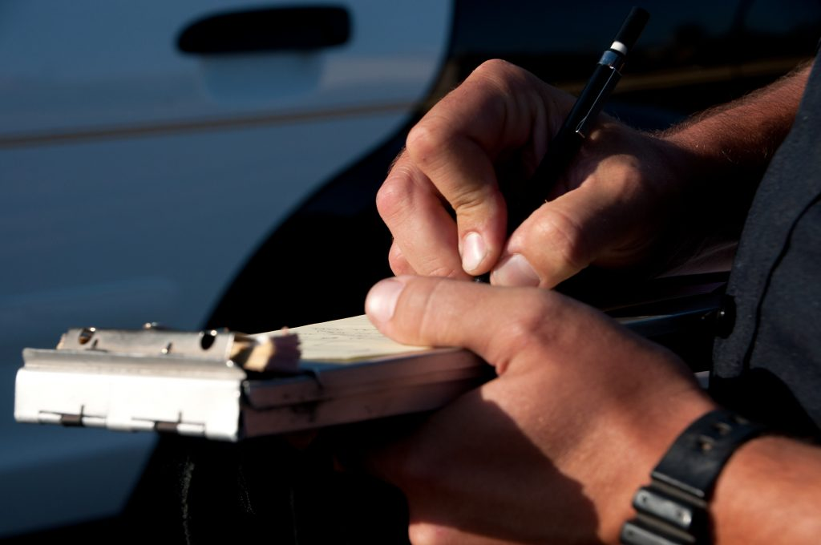
RECEIVING A TICKET
The officer may issue you a ticket. If you feel the reason is vague or unclear, ask the officer for details.
Avoid becoming argumentative. Arguing will not change the officer's mind. If you contest the violation, you will have an opportunity to address the matter in court.
If you receive a ticket, accept it calmly. Accepting it is not an admission of guilt.

Slide 36
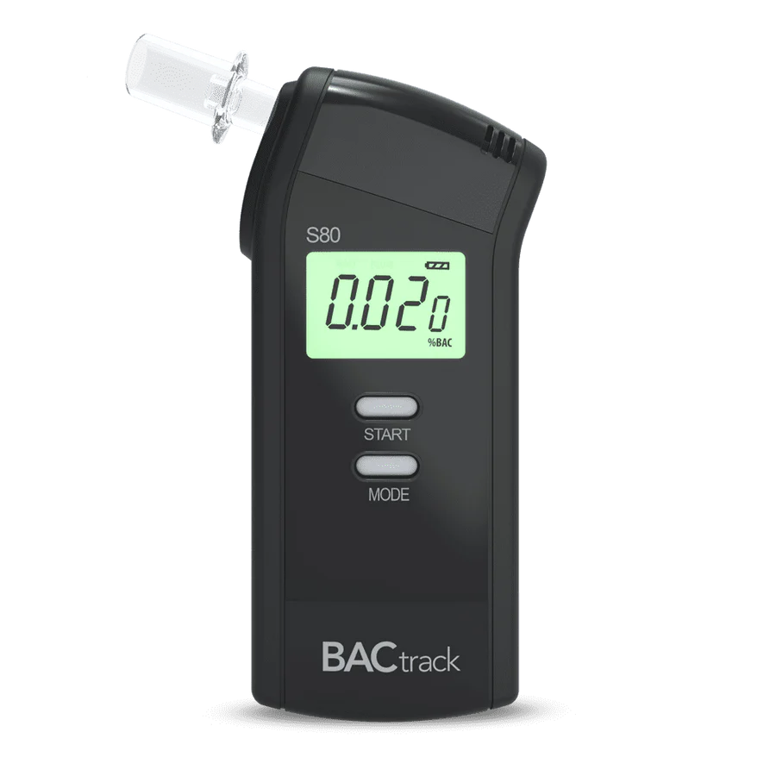
BLOOD ALCOHOL CONTENT TESTING
If a driver is suspected of drunk driving, you will be asked to take a breath-alcohol and coordination test.
If you fail the tests, or if you refuse to take them, you will be arrested, your driver’s license may be suspended, and your vehicle may be taken away.

Slide 37

NEW YORK LEGISLATION TO ADDRESS RACIALLY DISPARITY IN TRAFFIC STOPS
On March 10, 2022 the NY General Assembly passed legislation to address racial disparities in traffic stops by reducing the number of traffic stops for minor, nonmoving violations such as stickers on vehicle windows and objects placed or suspended in or on the vehicle.

Slide 38
POLICE INTERACTIONS
According to 2020 research published by the Stanford Open Policing Project, of a dataset of nearly 100 million traffic stops carried out across the United States.
Black drivers were about 20 percent more likely to be stopped than white drivers relative to their share of the residential population. The study also found that once stopped, Black drivers were searched about 1.5 to two times as often as white drivers.

Slide 39
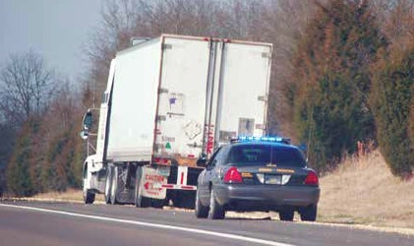
IF YOU BELIEVE YOUR RIGHTS WERE VIOLATED
Write down everything you remember, including officers’ badges and patrol car numbers, which agency the officers were from, and any other details.
Get contact information for witnesses.
File a written complaint with the agency’s internal affairs division or civilian complaint board. In most cases, you can file a complaint anonymously.

Slide 40
PROTECTION FROM LIABILITY
IT IS VITALLY IMPORTANT THAT DRIVER’S ARE AWARE OF HIS/HER RIGHTS RELATED TO WARRANTLESS SEARCHES IN ORDER TO EFFECTIVELY PROTECT OUR COMPANIES FROM LEGAL EXPOSURE.
PASSENGERS RELY ON OUR TRANSPORTATION SERVICES FOR SAFE AND ENJOYABLE TRAVEL TO THEIR DESTINATIONS.
STOPS CAN CREATE ANXIETY AND/OR FEAR

Slide 41

HELPFUL TIPS:
If you are pulled over in a traffic stop and have a dash camera station in your vehicle, consider turning on your camera to record the interaction.
Make sure to do this before the officer gets out of the police car so that the entire event is recorded.
There may be instances of police misconduct, if that takes place..
FILE A CCRB COMPLAINT REPORT

Slide 42
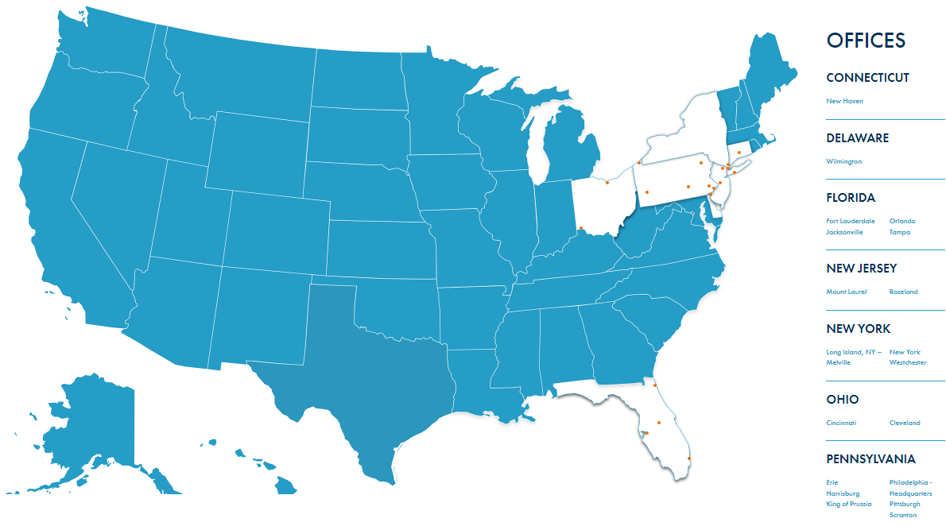

THANK YOU FOR LISTENING!

Slide 43
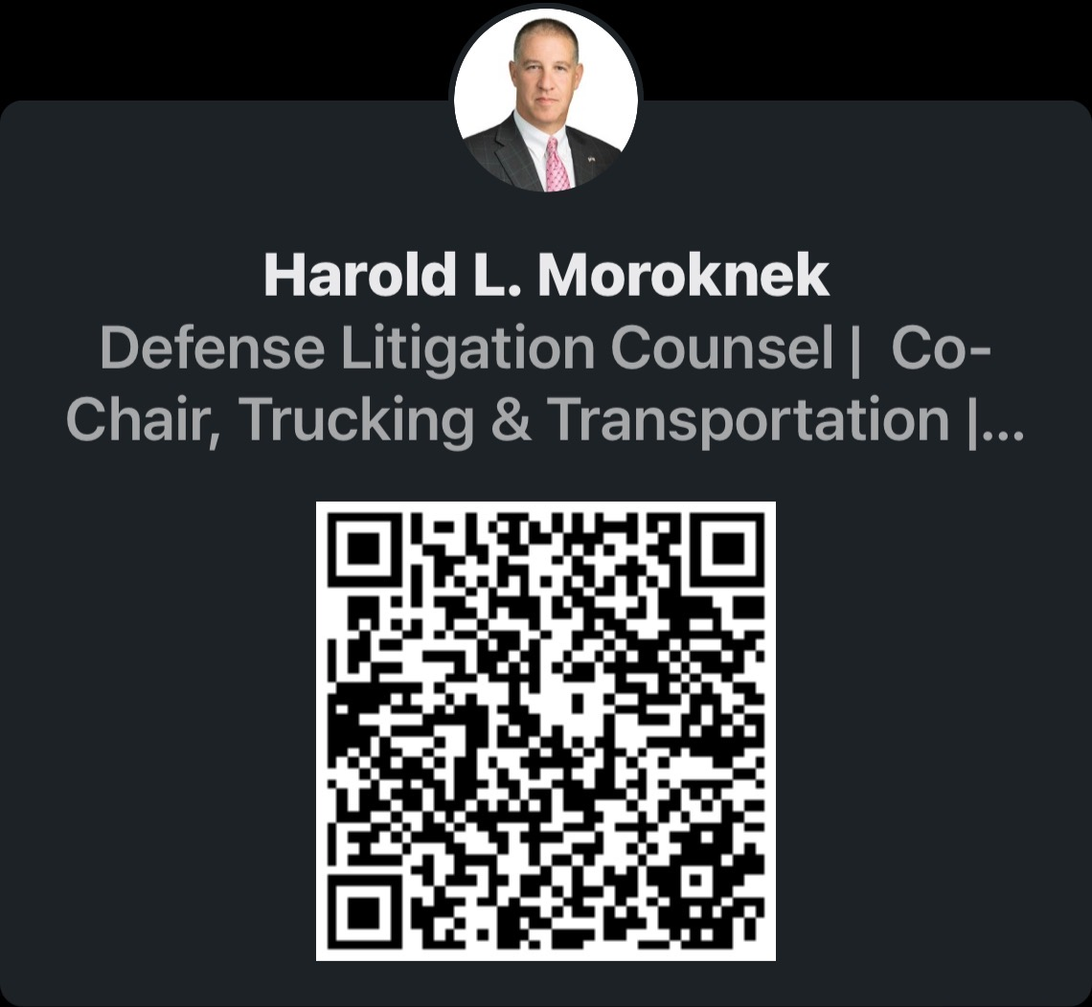
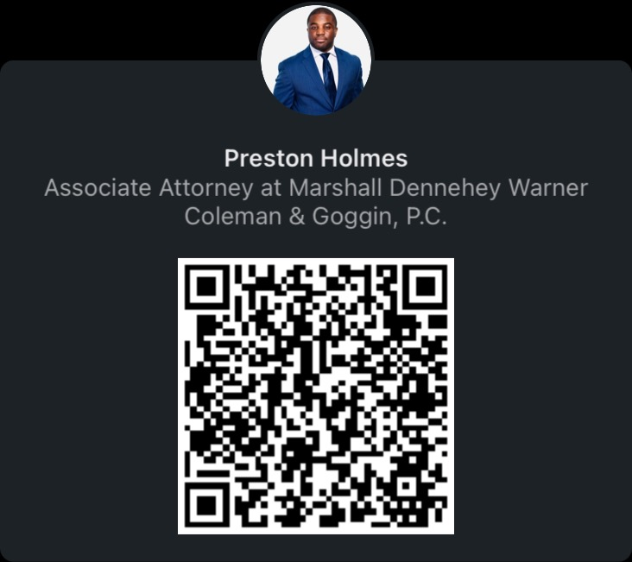
Let’s Connect!

