Slide 1

Government Affairs and Policy Feedback
BISC MEETING
July 26, 2023
Orlando, FL

Slide 2
Regulatory Monitoring
Where Can You Look?:
Federal Register
ABA Publications
ABA Website
Daily Bus Bulletin
Weekly ABA Insider
Monthly Government Affairs and Policy Newsletter
Monthly TSA Conference Calls
Periodic ABA Open Conference Calls
State Association Meetings
BISC/BusMARC
Peers/Mentors

Slide 3
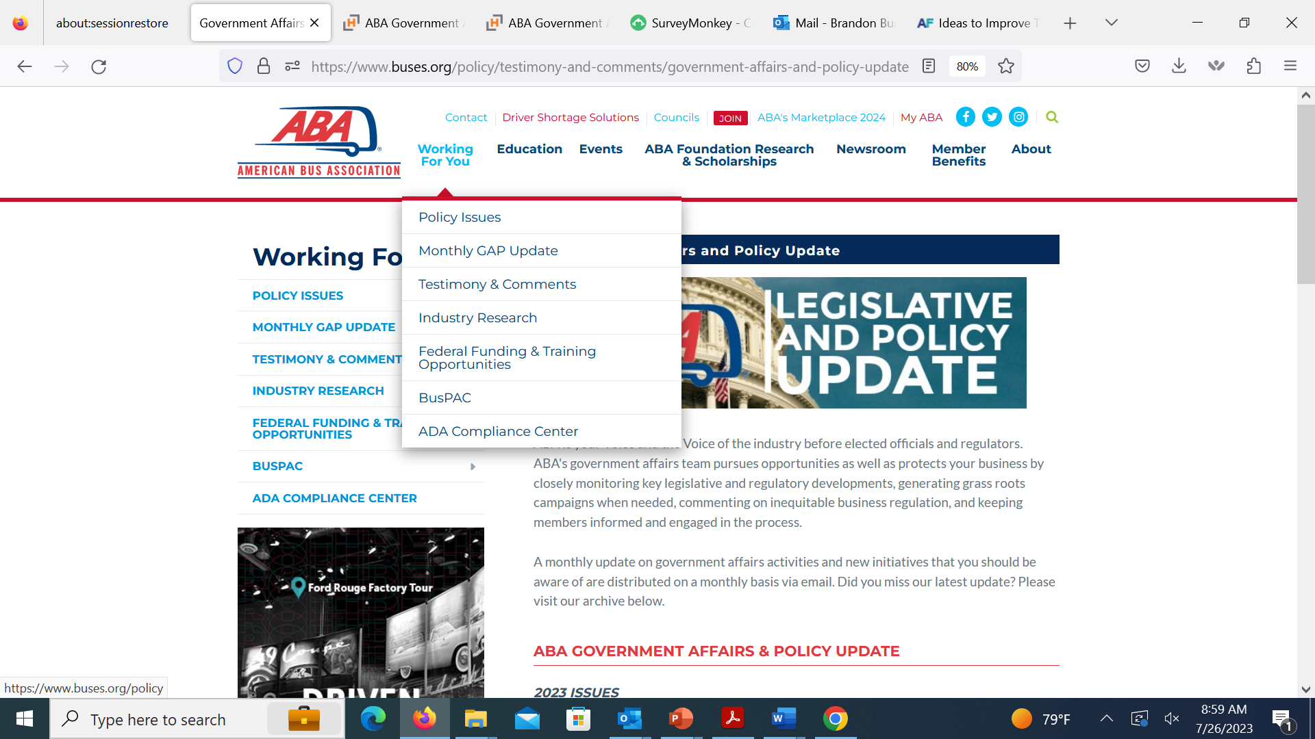
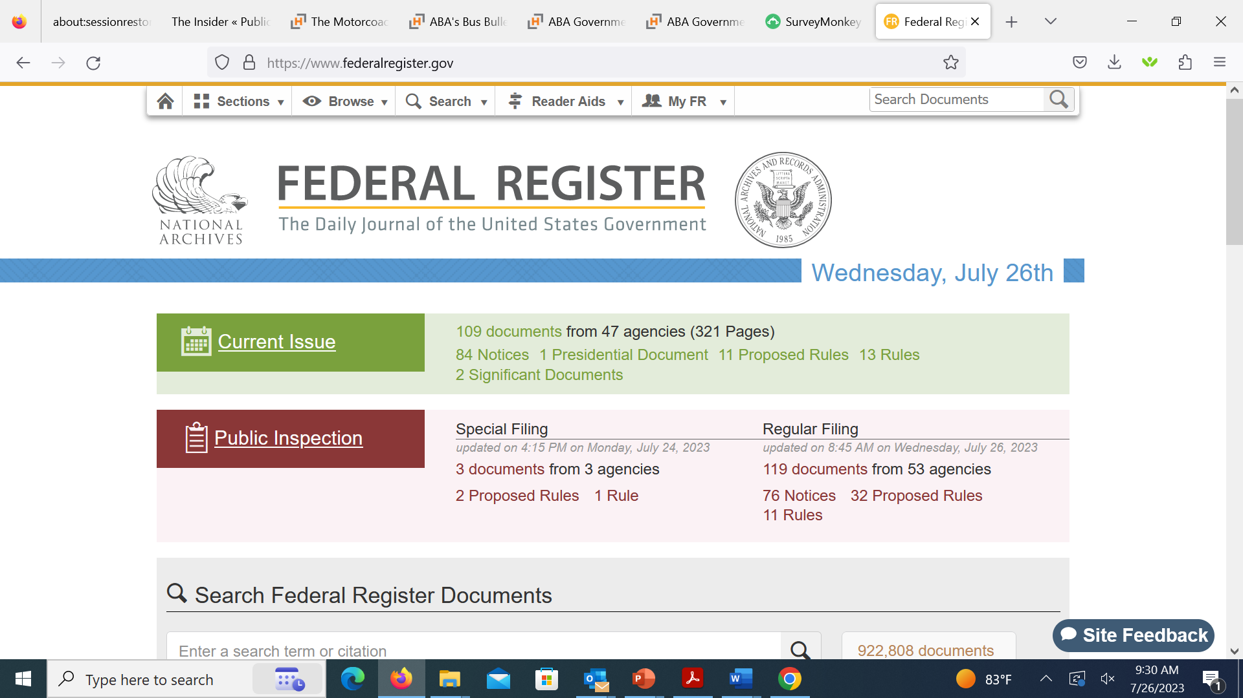
Regulatory Monitoring

Slide 4
Regulatory Monitoring

Slide 5
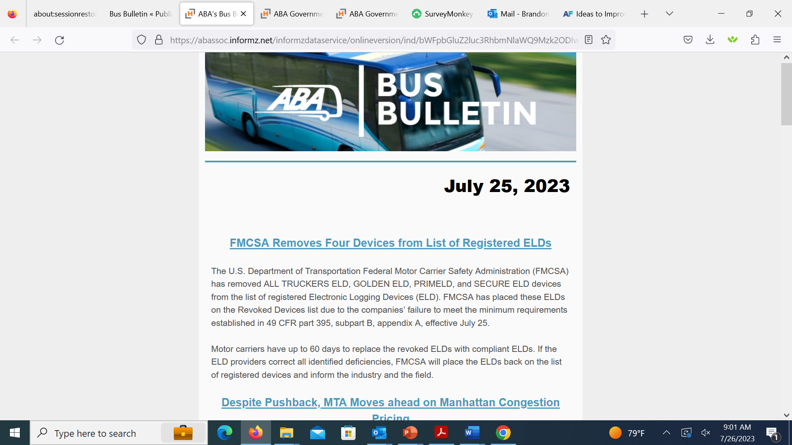
Regulatory Monitoring

Slide 6
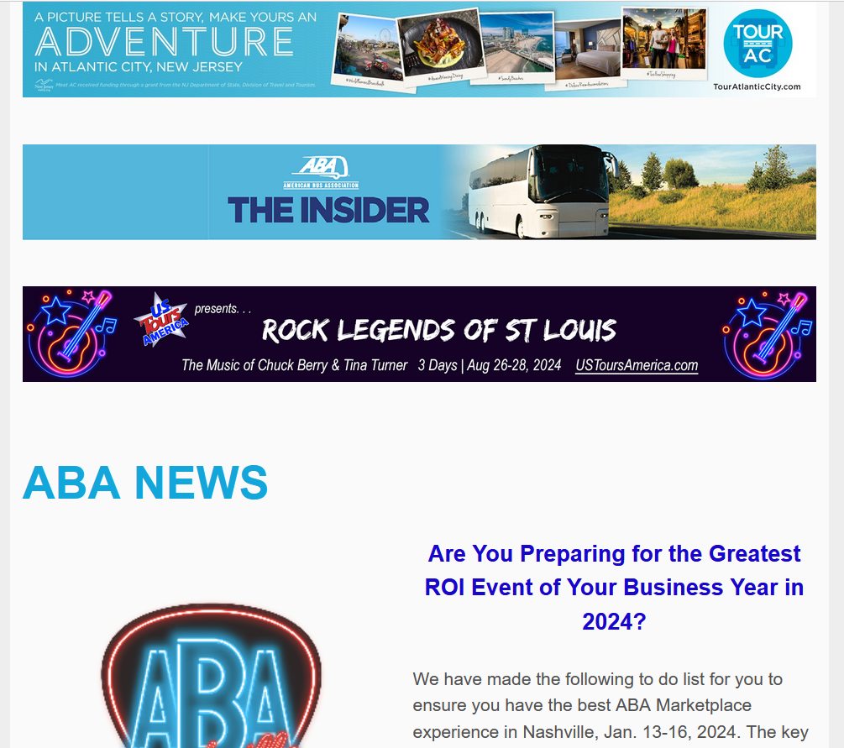
Regulatory Monitoring

Slide 7
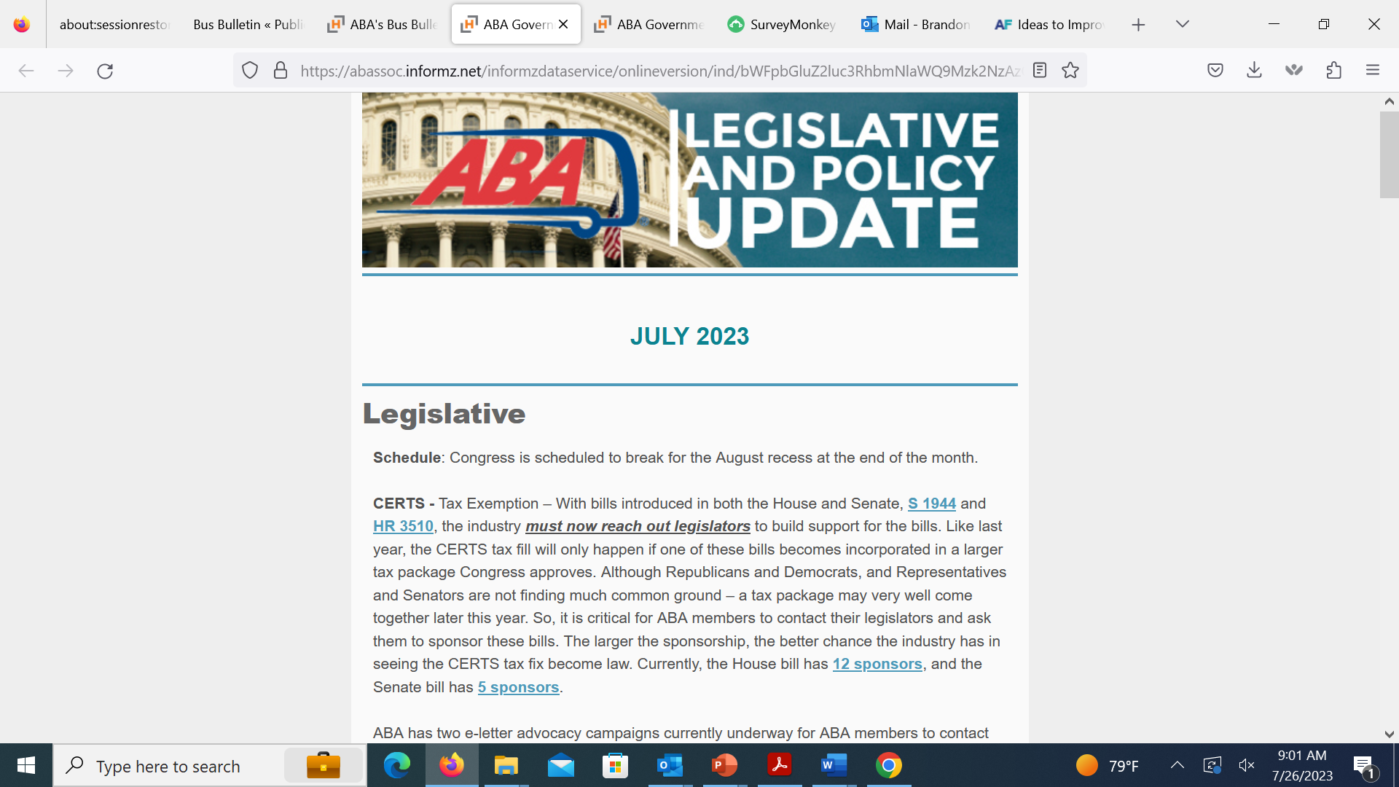
Regulatory Monitoring

Slide 8
Regulatory Activity
DOT: - FMCSA: Speed Limiters – SANPRM, Await SNPRM – August?
- DOT/FTA: ADA regulations update – imminent
- NHTSA: Automatic Emergency Braking – Comments due September 5
- PHMSA: HazMat on Passenger Carrying Vehicles – Comments due October 3
DHS: FEMA/TSA
- FY 2023 Security Grant Awards – Grants Award announcement July 21 - Vetting Rule – Notice/comment – comments due August 21
DOL:
- OT Threshold (W&H)
- OSHA Injury Reporting
- Heat Injury and Illness Prevention in Outdoor and Indoor Work Settings

