Slide 1
Getting Your Tires Ready to Roll Again
Tue, Jul 14, 2020 11:00 AM - 12:00 PM EDT
July 14, 2020

Slide 2
Agenda
Best Practices
Irregular Wear Examples
Q & A

Slide 3
BEST PRACTICES for TIRE MAINTENANCE

Slide 4

DOT NUMBER – HOW OLD ARE THOSE TIRES?
Date of Manufacture
(44th week of 2001)
Group of 3 or 4 Option Symbols used by the Manufacturer
Tire Size Code
Mfr. & Plant Code No.

Slide 5
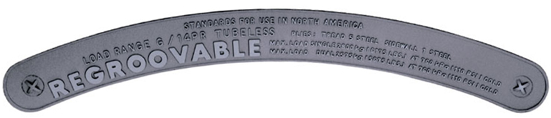
MAXIMUM COLD INFLATION AND LOAD LIMITS
BRIDGESTONE R249 315/80R22.5 LRL CAPACITIES:
MAX. LOAD SINGLE 4250 kg (9370 LBS.) AT 900 kPa (130 PSI) COLD
MAX. LOAD DUAL 4000 kg (8820 LBS.) AT 900 kPa (130 PSI) COLD

Slide 6
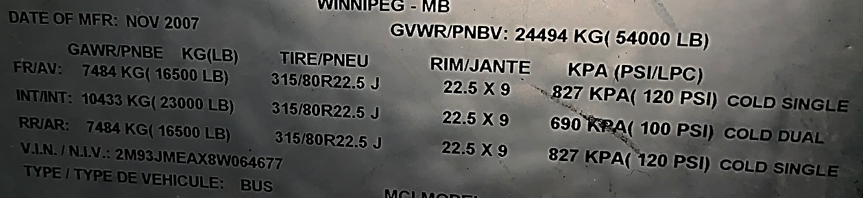
PLACARD IS BEST
Information on Placard:
Tire Size AND Load Range
Recommended COLD inflation pressure
COLD = room temp.
Axle weight ratings
Recommended rim size

Slide 7
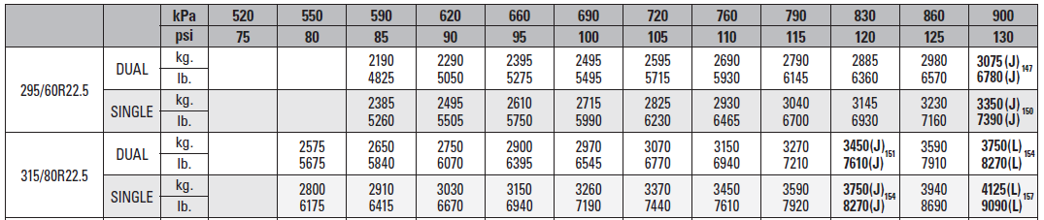
INFLATION FOR LOAD CAPACITY
Know where your pressures need to be
Ask your tire supplier for Load & Inflation Tables
Also available from several online resources

Slide 8
BEFORE YOU START ROLLING
First and foremost, inflation pressures of all tires must be verified and adjusted if needed.
If tire is under inflated by 20% or more, tire must be placed in a safety cage before inflating to proper pressure.
Visually inspect all tires.
After inspecting each tire and verifying tire pressure, get the buses out and warm the tires up, maybe 50 miles. This will help remove any potential flat spots prior to passengers being onboard.

Slide 9
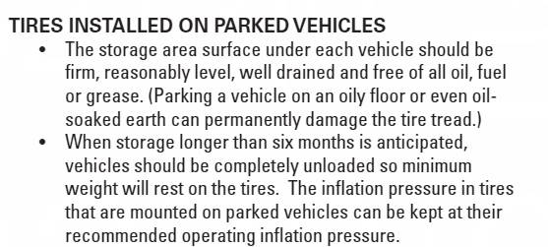
TIRE MAINTENANCE COUNCIL RECOMMENDATIONS

Slide 10
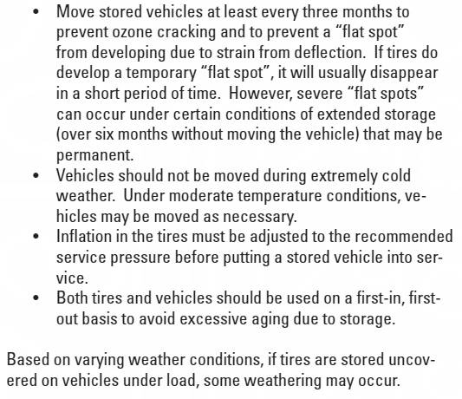
TIRE MAINTENANCE COUNCIL RECOMMENDATIONS

Slide 11
TIRE WEAR EXAMPLES

Slide 12
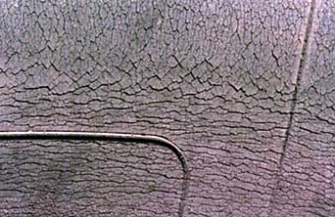
RUBBER CRACKING
"The anti-aging chemicals used in the rubber compounds are more effective when the tire is exercised...The repeated stretching of the rubber compound actually helps deter cracks from forming."
The surface cracks that occasionally appear have been called many things: Weather Checking, Weather Cracking or Ozone Cracking. These small cracks typically develop in the sidewalls or at the base of the tread grooves. Depending on their severity, they may be cosmetic in nature if they don't extend past the rubber's outer surface, or may be a reason to replace the tire if they reach deep into the rubber.

Slide 13
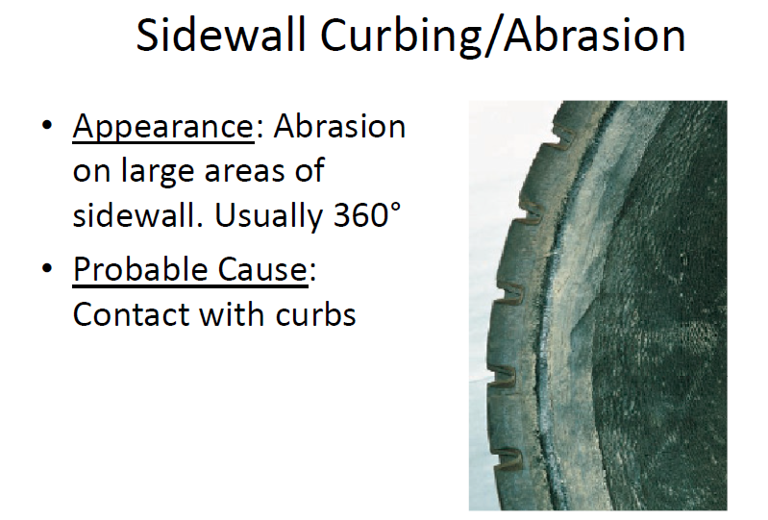

Slide 14
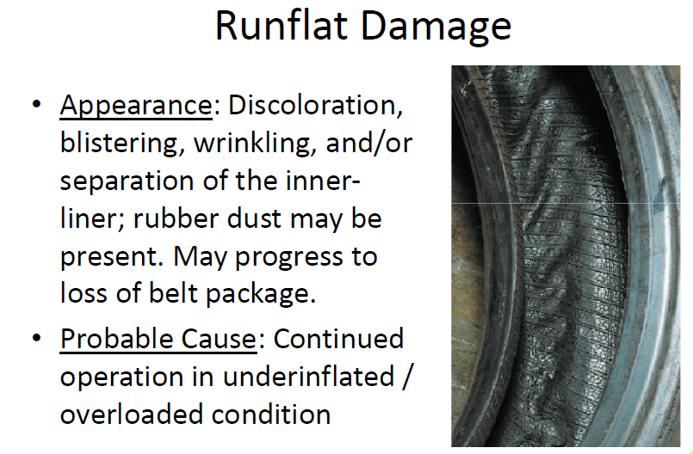

Slide 15
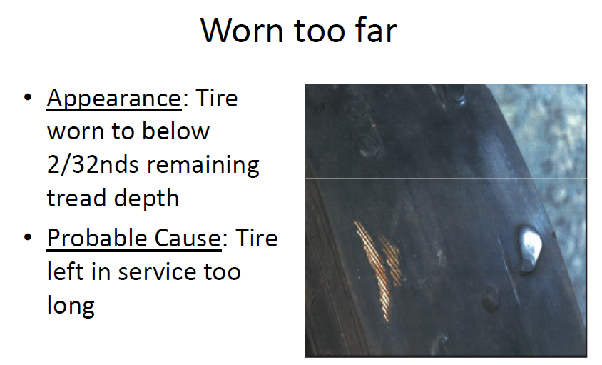

Slide 16
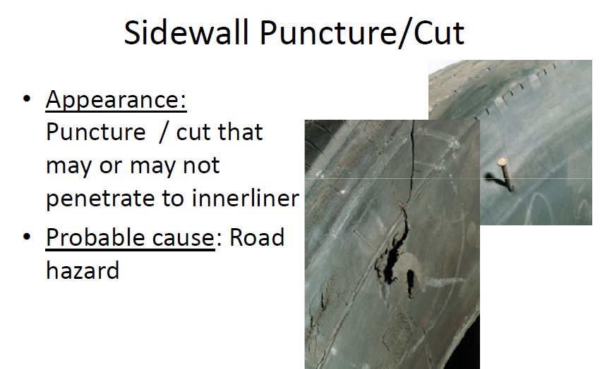

Slide 17
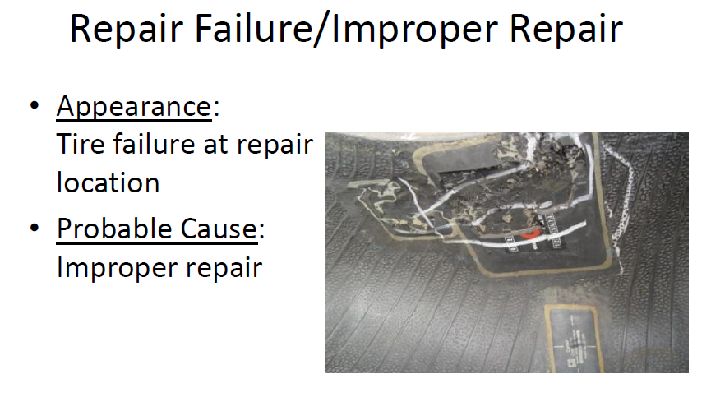

Slide 18
Questions? YorkBrad@bfusa.com (615) 424-7869

