Slide 1


Looking from the Outside In

Slide 2

Does our business or agencies appear to be the perfect apple?
In other words, enticing
Does it make you want to bite into the apple or take a step inside?
We are all curious about how the first bite will be.
Did that bite make you want more or ???

Slide 3

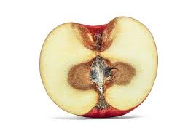
As employers we all would like our outside to be a representation of how the inside tastes and appears.

Slide 4

New Hire Retention begins with the first look and items we can control.
Many items we can not change, costs associated with regulations, CDL’s, ELDT, compensation
How is the first good look?
First impression, everyone wants to feel a sense of pride where they work.
I notice their operators, and equipment, clean, organized, drive up appearance, office equipment, dry floor shop, professional administration
Inviting atmosphere, a safe, inclusive and positive culture for your employees.
As a driver; look good feel-good locker rooms, available clean restrooms, well maintained and comfortable equipment, employee engagement and attitude, driver/employee talk, work life balance, employee safety
Allows for a sense of accomplishment and development.
Driver talk, operators have accomplishments also, passengers, families, safety, degree assistance, data collection, mentoring, promote with in, teaching, bid details
Promotes value, stability and need.
Do they understand the companies' vision, managers/owners in the field (face time), how do you demonstrate stability, feed back, concerns

Slide 5
The top predictor of workplace satisfaction is not pay: It is the culture and values of the organization, followed closely by the quality of leadership and the career opportunities at the company.

Slide 6
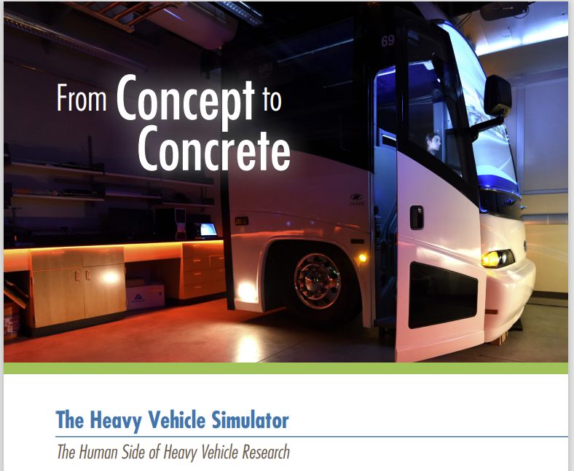

Slide 7
The Human Side of Heavy Vehicle Research (HVS)
The human factor. It’s possibly the most important factor to consider when researching heavy vehicle technologies and alternative fuels.
HVS researchers jumped into action when they discovered that motor-coach drivers for the INL fleet could drive the same bus over the same route yet have differing fuel efficiencies of up to 30%.
Using knowledge of INL road topography, combined with engine data, HVS researchers developed a prototype simulator that predicted – in advance – what steps the driver needed to take to maximize fuel efficiency

Slide 8
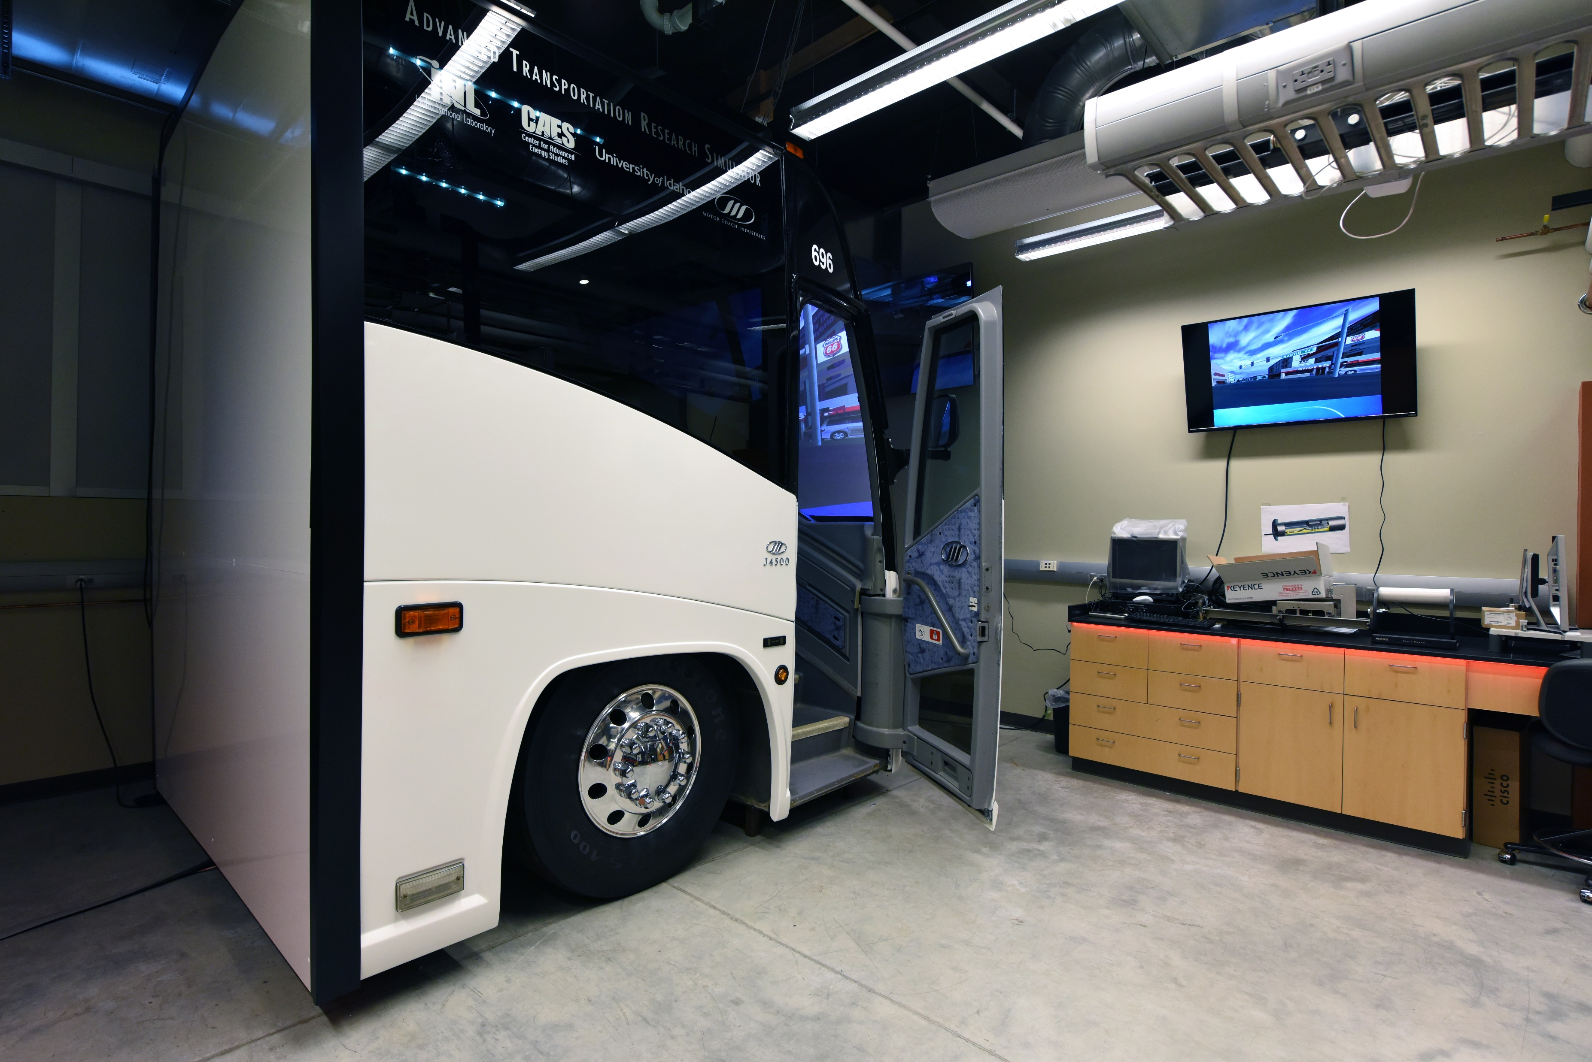
Best Driver Practices

Slide 9
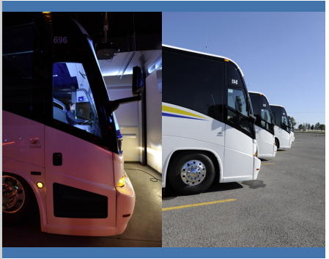
Collaboration with INL means
CAES researchers have access to
Data covering
86 bus drivers, driving
87 motor coaches, carrying
2,500 passengers per day, totaling
2.7 million miles per year.
This collaboration led to an unexpected discovery:
30%
That’s how much fuel efficiency can differ between drivers of the same INL bus, following the same route.
Equated to a 1.7 increase in MPG.
Savings of 112,000 diesel gallons annually.
Goal savings of 1,137 MTC annually

Slide 10
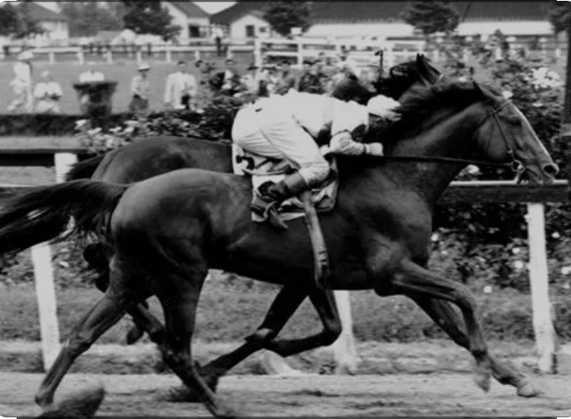

Seabiscuit
“We had to rebuild him, both mentally and physically, but you don’t have to rebuild the heart when it’s already there”

