Slide 1
safety &
maintenance
VIRTUAL SERIES
Tips and Tricks for Bus Operators with the FMCSA Drug & Alcohol Clearinghouse

Slide 2
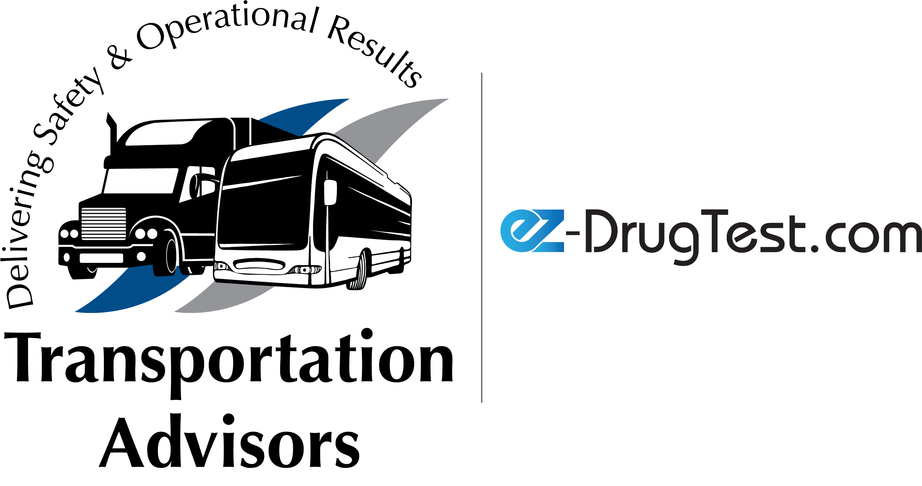

Step one: Registering your company
The first step in the clearinghouse process is registering your company. This should have been completed in January 2020, but if you are not registered you must do so immediately.
If you need help registering your company, there are step by step instructions at: https://clearinghouse.fmcsa.dot.gov/Learn
How to Register: Interactive Guide for Employers
How to Register: Employers With Portal Accounts
How to Register: Employers Without Portal Accounts
*You will need access to your FMCSA account – if you do not have an account
or need to reset your account this must to be completed first!**

Slide 3
Step two: Designate your C/TPA
Once you have access to your clearinghouse account you will need to designate a C/TPA. This is a company that you use to report any refusals to test and can conduct your full and/or limited queries for you.
If you need help registering your company, there are step by step instructions at: https://clearinghouse.fmcsa.dot.gov/Learn
How to Designate Your C/TPA
Are you in need of a C/TPA? Contact us for more information!

Slide 4
Step three: Purchasing a Query Plan
After your company has decided which C/TPA is right for you, you will need to add a query plan to your account. You can choose from a variety of different options of plans. Each query currently cost $1.25 and can be used for both limited and full queries.
If you need help registering your company, there are step by step instructions at: https://clearinghouse.fmcsa.dot.gov/Learn
How to Purchase a Query Plan

Slide 5
Step four: Query Types
There are two different types of query's that your company should be running.
Full Query: Must be run on each NEW CDL applicant prior to hiring.
Limited Query: Must be run on ALL CDL drivers currently employed by your company. Your companies first annual limited queries must be completed by January 5, 2021.
Before completing your companies annual limited queries, you must have a limited query consent form signed by all current CDL drivers
Queries and Consent Requests Factsheet
Sample Limited Consent Request Form

Slide 6
Step four: Query Types continued…
If you are running a Full Query – the driver must be registered in the clearinghouse to manually approve said query. If the driver is not registered into the clearinghouse the query will NOT complete.
If you are running a Limited Query – you can perform queries in bulk or one by one. The clearinghouse provides a sample spreadsheet that may be used to perform bulk queries. If the spreadsheet is not filled out 100% accurate the clearinghouse will not accept your bulk import. Bulk Query Template File
If you need help registering your company, there are step by step instructions at: https://clearinghouse.fmcsa.dot.gov/Learn
How to Conduct a Limited Query (Employers)
How to Conduct a Full Query (Employers)

Slide 7
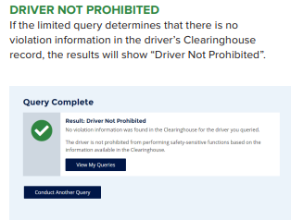
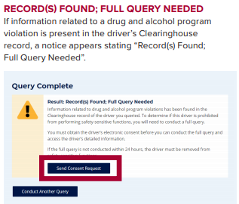
Limited Query Results
When performing a limited query there are three different results you may receive.
This means that your driver is good to go, and no further action needs to take place.
This means that a violation may be reported for your
driver, and a full query must be performed within 24
hours. The driver also must
be removed from any
safety-sensitive function.

Slide 8
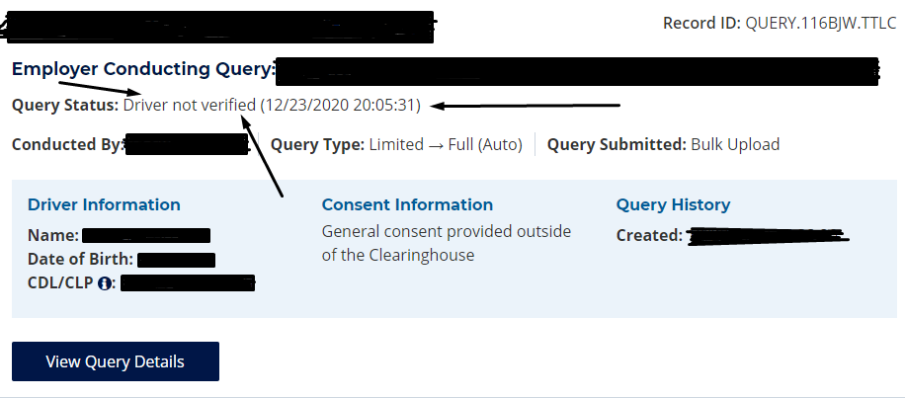
Limited Query Results continued
The third result you may receive only occurs when performing a bulk upload.
This result means that something about the driver's license
or drivers name is not what has been imported into the
clearinghouse. You must verify the driver's information and
retry.

Slide 9
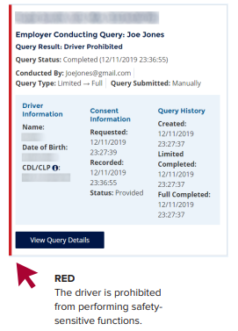
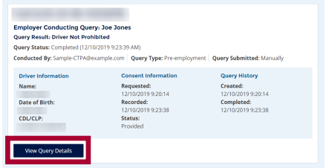
Full Query Results
Once your new CDL applicant has approved your query to run you will see these results.
This means that there is a violation
reported for your driver that is
preventing them from completing any safety-sensitive activities.
This means there are no violations reported for the driver.

Slide 10
Questions?
There are a few things that were not covered like;
Reporting a refusal to the clearinghouse
Reporting a RTD Test into the clearinghouse.
Problems with drivers not completing registration into the clearinghouse.
As well as many other small yet important details. If you have any questions or would like some guidance please contact us at; info@theadvisors.org or give us a call at
980-999-8484!

Slide 11
Thomas Holden
President
Transportation Advisors & EZ-Drugtest
tom@theadvisors.org
980-999-8484

