Slide 1




Electronic Data Management
Tim Brewster
AVP, Loss Control & Recovery
Matt Daecher
President, DCG
Notes:
Tim & Matt

Slide 2


What is Telematics & the Evolution
Benefits of Telematics
TODAY’S AGENDA
Evaluating & Controlling Performance
How Data Can Affect Insurance
Notes:
Matt

Slide 3
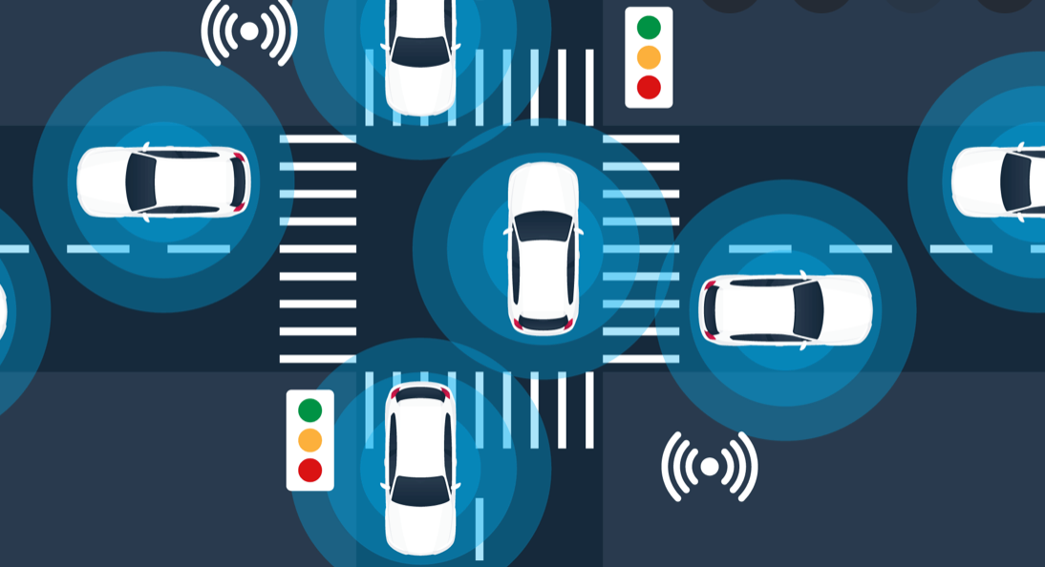
What is Telematics?
Telematics is a very broad term
Sensor communications with external entities
For this presentation's purpose:
“Vehicle-based information that can provide insight into vehicle operations & driving behaviors”
Allows for pre-incident intervention measures when indicated
Notes:
Manual poll on telematic deployment?

Slide 4
Data Provided By Telematics
Vehicle Operating Information
Location
Speed
Braking
Fuel consumption
Acceleration
Idling
Faults
Tire pressure
Engine codes
Cameras
Driver insight
Notes:
Matt

Slide 5
Evolution of Vehicle-based Technology
GPS
Cameras
Integration of Components
Vehicle Diagnostics
Computer Intelligence
Evaluating Driver Performance
Notes:
Matt

Slide 6
Benefits of Telematics
Better understand your company performance
Coaching drivers to success
Improve auto liability & workers compensation performance
Increase defensibility of operation
Improved operating efficiency
CAUSE OF COLLISIONS
CHANGING BEHAVIOR
1 Major Collision
Vid1
Vid2
Vid3
Driver 95%
29 Minor Damage or Near Collisions
Environment 30%
Vehicle 10%
300 No-Damage Risky Incidents
Driver Behavior
Distraction
Speed
Awareness
Limited Visibility
Road Design
Weather
Blind Spots
Tire Failure
Mechanical Failure
Changing risky behaviors prevents future collisions
Source: Accident Research and Safety Report, Haddon Matrix
Source: H.W. Heinrich, Industrial Accident Prevention: A Scientific Approach
Better Control of Your Outcomes!
Notes:
Tim B

Slide 7
Telematic Impact: Driver Performance
Individual driver metrics provides proactive information on driver behaviors
Timely coaching and interventions
Data can be used to recognize drivers
Transparency of driver data can drive competition
Advanced telematics actively coach driver in real time
Evaluating Driver Performance
Notes:
Matt
Largest issues:

Slide 8
Telematic Impact: Company Performance
Permits safety to be proactive instead of reactive
Provides vehicle health insights
Provides information to align safety campaigns with
Reduces fuel costs
Reduces roadway incidents
Evaluating Driver Performance
Notes:
Matt

Slide 9

Consequences of Poor Management
Minimal ROI for your investment
Cultivates a poor safety culture
Increase likelihood of loss potential
Increased liability/results in less defensibility
Notes:
Tim B

Slide 10

Effectively Managing Telematics
Leadership commitment
Dedicating resources to management of program.
Introduce the technology so drivers understand how it will benefit them. (Buy-in is key!)
Consistently monitor, manage and coach drivers to success
Benchmark your individual performance
Remember, telematics is only one component of your safety management program!

Slide 11

Best Practices & Ideas
Incorporate telematics data into your safety incentive program
Gamify the experience for drivers
Create transparency across your enterprise
Use telematics data for company training (Orientation, Recurrent & Remedial)
Notes:
Tim B

Slide 12
Telematic Data & Insurance Rates
Traditional insurance underwriting models utilize loss activity
Poor data management = increased likelihood of losses & increased liability
Good data management = positive influence on event occurrence and more predictable outcomes
Telematic data is being incorporated in some advanced models
Likely in future to expand into other markets
Evaluating Driver Performance
Notes:
Matt
Advanced models: other markets: private passenger (State Farm, Progressive, etc.); truck insurance startups

