Slide 1
2023 Out-of-Service Criteria Changes Emergency Exits- Inspection Bulletin
Danielle Smith, Transportation Specialist
Federal Motor Carrier Safety Administration
Passenger Carrier Safety Division

Slide 2


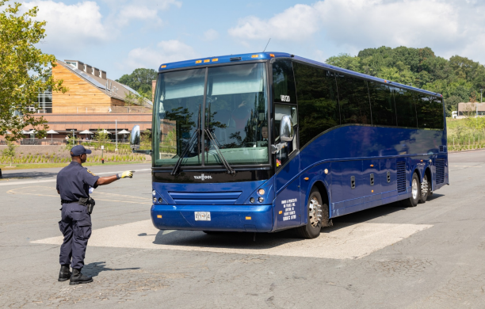
Topics
2023 Out-of-Service Criteria Changes
Emergency Exit Inspection Bulletin Background
  Applicability
  Compliance with Inspection Methods
    Method One or
    Method Two (Option A or Option B)
  Exit Functional Requirements
    Operation
    Access
    Identification and Labeling

Slide 3
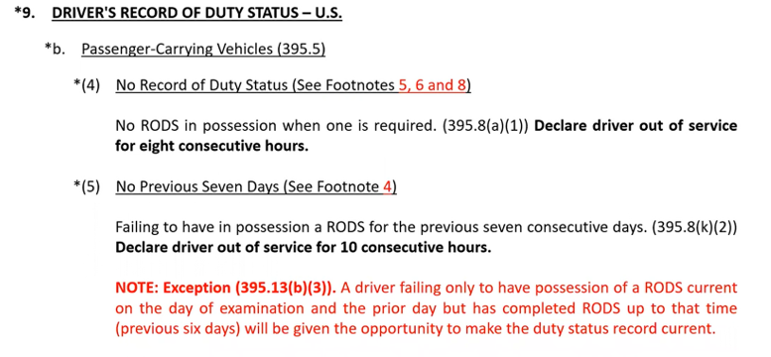
2023 Out-of-Service Criteria Changes
Notes:
Only moved from footnotes to the NOTE – easier to read

Slide 4
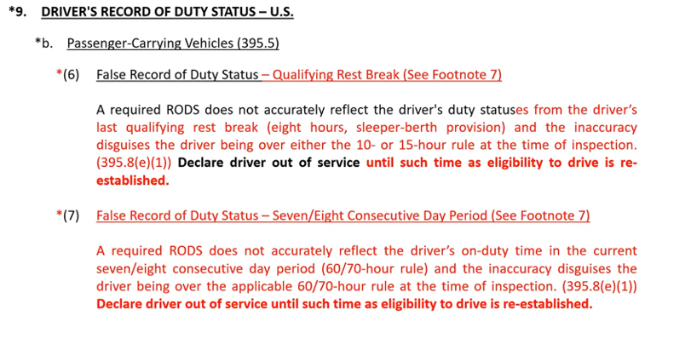
2023 Out-of-Service Criteria Changes

Slide 5
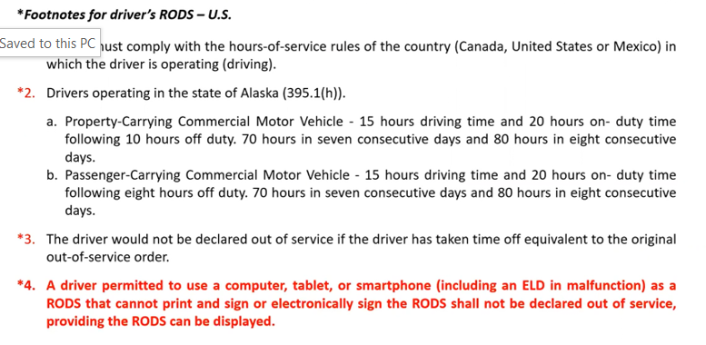
2023 Out-of-Service Criteria Changes

Slide 6
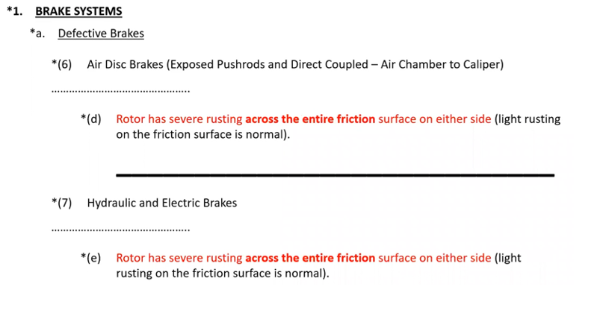
2023 Out-of-Service Criteria Changes
Notes:
Changed in hydraulic, air disk and electric

Slide 7
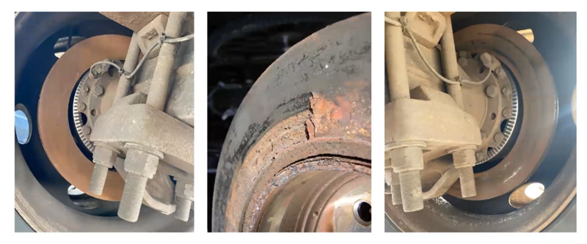
2023 Out-of-Service Criteria Changes
OUT-OF-SERVICE CONDITION
Notes:
Rusting across entire friction surface

Slide 8
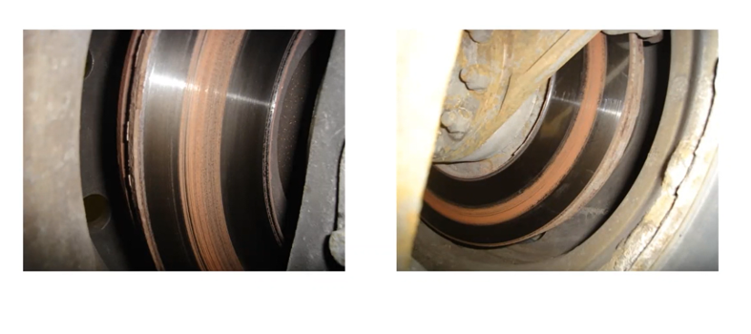
2023 Out-of-Service Criteria Changes
NOT an OUT-OF-SERVICE CONDITION
Notes:
You have rusting but Still have contact on pad to rotor surface

Slide 9
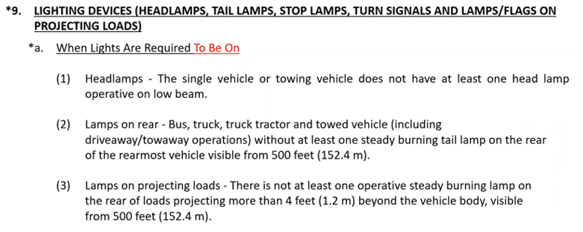
2023 Out-of-Service Criteria Changes

Slide 10
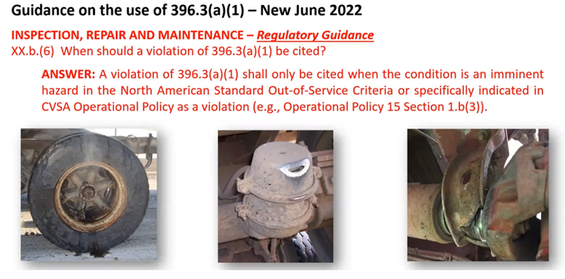
2023 Out-of-Service Criteria Changes (OPs Policy 15)
Notes:
Smoking hub, hole in spring brake housing and a carrier bearing

Slide 11
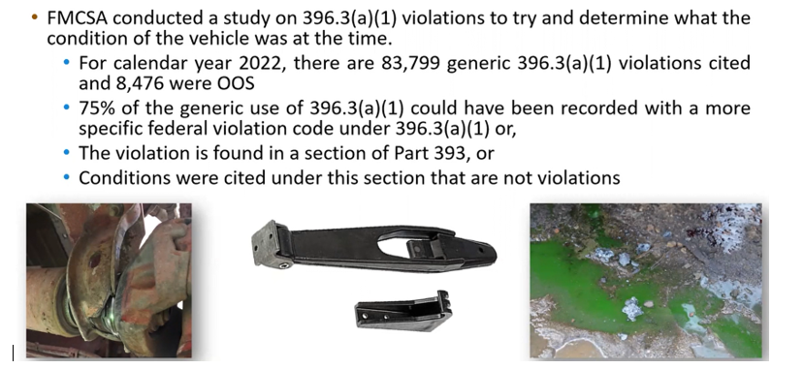
396.3(a)(1) Study
Notes:
Carrier bearing bracket - - drill down to the correct site so the motor carrier knows it is a driver line drive shaft issue.

Slide 12
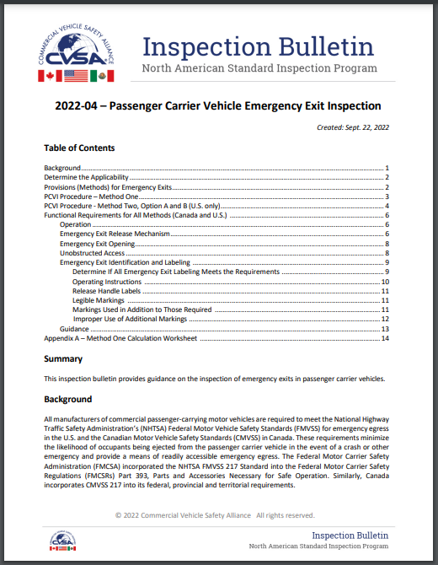
2022-04 – Passenger Carrier Vehicle Emergency Exit Inspection
Commercial Vehicle Safety Alliance (CVSA)
  Passenger Carrier Committee
Bulletin is designed to provide industry and enforcement with a clear understanding of the emergency exit requirements and methods used for calculating exit requirements.
https://www.cvsa.org/wp-content/uploads/2022-04-Inspection-Bulletin.pdf

Slide 13
Applicability
Applies only to passenger vehicles that meet the definition of a “bus” as defined in the Federal Motor Vehicle Safety Standards(FMVSS) manufactured after 09/01/1994.
  “Bus means a motor vehicle with motive power, except a trailer,
  designed for carrying more than 10 persons.”
Federal Motor Carrier Safety Regulation “bus” definition does not apply.

Slide 14

Applicability
Original Manufacture VS. Modified Configuration
  Complete Manufactured Vehicle
  Second Stage Manufactured Vehicle
  Modified Vehicle (Altered from original configuration)
  The original configuration of the bus, even if it was manufactured as a school bus, is irrelevant.
FMVSS lists requirements for two types of buses.
  Buses Other than School Buses (Method One)
  School Bus requirements (Method Two)

Slide 15
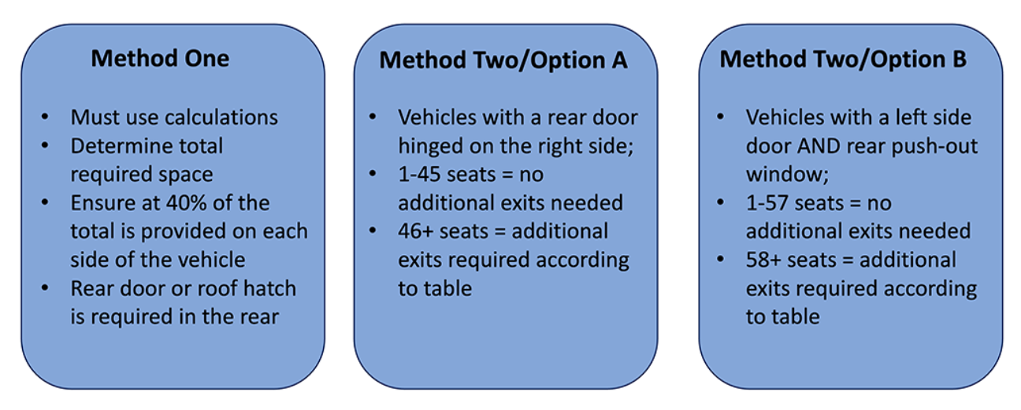
Compliance with Inspection Methods

Slide 16
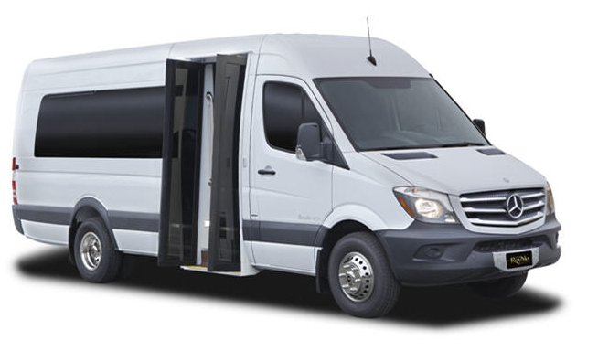
Buses 10,000 lbs. or less
Buses with a GVWR less than 10,001 lbs. (4,536 kg), may meet the unobstructed opening requirements by providing windows/doors that open manually.
Notes:
Buses (meaning vehicles designed to transport more than 10 people) may sometimes have a GVWR less than 10,001 pounds or 4,536 kilograms. These will typically be small shuttle vans or sprinter vans. Be aware that these vehicles may simply meet the emergency exit requirements by having manually opening doors and windows. This is typically achieved by using the original side doors and rear doors that are installed by the manufacturer.

Slide 17
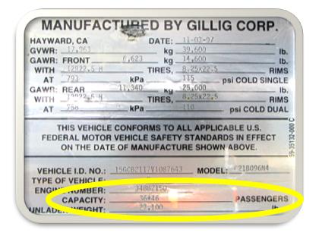
Compliance With Inspection Methods
Step One – Identify the total number of
designated seating positions for the vehicle
Step Two – Determine if the vehicle complies
with ANY of the below methods
A bus that does not comply with the minimum requirements of either Method One (Option I), Method Two A (Option II), or Method Two B (Option III) will result in an out of service condition for a “Required Emergency Exit Missing”.

Slide 18
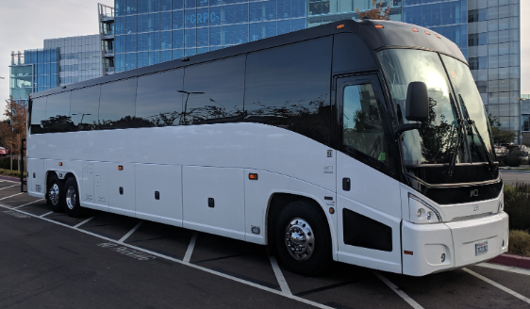
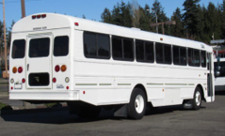
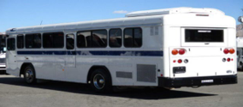
Compliance With Inspection Methods
Method One
Method Two, Option A
Method Two, Option B
Notes:
Starting in the upper left corner, we have an MCI bus that does not have a rear door as required to use Method 2 Option A in the US. It also does not have a rear pushout window and emergency door on the left side as need to use Method 2 Option B in the US. This then requires the inspector to use Method One in the US and Canada to calculate the required emergency exit space.

Slide 19
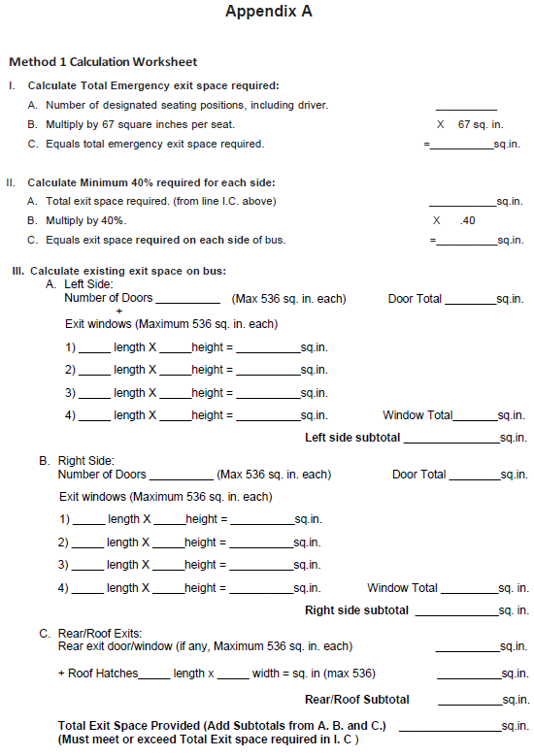
Method One
  Determine the number of designated seating capacity
  Use the calculation sheet to ensure:
    Total required exit space is achieved
    At least 40% of the exits are on each side
    There is a rear exit or roof hatch in the rear most portion of the vehicle.
  Method 1 Calculation Worksheet is found at the end of the Emergency Exit Inspection Bulletin
Notes:
To use Method One, the inspector must determine if the total required exit space is achieved. Is there at least 40% of the exits on each side and is there a rear exit or roof hatch in the rear of the bus.
The inspector will need to do some calculations. Appendix A of the inspection bulletin includes a worksheet that can be used to easily calculate the requirements.

Slide 20

Method One
  Determine the number of designated seating capacity
  Use the calculation sheet to ensure:
    Total required exit space is achieved
    At least 40% of the exits are on each side
    There is a rear exit or roof hatch in the rear most portion of the vehicle.
Notes:
To use Method One, the inspector must determine if the total required exit space is achieved. Is there at least 40% of the exits on each side and is there a rear exit or roof hatch in the rear of the bus.
The inspector will need to do some calculations. Appendix A of the inspection bulletin includes a worksheet that can be used to easily calculate the requirements.

Slide 21

Method One
  Determine the number of designated seating capacity
  Use the calculation sheet to ensure:
    Total required exit space is achieved
    At least 40% of the exits are on each side
    There is a rear exit or roof hatch in the rear most portion of the vehicle.
Notes:
To use Method One, the inspector must determine if the total required exit space is achieved. Is there at least 40% of the exits on each side and is there a rear exit or roof hatch in the rear of the bus.
The inspector will need to do some calculations. Appendix A of the inspection bulletin includes a worksheet that can be used to easily calculate the requirements.

Slide 22

Method One
  Determine the number of designated seating capacity
  Use the calculation sheet to ensure:
    Total required exit space is achieved
    At least 40% of the exits are on each side
    There is a rear exit or roof hatch in the rear most portion of the vehicle.
Notes:
To use Method One, the inspector must determine if the total required exit space is achieved. Is there at least 40% of the exits on each side and is there a rear exit or roof hatch in the rear of the bus.
The inspector will need to do some calculations. Appendix A of the inspection bulletin includes a worksheet that can be used to easily calculate the requirements.

Slide 23
Method One
  Determine the number of designated seating positions
  Use the calculation sheet to ensure:
    Total required exit space is achieved
    At least 40% of the exits are on each side
    There is a rear exit or roof hatch in the rear most portion of the vehicle.
  Total exit space provided must meet or exceed Total Exit space required.
Notes:
To use Method One, the inspector must determine if the total required exit space is achieved. Is there at least 40% of the exits on each side and is there a rear exit or roof hatch in the rear of the bus.
The inspector will need to do some calculations. Appendix A of the inspection bulletin includes a worksheet that can be used to easily calculate the requirements.

Slide 24
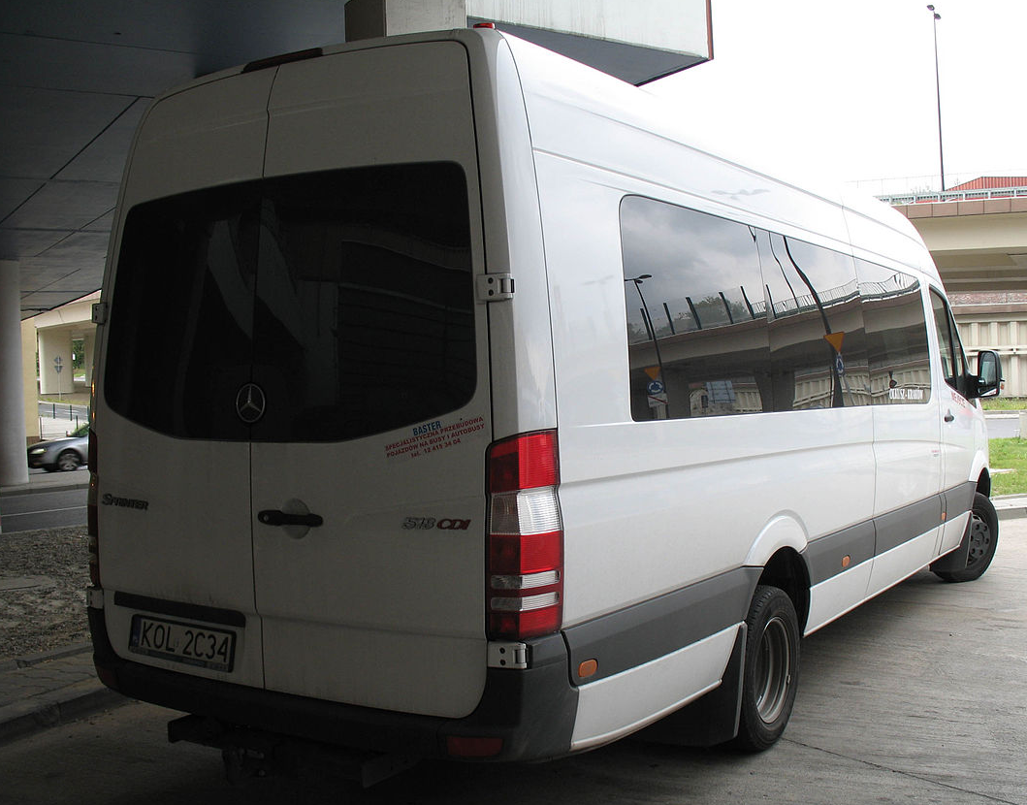
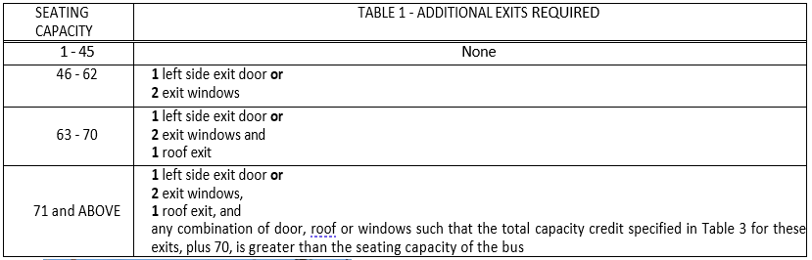
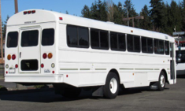
Method Two, Option A
  Determine the designated seating capacity
  Verify the vehicle has a rear door that hinges on the right
  Use the below table to determine if any additional emergency exits are required
Notes:
Method Two Option A in the US is much simpler.
If the vehicle has a rear emergency door that hinges on the right side, this method can be used. The inspector will need to use the Table 1 that is in the bulletin for this method.
The first step is the same, you will identify the seating capacity of the bus from the specification plate, or by counting the seats, including the driver’s seat. If the bus has a rear emergency door and 45 or less seats, no additional exits are required.
46-62 seats will require a left side door, OR 2 exit windows, OR 1 roof exit.
For 63-70 seats, the vehicle will need either a left side door, OR 2 exit windows AND a roof exit. For 71 seats or more, the inspector will have to refer to Table 3 in the FMVSS standard keeping in mind that 71 is greater than the seating capacity of the bus, so this would be rare.

Slide 25
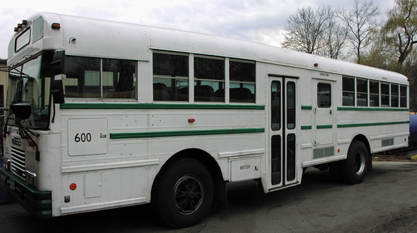
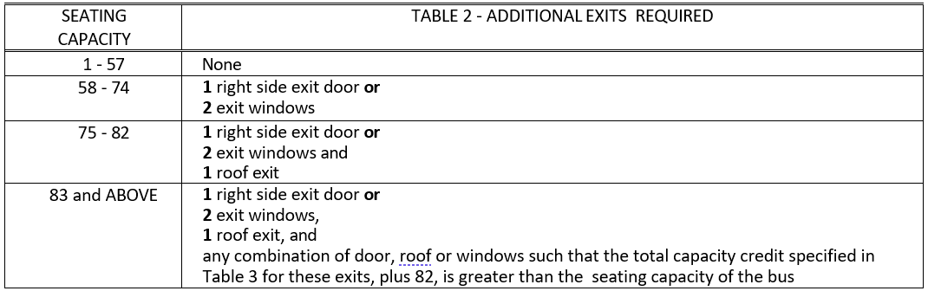
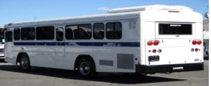
Method Two, Option B
  Determine the designated seating capacity
  Verify the vehicle has a left side door that is hinged on the forward side AND has a rear push-out window
  Use the below table to determine if any additional emergency exits are required
Notes:
Method Two Option B in the US, is the last possible method.
If the vehicle has a left side emergency door that hinges on the forward side AND has a rear pushout emergency window, this method can be used. The inspector will need to check Table 2 that is in the bulletin for this method. The first step is always the same, you will identify the seating capacity of the bus from the specification plate, or by counting the seats, including the driver’s seat. If the bus has 57 or less seats, no additional exits are required. 58-74 seats will require a right side door, OR 2 exit windows. For 75-82 seats, the vehicle will need either a right side door, OR 2 exit windows AND a roof exit. For 83 seats or more, the inspector will have to refer to Table 3 in the FMVSS standard keeping in mind that 83 is greater than the seating capacity of the bus, so this would be rare.

Slide 26
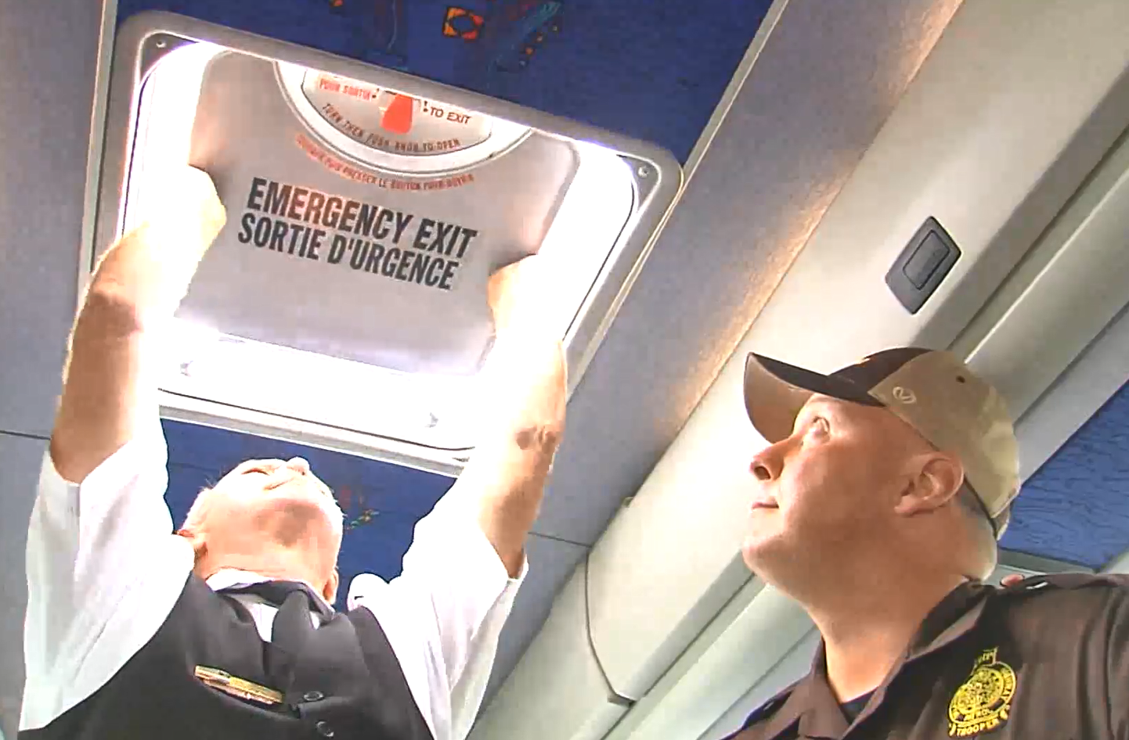

Operation of Emergency Exits
  Emergency exits must open and close as designed
  The driver must open/close exits, not the inspector
  Emergency exits cannot use a tool or remote control to function
Notes:
After determining the number of required emergency exits, each required and/or marked emergency exit will need to be inspected carefully.
As with any inspection, the driver will be responsible for operating any components. The inspector will direct the driver to open and close each exit to ensure proper operation. Each exit must open to allow a passage area that meets the required space, and close securely. All exits are required to function without the use of tools or remote controls. If a required or marked emergency exit cannot open or close securely without the use of tools or remote controls, the vehicle will be declared out of service for a “required or marked emergency exit inoperative”.

Slide 27
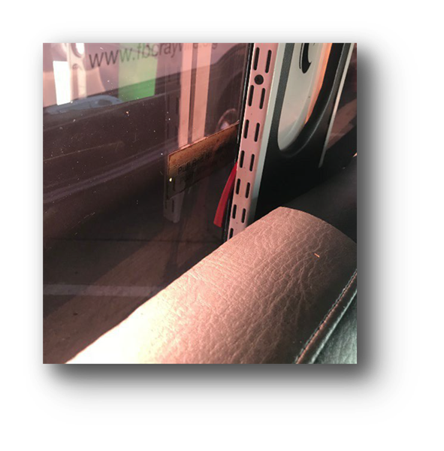


Emergency Exit Release Mechanism
  Each exit must be released by operating one or two manual mechanisms in the appropriate location
  Vehicles with interior modifications must redesign the exits to maintain compliance with FMVSS/CMVSS 217
Notes:
Emergency exit release mechanisms must be released by operating one or two manual mechanisms located above the seat or armrest, whichever is higher - within that exit space. The locations are outlined in the diagrams on this slide and in the bulletin.

Slide 28
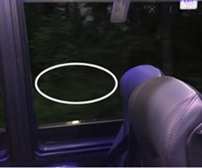
Emergency Exit Opening
  Each emergency exit must allow for manual operation by a single occupant
  Each opening must allow passage of a 19.7in x 13in (50cm x 33cm) ellipsoid
Notes:
Each emergency exit must allow for manual opening by a single occupant.
After the release mechanism is operated, the opening must allow unobstructed passage of a 19.7 X 13-inch (50cm X 33cm) ellipsoid (a shape similar to a football).
Again, during interior restoration or customization, seating or other fabrications may be positioned differently. This may block access to the entire area of the emergency exit and reduce the size of the opening below the required minimum dimension. This would result in an out-of-service condition for “required/marked emergency exit obstructed”. Keep in mind that if the space is reduced, but the required space is still there, which is the 19.7 x 13 inch football size, there is no violation as the dimension is still acceptable and allows passage through the exit.

Slide 29


Unobstructed Access
  Interior customizations or obstructions that hinder access to a marked and/or required emergency exit would be considered an obstructed emergency exit
Notes:
This rear exit door is blocked by large television and perimeter seating. There is no roof hatch installed to comply with rear exit requirement.

Slide 30
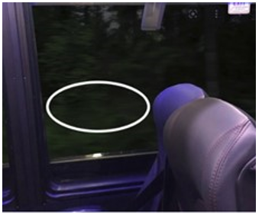
Unobstructed Access
  Interior customizations or obstructions that do not lower the required exit space or reduce the minimum exit dimension will not result in a violation.
Notes:
Interior customizations or obstructions that do not lower the required exit space or reduce the minimum exit dimension will not result in a violation. This bus has a TV monitor and high back seat dividing the emergency exit space yet it still allows passage through the exit.

Slide 31
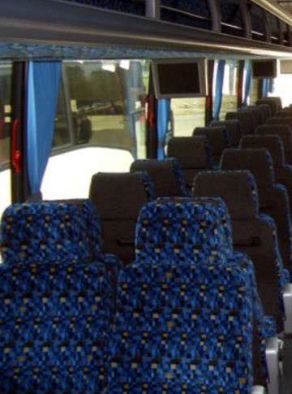
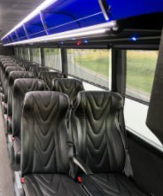

Unobstructed Access
  Curtains/sunshades that can easily be moved out of the way will not be considered an obstruction
Notes:
Curtains/sunshades that can easily be moved out of the way will not be considered an obstruction.

Slide 32

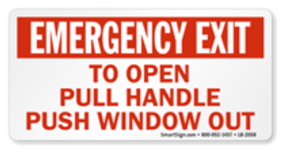

Emergency Exit Identification and Labeling
Identification and labeling requirements DO NOT apply to buses with a GVWR of 10,000 lbs. (4,536 kg) or less
Each REQUIRED emergency exit shall have the designation “Emergency Door” or “Emergency Exit” as appropriate
Service doors that are NOT REQUIRED emergency exits, do not require labels
Notes:
emergency exit labeling DOES NOT apply to buses with a GVWR of 10,000 pounds / 4,536 kg or less. Those lightweight vehicles do not require any emergency exit labels.
Each REQUIRED emergency exit, as determined by the emergency exit calculation, shall have the designation "Emergency Door" or "Emergency Exit" as appropriate.
Failing to properly mark a required emergency exit is an OOS condition

Slide 33

Emergency Exit Identification and Labeling
  Operating instructions (not required for buses 10,000 lbs. (4,536 kg) or less)
  Concise operating instructions must be located within six inches of release mechanism
Notes:
Operating instructions are also not required on buses 10,000 lbs. (4,536 kg) or less.
Concise operating instructions describing the motions necessary to unlatch and open the emergency exit must be located within 6 inches (16 cm) of the release mechanism.

Slide 34
Emergency Exit Identification and Labeling
  Damaged labels that still convey the message or are not in the proper location will be a violation
Notes:
If the instructions are damaged but still convey the message or are not within the required distance, a violation is present.

Slide 35

Emergency Exit Identification and Labeling
  Damaged labels that no longer convey the message, or are completely missing, will result in an out-of-service violation for “Not Properly Marked”
Notes:
If the instructions are damaged to the point that they no longer convey the message or are completely missing, an out-of-service condition exists for “required emergency exit not properly marked”.

Slide 36

Emergency Exit Identification and Labeling
  Secondary manufacturers of limousines and custom coaches
  Placing red lights over emergency exit windows in lieu of the designation marking.
  Done in addition to the required labeling but does not meet the requirements of the Standard
Notes:
Some secondary manufacturers of limousines and custom coaches are placing red lights over emergency exit windows in lieu of the designation marking. This may be done in addition to the required labeling but does not meet the marking requirements in FMVSS/CMVSS 217.

Slide 37
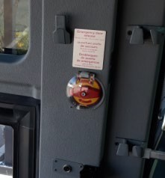
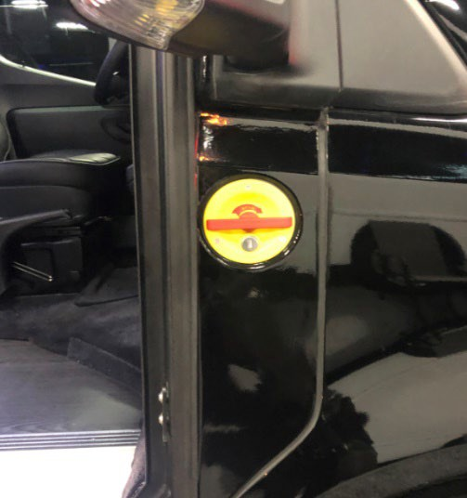
Emergency Exit Identification and Labeling
Front Service Door
  Locked by an internal system rather than manual door handles.
  A valve is provided inside and/or outside to exit the bus.
  Marked “Emergency Door Release or Emergency Exit” with instructions
  Entrance door may not necessarily be a required exit and not marked as an emergency door unless needed to achieve the required 40% of exit space
Notes:
Many passenger carrier vehicle front entrance doors (service) doors are locked by an internal system rather than manual door handles. In the event of a malfunction in the electrical system, or an inoperative door circuit, a valve is provided inside and/or outside to exit the bus. These valves may be marked “Emergency Door Release or Emergency Exit” with instructions indicating a direction to turn the knob to release the door. Even though the valve is provided as an emergency release, the entrance door may not necessarily be a required exit and therefore not marked as an emergency door or emergency exit.
If the required exit space is NOT provided by marked operative emergency exits, either collective or for the right side 40% space requirement, the entrance door would be a required exit and a missing emergency exit label would be an out-of-service condition for “required emergency exit not properly marked.”

Slide 38
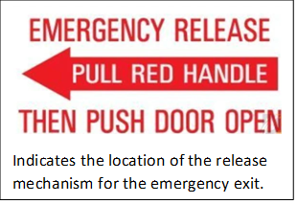
Emergency Exit Identification and Labeling
Release Handle Labels
  Release handle labels (not required for buses 10,000 lbs. (4,536 kg) or less)
  For exits that span multiple rows of seats, rows without release mechanisms must have a label indicating the nearest release mechanism
  Absence of labels for the nearest emergency exit release mechanism will result in a violation
Notes:
Similar to the operating instructions, release handle labels are also not required on buses 10,000 lbs. (4,539 kg) or less.
Emergency exit windows that span multiple rows of seats must have a label that indicates the nearest release mechanism, if a release mechanism is not provided in that row of seats.
The picture illustrates an emergency exit that spans two rows of seats. The release handle is in the rear row of seats, but there is no release handle in the front row.

Slide 39
Emergency Exit Identification and Labeling
Legibility of Labels
  Legibility of labels (not required for buses 10,000 lbs. (4,536 kg) or less
  Required labels must be visible, at a minimum, during normal nighttime illumination from all three of the following locations:
    The seats adjacent to (within) the emergency exit space
    A seat beside the seat adjacent to the exit
    Standing in the aisle beside these seats, even when they are occupied
  If the required emergency exit labels and release instructions are not visible from all three positions, an out-of-service condition is present for “not properly marked” exits.
Notes:
Legibility of labels is also not a requirement on buses 10,000 lbs. (4,539 kg) or less.
Each required exit marking must, at a minimum, be legible when the only source of light is normal nighttime illumination from all specified locations near the emergency exit. These locations include:
• the seat(s) adjacent to or within the emergency exit space; and
• a seat beside the seat adjacent to the exit; and
• standing in the aisle beside these seats even when they are occupied
If required exit markings are not legible/visible from the required positions during normal nighttime illumination, an out of service condition exists for “required emergency exit not properly marked”.

Slide 40
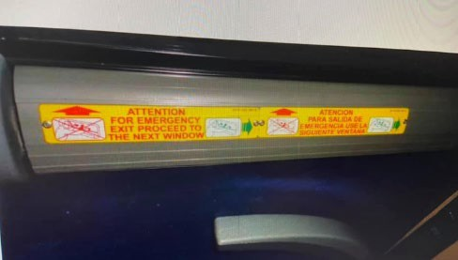
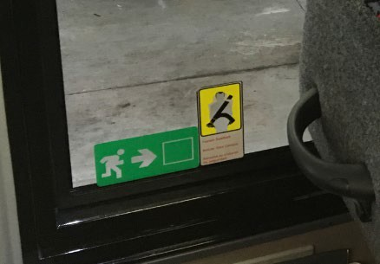
Emergency Exit Identification and Labeling
Markings Used in Addition to Those Required
  Additional labels that are not required in FMVSS/CMVSS are permissible, as long as they cannot be misconstrued or cause confusion in an emergency
  Damage to non-required labels should NOT be documented as a violation
Notes:
Many manufacturers or motor carriers apply labels to non-opening or non-emergency exit windows to indicate the location of the nearest emergency exit. The additional markings are considered permissible, and should not be documented as a violation, unless they are likely to be misconstrued during an emergency. Damage to non-required labels should NOT be documented as a violation
These pictures clearly show through either text or a pictograph that the emergency exit is in a different row, these are permitted but not required.

Slide 41
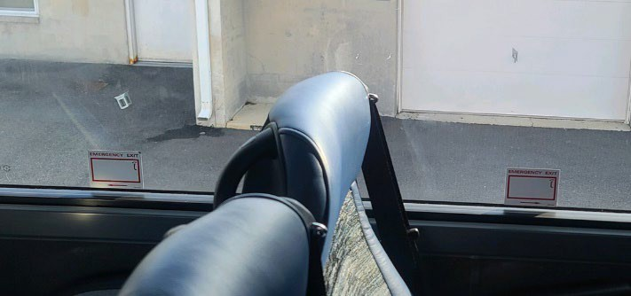
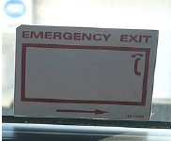
Emergency Exit Identification and Labeling
Improper Use of Additional Markings
  Labels that identify an emergency exit, where no exit is present, are not permitted. A violation should be documented for “inoperative marked emergency exit” and the vehicle should be declared out of service
Notes:
This is because the label could lead a person to believe that the row they occupy is beside an emergency exit because the label is pointing to the location of the release handle which is not there. Labels that identify an emergency exit, when it is not, are not permitted. A violation should be documented for “inoperative marked emergency exit” and the vehicle should be declared out of service.

Slide 42
Guidance
  Determine the applicability of the emergency exit requirements
  Ensure the exits comply with ANY one of the three calculation methods
  U.S. Only: When components exhibit questionable performance (e.g. excessive force is required to unlatch/open emergency exits), submit detailed information to the FMCSA Passenger Carrier Safety Division at MCSEP@dot.gov for further investigation
  Danielle.Smith@dot.gov
  Jeremy.Disbrow@cvsa.org
Notes:
When inspecting passenger carrier vehicles, follow the inspection guidance in this bulletin and ensure that all emergency exit requirements of the applicable FMVSS/CMVSS 217 standard are compliant.
Ensure that the exits meet the requirements of either Method One in Canada and the US or Method Two in the US. for the required number of exits, minimum marking requirements and appropriate operating release mechanisms (handles, bar, etc.)
For U.S. inspectors, if during an inspection, a component exhibits questionable performance (e.g., excessive force is needed to unlatch and open the emergency exit), submit detailed information to the FMCSA Commercial Passenger Carrier Safety Division at MC- SEP@dot.gov for further investigation.
Now exit and take an Inspector Focus Quiz.

