Slide 1
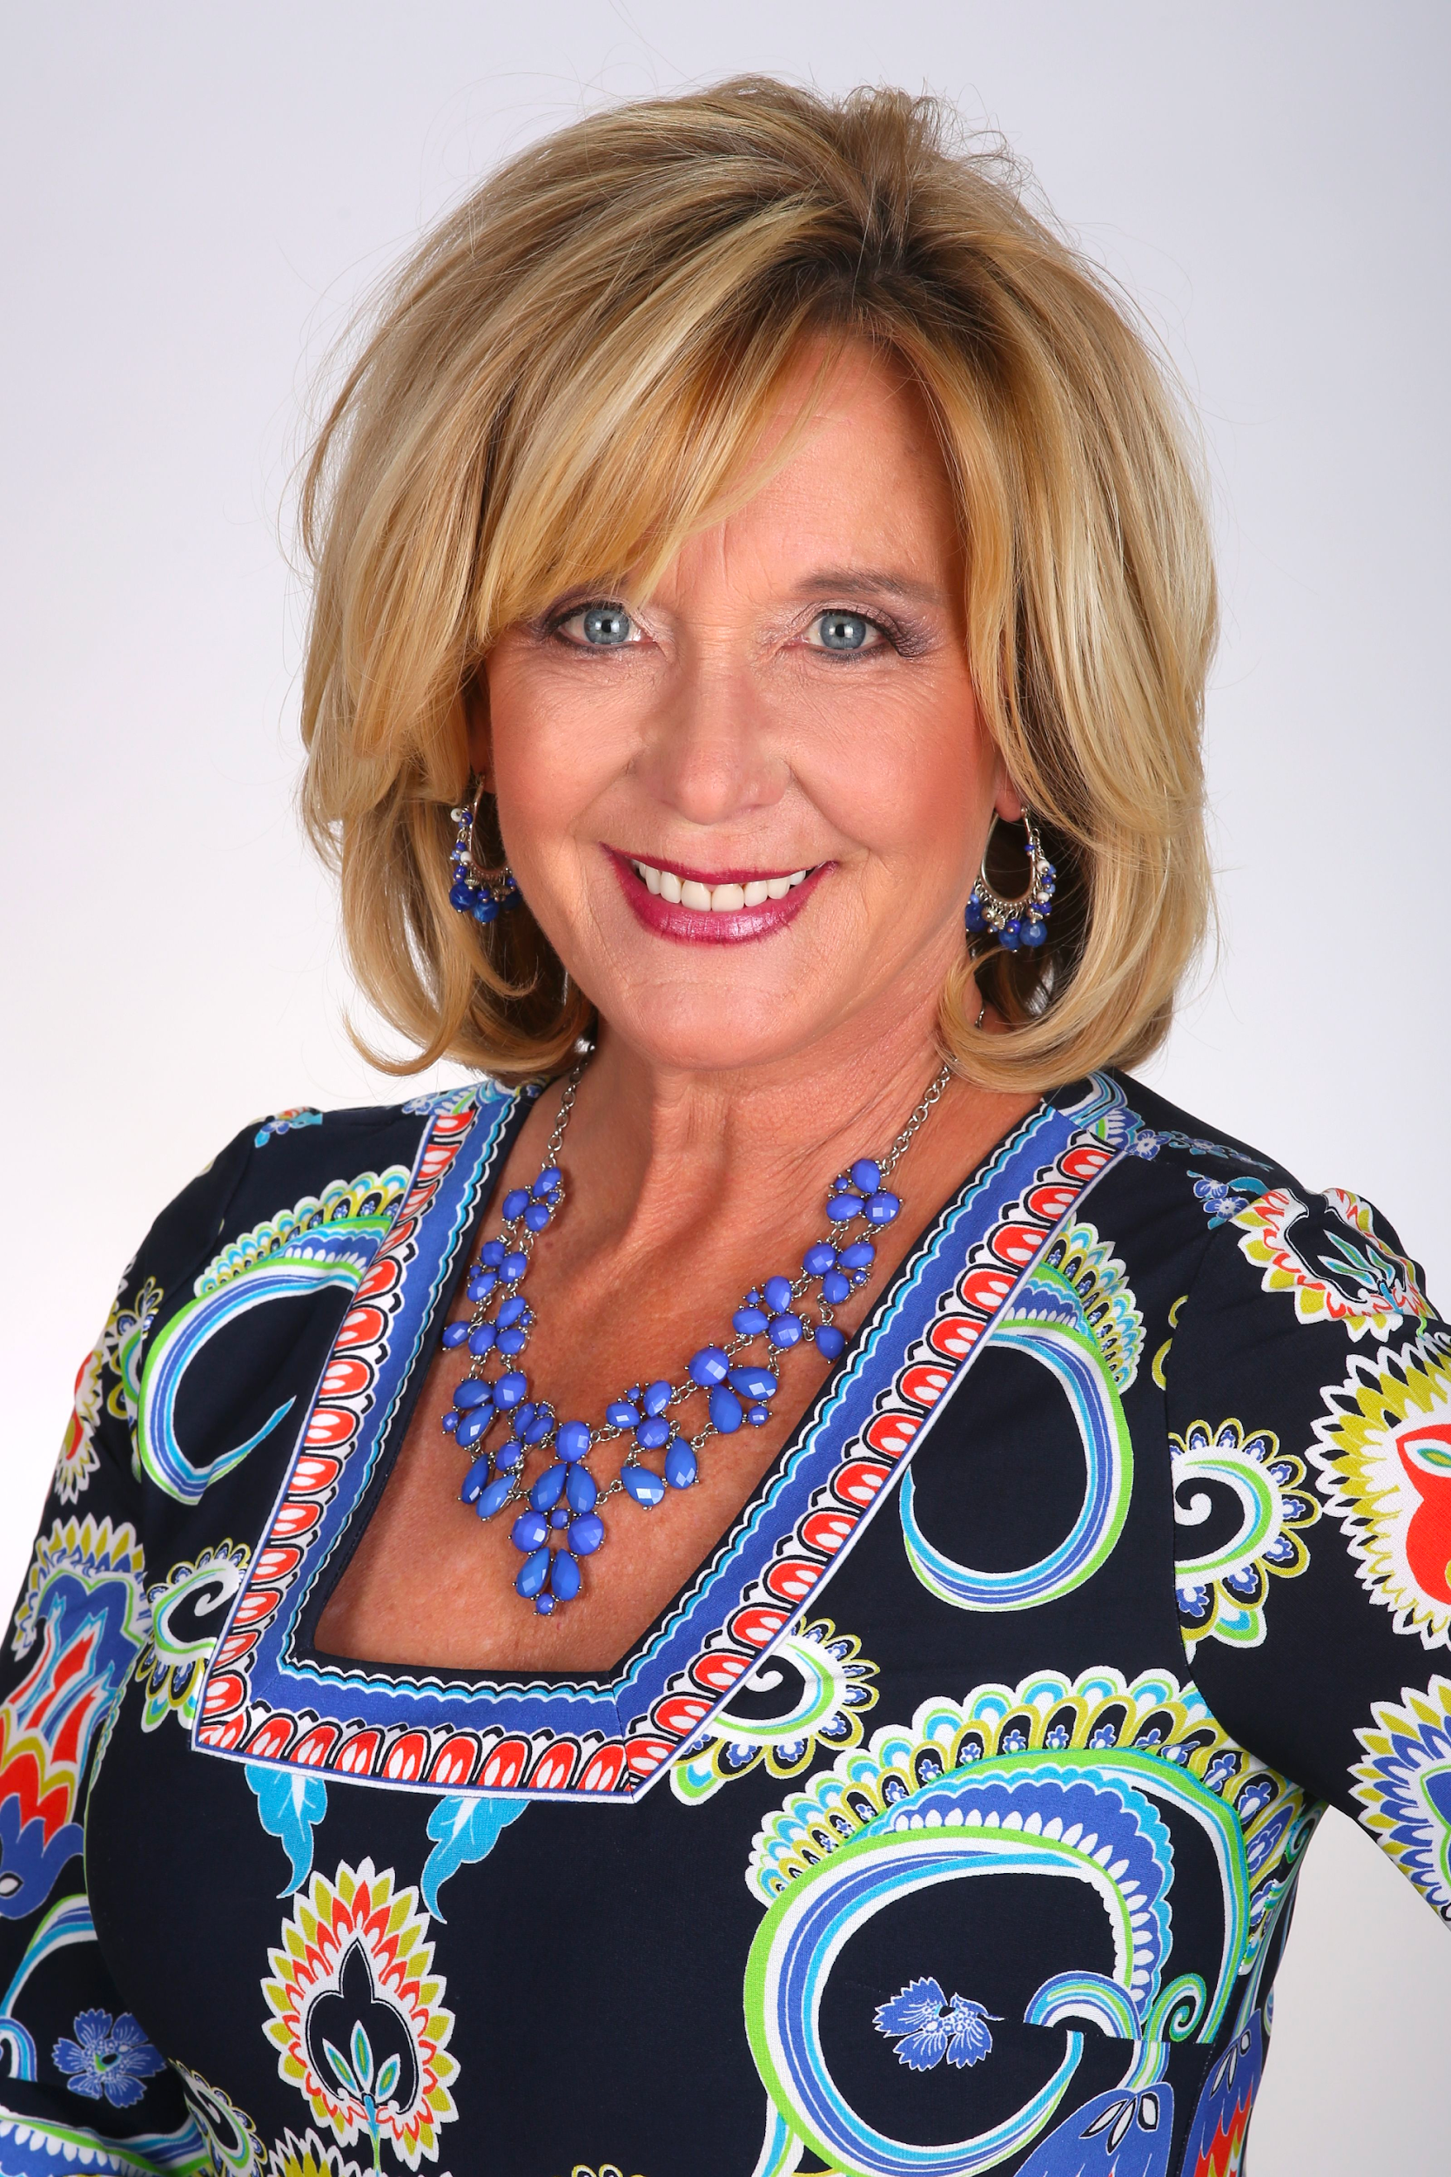


Media Training Session for:
Presented by:
Ann Baldwin
President & CEO
1 Grove Street, Suite 100, New Britain, CT 06053
(860) 408-1580
www.baldwinmedia.net

Slide 2
This session will give you a better eye toward gaining an intelligence that will enable you to be better prepared for future disruptive events

Slide 3
Observation #1
Most Companies are NOT Prepared
Most companies are not prepared
(85% have a plan in place and 90% update their plan
annually, only about 30% hold a practice drill or
exercise)
MOST PLANS TELL PEOPLE WHAT TO DO,
But not how to do it!

Slide 4
Observation #2
Communication failures from the inside/out
Internal communication is just as important as external communications (what & when do you tell people on the inside?)
What are your internal & external notification systems?
Do they work in the case of a power outage or system failure?
Have they been tested to gage volume?
Has critical training been provided and are messages ready?

Slide 5
Observation #3
Accuracy is critical to communication
Incorrect or incomplete information can create obstacles for communication
Not only do you need e-mails, but you also need cell numbers, home numbers, office numbers, e-mail & text capabilities
All information needs to be kept up to date
Whose information do you need? Employees, vendors, media and other stakeholders

Slide 6
Observation #4
Your own employees & the media can destroy your brand!
Company spokespeople, employees, or the media can tarnish, if not destroy your company’s reputation
Jared Fogle-Subway
Bill Cosby- Jell-O
Volkswagen Engineers
Establish and clearly share corporate communication & behavior standards with all employees
Be aware of potential negative information
Establish strong corporate guidelines for social media & acceptable social behavior

Slide 7
What Could Happen?
Bus Accident
COVID Situation
Impaired Driver
Disruptive Passenger (s)
Kid left on Bus
Active Shooter
Bus fire
Natural Disaster
Robbery
Viral Video

Slide 8
The Media has its
agenda…
What’s yours?

Slide 9
The Story Goes On...With or Without You

Slide 10
Attitude + Behavior + Candor =
CREDIBILITY
Credibility is defined as a “source of honor”
Credibility is personal
Having credibility means that you are believable, trustworthy & reliable

Slide 11
Attitude + Behavior + Candor =
CREDIBILITY
Trust is nontransferable
Trust speaks to your integrity
When others have confidence in you, they are open to your influence

Slide 12
Communications Preparation
Keys to Successful Messages
Form a communications team
Organize and maintain a complete file system with updated information
Create a media plan
Effective communication begins with YOU

Slide 13
Communications Preparation
Keys to Successful Messages
Keep your team informed
Watch for changes in the message
How will this new information be communicated ?

Slide 14
Got the Message -
Get the Message!
What is your key message?
Focus on your organization’s key messages
What is the background and history of that message?

Slide 15
Got the Message -
Get the Message!
What is the best way to get the message out?
A successful campaign requires a specific and detailed plan
Getting your message to the public takes work

Slide 16
Got the Message -
Get the Message!
Make sure your message is understood internally
Be familiar with your communications material
Be comfortable with the material

Slide 17





Getting Your Message Out Via
Social Media
Outlets include:
Local News or “Blogs”
New sites added everyday

Slide 18
Getting Your Message Out Via
Social Media
Social media outlets respond faster than conventional media
No editorial oversight or verification
Information can come from anyone, anonymously
Need to monitor and release information accordingly

Slide 19
Interviews
Media Interview Formats
Usually on-scene or home turf
Be brief
May involve several reporters – look at the reporter
Answer each question
Avoid negative images

Slide 20
Pre-Interview Checklist
Preparing for Media Interviews
Request Interview Particulars:
Topic?
Location?
Name of interviewer?
Will there be other guests?

Slide 21
Pre-Interview Checklist
Preparing for Media Interviews
Determine the reporter’s angle
Select the organization’s best spokesperson
Set ground rules and stick to them!

Slide 22
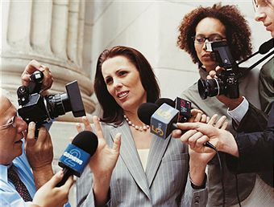
Crisis Communications

Slide 23
Establishing a Media Protocol
Memo to be sent to all internal employees
  Where is the reporter calling from?
  What is the purpose of their call ?
  Take a message- do not transfer the call.
  Gather contact information- first, last, media outlet, phone number, DEADLINE, who they are looking to speak with.
Advise employees to inform you immediately
Media Inquiries are extremely time sensitive!
If employee sees reporter on your property, they need to notify you immediately
Notify you if they see negative press via social media, news articles, comments, etc.

Slide 24
Key Messages to Divert Media
I am not the spokesperson for our company, if you would give me your information, I will have them contact you.
I am not in a position to speak to this, please contact ___as he/she handles all media inquiries.

Slide 25
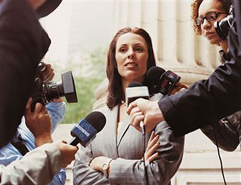
Strategies for Crisis Communications:
Take Control
Be aggressive… take control
Use the media as a tool to dispel any rumors
Never speculate on the cause, cost, or future ramifications of a crisis

Slide 26
Strategies for Crisis Communications
Take Control
Firmly establish the spokesperson during a crisis
The most effective and decisive thing you can do is respond immediately

Slide 27
Strategies for Crisis Communications
Prevent Panic
Understanding human nature is important
Panic increases exponentially the longer people must deal with uncertainty
Respond immediately
Gear your statements to the most basic human needs first

Slide 28
Q & A

Slide 29
Presented by:
Ann Baldwin/President & CEO
Baldwin Media Strategic Communications
1 Grove Street, Suite 100
New Britain, CT 06053
(860) 408-1580
www.baldwinmedia.net

