Slide 1

Electronic Logging Devices – Effects on Drivers and Organizations
2016 BISC West Meeting
Presented by Jacqui Fortsch
Saucon Technologies
Notes:
1

Slide 2
True/False ELD Pop Quiz
Effects on Drivers
Closing thoughts
About ELD manufacturers and registration
Effects on your organization
Notes:
Saucon has done a lot of electronic log implementations in the Motorcoach industry.
Our electronic RODS product is AOBRD compliant, and in the process of review for enhancements to make it ELD compliant.
However, the real effect on operations doesn’t come from which set of letters apply to the product – AOBRD, EOBR, ELD.
The real effect on motorcoach operations comes from the automatic recording of drive time via connection to the engine, and the use of an electronic logging product that automate RODS instead of hand-written paper logs.
Don’t get me wrong – it is just as important that you are using an electronic logging device that is compliant with currently enforced regulations – however, I chose to focus this presentation on how the switch from paper to electronic will affect your drivers, your safety directors and administrators, and really your operations as a whole.
I will have a short section at the end with some key highlights from the newly published regulations.

Slide 3
True or False #1:
“Our Drivers are going to quit because they have to use an ELD.”
False

Slide 4
True or False #1:
“Our Drivers are going to quit because they have to use an ELD.”
If you do it right . . .
Train in small groups at a time
Drivers may grumble to start
Most will never go back to paper once they have used electronic logs
Make sure your support/safety staff can support the drivers – know how to use the equipment, address training issues, etc.
Choose a vendor with a good support system (outside the vehicle applications, good and responsive Support Team, etc.)

Slide 5
True or False #2:
“Our drivers will always need to keep paper logs AND electronic logs. We will never be able to go paperless.”
False

Slide 6
True or False #2:
“We will always need to keep paper logs. We will never be able to go completely paperless.”
During Transition
Both paper and electronic
Until each driver/driver group is fully trained
When Driver and Safety Admin Agree
Driver can go fully electronic
No longer needs to keep a daily paper log
Unless . . .
ELD Malfunction
Blank paper log MUST be kept on the bus in case of malfunction
Until all training issues are addressed and corrected
Driver needs to recreate to the best of his ability until device is repaired

Slide 7
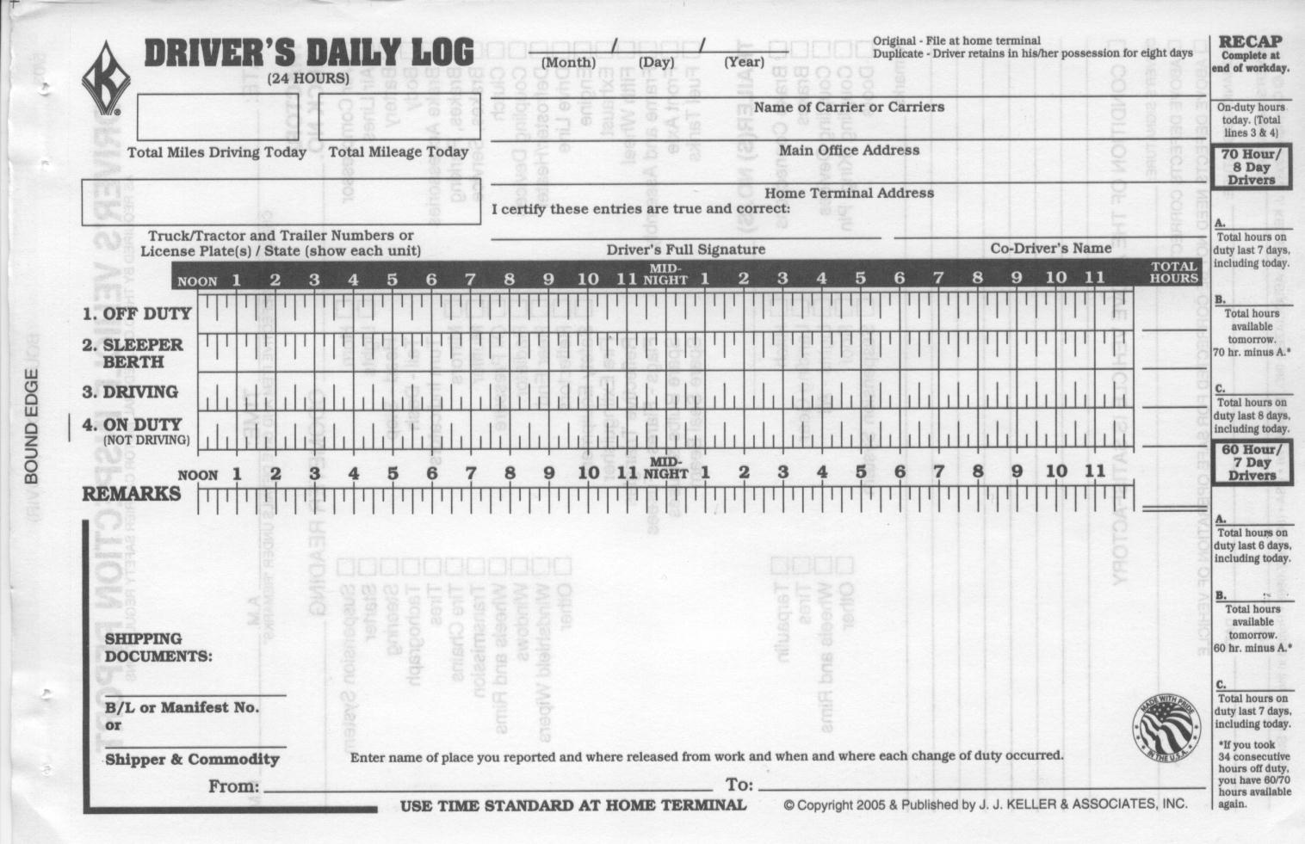
ELD Effects on Drivers
Paper logs vs. Electronic logs
Miles Driven Today
Driver’s Signature
Company Name
Today’s Date
Asset Number
Recap
Trip ID Number
Logbook Grid Graph
Notes:
So a big question for operators is “How are electronic logs going to affect my drivers?” We all know that it’s hard to find qualified drivers – and the last thing you want is to lose drivers because they are being forced to use new technology.
Our experience has been that none of our customers who have transitioned to electronic logs has lost a driver as a result – in fact, most would say their drivers would revolt if the company went back to paper.
So let’s look at how a driver’s day is going to be affected by using an electronic log vs. the current paper log.
So I’m guessing this looks familiar to some of all of you?
This is an example of a paper log.
You’ll notice I’ve highlighted some of the main elements that drivers must include in their logs.
So they’ll start out by adding the asset/bus number, Trip ID, today’s date, Company name, and draw their graph showing duty status changes.
Then they’ll end their day with the ‘math’ – how many miles they drove today, and the recap of hours of service. Then they sign their log to certify the log is true and correct.

Slide 8
Paper vs. Electronic Logs
ELD Effects on Drivers
Logbook Element | Paper Logs | Electronic Logs
Driver Name | By Driver | Automatic (by driver ID)
Trip ID | By Driver | By Driver
Company Name | By Driver or Pre-printed | Automatic
Asset Name | By Driver | Automatic
Location | By Driver | Automatic (on Duty Status changes)
Miles Driven | By Driver | Automatic
Grid | By Driver | Automatic
Recap | By Driver | Automatic
Driver Signature | By Driver | Automatic (on Driver electronic signature)
Notes:
When we look at Electronic RODS, the same elements are there – but many of them are filled in automatically simply by the driver signing into the ELD.
A driver is given a unique sign in that is attached to an ELD account containing his/her name, CDL, etc.
The ELD is attached to the engine of a bus that is owned/operated by a company under a DOT number.
By signing in, the driver ‘pulls’ the Driver Name, Company Name, and asset name into his/her log.
Location is automatically ‘populated’ by the device when needed – like at driver sign on, change in duty status, etc.
The Graph grid is drawn on the ELD based on entries made by the driver throughout the day.
The Miles driven and HOS recap are automatically calculated by the device throughout the day. The Driver’s signature is electronic based on an entry by the driver.
The only thing left that is truly a manual entry is the Trip ID number.
With ELDs, there will be more elements added to the driver’s log – including engine on/off events, engine hours, etc – but these will all be automatically recorded using the ECM connection.

Slide 9
True or False #3:
“Drivers need to pay attention to and interact with the device. It isn’t all automatic.”
True

Slide 10
True or False #3:
“Drivers need to pay attention to and interact with the device. It isn’t all automatic.”
Automatic Duty Status Changes
At ECM Speed of 3 mph (From ODND to Driving)
At driver sign in (From Off Duty to ODND)
At Engine shut down (From Driving to ODND)
After 6 minutes of ‘no motion’ (From Driving to ODND)
After driver has told the device to sign log, but did not complete the 2nd step of reviewing and certifying (From Driving or ODND to Off Duty but without a valid signature)

Slide 11
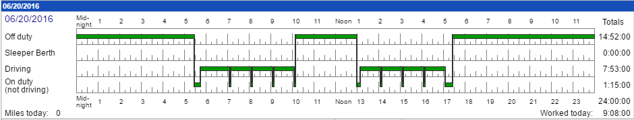
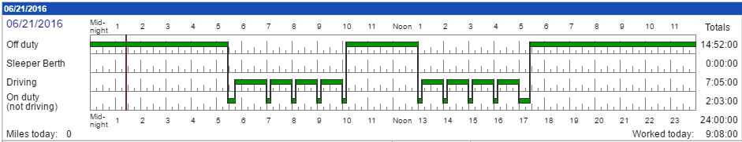
Benefits of Interacting with the ELD instead of relying on Automatic events
ELD Effects on Drivers
Driver 1
Little interaction with device
Driver 2
Interacts more frequently with the device
Relies on automatic duty status changes
Does not rely solely on automatic duty status changes
PA to NYC Run
4 Stops each way
Stops last 10 min each
Driver 1
+ 43 minutes of Driving Time
Driver 2
Notes:
Let’s look at an example where a driver benefits from having gotten in the habit of ‘telling’ the device what he/she is doing.
The above two logs show a driver doing the same run, from Bethlehem PA to New York City. The On Duty line drops at the start and end of the logs are the same pre and post trips.
The first driver did not indicate on the device that he/she was stopping to load/unload passengers. The second driver told the device that he/she was making 6 stops, 10 minutes each, to load/unload passengers.
Look at the difference in the drive time recorded by the two drivers. The second driver gains an hour of drive time.
This example may be a little bit exaggerated, but it shows the basic concept.
The advantage over a paper log is clear – each of these loading/unloading events would have been recorded at 15 minutes each – the driver would have had an additional 30 minutes of driving for the day.

Slide 12
Other Benefits of Interacting with the ELD
Driver is ‘trained’ to interact with ELD
Minimizes Unassigned Driving
Minimizes driver forgetting to go Off Duty

Slide 13
True or False #4:
“Using Electronic Driver Logs will affect every aspect of your organization, not just drivers.”
True

Slide 14
Review Tight Line Runs
Personal Conveyance Policy
Train Dispatch staff
Train Sales Staff
Train Mechanics

Slide 15
True or False #5:
“Drivers may find more driving time available to them with electronic logs.”
“True”

Slide 16
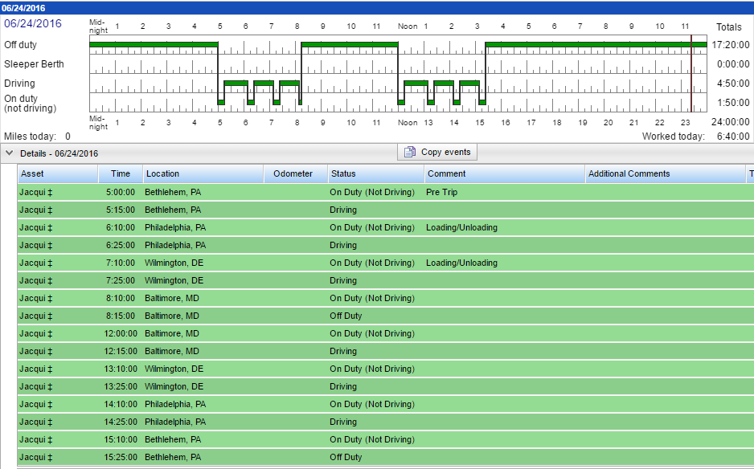
‘Finding’ More Driving Time with Electronic Logs
ELD Effects on Drivers
Result:
5 ‘extra’ minutes of driving time for each stop
X 6 stops
= 30 ‘found’ minutes of driving time
Paper logs – driver would have dropped the line to ODND at :15 after the hour instead of :10 after.
Notes:
Let’s look at an example where a driver benefits from having gotten in the habit of ‘telling’ the device what he/she is doing.
The above two logs show a driver doing the same run, from Bethlehem PA to New York City. The On Duty line drops at the start and end of the logs are the same pre and post trips.
The first driver did not indicate on the device that he/she was stopping to load/unload passengers. The second driver told the device that he/she was making 6 stops, 10 minutes each, to load/unload passengers.
Look at the difference in the drive time recorded by the two drivers. The second driver gains an hour of drive time.
This example may be a little bit exaggerated, but it shows the basic concept.
The advantage over a paper log is clear – each of these loading/unloading events would have been recorded at 15 minutes each – the driver would have had an additional 30 minutes of driving for the day.

Slide 17
True or False #6:
“When a driver is out of hours, the ELD will shut the bus down.”
False

Slide 18
True or False #6:
“When a driver is out of hours, the ELD will shut the bus down.”
Safety First – Saucon does not shut bus off automatically
Alert immediately sent to driver AND to back office each time driver drives
It is up to the driver and dispatch/back office to determine the plan to recover from exceeding HOS limits

Slide 19
True or False #7:
“Safety Administrators don’t need to review drivers’ logs. Electronic logs are self-auditing.”
False

Slide 20
ELD Effects on Safety Administrators and Support Staff
Effects on Safety Managers
A daily review of logs should be done to address issues immediately.
Did the driver reflect adequate amount of time spent on pre- or post-trip?
Did the driver claim Adverse Conditions – and go into violation?
Did the driver use Personal Conveyance and if so was it used properly?
Did the driver go Off Duty from the night before or during his break times?
Does the driver have a signature on each 24 hour period?
Has the driver approved and recertified any edits made to his/her log by an administrator?
Were there any HOS violations and were they addressed with the driver?
Notes:
For Safety Managers, once the initial roll-out is complete, reviewing and internally auditing logs should take less time than it was with paper logs.
However, the logs WILL STILL NEED review, even though they are generated using an automated process.
The review of electronic logs should be done from the point of view of an external audit. Safety managers should ask themselves when reviewing electronic logs:
Have I reviewed all unassigned driving events, and either ensured the time is assigned to a driver’s log, or explained why the time does not belong to a driver?
Can I explain this to a regulating authority? If a driver claimed an Adverse Conditions event, and went into violation as a result – am I able to prove during an audit that I reviewed the event to ensure it was UNFORESEEN and that the driver’s time spent in violation did not greatly exceed the actual duration of the Adverse Conditions event?
Can I justify the edit I proposed to a driver’s log as a plausible, legal edit? For example if the driver forgot to sign himself Off Duty, can I show data that supports the proposed edit I made to the log to sign him off? Can I show when the bus arrived back to the terminal and was shut down? Did I then ensure the driver certified the edit I proposed to his/her log? Some edits an administrator proposes to a log can be explained and legitimate. But some cannot.
Can the edit I proposed to the log be interpreted as ‘log falsification’? Let’s take the example of a driver who is not careful when signing on in the morning – he/she signs in too early before the full 8 hours consecutive off duty have been reached. If an admin edits the driver’s log to ‘sign them out,’ it can lead to a lot of questions. Why was the driver on your property before getting the full 8 hours off? If the driver is on your property, and being compensated from time of arrival, should he/she be considered on duty? These are the kinds of edits safety managers need to be very careful about proposing.
Because ELDs will give safety administrators a lot of data, it is expected that the safety managers took meaningful action when an issue is found. For example, if I see that a driver is going into violation because he is not going off duty at the points in his day when he takes a break – can I prove that I addressed this with the driver? If a dispatcher is putting a driver on a run knowing that his remaining HOS are very tight – did I address that with the dispatcher and driver? If a driver advised that an ELD was malfunctioning, did I take immediate action to address the malfunction with my mechanic staff or the ELD manufacturer?
Document, document, document. Safety managers will receive A HUGE amount of data and will be expected to take meaningful action on it when necessary. Remember – at an audit you may be asked about an event that happened 6 months ago. You may not remember what an Adverse Conditions was caused by or if it qualified.

Slide 21
ELD Effects on Safety Administrators and Support Staff
Effects on Safety Managers
Logs will eventually take less time to review, but should be looked at from the point of view of an external audit.
Can I explain this action to a regulating authority?
Can I justify the edit made to a driver’s log as a plausible, legal one?
Can the edit I proposed be interpreted as ‘log falsification?’
Can I prove that I took corrective action when I found a problem?
Can I show that I am using the data I receive from ELDs or Fleet Management System to take meaningful action?
Did I take immediate action when I was advised of an ELD malfunction?
Have I assigned all ‘unassigned driving’ to a driver – or explained why an unassigned driving event is not attributable to a driver?
Notes:
For Safety Managers, once the initial roll-out is complete, reviewing and internally auditing logs should take less time than it was with paper logs.
However, the logs WILL STILL NEED review, even though they are generated using an automated process.
The review of electronic logs should be done from the point of view of an external audit. Safety managers should ask themselves when reviewing electronic logs:
Have I reviewed all unassigned driving events, and either ensured the time is assigned to a driver’s log, or explained why the time does not belong to a driver?
Can I explain this to a regulating authority? If a driver claimed an Adverse Conditions event, and went into violation as a result – am I able to prove during an audit that I reviewed the event to ensure it was UNFORESEEN and that the driver’s time spent in violation did not greatly exceed the actual duration of the Adverse Conditions event?
Can I justify the edit I proposed to a driver’s log as a plausible, legal edit? For example if the driver forgot to sign himself Off Duty, can I show data that supports the proposed edit I made to the log to sign him off? Can I show when the bus arrived back to the terminal and was shut down? Did I then ensure the driver certified the edit I proposed to his/her log? Some edits an administrator proposes to a log can be explained and legitimate. But some cannot.
Can the edit I proposed to the log be interpreted as ‘log falsification’? Let’s take the example of a driver who is not careful when signing on in the morning – he/she signs in too early before the full 8 hours consecutive off duty have been reached. If an admin edits the driver’s log to ‘sign them out,’ it can lead to a lot of questions. Why was the driver on your property before getting the full 8 hours off? If the driver is on your property, and being compensated from time of arrival, should he/she be considered on duty? These are the kinds of edits safety managers need to be very careful about proposing.
Because ELDs will give safety administrators a lot of data, it is expected that the safety managers took meaningful action when an issue is found. For example, if I see that a driver is going into violation because he is not going off duty at the points in his day when he takes a break – can I prove that I addressed this with the driver? If a dispatcher is putting a driver on a run knowing that his remaining HOS are very tight – did I address that with the dispatcher and driver? If a driver advised that an ELD was malfunctioning, did I take immediate action to address the malfunction with my mechanic staff or the ELD manufacturer?
Document, document, document. Safety managers will receive A HUGE amount of data and will be expected to take meaningful action on it when necessary. Remember – at an audit you may be asked about an event that happened 6 months ago. You may not remember what an Adverse Conditions was caused by or if it qualified.

Slide 22
True or False #8:
“My driver needs to be able to print his/her log from the ELD at a Roadside inspection.”
False

Slide 23
True or False #8:
“My driver needs to be able to print his/her log from the ELD at a Roadside inspection.”
Telematics Transfer
Email & Web Services
Local Transfer
Bluetooth & USB
Back-up method
Officer can view the log on the display without entering the vehicle

Slide 24
ELD Effects on Safety Administrators and Support Staff
Planning for elogs
Transitioning to electronic logs will take investment and work
Install any hardware/software
Train drivers – recommend break them into groups
Drivers will likely be doing both paper and electronic during training period
Safety Managers will need to review logs daily and address training issues immediately
Notes:
Making the decision to move to electronic logs will take investment and work
You may need to install hardware and/or software to use electronic logs
Drivers need to be trained. When we do electronic log roll outs, we usually recommend breaking the drivers into groups. It allows the admins to build a set of ‘experienced’ drivers that can help train new drivers, and allows for a bit of controlled roll out.
Drivers will likely be doing both paper and electronic logs during training period, until administrator and driver agree that the driver is ready to go fully electronic.
Safety Managers need to commit to reviewing electronic logs daily, comparing to any paper logs still being kept and address training issues immediately with the drivers – with the goal being to get that driver fully on paperless logs.

Slide 25
ELDs – Closing notes
ELDs – Highlights of the new Regulations
Compliance dates:
If your drivers are not using AOBRD devices – you must be ELD compliant by Dec 16, 2017
ELD manufacturers and registration:
Be wary of any vendors claiming they are ELD compliant
Currently there are about 5 vendors registered. But none of the “big players.”
If your drivers are using an AOBRD device, or if you voluntarily opt to use an AOBRD device before Dec 16, 2017 (i.e. purchase an AOBRD and require your drivers to use it) – you will be given an additional 2 years to be ELD compliant.
Saucon’s approach: “We don’t want to be first. We want to be right.”
Notes:
Compliance dates:
If drivers are not using AOBRD devices – you must be ELD compliant by mid-December 2017.
If you drivers are using AOBRD devices – or if you voluntarily opt to purchase and require your drivers to use AOBRD devices between now and mid-December 2017 – you will get an additional 2 years to be ELD compliant.
ELD manufacturers:
We’ve gotten a lot of questions about whether our product is ELD compliant
I’m not going to stand up here today and tell you that it is.
Honestly, I would be very wary of any supplier who claims they are ELD compliant.
“ELDs” did not exist before mid-December 2015, because the regulations were not published until then.
FMCSA is going to release optional test procedures, that providers can use when testing ELD compliancy. The regulations say to expect these sometime in the first quarter of 2016.
There is still a lot of grey area. This could be an instance where it’s not necessarily an advantage to be ‘first in compliance.”
Make sure you are working with a provider that had good contacts and relationships with the regulating authorities.

Slide 26
Questions?
Notes:
Compliance dates:
If drivers are not using AOBRD devices – you must be ELD compliant by mid-December 2017.
If you drivers are using AOBRD devices – or if you voluntarily opt to purchase and require your drivers to use AOBRD devices between now and mid-December 2017 – you will get an additional 2 years to be ELD compliant.
ELD manufacturers:
We’ve gotten a lot of questions about whether our product is ELD compliant
I’m not going to stand up here today and tell you that it is.
Honestly, I would be very wary of any supplier who claims they are ELD compliant.
“ELDs” did not exist before mid-December 2015, because the regulations were not published until then.
FMCSA is going to release optional test procedures, that providers can use when testing ELD compliancy. The regulations say to expect these sometime in the first quarter of 2016.
There is still a lot of grey area. This could be an instance where it’s not necessarily an advantage to be ‘first in compliance.”
Make sure you are working with a provider that had good contacts and relationships with the regulating authorities.

