Slide 1
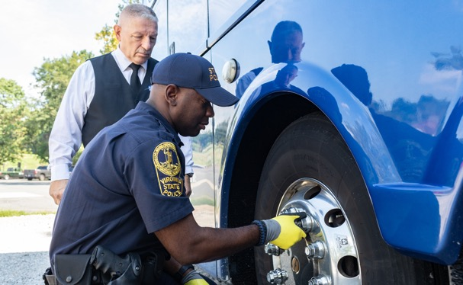

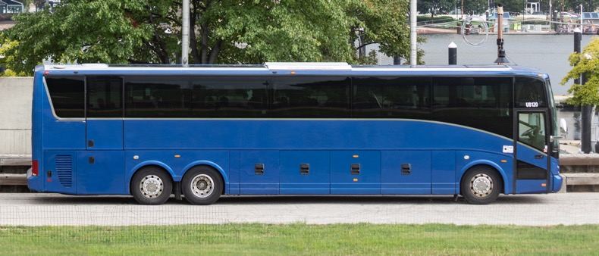
Federal Motor Carrier Safety Administration
Notes:
Available cover design option. Please delete any unneeded cover page designs.

Slide 2
BISC West
FMCSA Update
Danielle Smith, Transportation Specialist
Passenger Carrier Safety Division

Slide 3
Federal Emergency Declarations by FMCSA
Extension and Amendment of the Modified Emergency Declaration No. 2020-002 Under 49 CFR § 390.25 (May 27, 2022)
Effective: 09/01/2022 | Expires on: 10/15/2022
  Amended to address direct emergency assistance for some supply chains arising out of the ongoing emergency.
  Continues to be extended because the presidentially declared emergency is still in place.

Slide 4
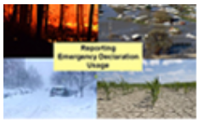

Emergency Related Declarations
COVID-19 Updates
Federal Emergency Declarations by FMCSA
Federal Emergency Declarations by FMCSA Service Centers
Federal Notice of Enforcement Discretion Determination
Canadian Emergency Declarations
State Emergency Declarations by State
https://www.fmcsa.dot.gov/emergency-declarations

Slide 5
CDL Downgrades for Drug & Alcohol Violations
FMCSA published a final rule prohibiting State driver’s licensing agencies (SDLAs) from issuing a CDL to individuals prohibited from performing safety-sensitive functions due to drug and alcohol violations, as reported to the Drug and Alcohol Clearinghouse (DACH). (November 18, 2024)
SDLAs must…
  Query the DACH prior to issuing, renewing, transferring, or upgrading a CDL or CLP.
  Remove a CLP or CDL privilege (downgrade) when notified of a driver’s DACH violation by FMCSA.
FMCSA will notify the SDLA when a driver completes the return to duty requirements and is no longer prohibited.

Slide 6
Federal Register Publication 3/09/2022
Record of Violations [Docket No. FMCSA-2018-0224]
  FMCSA amends its regulations to eliminate the requirement that drivers prepare and submit a list of their convictions for traffic violations to their employers annually.
  Requires motor carriers to make an annual inquiry to each driver’s licensing authority.
  Removes 391.27
  Effective May 9, 2022.

Slide 7
Speed Limiting Devices
FMCSA published an advance notice of supplemental proposed rulemaking announcing its intent to proceed with a speed limiter rulemaking. A follow-up to FMCSA's and NHTSA's joint action in 2016.
  Questions are asked to obtain relevant information.
  Comment period was extended to July 18, 2022.
Comments will be requested about draft regulatory standards in a future publication.

Slide 8
Federal Register Publication 8/11/2022
Waiver of Certain Pre-trip Vehicle Inspection Skills Test Requirements for Certain School Bus Drivers (June 30, 2022)
  Expires on September 30, 2022
Commercial Driver’s License: Application for Exemption; National
School Transportation Association
[Docket No. FMCSA–2022–0148]
  National School Transportation Association (NSTA) has applied for an exemption for commercial driver’s license (CDL) applicants seeking a school bus endorsement, from the engine compartment portion of the pretrip vehicle inspection skills testing requirement.
  Drivers issued a CDL under the exemption would be restricted to intrastate operation of school buses only.
  FMCSA requests public comment. Comments must be received on or before September 12, 2022.

Slide 9
Federal Register Publication 8/16/2022
Qualifications of Drivers: Medical Examiner's Handbook and Medical Advisory Criteria Proposed Regulatory Guidance
  [Docket No. FMCSA–2022–0148]
  FMCSA announces the draft Medical Examiner's Handbook (MEH) with proposed changes to the Medical Advisory Criteria
  The MEH and Medical Advisory Criteria provide information about regulatory requirements and guidance to medical examiners (ME) listed on FMCSA's National Registry of Certified Medical Examiners (National Registry) who perform physical qualification examinations of interstate commercial motor vehicle (CMV) drivers.
  Comments must be received by September 30, 2022.

Slide 10
Technical Notice about ELDs Relying on 3G Network
3G Sunset Dates
The sunset dates announced* by cellular providers are:
  AT&T 3G: February 22, 2022 (completed)
  Sprint 3G (T-Mobile): March 31, 2022 (delayed)
  Sprint LTE (T-Mobile): June 30, 2022
  T-Mobile 3G: July 1, 2022
  Verizon 3G: December 31, 2022
Notes:
Not all providers are changing at the same time.

Slide 11
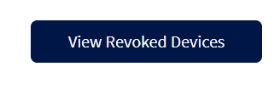
FMCSA Removes ArionT ELD and EL Dorado ELD
FMCSA removed the devices below due to the company's failure to meet the minimum requirements established in 49 CFR part 395, subpart B, appendix A. https://eld.fmcsa.dot.gov/List/Revoked
  ELD Name: ArionT ELD
  Model Number: AT5000
  ELD Identified: AR1ONT
  ELD Provider: Arion Tech Inc.(Replace by August 24, 2022)
  ELD Name: ELDorado ELD
  Model number: ERS
  ELD Identifier: ERS186
  ELD Provider: ELDorado (Replace by November 6, 2022)
Motor carriers and drivers using the device above must take the following actions:
  Discontinue using the revoked device(s) and revert to paper logs or logging software to record required hours of service data.
  Replace the revoked device(s) with compliant ELD(s) from the Registered ELDs.

Slide 12
Federal Register Publication 9/16/2022
Electronic Logging Device Revisions (ANPRM-Request for comment)
  [Docket No. FMCSA–2022–0078]
  FMCSA solicits comment on ways to improve the clarity of current regulations on the use of electronic logging devices (ELD) and address certain concerns about the technical specifications raised by industry stakeholders. There are five specific areas in which the Agency is considering changes:
  Applicability to pre-2000 engines
  Addressing ELD malfunctions
  Removal process for ELD products from FMCSA’s list of certified devices
  Technical specifications
  ELD certification.
  Comments must be received on or before November 15, 2022.

Slide 13
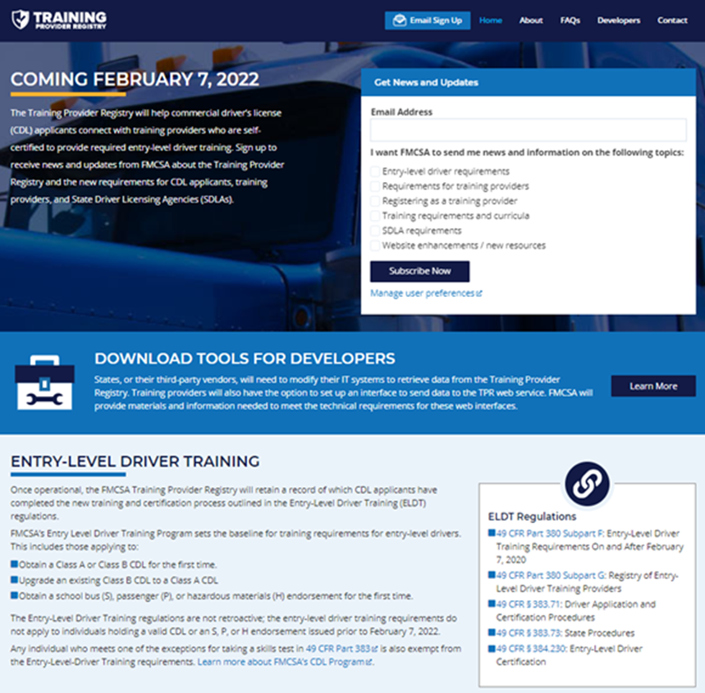
ELDT – Training Provider Summary
Training providers/prospective training providers should review the
  Registration guide,
  The registration tutorial video,
  The factsheet,
  Checklist,
  FAQs and more.
https://tpr.fmcsa.dot.gov/

Slide 14

Drug and Alcohol Clearinghouse - Notifications
Clearinghouse does not link employers to drivers.
Notification provided only for pre-employment queries.
  No more than 30 days after the inquiry
  Notification set up in the Clearinghouse Account
    Email notification
    Bell Icon - indicates the number of notifications

Slide 15
United States Access Board
Formal Agency name is the Architectural and Transportation Barriers Compliance Board which is an independent Federal Agency.
  Known as the "Access Board" for short.
Access Board Guidelines address access to transportation vehicles.
U.S. Department of Transportation enforces its own accessibility standards for transportation vehicles that are based on the Access Board’s ADA Accessibility Guidelines for transportation vehicles.
The Access Board issued its final rule updating bus and van accessibility standards in December 2016.
  This rule is applicable to over-the-road buses (OTRBs)

Slide 16
Access Board Related Rulemaking
Federal Transit Administration will lead a rulemaking to adopt these new accessibility standards into USDOT regulations.
  These regulations will apply to over-the-road buses (OTRBs) operated by private sector entities.
A proposed rule, will be published soon, will address:
  Designation of a specific number of priority seats for passengers with disabilities on OTRBs used in fixed route service;
  Required signs about priority seats on OTRBs;
  Destination and route sign standards for front and boarding side of OTRBs;
  Automated stop announcement and route identification systems on OTRBs operated in fixed route service with multiple designated stops;

Slide 17
Access Board Related Rulemaking
Continued...
5. Stop request systems for OTRBs operated in fixed route service with multiple designated stops;
6. Whether movable seating in wheelchair securement locations on OTRBs is allowed; and
7. Identification of wheelchair securement locations on OTRBs with the International Symbol of Accessibility.
If you have concerns about any of these proposed standards, it is very important that you submit comments to the proposed rule docket!

Slide 18
Emergency Egress Requirements and the Out-of-Service Criteria

Slide 19
Emergency Egress Compliance
Emergency exits only apply to vehicles that meet the definition of a bus in FMVSS 571.3:
    “Bus means a motor vehicle with motive power, except a trailer,
    designed for carrying more than 10 persons.”
Must comply with one of two provisions of emergency egress.
  Method One – Buses other than a school bus
  Method Two (Option A or Option B) – School bus requirements
Buses with a GVWR of 10,000 or less.
  May meet the unobstructed openings requirements of Method One by
    Providing emergency exit releases (handles, latches, etc.) without using remote controls or central power.
    Manual windows that can open to the required size.

Slide 20
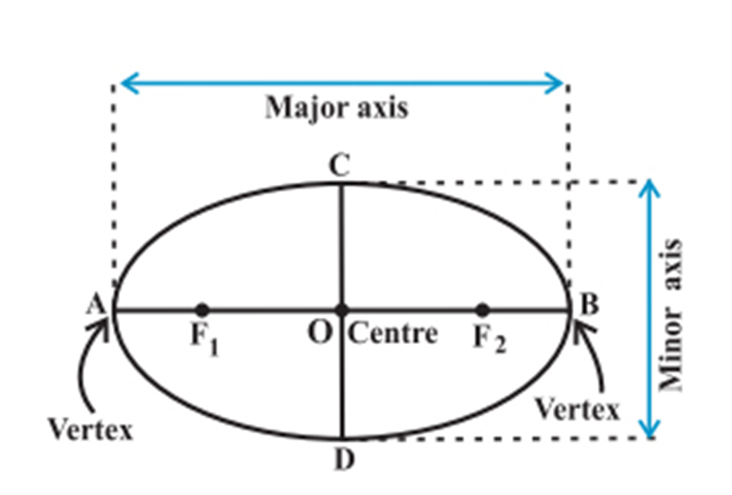
Emergency Egress Compliance
Required Emergency Exits Must:
  Open and close securely as designed.
  Allow opening by a single occupant.
  Open to allow for passage meeting
  the required space.
  Meet marking and marking visibility
  requirements.
What is the required space?
  A football shape 19.7” X 13”
    must pass through the opening.

Slide 21
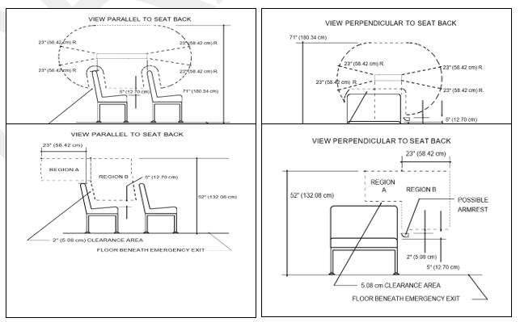
Emergency Exit Compliance
Emergency exit release mechanism.
Must be released by operating one or two mechanisms located above the seat or arm rest within that exit space, whichever is higher.
An emergency exit may not be opened with a tool or remote control.

Slide 22
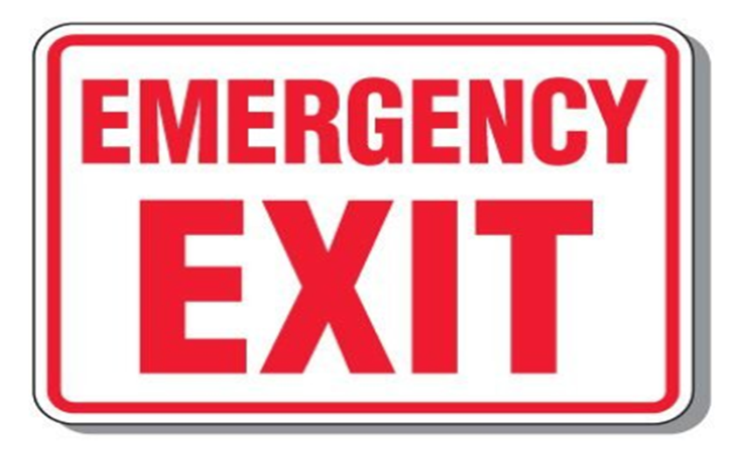

Marking Identification and Labeling
Requirement 1 - Each required emergency exit shall have the designation "Emergency Door" or "Emergency Exit" as appropriate.
* Buses 10,000 pounds or less are not subject to the marking requirements.

Slide 23
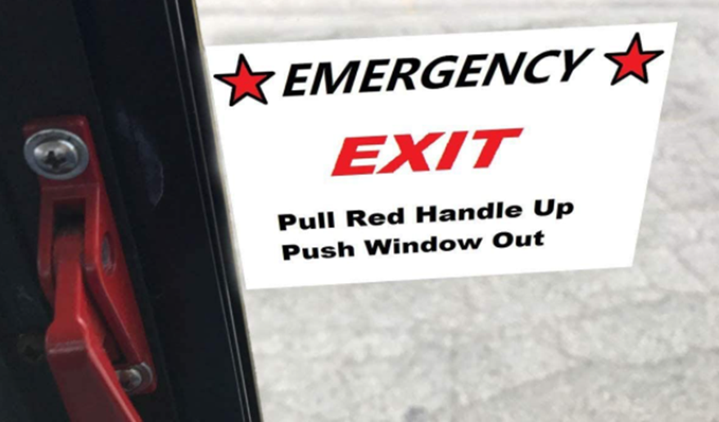
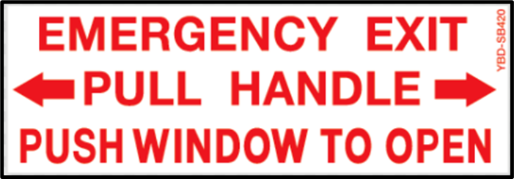
Marking Identification and Labeling
Requirement 2 - Concise operating instructions describing the motions necessary to unlatch and open the emergency exit must be located within 6 inches (16 cm) of the release mechanism.
* Buses 10,000 pounds or less are not subject to the marking requirements.

Slide 24
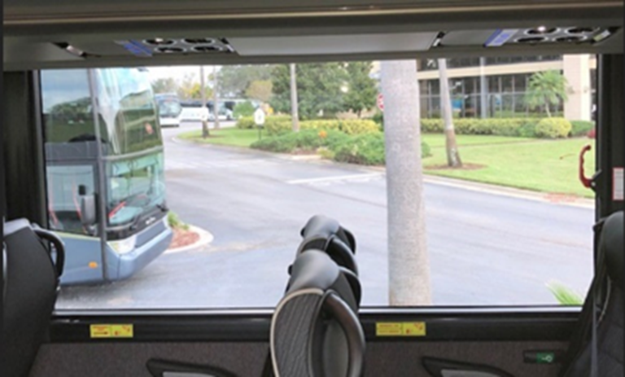



Marking Identification and Labeling
Requirement 3 - If a release mechanism is not present in the occupant space of a seat within the emergency exit area, a label indicating the location of the exit release mechanism, must be placed within the occupant’s space.
* Buses 10,000 pounds or less are not subject to the marking requirements.

Slide 25
Marking Identification and Labelingtificatin and Labeling
Legible Markings. Each required exit marking must be legible and capable of being read or deciphered when the only source of light is normal nighttime illumination from all specified locations near the emergency exit. These locations are:
  The seat(s) adjacent to (within) the emergency exit space.
  A seat beside the seat adjacent to the exit, and
  Standing in the isle beside these seats even when they are occupied.
If the exit has no seats within the exit space, they must meet the legibility requirements for occupants standing in the aisle nearest to the emergency exit.
* Buses 10,000 pounds or less are not subject to the marking requirements.

Slide 26
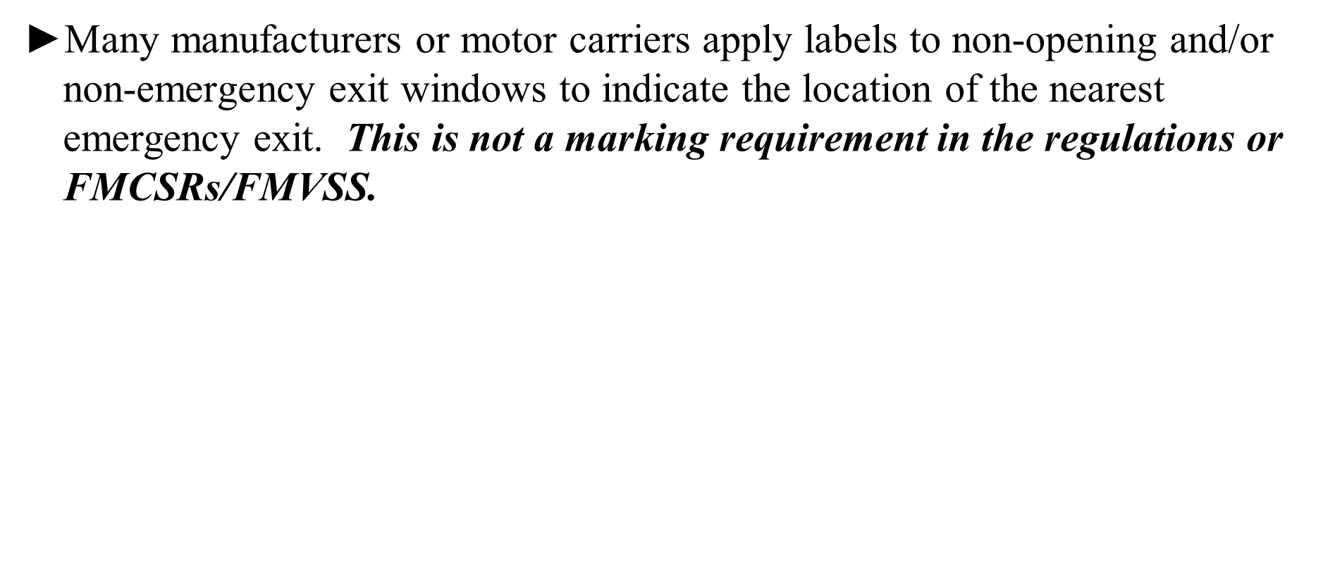
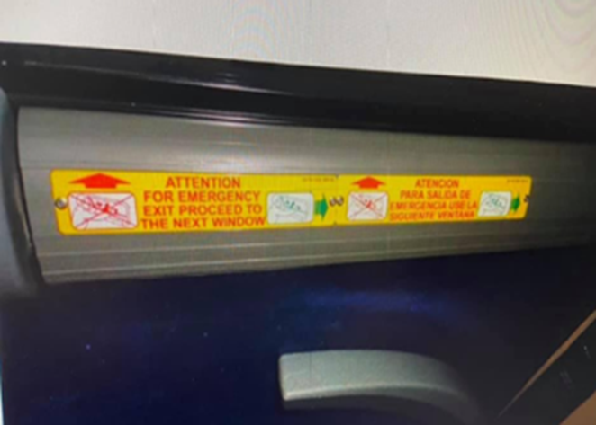
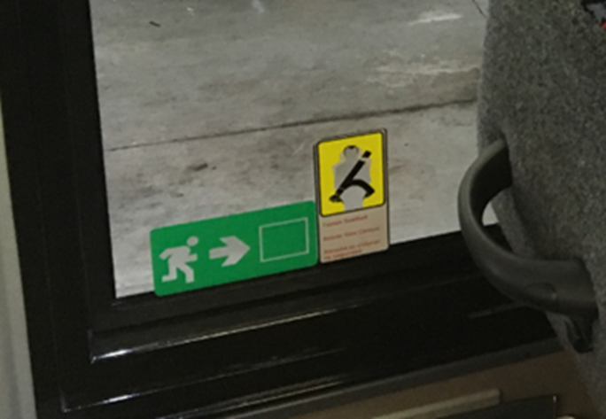
Marking Identification and Labeling

Slide 27
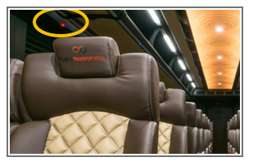
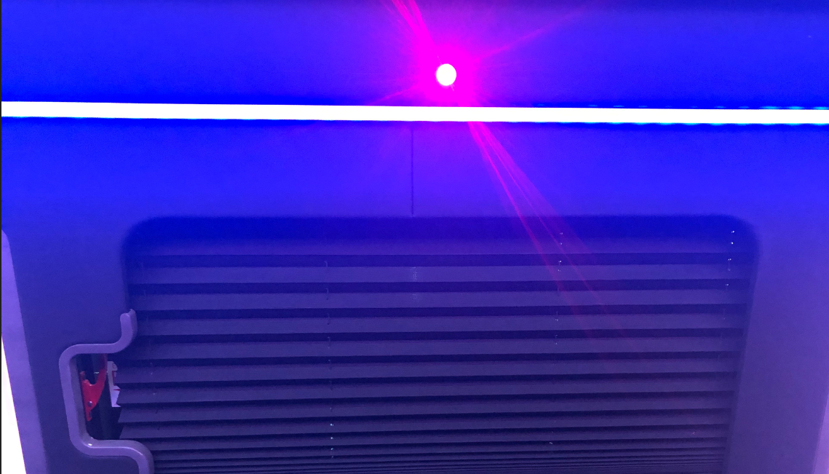

Marking Identification and Labelingcti and Labeling
Some secondary manufacturers of limousines and custom coaches are placing red lights over emergency exit windows in lieu of the designation marking. This may be done in addition to the required labeling but does not meet the marking requirements in FMCSRs/FMVSS.

Slide 28
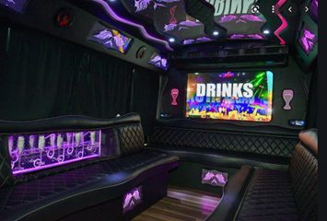
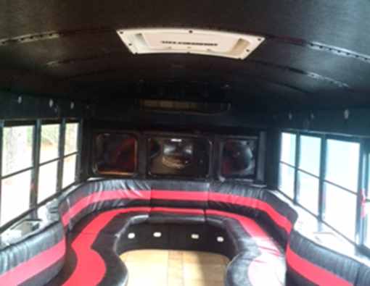
Exit Location, Type, Size and Operation
If no rear exit, a roof hatch in the rearmost part of the vehicle is required.

Slide 29
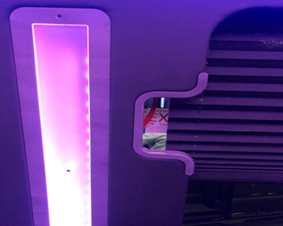
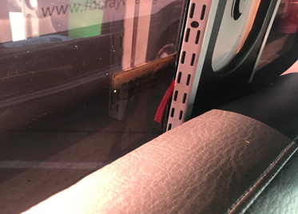
Exit Location, Type, Size and Operation

Slide 30
Out-of-Service Criteria for Emergency Exits
A required emergency exit, as determined by the emergency exit calculation/formula, has one of the following conditions:
  Missing
  Inoperative (does not open, close and/or secure as designed).
  Not properly marked.
  Obstructed (includes obstructions of the markings, release mechanism and/or the opening of the emergency exit.)
Also applicable to a marked emergency exit, provided in addition to the required exits.
  If marked with the emergency designation, it must comply with requirements.

Slide 31
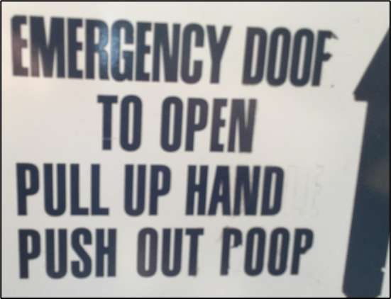
Avoiding Out-of-Service Conditions
Ensure each emergency exit is properly marked.
  Marking meets the visibility requirements.
  Marking conveys the proper message.
Add Emergency Exits to pre-trip inspections.
  Ensure all drivers know how to operate each
  type of emergency exit.
(ESPECIALLY ROOF HATCHES!)
  Train drivers on how to inspect exit condition
  (open and close) and markings.
  Require a walk-through inspection of exits by the driver
  after dropping off groups.
  Ensure each bus/coach has a supply of markings on board to replace
  missing or damaged markings that may occur during trips.

Slide 32
Danielle.Smith@dot.gov
MC-SEP@dot.gov

