Slide 1

BISC West Summer Meeting
2016
State Lawmaking Proposals Impacting
Vehicle Improvements

Slide 2
California Legislative Initiatives Effective July 1, 2020
SB 247, Goal to mandate NTSB coach recommendations for motorcoach construction and operation from the Orland CA crash.
Requested items:
Mandate Driver Safety Announcements
Reflective emergency exit markings
Secondary rear door
Emergency windows that stay open once unlatched
Emergency light fixtures that will turn on in the event of a collision

Slide 3
California Legislative Initiatives Effective July 1, 2019
SB 247
Summary items:
Mandate Driver Safety Announcements
Reflective emergency exit markings
The requirements stated above, have been agreed to by CBA leadership, as they felt that these items can be implemented on current coaches and/or by amended company policies.
Standards to be developed by the CHP.

Slide 4
California Legislative Initiatives Effective July 1, 2020
SB 247
Summary items:
Secondary rear door
Emergency windows that stay open once unlatched
Emergency light fixtures that will turn on in the event of a collision
The consensus of the manufacturers present, were that the items stated above come under the jurisdiction of the NHTSA, and therefore opposed these items in the bill. It was felt that the state of CA could not match the ability of NHTSA in providing the necessary testing, protocol, and vetting of uniform standards for the remaining 49 states.
In addition, the ability for states to mandate these types of requirements as opposed the NHTSA, was not clear.

Slide 5
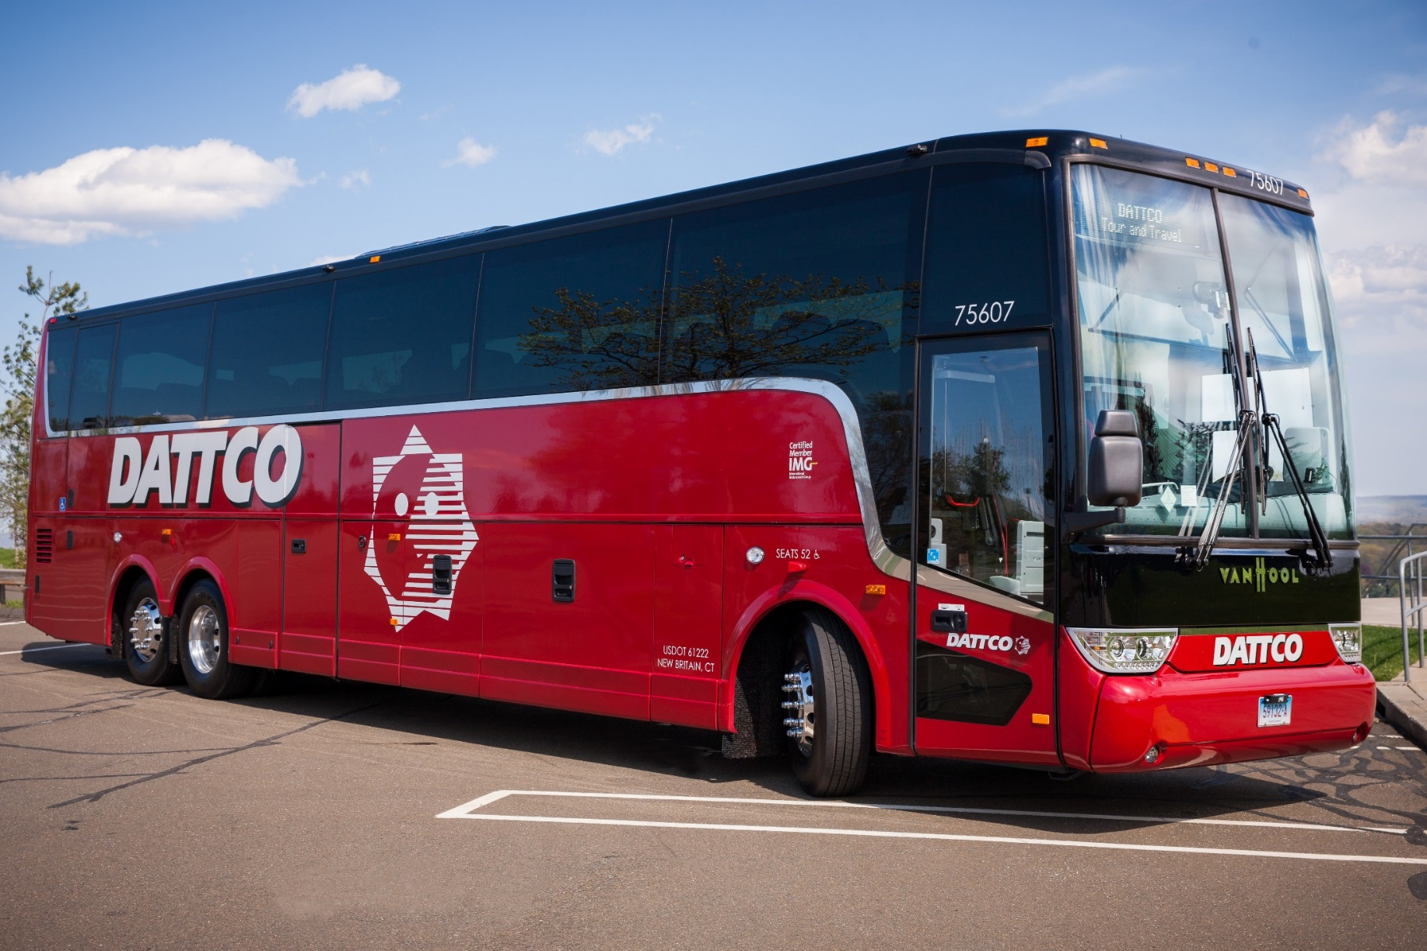
TX 45 With Rear Door

Slide 6
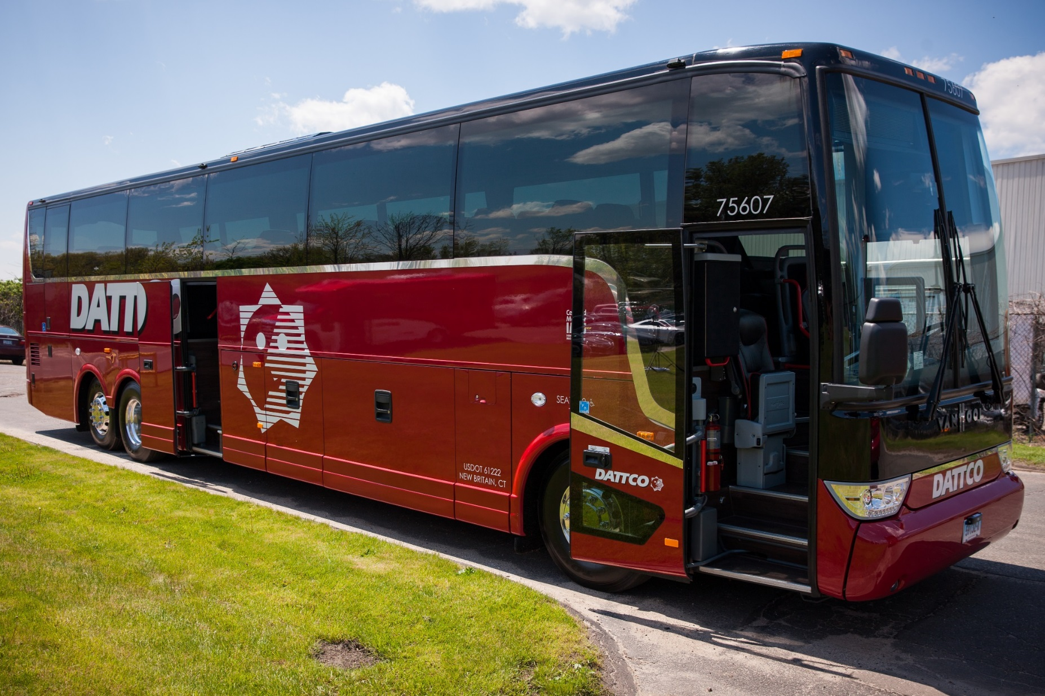
TX45 With Rear Door

Slide 7
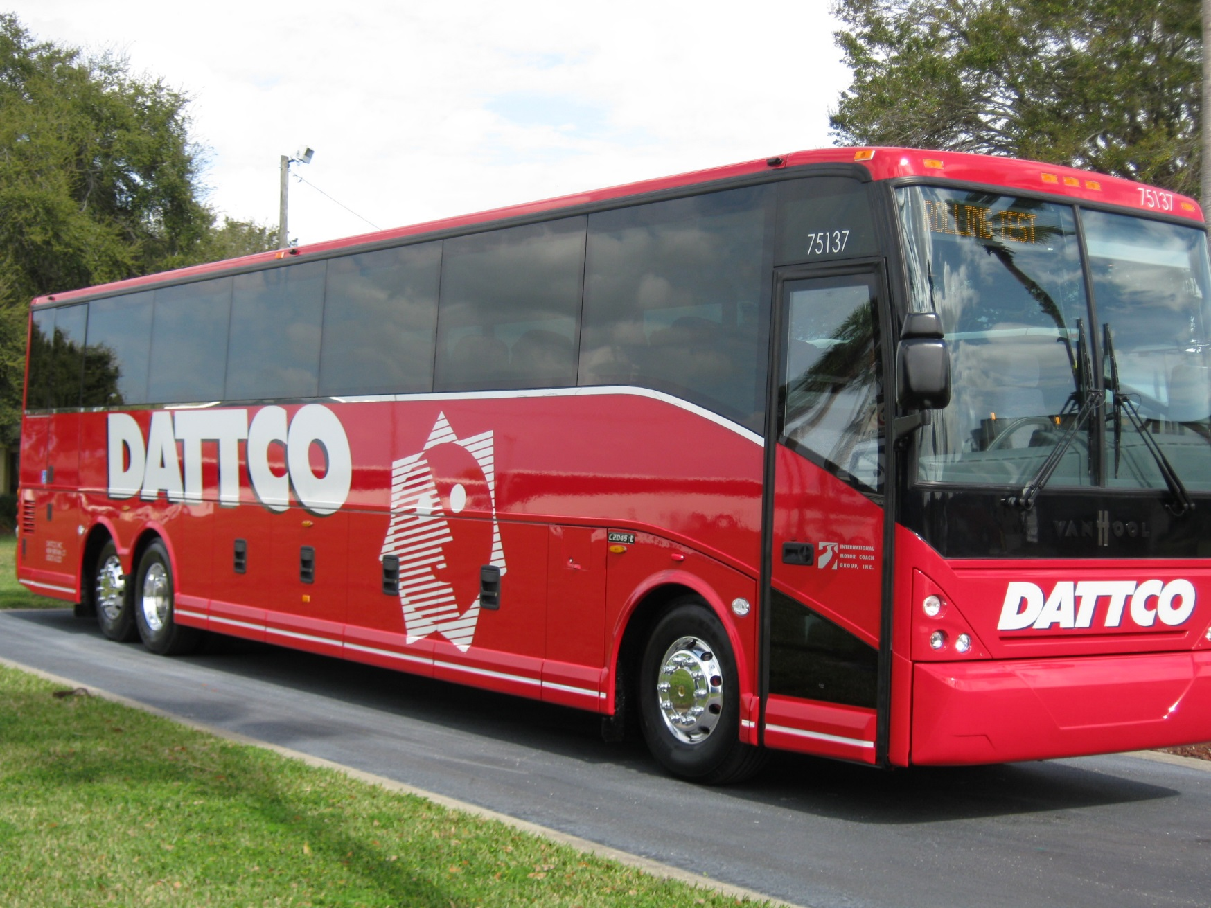
C2045 With Lift Door

Slide 8
California Legislative Initiatives
SB 1072 School bus Safety
Bill requires a Child Safety Alarm System. This system requires a driver after a run, to proceed to the rear of the bus to activate a switch that will disarm certain attention signals if an interior inspection for remaining children is not performed.
Proposal also called for this safety device in all school buses and motorcoaches that transport school kids.

Slide 9
California Legislative Initiatives
SB 1072 School Bus Safety
The CBA leadership agreed with the implementation of this system in school buses, however opposed the it in motorcoaches. Motorcoaches, unlike school buses, have restrooms, parcel racks, as well as parcel rack doors, and baggage compartments. It was felt that this system would not be effective in motorcoaches as it would be in school buses.
The CBA recommended that adult chaperones be required on field trips taken with motorcoaches.

Slide 10
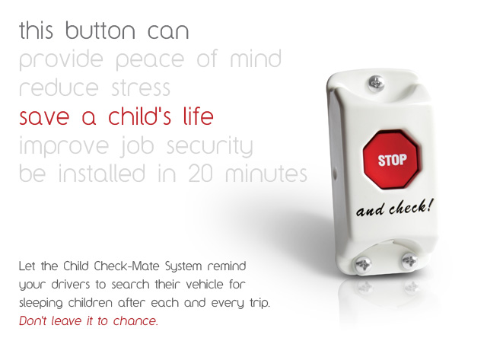
Child Check-Mate System

Slide 11
NHTSA Initiatives
Three point FMVSS 210 passenger seat belts.
Effective November 2016
Final rule for Roll Over Standards
Date unknown
NPRM for new Bus Emergency Exits and Window Retention and Release, and Anti Ejection Glazing
Still open for comments
Electronic Stability Control
Effective Fall 2015
GHG Phase 2 Emission Standards
HVAC Systems
Low Rolling Resistance Tires
Aerodynamic Body Designs
Weight Reduction

Slide 12
Future/Current Options
Electronic Braking
Adaptive Cruise Control
Adaptive Cruise Braking
Fatigue Management Systems
LDW (Lane Departure Warning)
ELD Provisions
Telematics Vehicle Monitoring

Slide 13
Thank You
Louis Hotard
Director of Technical Service
ABC Companies
Lhotard@abc-companies.com
407-287-3032

