Slide 1
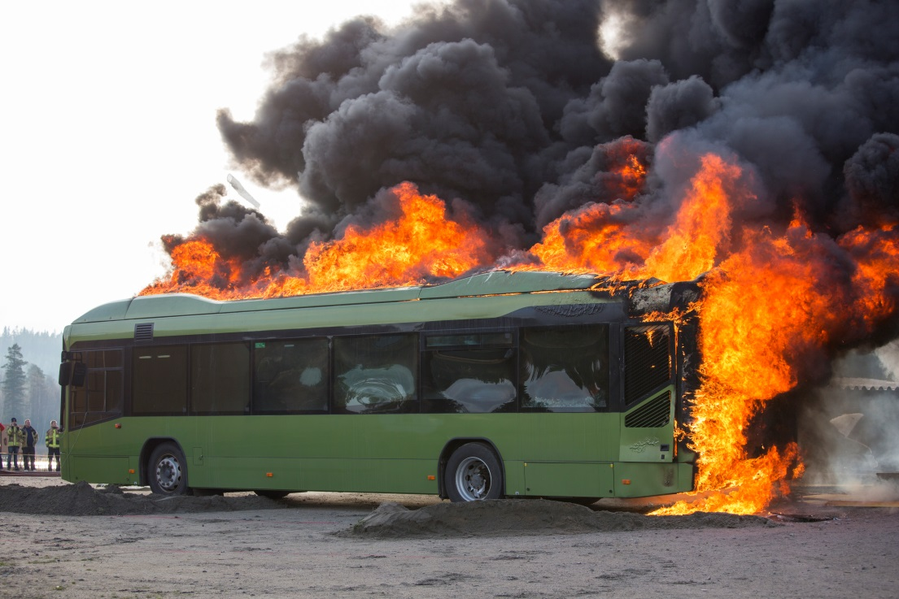
An Overview of the Epidemic of Bus Fires
BISC West – July 19, 2016
Joseph Peoples
Vehicle Fire Consultant
busfireguy@gmail.com
919 608-3878

Slide 2
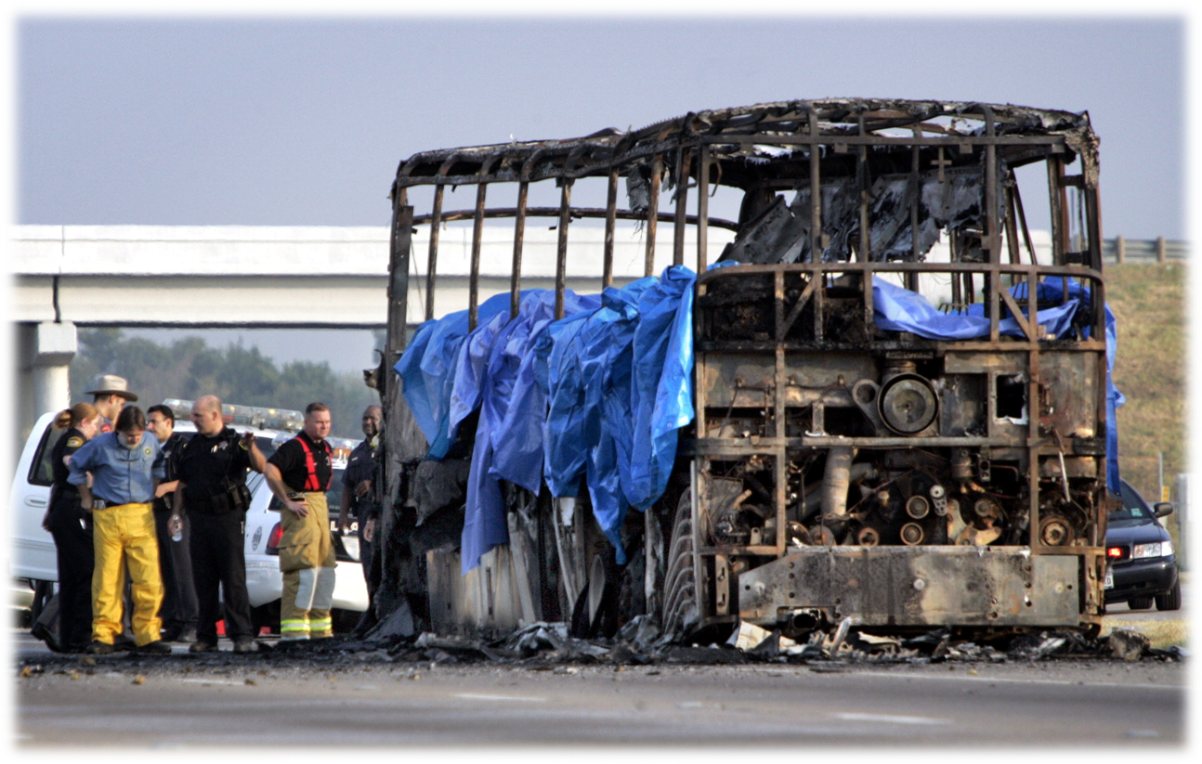
SEPT 2005
23 deaths
Fire engulfs vehicle carrying seniors from Houston area nursing home

Slide 3
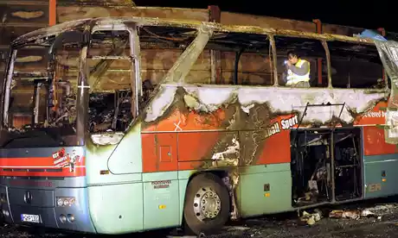
November 2008
20 people die after Germany bus fire
It is thought that some of the elderly passengers who perished had walking disabilities and were unable to escape in time.
A fire department official, Claus Roehrbein, said: "Passengers who were sitting close to the exit could get away, but the others had no chance."
Police suspect the blaze was caused by a passenger sneaking a cigarette in the coach toilet.

Slide 4
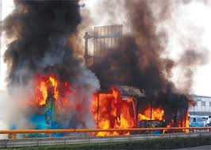
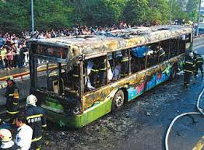
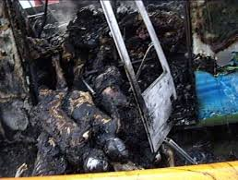
November 2008
An express bus burst into flames on an elevated roadway in southeastern China
47 people died and 34 were injured.
According to a suicide note found in his home, the man was unhappy with his life and had decided to light the fire to vent his anger.

Slide 5
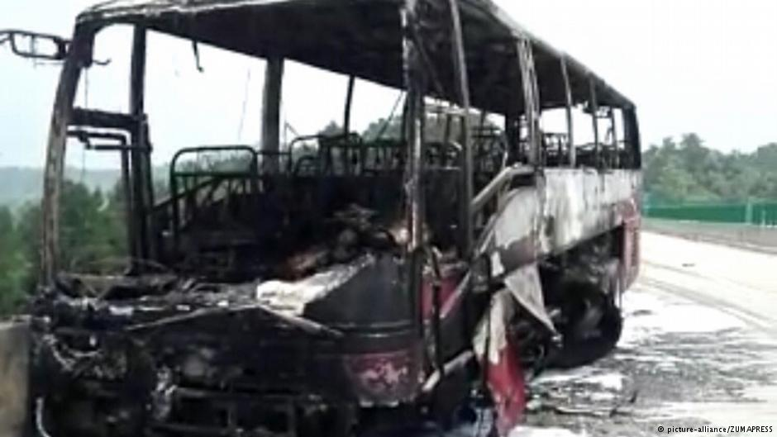
June 2016
China tourist bus fire kills 30
local officials believed an oil leak caused by the crash may have sparked the fire.

Slide 6
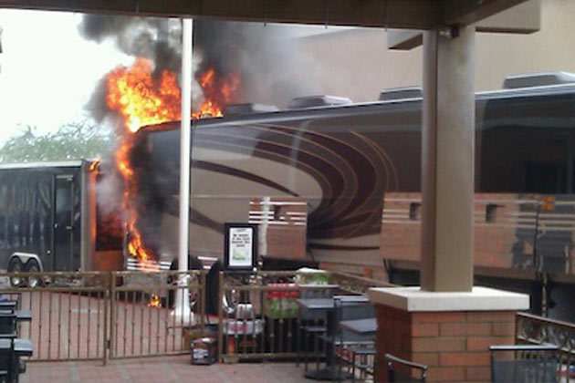
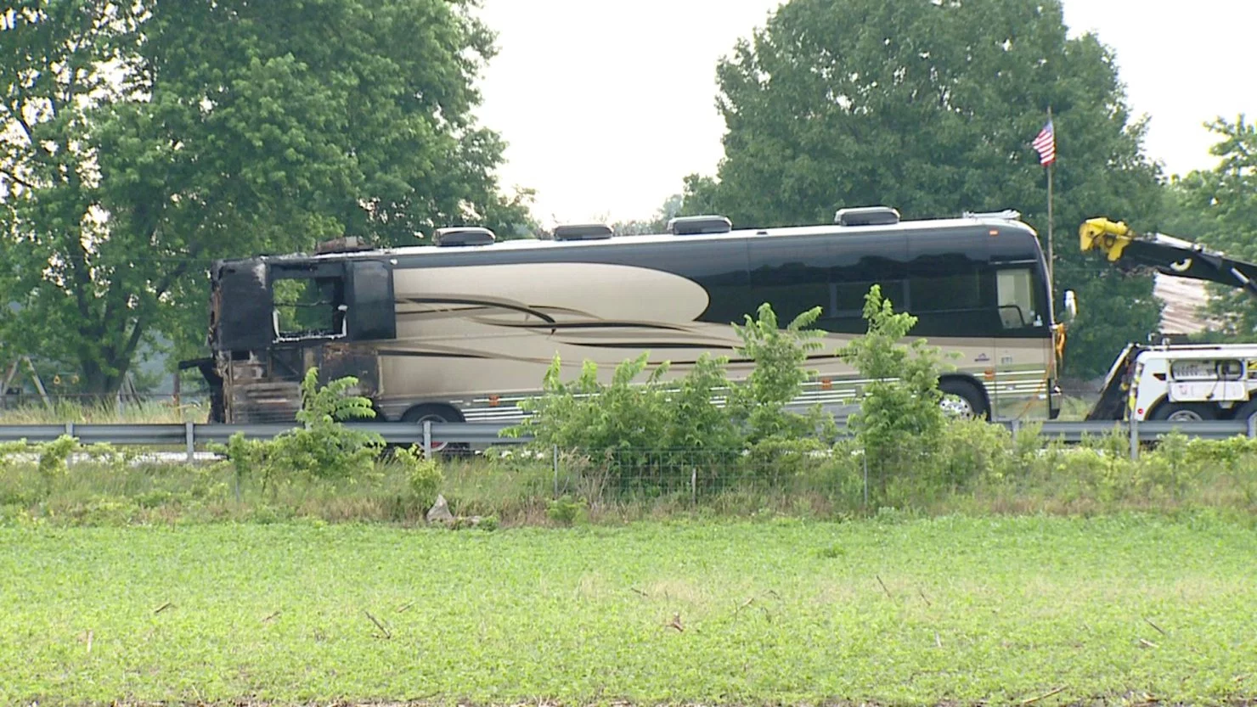
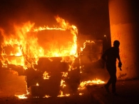
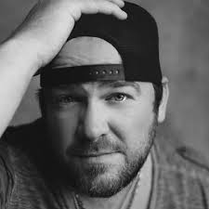


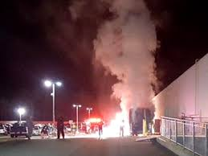
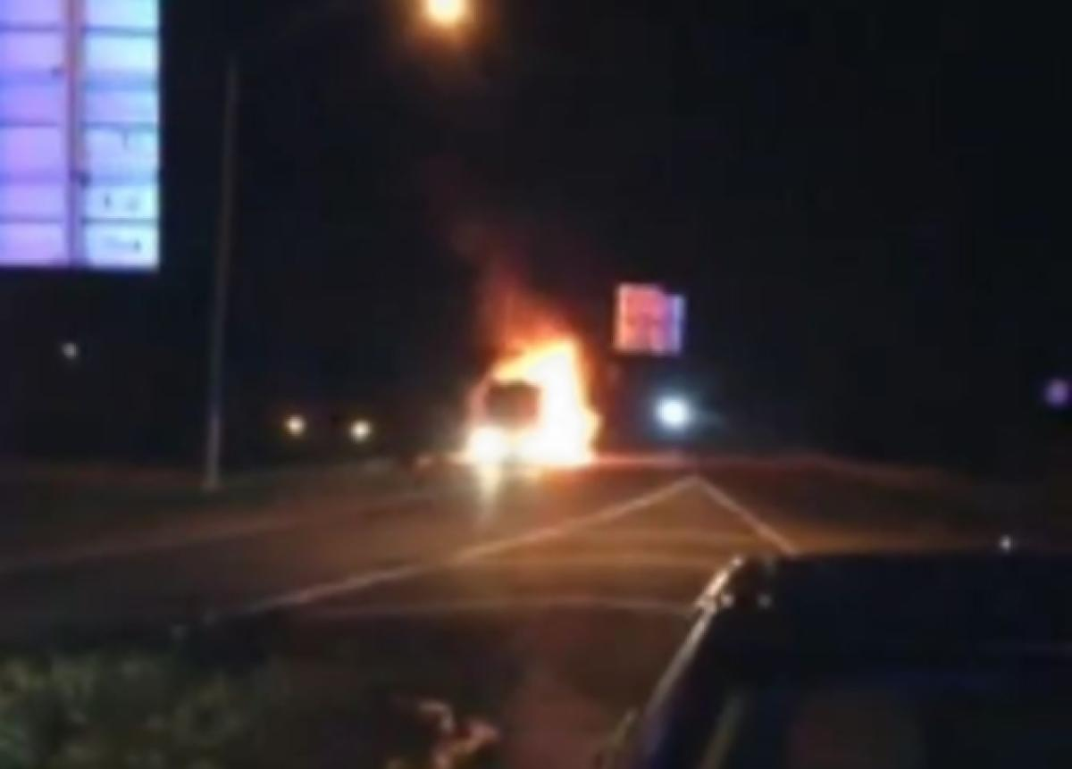
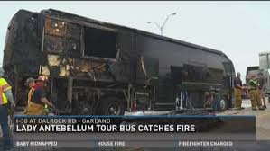

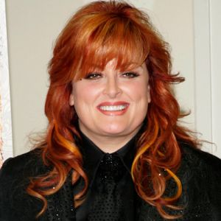

What do these famous people have in common
Lee Bryce
Toby Keith
Miley Cyrus
Lady Antbellum
Whoopi Goldberg
Wynonna Judd

Slide 7
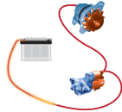


4. How do bus fires occur
4. How do bus fires occur
Design
Equipment Failure
Age of Bus
Maintenance Issues
Flammable
Liquid/Gas
Friction
Electrical
Arc/Short
Accident/Collision
Arson

Slide 8




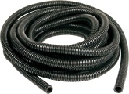

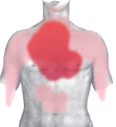

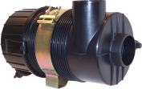
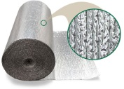

NEW risk considerations
5. Preventive fire safety
?
EMMISSIONS
WEIGHT
NOISE
1992
Euro I
Euro II
Euro III
Euro IV
Euro V
Euro VI
DPF
PLASTICS
INSULATION
HEAT
FUEL LOAD
Oxygen
2013

Slide 9
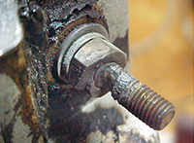
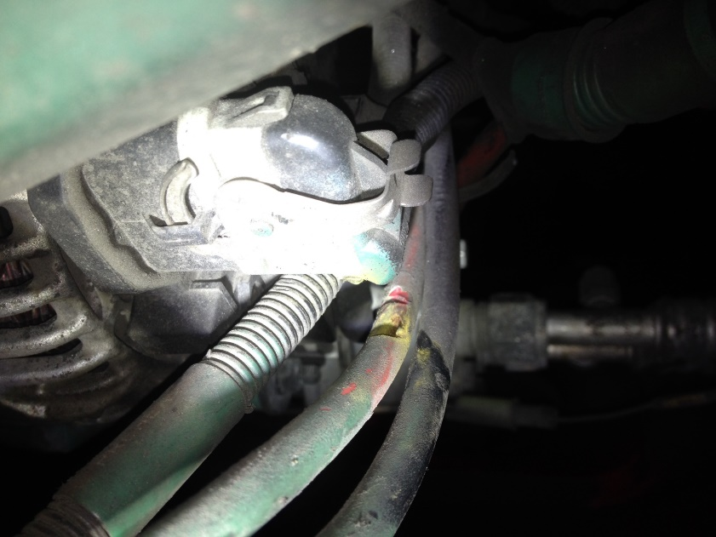

The Fire Timeline (Stages)
5. Preventive fire safety – FRA, Inspections, Improved processes
AN increase of 10 ° above max temp can Shorten Hose life by half.
Heat
Fuel
?
Hydraulic Hoses
Electrical Cables/Loom
Air Cleaner Housing
Insulation/Sealants
Rubber Hoses
Bearings
Fuels/Lubricants
Turbocharger
Exhaust Components
Bearings (Friction)
How can we better prevent fires
Aging
Premature Failure
Detection
Suppression
Mechanical Damage
FIRE GROWTH
INCIPIENT
SMOKE
FLAME

Slide 10

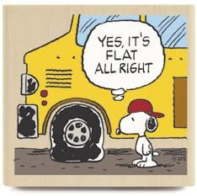
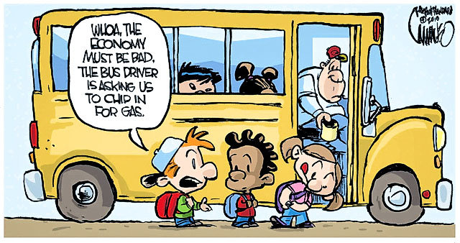
Fire Risk Management
Management Policy
-Highest level of safety
-Minimize Bus Fire Risks
-Meet or exceed safety objectives
Baseline
Increase Awareness
knowledge or perception
Increase Concern
well-informed interest
monitor the effectiveness of safety risk controls
Drivers
Knowledge of early fire indicators
Passenger Safety
  Briefings
  Emergency Evacuations
Fire Actions
Dispatch
911 Style Flipcards
Maintenance
Fire Causes
Risk Assessment
Best Practices

Slide 11
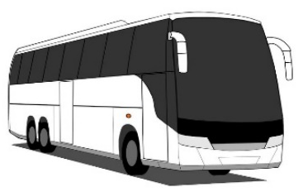

Fire Risk Assessment
Identify
Assess
Control
Hazard Areas
Engine Compartment
Luggage Compartment
Lavatory
Wheel wells
Likelihood
Fire Risk Causes
Duty Cycle
Aging (temperature)
Mechanical Damage (abrasion)
Improved Specifications
Temperature Rating
Training
Repair /Replacement Procedures
Geometry, Clutter
Ventilation/Penetration
Consequence
Highest level of safety practical
Keep risks as low as reasonably practical
Passenger injury/fatality
By-Products/Evacuation
Vehicle Damage $$$$$$
Growth and spread of fire
Fuel
Liquid/Gaseous
Solids (Plastics/Insulation)
Emergency Exits
Firewalls/Fire Resistance methods
Fire Detection and Suppression
Ignition Sources
Turbocharger/Exhaust

Slide 12

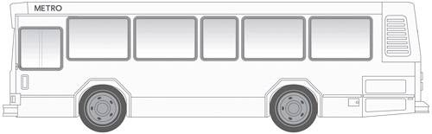


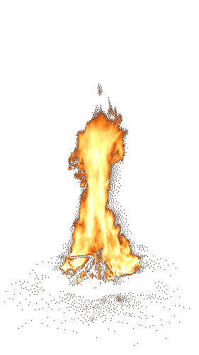


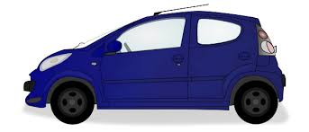

The fire event
5. Preventive fire safety – Safety features
Detect
Safety of Passengers
Prevent introduction of toxic fumes
  Shutdown (HVAC)
Safely Stop Bus
Evacuate Passengers
Control
Fire growth (engine/cooling fan)
  Shutdown Engine
  Shut Off Batteries
?
Alert Driver
Acknowledge Risk
I SMELL SOMETHING BURNING
YOUR BUS IS ON FIRE

Slide 13
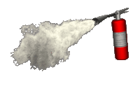


Automatic detection and suppression
5. Preventive fire safety – Safety features
Detect
Safety of Passengers
Shutdown (HVAC)
Prevent introduction of toxic fumes
Safely Stop Bus
Evacuate Passengers
Control
Fire growth (engine/cooling fan)
Alert Driver
Shutdown Engine
Shut Off Batteries
Discharge Extinguisher

Slide 14
Benefits
5. Preventive fire safety – Safety features
ALLOW THE DRIVER TO FOCUS ON THE SAFETY OF THE PASSENGERS
AUTOMATIC FIRE SUPPRESSION SYSTEMS
REMOVE THE HUMAN FACTOR
Safety of Passengers
Safely Stop Bus
Evacuate Passengers
Alert Driver
Shutdown (HVAC)
Shutdown Engine
Shut Off Batteries
Discharge Extinguisher

Slide 15
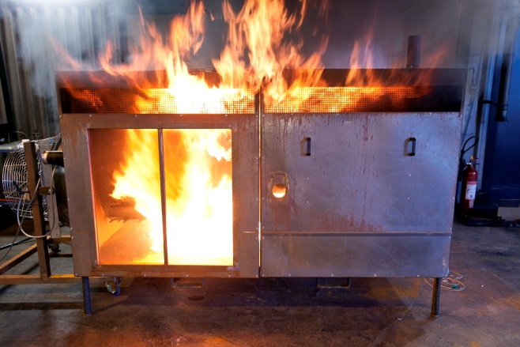

Are Fire Suppression Systems Effective
Detection
Fast Detection with minimal nuisance alarms
Components
harsh environments
Required maintenance
Suppression
Sufficient qty of extinguishing agent and nozzzles
Re-Ignition Protection
Effective during all operation modes (high airflow, low airflow)

Slide 16
Voluntary certification - Fire suppression systems
5. Preventive fire safety – Safety features
Common platform for securing minimum level of safety and security
Tested in a well-defined and objective way with realistic fire hazards that can occur on a bus based on sound science
Components tested for harsh environments to secure survivability
Ensures good distribution and amount of suppression agent
Re-igntition protection
Repeatable and reproducible

Slide 17

3. Current and upcoming regulations
3. Current and upcoming regulations

Slide 18


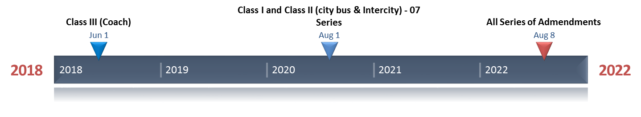
Regulation 34 liquid fuel tanks.
Regulation 43 plastic safety glazing
Regulation 44 materials of child restraint systems
Regulation 67 LPG
Regulation 100 electric power train of vehicles, including fuel cells
Regulation 110 CNG and/or LNG
Regulation 118 burning behavior of interior materials
Regulation 122 heating systems, in particular combustion heaters
Regulation 107 uniform provisions with regard to general construction
Based on the European bus directive 2001/85/EC
  No flammable or liquid-absorbing sound-proofing materials in engine compartment.
  Heat-resistant partitioning between engine compartment and rest of the bus.
  Safe construction and installation of cables.
  Fusing.
  Isolating switch for circuits with a voltage exceeding 100 V.
  Safe and accessible installation of the battery.
  Space provided for fire extinguishers and first-aid kits.
  No flammable materials within 10 cm of any potential heat source, such as exhaust systems or high voltage equipment for example.
  Number of Doors
  Size of Seats
  Rear View Mirrors
  Wheelchair Places
  Evacuation Routes
  (Automatic Extinguishing Systems)
“Extinguishing systems shall be provided in buses with combustion engine placed behind the driver: “

Slide 19
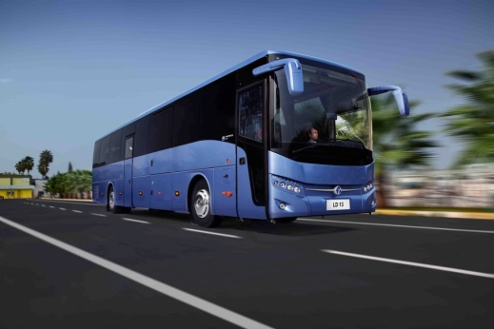
Summary
7. Summary
Bus fires – a common issue world wide
Preventive fire safety
- Reduction of loss of buses
- Securing business continuity
- Enhancing goodwill
More research is needed
Isolated events seldom lead to a fire…
but more often the combination of several events. Experience should be used for prevention not as a lesson

Slide 20










4th International Conference on Fires in Vehicles - FIVE 2016
Key Note Speakers
October 5-6 2016
Baltimore, MD
Casey C. Grant
Executive Director,
The Fire Protection Research Foundation
Thomas Littleton
Associate Administrator for Transit Safety and Oversight, Federal Transit Administration (FTA)
Mike Weston
Director of Buses, Transport for London
Event partner:
Honorary Sponsors:
Jonas Brandt
SP Technical Research Institute of Sweden
www.firesinvehicles.com

