Slide 1



BISC Federal Update
11:00 am
Tuesday, June 23, 2020

Slide 2

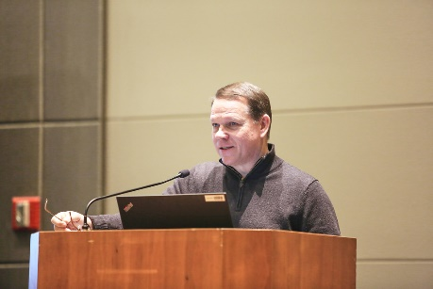
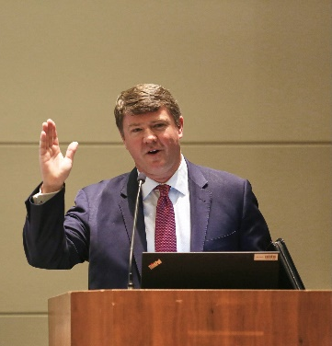


Remember when….
We were all back in Omaha …
… Congressman Sam Graves presented BISC’s 20th Anniversary Congressional Statement …
…The FMCSA Acting Administrator
announced the California Meal &
Rest Break decision…

Slide 3

… And then …
…then this guy showed up…
C-19
...and everything changed.

Slide 4

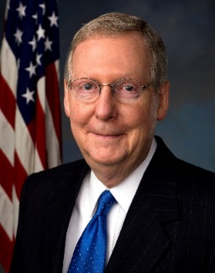
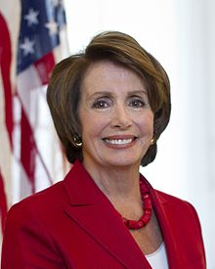
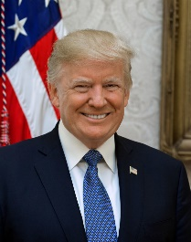
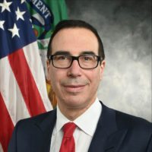

“Refresher”
U.S. House of
Representatives
U.S. Senate
Majority Leader McConnell
Speaker Pelosi
53-R v. 45-D
2-I
233-D v. 197-R
1-L
4 Vacancies
Donald J. Trump
45th President of the USA
Treasury Sec. Mnuchin

Slide 5
Federal Actions: Congress
1st Relief Package – March 6, 2020
Coronavirus Preparedness & Response
$8.3 billion
$$$$ for HHS
$20 million for SBA’s Disaster Loan Program
2nd Relief Package – March 18, 2020
Families First Coronavirus Response Act
$192 billion
Expanded Family Medical Leave/Sick Leave
Ensured free testing
Stabilized State Unemployment Programs
Tax Credits

Slide 6
Federal Actions: Congress
3rd Relief Package – March 27, 2020
Coronavirus Aid, Relief, and Economic Security or CARES Act
$2.2 trillion
$$$ for just about everything
Health
Education
Transportation
Created or Expanded Programs
Individual payments – recovery rebates (based on 2019 AGI)
Unemployment Benefits & bonus
EIDL - grants
Paycheck Protection Program (PPP) – grant/loans
Distressed Sector – loans
Air Carrier Worker Support – grants
Coronavirus Relief Fund – grants to states

Slide 7

Federal Actions: Congress
4th or “3.1” Relief Package – April 24, 2020
Paycheck Protection Program & Health Care Enhancement Act
$484 billion
$321.3 billion to support PPP
$50 billion for Disaster Loans, and $10 billion for EIDL
More $$$$ for PPP & Health related needs
Expanded PPP eligibility, changed %, lengthened term
5th Relief Package – Passed by House May 15, 2020
Health and Economic Recovery Omnibus Emergency Solutions or HEROES Act
$3+ billion
More?????

Slide 8
Federal Actions: Administration
National Emergency Declaration – March 13, 2020
DOT/FMCSA –
1. HOS
2. Extension of Medical Cards & expiring CDLs
3. Remote CR’s
4. Extension of Drug & Alcohol Screening Rules
DOD
1. Extension of implementation of Bus Agreement
DHS
1. CISA – “Essential services”
2. FEMA – Security Grant application extensions
3. TSA – Security Training Rule
DOI/NPS – Dropped fee increases/CUAs

Slide 9
Additional ABA Actions:
Advocacy
Resources
www.busesmoveamerica.com
www.buses.org/policy/issues/coronavirus-federal-action
Masks
Webinars
https://www.buses.org/education
Safety Task Force
Report: www.buses.org/assets/images/uploads/pdf/The_Motorcoach_Industry_Recommendations_on_Post-COVID_Travel.pdf
Sample Policies
Webinars - BISC’s June 30
Updates

Slide 10
Other Updates:
Legislation:
FY 2021 Appropriations bills
Surface Transportation Reauthorization
HOUSE - INVEST Act – T&I bill
SENATE – America’s Transportation Infrastructure Act
Regulations/Administrative:
Final Rule – HOS tweaks – 6/1/20
NPRM – CDL/CLP downgrades by SDLA’s – 4/28/20
Crash Preventability Program - Permanent – 5/6/20

Slide 11
Questions?
Thank you!
Suzanne Rohde
American Bus Association
202-218-7224
SRohde@buses.org

