Slide 1
DOD Bus program
Donna Johnson, Program Manager
JULY 2021

Slide 2
Program Overview
Group Operational Passenger System (GOPAX)
Updated Carrier Management Tool Demonstration

Slide 3
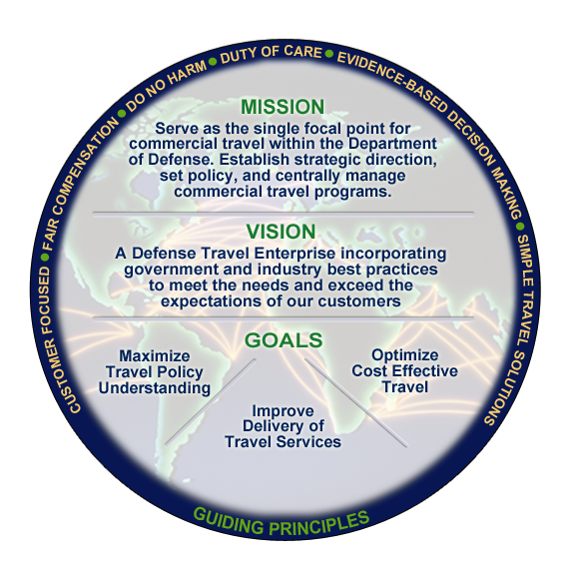

Defense Travel Management Office
Scope of the Enterprise
DoD Travel Spend: $10.5B (FY19)
Travel Management Company Services: $279M/5 years
U.S. Car/Truck Rental Program: $296M (CY20)
Government Travel Charge Card: ~$54.5B/1.99M cardholders (FY20)
DoD Preferred Commercial Lodging: $111M (FY20)
Commercial Travel Program Management
GSA City Pair – DoD Customer Interface
U.S. Government Rental Car/Truck
DoD Bus Program
Recruit Travel & Assistance
Travel Management Company Services
Premium Class Travel Oversight
Integrated Lodging Program
Preferred Dining Program
Travel Policy and Implementation
Joint Travel Regulations (JTR)
Policy Simplification
Travel Policy Compliance Program
OCONUS Non-Foreign Per Diem
Customer Support and Training
Travel Assistance Center (TAC)
Travel Training Resources
Service and Agency Liaison
DoD Travel Card Program Management
Individually Billed Accounts
Centrally Billed Accounts
Defense Travel System
Functional Requirements and Oversight
Travel System Modernization
The Past: Establishment and consolidation
The Present: Sustainment, improvement, run operations, and conduct Travel Transformation efforts
The Future: Reformed Travel Enterprise
Area of Focus
Travel Reform – Reform travel management by streamlining processes, simplifying policies, and strategic sourcing to improve the travelers’ experience and optimize travel costs
Notes:
Defense Travel Management Office Background
MID 921 established DTMO in 2006 to consolidate, streamline, and centrally manage commercial travel for the DoD
DTMO has direct oversight for the programs, policies, processes, and the system that results in $8.1B (FY15) in annual travel spend across the Department
DTMO has direct oversight of station/housing allowance programs that benefit members when they travel/move that result in $24.3B (FY16) spend across DoD
Partnerships – DTMO partners across the government and private sector to maintain an in-depth perspective of the travel industry and determine the best practices and standards for DoD travel. This provides us with a way to think about how to manage and reform travel for the DoD customer
Commercial Travel Management - Provides program management for Travel Management Company (TMC) services; U.S. Government Rental Car/Truck Programs; Department of Defense (DoD) Integrated Lodging Program Pilot; DoD Preferred Dining Program Pilot; Recruit Travel & Assistance Programs; Military Bus and Passenger Surface Inspection Programs (PSIP); Premium Class Travel (PCT) Management; and the GSA Contract City Pair Program (Air).
Travel Card Program Management - Provides program management of the DoD Government Travel Charge Card (GTCC) Program (~$4B/year) for ~1.6M cardholders through the GSA SmartPay® 2 task order to include: coordination with GSA, DoD components and the GTCC card vendor; development of travel card policy and procedures; travel card training; Centrally Billed Account (CBA) reconciliation; Individually Billed Account (IBA) management; delinquency management; Rebate Program management; and Agency support.
Travel Policy and Implementation - DTMO develops and implements policy and regulations for the reimbursement of travel expenses to all Uniformed members (Army, Navy, Air Force, Marine Corps, Coast Guard, Public Health Service, and the National Oceanic and Atmospheric Administration) and for DoD civilian employees, and implements within DoD the civilian travel rules prescribed for Federal civilian travelers by the General Services Administration (GSA) in the Federal Travel Regulation (FTR). This includes a single volume, Joint Travel Regulations; DoD Instruction (DoDI) 5154.31 (new multi-volume issuance); travel policy simplification; Travel Reengineering Information Process System (TRIPS); and Travel Policy Compliance Program
Customer Support and Training - Provides a comprehensive set of resources to DoD travelers and travel managers to include: management of the Travel Assistance Center (TAC) providing 24/7/365 assistance to DoD travel community; training resources for DTS users and administrators to include Web-based Training courseware, reference materials, and instructor resources for use DoD-wide; and management of the Travel Certificate Program.
Allowance Program Management - DTMO performs analysis, prescribes rates, and provides program management for Basic Allowance for Housing (BAH), Overseas Cost of Living Allowance (COLA), CONUS COLA, Overseas Housing Allowance (OHA), OCONUS Non-foreign per diem rates, and currency adjustments.
Functional Oversight of the Defense Travel System (DTS) - Develops functional requirements for DTS and coordinates/obtains their approval through the Governance Board(s); manages the DTS change/configuration management process (DTS sustainment); program lead for the DTS Modernization Initiative.
Our focus is on Travel Reform--Simplify travel policy, explore the best strategy for providing travel services in the future, and implement allowance efficiencies

Slide 4

DoD Bus Program Overview
The Defense Travel Management Office manages the program on behalf of the Department of Defense through Agreement #5
Over 400 approved carriers focus on ensuring safe, cost-effective, and reliable ground transportation for DoD travelers
Essential to meeting movement requirements during peacetime, contingency,
and national emergencies
Program partners with:
Federal Motor Carrier Safety Administration
Department of Homeland Security
Commercial Vehicle Safety Alliance
Notes:
Regulatory guidance for DoD Bus movements outlined in the Defense Transportation Regulation, Part 1, Chapter 104, Buses
DoD Bus Agreement established as the standard of service
Only DoD-approved bus carriers with Agreements on file with DTMO will be used
DTMO manages the program and administers the DoD Bus Agreement

Slide 5
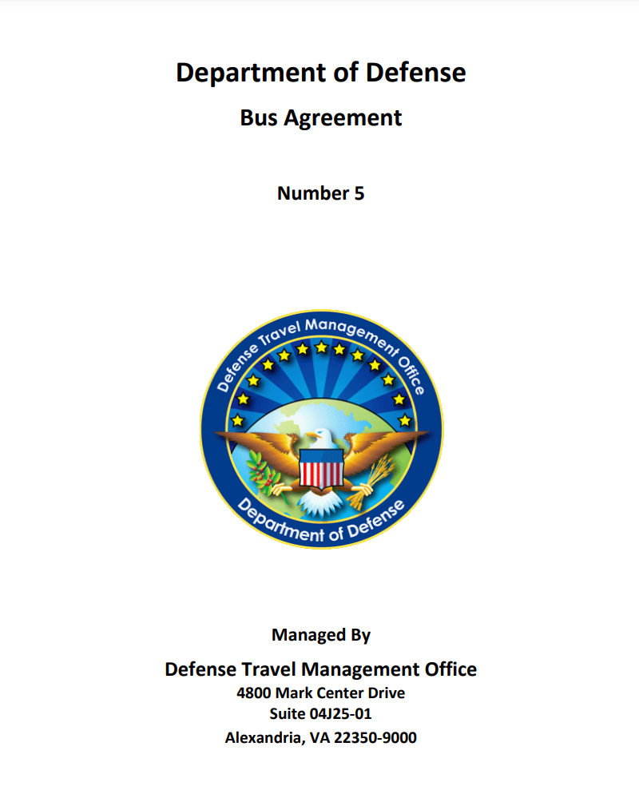
DoD Bus Agreement #5
Establishes terms, conditions, and safety standards for commercial motor carriers
Incorporates regulations outlined in Federal Motor Carrier Safety Regulation
Provides guidance on:
Carrier qualifications
Application
Quality assurance requirements
Carrier compliance
Performance
Requirements
Inspections—scheduled and unscheduled

Slide 6
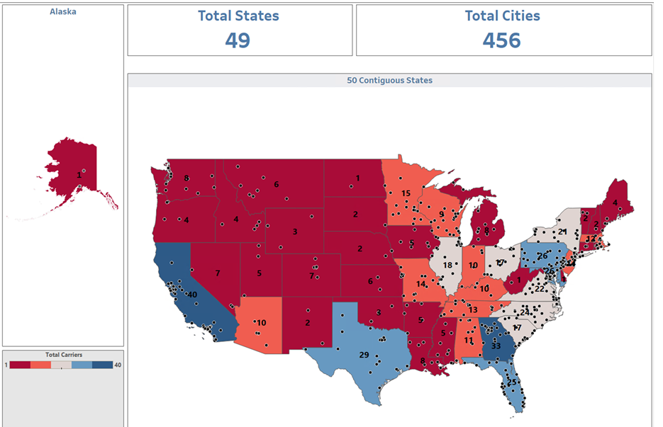
DoD Approved Carriers
*07/2021
422 Approved Carriers

Slide 7

Types of Group Charter Moves
DoD requests moves for:
Military exercises
Annual training
Deployments/redeployments
Emergency evacuations
Recruit travel (approx. 65 MEPS routes)
High volume markets:
Atlanta Airport to Ft. Benning, GA
Atlanta Airport to Ft. Jackson, SC
Columbia, SC Airport to Ft. Jackson, SC
St. Louis Airport to Ft. Leonardwood, MO
Oklahoma City Airport to Ft. Sill, OK

Slide 8
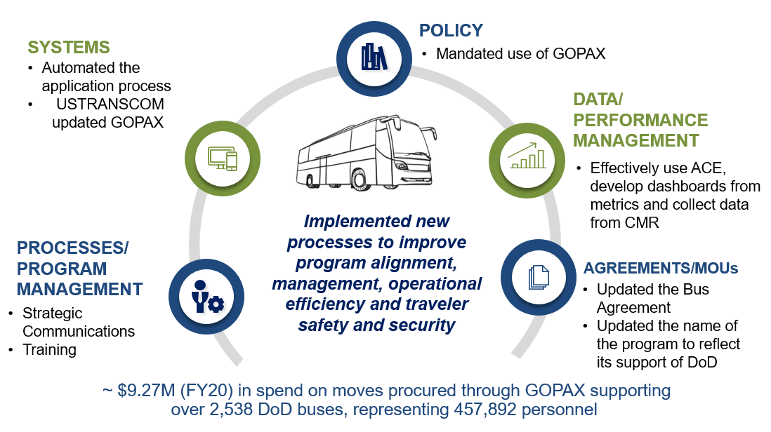
DoD Bus Program – 2020 in Review
Effectively use Automated Commercial Environment (ACE), develop dashboards from metrics and collect data from CMR

Slide 9
How to Obtain DoD Bus Business
Apply for the program
Review gopax requests daily
Check your inbox
1
2
3
Become a DOD-approved carrier
Network
Look for our emails
Complete the DoD Bus application
Register for GOPAX
Reach out to the bases/installations to let them know you are an approved carrier
Solicitation will not be allowed
Court cases (Bribery)
DTMO emails information periodically regarding upcoming moves

Slide 10
Bidding Process for DoD Bus Moves
Bids are awarded based on Best Value
Presence of sufficient equipment to perform the move
Overall condition of the equipment (with an emphasis on safety)
Carrier’s history of providing timely and responsible service
Conduct and performance of operating personnel
Review public reference file in GOPAX
Provide details on what you are offering as a carrier (price, equipment, customer service, etc.)

Slide 11
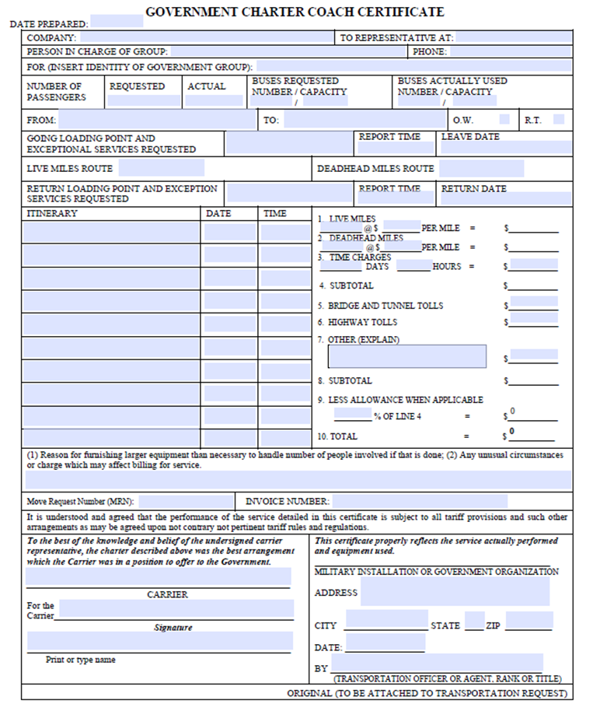
DoD Bus Payment Procedures
Carriers must submit all associated expenses/invoices via on the Government Charter Coach Certificate form (GCCC) within seven (7) business days for after transportation rendered
98% of moves are paid using a Government Travel Charge Card (GTCC) unless alternate payment procedures are directed
Transportation Officer verifies the information and sends the carrier the GTCC information for payment
No credit card information is kept on file
If you have questions about payments or need to pursue payment, first contact the billing point of contact identified on the Request for Service
In situations where payment is outstanding, carrier may email us at dodhra.mc-alex.dtmo.mbx.military-bus-program@mail.mil

Slide 12
Avoid Common Carrier Pitfalls
Application Process
Be familiar with Agreement #5
Read information provided carefully
Utilize DTMO website for instructions and frequently asked questions
Ensure Equipment List matches MCS-150
Generate and keep an active SAM Registration
Keep your contact information up-to-date
Carrier Movement Reporting
Utilize the CMR User Guide for instructions on how to get password and how to submit reports

Slide 13
Avoid Common Carrier Pitfalls (continued)
GOPAX
Don’t share ECA certificates or passwords
Puts user and/or company at risk of being removed from the DoD Bus Program
Keep computer system updated
Outdated computer system (root certificates) causing error messages
Invoicing
Carriers not submitting invoices on GCCC form
Carriers not submitting GCCC form 7 days after transportation rendered
Carriers not maintaining record/emails sent to Transportation Officer (TO) for payment

Slide 14
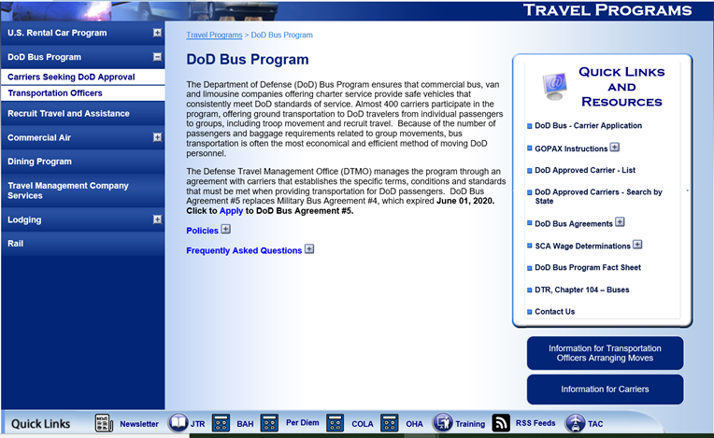
DoD Bus Web Page: www.defensetravel.dod.mil/site/bus.cfm

Slide 15
USTRANSCOM’s Group Operational Passenger System (GOPAX) David (Doc) Comfort USTRANSCOM J39

Slide 16
GOPAX – Updated Features
Justification tab when lowest bid is not selected (free text option)
Break out city/state fields in the Bus Inspector Report
Request Access button for carriers and TOs (no more emails)
Accept & Login button – 1st time users must accept users Rules of Behavior
Estimator on the TO’s homepage

Slide 17
GOPAX – Updated Features (cont.)
Updated users External Certification Authority (ECA) policy
1st violation: Written warning to the individual from the functional manager with notice to the company and GOPAX Program Manager (PM). Users will also be required to obtain a new certificate at their own expense
2nd violation: 90-day individual account suspension by the functional manager with notice to the company and GOPAX PM. Users will be required to obtain a new certificate at their own expense
3rd violation: 1-year removal of the company from the DOD bus and/or air program

Slide 18
GOPAX Resources
GOPAX System Support
Call: 618-220-6432
Email: transcom.scott.tcj3.mbx.gopax@mail.mil
Training: https://transcom.deps.mil/org/tcaq/PEOT/GOPAX/GOPAXTraining/Forms/AllItems.aspx
GOPAX Point of Contact
David “Doc” Comfort
Call: 618-220-2121
Email: david.l.comfort.civ@mail.mil

Slide 19
Updated Carrier Movement Reporting Tool Video Demonstration

Slide 20
Carrier Data Reporting Requirements
DoD Bus Agreement #5 (section 3.25) requires Carriers to electronically submit a monthly data report of all contracted activity for DoD movements
Reports are due no later than fifteen (15) calendar days after the last day of the previous month
Monthly data reports are submitted online through the DTMO’s Carrier Movement Reporting (CMR) Tool
* DoD reserves the right to remove any Carrier from the program that does bot submit a data
report

Slide 21
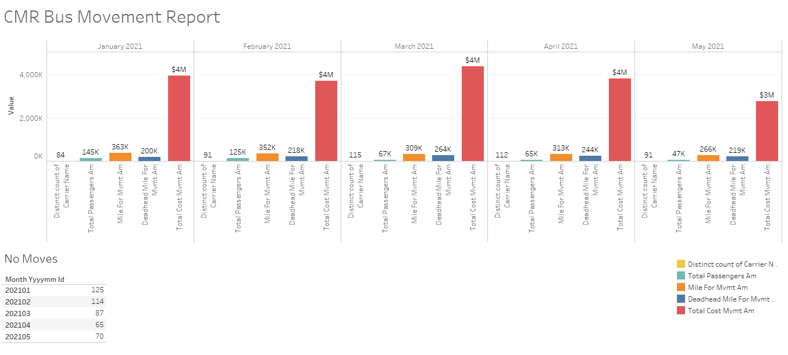
CMR Report [January – May 2021]

Slide 22
DoD Bus Program Contact Information
DoD Bus Program Webpage
www.defensetravel.dod.mil/site/bus.cfm
DoD Bus Program Team
dodhra.mc-alex.dtmo.mbx.military-bus-program@mail.mil
Notes:
On our website you will find pertinent information on how to participate, the Bus application, FAQs, and the Approved Carrier List which is updated whenever a new carrier is either added or removed from the program.

Slide 23
New Carrier Movement Reporting (CMR) Tool Screenshots

Slide 24
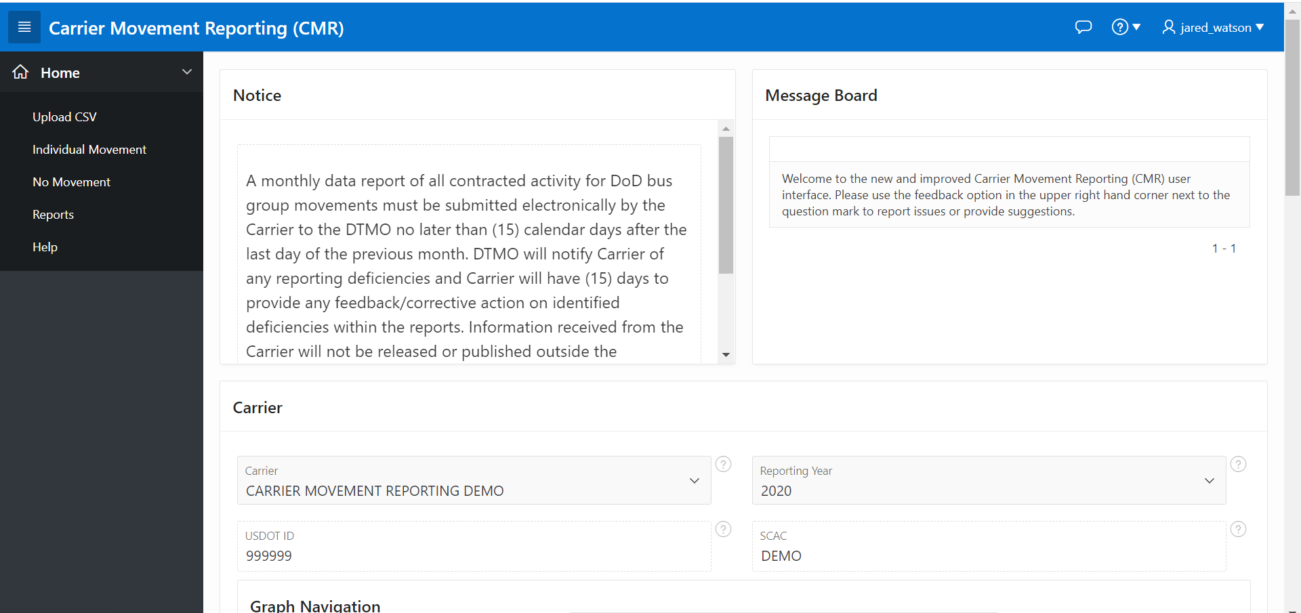

Slide 25
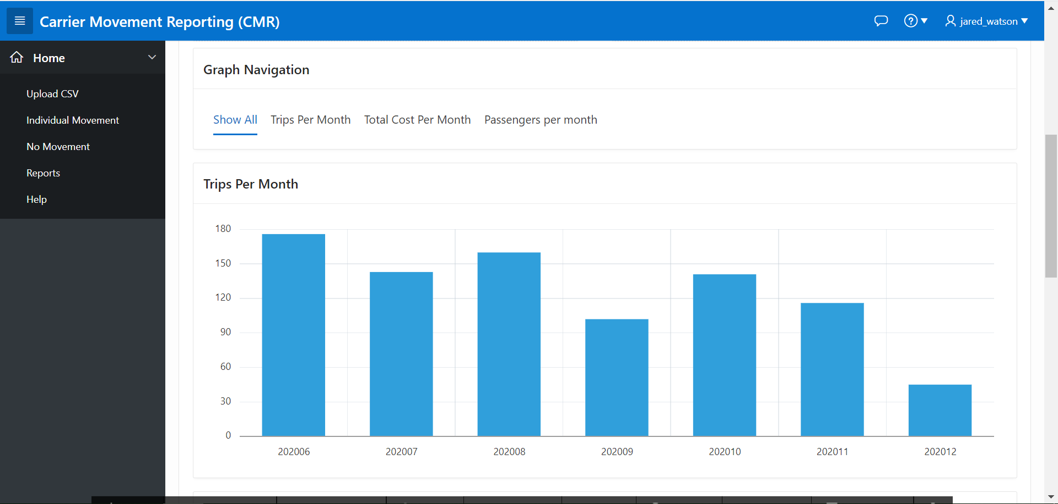

Slide 26
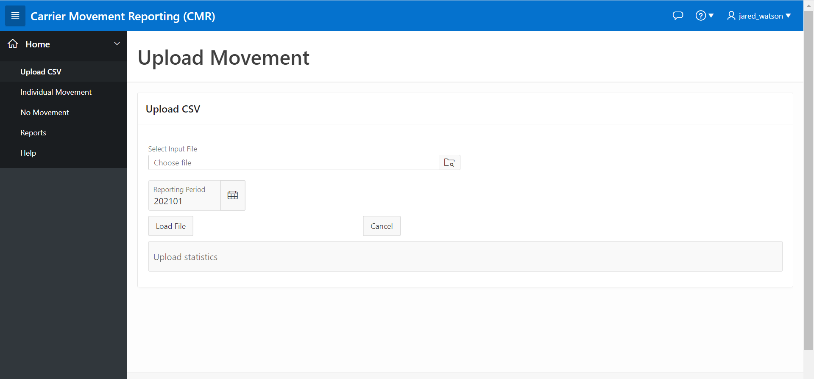

Slide 27
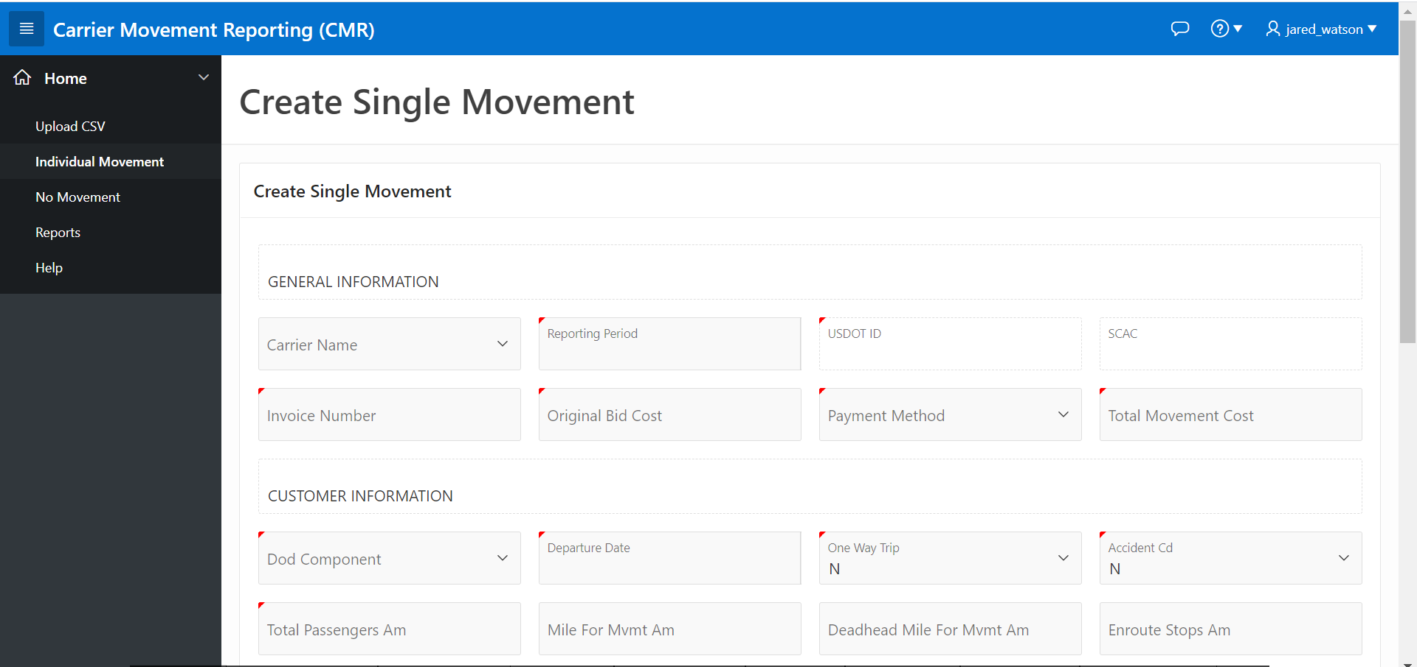

Slide 28
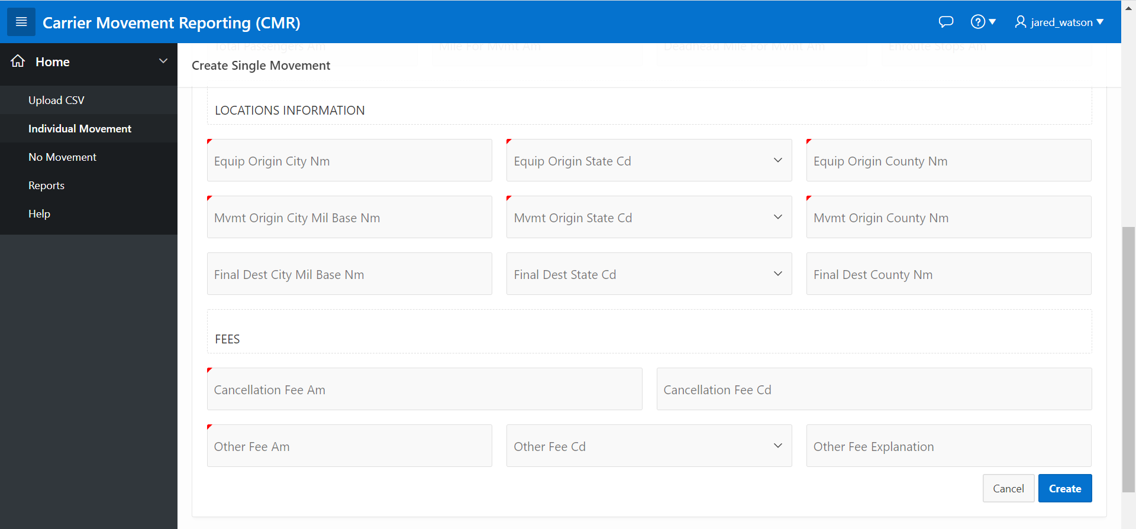

Slide 29
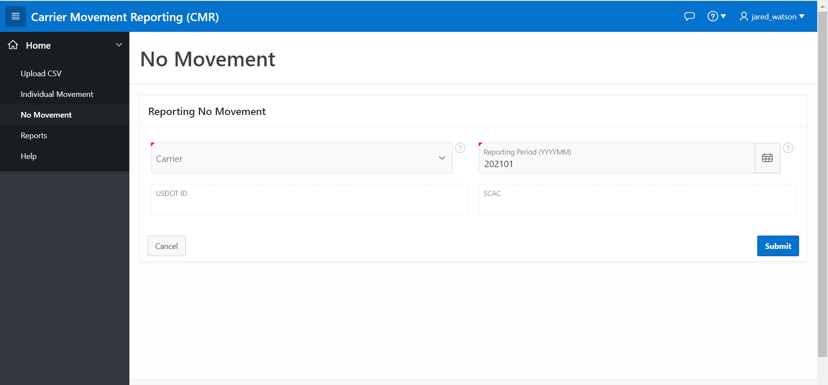

Slide 30
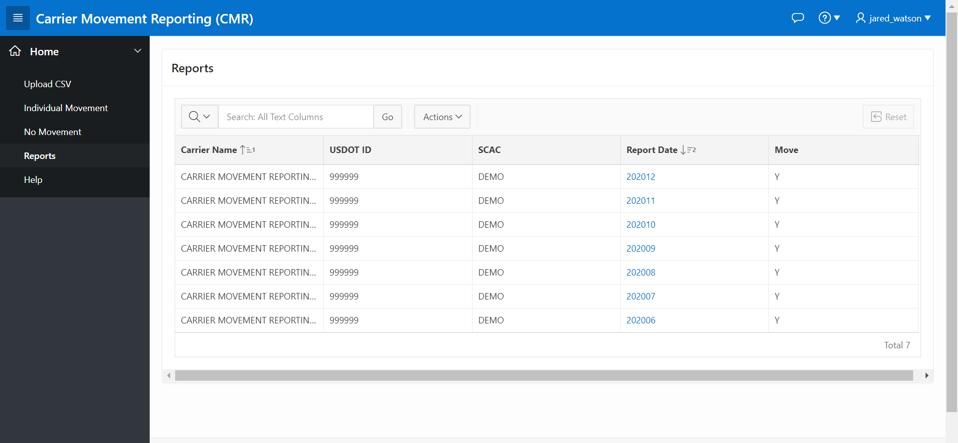

Slide 31
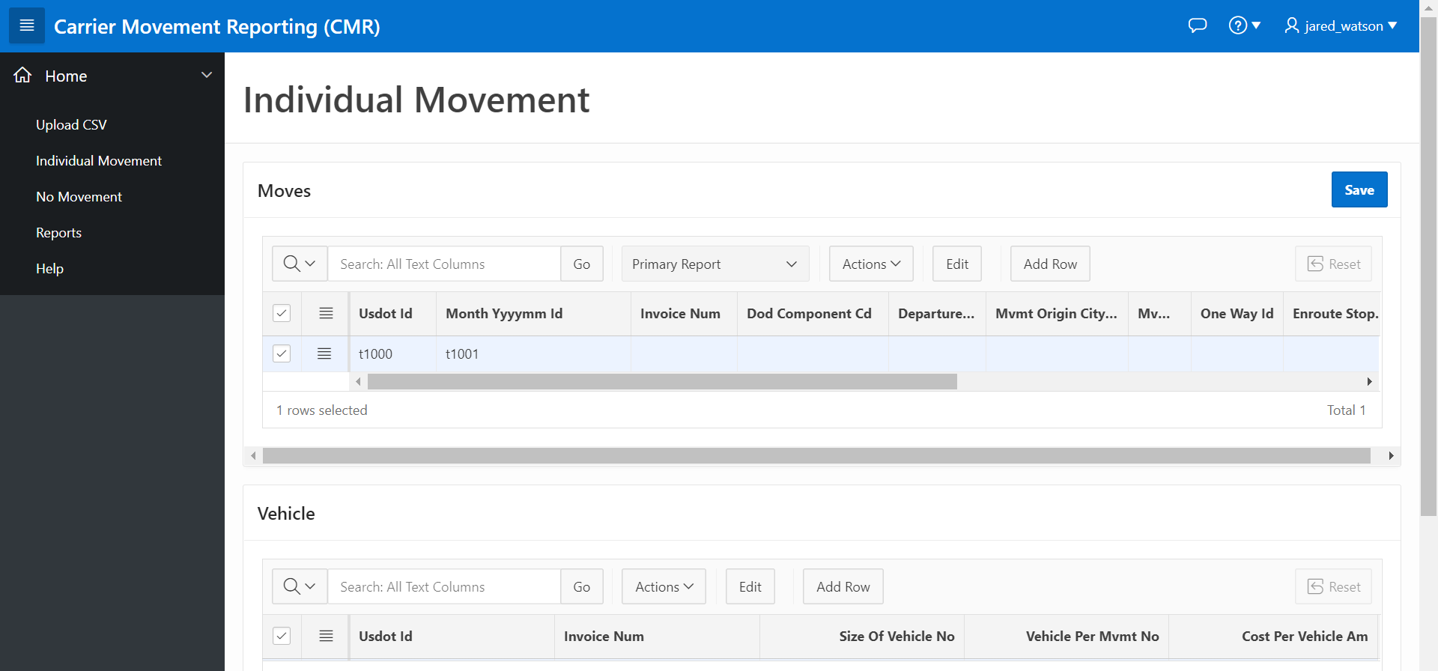

Slide 32
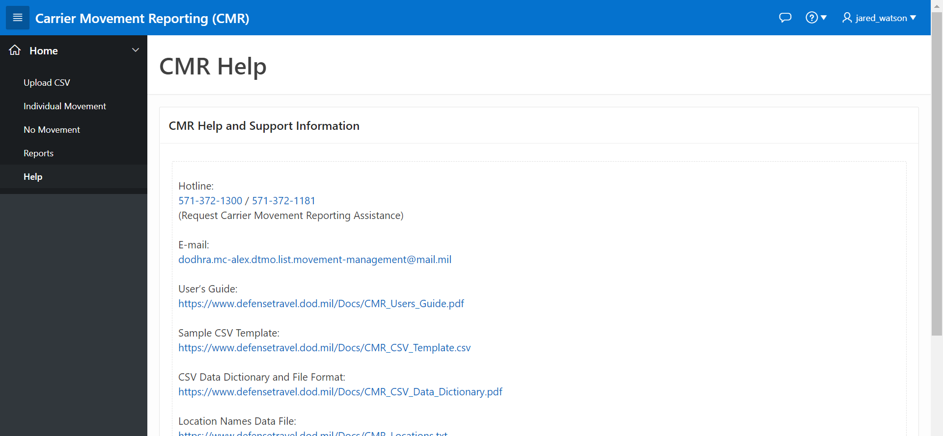

Slide 33


CMR Tool Customer Support
Email with the subject line “CMR” to:
dodhra.mc-alex.dtmo.mbx.military-bus-program@mail.mil
CMR Tool Assistance - (571) 372-1181
Email - Romael.M.Boyd.civ@mail.mil

