Slide 1


Save The Skilled Drivers You Know Today - Before Hiring The Next Unknown Drivers Tomorrow!
Recruiting Through Retention

Slide 2
ATRI Top Ten
1. Driver Shortage
2. Driver Retention
3. Driver Compensation
4. Lawsuit Abuse Reform
5. Truck Parking
6. Compliance & Safety
7. Detention Delay at Customers
8. Transportation Infrastructure
9. Insurance Costs
10.Diesel Tec Shortage

Slide 3
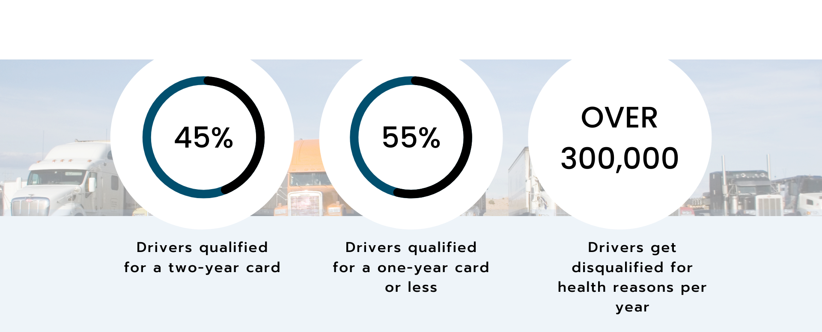
Driver Medical Card Facts
One Year Medical Cards are Becoming The Norm

Slide 4

How Driver Health Impacts All Departments
HR - wants to retain skilled drivers.
Safety - wants to reduce fatigued drivers & poor health – reducing potential accidents.
C-Suite -Execs want to increase driver productivity and reduce insurance costs.
Recruiters - can use health benefits as a tool to incentivize hiring
Compliance teams - must ensure drivers are DOT qualified.
Drivers - They want to work and maintain their livelihood, achieve personal goals, improve health and well-being

Slide 5
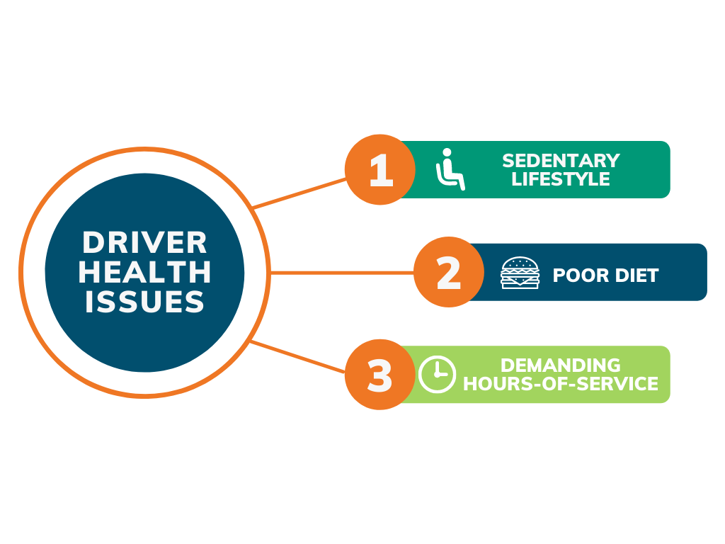
Driver Health Issues
Results of The Profession

Slide 6




Top Driver Conditions
Elevated Glucose
1
2
3
High Blood Pressure
Sleep Apnea

Slide 7
Breaking Through the Silos
Where to look to find potential loss in skilled drivers?
What to do once you find the information?
How do you engage with those “on the bubble drivers”
What do you do with DQ drivers?
How many here know on a daily or weekly bases number of drivers on short term cards and number of drivers Disqualified?

Slide 8
Wanted; Worlds Best Bus Drivers
Recruiting doesn’t stop once they’re onboarded. Since driver health impacts every department, we must engage drivers from pre-hire to retire with consistent marketing. That includes:
Social Media
Content
Newsletters
& Blog
Content
Compliance & Wellness Programs
Healthy, Grab & Go Meals
You Can’t Be Safe – If You Are Not Well

Slide 9
Driver Health Resources
Fit To Pass (www.fittopass.com) – CDL Health Coaching
Galilieo (galilieo.io) - Virtual Medical Care
CDL Health Scanner – (CDLhealthscanner.com) Electronic biometric tool

Slide 10
Simple Driver Health Steps – Education
Provide your drivers with helpful healthy nutritional tips on how to pack snacks & meals.
If you have an EAP in place, make sure your drivers know about it and how to use it during these stressful times.
Stock your driver break areas at your terminals with fresh fruit, water and healthy nuts - please NO high sugar comfort treats
Create a healthy plan hotel & restaurant partners
Make to extend to the Drivers family members

