Slide 1
EPA’s Heavy-Duty Engine and Vehicle Standards Final Rule for 2027+ Model Years
Amy Kopin
February 4, 2023

Slide 2
Agenda
Rule Overview
Inducements
Serviceability and Onboard Diagnostics Improvements
Next Steps

Slide 3
Rule Overview

Slide 4
EPA’s Heavy-Duty 2027 Final Rule
EPA Administrator signed the Notice of Proposed Rulemaking (NPRM) on March 7, 2022, and the Final Rulemaking (FRM) on December 20, 2022
Manufacturers must comply with the final program beginning in Model Year (MY) 2027
No final action on the proposed targeted updates to the existing Heavy-Duty GHG Phase 2 program (intend to propose in GHG Phase 3 rule this year)
FRM Published in the Federal register on January 24, 2023
88 FR 4296, https://www.govinfo.gov/content/pkg/FR-2023-01-24/pdf/2022-27957.pdf
EPA webpage for more information https://www.epa.gov/regulations-emissions-vehicles-and-engines/final-rule-and-related-materials-control-air-pollution

Slide 5
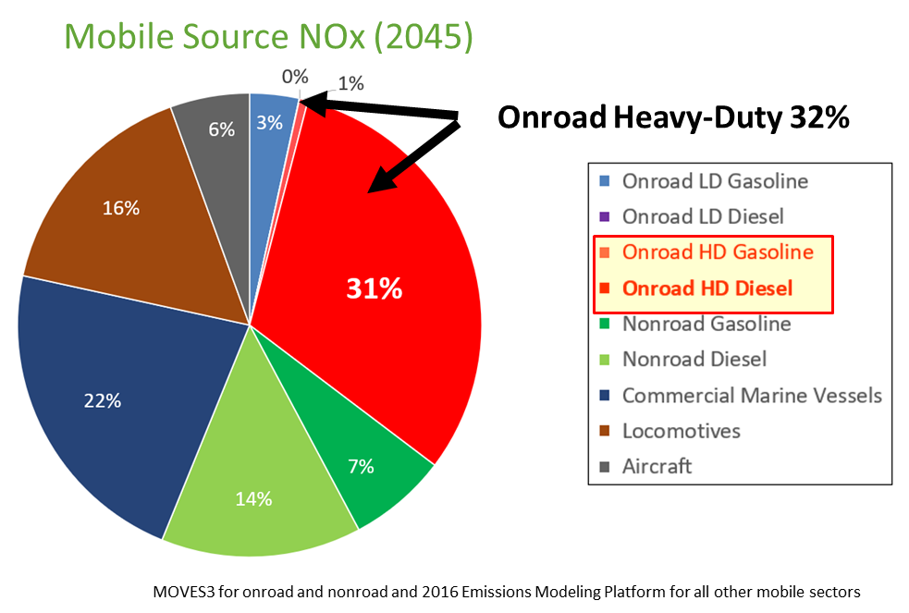
Context for EPA Heavy-Duty 2027 Final Rule
The heavy-duty industry is diverse, spanning delivery trucks, tractor-trailers, school buses, and other types of vocational vehicles
Heavy-duty vehicles contribute significantly to local, regional, and global air pollution
The Clean Air Act gives EPA authority to set standards for HC, CO, NOx, and PM for heavy-duty
These standards must “achieve the greatest degree of emission reduction achievable …”, and provide a minimum of 4 years lead-time, and 3 years of stability between new standards
EPA’s last heavy-duty rulemaking for these pollutants was over 20 years ago, with standards that phased in through 2010.

Slide 6
Major Elements of the Final Rule
Changes to 4 key elements of heavy-duty engine criteria pollutant program
1) Test Procedures, 2) Emission Standards, 3) Regulatory Useful Life, & 4) Emissions Warranty
Updated Averaging, Banking, and Trading (ABT) program
New maintenance, serviceability, and onboard diagnostics (OBD) requirements to help owners:
Access more maintenance information to facilitate repairs
Quickly identify failed emissions control parts
Limit frustration, cost, and downtime due to repairs
New regulations for engine derating related to SCR-based systems
Ensure that all critical emission related scheduled maintenance has a reasonable likelihood of being performed while also deterring tampering of the SCR system.
Set an appropriate inducement speed derating schedule that reflects experience gained over the past decade with SCR systems

Slide 7
New Test Procedures and Emission Standards
For all engine categories, the final standards are a single-step, beginning in MY 2027
Lower standards over laboratory current duty cycles
New “low-load” cycle and standards for compression-ignition engines covering stop-and-go and idle operation to help address emissions from urban driving conditions
New “supplemental emission test” cycle and standards for spark-ignition engines covering sustained higher speed and higher load operation to help reduce fuel enrichment under highway driving conditions
For in-use Medium HDE or Heavy HDE, EPA included a compliance allowance that applies when EPA evaluates whether engines are meeting the final standards after these engines are in the real world
Compression-ignition HDE NOx Standards (mg NOx /brake hp-h)
 | Current | MY 2027+ | MY 2027+ In-Use Compliance Allowance
Federal Test Procedure (transient mid/high load conditions) | 200 | 35 | 50
Supplemental Emission Test (steady-state conditions) | 200 | 35 | 50
Low Load Cycle (low-load conditions) | N/A | 50 | 65
Spark-ignition HDE NOx Standards (mg NOx /brake hp-h)
 | Current | MY 2027+
Federal Test Procedure (transient mid/high load conditions) | 200 | 35
Supplemental Emission Test (steady-state conditions) | N/A | 35

Slide 8
Longer Regulatory Useful Life Periods
Longer useful life periods ensure engines are designed to meet emission standards through more of their operational lives
Our final useful life periods are generally based on average mileage at time of rebuild or replacement
Useful life periods have been increased for all engine categories starting in MY 2027
Primary Intended Service Class | Current |  |  | MY 2027+
 | Miles | Years | Hours | Miles | Years | Hours
Spark-ignition HDE | 110,000 | 10 | - | 200,000 | 15 | 10,000
Light HDE | 110,000 | 10 | - | 270,000 | 15 | 13,000
Medium HDE | 185,000 | 10 | - | 350,000 | 12 | 17,000
Heavy HDE | 435,000 | 10 | 22,000 | 650,000 | 11 | 32,000

Slide 9
Longer Emission-Related Warranty Periods
Warranty ensures end-users don’t bear all the risk of emission technologies that fail prematurely
We lengthened warranty, in part, because owners are more likely to repair and maintain their emission controls, and less likely to tamper, if emission controls are covered by warranty
Warranty periods have been increased for all engine categories starting in MY 2027
Primary intended Service Class | Current |  |  | MY 2027+
 | Mileage | Years | Hours | Mileage | Years | Hours
Spark-ignition HDE | 50,000 | 5 | - | 160,000 | 10 | 8,000
Light HDE | 50,000 | 5 | - | 210,000 | 10 | 10,000
Medium HDE | 100,000 | 5 | - | 280,000 | 10 | 14,000
Heavy HDE | 100,000 | 5 | - | 450,000 | 10 | 22,000

Slide 10
Inducements

Slide 11
SCR Inducement Proposal Background
SCR is very different from other emission control technologies in that it requires operators maintain an adequate supply of diesel exhaust fluid (“DEF”)
Operating an SCR-equipped engine without DEF would cause NO_{X} emissions to increase to levels comparable to having no NO_{X} controls at all
In response to this concern, EPA issued guidance describing how manufacturers could use engine derates or “inducements” for certain DEF-related faults to ensure that operators use an adequate supply of high-quality DEF
Today – manufacturers design engines with a 5-mph final inducement for many reasons unrelated to DEF refills, and once a vehicle reaches ‘final severe inducement’ it generally must be towed to a specialized repair facility to have the condition reset

Slide 12
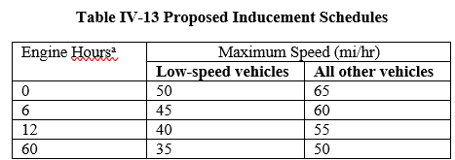
Proposed Inducement Schedules
Proposed inducement schedules
Two separate categories and final inducement speeds – one schedule
To ensure vehicles that operate primarily off the highway and in urban areas have an appropriate low final inducement speed, and
properly qualified high-speed vehicles cannot operate commercially on the highway
Comments received on NPRM
Operators confirmed proposed derate schedule would be effective, but wanted more time and more speed
Other commenters suggested less time & lower final speeds were more appropriate

Slide 13
Inducements in the FRM
EPA expects SCR will continue to be used to meet new standards
FRM includes several changes from proposal after consideration of comments
Added a third speed category (low-, medium-, and high-speed vehicle inducements)
Revised inducements speeds and schedules
Does not include a NOx override
Includes a separate schedule for engines used in motorcoaches
The final inducement program is mandatory for MY 2027 engines, but can be used voluntary before then

Slide 14
Inducement Requirements
Triggers
Three categories: DEF Supply is Low, DEF Quality Problems, and Tampering
Tampering is defined as open circuit faults for specific components or missing catalysts
Driver Information
EPA is requiring additional information be provided to the driver to help operators and owners to make timely and informed decisions, including: the condition causing the derate (e.g., DEF quality, tampering or level), the fault code and description of code associated w/inducement, the current speed restriction, and the next derate step and speed
Removing Inducements
EPA is requiring engines ‘self heal’ if the fault condition is confirmed to be remedied
FRM allows for a generic scantool to be used to remove the condition
Repeat Faults are subject to immediate reevaluation that would lead to resuming the derate where it left off if a code persists within 40h of first appearance

Slide 15
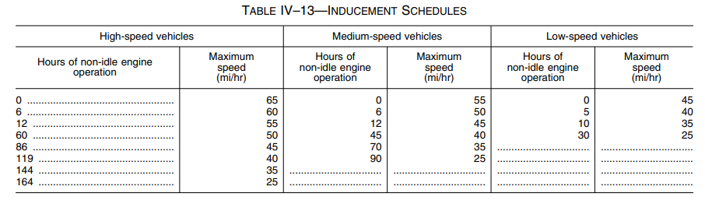
Final Rule Inducement Schedules
Inducement category is based on average speed over last 30 hours of non-idle operation speed
Low speed vehicles are defined as having average operating speed of <15mph and a high-speed vehicles ≥25
There is a speed transition between steps of 1mph /5mins (prior to each step and before any repeat inducement)

Slide 16
Inducements for Motorcoaches
Motorcoach operators submitted comments describing a greater sensitivity to any speed derate because of a much greater responsibility for carrying people safely to their intended destinations over longer distances, including their role in emergency response and national defense operations
EPA defines motorcoaches in 40 CFR 1036.801 to include buses that are designed to travel long distances with row seating for at least 30 passengers. This is intended to include charter services available to the general public.
Motorcoach Inducement Schedule
Hours of non-idle engine operation | Maximum Speed
0 | 65mph
80 | 50mph
180 | 25mph

Slide 17
Inducements and Existing Vehicles
As stated in the FRM Preamble:
“EPA believes field fixes with updated inducement algorithms may fall within EPA’s field fix guidance for engines that have EPA-only certification (i.e., does not include certification to California standards), but has concerns about such field fixes falling within the scope of the guidance for engines also certified by CARB if CARB considers such changes to be tampering with respect to requirements that apply in California. EPA intends to also consider alternative field fix inducement approaches that manufacturers choose to develop and propose to CARB and EPA, for engines certified by both EPA and CARB, such as approaches that provide a more balanced inducement strategy than that used in current certifications while still being effective.”
EPA would consider approaches that do not include all aspects of the FRM inducement program
EPA can only approve changes to EPA-only certified engines

Slide 18
Serviceability and OBD Provisions

Slide 19
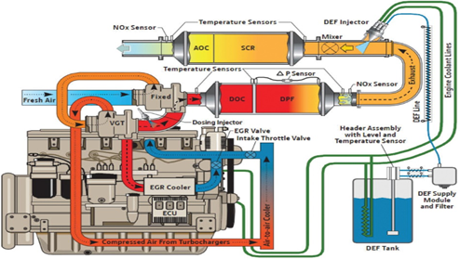
Finalized Serviceability Improvements
More repair and servicing information in owner’s manual, including:
A description of how the emission control systems operate
Diagrams of the engine and emission-related components:
Figure used with permission from John Deere
Showing the flowpath of air, exhaust, coolant, DEF
Identify location of relevant emission sensors, DEF heater and delivery components, and other critical emissions components (terminology must be consistent with OBD)
Include part numbers for emission sensors and filters
A description of how to use the OBD system to troubleshoot problems and access emission-related diagnostic information
For example, what OBD protocol used and where the connector is

Slide 20
Finalized Serviceability Improvements
A troubleshooting guide to address SCR inducement-related and DPF regeneration-related warning signals
For the SCR system this requirement includes: derate schedule , the meaning of any trouble lights that indicate specific problems (e.g., DEF level) and a description of the three types of SCR-related derates
For the DPF system the troubleshooting guide requirement includes information on the occurrence of DPF-related derates
Improved information displayed on demand
Average DEF consumption (historical and current w/an available reset)
Total number of regens on the existing DPF
Type of derate and fault code for other SCR- and DPF-related engine derates (speed or torque)
Provide instructions on where to find emission recall and technical repair information that is available without charge
Changes are mandatory for MY 2027 and voluntary before then

Slide 21
Onboard Diagnostics
EPA largely harmonized with existing California Air Resources Board (CARB) OBD requirements
EPA finalized additional emission-related parameters to include in freeze frame data
Freeze frame data is a set of parameters taken as a “snapshot” when a trouble code is set
EPA also finalized additional data parameters be made public
Access to emission-related data parameters is critical for prompt and proper repair
Provides more information and value to owner while simultaneously help achieve long term emission benefits
All data parameters used in an engine’s decision process to put vehicle into an SCR- or DPF-related derate must also be made publicly available

Slide 22
Next Steps
EPA is currently working on a Heavy-Duty “Phase 3” GHG proposal
Goal is to issue an NPRM in March 2023 and a Final rule in December 2023
More information on EPA’s Heavy-duty GHG regulations can be found here: https://www.epa.gov/regulations-emissions-vehicles-and-engines/regulations-greenhouse-gas-emissions-commercial-trucks
We look forward to getting input from stakeholders on the program
There will be a public comment period and a public hearing later this spring

Slide 23
Questions?

