Slide 1
Update on the Intercity Bus Security Grant Program & Associated Initiatives June 18, 2020
Kerry L. Thomas
Director, Preparedness Grants Division
Notes:
(Title Slide Option 1)

Slide 2
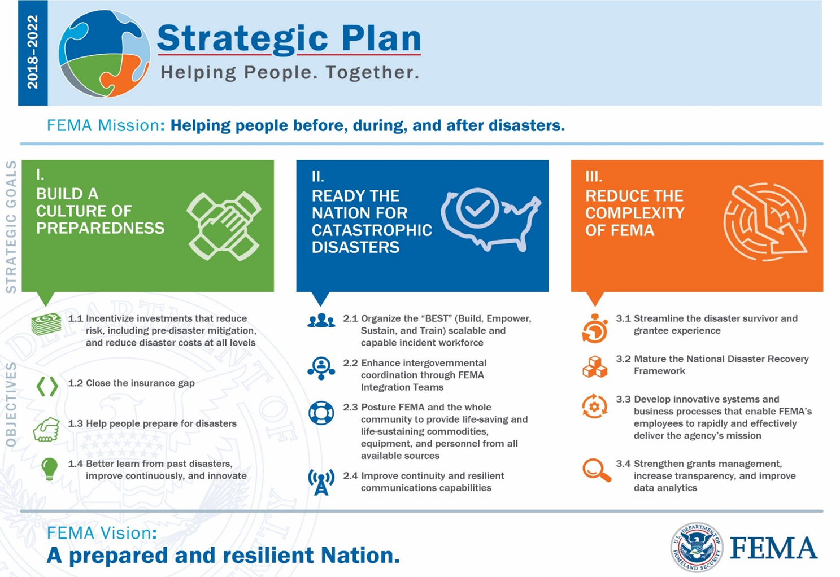
Our Mission

Slide 3
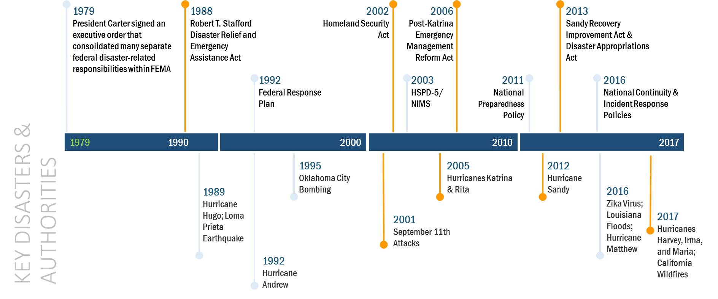
Our History

Slide 4
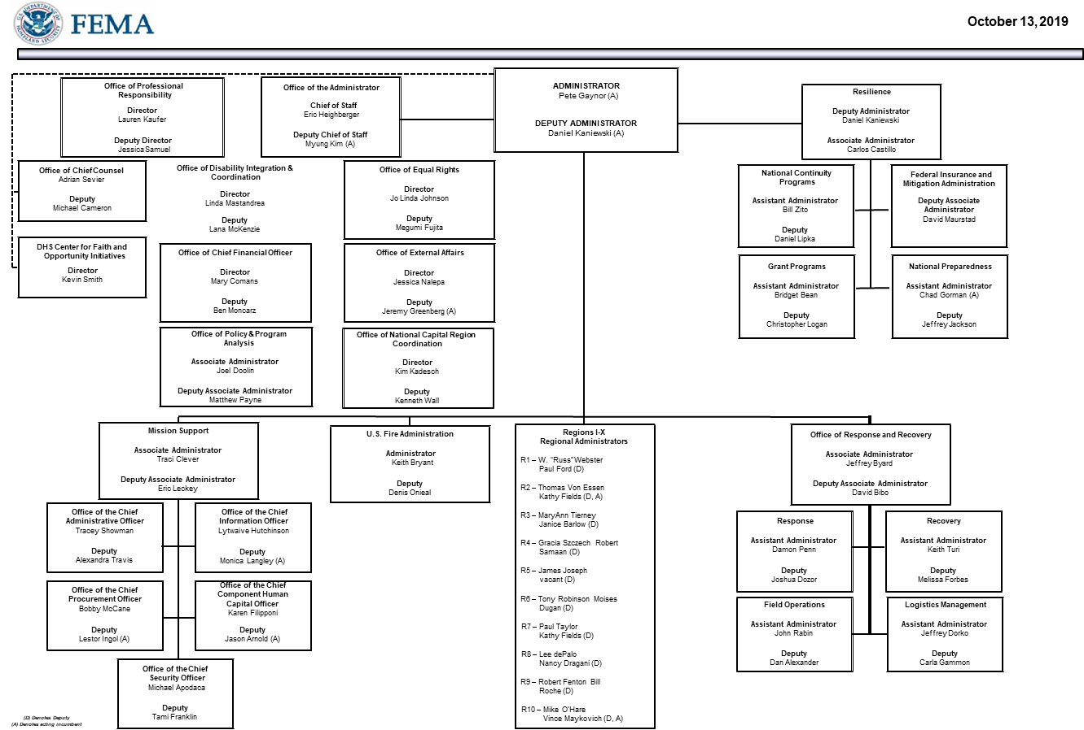
Our Organization

Slide 5
Preparedness Grants Division
Overview
The Preparedness Grants Division (PGD) oversees a $2.4 billion portfolio of grants that assist with community and infrastructure security; fire and life safety; emergency management; and other pre-disaster activities:
Preparedness Grants Division
Transportation Infrastructure Security Branch
Homeland Security Programs Branch
Assistance to Firefighters Grant Programs Branch
National Programs Branch

Slide 6
Transportation Infrastructure Security Branch
Overview
The Intercity Bus Security Grant Program (IBSGP) is one of four funded grant infrastructure security programs within the Transportation Infrastructure Security Branch (TISB):
Transportation Infrastructure Security Branch
Maritime Section
(PSGP)
Surface Section
(TSGP, IBSGP, IPR)

Slide 7
IBSGP Historical Overview
Fiscal Year Program$ | Amount
FY 2003 Intercity Bus Security Grant Program | $19,800,007
FY 2004 Intercity Bus Security Grant Program | $9,925,532
FY 2005 Intercity Bus Security Grant Program | $9,657,138
FY 2006 Intercity Bus Security Grant Program | $9,503,000
FY 2007 Intercity Bus Security Grant Program | $11,640,000
FY 2008 Intercity Bus Security Grant Program | $11,172,250
FY 2009 Intercity Bus Security Grant Program | $11,658,000
FY 2010 Intercity Bus Security Grant Program | $11,520,000
FY 2011 Intercity Bus Security Grant Program | $4,990,000
FY 2015 Intercity Bus Security Grant Program | $3,000,000
FY 2016 Intercity Bus Security Grant Program | $3,000,000
FY 2017 Intercity Bus Security Grant Program | $2,000,000
FY 2018 Intercity Bus Security Grant Program | $2,000,000
FY 2019 Intercity Bus Security Grant Program | $2,000,000
FY 2020 Intercity Bus Security Grant Program | $2,000,000
Total | $103,965,927

Slide 8
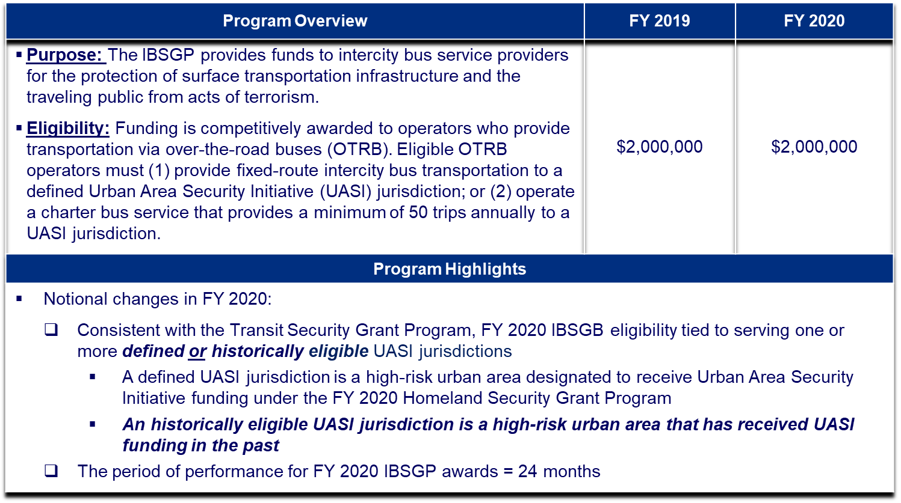
FY 2020 Intercity Bus Security Grant Program (IBSGP)

Slide 9
Associated Initiatives
Enhancing stakeholder engagement
Active participation in industry events like the BISC Summer Meeting and Marketplace 2020
Providing targeted grants management technical assistance
FEMA and ABA will co-host a half day session on post-award grants management during August 2020
Additional assistance is available upon request
Developing a risk assessment tool and associated planning templates
Industry is asking for this, and it helps address an enduring challenge for FEMA… measuring the impact of programs like the IBSGP
How do you measure something that hasn’t happened?
How are we reducing risk to the nation’s transportation systems?

Slide 10
Risk Assessment Tools and Templates
The challenge:
Risk can be very subjective and often depends on the evaluator
In partnership with ABA and TSA, FEMA is developing a risk assessment tool tailored for use by over-the-road-bus (OTRB) operators
The OTRB Risk Assessment Methodology (OTRB-RAM) provides a standardized set of incidents, paired with operator assets, to determine current risk in three asset categories:
Buses
Public access fixed facilities
Restricted access fixed facilities
OTRB-RAM is being specifically tailored to eliminate as much of the guesswork as possible
OTRB stakeholders will be able to use the results of this risk assessment to identify security gaps and establish a plan for addressing them using standardized templates

Slide 11
Risk Assessment Tools and Templates (cont.)
Risk = Threat x Vulnerability x Consequence
Threat is the indication of potential harm to life, information, operations, the environment and/or property
For strategic planning purposes, FEMA holds threat constant at a value of “1” in the OTRB-RAM
Vulnerability is an assessment of the likelihood that a type of incident would compromise an asset or capability. OTRB-RAM assesses vulnerability by:
Degree of exposure the asset has to the incident type
Protective measures in place to protect the asset from the type of incident
The asset’s robustness or resilience in the face of the incident type
Consequence is an assessment of how severe the effects of a particular incident would be if applied to a particular asset. OTRB-RAM assesses consequence by:
Human impact
Economic impact

Slide 12
Risk Assessment Tools and Templates (cont.)
FEMA and TSA collaborated to develop a standardized list of incident types to be assessed:

Slide 13
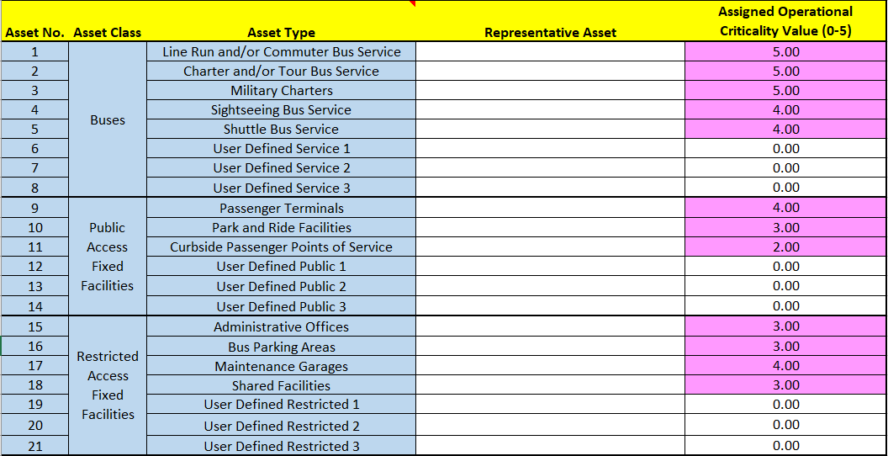
Risk Assessment Tools and Templates (cont.)
FEMA and the BISC Safety Committee collaborated to develop a list of representative asset types:

Slide 14
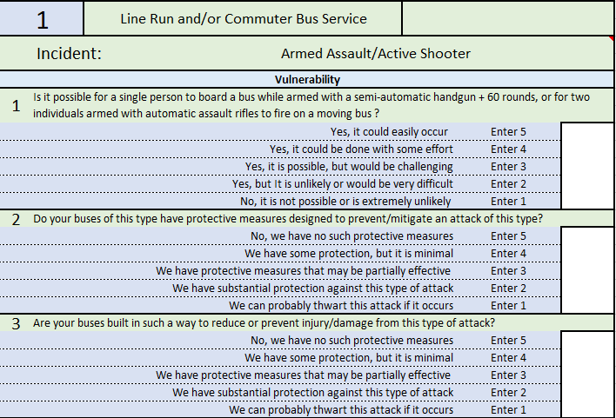
Risk Assessment Tools and Templates (cont.)
Vulnerability will be scored by individual bus companies based on values derived from their TSA BASE assessment.

Slide 15
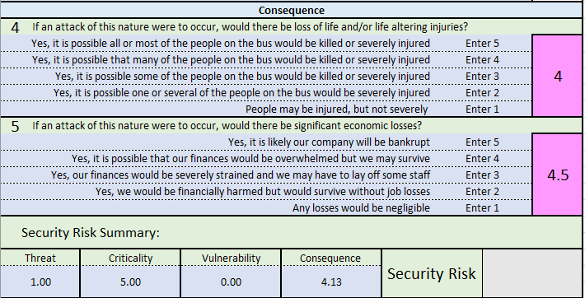
Risk Assessment Tools and Templates (cont.)
Standardized criticality and consequence values are being developed by FEMA and the BISC Safety Committee.
Consequence is pre-determined for Attacks on Buses only.
Notes:
Create +/- 1 boundary for adjusting consequence scale

Slide 16
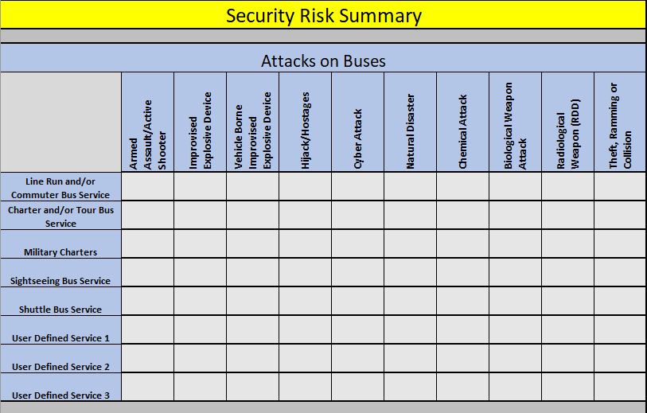
Risk Assessment Tools and Templates (cont.)
In the OTRB-RAM, risk scores are categorized by the following code:
The OTRB-RAM tool produces a summary report as its final product for:
Buses
Public Access Fixed Facilities
Restricted Access Fixed Facilities

Slide 17
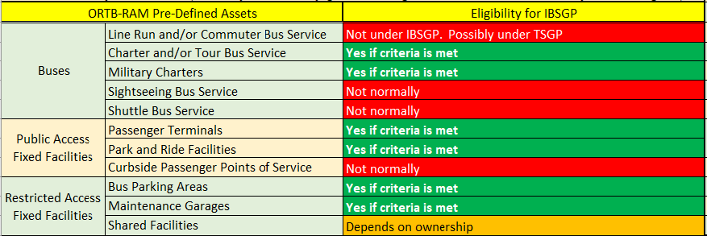
Risk Assessment Tools and Templates (cont.)
Not all asset types are eligible for funding under IBSGP. However, understanding risk in full is vitally important to capture an accurate system-wide security posture. For that reason, all asset types typically found in an OTRB system are included in the tool.

Slide 18
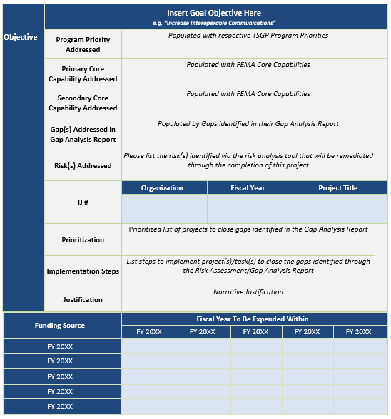
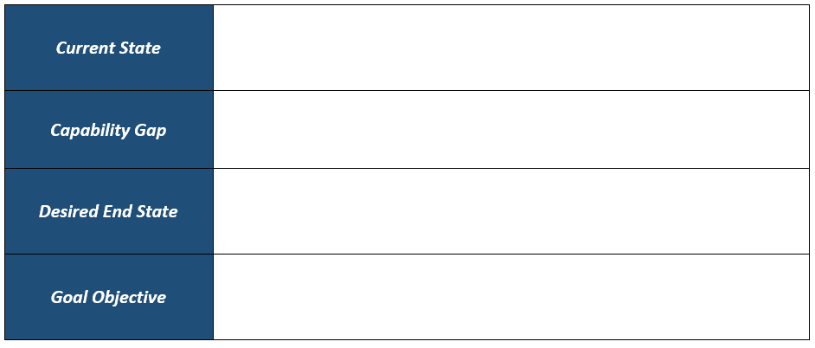
Risk Assessment Tools and Templates (cont.)
Supporting tools and templates:
Gap Analysis template
Implementation Plan template
Implementation Plan
Gap Analysis
Identified Capability Gap: XXXX

Slide 19
Risk Assessment Tools and Templates (cont.)
Current status and next steps:
Continue to work with ABA and the BISC Safety Committee to finalize the OTRB-RAM tool and templates by mid-2020
Make OTRB-RAM available through ABA and possibly other organizations as a free resource
Encourage IBSGP stakeholders to use the results in justifying projects in their applications

Slide 20
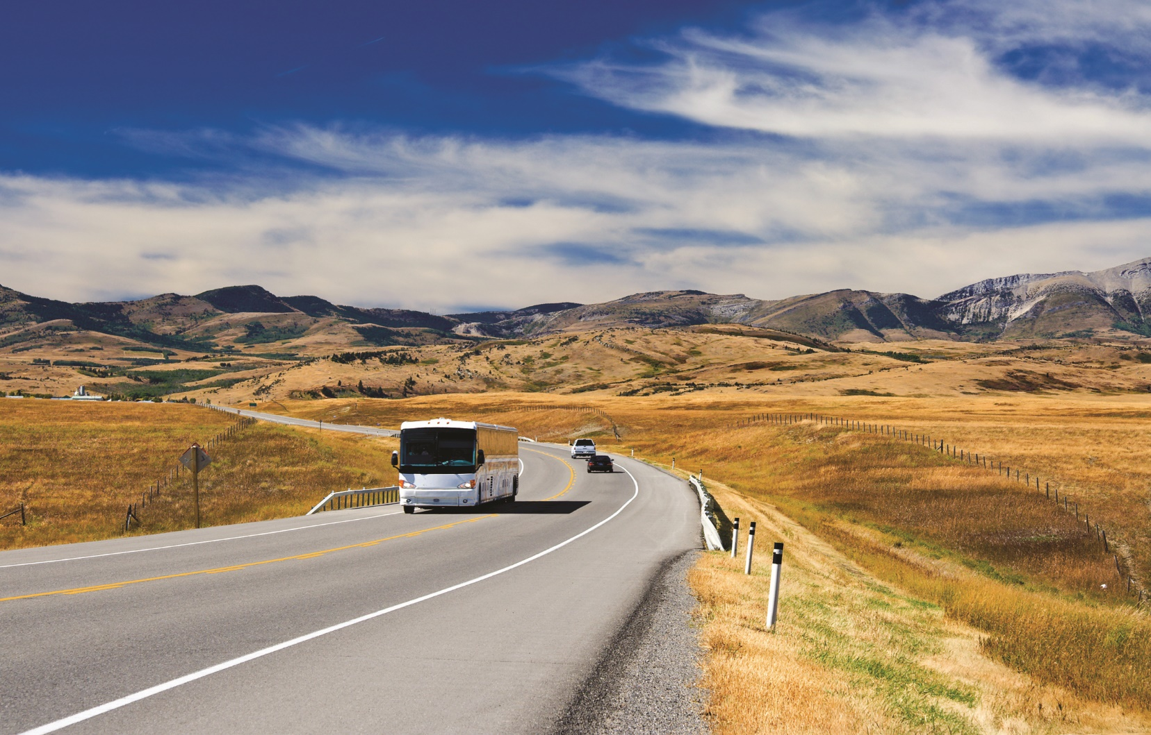
Questions?

