Slide 1

The Building Blocks of Safety Culture How Do I Stack Them?

Slide 2

Session # 14 Salvatore Caccavale, Corporate Director EHSS scaccavale@martzbus.com 570-821-3830 office 815-302-9185 cell

Slide 3
Attitude:
Position as indicating action, feeling, or mood. “State of mind.”
Behavior:
Manner of behaving, whether good or bad; mode of conducting one’s-self; conduct; deportment; carriage.
Commitment:
The act of pledging or engaging; the act of exposing, endangering, or compromising; also, the state of being pledged or engaged.
Safety:
The condition or state of being safe; freedom from danger or hazard; exemption from hurt, injury, or loss.

Slide 4

What exactly is World Class?
According to Merriam-Webster:
“being of the highest caliber in the world.”

Slide 5
Who developed the term and why was it important to them?
Who sets the standard?
Who am I judged against?
Why is this so important?
Does anyone really care?

Slide 6
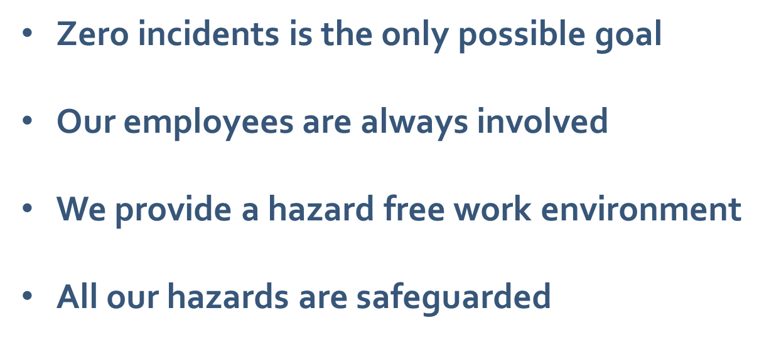
Heard around the water cooler

Slide 7
Effective safety leaders have the courage to ask for candid feedback and the humility to accept and apply suggestions for reasonable change.

Slide 8
A is for Attitude

Slide 9
A = Attitude
Good attitude:
Important employee trait
Contributes to work environment & how employees get along
Positive attitude can improve morale & increase productivity
Bad attitude:
Destructive to the work environment, can kill morale
Excuses:
Bad hair day
Woke up on wrong side of the bed
Murphy’s law

Slide 10
Evolution of attitude changers
Don’t talk to Strangers
Look both ways before crossing
Eat your carrots and you will never have to wear glasses
Wear your bike helmet
Wear your protective gear (mouthpiece, shin pads, helmet, etc.)
Always wear your seatbelt
Study hard and you will get somewhere in life
Wear your PPE – steel toed shoes, hard hat, safety glasses
Lift properly

Slide 11
Categorized in positive and negative phrases
Examples from job performance reviews:
+ Enthusiasm; emulated; positive mind-set; attribute; constant;
accentuates the positive; atmosphere of trust; steady hand;
want to be around; consummate team player
Gives off air of superiority; unpleasant; dreadful outlook; instigator;
sporadic bout of attitude problems; kept in check;
erratic; outbursts; not fully connected

Slide 12
Safety Goals - feel good or bad
Total Recordable Incidence Rate – TRIR
Days Away, Restricted or Transferred - DART
Days Away From Work Case Rate – DAFWCR (Lost Time)
Preventable Vehicular Incidents/Accidents
First Aid
Near Miss/Close Call
Observations (behaviors/actions)
Leading versus Lagging indicators

Slide 13
ISHN – Industrial Safety and Health News
Polled 100 safety professionals from around the world.
Conclusion: in the past 30 years no one had an example of a company making a significant change or pivot based on Leading indicators.

Slide 14
Usual Leading Indicators
Near miss reports
Hazard identifications
Pre-shift briefings
Walk abouts
Inspections
Pre-trip inspections
Employee suggestions
Risk assessments
Leadership communication
Job Safety/Hazard Analysis
Behavioral observations
Safety Meeting attendance
Different leading indicators
for different companies.
There is no one size fits all!
How you manage your risk!!

Slide 15

STOP Work Authority
Do we really mean it………..

Slide 16


Influential People in Our Life:
Parents
Grandparents
Siblings
Teacher/Professor
Aunt/Uncle
Religious
Friend/Co-worker

Slide 17
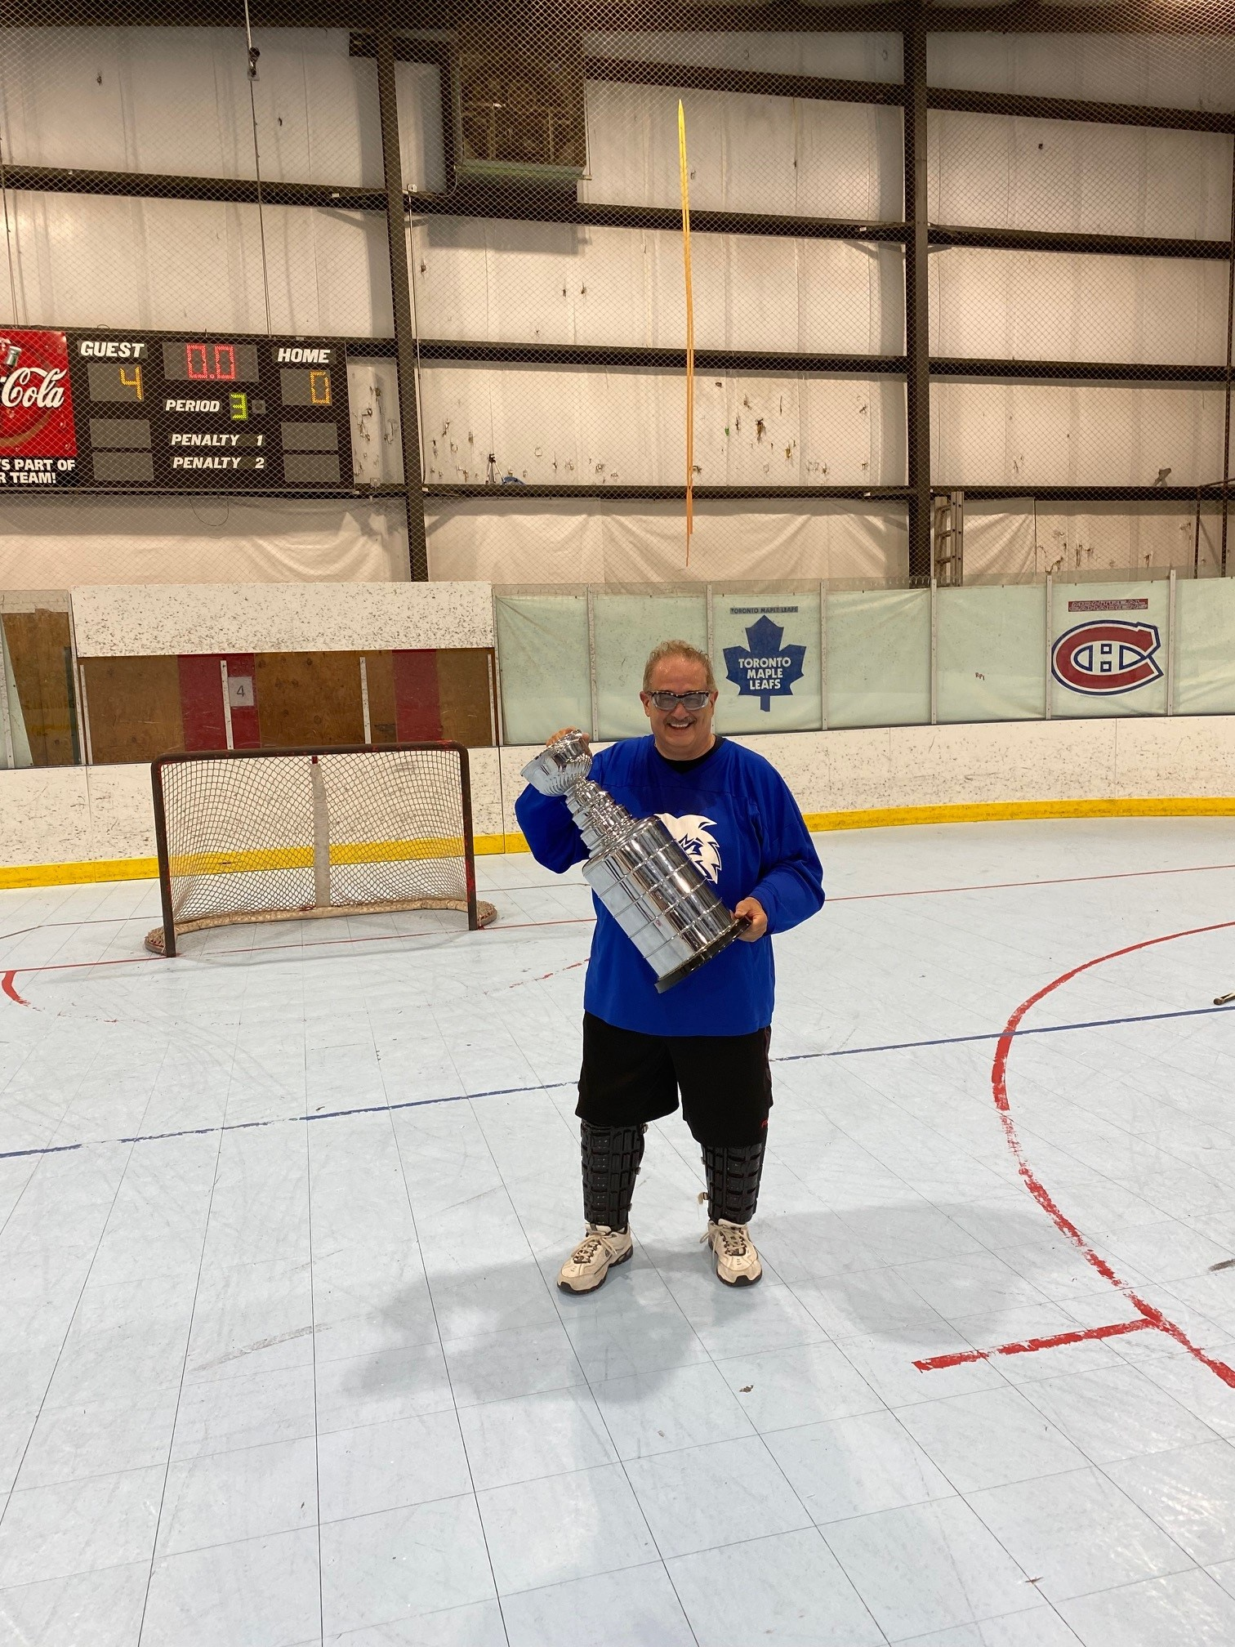
Integrity
Training & Education
Workforce – orientation/job skills
Supervision – moving on up/skills set
Leaders – dynamic decision makers
How does my Safetitude affect my life?
Family
Activities

Slide 18
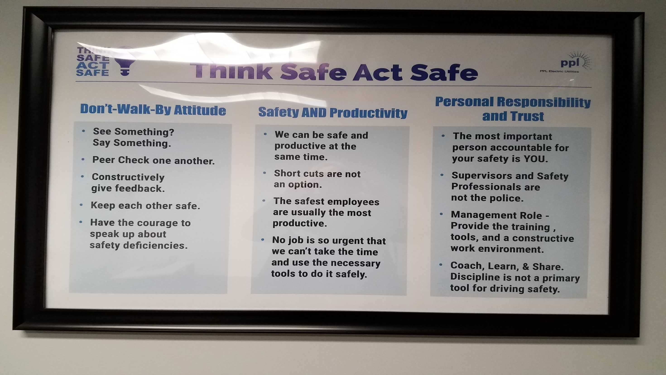

Slide 19

B is for Behavior

Slide 20
Some misconceptions about behavior:
Behavior is the “heart of the matter”
Too sensitive to touch (can’t talk about it)
Workforce (union environments) find behavior as negative or blame

Slide 21
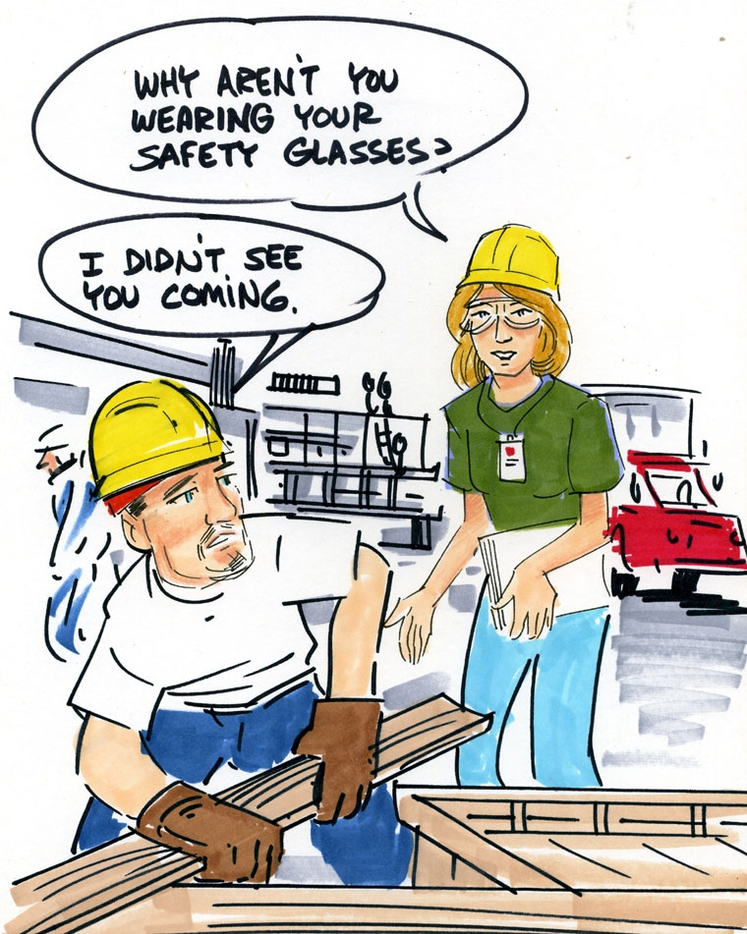
What you do when no one’s holding you accountable is self-motivated.
“The best kind of pride is that which compels people to do their very best work, even if no one is watching.” - Unknown
The Tom Post story

Slide 22
B = Behavior
People feel empowered when they answer “yes” to three questions:
Can I do it?
Will it work?
Is it worth it?

Slide 23
Are Employees Success Seekers for Safety?
Do They Seek Success?
No
Yes
Failure
Accepter
Success
Seeker
No
Do They Avoid Failure?
Failure
Avoider
Yes
Overstriver

Slide 24
Employees feel included and self-motivated when they believe they:
Are Heard
Contribute
Belong
Achieve
Choose
Are Appreciated
Feel Empowered
“Don’t blame people for problems created by the system.” - W. Edwards Deming

Slide 25
People Are Self-Motivated When Their Values Match Behavior.
Personal Values
Personal Behaviors
Self-Motivated Behavior
Cultural Values
Cultural Behavior

Slide 26
A financial bonus based on organizational performance can become an entitlement and have no impact on what people do.
People with empathy don’t judge others until they understand the other person’s perceptions and intentions.

Slide 27
Listening Has Five Levels
Empathic
Attentive
Selective
Pretend
Ignore

Slide 28
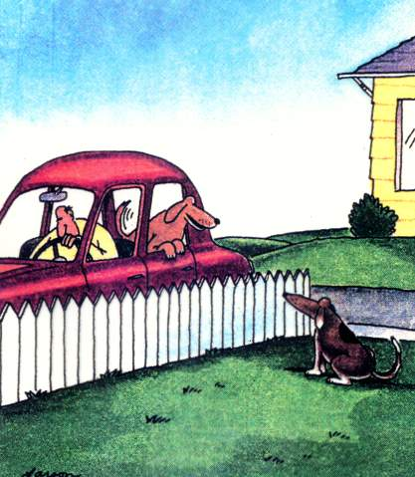
We Don’t Always Hear What Was Said
“Ha ha ha. Biff. Guess what? After we go to the drugstore and the post office, I’m going to the vet’s to get tutored.”

Slide 29
B = Behavior
When people believe they are competent at worthwhile tasks, they are more self-motivated.
“People are not successful because they are motivated;
they are motivated because they are successful.” – Paul Chance

Slide 30
B = Behavior
Continuous self-improvement starts with:
a behavior-based commitment;
opportunities to perform the target behavior,
self-congratulating occurrences of that behavior,
reflecting on relevant success and
opportunities for improvement.

Slide 31
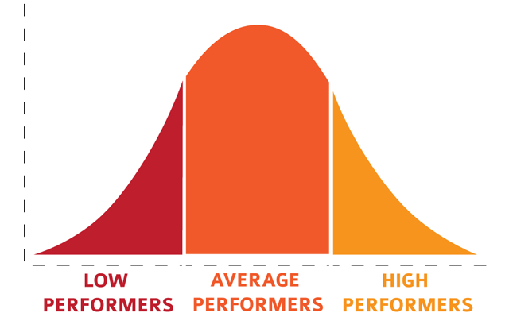
B = Behavior
A ranking system that promotes win/lose over win/win thinking and behavior does more harm than good.
The Curse of the Bell Curve

Slide 32
Barriers to Safe Work
Direct Causes
Severe Fatigue Alcohol/Drug use Intense/Prolonged Illness Stress
Indirect Causes
Workplace Stressors
Shift Schedule
Interpersonal Conflicts
Role Conflicts
Production Schedules
Cultural Change
Unclear Policies
Individual Stressors
Family Conflict
Financial Problems
Reaction To Change
Personality Factors

Slide 33
Involvement / Ownership by All Employees
Natural Instincts
Supervision
Incident Rates
Self
Teams
Reactive
Dependent
Independent
Interdependent
Safety by Natural Instinct
Compliance is the Goal
Delegated to Safety Manager
Lack of Management Involvement
Management Commitment
Condition of Employment
Fear/Discipline
Rules/Procedures
Supervisor Control, Emphasis, and Goals
Value All People
Training
Personal Knowledge, Commitment, & Standards
Internalization
Personal Value
Care for Self
Practice, Habits
Individual Recognition
Help Others Conform
Others’ Keeper
Networking Contributor
Care for Others
Organizational Pride

Slide 34
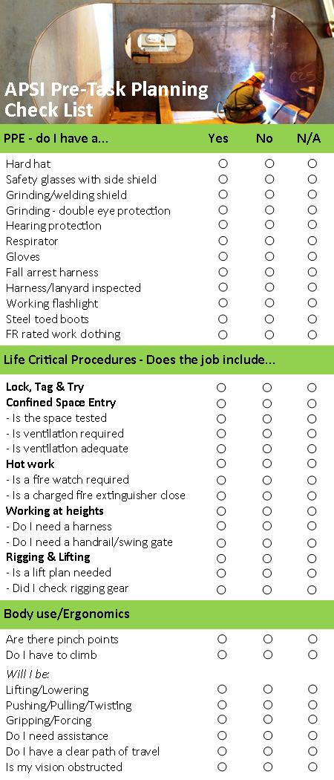
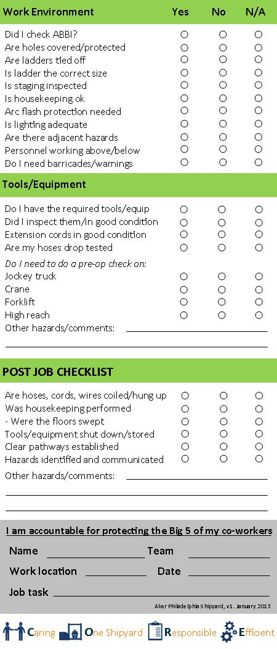
Pre/post task planning card

Slide 35

PPE – do I have……. Yes No N/A
28. Hard hat /bump cap
29. Safety glasses w/side shield
30. Grinding/welding face shield
31. Hearing protection
32. Respirator – Full Face/Airline
33. Gloves – What type do I need?
34. Harness/lanyard/retractable(inspected?)
35. Working flashlight
36. Personal Gas Monitor (calibrated?)
37. Steel/Composite toe boots
38. Chemical protective clothing
Pre-Job Task Card
Body Use/Ergonomics Yes No N/A
1. Are there pinch points
2. Do I have to climb
3. Am I in the line of fire
Will I be:
4. Lifting/Lowering
5. Pushing/Pulling/Twisting
6. Gripping/Forcing
7. Clear path of travel
8. Is my vision obstructed
ZIP Opportunities: ________________________ ____________________________ ________________________________
How Can Hazard(s) Be Controlled/Eliminated?
Hazard (#):_________________________________
_________________________________________
Action(s) to Mitigate: ________________________
_________________________________________
_________________________________________
Hazard (#): ________________________________
_________________________________________
Action(s) to Mitigate: ________________________
_________________________________________
_________________________________________
Hazard (#): ________________________________
_________________________________________
Action(s) to Mitigate: ________________________
_________________________________________
_________________________________________
Hazard (#): ________________________________
_________________________________________
Action(s) to Mitigate: ________________________
_________________________________________
_________________________________________
Tools/Equipment
9. Do I have required tools/equip
10. Are tools/equip in good condition
11. Extension cords in good condition
12. Hoses in good condition
Do I need to do a pre-op check on:
13. Hoist
14. Forklift
15. Aerial/Scissor lift
16. Electric pallet jack
17. Other Mobile Equipment
Does my work environment have…….
18. Holes covered/protected
19. Correct size ladder
20. Good housekeeping
21. Need for ventilation
22. Adequate lighting
23. Adjacent hazards
24. Personnel working above/below
25. Need for barricades/warnings
26. Struck by/against hazards
27. Caught between/in hazards
Site Specific hazards (ex. Heat Index, Wind Direction, etc.):
___________________________________________________
___________________________________________________
(Other Side)
I’m accountable to protect my Big 5 & of my co-workers
Name: ____________________ Dept: ___________________
Job Task:___________________ Date: ___________________
Name: ____________________ Name: ___________________
Name: ____________________ Name: ___________________
Print Your Name & Initial

Slide 36
What’s Your ZIP?
I ____________ being of sound mind and body will provide constructive
suggestions and/or recommendations to the HSES Group that can improve
working conditions at our facilities OR a program that will improve the quality
of the XXX safety process AND I can be part of the solution either through
resolving the issue, myself or being part of a solution team.

Slide 37
C is for Commitment

Slide 38
C = Commitment
Employees at all levels of the organization must be committed to perform every job task safely and return home the same way they came in every day!
Family involved (safety events)

Slide 39
C = Commitment
The basic tenets of a personal safety commitment philosophy should include:
Safety is everyone’s responsibility.
I am responsible for my own workplace safety.
I will go above and beyond the minimum safety standards required of my job.
I will continually improve my safety behaviors.
I will work with management to decrease my exposure to risk.
I will set an example of safe behavior for my coworkers.
Every incident can be prevented.
Every job can be done safely.
Working safely is a Condition of my Employment!

Slide 40
C = Commitment
Follow all safe work practices and procedures
Reporting all incidents to supervisor
Participate in Pre-Shift & Safety Meetings
Good housekeeping performance
Report workplace hazards
Participate in safety/adhoc committees
Submit safety suggestions
“We are what we repeatedly do. Excellence then is not an act,
but a habit.”- Aristotle

Slide 42
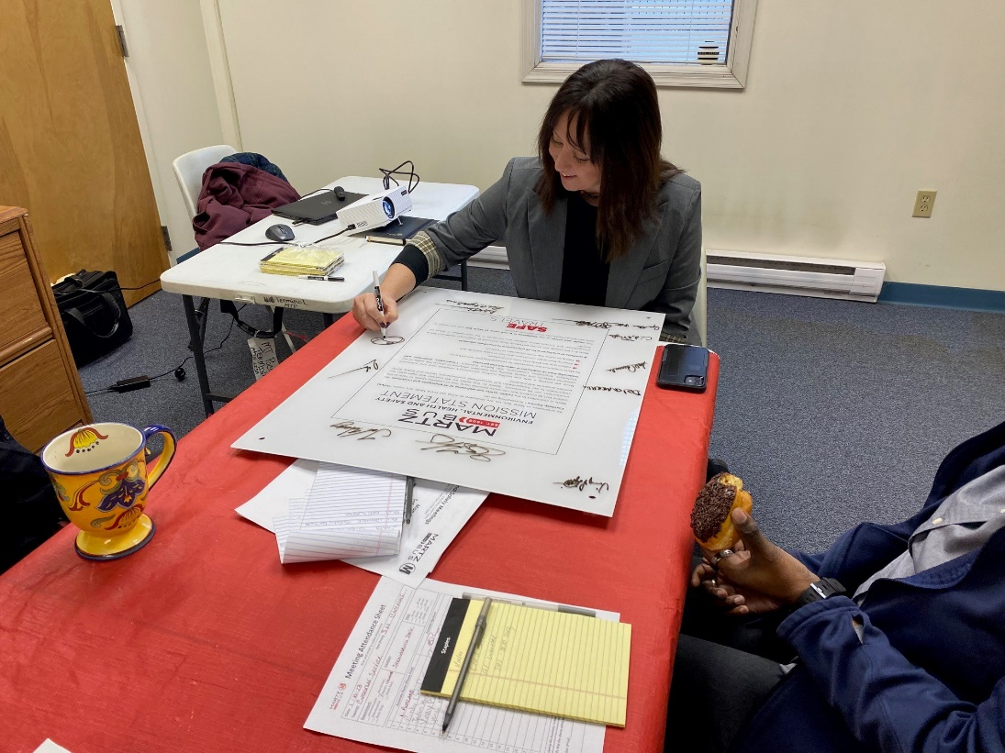
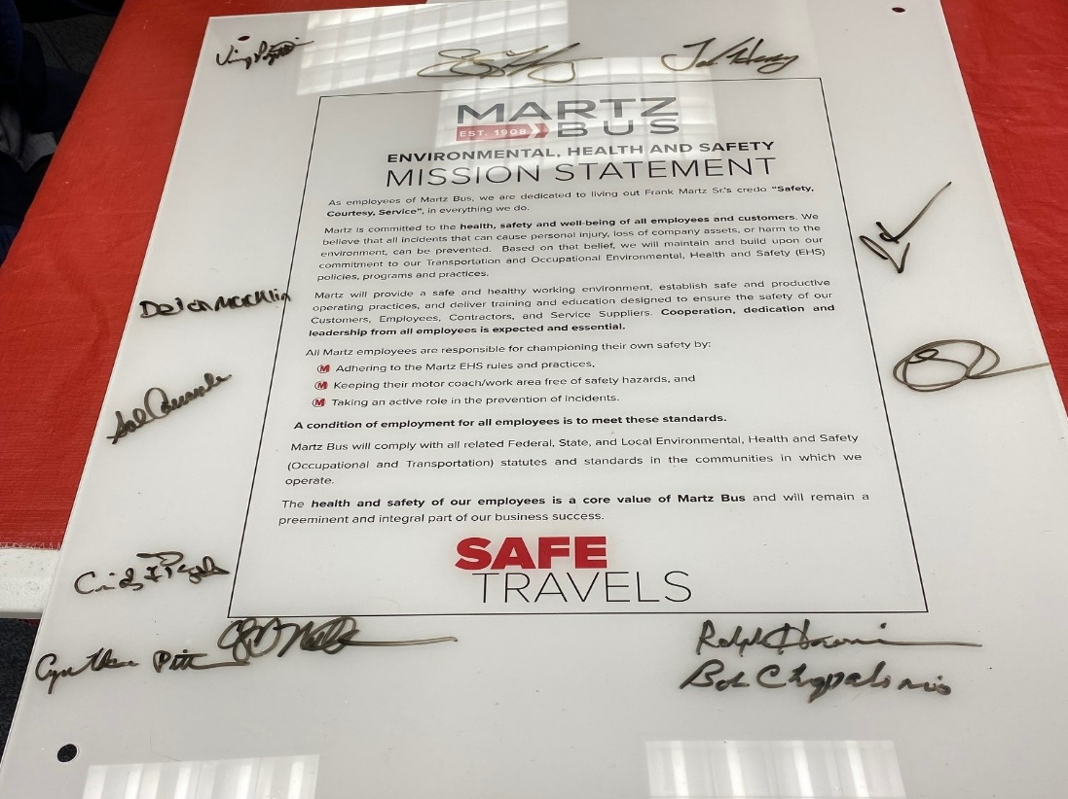

Slide 43
EHSS Operating System
Management Commitment, Caring & Leadership
Organizational Roles & Responsibilities
Hazard Recognition, Evaluation & Control
Training & Development
Policies & Procedures
Incident Reporting, Investigation & Analysis
Emergency Preparedness & Response
Employee Involvement & Expectations

Slide 44
Safety – it’s all about people
If we get injured, our fellow workers and families are also negatively impacted
A safety leader is:
Passionate about safety
A safety leader does not run hot and cold with regards to safety. It is first and foremost in everything they do, every day.
Personally involved
A safety leader does more than just condone or verbally approve of a safe-work culture. They are fully immersed in that culture’s processes and steward its growth.
A positive example
A safety leader uses more than words to convey their passion for safety. Often just their presence in the workforce will speak volumes.

Slide 45

Always lead by a positive example.

Slide 46
Attitude
Behavior
Commitment
Integrity

Slide 47
Integrity
Being an ambassador for safety no matter what level of the organization
Working safely is a condition of employment
Committing to a Safetitude each and every day!

Slide 48


