Slide 1
CBA BISC Meeting Rancho Mirage, CA
NTSB Update
Mike LaPonte
Highway Accident Investigator
Washington, DC
Notes:
Thank you for allowing me to present to the conference today.
Today I will be covering a lot of information. Hopefully, I can unpackage the information in a meaningful way.
My goal is to provide some new tools that you can take back home to put in your toolboxes to help strengthen your safety programs.
[NEXT SLIDE]

Slide 2
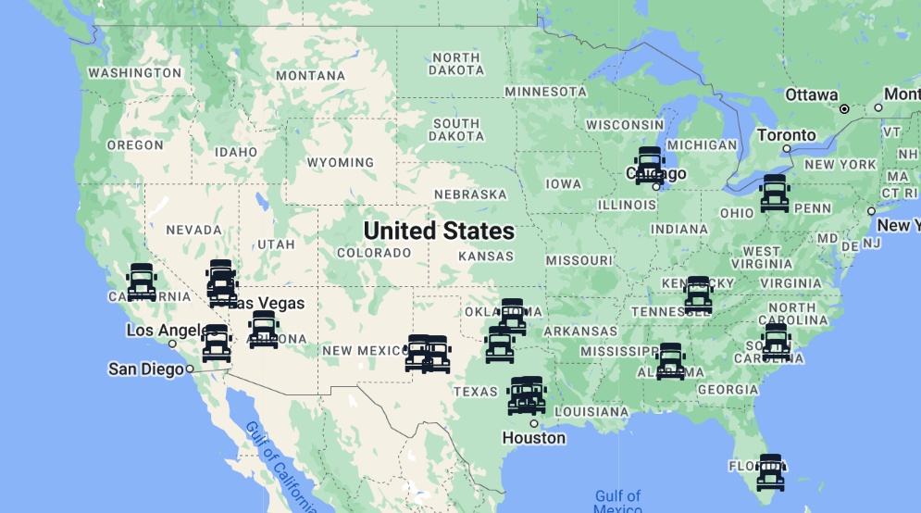
Current Crash Investigations
Notes:
Currently we have 19 open crash investigations throughout the US which are in various stages of development. I’ll take a few moments to review a couple of current and relevant crashes.
[NEXT SLIDE]

Slide 3
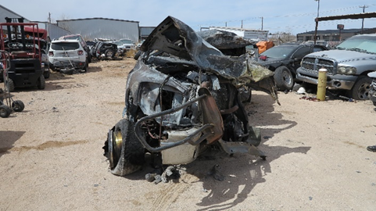
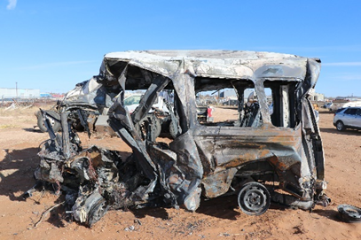
March 15, 2022 Andrews, Texas
Notes:
This was the 1st crash we launched on in 2022. This crash occurred on March 15, 2022 at 8:17 pm. A 2007 Dodge 2500 pickup truck and a 2017 Ford transit van towing a 2019 Salvation single-axle, enclosed cargo trailer, were traveling in opposite directions on Road 1788 in Andrews County, Texas. The posted speed limit in this area was 75 mph.
The pickup truck was occupied by a driver and a passenger; the van was occupied by a college golf team consisting of a 26-year-old male coach and eight team members from the University of the Southwest, located in Hobbs, New Mexico. The van was returning to Hobbs from a golf tournament in Midland, Texas, when the pickup truck crossed into the northbound lane and collided head-on with the van. Both vehicles caught on fire and were destroyed. Both truck occupants, the coach, and six students in the van were fatally injured. The two remaining students were seriously injured. Immediately following the impact there was a post-crash fire. On the left is a photo of the pickup truck and on the right is a photo of the van taken post-crash. [NEXT SLIDE]

Slide 4
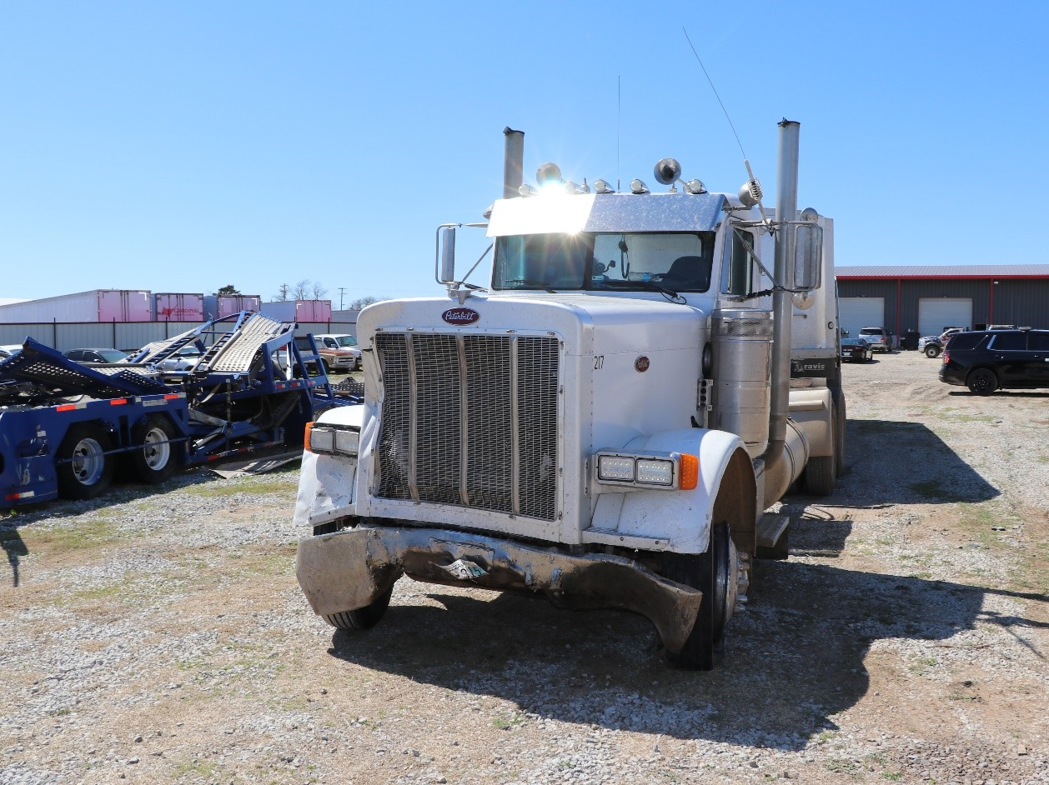
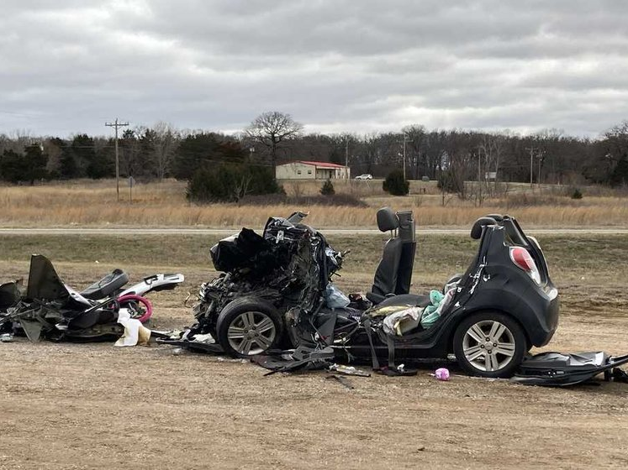
March 22, 2022 Tishomingo, Oklahoma
Notes:
​About 12:19 p.m. on March 22, 2022, a truck-tractor loaded with gravel was traveling south on US Highway 377 in Tishomingo, Oklahoma. The posted speed limit for US-377 was 50 mph. At the same time, a 2015 Chevrolet Spark passenger car, occupied by a 16-year-old driver and five teenage passengers, was traveling east on State Highway 22 approaching US-377. The teenagers were off campus for lunch break.
At this location, SH-22 traffic was controlled by a stop sign. The car did not stop and made a left turn in front of the combination vehicle and was struck on its front-left side. As a result of the crash, all six occupants in the car were fatally injured. The truck driver was not injured in the crash. Post-crash toxicology reports indicated that the car driver was positive for cannabis, and the combination vehicle driver was negative for drugs and alcohol. On the left is a photo of the car at final rest.
The car driver was issued an intermediate driver’s license less than 6 months before the crash. According to the state of Oklahoma‘s Graduated Driver License requirements, a driver who is issued an intermediate license may carry only one non-household passenger in the vehicle unless accompanied by a licensed driver at least 21 years old. [NEXT SLIDE]

Slide 5
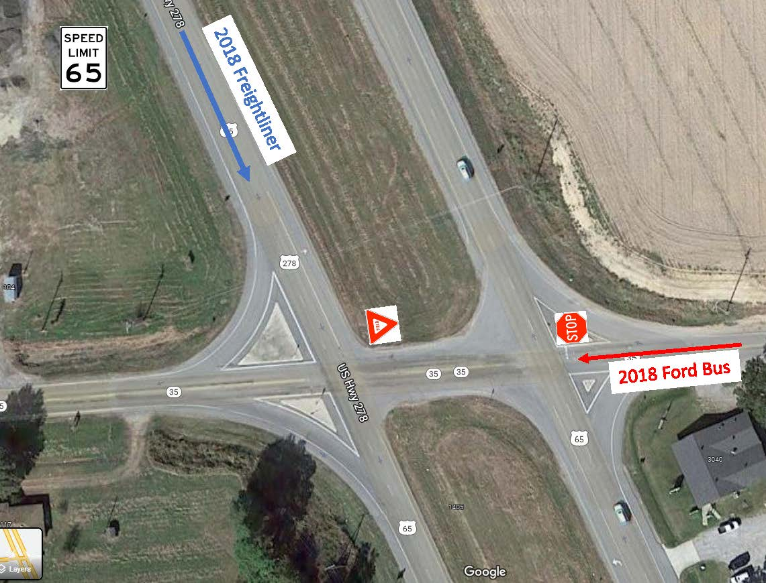
June 6, 2022 Dermott, Arkansas
Notes:
​About 2:45 p.m. central daylight time on Monday, June 6, 2022, a 2018 Ford F-350 chassis with a nine passenger, two wheelchair position Starliner bus body, operated by C.B. King Memorial School, occupied by the 47-year-old driver and eight passengers ranging in age from 19 to 73 years in age. The bus was traveling west on Arkansas State Highway 35 (SH 35) approaching the intersection of United States Highway 65 (U.S. 65) near Dermott, Chicot County, AR. At this location SH 35 is a two-lane highway running east-west. U.S. 65 has 2 lanes each for northbound and southbound traffic, separated by an earthen median. Westbound SH 35 traffic at the intersection was controlled by a stop sign at the U.S. 65 northbound lanes, and a yield sign at the U.S. 65 southbound lanes. As the Ford bus was crossing the southbound lanes of U.S. 65, it was struck by a southbound 2018 Freightliner truck-tractor in combination with a semi-tank trailer operated by J.B.Hunt Dedicated Contract Services occupied by a 52-year-old driver. Post-crash both vehicles departed the roadway to the southwest and came to rest. As a result of the crash, 5 bus passengers were fatally injured. The drivers of both vehicles and the other 3 bus passengers were injured. The injured were transported to area hospitals for treatment.

Slide 6
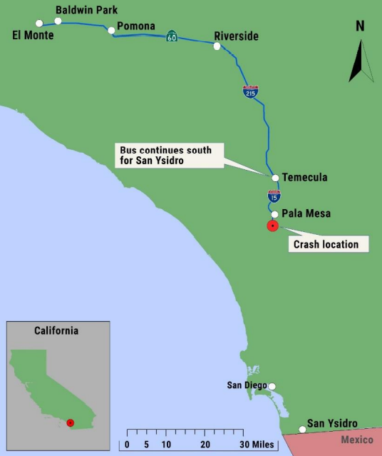
Pala Mesa, CA February 22, 2020
2014 Freightliner bus
Driver + 20 passengers
Los Angeles to San Ysidro via I-15
Driver’s regular bus and regular route
Raining off/on throughout trip
Roadway was wet
Notes:
The last crash I will be discussing happened in Pala Mesa, CA on February 22, 2020, about 10:23 a.m. This involves a midsize bus that many of you may have in your fleets. The crash involved a 2014 Freightliner 30-passenger bus. The bus was occupied by the driver and 20 passengers. The trip began at 8 am outside of Los Angeles and was to end in San Ysidro along a route on Interstate 15. The driver was scheduled to pick up some passengers along the route. Not counting time for stops, the trip would take approximately 3 hours. The driver was familiar with the bus and the route. Rain had begun falling during the trip and the roadway was wet.
[NEXT SLIDE]

Slide 7
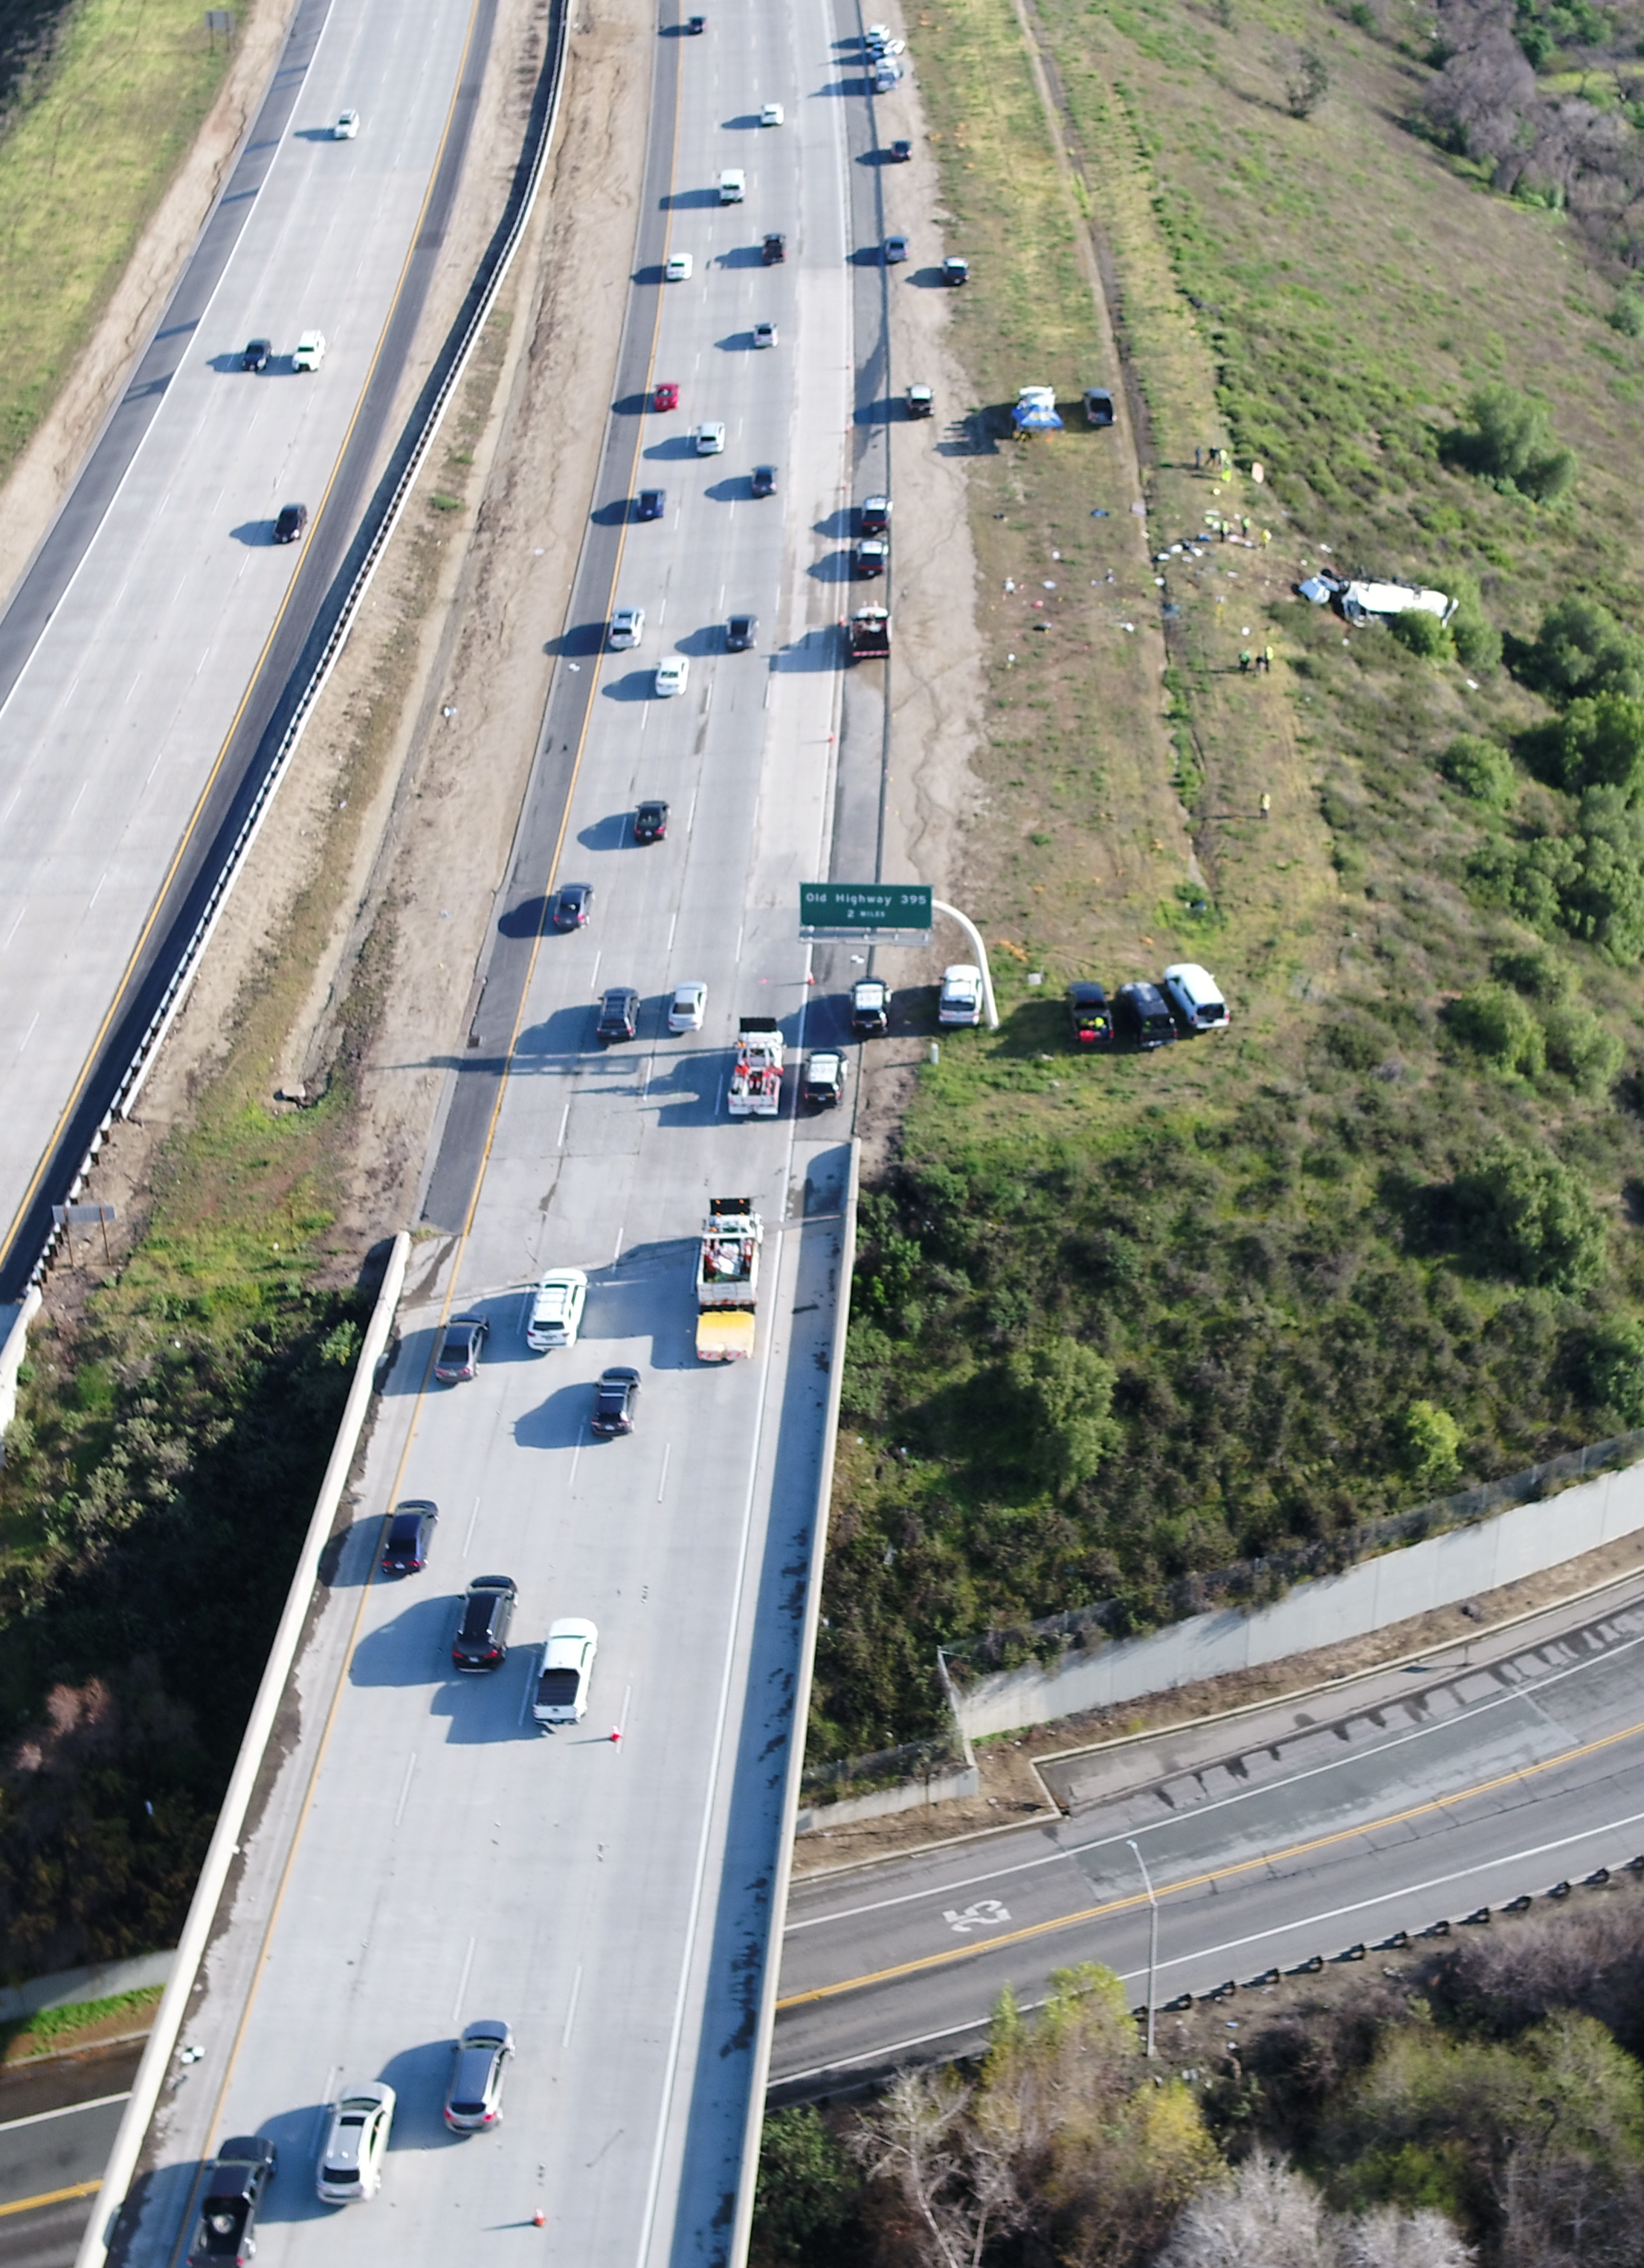
The Crash
Driver and 20 passengers on bus after Temecula stop
About 10:23 a.m.
Driver lost control
Bus departed roadway to the right, rolled 1.5 times, came to rest on roof
Data shows about 74 mph, sustained braking, sharp steering to the right
Reports of moderate rain and wet roadway at the time
Source: California Highway Patrol

Slide 8
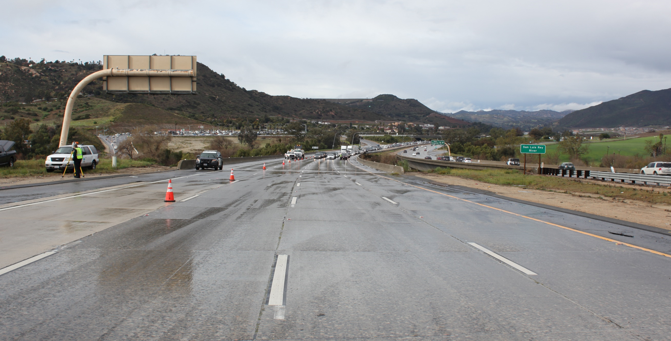
CHP
Notes:
Here is a photo of interstate 15 at the crash scene near Pala Mesa. As mentioned, the roadway is wet, but no pooling is observed. For reference, the bus would be travelling towards us.
[CLICK]

Slide 9
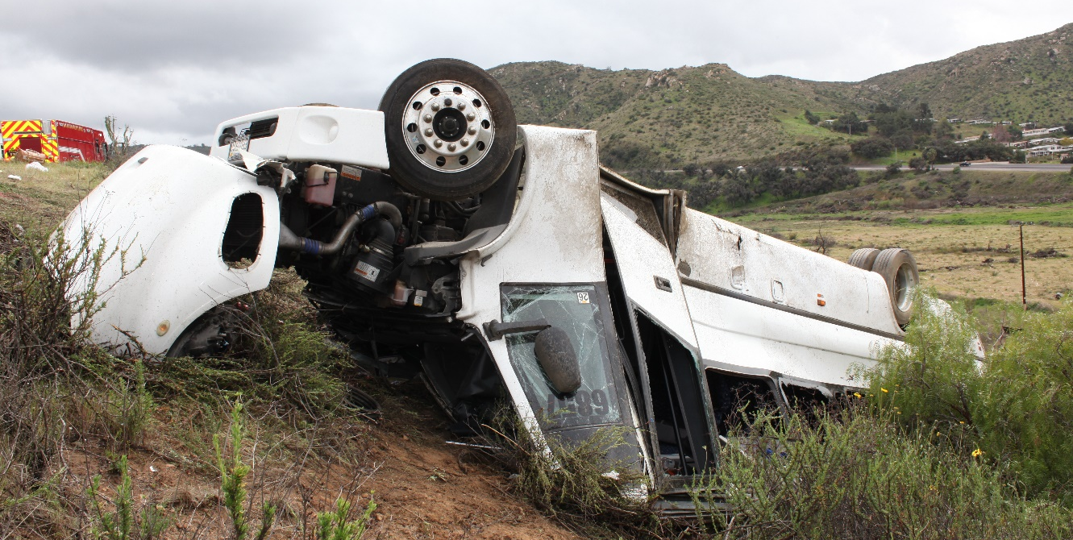
Source: CHP
Notes:
The bus departed the roadway to the right and collided with a roadway barrier. Following the collision, the bus rolled down an embankment and came to rest on its roof. As a result of the crash, 5 passengers were ejected. 3 of the 5 ejected passengers were fatally injured. The driver sustained minor injuries and 12 passengers received serious injuries.
[NEXT SLIDE]

Slide 10
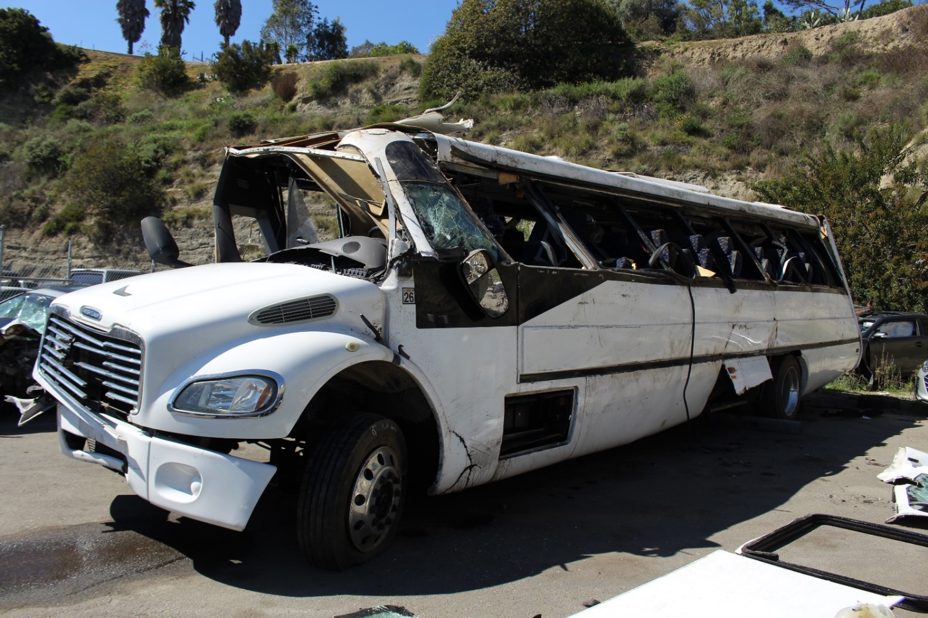
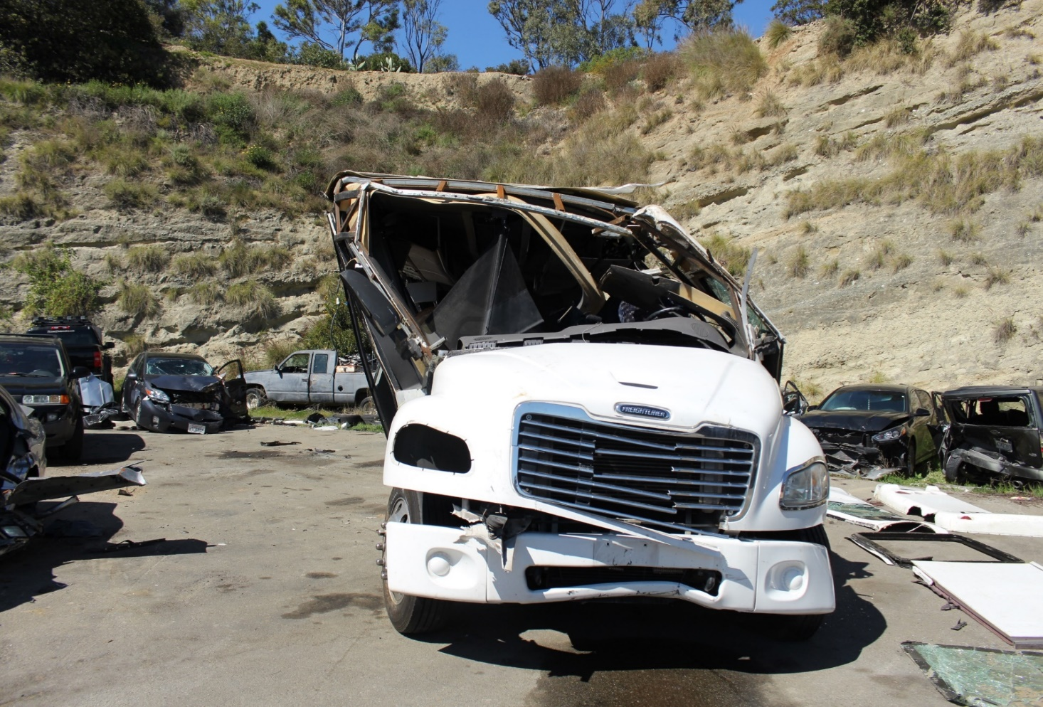
Notes:
These photographs were taken at the tow yard and show the structural deformation that occurred as a result of the bus rollover and impact with the ground. Some of the structural roof supports on the left side failed and most of the windows were broken out which resulted in several passengers being ejected.
[NEXT SLIDE]

Slide 11
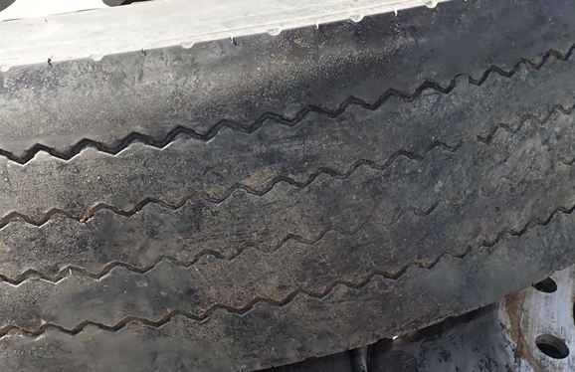
Bus Tire Tread Condition
Axle | Regulatory Minimum Tread | Postcrash Bus Tread (Left) | Postcrash Bus Tread (Right)
Steer | 4/32nd inch | 10/32nd inch | 11/32nd inch
Rear/Drive | 2/32nd inch | 1/32nd inch (inside dual) | 1/32nd inch (inside dual)
11
Notes:
In the inspection of the vehicle post-crash, The tire were measured an above is the measurements on the rear inside tire of the bus.

Slide 12
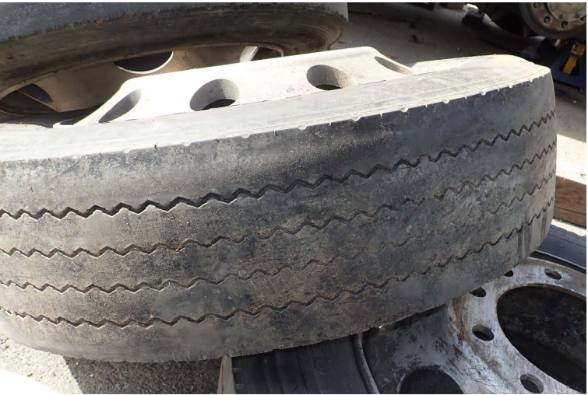
Notes:
Here is a close-up photo of one of the two rear wheels taken off the bus. Both inside tires on the rear axles were at or below 1/32.
[NEXT SLIDE]

Slide 13
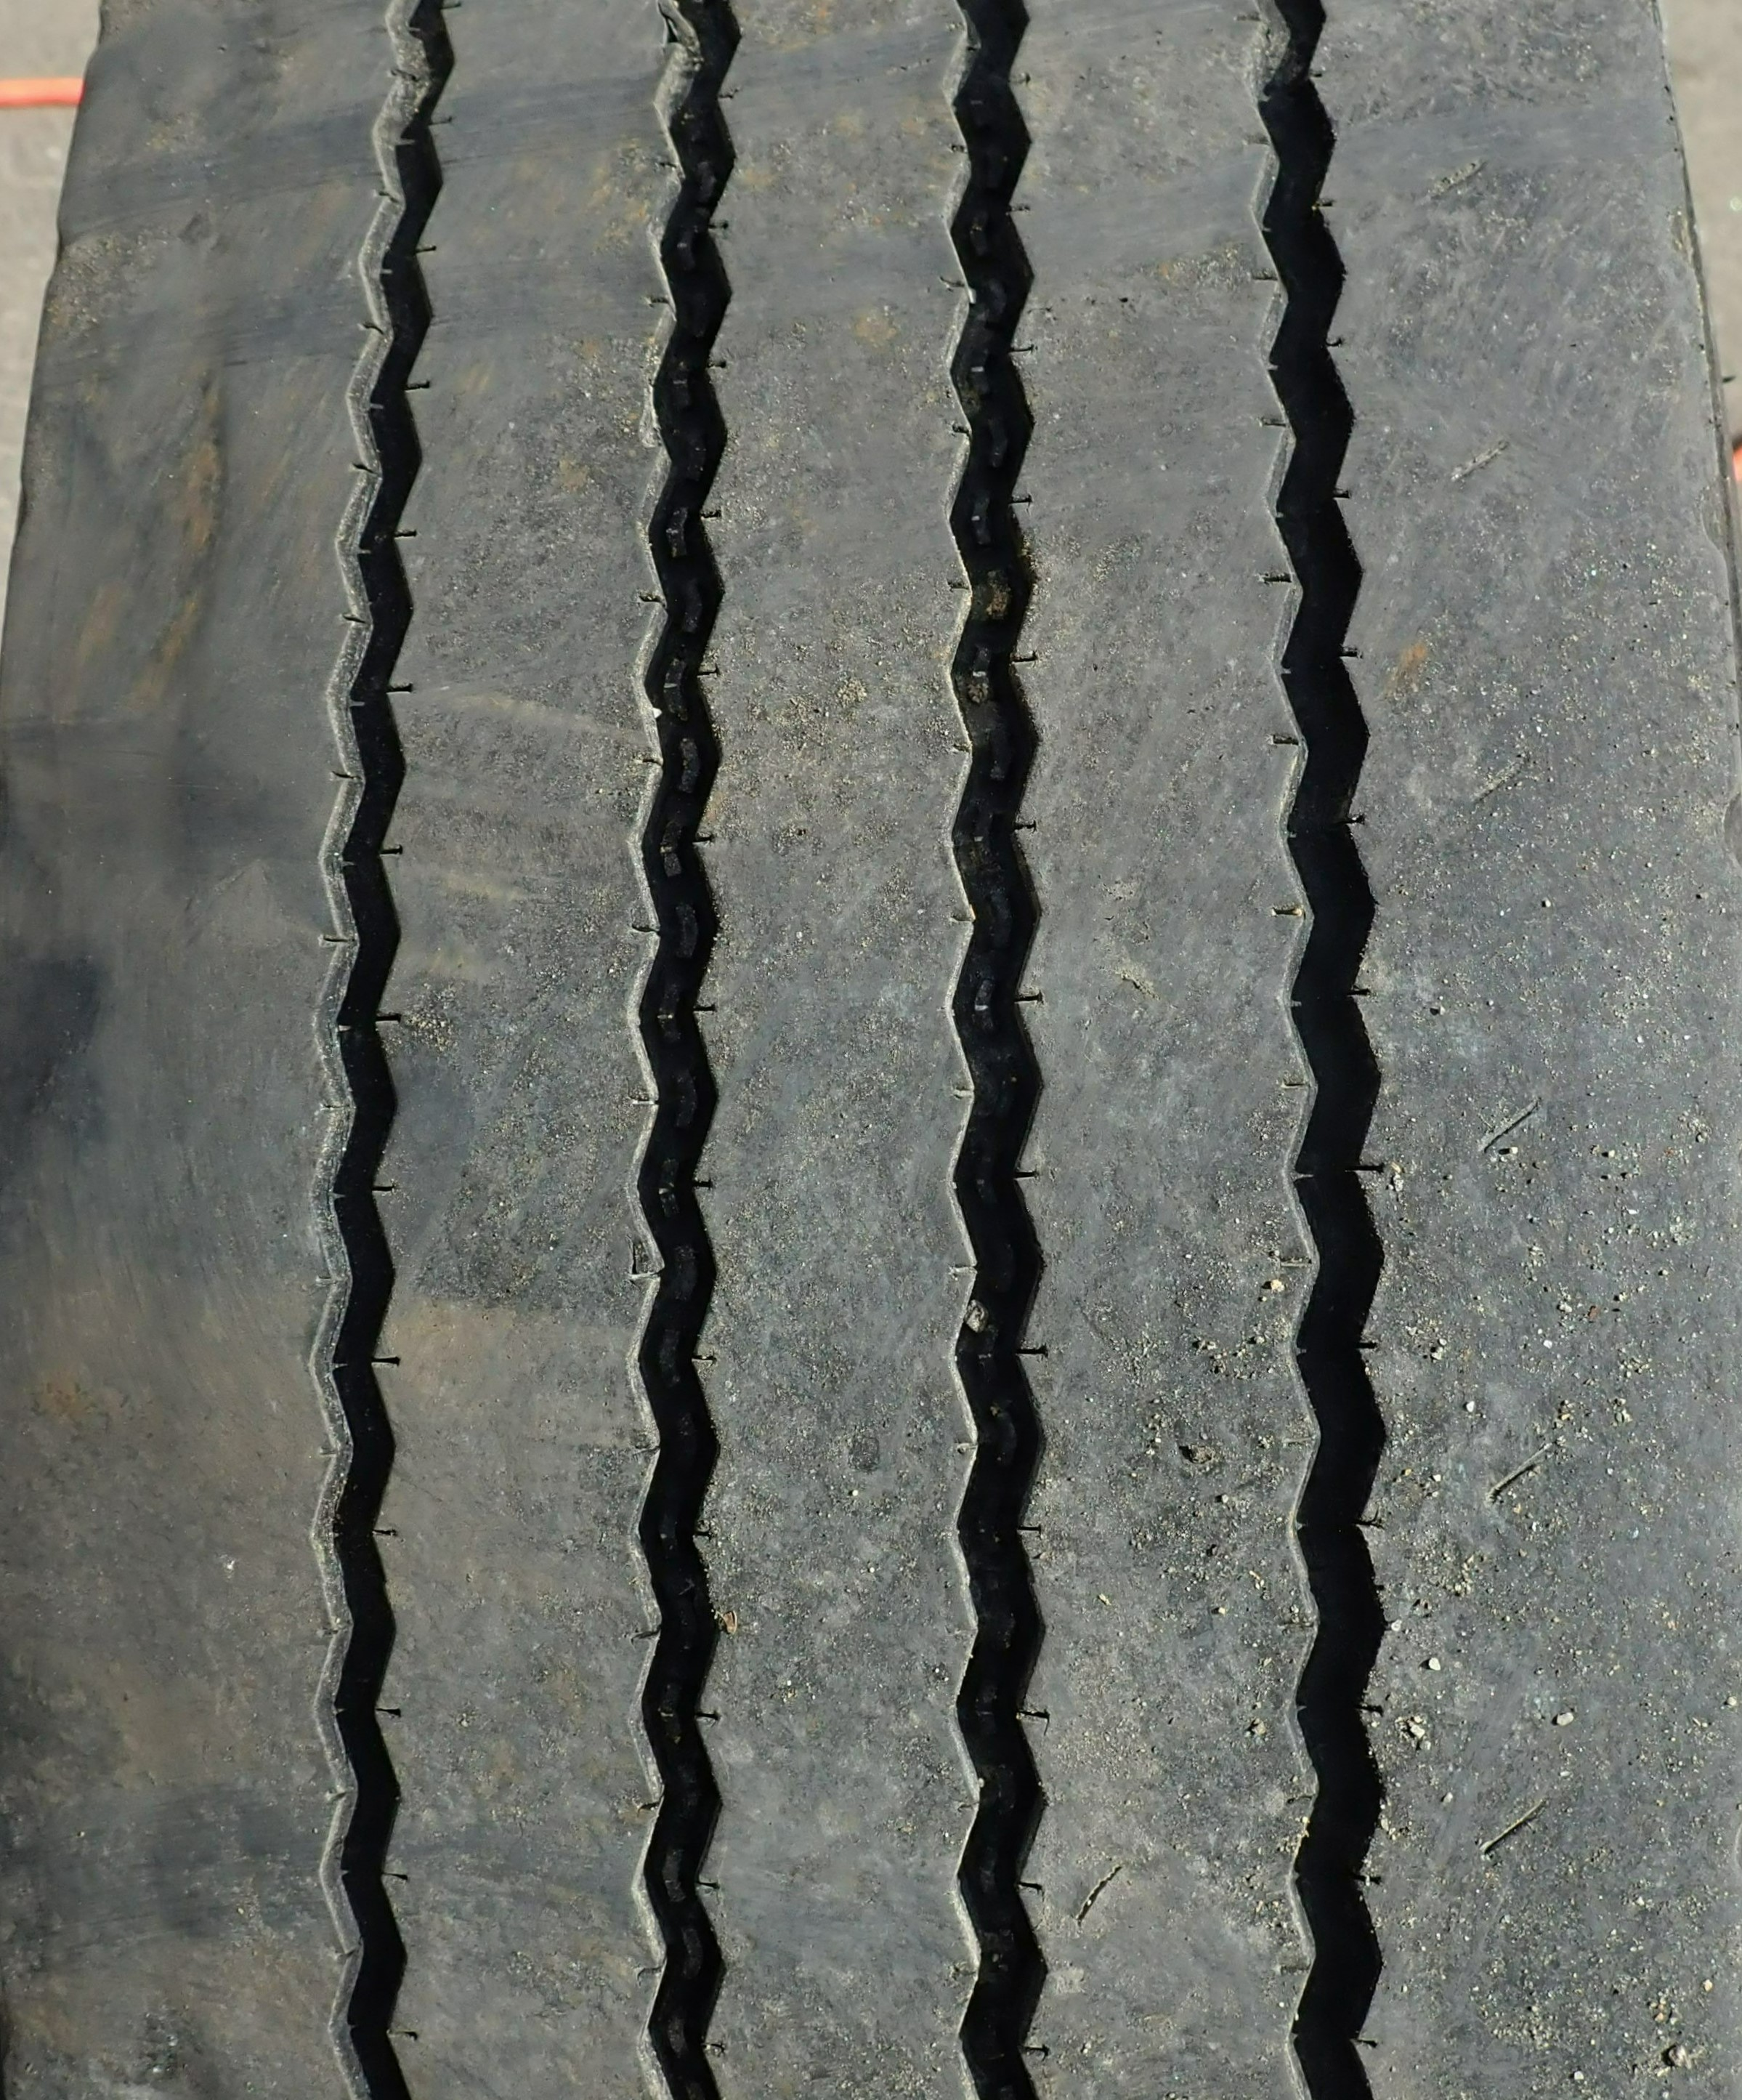
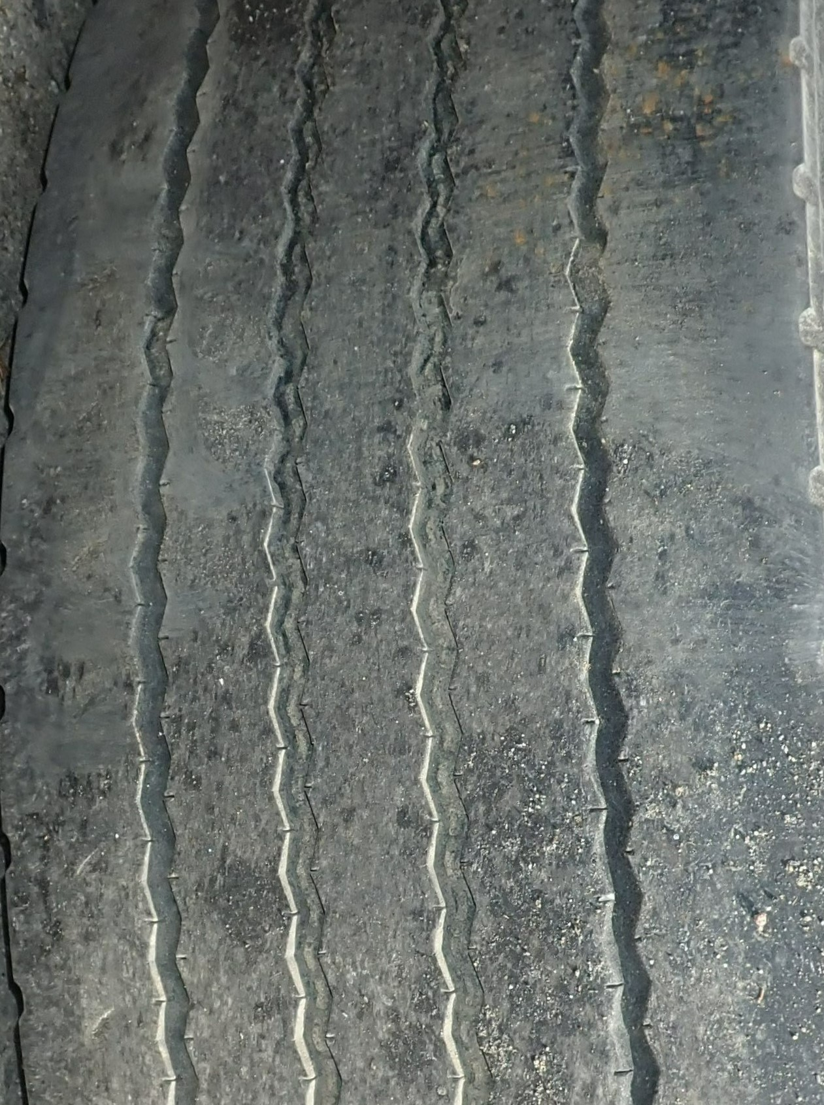
Bus Tire Tread Condition
Axle | Postcrash Bus Tread
 | Left | Right
Steer | 10/32nd inch | 11/32nd inch
Rear/Drive | 1/32nd inch (inside dual) | 1/32nd inch (inside dual)
Steer Tire
Inside Dual Tire
13
Notes:
In these photos of the bus tires, you can see how the tread depth of the steer axle tire, shown on the left, would be more effective in channeling water at the tire/road interface than the near non-existent tread on the rear tire shown on the right.
The steer axle tires had tread depths of at least 10/32^{nds} of an inch while the inside dual tires on the rear axle had tread depths of 1/32nds of an inch.
[NEXT SLIDE]

Slide 14
Tire Rotation Practice
Executive used new tires only on the front axle
  Would move both front tires to rear axle at 5/32 inch tread depth
  Would remove rear tires from service at 2/32 inch tread depth
  Rear tires on the crash bus replaced twice since November 3, 2019
Some motor carriers follow the same tire rotation practice
UMA and U.S. Tire Manufacturers Association (USTMA) does not recommend this tire rotation practice
Notes:
The proposed update to the maintenance form 108A is particularly needed when considering tire rotation policies used by some carriers, including Executive.
The NTSB investigators inquired with the carrier’s owner and its maintenance staff about the company’s policy on tire maintenance and rotation. They stated that the standard practice included removing the steer axle tires when their tread depths reached 5/32 inch and placing them on the rear axle wheels until their tread depths reached 2/32 inch, at which point they would be removed from service.
However, the two inside rear tires on the crash bus still remained in service. The 4 rear tires on the crash bus were replaced twice in the months prior to the crash.
According to the UMA, this practice of replacing tires on the rear axle(s) with used tires from the steer axle, is followed by some other motor carriers as well. And this practice is not recommended by the UMA or the U.S. Tire Manufacturers Association.
Next Slide:

Slide 15
California Bus Inspection Form
Bus Maintenance & Safety Inspection Form 108A
Inspections are required every 45 days
  Conducted by carrier
Covers 40 inspection items, including condition of tires
Records repairs to the vehicle, noting mileage at time of repairs
Notes:
California Vehicle Code regulations also recommend passenger motor carriers to regularly complete Bus Maintenance and Safety Inspection Form – 108A, which documents the regular bus maintenance and safety inspections. CHP requires motor carriers to complete this form for each bus at least every 45 days.
Included in the 40 inspection items are safety items such as checking fire extinguishers, interior and exterior lights, and item 28, Tires-tread depth, inflation, and condition.
The last time the CHP updated this form was in 2005.
Next Slide:

Slide 16
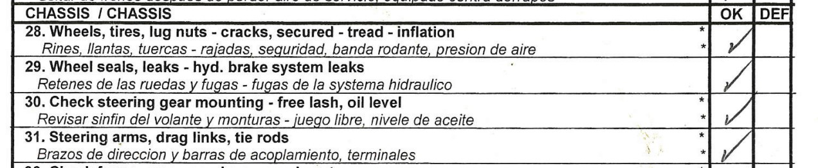
CHP Form 108A (February 10, 2020)
Notes:
Executive Lines had completed its most recent CHP Form 108A—on February 10, 2020.
Item 28, that refers to the inspection of tire tread depth, as well as to the inspection of proper tire inflation and the condition of wheels and lug nuts, was checked as OK by the maintenance staff. The form does not require the carrier to include any specific information, such as tread depth.
Next Slide:

Slide 17
What We Found: Tire Rotation
Executive deficiencies in tire replacement and rotation practice allowed the bus to operate with tires with less than required tread depth
The practice of replacing rear axle tires with used tires from steer axle can result in non-uniform tread depths, leading to loss of traction
What we propose:
  One Recommendation to American Bus Association and the United Motorcoach Association
Notes:
NTSB found that although the carrier had an overall adequate safety record, Executive Lines’ deficiencies in tire replacement and rotation procedures allowed the bus to operate in service with tires that had less than the required tread depths, which contributed to the crash.
The U.S. Tire Manufacturers Association recommends rotating steer axle tires side to side, while it recommends rotating rear axle tires between axles or side to side. The practice adopted by Executive and followed by some other carriers is not recommended, since placing tires with poor tread on the rear axle and tires with substantially better tread on the steer axle can adversely affect the vehicle’s handling on wet surfaces.
Staff is proposing that ABA and UMA encourage their members to adopt tire rotation practice established by the U.S. Tire Manufacturers Association.
Next Slide:

Slide 18
California Bus Passenger Safety Laws
Passenger obligation
  Seat belt use required
  Penalty for violation
Motor carrier obligation
  Driver notification to passengers regarding mandatory use
  Posted placards and/or signs

Slide 19
California Seat Belt Law SB 247
SB 247 signed into law in 2016
Ensures that the driver of a charter bus that is designed to carry 39 or more passengers provides oral and written or video instructions to all passengers on the safety equipment and emergency exits on the vehicle prior to the beginning of any trip.

Slide 20
California Seat Belt Law 27318 Enacted July 1, 2018
A motor carrier operating a bus equipped with safety belts shall do one of the following:
  Require the bus driver, before departure of a bus carrying passengers, to inform passengers of the requirement to wear the seatbelt under California law and inform passengers that not wearing a seatbelt is punishable by a fine.
Post, or allow to be posted, signs or placards that inform passengers of the requirement to wear a seatbelt under California law and that not wearing a seatbelt is punishable by a fine. The signs or placards shall be in a font type and font size that is reasonably easy to read and shall be affixed to a bus in multiple, conspicuous locations.

Slide 21
What We Found: Seat Belt Use Law
Passengers unaware or not restrained
Driver did not provide required passenger notification on mandatory seat belt use law
No placards/signs affixed to bus
Owner of motor carrier stated he was unaware of California vehicle law regarding mandatory seat belt use
What we propose:
  Two recommendations to the California Highway Patrol
  One recommendation to the American Bus Association and the United Motorcoach Association

Slide 22
Findings
Excessive speed for conditions
Inadequate tread depth
Tire depth requirements for rear tires
Inappropriate driver responses
Most not wearing seatbelts
Notes:
Some of the potential safety issues for this crash include: roof stiffness for medium size buses, pre-trip safety briefing, speeding in inclement weather, and tire depth requirements for rear tires.
[NEXT SLIDE]

Slide 23
Passenger Transportation Safety Checklist
Do you have a safety manual – safety plan with safety culture
Hiring process and training program – new hires and concurrent driver training
Qualification – CDL renewals, Medical certification, violations, annual review
Pre-Trip Briefing and emergency training – fire extinguisher, emergency windows, doors, seat belts, what do you do in a fire? Is the training documented?
Maintenance – do you do a pre-trip and post trip? Are maintenance records kept on file is there a designated person to manage the program?
Fatigue management program – NAFMP
Technology – cameras, collision avoidance, fire suppression
Driver behavior modification tools
Notes:
I took the liberty to make you a check list that might help you to audit your safety program. Many or all of these items I would ask for and review if I came into investigate a fatal bus crash you were involved in. [NEXT SLIDE]

Slide 24
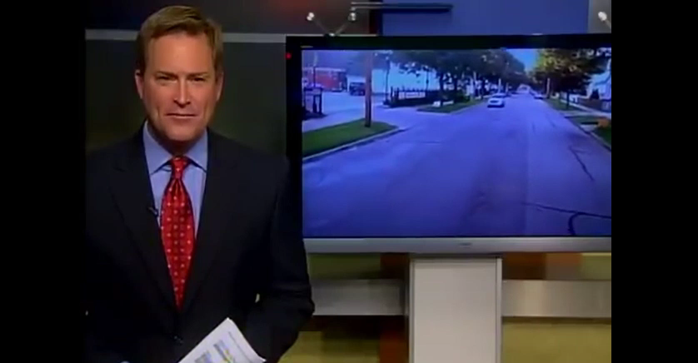
Video
Notes:
A short video with a happy ending. Be Safe Be Prepared. [NEXT SLIDE]

Slide 25
Michael.LaPonte@ntsb.gov
ntsb.gov
Notes:
This concludes my presentation. Here is my contact information and the best way to reach me if you have additional questions after the conference. Please visit our website for additional information on the crashes discussed today as well as other crashes that you can review other lessons learned. Thank you so much for having me today. Are there any questions?

