Slide 1




In Case of Emergency, Passenger Safety Briefings and Evacuation Tips
2019 BISC West Session #1
B I S C
20 Years

Slide 2

Background The NTSB issued recommendations to FMCSA in response to a motorcoach crash on I–95 near Stony Creek, Virginia (7/29/1997).
1 fatality, 4 serious injuries, 28 minor injuries
H-99-7, Provide guidance on the minimum information to be included in safety briefing materials for motorcoach operators.
H-99-8, Require motorcoach operators to provide passengers with pre-trip safety information.
PRESENTED BY THE BUS INDUSTRY SAFETY COUNCIL SPONSORED BY ABC COMPANIES

Slide 3
Background FMCSA formed a working group and worked with ABA, BISC, UMA, CVSA to develop guidance (July/August 2003)
FMCSA initially publishes guidance for public comment (August 2006)
FMCSA adopts guidance (September 2007)
NTSB issues additional recommendations (August 2015 – post Orland crash)
FMCSA amends guidance (August 2016)
PRESENTED BY THE BUS INDUSTRY SAFETY COUNCIL SPONSORED BY ABC COMPANIES

Slide 4
Key Topics to Highlight in a Passenger Safety Briefing Emergency Exits & How to Use Them
Seat Belt Use
Emergency Contact
Follow Drivers Directions
Fire Extinguisher Location(s)
Restroom Emergency Push Button or Switch
How to Avoid Slips and Falls
Remaining Seated While In-Motion
PRESENTED BY THE BUS INDUSTRY SAFETY COUNCIL SPONSORED BY ABC COMPANIES

Slide 5
Timing and Frequency of the Presentation
Charters Should present the safety information to motorcoach passengers after boarding and prior to movement of the motorcoach.
Scheduled Service Should present the safety information at all major stops or terminals, after any new passengers have boarded and prior to movement of the motorcoach.
PRESENTED BY THE BUS INDUSTRY SAFETY COUNCIL SPONSORED BY ABC COMPANIES

Slide 6
Common Methods of Presenting the Safety Briefing Information
The driver/guide requests the passengers to review informational pamphlets/printed materials located in the seat back pocket.
The driver/guide provides an oral presentation.
Pamphlets are handed to passengers as they board.
An automated audio presentation
An automated video presentation
PRESENTED BY THE BUS INDUSTRY SAFETY COUNCIL SPONSORED BY ABC COMPANIES

Slide 7
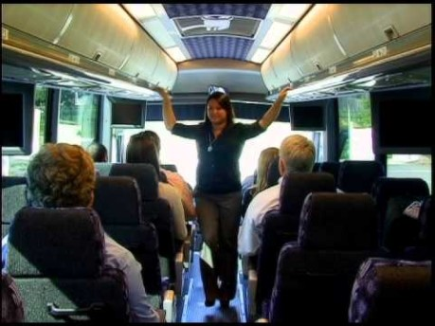
PRESENTED BY THE BUS INDUSTRY SAFETY COUNCIL SPONSORED BY ABC COMPANIES

Slide 8
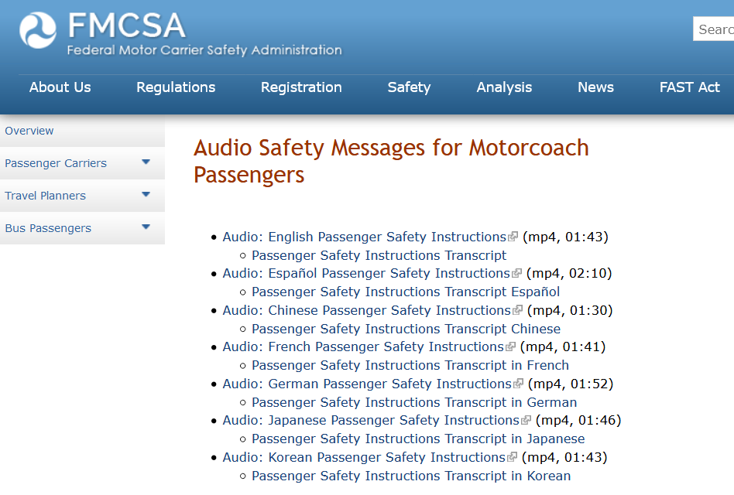
https://www.fmcsa.dot.gov/safety/passenger-safety/pre-trip-safety-information-motorcoach-passengershe Safety Briefing Information
PRESENTED BY THE BUS INDUSTRY SAFETY COUNCIL SPONSORED BY ABC COMPANIES

Slide 9
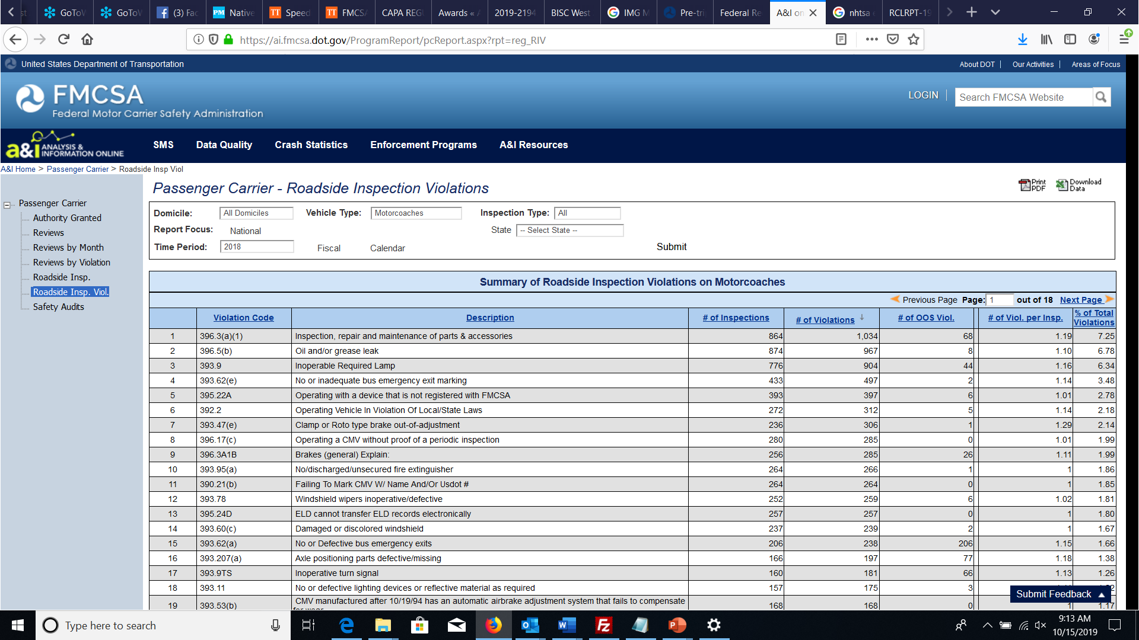
PRESENTED BY THE BUS INDUSTRY SAFETY COUNCIL SPONSORED BY ABC COMPANIES

Slide 10
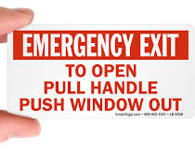
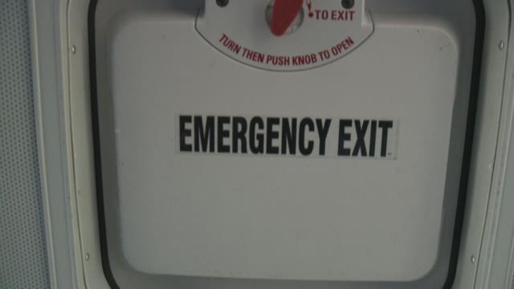
PRESENTED BY THE BUS INDUSTRY SAFETY COUNCIL SPONSORED BY ABC COMPANIES

Slide 11
Don’t Forget, It’s the Law in CA!
SB 247 signed into law in 2016 (the Lara Bill)
Ensures that the driver of a charter bus that is designed to carry 39 or more passengers provides oral and written or video instructions to all passengers on the safety equipment and emergency exits on the vehicle prior to the beginning of any trip.
Vehicles manufactured after July 1, 2020, to be equipped with emergency lighting fixtures that will turn on in the event of an impact or collision.
PRESENTED BY THE BUS INDUSTRY SAFETY COUNCIL SPONSORED BY ABC COMPANIES

Slide 12

PRESENTED BY THE BUS INDUSTRY SAFETY COUNCIL SPONSORED BY ABC COMPANIES

Slide 13











Special Thanks to our Sponsors
PRESENTED BY THE BUS INDUSTRY SAFETY COUNCIL SPONSORED BY ABC COMPANIES

